Slide 1
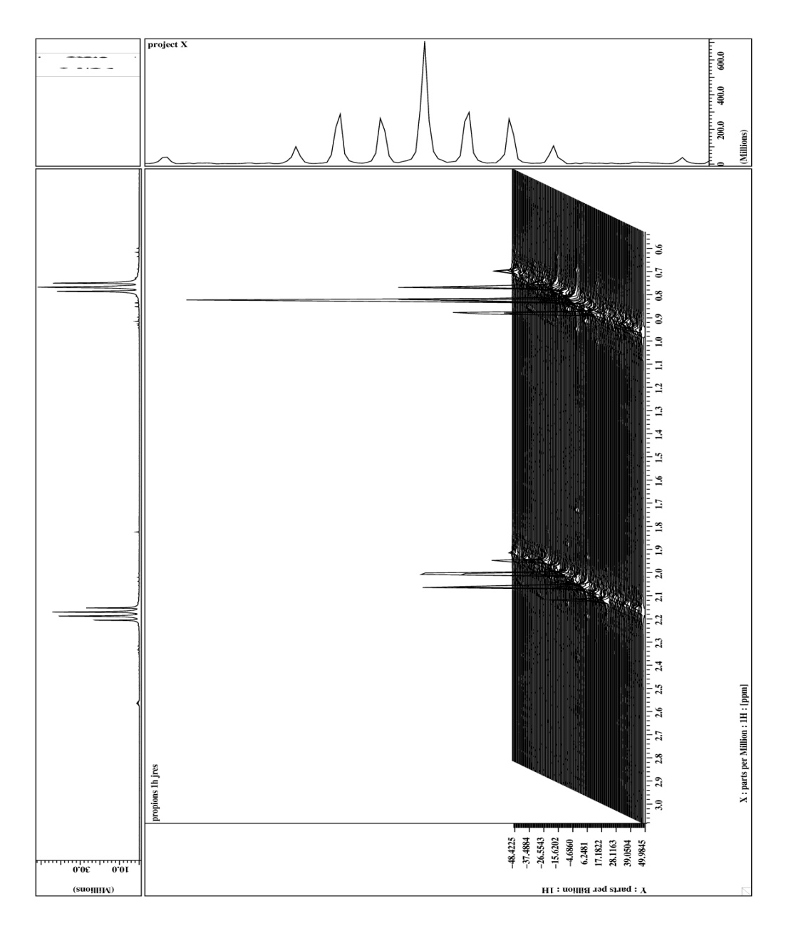

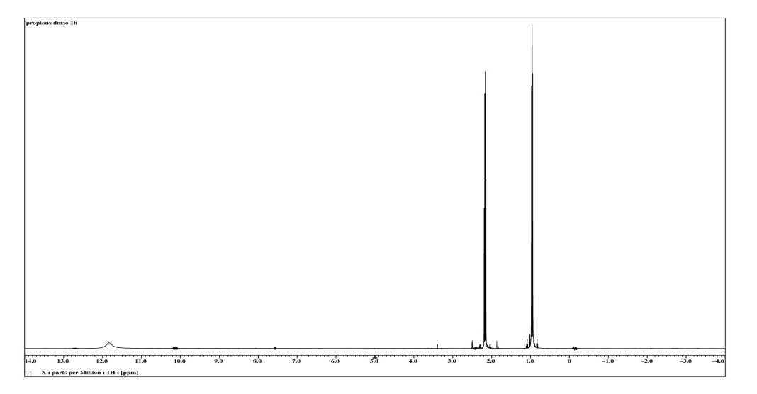
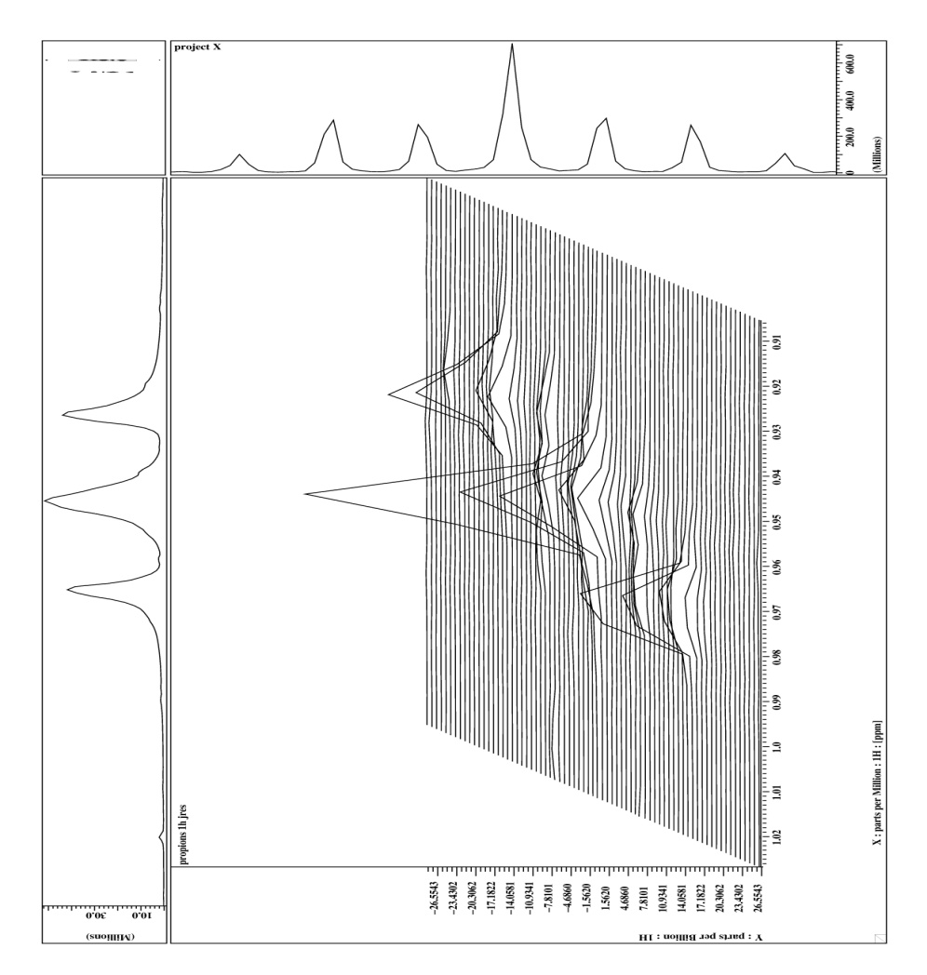
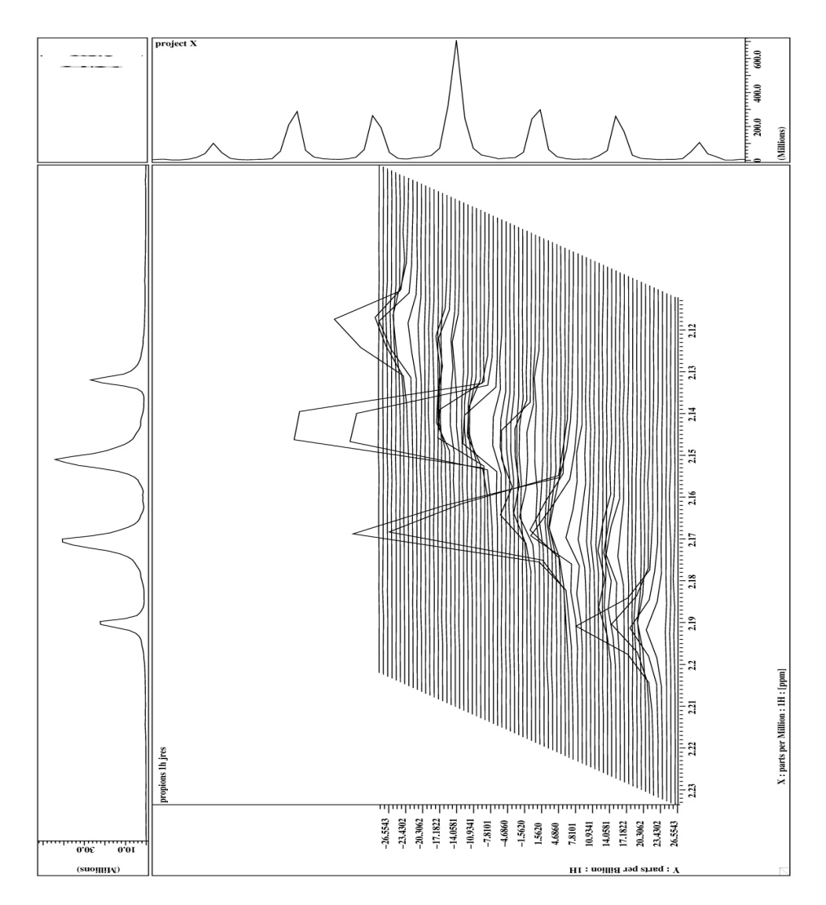
Homonukleares J- aufgelöstes Experiment
Homo Nuclear J- Resolved Experiment

Slide 2
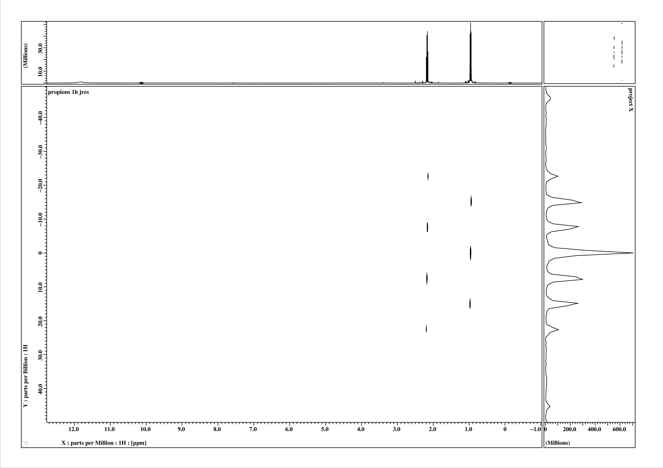
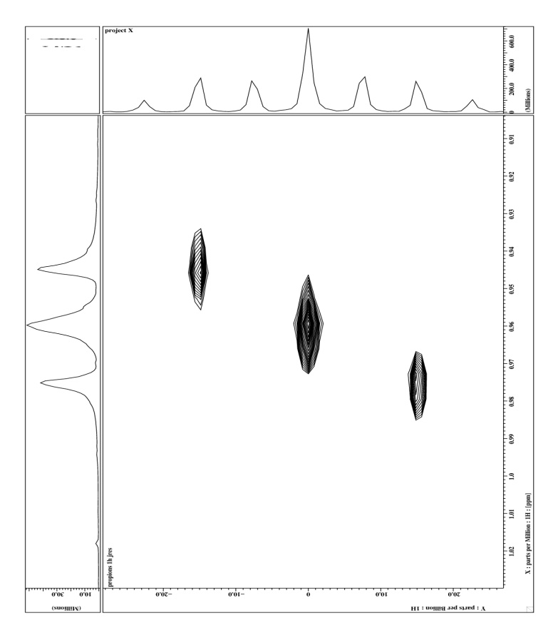
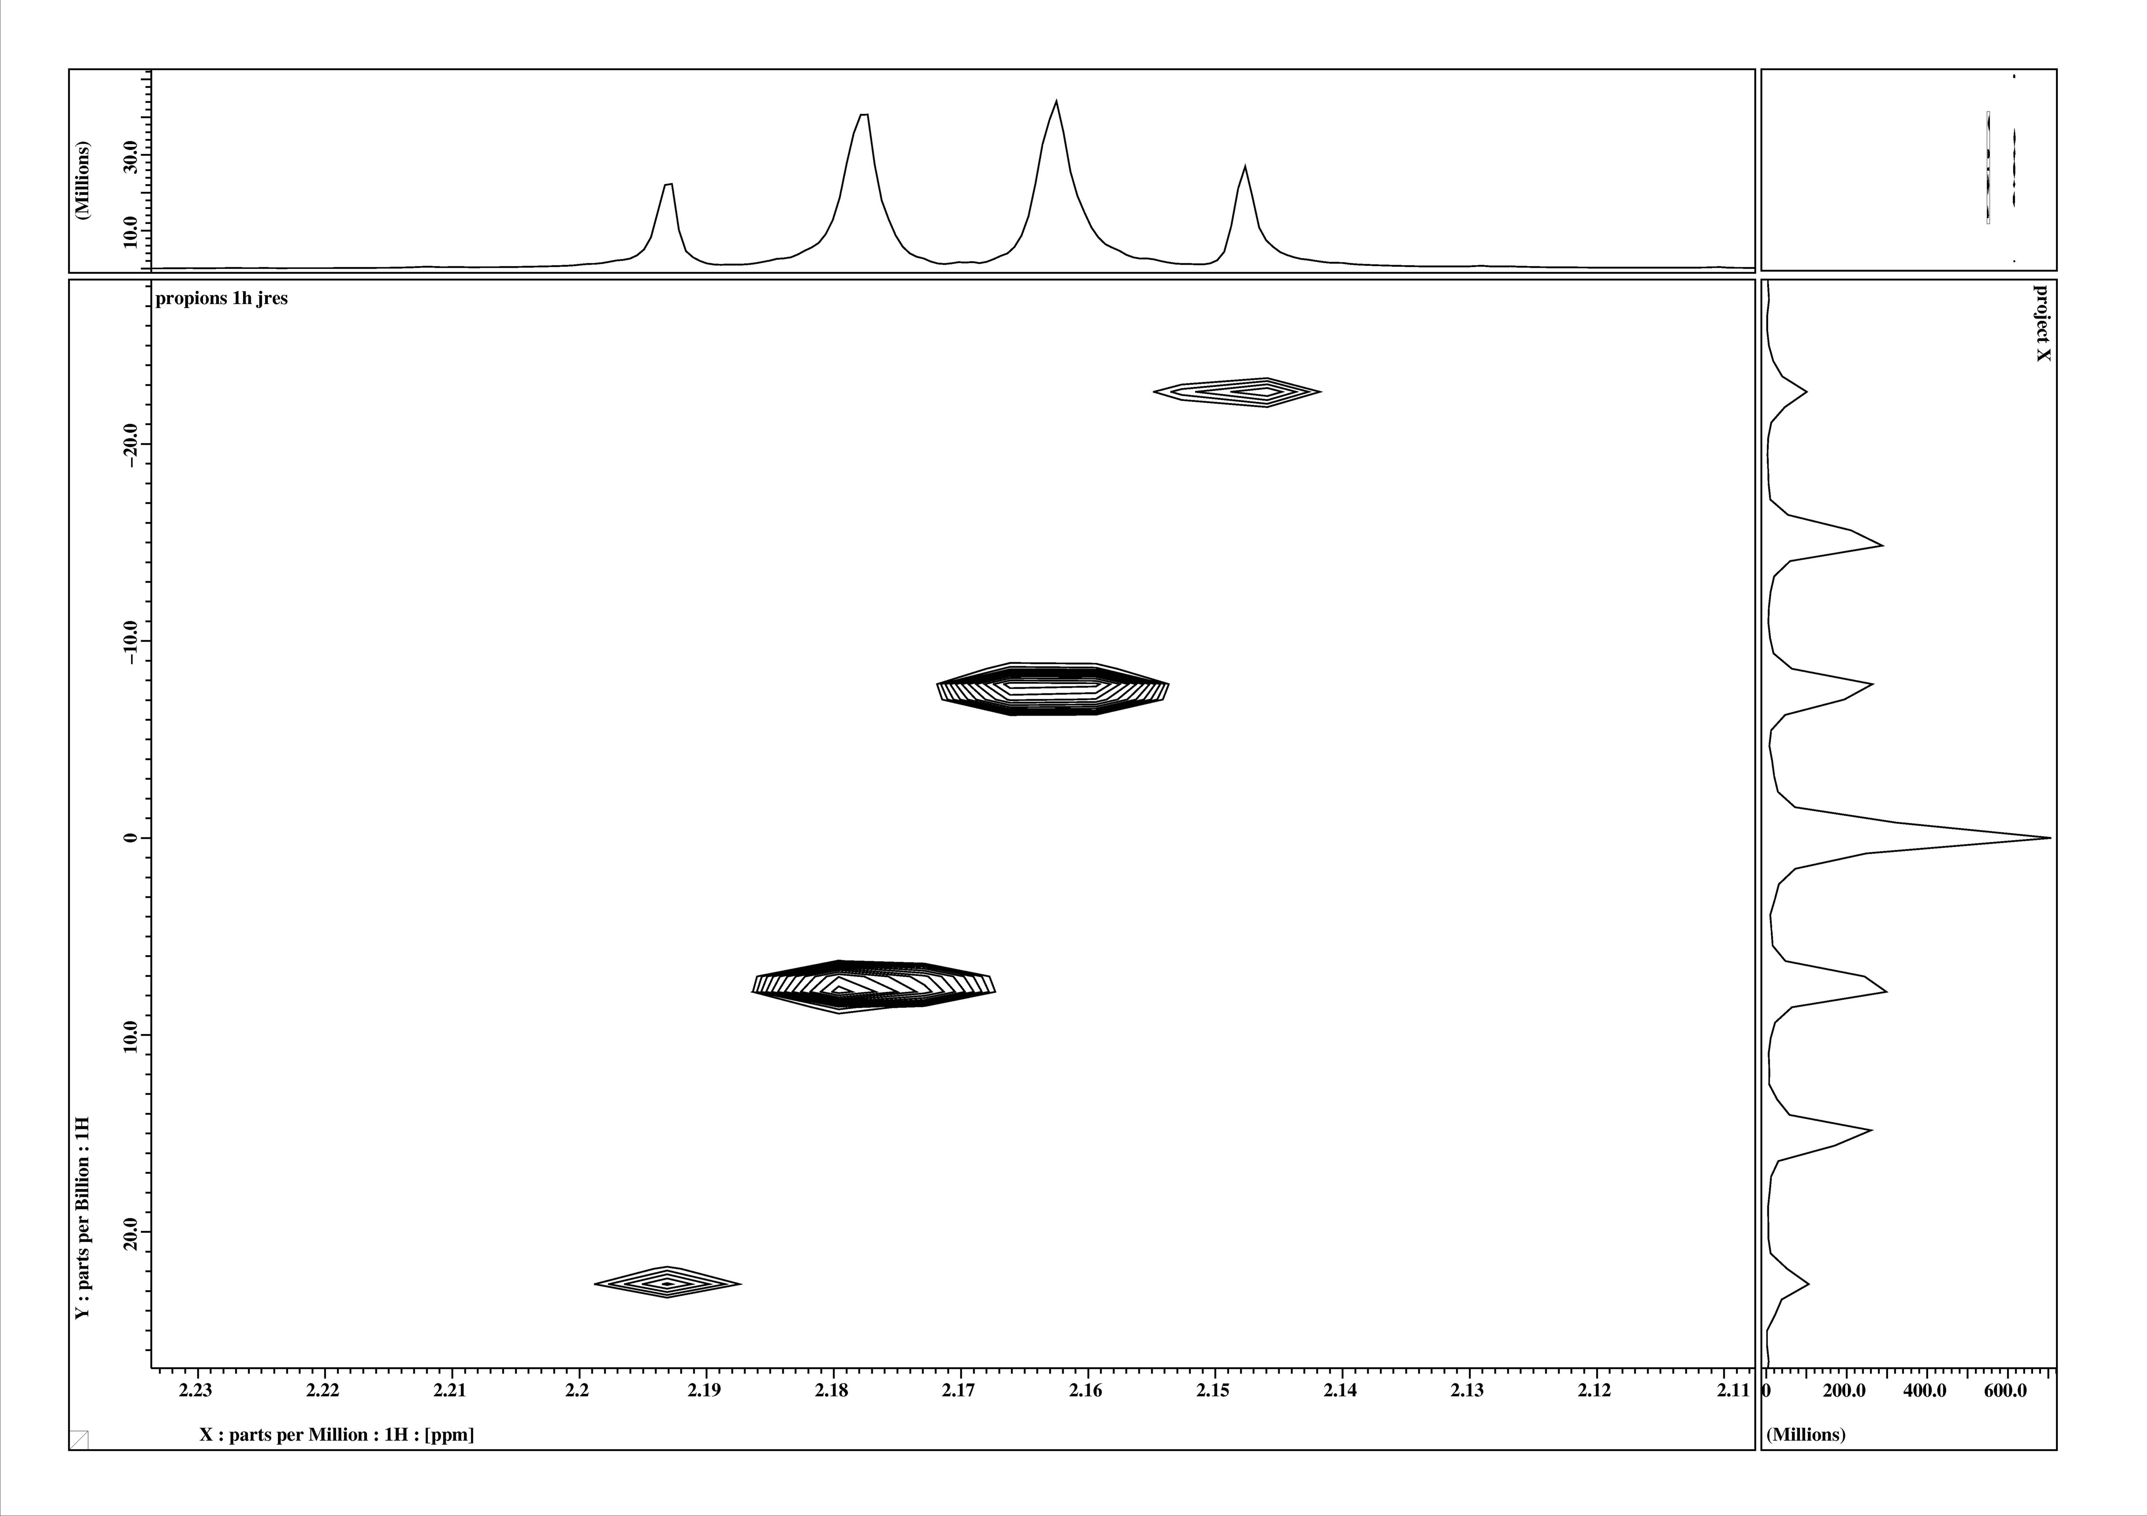
Homonukleares J- aufgelöstes Experiment
Homo Nuclear J Resolved Experiment
δ- CH₃
δ- CH₂
J
J

Slide 3
COSY , Two RF- pulses
90°
90°
t₁δtincrements
acquisition
δtdwell time
90°
90°
t₁ –evolution,
t₁ incremented
cos ω t₁
sin ω t₁
t₂ – evolution, acquisition M₊ = M_{x}+ i M_{y}
I_{x}- magnetization
sin ω t₁
sin ω t₁ (exp (i ω t₂ ))

Slide 4
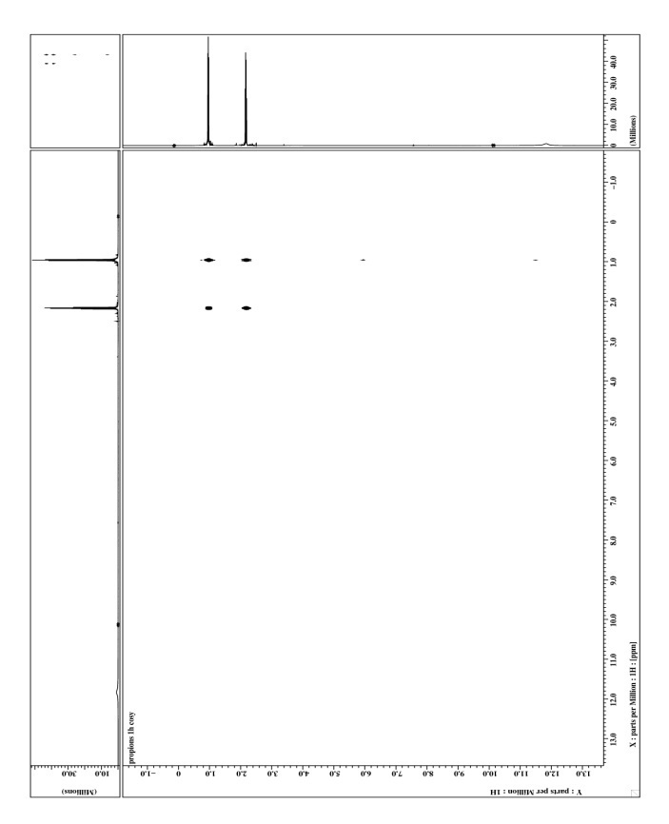
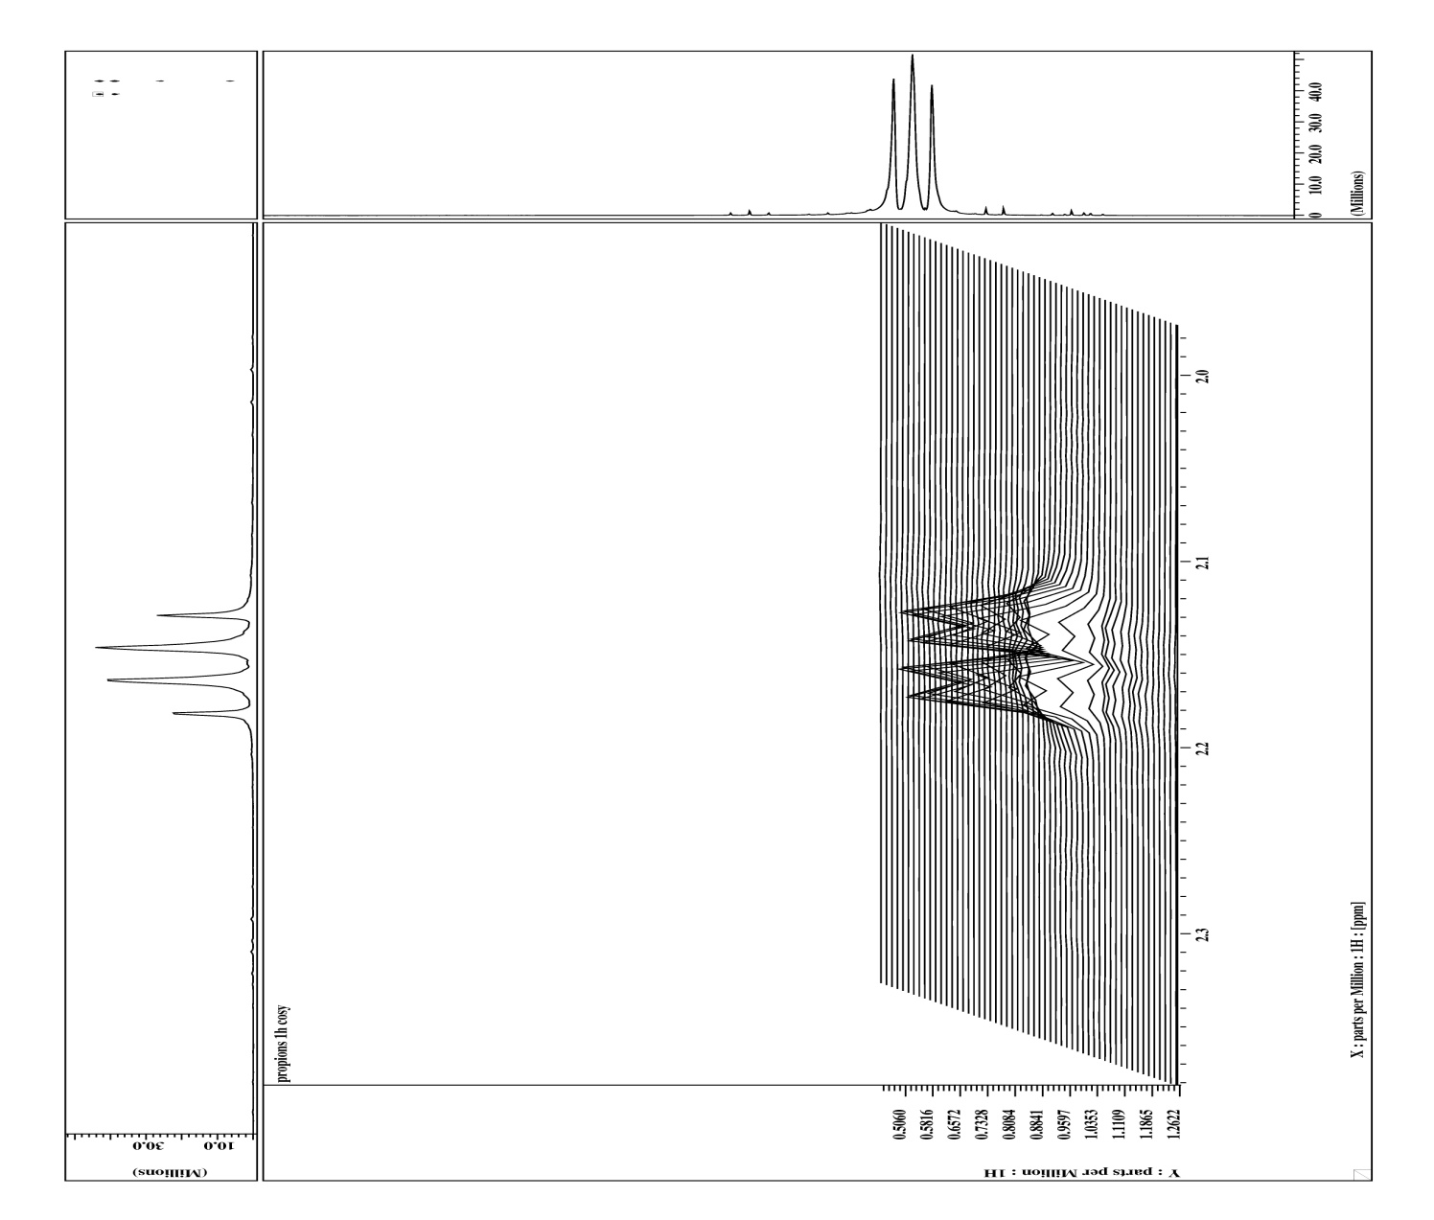
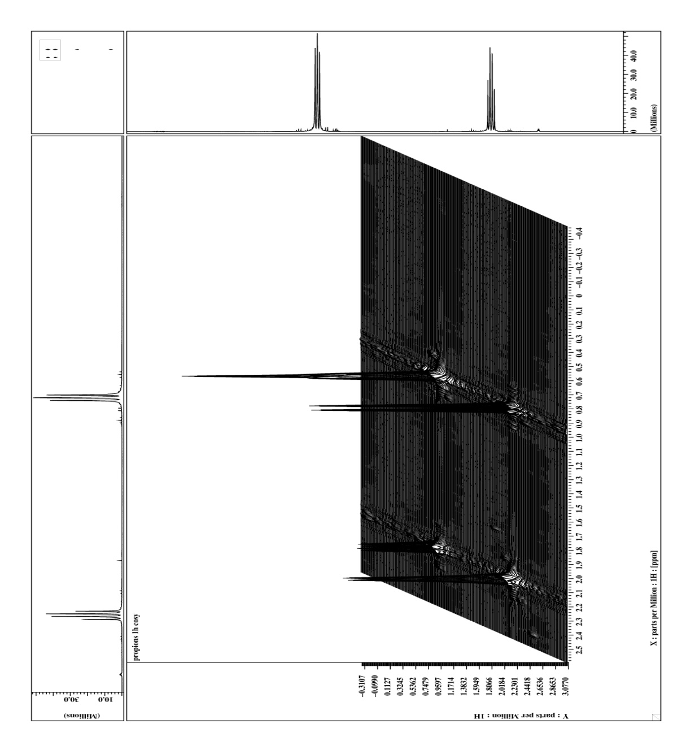
COSY- Experiment (¹H, ¹H)
COSY – Experiment (¹H, ¹H)
90°
90°
t₁ incremented
t₂ acquisition
propionic acid

Slide 5
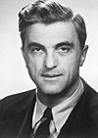
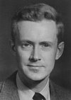
Different Viewpoints
Nobel price 1952
Felix Bloch
1905- 1983
Edward Mills Purcell
1912- 1997
Classical
macroscopic magnetization vectors
Faraday induction
Quantum mechanical
Stimulated (or spontaneous)
absorption and Emission

Slide 6
Bloch und Purcell
Different Viewpoints
D. I. Hoult and N. S. Ginsberg
By the middle of the 20th century, the quantum theories of
matter and its interaction with radiation were well established
(1). Thus with the discovery of NMR by Bloch and Purcell, a
quantum explanation of the voltage present in a receiving coil
was sought. However, such an explanation was not readily
forthcoming. Bloch had described his observations in terms of
Faraday induction while Purcell saw his as absorption and
emission of energy, and two initially had great difficulty believing
that they were observing the same phenomenon. In
particular, describing the origins of the free induction decay
caused significant problems, and as the proffered explanation
of this phenomenon is still only well known to a handful of
NMR physicists, we therefore begin by describing its origins
Nobel price 1952
Felix Bloch
1905- 1983
Edward Mills Purcell
1912- 1997
Classical
macroscopic magnetization vectors
Faraday induction
Quantum mechanical
Stimulated (or spontaneous)
absorption and Emission

Slide 7
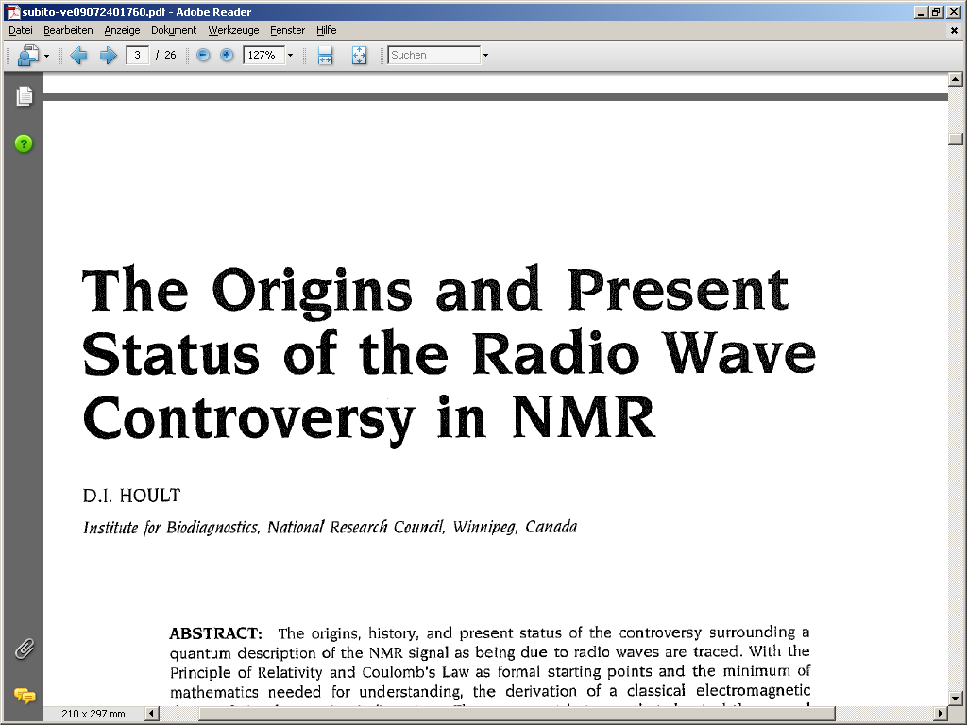
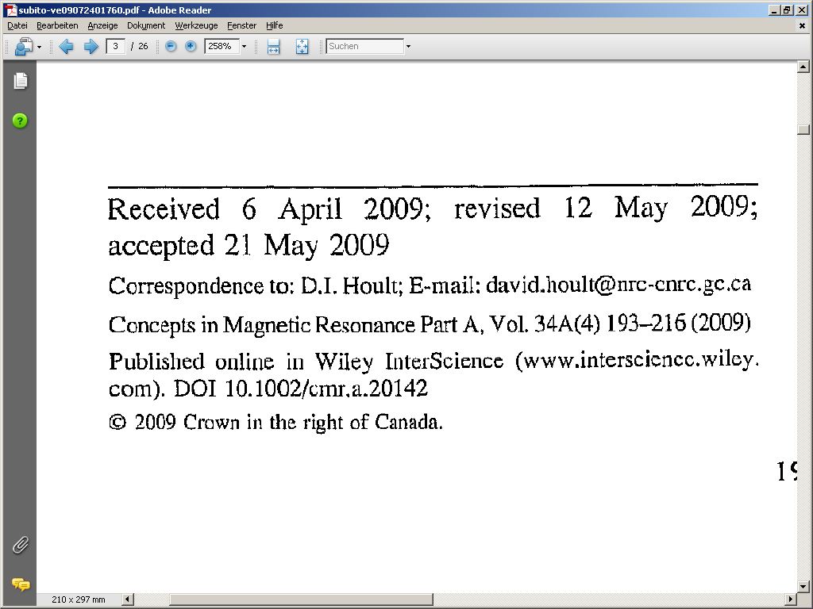
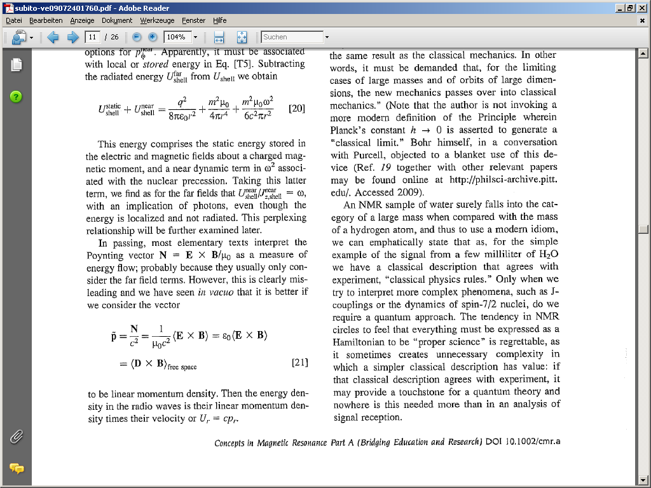
Klassisch vs. quantenmechanisch
Different Viewpoints

Slide 8
QM for Ensembles
Single particle state : Wave functions as linear combination of α, β Φ = α + β
State evolution during exp. : d/dt Φ= i h H Φ solve for H₁ during t₁ , H₂ during t₂ …..
Measure outcome for initial states : M _{x} (Φ_{α}) = <Φ_{α} | I_{x} | Φ_{α}> , M _{x} (Φ _{β}) = <Φ _{β} | I_{x}| Φ_{β}>
Determine initial ensemble state : Probability(α) Φ_{α} = α , Probability(β ) Φ _{β} = β
Calculate ensemble average :M _{x} = Probability(α) M _{x} (Φ_{α}) + Probability(β) M _{x} (Φ _{β})
Example 1D NMR
90°
acquisition
Initial state
pulse
(Δt increments)
detection
α
1/√2 (α+ β)
1/√2 (exp (i ω/2 t) α + exp (−i ω/2 t) β)
1/√2 (exp ( i ω/2 t) < α I_{x} α >
+ exp (−i ω/2 t) < β I_{x} β> )
P (α) = 0.49999 : ( = ) −1
= 1/√2 (exp ( i ω/2 t) 1/2
+ exp (− i ω/2 t) −1/2 )
β
−1/√2 (α+ β)
−1/√2 (exp (i ω/2 t) α + exp (−i ω/2 t) β)
−1/√2 (exp ( i ω/2 t) < α I_{x} α >
+ exp (−i ω/2 t) < β I_{x} β> )
P (β) = 0.50001 : ( = ) +1
= −1/√2 (exp ( i ω/2 t) 1/2
+ exp (− i ω/2 t) −1/2 )
P (α) 1/√2 (1/2 exp ( i ω/2 t) + −1/2 exp (− i ω/2 t)) + − P (β) 1/√2 (1/2 exp ( i ω/2 t) −1/2 exp (− i ω/2 t))

Slide 9
QM for Ensembles
Single particle state : Wave functions as linear combination of α, β Φ = α + β
State evolution during exp. : d/dt Φ= i h H Φ solve for H₁ during t₁ , H₂ during t₂ …..
Measure outcome for initial states : M _{x} (Φ_{α}) = <Φ_{α} | I_{x} | Φ_{α}> , M _{x} (Φ _{β}) = <Φ _{β} | I_{x}| Φ_{β}>
Determine initial ensemble state : Probability(α) Φ_{α} = α , Probability(β ) Φ _{β} = β
Calculate ensemble average :M _{x} = Probability(α) M _{x} (Φ_{α}) + Probability(β) M _{x} (Φ _{β})
Different Approach
Identify state with operator : Φ O_{Φ} if O_{Φ}Φ = ο_{Φ} Φ , O_{Φ}Ψ = 0 < Φ Ψ > = 0
Basis : I_{z} , I_{y}, I_{x}, 1 ( I² = I_{x}² + I_{y}² + I_{x}² = ¾ 1 )
Arbitrary state linear combination : σ = c _{z} I _{z} ,+ c _{y} I _{y} + c _{x} I _{x} + c ₁ 1
projector α (1/2 + I _{z} ) because ( 1/2 + I _{z} ) α = α and ( 1/2 + I _{z} ) β = 0 β (1 /2 – I _{z} )
Determine initial state : σ = Probability(α) ( ½ + I _{z} ) + Probability(β ) for( ½ - I _{z} ) = I _{z}
State evolution during exp. : d/dt σ = i h [ H , σ] solve for H₁during t₁ , H₂during t₂ …..
Decompose state into basis : σ(t) = c_{z}(t) I_{z} ,+ c_{y}(t) I_{y} + c_{x}(t) I_{x} + c₁(t) 1
Measure outcome for initial state : M _{x} c_{x}(t)

Slide 10
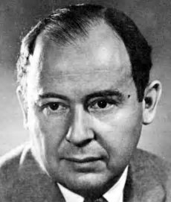
Statistical Operator (Density Matrix)
arbitrary single spin state Φ = c1 α + c2 β
statistical operator σ =
*
*
c1 c1 c1 c2
c2 c1 c2 c2
*
*
John von Neumann
1 0
0 1
½ 0
0 - ½
0 ½ ½ 0
0 - i/2
i/2 0
I²g
I _{z}->
I _{x}->
I _{y}->
¾

Slide 11
Solution for d/dt σ = i h [ H , σ ]
Classical mechanics : dl/dt = fxl , torque by diagonalization : calculate M₊ and M₋
Solution by diagonalization : calculate M₊ and M₋
rotations (precession) about axis of torque
M_{x}(t)aM_{x}(0)cos ( ω t)+M_{y} (0)sin ( ω t) , M₊ (t)aM₊ (0) exp( − i ω t)
QM wave function : d/dtΦ = ihH Φ Φ (t) = exp (i h H t ) Φ(0)
Solution Φ (t) = exp (i h H t ) Φ(0)
Statistical operator : Solution of d/dtσ = ih [ H , σ] σ(t) = exp(-ihH t) σ(0) exp( ihΗt)
Meaning of exp (operator) : exp ( c H t) = 1 + 1/1! H t c + 1/2! H² t²c² + 1/3! H³ t³c³+ …
d/dt exp(c H t) = c H exp( c H t) = exp( c H t) c H H : constant
d/dt (exp(-i H t) σ(0) exp( i Η t)) = -i H exp(-i H t) σ(0) exp( i Η t) + exp(-iH t) σ(0) i Η exp( i Η t)
d/dt (exp(-i H t) σ(0) exp( i Η t)) = -i H exp(-i H t) σ(0)exp( i Η t) + exp(-iH t) σ(0) exp( iΗt) ) i Η
d/dt (exp(-i H t) σ(0) exp( i Η t)) = -i H σ(t)+ σ(t) i Η
d/dt (exp(-i H t) σ(0) exp( i Η t)) = i [ H , σ(t)] = d/dt σ(t)

Slide 12
Auxiliary Calculation : exp(c A)
exponential function exp ( c A ) = 1 + 1/1! A c + 1/2! A² c² + 1/3! A³ c³ + …
c = i φ φ real A²multiple of unity A²= a ² * 1 n! factorial of n
exp ( i φ A ) = 1 + 1/1! i φ A− 1/2! φ ² a ²1− 1/3! i φ ³a ²A + 1/4! φ ⁴ a ⁴1 + 1/5! i φ ⁵a ⁴ A …
real part
Re ( exp ( i φ A ) ) = 1 1− 1/2! (φ a ) ²1 + 1/4! ( φ a ) ⁴1− 1/6! (φ a ) ⁶1 …
cos ( a φ ) = 1 − 1/2! (φ a )² + 1/4! ( φ a )⁴− 1/6! (φ a )⁶. . . .
Re ( exp ( i φ A ) ) = cos (φ a ) 1
imaginary part
Im ( exp ( i φ A ) = 1/1! (φ a ) i/a A− 1/3! (φ a ) ³ i /a A + 1/5! (φ a) ⁵i /a A…
sin ( a φ ) = 1/1! (φ a ) − 1/3! (φ a )³ + 1/5! ( φ a ) ⁵ . . . .
Im ( exp ( i φ A ) ) = sin (φ a ) i /a A
exp( i φ A) = cos ( φ a ) 1 + i /a sin ( φ a ) A
exp( i φ A ) ∗ = cos ( φ a ) 1− i /a sin ( φ a ) A

Slide 13
1D Experiment
Initial state : σ(0) = exp ( - H /kT ) = 1 - H /kT + ½ (H /kT)² …..
: σ(0) = 1 -h (1+ δ) B₀ /kT I_{z}
…. = I_{z}
evolution during RF : H = B₁ I_{y} t_{pulse} = ω₁t_{pulse} I_{y} = φ I_{y} I_{y}² = ¼ 1
σ(φ)= (cos ( φ /2 ) 1 + 2 i sin ( φ /2) I_{y}) I_{z} (cos ( φ /2 ) 1 - 2 i sin ( φ /2 )I_{y})
σ(φ)= (cos ( φ /2 )² - sin ( φ /2 )² ) I_{z}+ 2 (cos ( φ /2 )sin ( φ /2)) I_{x}
σ(φ)= cos ( φ ) I_{z}+ sin ( φ ) I_{x}
I_{z} a I_{z} cos (φ ) + I_{x}sin (φ)
Free precession : H = -h (1+ δ) B₀ I_{z} H = ωI_{z} H² = ω² I_{z}² = ω² ¼ 1
exp( i ω Ι_{z} t) = cos ( ω/2 t ) 1 + i 2 sin (ω/2 t ) I_{z}
σ(t)= (cos ( ω/2 t ) 1 + 2i sin(ω/2 t) I_{z} ) I_{x} (cos( ω/2 t ) 1 - 2i sin (ω/2 t) I_{z} )
I_{x} a I_{x} cos (ωt) + I_{y}sin (ωt)
Measure outcome for initial states : M _{x} I_{x} M _{x} = cos (ωt)
M _{y} I_{y} M _{y} = sin (ωt)
M _{+/-} I_{+/-} M _{+/-} = exp (+/- i ωt)
Measure outcome for initial state : M _{x} c_{x}(t)

Slide 14
Two Spin System
Single particle states : Φ linear combination of basis αα, αβ , βα, ββ e.g. Φ = β (α + β)
Initial state σ = I_{z} + S_{z}
If there is no coupling spins evolve independently
[ A, B ] = 0 a exp( i (A + B) t) = exp( i At) exp( i B t) = exp( i B t) exp( i At)
e.g. RF pulse H = ω₁I_{y} +ω₁S_{y} = ω₁ ( I_{y} + S_{y} ) , [ I_{y} , S_{y}] = 0
σ = exp( i I_{y}φ ) exp( i S_{y}φ ) (I_{z}+S_{z}) exp( -i I_{y}φ ) exp( -i S_{y}φ )
σ = exp( i I_{y}φ ) I_{z}exp( -i I_{y}φ ) +exp( i S_{y}φ ) S_{z}exp( -i S_{y}φ )
σ = I_{x} +S_{x}
Scalar Coupling (Quantum Mechanical)
Hamiltonian for time evolution H = ω_{I}I_{z}+ ω_{S}S_{z} + J ( I_{x} S_{x}+ I_{y}S_{y}+ I_{z}S_{z})
AX –approximation H = ω_{I}I_{z} + ω_{S}S_{z} + J I_{z}S_{z}
H² = J²I_{z}²S_{z}² = J² 1/16 11
exp( i J Ι_{z}S_{z} t) = cos ( J/4 t ) 1 + 4 i sin (J/4 t ) I_{z}S_{z}
I_{x} a (cos ( J/4 t ) 1 + 4i sin (J/4 t) I_{z}S_{z}) I_{x} (cos ( J/4 t ) 1− 4i sin (J/4 t) I_{z}S_{z} )
I_{x} a I_{x} cos (J/2t) + I_{y}S_{z} sin ( J/2t)
?
I_{z}S_{z}I_{x} = i I_{z}I_{x}S_{z} = I_{y}S_{z ,}I_{x}I_{z}S_{z}= -i I_{y}S_{z}

Slide 15
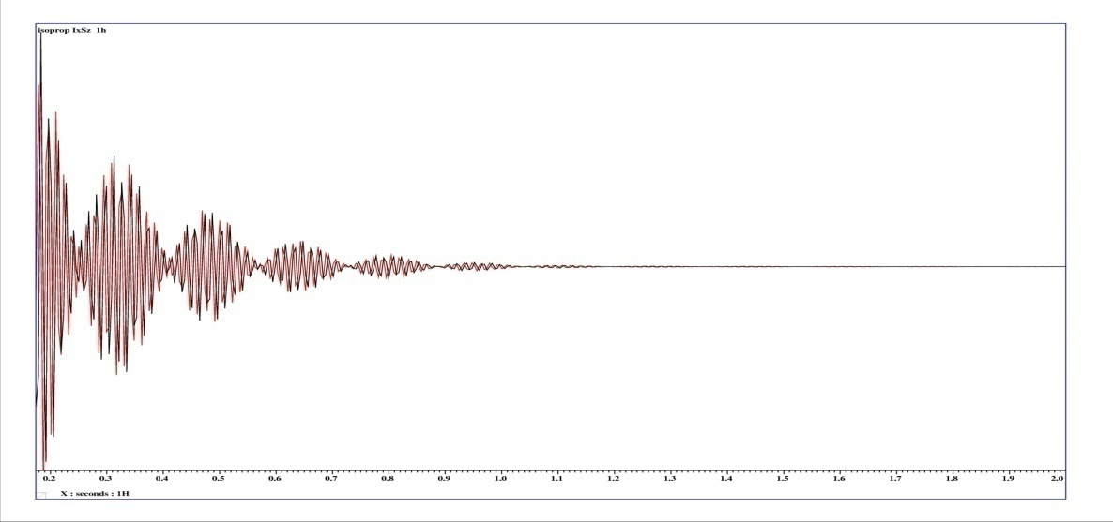
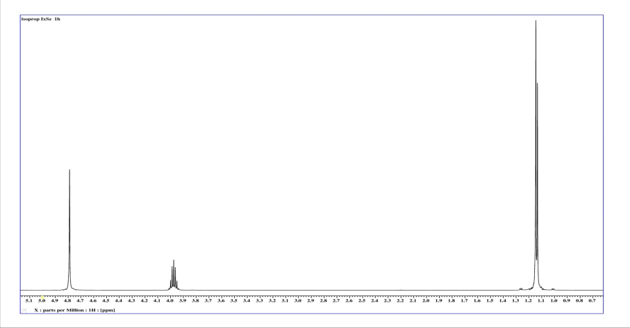
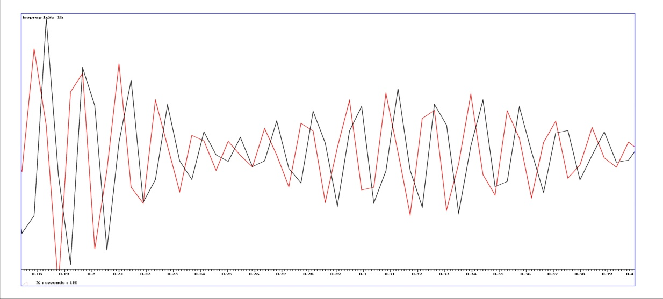
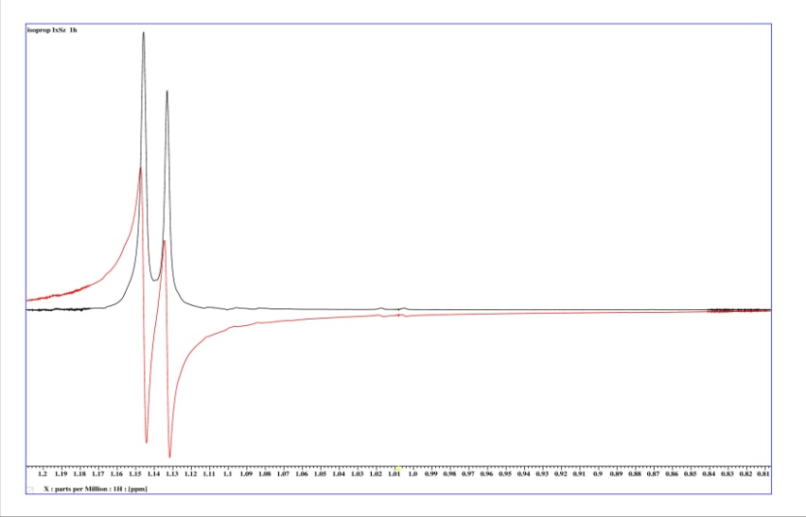
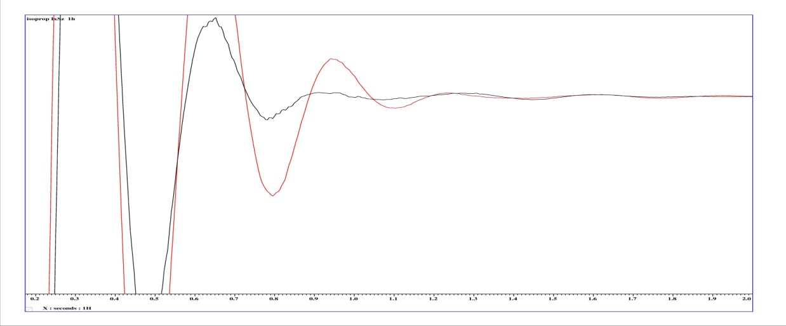
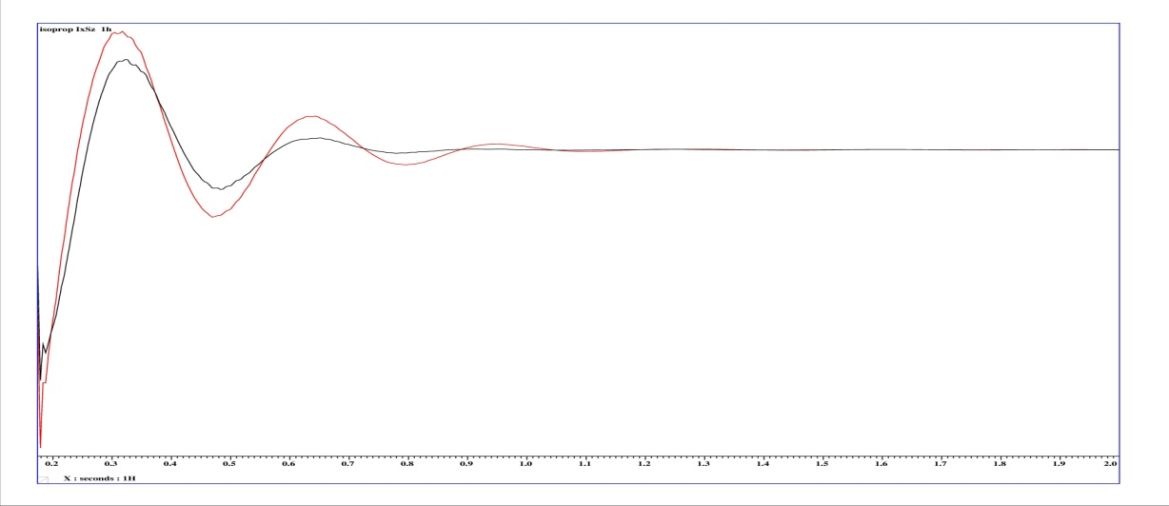
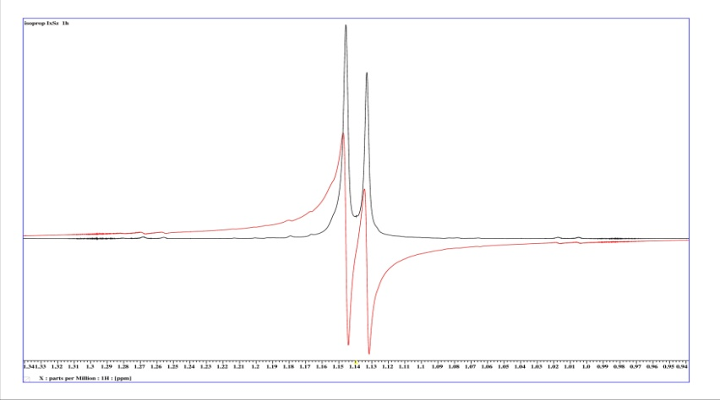
Kopplungsentwicklung 2 Spins ½
J Evolution 2 Spins ½
I_{x}I_{y}
I_{x}I_{y}
I_{x}I_{y}
I_{x}I_{y}
expectation values of I_{y} and I_{x}S_{z}
< I_{y} >_{Ens} ~ − cos ( ω_{I} t )cos ( J/2 t )
<I_{x}S_{z}>_{Ens} ~ sin ( ω_{I} t )sin ( J/2 t )
Rotating frame of reference assumed for Spin I ω_{I} = 0
< I_{y} >_{Ens} ~ cos ( J/2 t ) , <I_{x}S_{z}>_{Ens} ~ − sin ( J/2 t )

Slide 16
Two Spin System
Single particle states : Φlinear combination of basis αα, αβ , βα, ββ e.g. Φ = β (α + β)
I_{z}S_{z} I_{x}S_{x} I_{y}S_{y}
I_{x}S_{z} I_{y}S_{z}
I_{x} I_{y} I_{z}
S_{x} S_{y} S_{z}
S_{x}I_{z} S_{y}I_{z}
I_{y}S_{x} I_{x}S_{y} 1
only I_{x} , S_{x} ,I_{y}, S_{y}, I_{z},S_{z}can be observed
[ A, B ] = 0 a exp( i (A + B) t) = exp( i At) exp( i B t) = exp( i B t) exp( i At)
[ I_{z} , I_{z}S_{z}] = 0 a exp( i H t) = exp( i ω_{Ι}Ι_{z} t) exp( i ω_{S}S_{z} t) exp( i J Ι_{z}S_{z} t)
Time evolution according to B₀ for spins I and S and I_{z}S_{z} can be calculated one by one.
[ H, A ] = 0, [ H, C ] = 0 aexp( i Ht) AC exp( − i Ht) = exp( i Ht) A exp( − i Ht) C
H = ω_{I} I_{z} a
S_{z}I_{x} a S_{z}I_{x} cos (ω_{I}t) + S_{z}I_{y} sin ( ω_{I}t)
H = ω₁I_{y} a
S_{z}I_{x} a S_{z}I_{x} cos (φ ) − S_{z}I_{y} sin ( φ_{I})
H = ω₁S_{y} a
S_{z}I_{x} a S_{z}I_{x} cos (φ ) + S_{x}I_{x} sin ( φ_{I})

Slide 17
Different Views
Macroscopic View
Quantum View
M_{x}, M_{y}, M_{z}components of macroscopic magnetization
I_{x}, I_{y}, I_{z}operators of components of macroscopic magnetization
B₀ evolution
Δω t
M_{x} aM_{x} cos ( ω t) + M_{y} sin ( ω t)
z
I_{x}aI_{x}cos ( ω t) +I_{y}sin ( ω t)
M_{y} a M_{y} cos ( ω t) − M_{x} sin ( ω t)
I_{y}a I_{y}cos ( ω t) −I_{x}sin ( ω t)
-y
M₊ = M_{x} + ι M_{y}
I₊ = I_{x} + ι I_{y}
, M₋ = M_{x}− ι M_{y}
, I₋ = I_{x}− ι I_{y}
M₋ aM₋ exp( i ω t)
-x
I₋ aI₋ exp( i ω t)
x
M₊ aM₊ exp( − i ω t)
I₊ aI₊ exp( − i ω t)
y
-z
y-pulse
B₁ evolution x-pulse
φ = ω₁t_{pulse}
y-pulse
M_{z} aM_{z} cos ( φ) + M_{x} sin (φ)
z
I_{z}aI_{z}cos ( φ) + I_{x}sin (φ)
M_{x} aM_{x} cos (φ ) − M_{z} sin (φ )
-y
I_{x}aI_{x}cos (φ ) − I_{z}sin (φ )
x-pulse
-x
x-pulse
M_{z} aM_{z} cos ( φ )− M_{y} sin ( φ )
x
I_{z}aI_{z}cos ( φ )−I_{y}sin ( φ )
M_{y} aM_{y} cos ( φ )+ M_{z} sin ( φ )
y
I_{y}aI_{y}cos ( φ )+I_{z}sin ( φ )
-z

Slide 18
Time Evolution / Rotation of Operators
B₀- and B₁ - evolution
Iz
Iz
Iz
-Iy
-Iy
-Iy
-Ix
-Ix
-Ix
Ix
Ix
Ix
φ
ω t
φ
Iy
Iy
Iy
-Iz
-Iz
-Iz
J coupling evolution
H= IzSz
H= IzSz
− Ix
− 2 IxSz
−2 IySz
2 IySz
− Iy
Iy
π J t
π J t
Ix
2 IxSz
I₊ a? :
(I_{x}+ i I_{y}) a(I_{x}cos ( φ) +2 I_{y}S_{z}sin ( φ))
+ i (I_{y}cos ( φ) − 2I_{x}S_{z} sin ( φ ))
(I_{x}+ i I_{y}) aI₊ cos ( φ) +2i I₋S_{z}sin ( φ)

Slide 19
B₀- andB₁- Evolution
Iz
Iz
Iz
-Iy
-Iy
-Iy
-Ix
Ix
-Ix
-Ix
Ix
Ix
Iy
φ
Iy
φ
Iy
ω t
-Iz
-Iz
-Iz
J Coupling Evolution
IzSz
IzSz
AX- Approximation
− 2 IxSz
− Ix
−2 IySz
2 IySz
− Iy
Iy
π J t
π J t
Ix
2 IxSz
B₀- andB₁ -Evolution
IzSz
Iz
-IySz
-IySz
-Ix
-IxSz
Ix
IxSz
IySz
φ
I_{z}
IySz
ω t
I_{y}S_{z} ( I_{y} cos ω_{I}t₁ − I_{x} sin ω_{I}t₁ ) S_{z}
-IzSz
-Iz
I_{x}
+ S_{x}
( S_{z} cos φ− S_{y} sin φ)
I_{y}S_{z} ( I_{y} cos φ+ I_{z} sin φ) S_{z}

Slide 20
COSY , Two RF- pulses
90°
90°
t₁ δt increments
acquisition
δt dwell time
S_{x}- magnetization
( S_{y}- magnetization )
I_{z}S_{y}- coherence
90°
90°
t₁ –evolution,
t₁ incremented
cos ω t₁
sin ω t₁
I_{y}S_{z}- coherence
t₂ – evolution, acquisition M₊ = M_{x}+ i M_{y}
I_{x}- magnetization
sin ω t₁
sin ω t₁ (exp (i ω t₂ ))

Slide 21
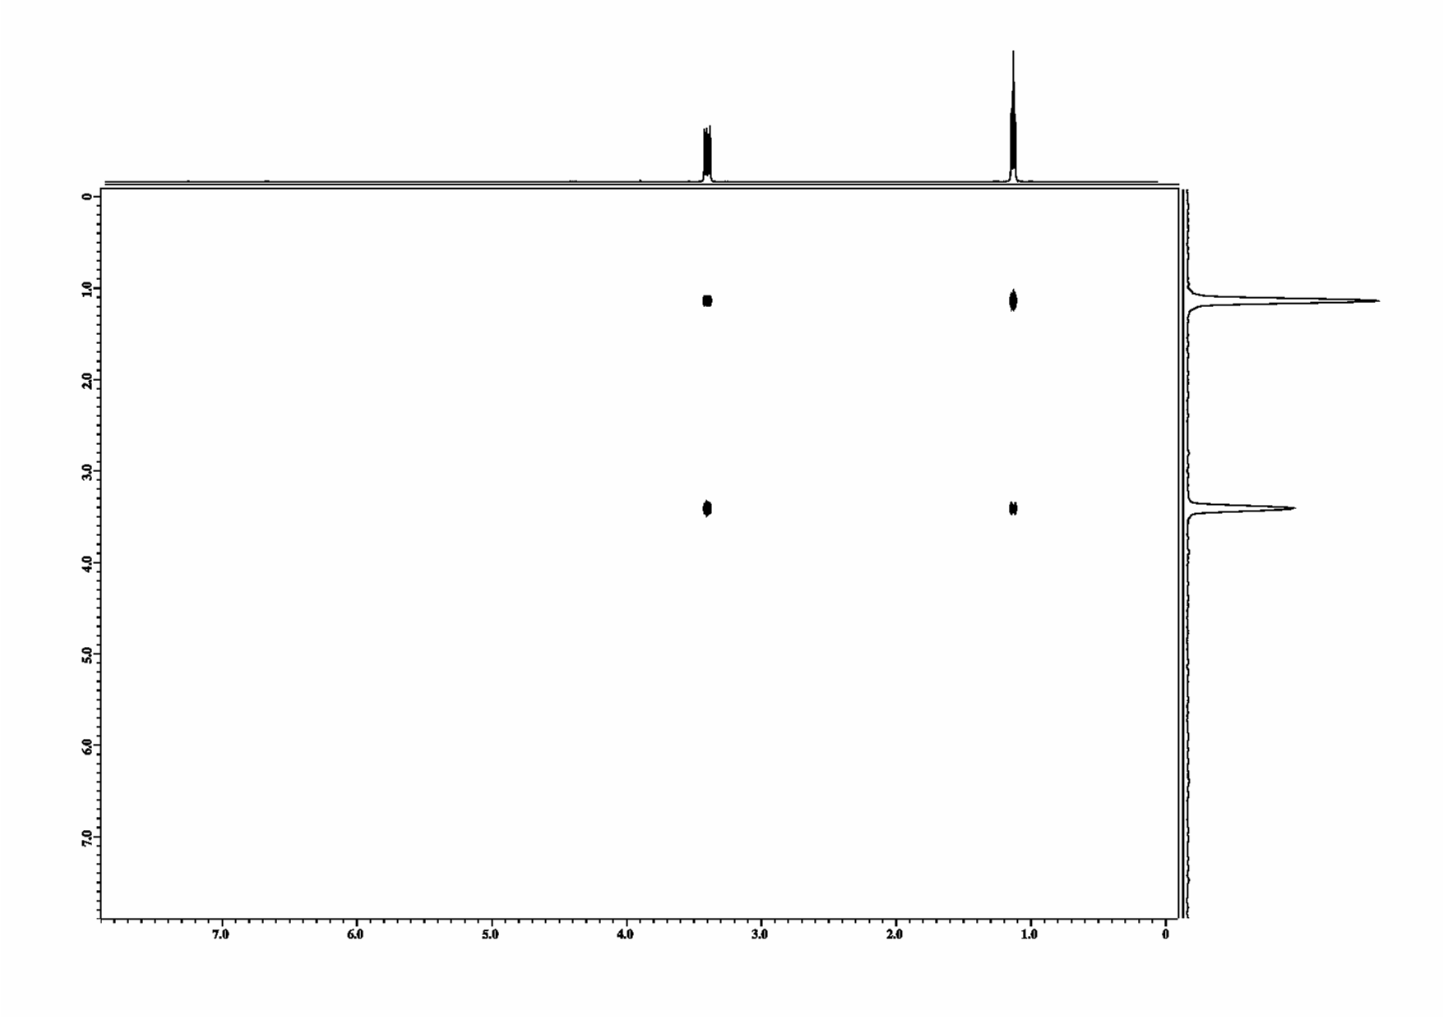
2D Spectrum
FID( t₁ , t₂ ) =
sin ω_{A}t₁ (exp (i ω_{A} t₂ ))
+
sin ω_{B} t₁ (exp (i ω_{B} t₂ ))
* cos J_{AB}/2t₁
* cos J_{AB}/2t₂
* cos J_{AB}/2t₁
* cos J_{AB}/2t₂
+
sin ω_{A}t₁ (exp (i ω_{B} t₂ ))
+
sin ω_{B} t₁ (exp (i ω_{A} t₂ ))
* sin J_{AB}/2t₂
* sin J_{AB}/2t₁
* sin J_{AB}/2t₁
* sin J_{AB}/2t₂
FT :
SPC( t₁ , ω₂ ) =
δ (ω_{A} − ω₁ ) δ (ω_{A}−ω₂ )
δ (ω_{B} -ω₁ ) δ (ω_{B} -ω₂ )
+
∗ (δ ( -J_{AB} /2 ) + δ ( J_{AB} /2 ))
∗ (δ ( - J_{AB} /2 ) + δ ( J_{AB} /2 ))
∗ (δ ( -J_{AB} /2 ) + δ ( J_{AB} /2 ))
∗ (δ ( - J_{AB} /2 ) + δ ( J_{AB} /2 ))
ω_{Α}
δ (ω_{A} −ω₁ ) δ (ω_{A} −ω₂ )
ω_{Α}
∗ (δ ( -J_{AB} /2 ) + δ ( J_{AB} /2 ))
∗ (δ ( -J_{AB} /2 ) + δ ( J_{AB} /2 ))
Opposite sign within a cross peak,
convolution with sine function

Slide 22
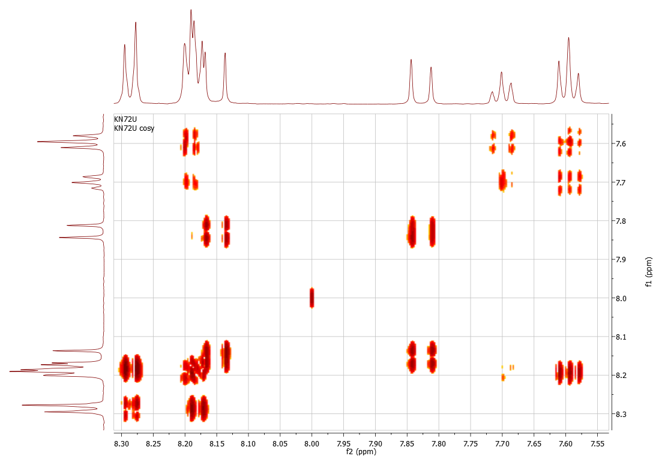
COSY Experiment

Slide 23
Axioms of Quantum Theory*
* Frederic Schuller FAB Erlangen Nuremberg
Axiom 1 : with every quantum system, there is associated a complex Hilbert space (H, +, ., < , >)
The states of the system are all positive trace-class linear maps ρ H ->H for which Tr ρ = 1
Almost everywhere it is stated: the (normalized) elements ψ ε H are the states of the quantum system.
False !!
Axiom 4 : Unitary dynamics: during time intervals (t1,t2)
during which no measurement occur
state ρ(t2) @ time t2
ρ(t1) @ time t1
are related through:
ρ(t2)=U(t2-t1) ρ(t1) U⁻¹(t2-t1)
where U(t) := exp (-i / hH t ) H energy observable

Slide 24
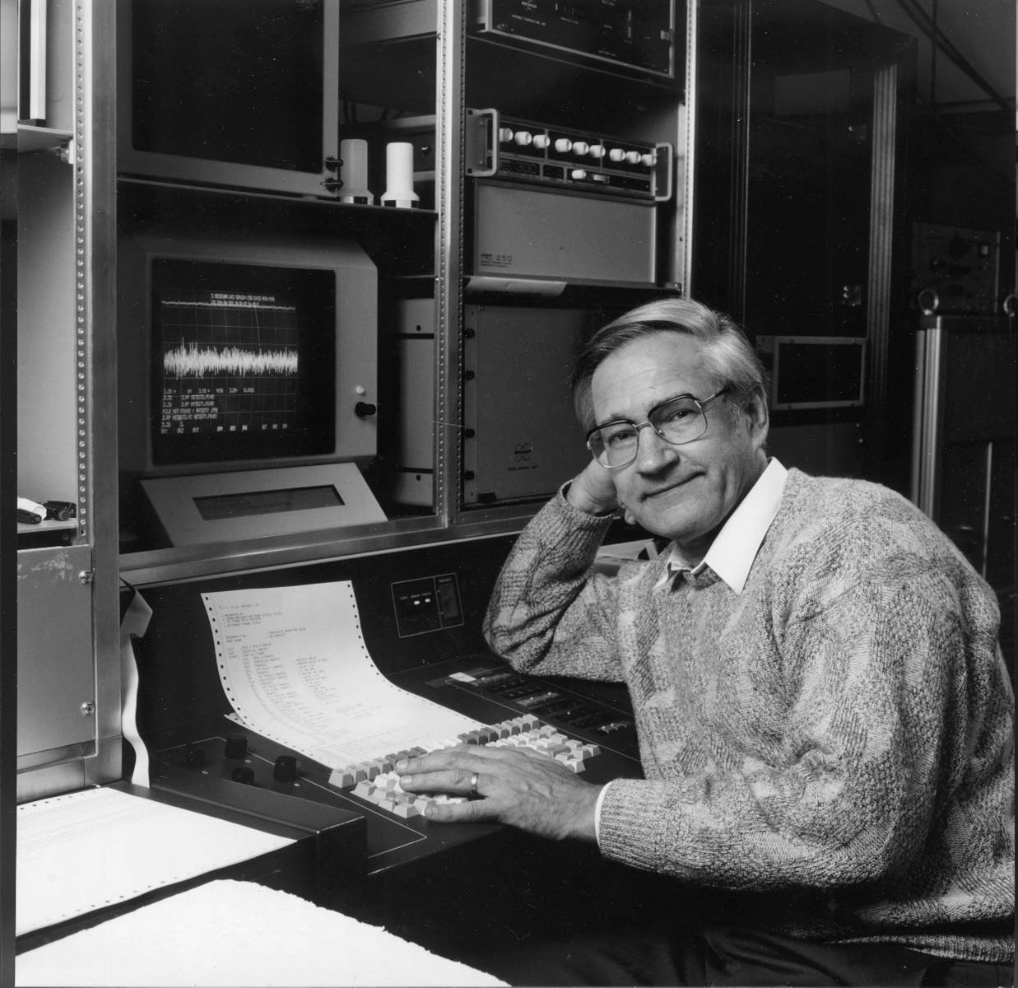
Nobel Laureate 1991
Richard Ernst Nobel laureate 1991

Slide 25
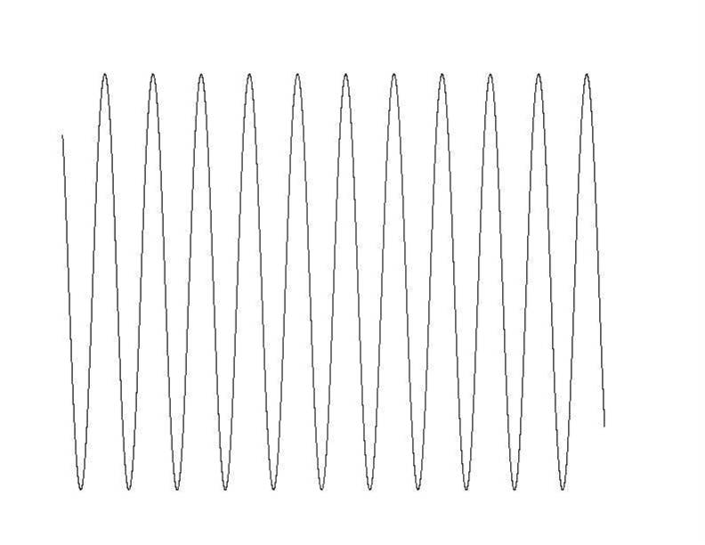
COSY / DELAYED COSY
acquisition
n* dw
n* dw
1/J
1/J
rf
rf
rf
rf
J large
J small
J too small
IzSz
− Ix
−2 IySz
2 IySz
S_{z}
I_{z}
π J t
I_{x} ( I_{x}cos π J t−I_{y}S_{z}sin π J t )
Ix

Slide 26
TOCSY
correlation spectroscopy COSY
Total correlated spectrum TOCSY
H
H
H
Echo refocuses shifts , scalar couplings remain
90°
180°
90°
180°
180°
180°
H
t₁ incremented
acquisition
H
O
H
H

Slide 27
TOCSY
correlation spectroscopy COSY
H
time dependent Schrödinger equation d/dt σ = i h [ H , σ ]
H
H
AX –approximation H _{coupl.} = J_{IS} I_{z} S_{z} + J_{SM} S_{z} M_{z}
H
I_{x} a I_{y}S_{z} , S_{y}M_{z}
O
H
90°
90°
t₁ incremented
acquisition
H
Total correlated spectrum TOCSY
90°
180°
180°
180°
180°
t₁ incremented
acquisition
Echo refocuses shifts , scalar couplings remain
AB- coupling H _{coupl.} = J_{IS} I_{z} S_{z} + J_{IS} I_{x} S_{x} + J_{IS} I_{y} S_{y} + J_{SM} S_{z} M_{z.} + J_{SM} S_{x} M_{x .}+ J_{SM} S_{y}M_{y}
I_{x} a I_{y}S_{z} a I_{y}S_{x}M_{y} a S_{z}M_{y} a M_{x}

Slide 28
Decapeptide (AG Koksch)
tyrosine
Y2
I1
N4
isoleucine
S3
asparagine
serine
P5
proline
D6
aspartate
G7
glycine
threonine
T10
T8
threonine
W9
tryptophan

Slide 29
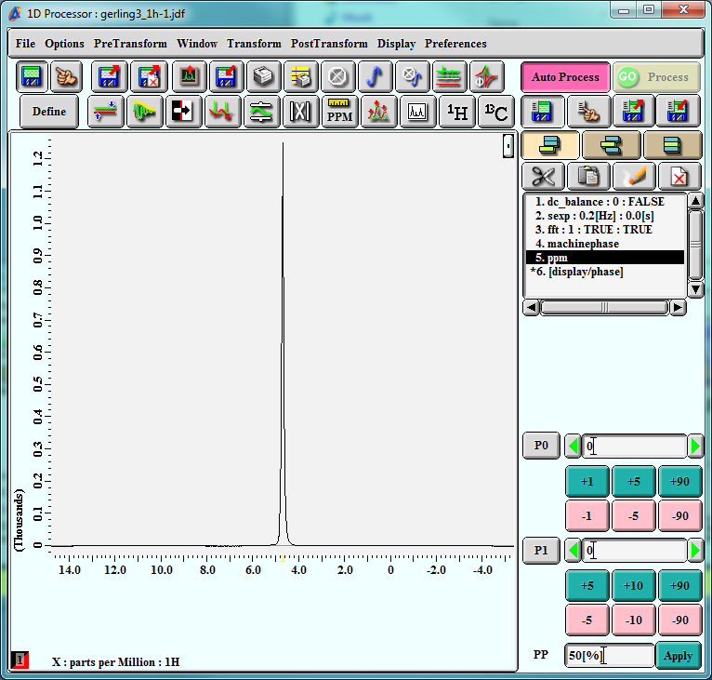
Decapeptide in 20% D2O
Native environment
NH – protons
indicate secondary structure

Slide 30
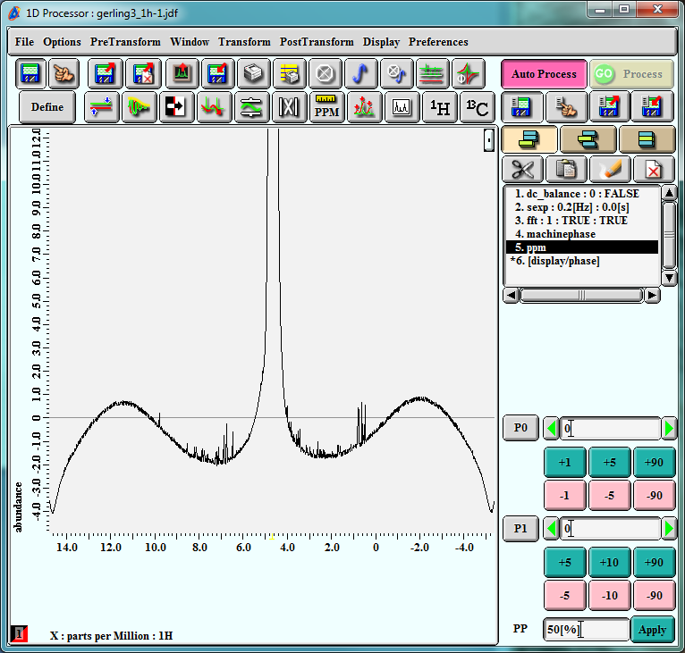
Decapeptide in 20% D2O

Slide 31
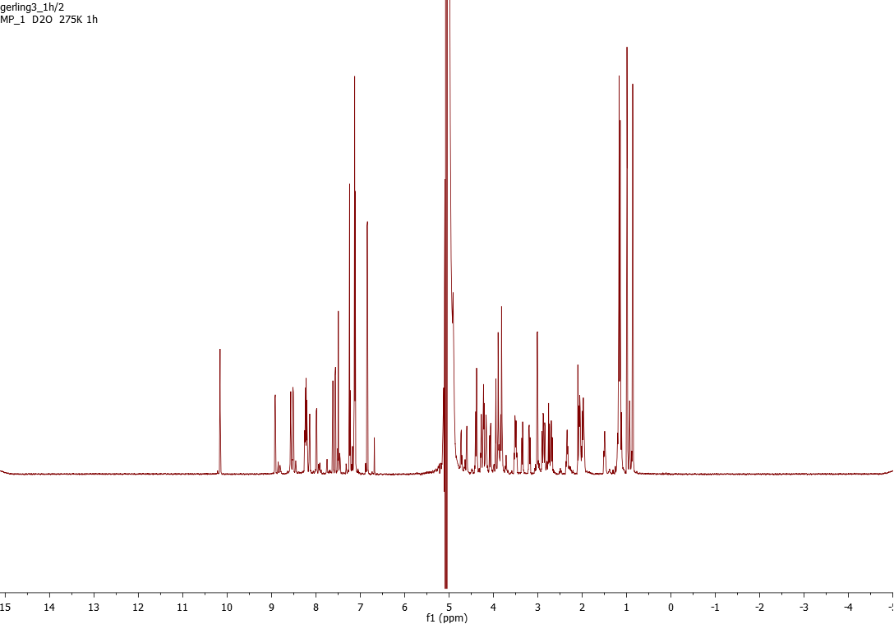
Presaturation Decapeptide in 20% D2O

Slide 32
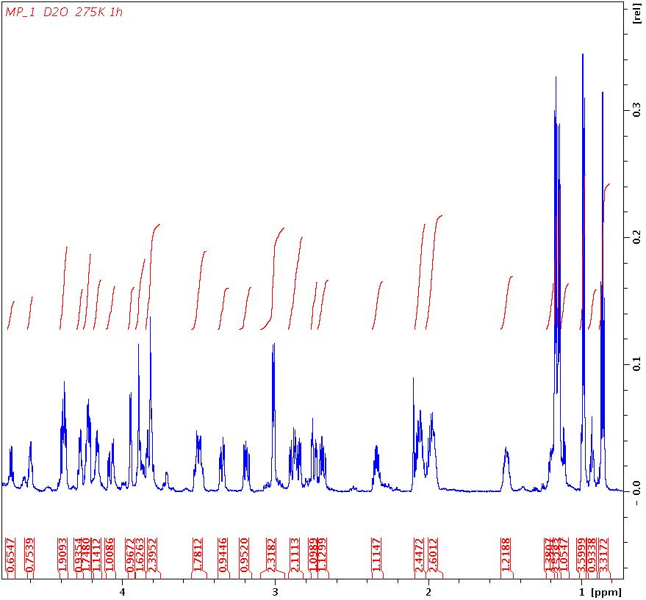
Aliphatic Region Decapeptide
P5
P5
Y2
P5
P5
P5
I1
I1
P5
G7
D6
D6
I1
I1
S3
W9
W9
N4
N4
I1
I1

Slide 33
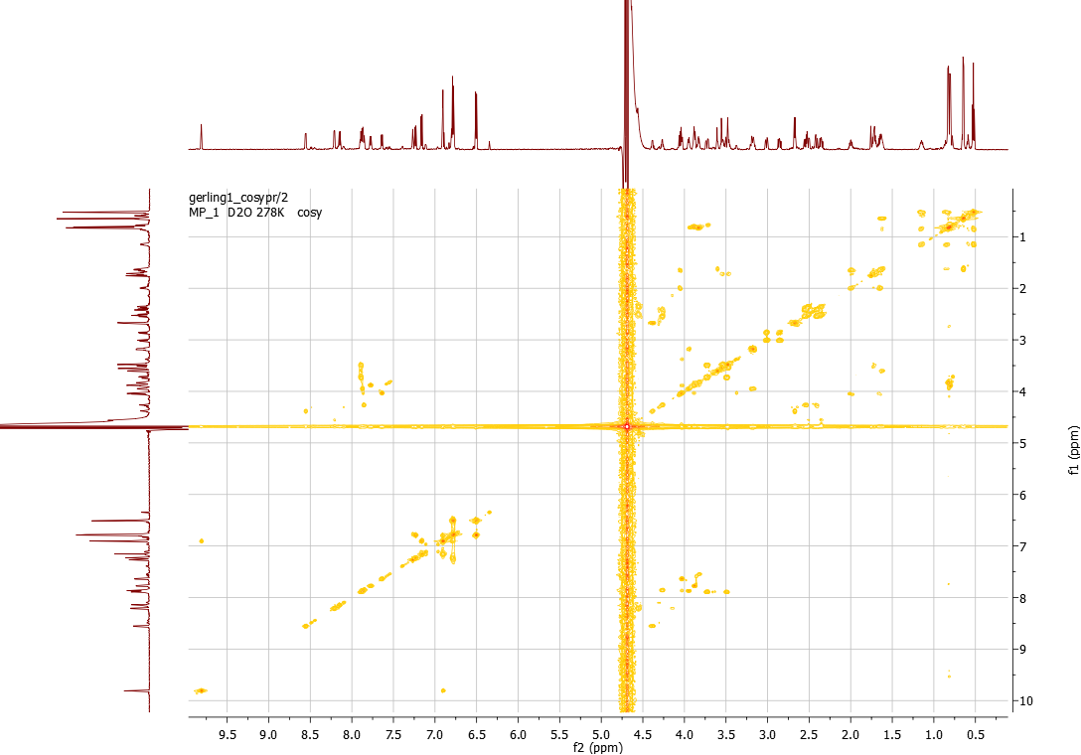
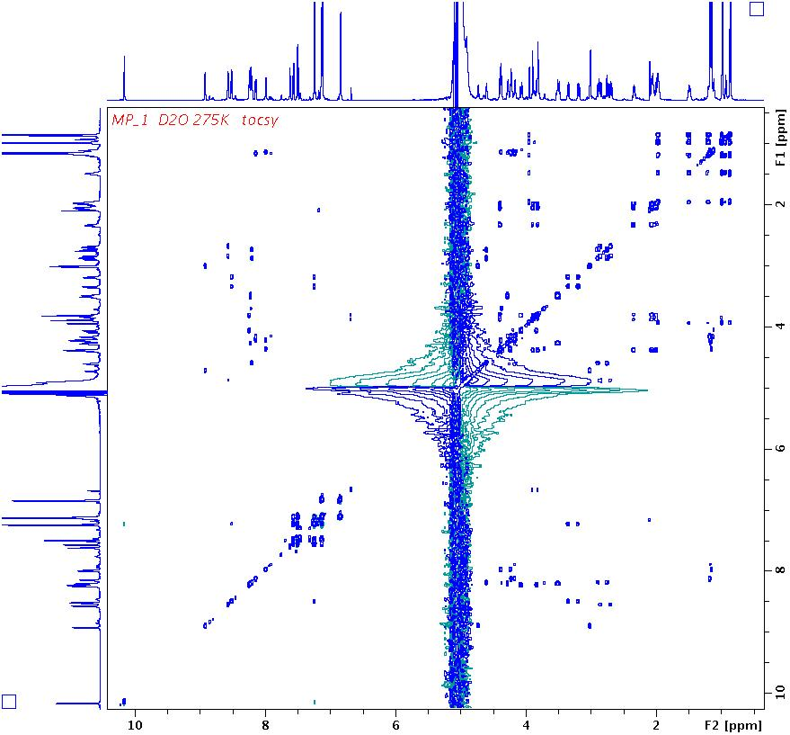
TOCSY / COSY
TOCSY
COSY
NH, CαH

Slide 34

  TOCSY 2° Amid – αHs - βHs

Slide 35
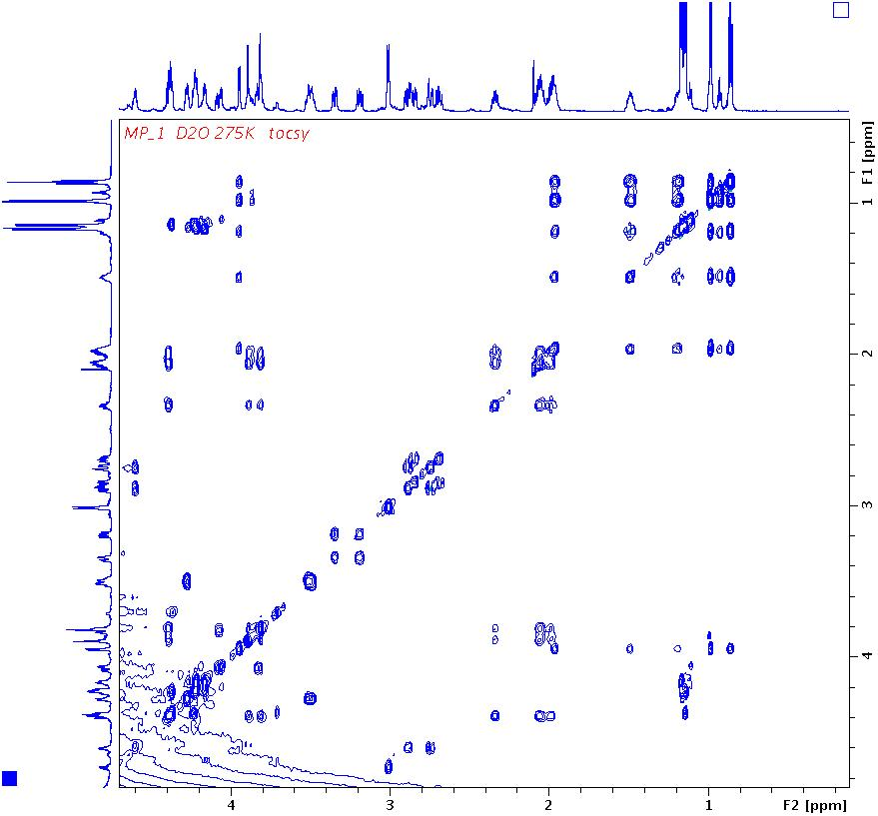

  TOCSY 2°
P5
P5
Y2
P5
P5
P5
T8,T10
I1
I1
P5
G7
D6
D6
I1
I1
S3
W9
W9
N4
N4
I1
I1
I1
I1
T8,T10
isoleucine
I1
I1
P5
D6
N4
D6
N4
threonine
Y2
G7
W9
proline
W9
S3
G7
P5
P5
P5
T8,T10

Slide 36
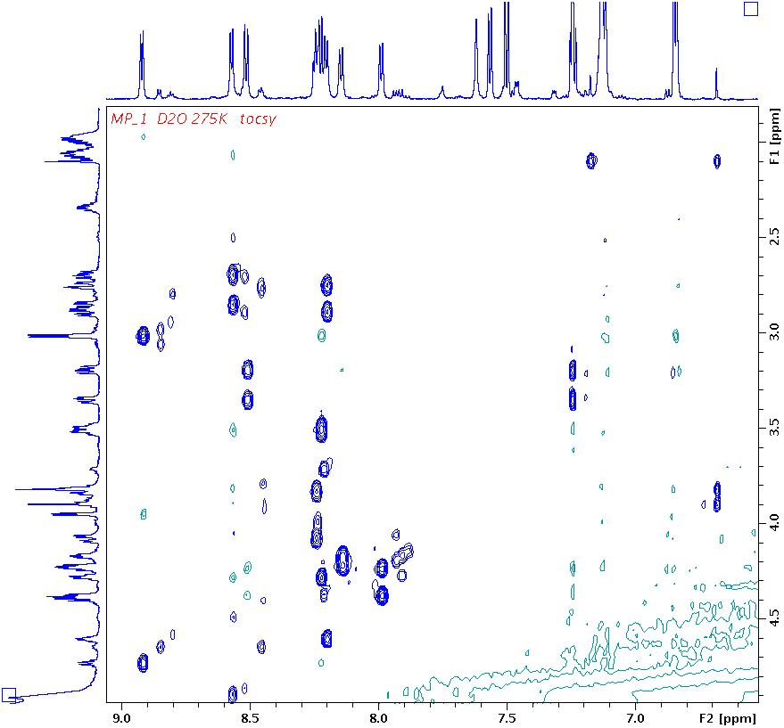
  TOCSY 2°
S3
W9
Y2
N4
W9
G7
D6
T10
T8
I1
N4
N4
D6
D6
D6
N4
N4
D6
Y2
Y2
W9
W9
W9
W9
W9
W9
S3
S3
G7
G7
G7
G7
T10
T8
T10
T10
S3
S3
T10
T8
T8
T8
D6
D6
Y2
Y2
N4
W9
N4

Slide 37
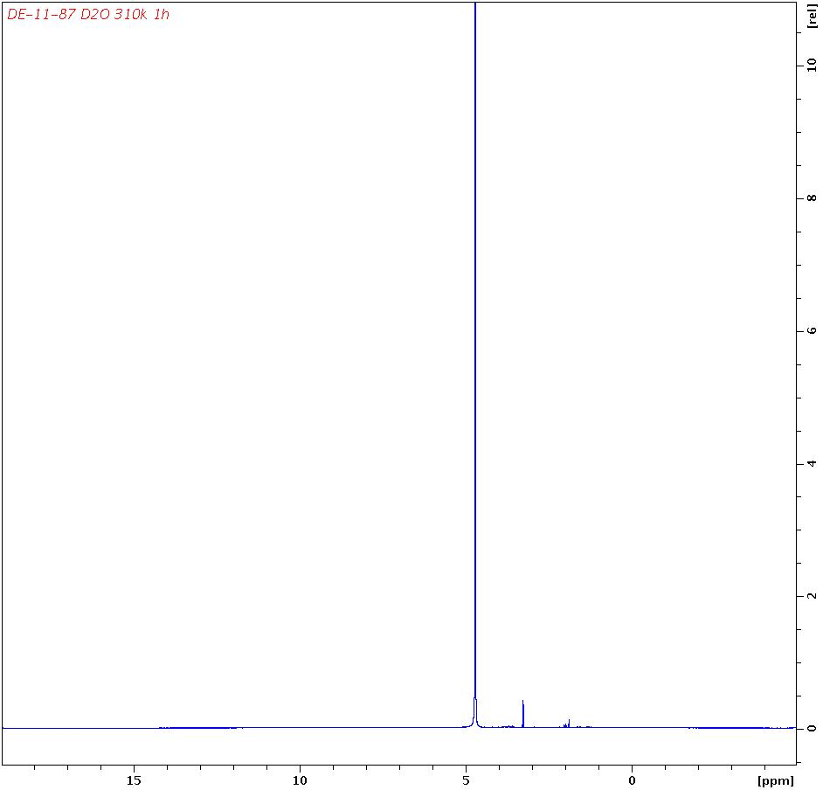
Pentasaccharide in D2O
  TOCSY 2° Amid – αHs - βHs

Slide 38
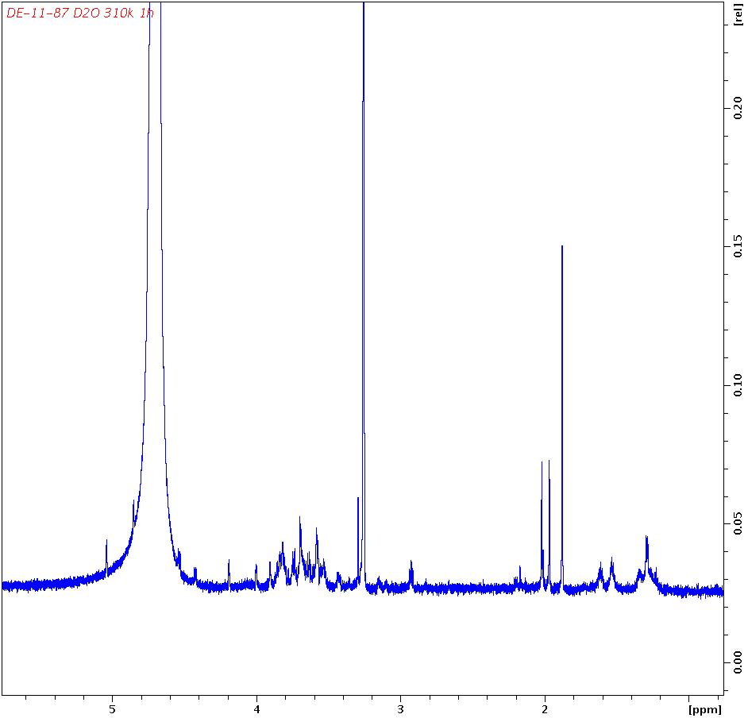
Pentasaccharide in D2O (AG Seeberger)
  TOCSY 2° Amid – αHs - βHs

Slide 39
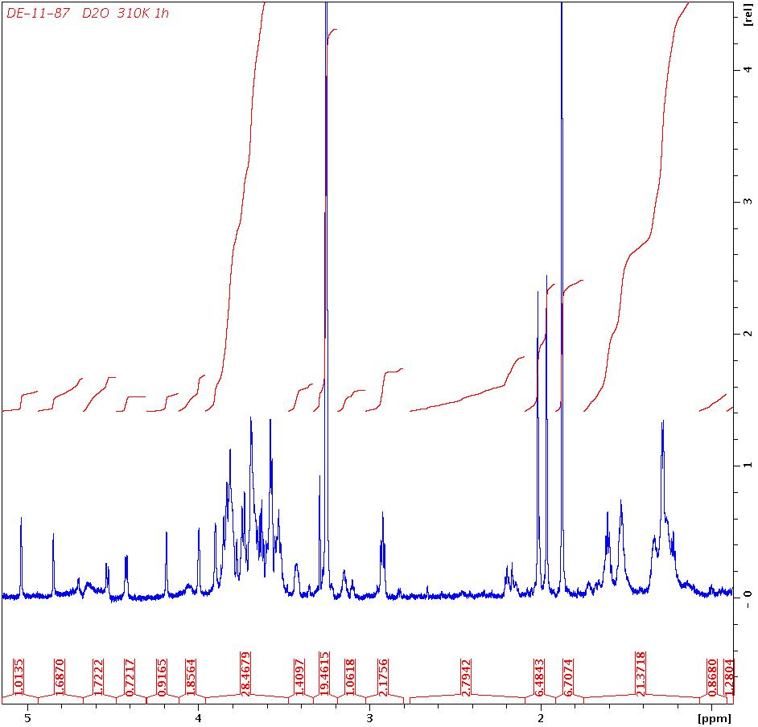
Pentasaccharide in D2O Presaturation
  TOCSY 2° Amid – αHs - βHs

Slide 40
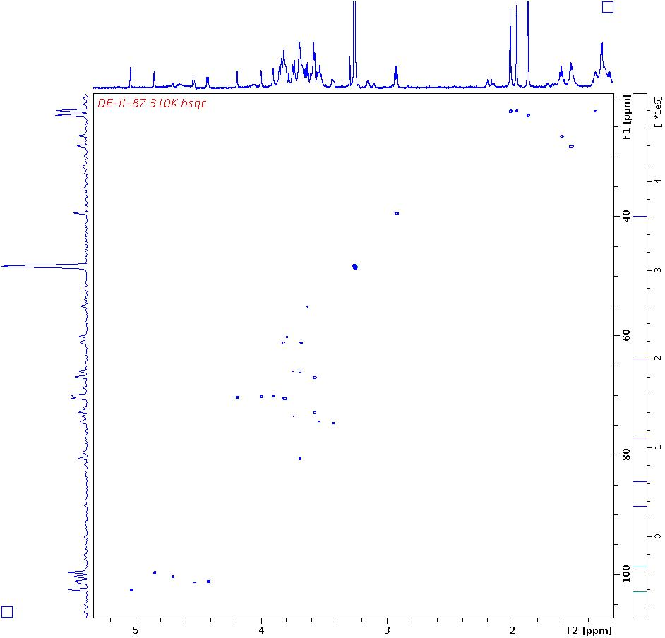
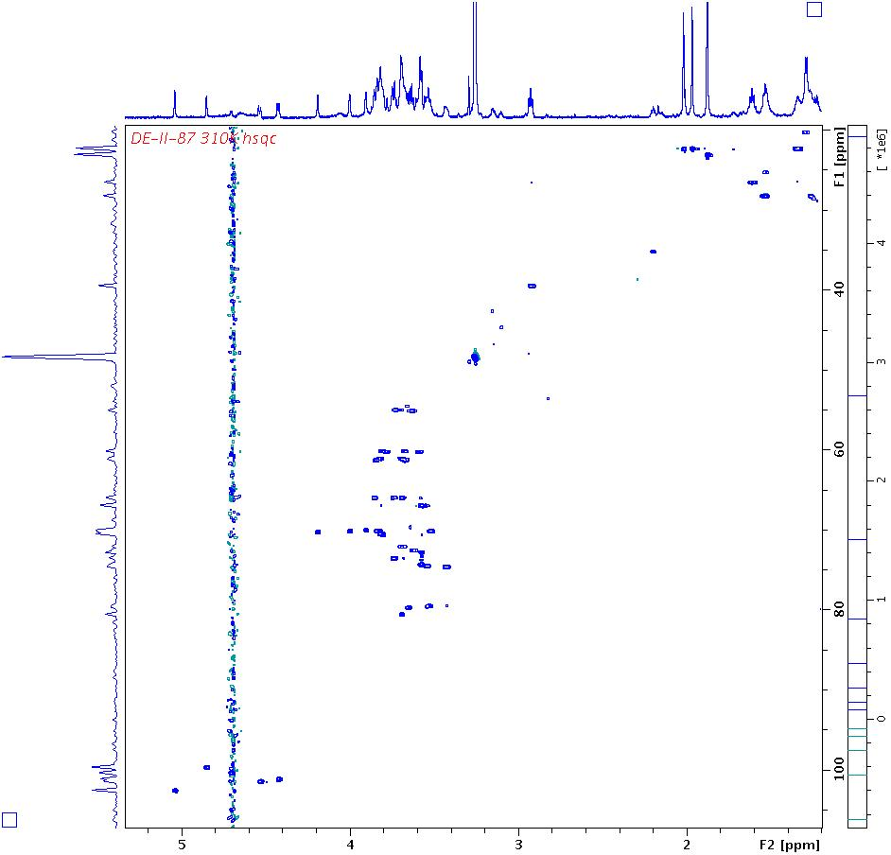
  HSQC Pentasaccharide
anomeric signals

Slide 41
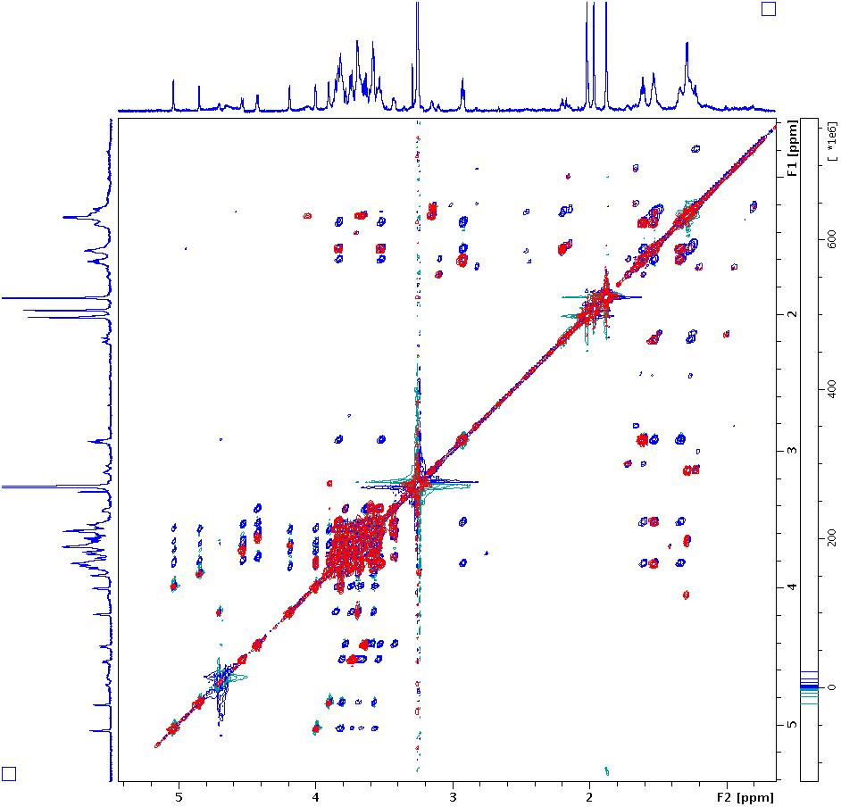
Pentasaccharide TOCSY / COSY
  TOCSY COSY
anomeric protons
carbohydrate signals

Slide 42
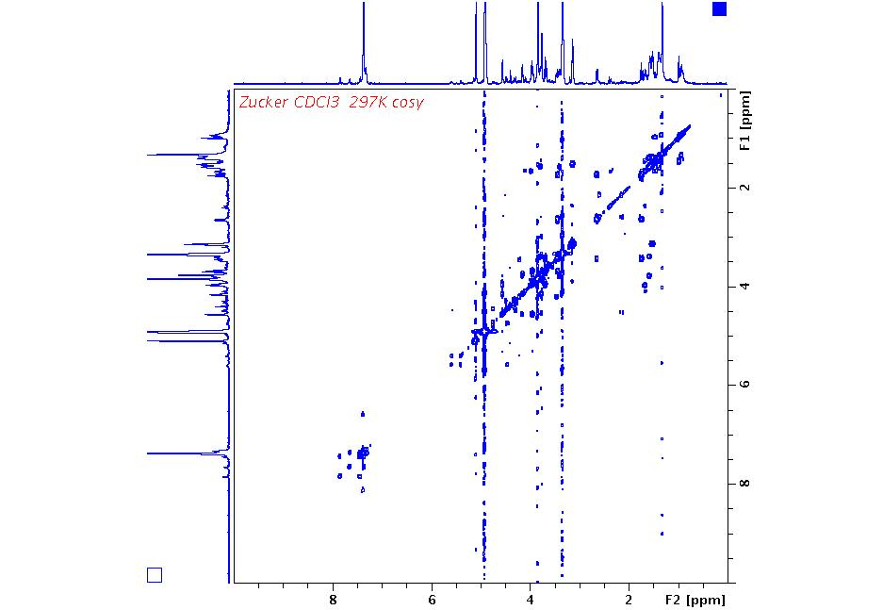
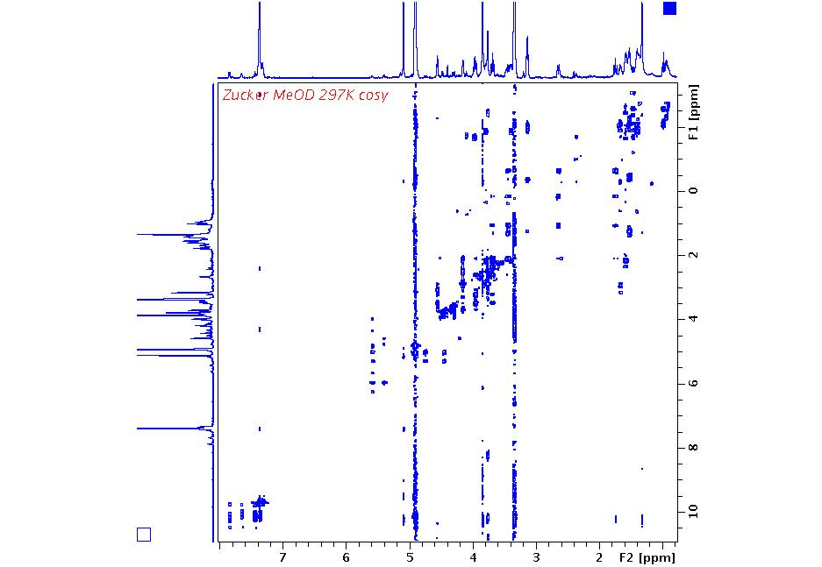
ECSY Exchange Experiment
90° y
90° y
- 90° y
t₁
t_{Mix}
t₂
DQT Experiment
90°
90°
90°
t₂
t_{Mix}
t₁
I_{x} a I_{y}S_{z} a I_{y}S_{x} a I_{y}S_{z} a I_{x}
Double quantum transitions in F1
Sugar MeOD 297K DQT/ZQT
Twice the spectral range needed

Slide 43
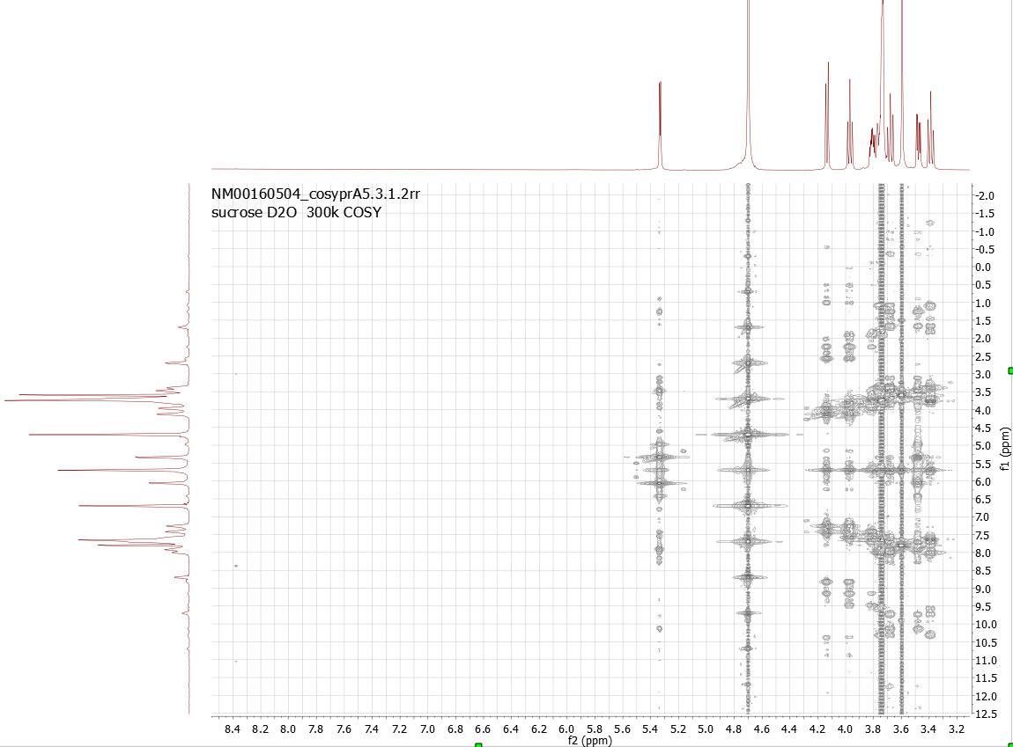
GRAZED Experiment
´¹H
t₁
t₂
90
90
A ordinary COSY without any gradients and phase cycling to select a specific coherence pathway displays all multiple quantum coherences when sufficiently amplified.
No Z-gradient no phase cycling
Sucrose in D2O (moderate concentration, 4 scans)
MQT = 5
MQT = 4
MQT = 3
Offset (Centre) O1
MQT = 2
MQT = 1
3* H₂O
MQT = 0
Offset (Centre) O1
H₂O

Slide 44
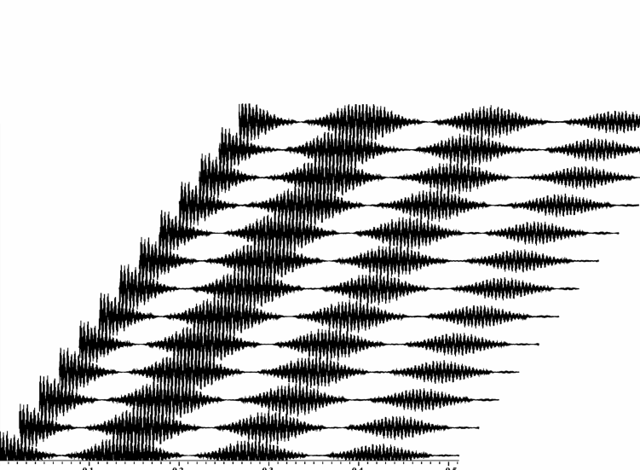
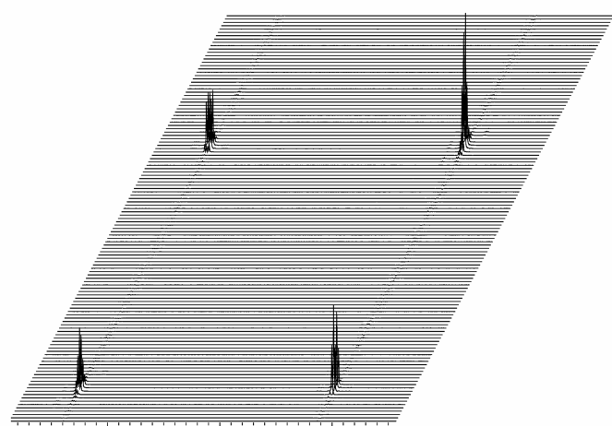
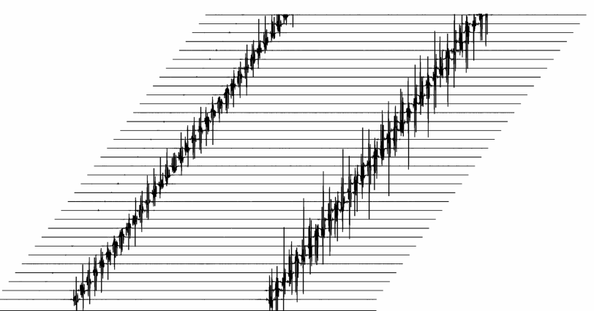

3D Experiments
Pulse sequence1
Pulse sequence2
Pulse sequence3
t₁
t₂
t₃
FT in t₂
FT in t₃

Slide 45
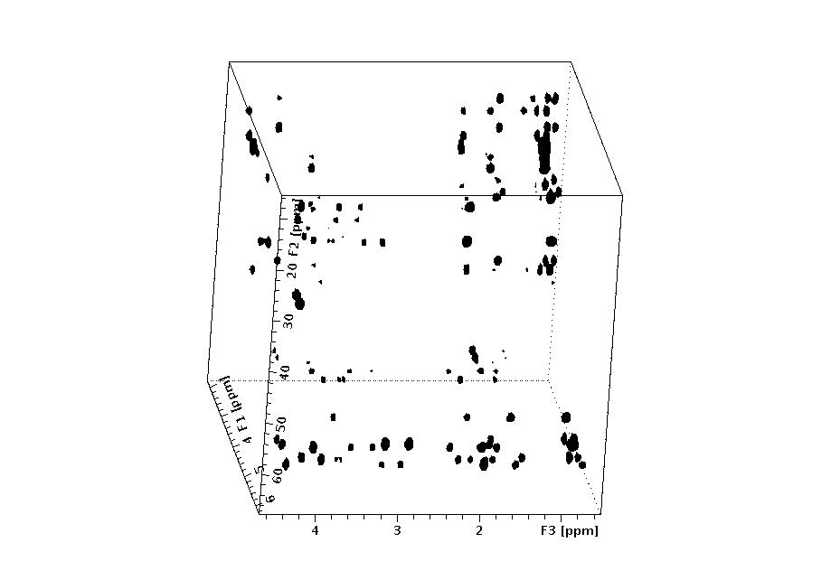
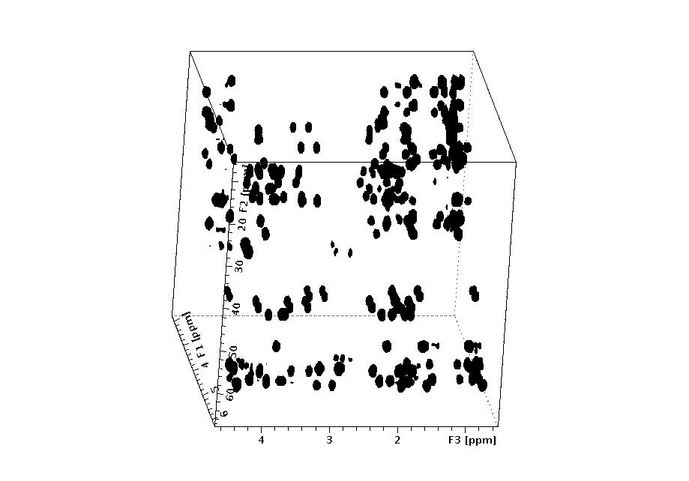
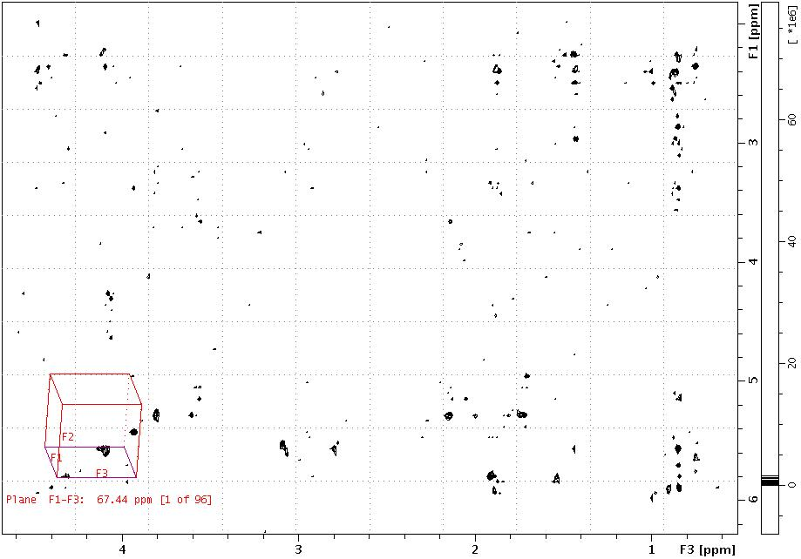
3D Experiments
t₁
t₂
t₃
Pulse sequence1
Pulse sequence2
Pulse sequence3

Slide 46
Appendix 1

