Slide 1

Spin Systems , 1D Spectra
principles
quantum mechanical theory
selected spin systems

Slide 2
Multiplet Splitting
B0
H
H
H
C
C
Energetically favourable
Electrons in equal spin states side step each other. -> lower energy (exchange integrals) (Hund‘s rule) ->
electrons of equal spin are most likely to be found at the carbon (highest probability).
At the position of the second proton the external field will be weakened or strengthened
depending on the spin of the first one.
One spin seems to take effect directly at the position of it‘s coupling partner.
The spin-spin interaction will not be averaged out.

Slide 3
Multiplet Splitting
ν0
H
singlet
H
H
J1
duplet
H
1 coupling partner
V0 + J1 /2
V0 - J1 /2
J1
2coupling partners
doublet of duplets
J2
J2
J1
J1
J1
J2
J2
3 coupling partners
J3
J3
J3
J3
duplet of duplets of duplets
J1
J3
J2

Slide 4
H
Multiplet Splitting
J2 = J3
J1
J2
J2
1 : 1
J3
J3
J3
J3
DDD DT
J1 = J2
J1
J1
J1
J2
J2
1 : 2 : 1
J3
J3
J3
J3
DDD TD
J1 = J2 = J3
1 : 3 : 3 1
J1
J1
J1
J1
DDD Q
J2
J2
J3
J3
J3
J3

Slide 5
Multiplet Splitting
Each coupling partner causes a doubling of splitting.
Equal couplings yield Triplets, quartets ….
General multiplicity rule = 2I + 1
1
Number of coupling partners Pascal‘s triangle
1
1
1
1
2
1
2
1
3
3
1
3
1
4
6
4
1
4
1
5
10
10
5
1
5
1
6
15
20
15
6
1
6
Isopropyl-
Similar coupling constants deliver „pseudo triplets“ , „pseudo quartets“ …
1
2
1
1
1

Slide 6
Multiplet Splitting I=1
in general M = 2I + 1

Slide 7
Multiplet Splitting
DMSO ¹³C
¹³C²D₃
I=3*1 multiplicity = 2*3+1
DMSO ¹H
¹²C ¹H₁²D₂
I=2*1 multiplicty= 2*2+1
CD₂Cl₂¹³C
I=2*1 multiplicity = 2*2+1

Slide 8
Convolution
+
F ( t´ ) G( t - t´) dt´
(F # G ) _{i}= Σ F _{j} G _{( i - j)}
(F # G ) ( t) =
-
j

Slide 9
Convolution
0
0
0
1
0
0
0
0
0
0
0
1
1
1
0
0
0
0
0
1
2
3
2
1
0
0
0
1
3
6
7
6
3
1

Slide 10
(Splitting Pattern , Convolution)
FT
∗
FT
∗
FT

Slide 11
(Splitting Pattern , Convolution)
DMSO ¹³C
DMSO ¹H
CD₂Cl₂¹³C

Slide 12
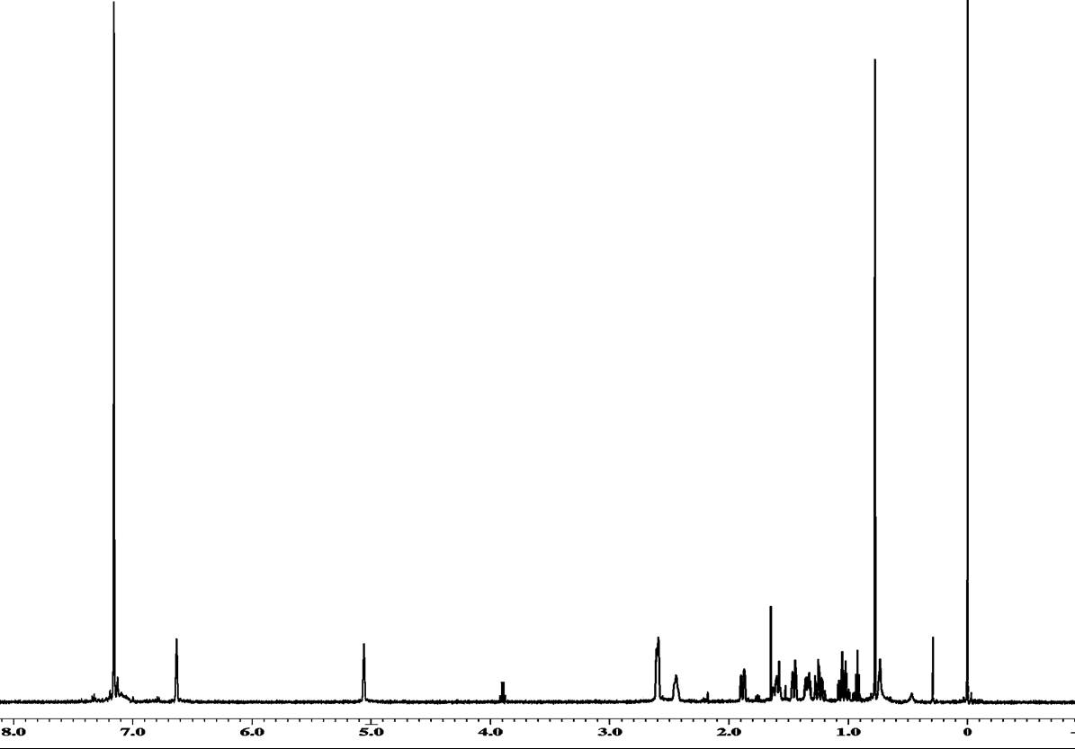
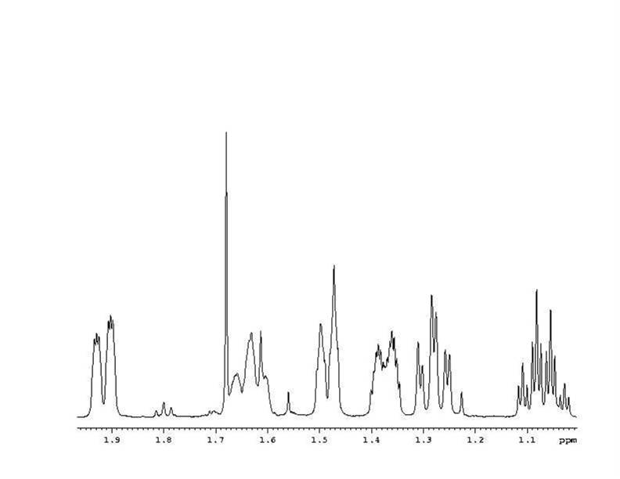
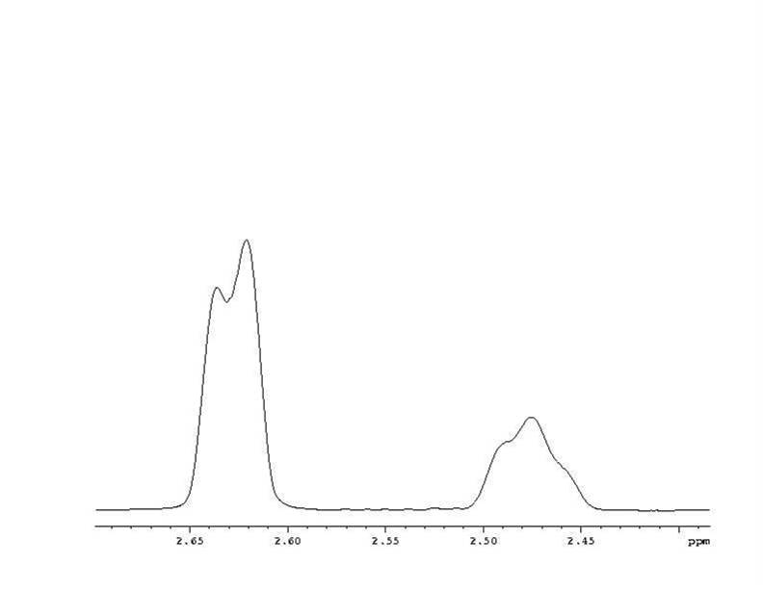
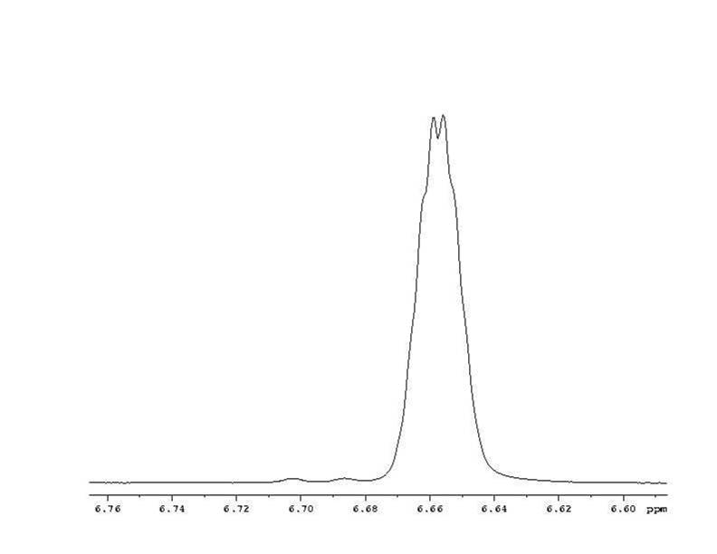
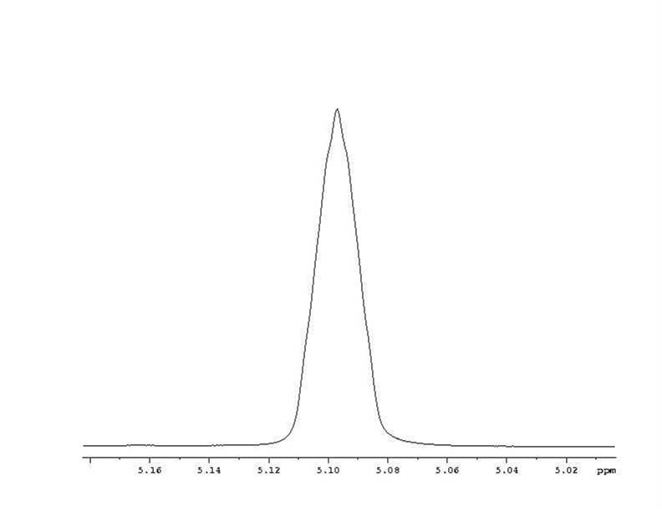
Multiplet Splitting e.g.
H2
H
H2
H2
H2
H
H
H
Olefine
CH2 CH
Ring

Slide 13
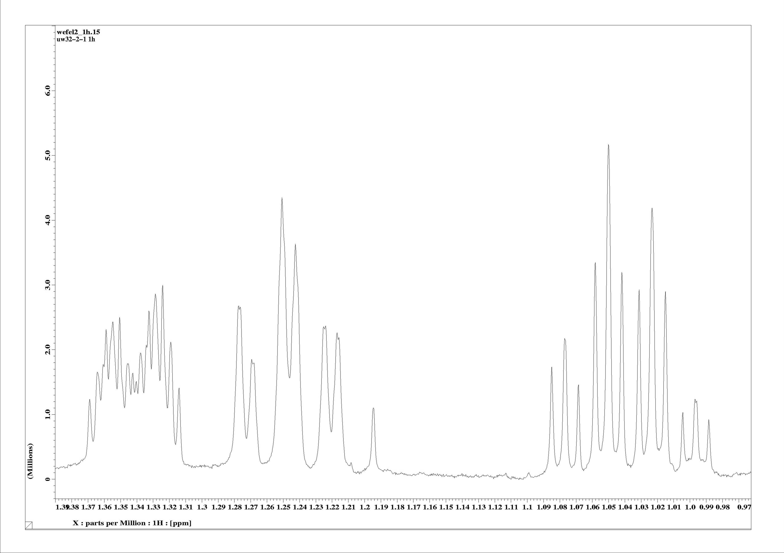
Beispiel
Multiplet Splitting e.g.
H
H
Ha
Me
H
H
H
H
H
H
H
H
Hb
H
H
OH
Hc
H

Slide 14
Multiplet Splitting e.g.
H
H
H
H
CH2 CH
Ring
Olefin.

Slide 15
Weitreichende Kopplung, Dihydrobenzol
Long Range Coupling , Dihydrobenzene
Η
Η
Η
Η
Η

Slide 16
Spinsysteme höherer Ordnung (ABC)
Higher Order Spin Systems (AMX - ABC)
ABC
15 lines
ABX
AMX

Slide 17
Spectroscopy, Quantum Mechanics
Hamiltonian H energy
H = h² /2 m Δ + V (r)
wave function Ψ (r) describes state
eigenfunction Ψ (r) belongs to eigenvalue E
H Ψ (r) = E Ψ (r)
expectation value E = <Ψ (r) | H | Ψ (r) >
Eigenfunctions Ψ_{i} and Ψ_{j} belonging to distinct eigenvalues are orthogonal to each other.
<Ψ_{i}(r) | Ψ _{j} (r) >= δ_{ij}
prediction of a spectrum (1D NMR crossed coils setup)
Expectation value for Hamiltonian
E = <Ψ (r) | H | Ψ (r) >
Transition probability , squared absolute value of transition operator
Δ E = E _{Ψ}- E _{Φ}W _{ΨΦ} = <Ψ (r) | D | Φ (r) >²

Slide 18
QM Description of Coupled Spin Systems
h
I _{z}
= m
I²
= ¾ h²
I = ½ : Two states m = ½ m = - ½
r
r
wave functions α β
orthonormality : <α , α> = 1 , <β , β> = 1 , <α , β> = 0 , <β , α> = 0
I _{y}
Hamiltonian H = B₀ * I = ( 0, 0 , B₀) * ( I _{x} =
I _{z}
)
B₀I _{z}
operator of z component of angular momentum I _{z}
½α = I _{z} α ,−½β = I _{z} β
α , βeigenfunctions with respect to I _{z}
matrix representation:
eigenfunctions of I _{z} constitute a basis of I², (I_{z}), H
1
0
½ 0
0 - ½
¾ 0
0 ¾
α g
β g
I _{z}g
I²g
0
1

Slide 19
QM Description of Coupled Spin Systems
matrix representation of angular momentum operators (needed for transition moment operators):
¾ 0
0 ¾
½ 0
0 - ½
0 ½ ½ 0
0 - i/2
i/2 0
I²g
I _{z}->
I _{x}->
I _{y}->
commutator relations:
[ I _{x} , I _{y} ]
=iI _{z}
[ I _{y} , I _{z} ]
=i I _{z}
[ I _{z} , I _{x} ]
=i I _{y}
[ I _{x} , I _{y} ] ->
0 ½
½ 0
0 -i/2
i/2 0
0 -i/2
i/2 0
0 ½
½ 0
i/2 0
0 -i/2
->iI _{z}
-
=
I _{x} I _{y} = i/2 I _{z} , I _{y} I _{x} = −i/2 I _{z} , I _{y} I _{z} = i/2 I _{x} , I _{z} I _{y} = −i/2 I _{x} , I _{z} I _{x} = i/2 I _{y} , I _{x} I _{z} = −i/2 I _{y}
I _{x} I _{x} = 1/4 1, I _{y} I _{y} = 1/4 1, I _{z} I _{z} = 1/4 1
Hamiltonian: H = ω I _{z}
E, m_{z}
½ ω
α
Transition probability, transition operator , transition amplitude
½β = I _{x} α ,½β = I _{x} α
Δ E = ω
Δ E = ω , W _{α β} = <α| I _{x} | β>² = ¼
− ½ ω
β
i ½β = I _{y} α , − i½β = I _{y} α

Slide 20
2 Spins without Coupling
product basis
α( s1 ) α( s2 ) , α( s1 ) β( s2 ) , β( s1 ) α( s2 ) , β( s1 ) β( s2 )
α α , α β , β α , β β
Hamiltonian : H = ω_{Ι} I _{z} + ω_{S} S _{z}
H αα = ( ω_{Ι}I _{z}+ ω_{S} S _{z})αα= ω_{Ι}I _{z} αα+ ω_{S} S _{z}αα
H αα = ω_{Ι}αI _{z} α + ω_{S} α S _{z}α= ½ ω_{Ι}αα+ ½ ω_{S} αα = ½ ( ω_{Ι} + ω_{S} ) αα
H αβ = ω_{Ι}βI _{z} α + ω_{S} α S _{z}β= ½ ω_{Ι}αβ− ½ ω_{S} αβ = ½ ( ω_{Ι}−ω_{S} ) αβ
E, m_{z}
α
α
½ ω_{Ι} + ½ ω_{S}
½ ω_{I}− ½ ω_{S}
α
β
½ ω_{S}− ½ ω_{I}
β
α
− ½ ω_{I} − ½ ω_{S}
β
β

Slide 21
2 Spins Transition Matrix Elements
W_{αα , α β} =
<αα| I _{x} +S _{x}| αβ>² = <αα| I _{x} αβ +S _{x}αβ>² = ( ½<αα| ββ>+½<αα| αα>)² = 1/4
½<αα| ββ> =
<α| β>
½<α| β> *
W_{α α , β β} =
<αα| I _{x} +S _{x}| ββ>² = <αα| I _{x} ββ +S _{x}ββ>² = ( ½<αα| αβ>+½<αα| βα>)² = 0
E, m_{z}
α
α
½ ω_{Ι} + ½ ω_{S}
ω_{S}
ω_{I}
α
β
½ ω_{I}− ½ ω_{S}
ω_{I} −ω_{S}
½ ω_{S}− ½ ω_{I}
β
α
ω_{S} + ω_{I}
ω_{S}
ω_{I}
− ½ ω_{I} − ½ ω_{S}
β
β
ω_{S}
ω_{I}

Slide 22
Scalar Coupling (weak, AX Approximation)
Hamiltonian : H = ω_{Ι} I _{z} + ω_{S} S _{z} + JI S
H = ω_{Ι} I _{z} + ω_{S} S _{z} + J( I _{x} S _{x} + I _{y} S _{y} + I _{z} S _{z} )
AX approximation : H = ω_{Ι} I _{z} + ω_{S} S _{z} + JI _{z} S _{z}
JI _{z} S _{z} αα = J I _{z}S _{z}αα= J I _{z} αS _{z}α = J ½ α ½α= J/4 α α
JI _{z} S _{z} αβ = J I _{z}S _{z}αβ= J I _{z} αS _{z}β = J ½ α (−½)β= − J/4 α α
J
J
E, m_{z}
½ ω_{Ι} + ½ ω_{S}
α
α
+ J/4
ω_{S}
+ J/2
ω_{I}
½ ω_{I}− ½ ω_{S}
+ J/2
α
β
ω_{S}
ω_{I}
− J/4
½ ω_{S}− ½ ω_{I}
− J/4
β
α
ω_{I}
ω_{S}
− J/2
− J/2
− ½ ω_{I} − ½ ω_{S}
+ J/4
β
β

Slide 23
Scalar Coupling (Strong , A2 , AB System)
Hamiltonian : H = ω_{Ι} I _{z} + ω_{S} S _{z} + JI S
H = ω_{Ι} I _{z} + ω_{S} S _{z} + J( I _{x} S _{x} + I _{y} S _{y} + I _{z} S _{z} )
JI _{x} S _{x} αα = J I _{x}S _{x} αα= J I _{x} αS _{x}α = J ½ β ½β= J/4 β β
JI _{y} S _{y} αα = J I _{y}S _{y}αα= J I _{y} αS _{y}α = J i ½ β i ½β= − J/4 β β
JI _{x} S _{x} αβ = J I _{x}S _{x} αβ= J I _{x} αS _{x}β = J ½ β ½α= J/4 β α
JI _{y} S _{y} αβ = J I _{y}S _{y}αβ= J I _{y} αS _{y}β = J i ½ β (−i ) ½α= + J/4 β α
½ ω_{Ι} + ½ ω_{S} + J/4
0
0
0
½ ω_{I}− ½ ω_{S}− J/4
+ J/2
0
0
0
0
+ J/2
½ ω_{S}− ½ ω_{I} − J/4
0
0
0
0
0
− ½ ω_{I} − ½ ω_{S} + J/4

Slide 24
Block Structure
Hamiltonian : H = ω_{Ι} I _{z} + ω_{S} S _{z} + JI S
H = ω_{Ι} I _{z} + ω_{S} S _{z} + J( I _{x} S _{x} + I _{y} S _{y} + I _{z} S _{z} )
F _{z} = S _{z} + I _{z}
E, m_{z}
[ H , F _{z} ] = 0 F _{z} and H commute => same subsets of eigenvectors
=> Matrix representations posses the same block structure
4 spins
Pascal‘s triangle again Number of coupling spins
αααα
f _{z} = 2
1
αααβ
1
1
1
2 spins
ααβα
3 spins
f _{z} = 1
1
2
1
2
αβαα
αα
f _{z} = 1
βααα
ααα
f _{z} = 3/2
1
3
3
1
3
αβ
ααββ
ααβ
1
4
6
4
1
4
βα
f _{z} = 0
αβαβ
αβα
f _{z} = 1/2
βααβ
f _{z} = 0
ββ
αββα
βαα
f _{z} = -1
βαβα
αββ
ββαα
ββα
f _{z} = -1/2
αβββ
βαββ
βαβ
f _{z} = -1
ββαβ
βββ
f _{z} = -3/2
βββα
ββββ
f _{z} = -2

Slide 25
Scalar Coupling (Strong , A2 System)
Hamiltonían: H = ω_{Ι} I _{z} + ω_{S} S _{z} + JI S
A2 system: ω_{Ι}= ω_{S}
½ ω_{Ι} + ½ ω_{S}+ J/4
ω_{Ι}+ J/4
0
0
0
½ ω_{I}− ½ ω_{S} − J/4
0
− J/4
+ J/2
0
0
½ ω_{S}− ½ ω_{I} − J/4
+ J/2
− J/4
0
−ω_{Ι}+ J/4
0
0
0
½ ω_{I} − ½ ω_{S} + J/4
symmetric eigenfunctions : αα , β β , 1/√ 2 ( αβ + β α )
antisymmetric eigenfunction : 1/√ 2 ( αβ − β α )
ω_{Ι}+ J/4
0
0
0
J( I _{x} S _{x} + I _{y} S _{y} ) αβ = J/2 β α
0
+ J/4
0
0
0
0
− 3/4 J
0
J( I _{x} S _{x} + I _{y} S _{y} ) βα = J/2 α β
0
0
0
−ω_{Ι}+ J/4
JI _{x} S _{x} βα = J I _{x}S _{x} βα= J I _{x} βS _{x}α = J ½ α ½β= J/4 α β
JI _{y} S _{y} βα = J I _{y}S _{y}βα= J I _{y} βS _{y}α = J (−i ) ½αi ½ β= + J/4 α β

Slide 26
Scalar Coupling (Strong , A2 System)
E, m_{z}
ω_{Ι}+ J/4
0
0
0
0
− J/4
+ J/2
0
0
+ J/2
− J/4
0
αα
0
0
0
−ω_{Ι}+ J/4
ω_{Ι}+ J/2
ω_{Ι}
1/√ 2 ( αβ + β α )
1/√ 2 ( αβ − β α )
ω_{Ι}+ J/4
0
0
0
ω_{Ι}
0
+ J/4
0
0
ω_{Ι}− J/2
0
0
− 3/4 J
0
ββ
0
0
0
−ω_{Ι}+ J/4
Η 1/√ 2 ( αβ + β α ) = 1/√ 2 ( − J/4 αβ + J/2 β α − J/4 βα + J/2 α β ) = J/4 1/√ 2 ( αβ + β α )
Η 1/√ 2 ( αβ − β α ) = 1/√ 2 ( − J/4 αβ + J/2 β α + J/4 βα − J/2 α β ) = − J 3/4 1/√ 2 ( αβ − β α )
W_{αα , ( αβ − βα )}=
<αα| I _{x} +S _{x}|( αβ − βα )>² = (<αα| I _{x} αβ+ S _{x}αβ> −(<αα| I _{x} βα+ S _{x}βα>) ²
= (½<αα| ββ>+½<αα| αα> - ½<αα| αα>+½<αα| ββ>)² = 0

Slide 27
Scalar Coupling (Strong , AB System )
AB system : ω_{Ι}= ω_{S}ω_{S} - ω_{I}<<J
Hamiltonian : H = ω_{Ι} I _{z} + ω_{S} S _{z} + JI S
H = ω_{Ι} I _{z} + ω_{S} S _{z} + J( I _{x} S _{x} + I _{y} S _{y} + I _{z} S _{z} )
½ ω_{Ι} + ½ ω_{S} + J/4
0
0
0
αα
0
½ ω_{I}− ½ ω_{S} − J/4
+ J/2
0
αβ
0
+ J/2
½ ω_{S}− ½ ω_{I} − J/4
0
βα
0
0
0
− ½ ω_{I} − ½ ω_{S} + J/4
β β
½ ( ω_{Ι} + ω_{S} ) + J/4= ε ₁ , − ½ ( ω_{Ι} + ω_{S} ) + J/4= ε ₄
− ε
½ ω_{I}− ½ ω_{S} = ½ Δω
½Δω− J/4
+ J/2
Det
= 0
− ε
+ J/2
− ½ Δω− J/4
ε ² − ¼ Δω² + ( J/4) ² + ε J/2 − J ² /4 = 0
ε ² + ε J/2 − 3/16 J ² − ¼ Δω² = 0
− J/4 +/− 1/2 √ (J ² + Δω² ) = ε _{2,3}
1/2 √ (J ² + Δω² ) = C

Slide 28
Transition Probability (AB System)
1/2 √ (J ² + Δω² ) = C
E, m_{z}
½ ( ω_{Ι} + ω_{S} ) + J/4
α
α
½ ( ω_{Ι} + ω_{S} ) + J/2 − C
− J/4 + C
α
β
½ ( ω_{Ι} + ω_{S} ) + J/2 + C
− J/4 − C
β
α
½ ( ω_{Ι} + ω_{S} ) − J/2 + C
− ½ ( ω_{Ι} + ω_{S} ) + J/4
β
β
½ ( ω_{Ι} + ω_{S} ) − J/2 − C
− ε
cos θ
cos θ
½Δω− J/4
+ J/2
= ε _{2,3}
− ε
sin θ
sin θ
+ J/2
− ½ Δω− J/4
cos θ αβ + sin θ βα = Ψ₂
cos θ αβ − sin θ βα = Ψ₃

Slide 29
Transition Probability (AB System)
1/2 √ (J ² + Δω² ) = C
½Δω− J/4
+ J/2
cos θ
cos θ
=
− J/4 + C
+ J/2
− ½ Δω− J/4
sin θ
sin θ
( ½Δω − C )´cos θ + J/2 sin θ = 0
cos θ αβ + sin θ βα = Ψ₂
−( ½Δω + C )´sin θ + J/2 cos θ = 0
cos θ αβ − sin θ βα = Ψ₃
cos 2 θ = ½Δω / C − sin 2 θ = − J/ 2 C
cos θ / sin θ = − J/ 2 ( ½Δω − C )
cos θ sin θ = J/ 4 C
W_{α α , Ψ2} =
<αα| I _{x} +S _{x}|(cos θ αβ +sin θ βα )>² = <αα| I _{x} βα sin θ + S _{x}αβ cos θ >²
= (½sin θ +½cos θ )² = ¼ ( sin²θ + cos θ ² + 2cos θ sinθ )= ¼ ( 1+ sin2 θ )

Slide 30
Higher Order Spin Systems
2 spin ½
J =1 Hz
Δδvaried
Δδ 1 Hz
A2 system
Δδ 2 Hz
higher order
AB system
Δδ 5 Hz
Δδ 10 Hz
Δδ 20 Hz
roof effect
Δδ 40 Hz
1st - Order
AX system
Δδ 50 Hz

Slide 31
Sign of Coupling Constants
In the case of ABC systems signs of coupling constants matter
sign varied
ν a = 1010 Ηz
ν b = 1020 Ηz
ν c = 1025 Ηz
Jab = 10 Ηz
Jac = 15 Ηz
Jbc = 20 Ηz
Jab = −10 Ηz
Jac = −15 Ηz
Jbc = −20 Ηz

Slide 32
Forbidden Transitions
ABC
15 lines
E
ααα
W= I _{x} +M _{x} +S _{x}
m_{z} = 3/2
AMX
W_{βαα , β αβ}= <βαα| S _{x} |β αβ> = 0
βαα
αβα
m_{z} = 1/2
ααβ
W_{βαα , β αβ}= <αβα| I _{x} |β αβ>= 0
W_{βαα , β αβ}= <αβα|M _{x}|β αβ>= 0
αββ
W_{βαα , β αβ}= <αβα| S _{x} |β αβ>= 0
βαβ
ββα
m_{z} = -1/2
ABC
Φ_{i} = ci1 αβα+ ci2 ααβ+ ci3 βαα
W_{i,k}= <Φ_{i}| I _{x} +M _{x}+S _{x} | Φ_{k}> ² = 0
βββ
m_{z} = -3/2

Slide 33
Äquivalente Protonen
Equivalent Protons
Arise from equal chemical surroundings
- Chemically equivalent : equal shifts , equal couplings constants, to distinct coupling partners
- Magnetically equivalent : equal shifts , equal coupling constants and equal (same) coupling partners (network)
e.g. Methyl groups
( rotating freely )
Magnetically equivalent protons cause triplet and quartet splitting
Equivalent Protons
don‘t interact with each other
don‘t show a splitting due to their mutual interaction
higher order spin systems
AX-System : Δ δ>>J
AB-System : Δ δ <J A2-System : Δ δ = 0
Δ δ = 0
Δ δ >>J
Δ δ = J
Δ δ <J

Slide 34
Protons which aren't Equivalent
Freely rotating methylene groups
CH2 next to a stereo centre
Ra
Ra
Ra
Ra
Ra
H
R
H
H
R
H
H
R
H
H
Rc
Rb
Rc
Rb
Rc
Rb
Rc
Ra
Rc
R
H
H
R
H
Ra
H
and
H
Never see the same surrounding.
H
and
H
Will therefore constitute an AB system (e.g. ascorbic acid).
A stereo centre in the vicinity (somewhere) suffices.
R
holds as well for methylene and methyl groups, ( CH3 )2 - CH - close to a stereo centre
H
H
hold as well if Ra equals CH2 – R , diastereotopic protons
H
H
Rc
R
Rb

Slide 35
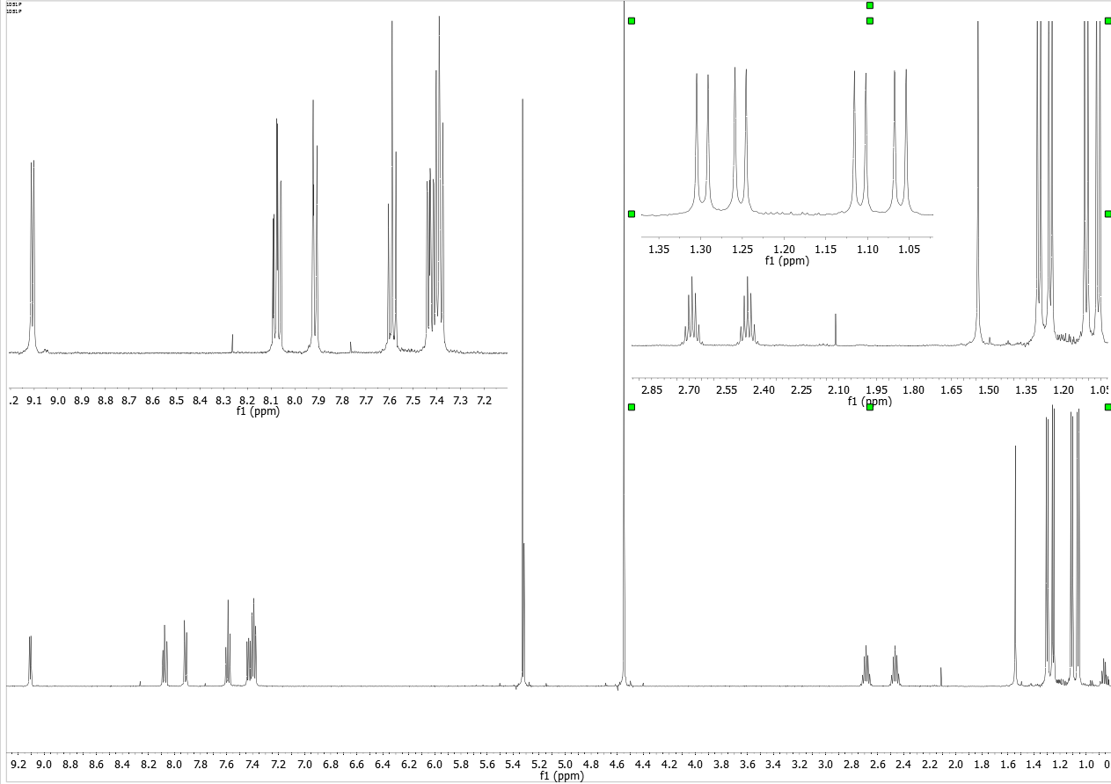
Non Equivalent Protons
SR0091051P1_1E5

Slide 36
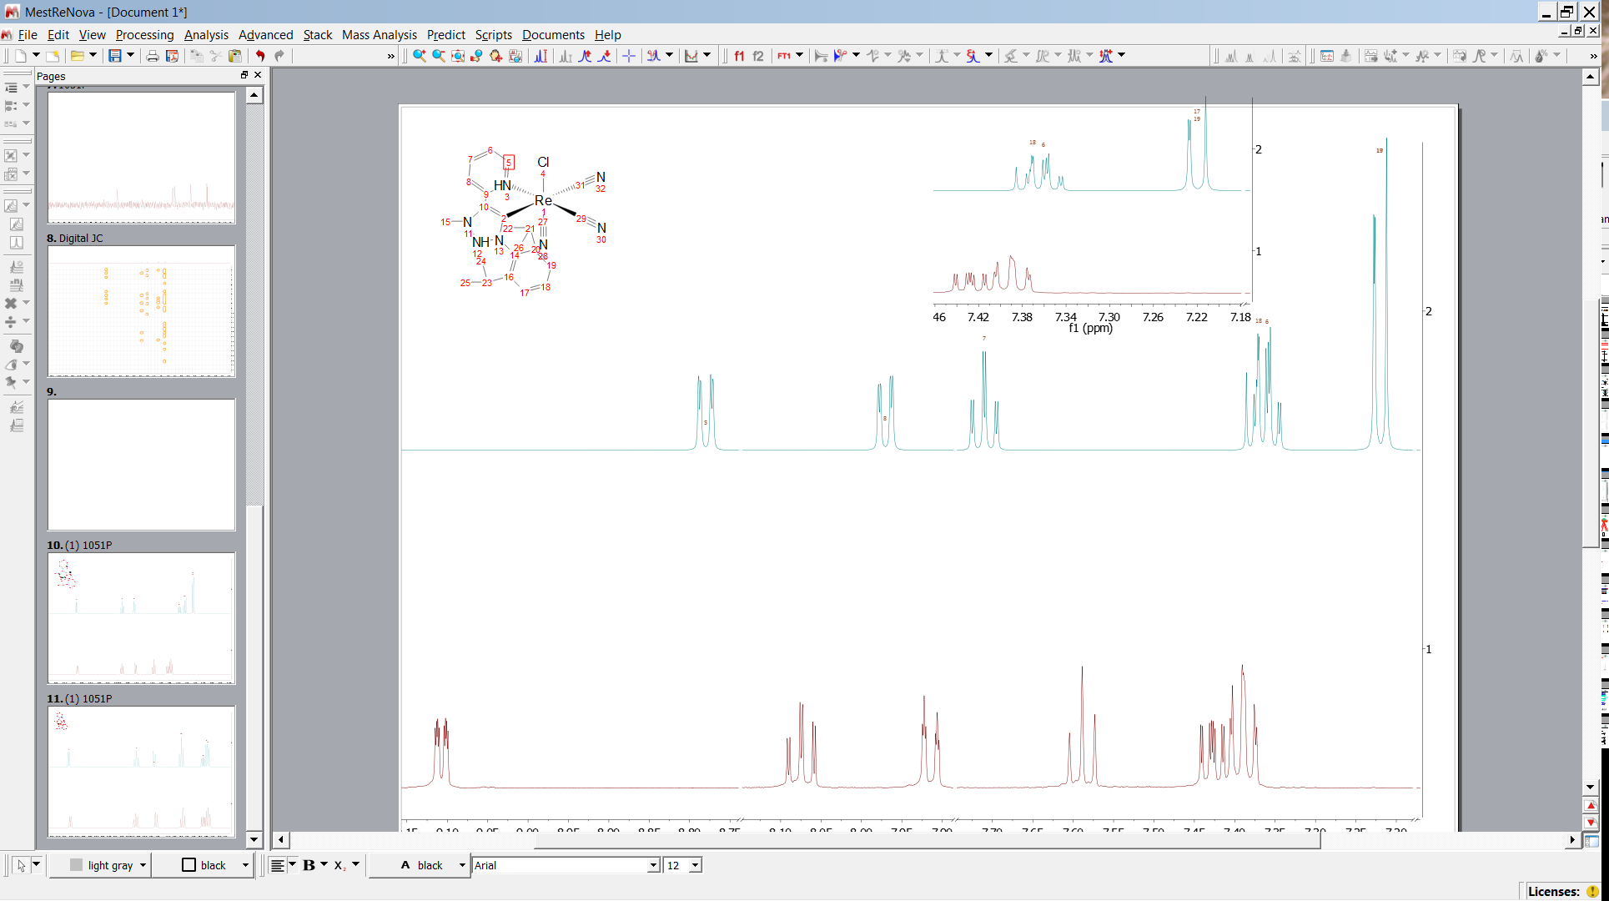
Non Equivalent Protons
MNOVA Prediction

Slide 37
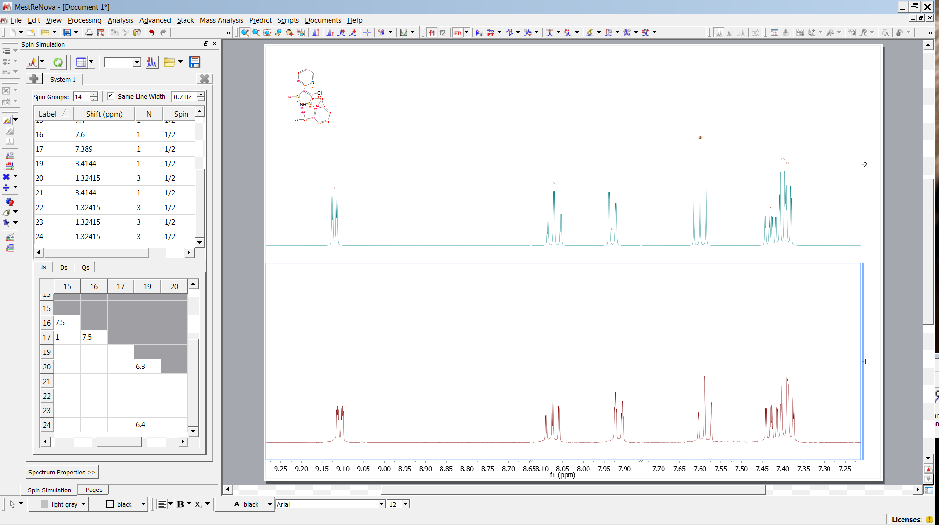
Non Equivalent Protons

Slide 38
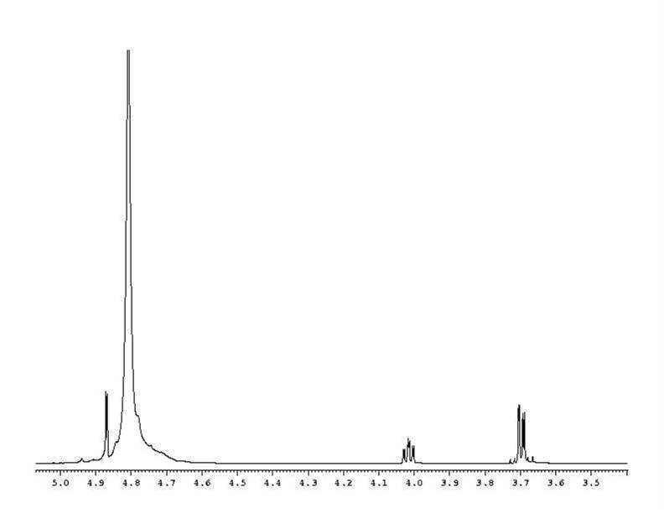
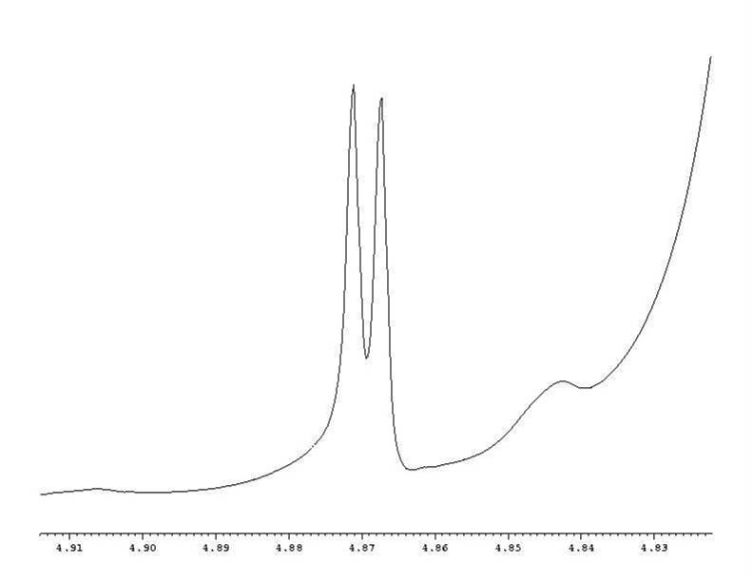
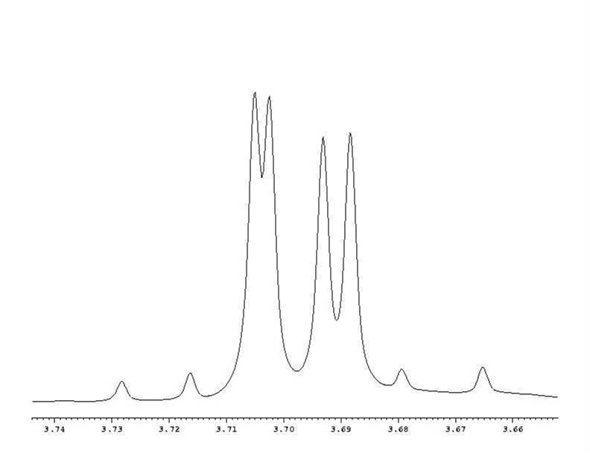
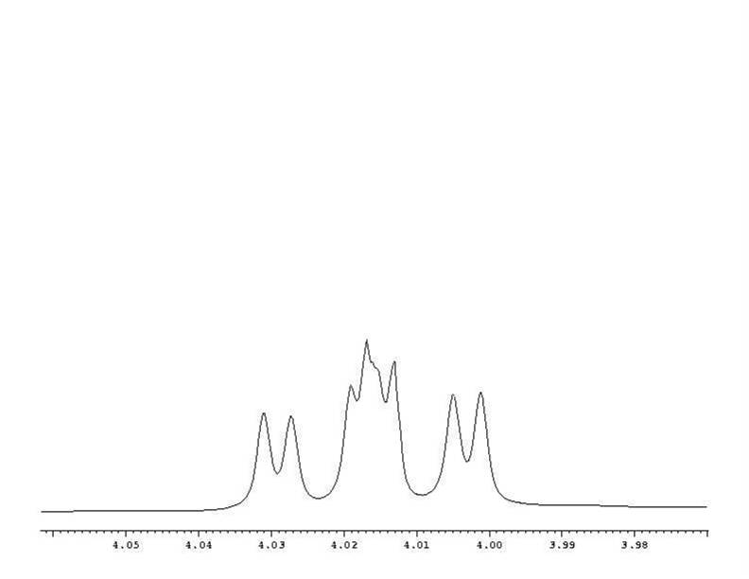
ABMX- System (Ascorbic Acid)
H2
H2
*
H
H
H
*
H
H

Slide 39
ABM System
Can be viewed as composed of two AB systems.
1stsystems M point up
2ndsystems M point down
νΑ
νΒ
M spin
A spin
B spin
JAB
JAM
JBM
JAB
- JBM

Slide 40
ABMX- System (Ascorbic Acid)
F2
F3
F2
F3
JAB = F1 – F2 = F3 –F4 = F1 – F2 = F3 – F4
ν0δ = ( F1 – F4) * ( F2 –F3 )
Ζ= ( F1 + F2 + F3 + F4 ) / 4
νΑ= Z – ½ ν0δ
νΒ= Z + ½ ν0δ
F1
F1
F4
F4
νΑ= 1849.75 HzνΒ = 1855.25 Hz JAB = 11.6
νΑ= 1842.04 Hz νΒ = 1849.76 Hz JAB = 11.6
νΒ= 1842.04 Hz νΑ = 1849.76 Hz JAB = 11.6
νΑνΑ= νΑ +/− JAM
νΒνΒ= νΒ+/− JBM
JAM= νA - νA JBX = νB - νB
JAM= νA - νB JBM= νB - νA
JAM=7.71
JAM= −0.01
JBM= 5.49
JBM=13.2

Slide 41
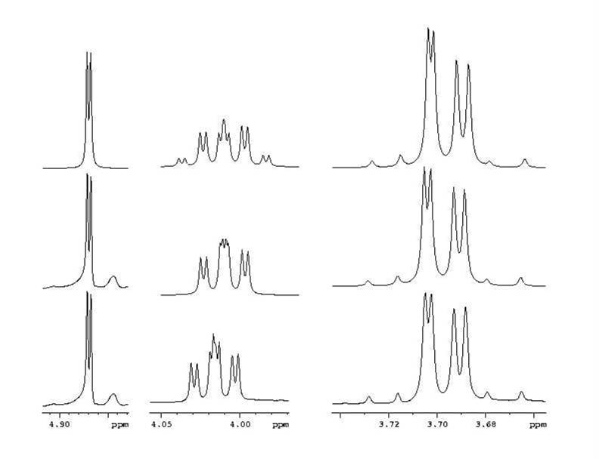
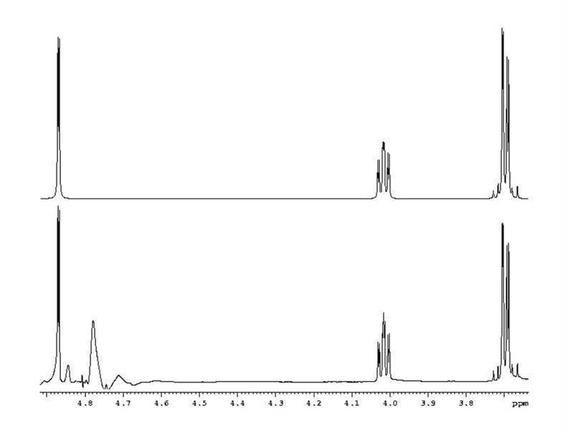
ABMX System (Two Solutions)
JAM= −0.01
JBM=13.2
JAB = 11.6
sim.
JAM=7.71
sim.
JBM= 5.49
JAB = 11.6
exp.

Slide 42
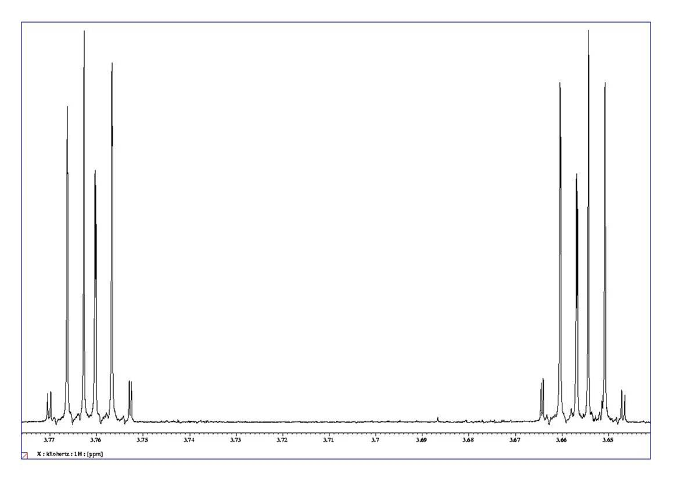
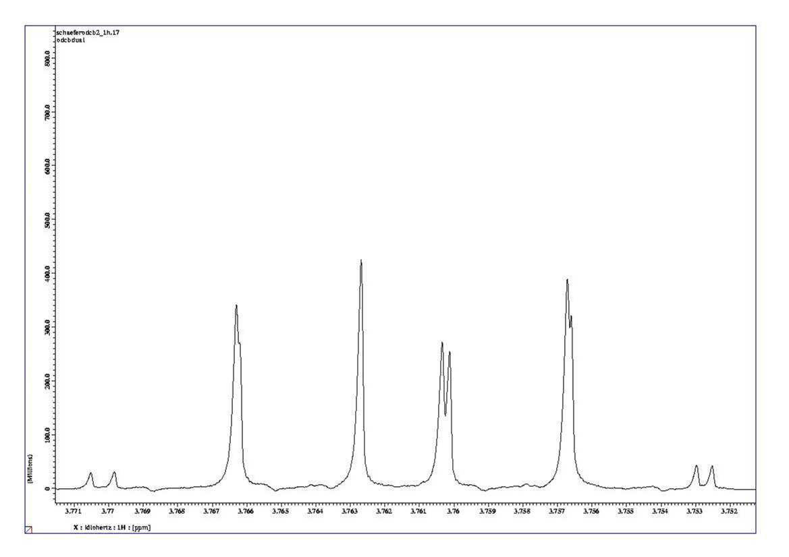
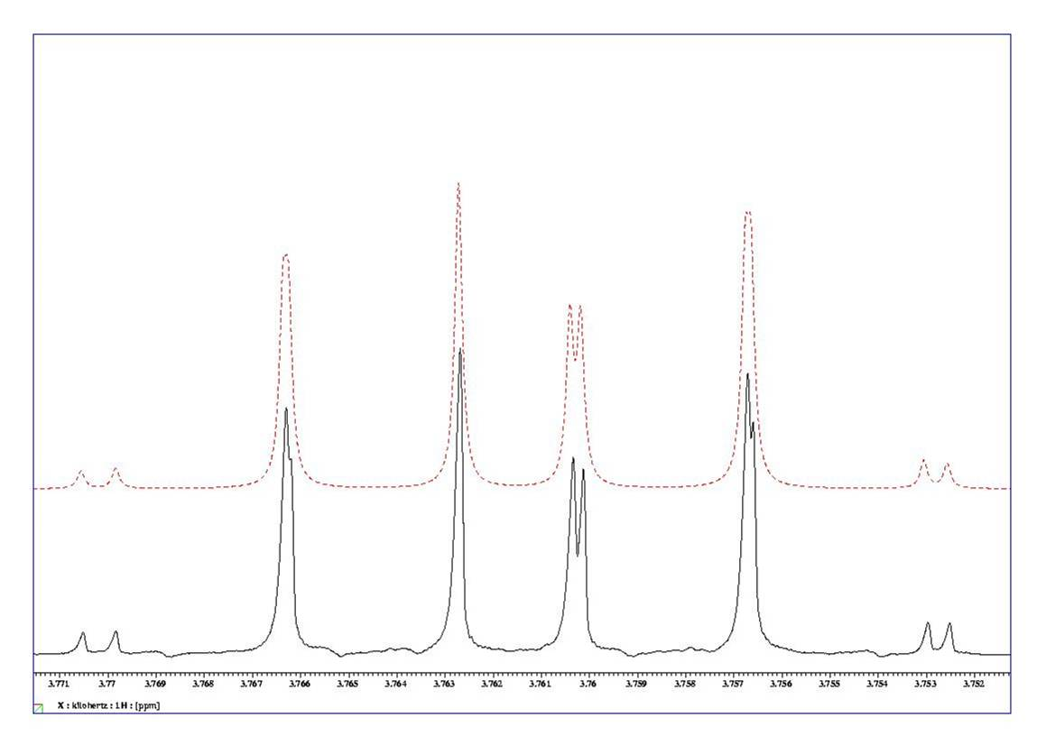
AA´BB´ System (ODCB)
chemically equivalent protons (magnetically non equivalent )
example ODCB
AA´BB´ System
JAB JAB´
JA´B´ JA´B
JA´A´ JB´B

Slide 43
AA´BB´ System (Assignment of Resonances)
Assignment of lines is the most demanding task (also in automated analysis, DAVINS, LAOCOON).

Slide 44
AA´BB´- System
AA´BB´ System
After all lines have been assigned the theoretical transitions, a set of equations has to be solved.
K = g-h = i-j = 7.83
l = ( (c-f) * (d-e) )^{1/2}
l = (( h-i ) * ( g –h )) ^{1/2}
M = c-d =e –f =7.15
d-e = 2.56
h-i = 2.35
N =a-b =k-l =9.6
g-j = 18.0
c-f = 16.88

Slide 45
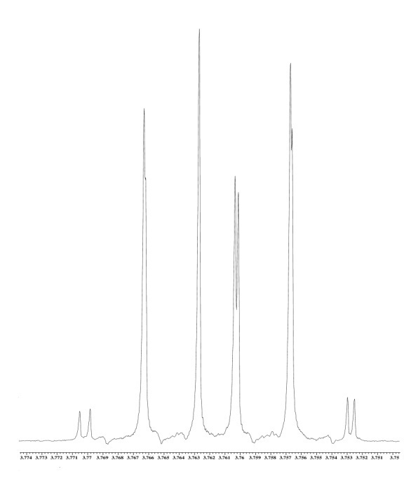
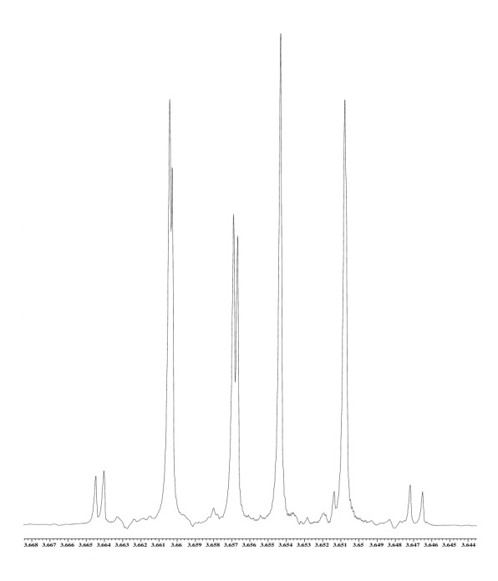
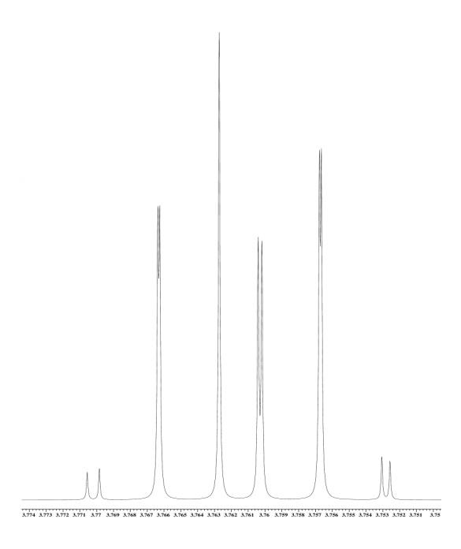
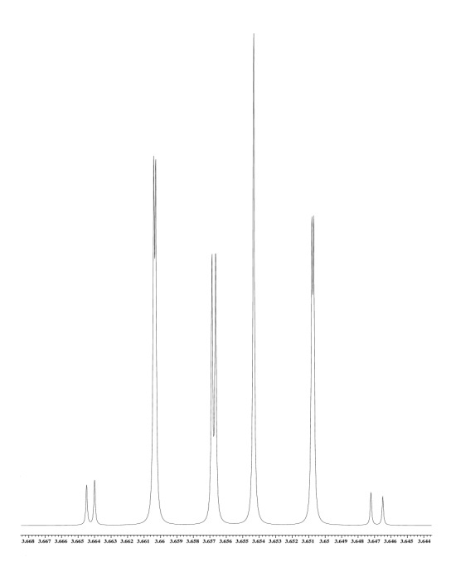
AA´BB´ System (Simulation)
8.05
1.55
0.34
7.49
Which multiplet belongs to ortho or meta position ?
simulation

Slide 46
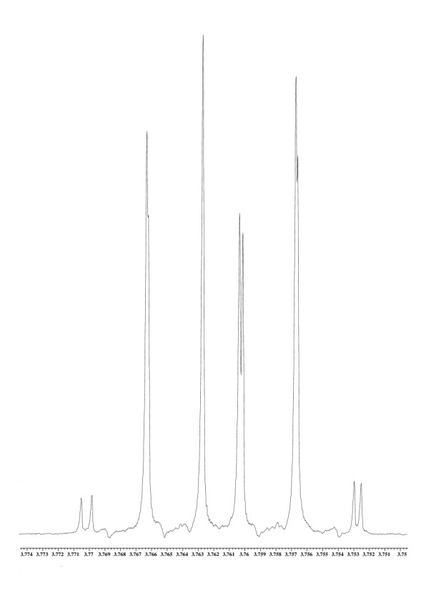

AA´BB´ System (Partial Spectra)
partial spectra are symmetric (mirror images)

Slide 47
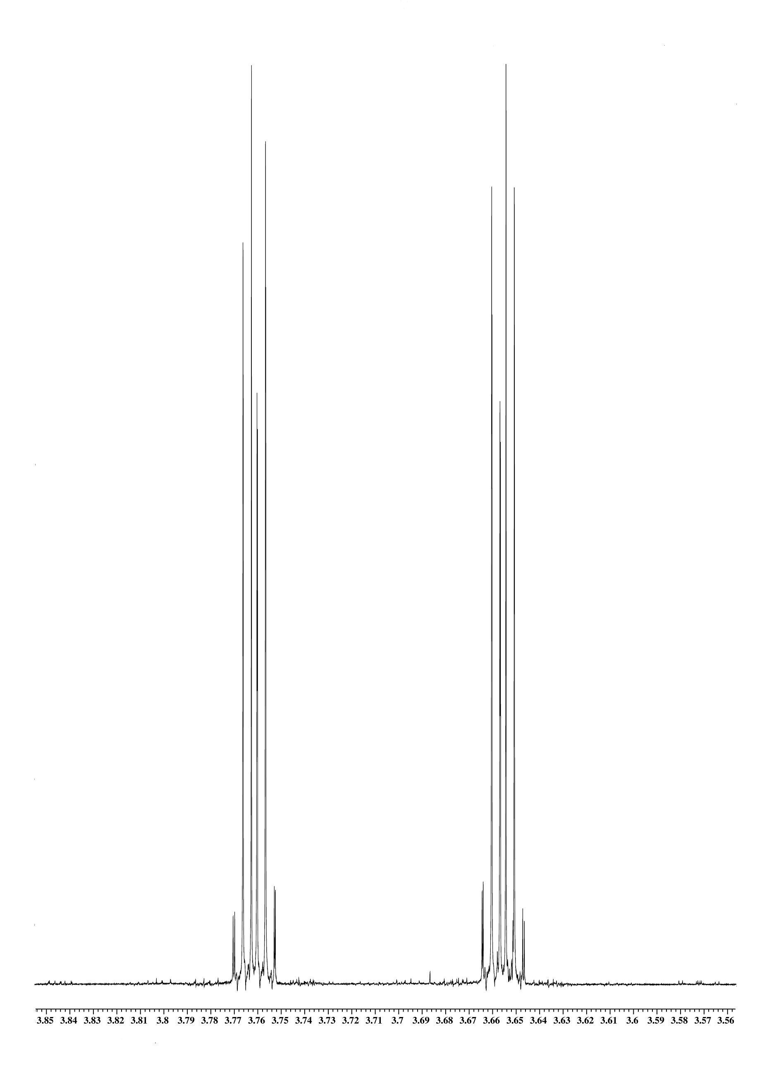
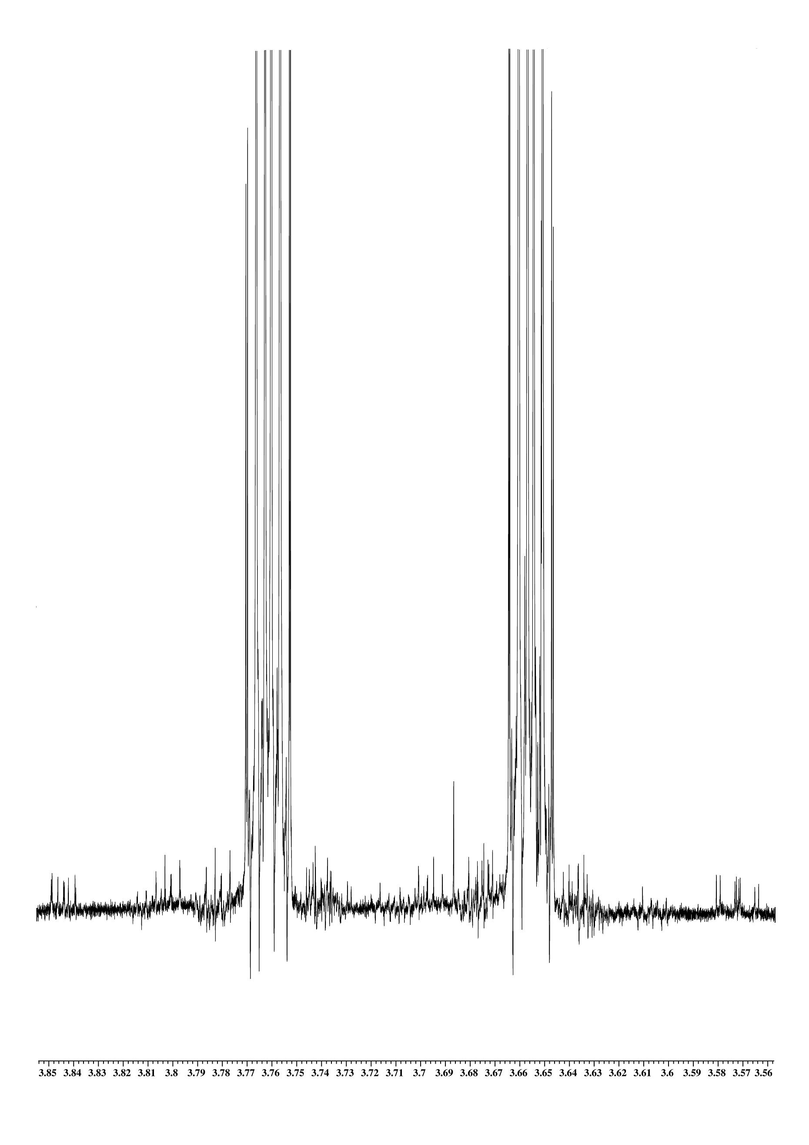
AA´BB´- System (Satelliten)
AA´BB´ System (13C Satellites)

Slide 48
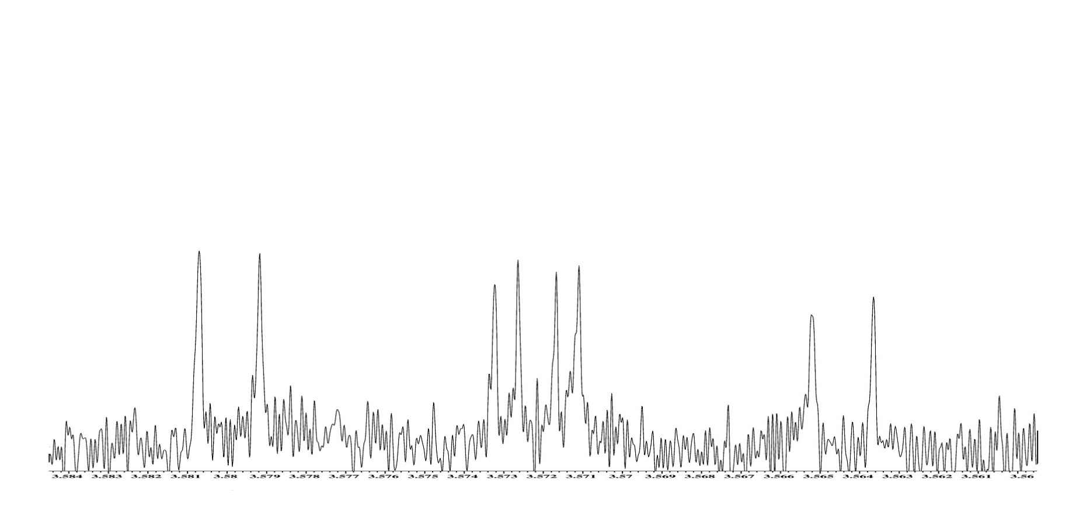
13C Satellites, Splitting Pattern
7.08 – J13C (ppm)
13C
8.04 Hz
7.47 Hz
1.55 Hz

Slide 49
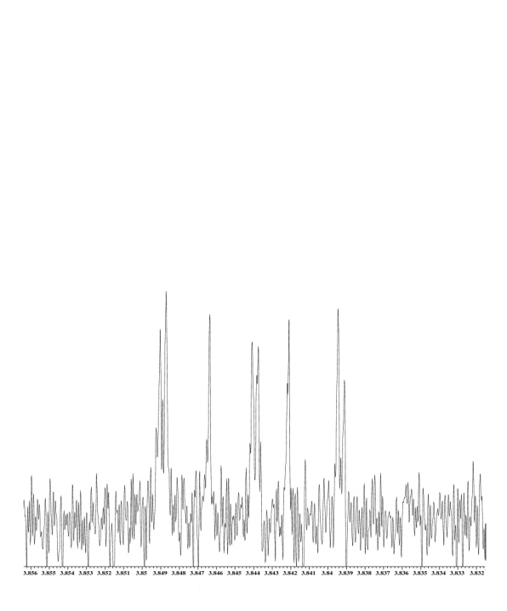



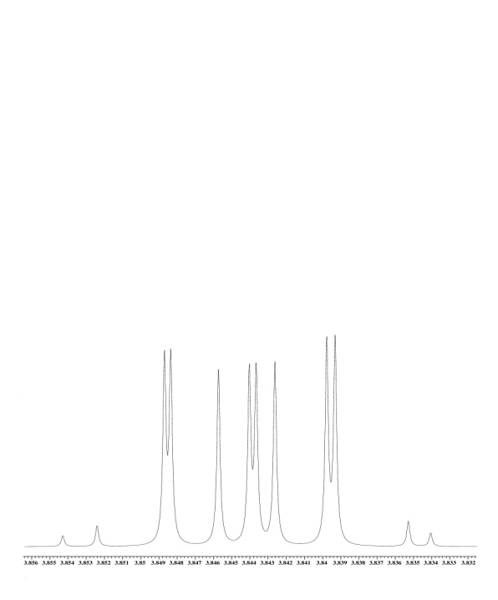
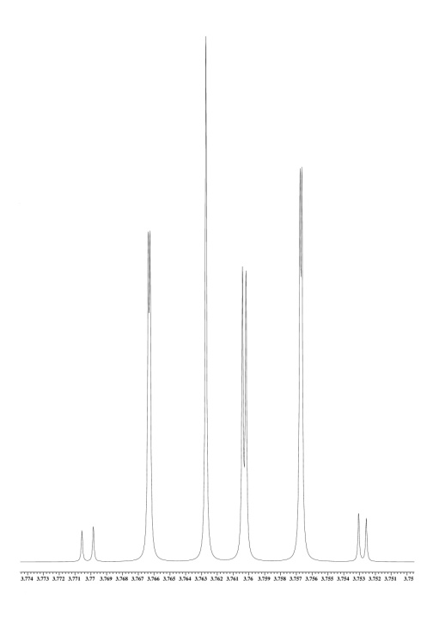
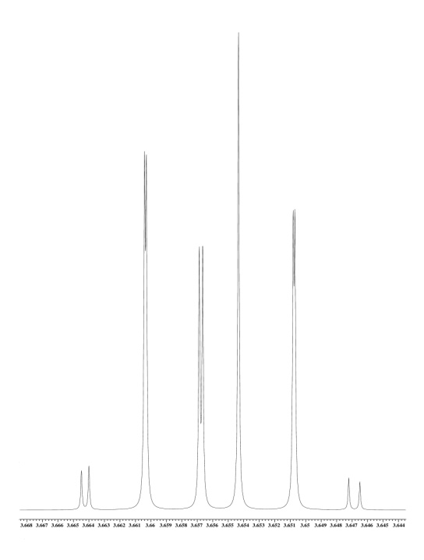
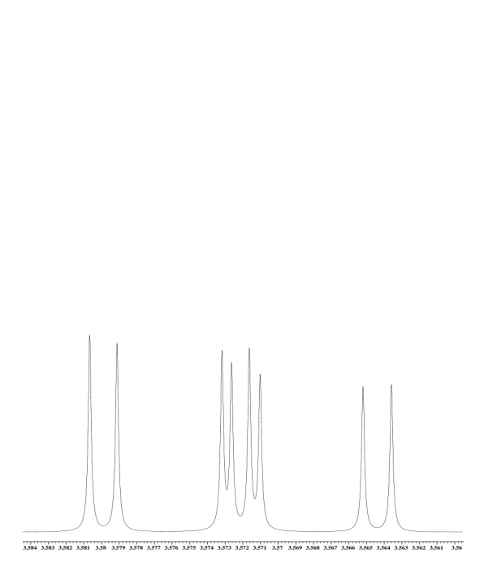
AA´BB´- System (Simulation)
AA´BB´ System (Simulation)
exp.
satellites
satellites
ortho position 13C: AA‘BB‘ splitting in satellites.
meta position 13C: Additional coupling and isotope effect perturb AA‘BB‘ system.
sim.

Slide 50
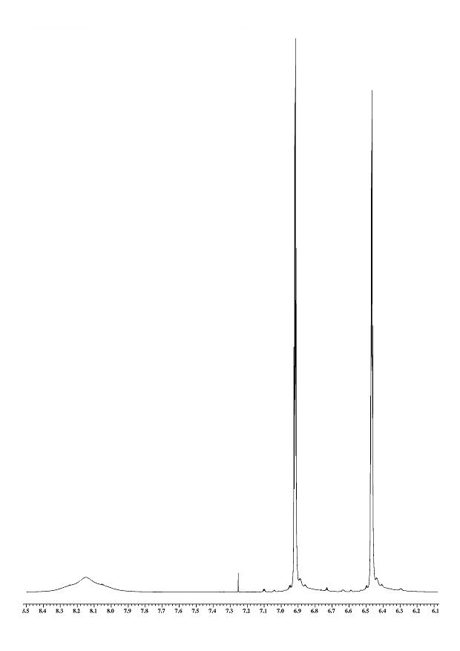
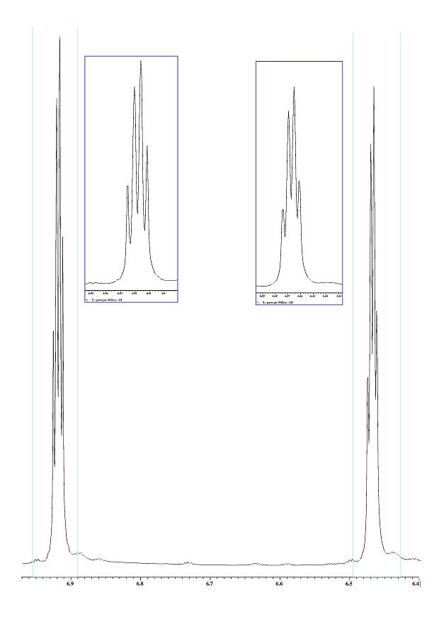
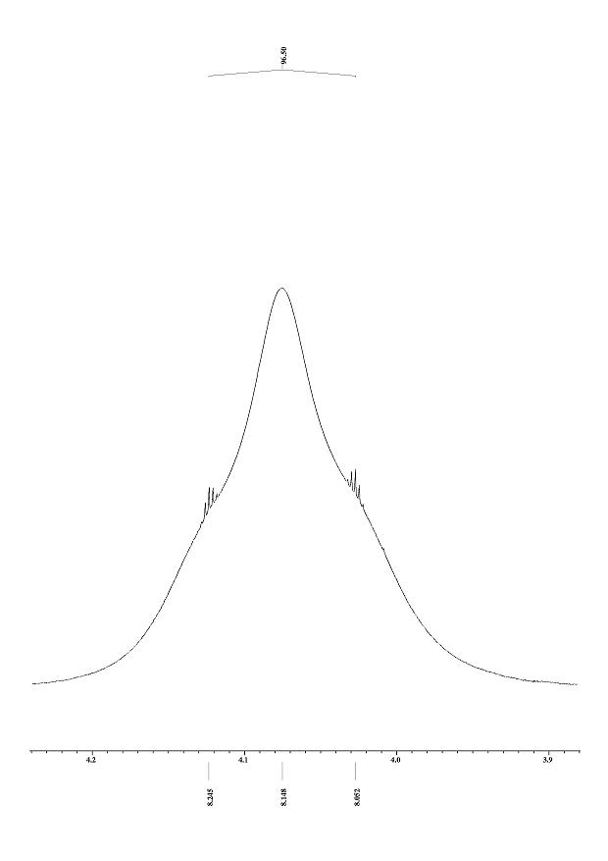
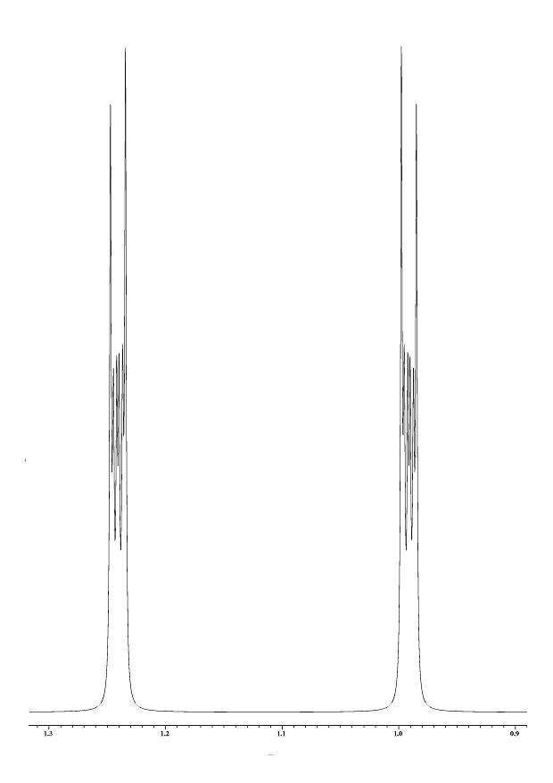
AA´BB´ System (Examples)
pyrrole

Slide 51
Electric Quadrupol Moment ¹¹B , ¹⁴N…
magnetic moment || nuclear angular momentum
B₀
electric quadruple moment for spin quantum number I > ½
electron
x,y- plain
T₁relaxation
T₂relaxation
angle enclosed between molecular axis and external field
( 1 − 3 cos ² θ )

Slide 52
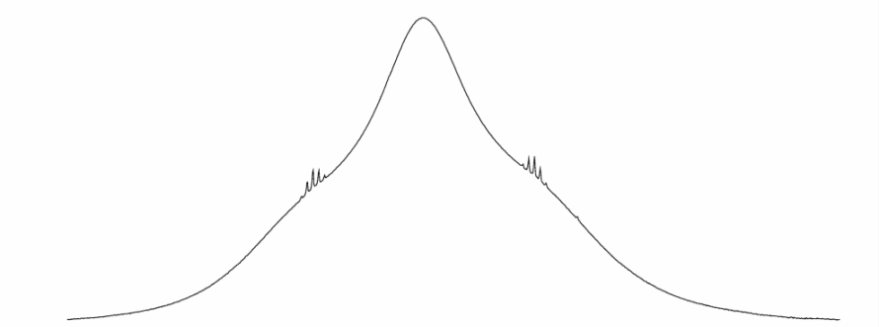
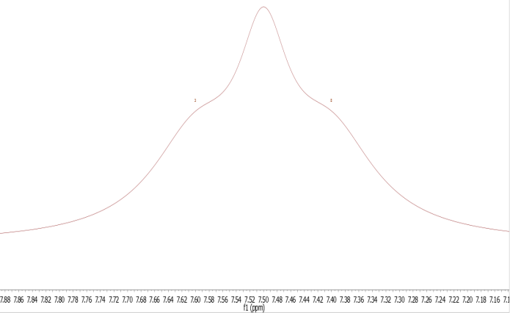
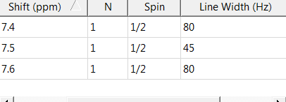
Relaxation and Scalar Coupling¹H / ¹⁴N, ¹¹B
¹⁴N (3 states I=1 ¹¹B (4 states I=3/2) )
¹H
¹H
¹⁴N (¹¹B) relaxation
¹H
¹⁴N (¹¹B ) decoupling

Slide 53
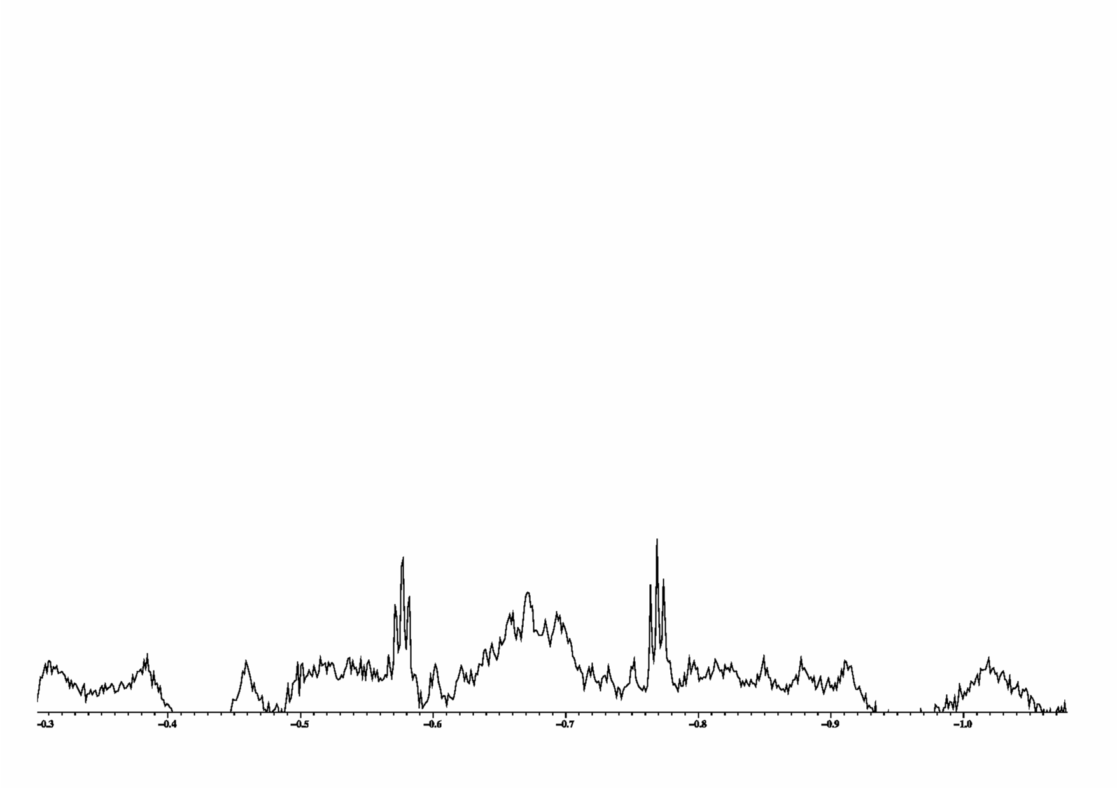

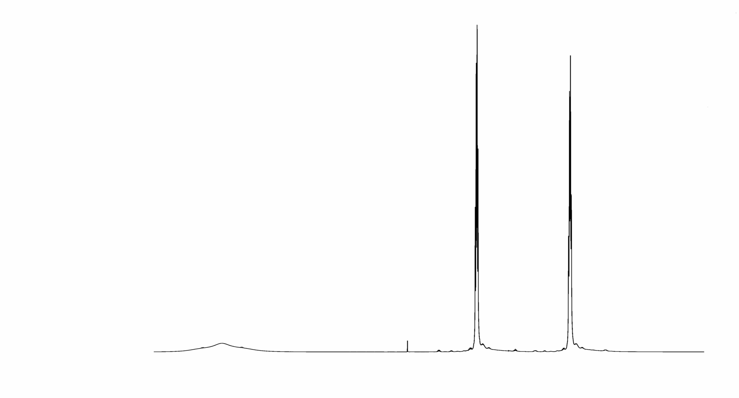
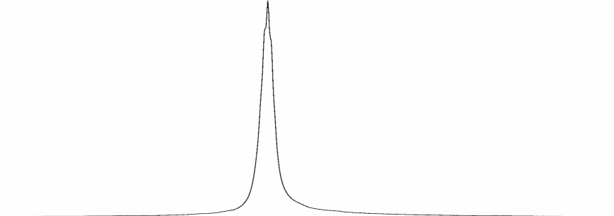
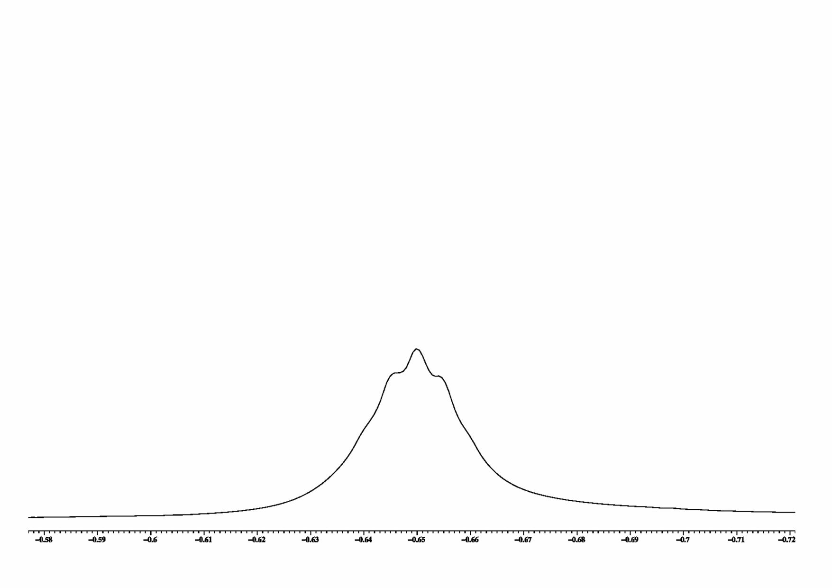
¹⁵N-,¹⁴N- ¹H- CouplingsPyrrol in DMSO
electr. quadrupol.
¹⁴N I = 1 99.6%
¹⁵N I = ½ 0.4 %
50 Hz
50 Hz
H_{o}
100 Hz
H_{m}
¹⁴N decoupled
NH

Slide 54
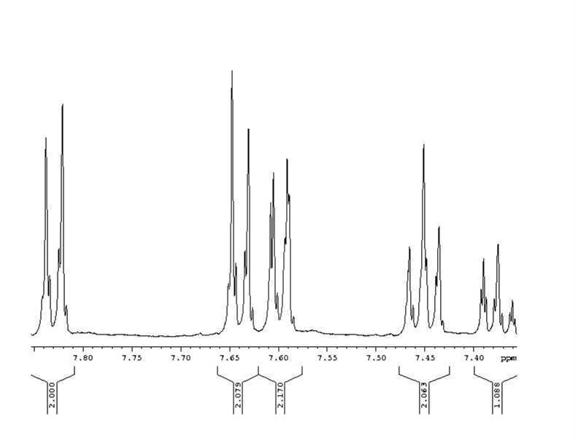
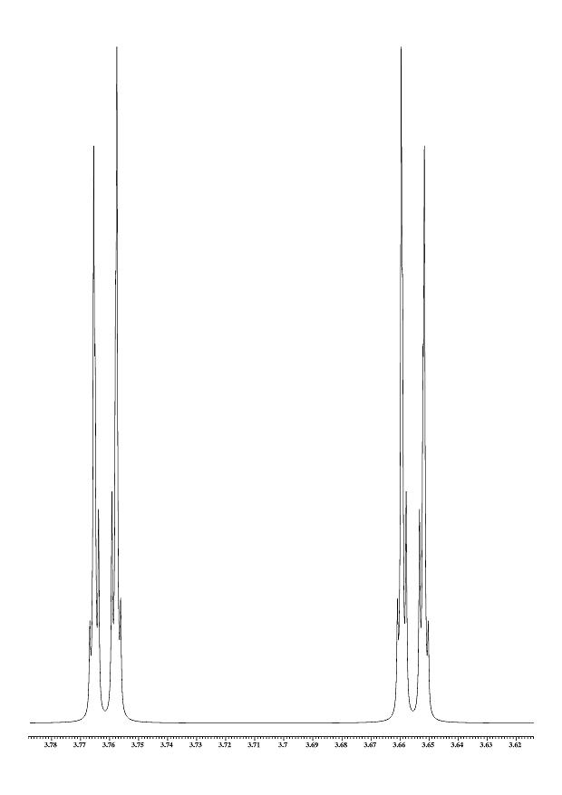
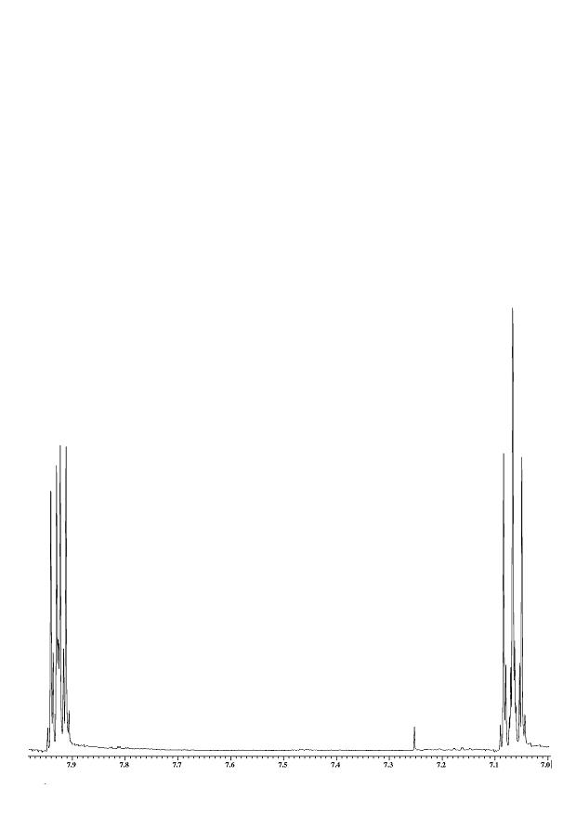
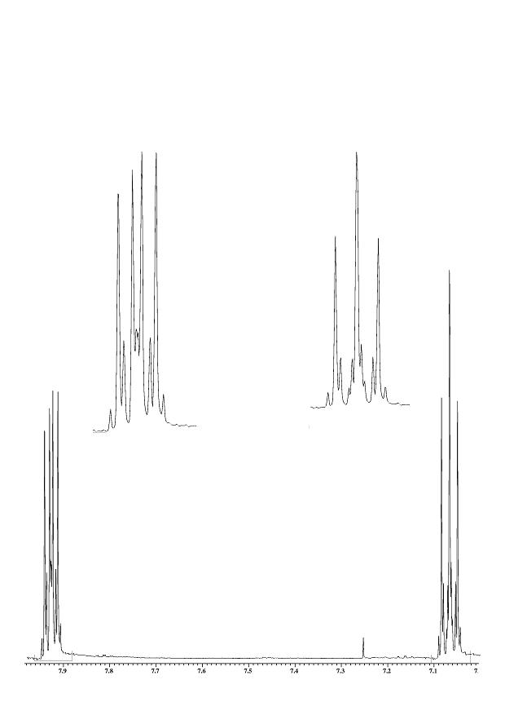
AA´BB´ System (Examples)
pyrrole

Slide 55
¹⁹F- ¹H -Kopplungen
¹⁹F- ¹H- Couplings
7 Hz
10 Hz
7 Hz
Notes:
Simulation JAB = 10 JAA´ = 2 JAB´ = 0.5 J19F = 7 bzw. 10 Hz dshift =100 Hz dshift19F=3000 Hz

Slide 56
¹⁹F- ¹H- Couplings (19F Splitting)
10 Hz
10Hz
7 Hz
¹⁹F

Slide 57
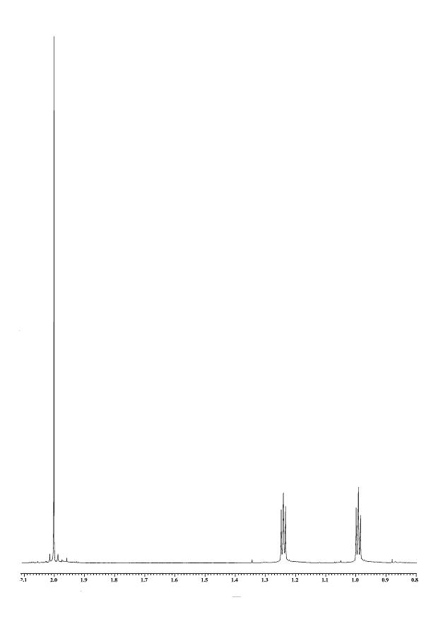
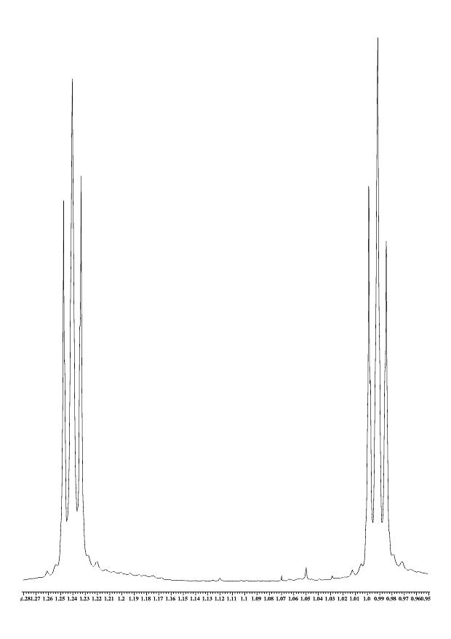
Weitere AA´BB´- Systeme
AA´BB´ System (Examples)
pyrrole

Slide 58
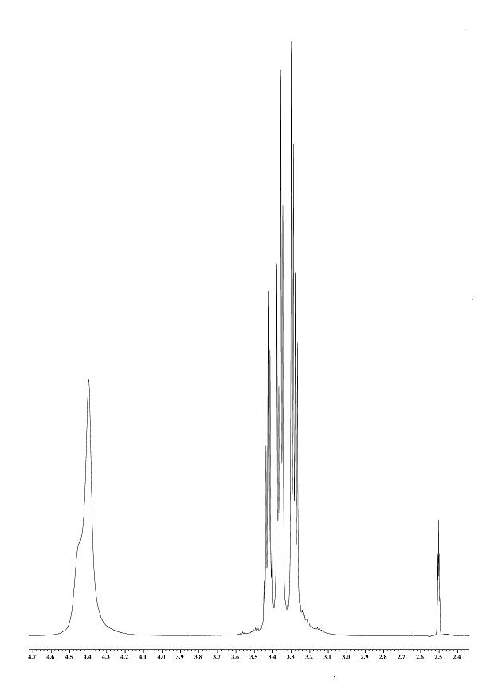
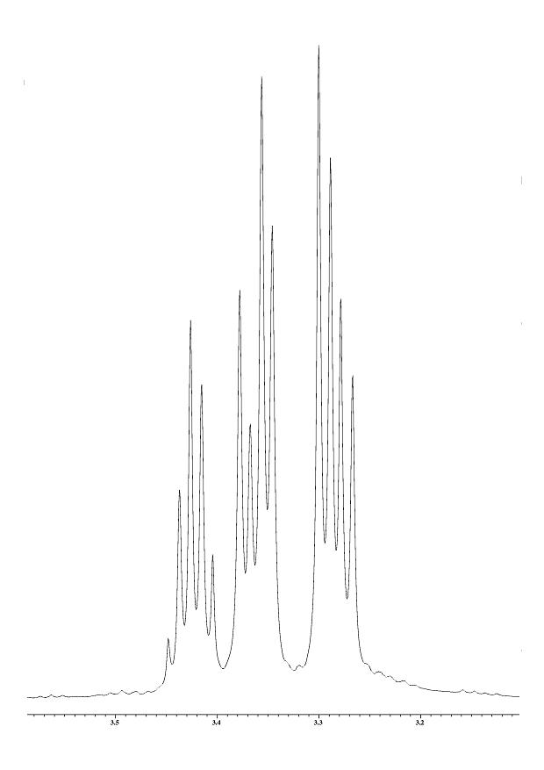
A2B2C- System (Glycerin)
AA´BB´C System glycerine)
chemically equivalent protons (magnetically nonequivalent)
sim.

Slide 59


1,4- Butandiol A2A2´B2 B2´- System
1,4- Butandiol A2A2´B2B2´ System
8 Hz
0.5 Hz
10 Hz
0.5 Hz

Slide 60
A2A2´B2B2´- System
1,4- Butandiol A2A2´B2B2´ System

Slide 61


Proposed Structure

Slide 62

A2A´2B2B´2 System

Slide 63


AA´BB´ System
MNOVA prediction
Simulation/spinanalysis
Exp.

Slide 64

5 Spin Systems (700MHz) Simulation
Even at 700 MHz higher order spectra may appear ( therefore spin simulation)
2
1
3
4
4a
4b, 3, 2
1

Slide 65

TIPS 500MHz

Slide 66




TIPS 700MHz (sim.)

Slide 67

AA´BB´ System
A
A´
B
B´
700 MHz
Both conformers can give rise to AA’BB’ Systems
A
B
B´
A´
Splitting is due to Coupling (independent of B₀)
400MHz

Slide 68



AA´BB´
Two AA´BB´ Systems needed
Population 1
A
A´
B
B´
A
B
A
B
B´
B´
A´
A´
Population 2
A
A´
B
Best match is achieved by the assumption of two conformers
B´

Slide 69

(1E,3E)-1,4-diphenylbuta-1, 3-diene
A
B
B´
A´
Population 2
A
A´
B
Best match is achieved by the assumption of two conformers

Slide 70



(1E,3E)-1,4-diphenylbuta-1, 3-diene
A
B
B´
A´
Population 2
A
A´
B
Best match is achieved by the assumption of two conformers

Slide 71


(1E,3E)-1,4-diphenylbuta-1, 3-diene
A
B
B´
A´
Population 2
A
Starting from MNOVA
prediction -> modifying
A´
B
Best match is achieved by the assumption of two conformers

Slide 72
(1E,3E)-1,4-diphenylbuta-1, 3-diene
experiment
simulation

Slide 74
Protons which aren't Equivalent
Protonen die nicht äquivalent sind
Freely rotating methylene groups
CH2 next to a stereo centre
Ra
Ra
Ra
H
H
R
H
H
R
Rc
R
Rb
Rc
Rb
Rc
Rb
H
H
H
and
H
Never see the same surrounding.
H
and
H
Will therefore constitute an AB system (e.g. ascorbic acid).
hold as well if Ra equals CH2 – R , diastereotopic protons
R
H
H
H
H
and
H
H
chemically equiv. but magnetically non equivalent
often appearing as AB System with double
intensity or as AA‘BB‘ System
H
H
e.g. glycerine
holds as well for methylene and methyl groups, ( CH3 )2
Rc
R
Rb

Slide 75
Non Equivalent Protons
Freely rotating methylene groups
CH2 next to a stereo centre
H
and
H
Never see the same surrounding.
H
and
H
Will therefore constitute an AB system (e.g. ascorbic acid).
A stereo centre in the vicinity (somewhere) suffices.
holds as well for methylene and methyl groups, ( CH3 )2 - CH - close to a stereo centre
hold as well if Ra equals CH2 – R , diastereotopic protons

Slide 77



AA´BB´ Systems (para Substitution)
H3
H3
H
H
H
H
H2
H3
H2
H3
H
H
H
H
H2
H3
H3
H3
H3
2J Si-H 6 Hz
Notes:
Silylgruppen und AB-Systeme xr032…

Slide 78
A2B2C- System (Glycerin)
ABMX - System (19F)
atropisomeres
H
H

Slide 79
Non Equivalent Protons
Freely rotating methylene group
Stereo centre in vicinity
Atropisomers i.e. stereoisomers created by hindered rotation.
F
Ph-F Fluorine has been turned out of plain.
Ra
F
F
H
H
H
H
Rc
R
Rb
R
F
H
H
R
A stereo centre has been created.

Slide 80
ABMX - System (19F)
Two AA’BB’ system leaving two multiplets to be assigned.

Slide 81
A2B2C- System (Glycerin)
ABMX - System (19F)
Measurements at different field strength allow to distinguish between couplings and shifts.
700 MHz
700 MHz
400 MHz
400 MHz

Slide 82
ABMX - System (19F)
Measurements at different field strength allow to distinguish between couplings and shifts. Two AB systems !!
700 MHz
400 MHz

Slide 83

ABMX - System (¹⁹F)
Fluorine proton couplings can be gained from fluorine NMR.
700 MHz
700 MHz
8 Hz
Hm
Ha
8.8 Hz
2 Hz
400 MHz
400 MHz
Hb
11 Hz
11
8.8
¹⁹F

Slide 84
ABM??? - System
Fluorine couplings give rise to two AB systems (compare ascorbic acid ABM (X) system M=19F ).
Ha
Hb
8.37
11.18
fluorine coupling
2.36
2.55
2.43
2.36
8 Hz
Hm
Ha
fluorine coupling
8.56
Hm
8.49
8.8 Hz
2 Hz
One proton and one fluorine coupling create the splitting pattern of Hm
Hb
11 Hz

Slide 85
Chemical Exchange (Aromatic Region)
299 K
400 MHz
349 K
379 K
409 K

Slide 86

Exchange Spectrum
Ha
Hb
Fluorine spin up or down.
´Hm spin up or down.
During mixing time 19F spin flip occur.

Slide 87





Some more Splitting
H
H2
H2
H2
H2
H2
H2
H
H2
H2
H2
H2
H2
H3
H
H
H
H
H
H
H
H
Notes:
hfrjb013 vom 12.3.04 Alkylkette & AA´BB´-System

Slide 88


AA´BB´
A
A´
B
B´

