Slide 1

COSY , Two RF- pulses
90°
90°
t₁ δt increments
acquisition
δt dwell time
90°
90°
t₁ –evolution,
t₁ incremented
cos ω t₁
sin ω t₁
t₂ – evolution, acquisition M₊ = M_{x}+ i M_{y}
I_{x}- magnetization
sin ω t₁
sin ω t₁ (exp (i ω t₂ ))

Slide 2
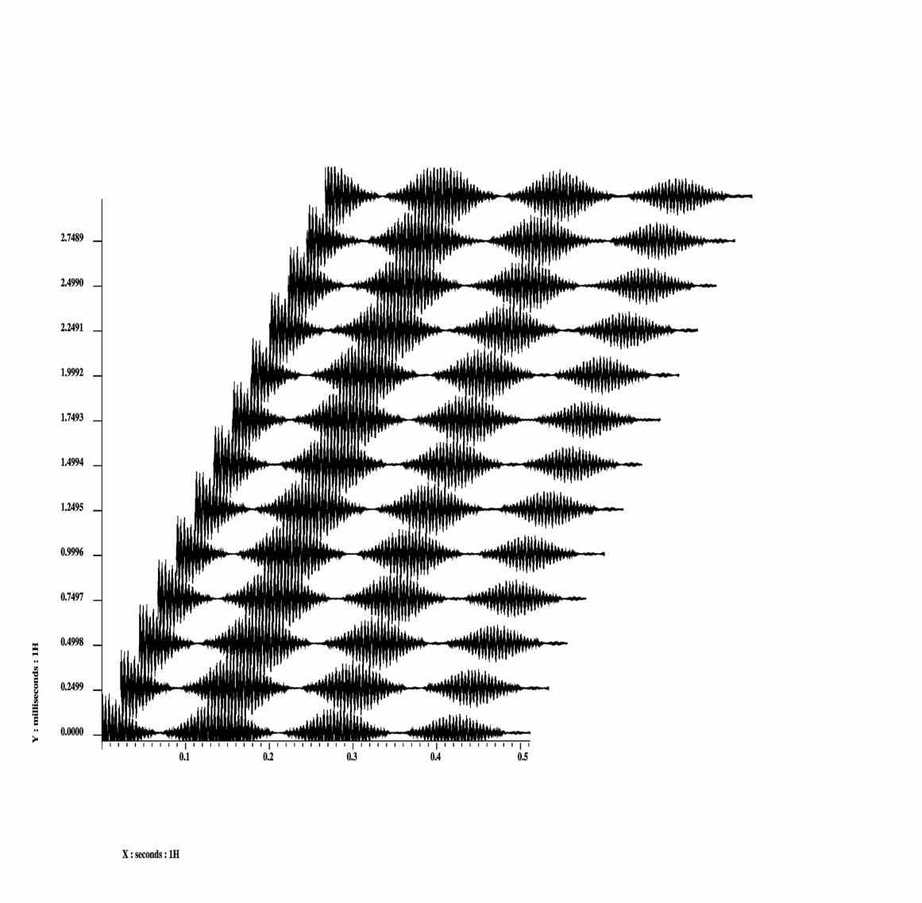
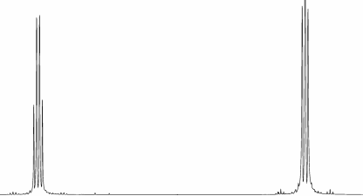
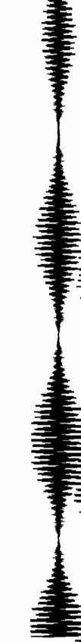
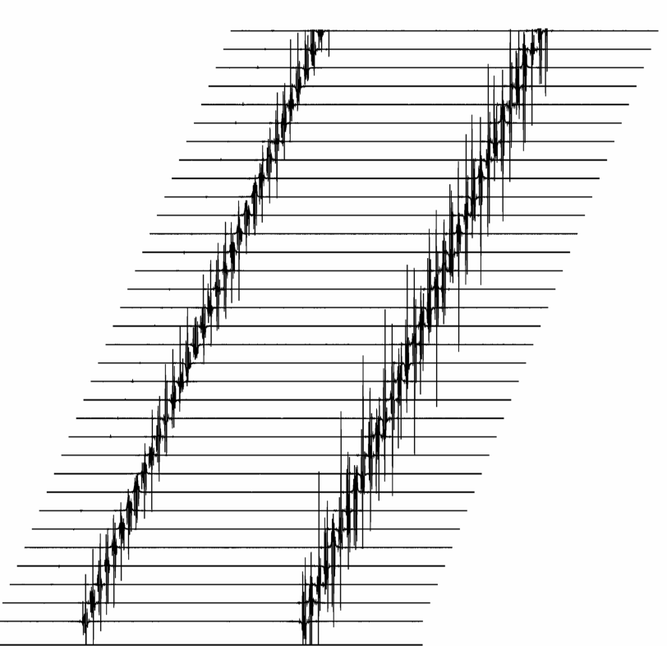
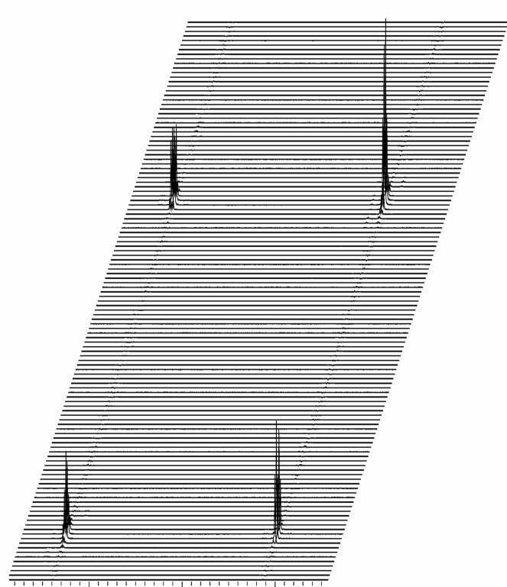
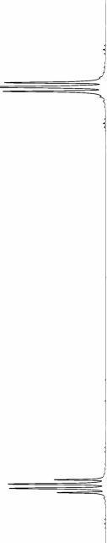
Two Frequency Axes
preparation λ = t₁ = n Δt
acquisition
t₁ has to be incremented
t₁
t₂
rf
rf
ω
ω
FT along t₂
FT along t₁
ω
t₁
t₁
(Sin ( ω t₁ ) Sin (J t₁ ) )
f₁
ω
t₂
f₂
f₂
sin ( ω t₁ ) exp ( i ω t₂ )

Slide 3
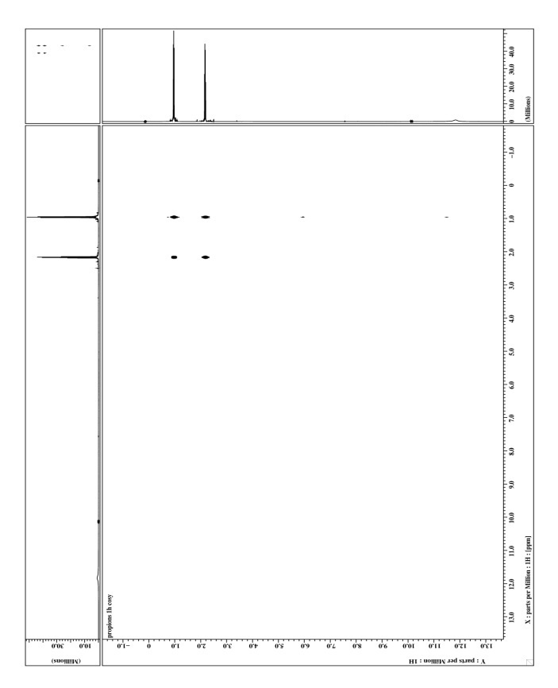
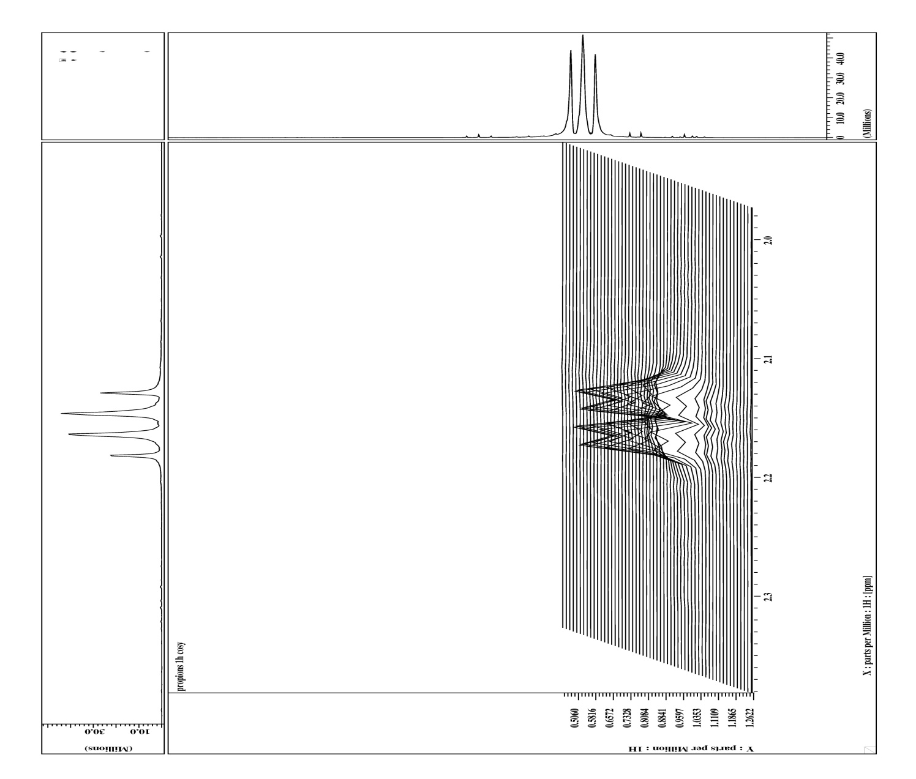
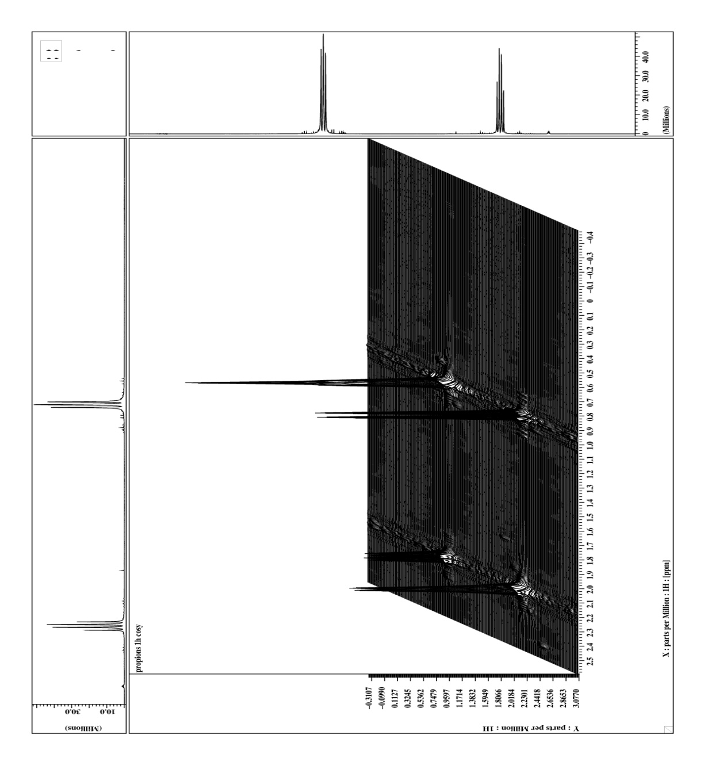
COSY- Experiment (¹H, ¹H)
COSY – Experiment (¹H, ¹H)
90°
90°
t₁ incremented
t₂ acquisition
propionic acid

Slide 4
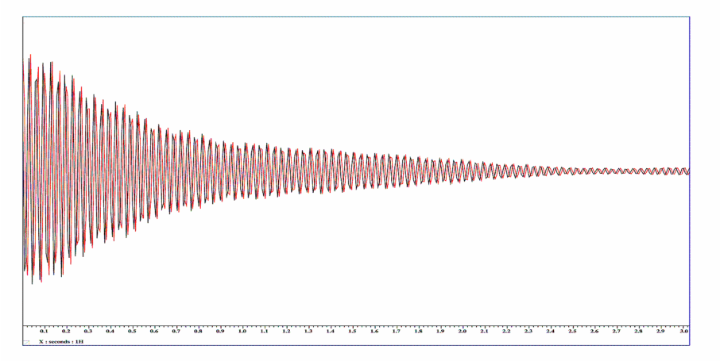
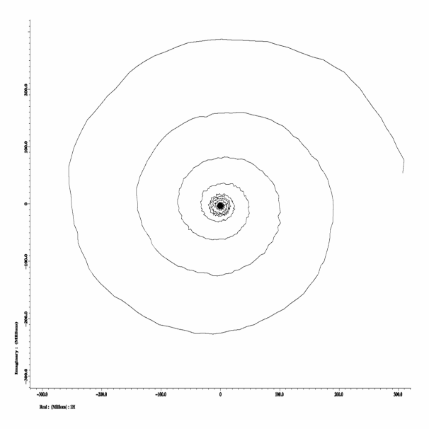
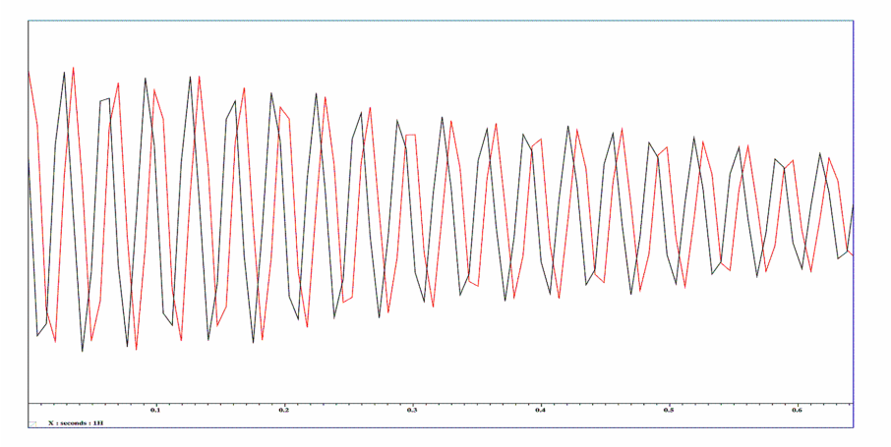
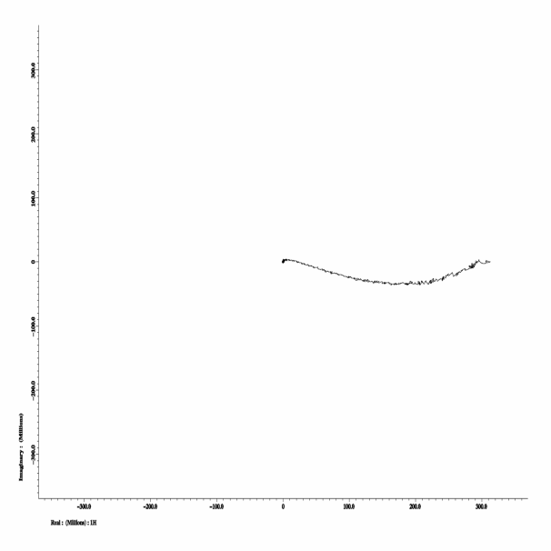
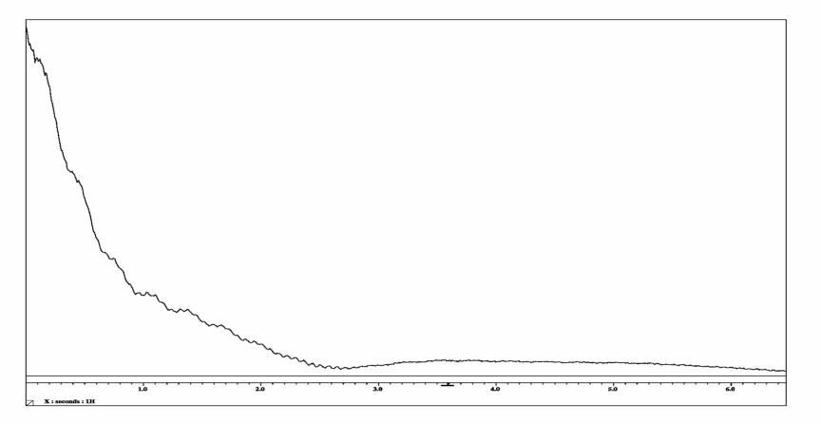
J Coupling Evolution
B₀ evolution
My
I_{x} I_{y}
I_{y}
ω − ω₀ large
I_{x} I_{y}
Mx
I_{x}
My
I_{y}
ω − ω₀ 0
√(I_{x}² + I_{y}²)
Mx
I_{x}

Slide 5
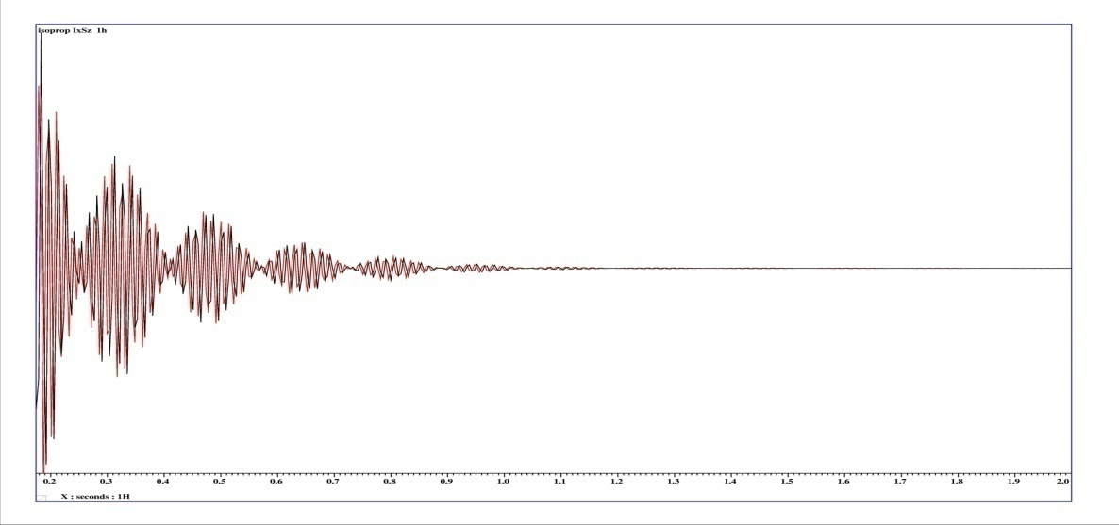
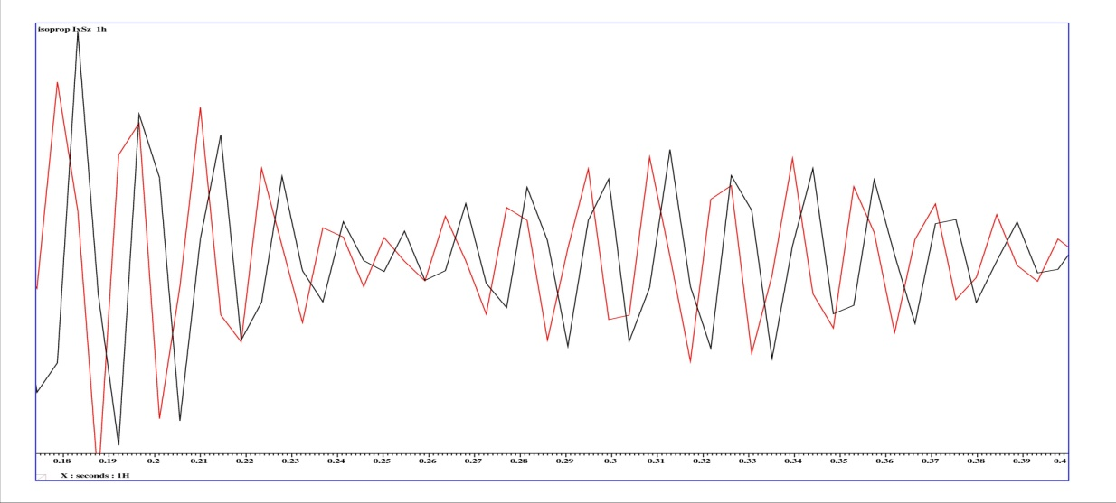
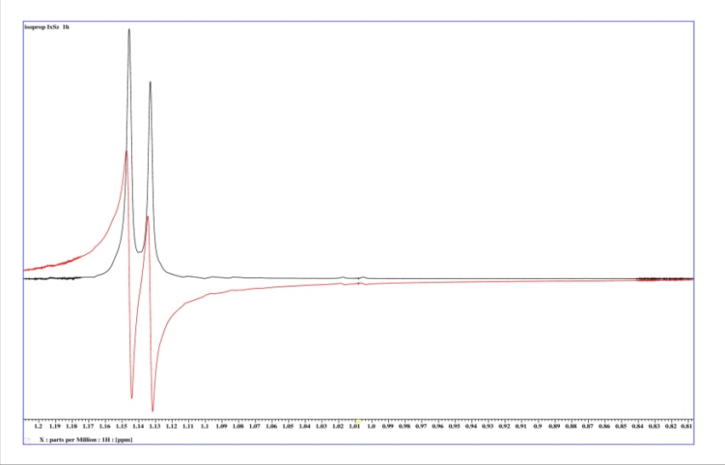
Kopplungsentwicklung 2 Spins ½
J Evolution 2 Spins ½
I_{x} I_{y}
I_{x} I_{y}
X Nuc (³¹P e.g.)
X Nuc (³¹P e.g.)

Slide 6
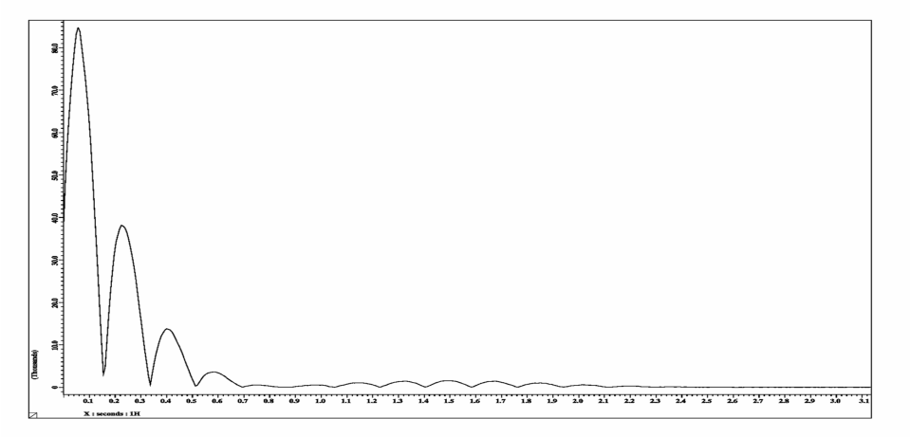
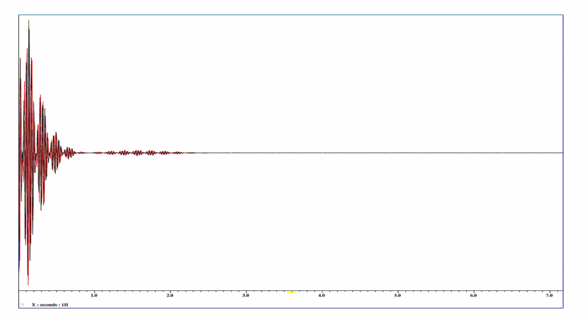
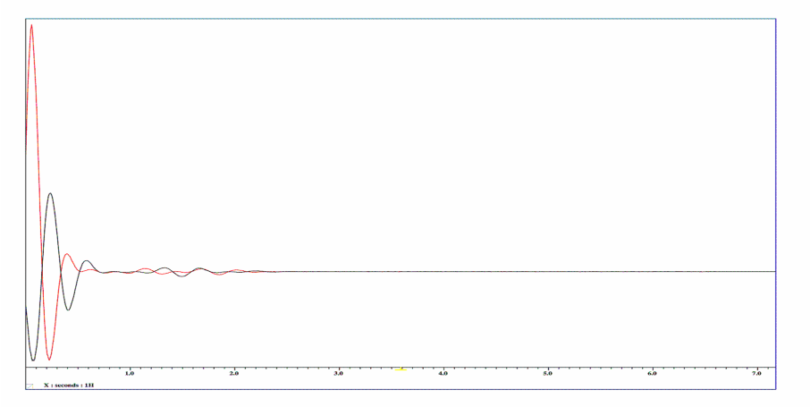
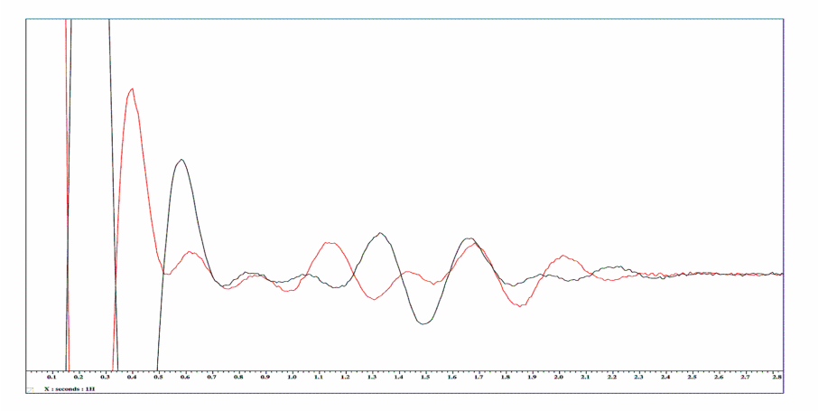
Kopplungsentwicklung
J Evolution
J evolution
B₀ evolution
√(I_{x}² + I_{y}²)
√(I_{x}² + I_{y}²)
I_{x} I_{y}
I_{x} I_{y}
I_{x} I_{y}
I_{x} I_{y}

Slide 7
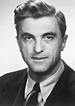
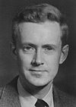
Different Viewpoints
Nobel price 1952
Felix Bloch
1905- 1983
Edward Mills Purcell
1912- 1997
Classical
macroscopic magnetization vectors
Faraday induction
Quantum mechanical
Stimulated (or spontaneous)
absorption and Emission

Slide 8
Bloch und Purcell
Different Viewpoints
D. I. Hoult and N. S. Ginsberg
By the middle of the 20th century, the quantum theories of
matter and its interaction with radiation were well established
(1). Thus with the discovery of NMR by Bloch and Purcell, a
quantum explanation of the voltage present in a receiving coil
was sought. However, such an explanation was not readily
forthcoming. Bloch had described his observations in terms of
Faraday induction while Purcell saw his as absorption and
emission of energy, and two initially had great difficulty believing
that they were observing the same phenomenon. In
particular, describing the origins of the free induction decay
caused significant problems, and as the proffered explanation
of this phenomenon is still only well known to a handful of
NMR physicists, we therefore begin by describing its origins
Nobel price 1952
Felix Bloch
1905- 1983
Edward Mills Purcell
1912- 1997
Classical
macroscopic magnetization vectors
Faraday induction
Quantum mechanical
Stimulated (or spontaneous)
absorption and Emission

Slide 9
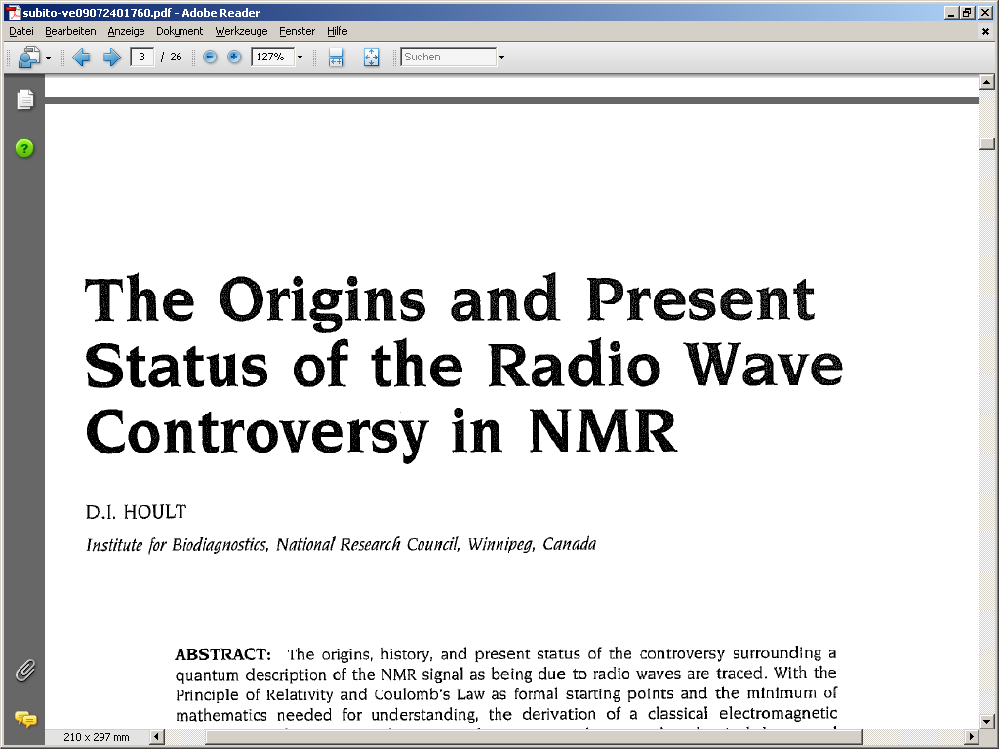
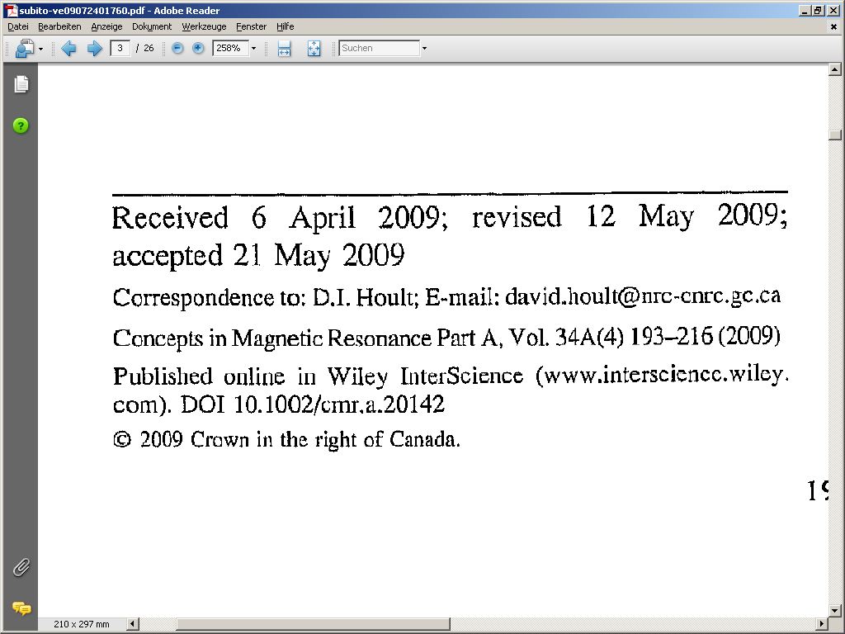
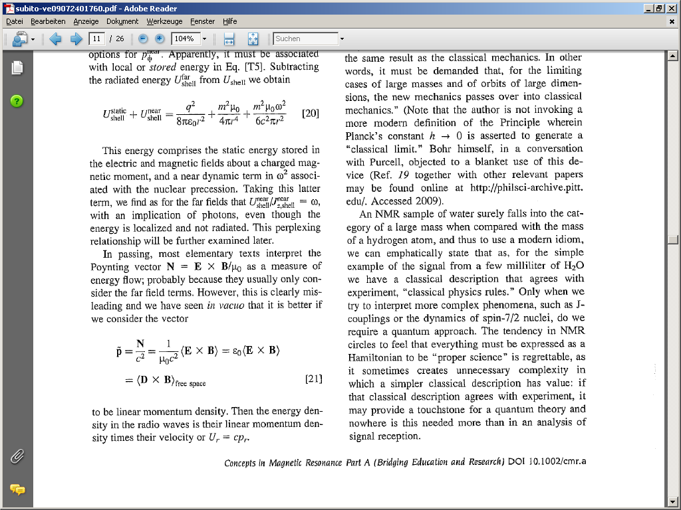
Klassisch vs. quantenmechanisch
Different Viewpoints

Slide 10
QM for Ensembles
Single particle state : Wave functions as linear combination of α, β Φ = α + β
Determine initial states : Probability(α) Φ_{α} = α , Probability(β ) Φ _{β} = β
State evolution during exp. : d/dt Φ = i h H Φ solve for H₁ during t₁ , H₂ during t₂ …..
Measure outcome for initial states : M _{x} (Φ_{α} ) = < Φ_{α} | I_{x} | Φ_{α} > , M _{x} (Φ _{β} ) = < Φ _{β} | I_{x} | Φ_{β} >
Calculate ensemble average : M _{x} = Probability(α) M _{x} (Φ_{α} ) + Probability(β) M _{x} (Φ _{β} )
Different Approach
Identify state with operator : Φ O_{Φ} if O_{Φ} Φ = ο_{Φ} Φ , O_{Φ} Ψ = 0 < Φ Ψ > = 0
Basis : I_{z} , I_{y} , I_{x} , 1
projector α (1/2 + I _{z} ) because ( 1/2 + I _{z} ) α = α β (1 /2 – I _{z} ) because ( 1/2 - I _{z} ) β = β
Arbitrary state linear combination : σ = c _{z} I _{z} ,+ c _{y} I _{y} + c _{x} I _{x} + c ₁ 1
Determine initial state : σ = Probability(α) ( ½ + I _{z} ) + Probability(β ) for ( ½ - I _{z} ) = I _{z}
State evolution during exp. : d/dt σ = i h [ H , σ] solve for H₁ during t₁ , H₂ during t₂ …..
Decompose state into basis : σ (t) = c_{z}(t) I_{z} ,+ c_{y}(t) I_{y} + c_{x}(t) I_{x} + c₁(t) 1
Measure outcome for initial state : M _{x} c_{x}(t)

Slide 11
Solution for d/dt σ = i h [ H , σ ]
Classical mechanics : Solution to dl/dt = torque by diagonalization : calculate M₊ and M₋
rotations (precession) about axis of torque
M_{x} (t) a M_{x} (0) cos ( ω t ) + M_{y} (0) sin ( ω t ) M₊ (t) a M₊ (0) exp( − i ω t)
QM wave function : Solution for d/dt Φ = i h H Φ σ (t) = exp (i h H t ) σ(0)
Statistical operator : Solution of d/dt σ = i h [ H , σ] σ(t) = exp(-i hH t) σ(0) exp( i hΗ t)
Meaning of exp (operator) : exp ( c H t) = 1 + 1/1! H t c + 1/2! H² t² c² + 1/3! H³ t³c³ + …
d/dt exp(c H t) = c H exp( c H t) = exp( c H t) c H H : constant
d/dt (exp(-i H t) σ(0) exp( i Η t)) = -i H exp(-i H t) σ(0) exp( i Η t) + exp(-i H t) σ(0) i Η exp( i Η t)
d/dt (exp(-i H t) σ(0) exp( i Η t)) = -i H exp(-i H t) σ(0) exp( i Η t) + exp(-i H t) σ(0) exp( i Η t) ) i Η
d/dt (exp(-i H t) σ(0) exp( i Η t)) = -i H σ(t) + σ(t) i Η
d/dt (exp(-i H t) σ(0) exp( i Η t)) = i [ H , σ(t) ] = d/dt σ(t)

Slide 12
Auxiliary Calculation : exp(c A)
exponential function exp ( c A ) = 1 + 1/1! A c + 1/2! A² c² + 1/3! A³ c³ + …
c = i φ φ real A² multiple of unity A² = a ² * 1 n! factorial of n
exp ( i φ A ) = 1 + 1/1! i φ A − 1/2! φ ² a ² 1 − 1/3! i φ ³ a ² A + 1/4! φ ⁴ a ⁴ 1 + 1/5! i φ ⁵ a ⁴ A …
real part
Re ( exp ( i φ A ) ) = 1 1 − 1/2! (φ a ) ² 1 + 1/4! ( φ a ) ⁴ 1 − 1/6! (φ a ) ⁶ 1 …
cos ( a φ ) = 1 − 1/2! (φ a )² + 1/4! ( φ a )⁴ − 1/6! (φ a )⁶ . . . .
Re ( exp ( i φ A ) ) = cos (φ a ) 1
imaginary part
Im ( exp ( i φ A ) = 1/1! (φ a ) i/a A − 1/3! (φ a ) ³ i /a A + 1/5! (φ a) ⁵ i /a A …
sin ( a φ ) = 1/1! (φ a ) − 1/3! (φ a )³ + 1/5! ( φ a ) ⁵ . . . .
Im ( exp ( i φ A ) ) = sin (φ a ) i /a A
exp( i φ A ) = cos ( φ a ) 1 + i /a sin ( φ a ) A
exp( i φ A ) ∗ = cos ( φ a ) 1 − i /a sin ( φ a ) A

Slide 13
Statistical Operator
Initial state : σ(0) = exp ( - H /kT ) = 1 - H /kT + ½ (H /kT)² …..
: σ(0) = 1 - h (1+ δ) B₀ /kT I_{z}
…. = I_{z}
evolution during r.f. : H = B₁ I_{y} ω₁ t_{pulse} = φ I_{y} ² = ¼ 1
σ(φ) = (cos ( φ /2 ) 1 + 2 i sin ( φ /2) I_{y} ) I_{z} (cos ( φ /2 ) 1 - 2 i sin ( φ /2 ) I_{y} )
σ(φ) = (cos ( φ /2 )² - sin ( φ /2 )² ) I_{z} + 2 (cos ( φ /2 )sin ( φ /2)) I_{x}
σ(φ) = cos ( φ ) I_{z} + sin ( φ ) I_{x}
I_{z} a I_{z} cos (φ ) + I_{x} sin (φ )
Free precession : H = - h (1+ δ) B₀ I_{z} H = ω I_{z} H² = ω² I_{z}² = ω² ¼ 1
exp( i ω Ι_{z} t) = cos ( ω/2 t ) 1 + i 2 sin (ω/2 t ) I_{z}
σ(t) = (cos ( ω/2 t ) 1 + 2i sin(ω/2 t) I_{z}) I_{x} (cos( ω/2 t ) 1 - 2i sin (ω/2 t) I_{z} )
I_{x} a I_{x} cos (ω t ) + I_{y} sin (ω t)
Measure outcome for initial states : M _{x} I_{x} M _{x} = cos (ω t )
M _{y} I_{y} M _{y} = sin (ω t )
M _{+/-} I_{+/-} M _{+/-} = exp (+/- i ω t )
Measure outcome for initial state : M _{x} c_{x}(t)

Slide 14
Two Spin System
Single particle states : Φ linear combination of basis αα , αβ , βα, ββ e.g. Φ = β (α + β)
Initial state σ = I_{z} + S_{z}
If there is no coupling spins evolve independently
[ A, B ] = 0 a exp( i (A + B) t) = exp( i A t) exp( i B t) = exp( i B t) exp( i A t)
e.g. r.f. pulse H = ω₁ I_{y} + ω₁ S_{y} = ω₁ ( I_{y} + S_{y} ) , [ I_{y} , S_{y} ] = 0
σ = exp( i I_{y} φ ) exp( i S_{y} φ ) (I_{z} + S_{z} ) exp( -i I_{y} φ ) exp( -i S_{y} φ )
σ = exp( i I_{y} φ ) I_{z} exp( -i I_{y} φ ) + exp( i S_{y} φ ) S_{z} exp( -i S_{y} φ )
σ = I_{x} + S_{x}
Scalar Coupling (Quantum Mechanical)
Hamiltonian for time evolution H = ω_{I} I_{z} + ω_{S} S_{z} + J ( I_{x} S_{x} + I_{y} S_{y} + I_{z} S_{z} )
AX –approximation H = ω_{I} I_{z} + ω_{S} S_{z} + J I_{z} S_{z}
H² = J² I_{z}² S_{z}² = J² 1/16 1 1
exp( i J Ι_{z} S_{z} t) = cos ( J/4 t ) 1 + 4 i sin (J/4 t ) I_{z}S_{z}
I_{x} a (cos ( J/4 t ) 1 + 4i sin (J/4 t) I_{z}S_{z}) I_{x} (cos ( J/4 t ) 1 − 4i sin (J/4 t) I_{z}S_{z} )
?
I_{x} a I_{x} cos (J/2 t ) + I_{y} S_{z} sin ( J/2 t )
I_{z} S_{z} I_{x} = i I_{z} I_{x} S_{z} = I_{y}S_{z ,} I_{x} I_{z} S_{z} = -i I_{y}S_{z}

Slide 15
Two Spin System
Single particle states : Φ linear combination of basis αα , αβ , βα, ββ e.g. Φ = β (α + β)
I_{z}S_{z} I_{x}S_{x} I_{y}S_{y}
I_{x}S_{z} I_{y}S_{z}
I_{x} I_{y} I_{z}
S_{x} S_{y} S_{z}
S_{x}I_{z} S_{y}I_{z}
I_{y}S_{x} I_{x}S_{y} 1
only I_{x} , S_{x} ,I_{y} , S_{y} , I_{z} , S_{z} can be observed
[ A, B ] = 0 a exp( i (A + B) t) = exp( i A t) exp( i B t) = exp( i B t) exp( i A t)
[ I_{z} , I_{z}S_{z} ] = 0 a exp( i H t) = exp( i ω_{Ι} Ι_{z} t) exp( i ω_{S} S_{z} t) exp( i J Ι_{z} S_{z} t)
Time evolution according to B₀ for spins I and S and I_{z}S_{z} can be calculated one by one.
[ H, A ] = 0, [ H, C ] = 0 a exp( i H t) AC exp( − i H t) = exp( i H t) A exp( − i H t) C
H = ω_{I} I_{z} a
S_{z} I_{x} a S_{z} I_{x} cos (ω_{I} t ) + S_{z} I_{y} sin ( ω_{I} t )
H = ω₁ I_{y} a
S_{z} I_{x} a S_{z} I_{x} cos (φ ) − S_{z} I_{y} sin ( φ_{I})
H = ω₁ S_{y} a
S_{z} I_{x} a S_{z} I_{x} cos (φ ) + S_{x} I_{x} sin ( φ_{I})

Slide 16
Different Views
Macroscopic View
Quantum View
M_{x} , M_{y} , M_{z} components of macroscopic magnetization
I_{x} , I_{y} , I_{z} operators of components of macroscopic magnetization
B₀ evolution
Δω t
M_{x} a M_{x} cos ( ω t ) + M_{y} sin ( ω t )
z
I_{x} a I_{x} cos ( ω t ) + I_{y} sin ( ω t )
M_{y} a M_{y} cos ( ω t ) − M_{x} sin ( ω t )
I_{y} a I_{y} cos ( ω t ) − I_{x} sin ( ω t )
-y
M₊ = M_{x} + ι M_{y}
I₊ = I_{x} + ι I_{y}
, M₋ = M_{x} − ι M_{y}
, I₋ = I_{x} − ι I_{y}
M₋ a M₋ exp( i ω t)
-x
I₋ a I₋ exp( i ω t)
x
M₊ a M₊ exp( − i ω t)
I₊ a I₊ exp( − i ω t)
y
-z
y-pulse
B₁ evolution x-pulse
φ = ω₁ t_{pulse}
y-pulse
M_{z} a M_{z} cos ( φ ) + M_{x} sin (φ)
z
I_{z} a I_{z} cos ( φ ) + I_{x} sin (φ)
M_{x} a M_{x} cos (φ ) − M_{z} sin (φ )
-y
I_{x} a I_{x} cos (φ ) − I_{z} sin (φ )
x-pulse
-x
x-pulse
M_{z} a M_{z} cos ( φ ) − M_{y} sin ( φ )
x
I_{z} a I_{z} cos ( φ ) − I_{y} sin ( φ )
M_{y} a M_{y} cos ( φ ) + M_{z} sin ( φ )
y
I_{y} a I_{y} cos ( φ ) + I_{z} sin ( φ )
-z

Slide 17
Time Evolution / Rotation of Operators
B₀- and B₁ - evolution
Iz
Iz
Iz
-Iy
-Iy
-Iy
-Ix
-Ix
-Ix
Ix
Ix
Ix
φ
ω t
φ
Iy
Iy
Iy
-Iz
-Iz
-Iz
J coupling evolution
H= IzSz
H= IzSz
− Ix
− 2 IxSz
−2 IySz
2 IySz
− Iy
Iy
π J t
π J t
Ix
2 IxSz
I₊ a ? :
(I_{x} + i I_{y} ) a ( I_{x} cos ( φ) + 2 I_{y}S_{z} sin ( φ ))
+ i ( I_{y} cos ( φ) − 2I_{x}S_{z} sin ( φ ))
(I_{x} + i I_{y} ) a I₊ cos ( φ) + 2i I₋S_{z} sin ( φ )

Slide 18
B₀- und B₁- Entwicklung
B₀- and B₁- Evolution
Iz
Iz
Iz
-Iy
-Iy
-Iy
-Ix
Ix
-Ix
-Ix
Ix
Ix
Iy
φ
Iy
φ
Iy
ω t
-Iz
-Iz
-Iz
J Coupling Evolution
IzSz
IzSz
AX- Approximation
− 2 IxSz
− Ix
−2 IySz
2 IySz
− Iy
Iy
π J t
π J t
Ix
2 IxSz
B₀- and B₁ -Evolution
IzSz
Iz
-IySz
-IySz
-Ix
-IxSz
Ix
IxSz
IySz
φ
I_{z}
IySz
ω t
I_{y}S_{z} ( I_{y} cos ω_{I} t₁ − I_{x} sin ω_{I} t₁ ) S_{z}
-IzSz
-Iz
I_{x}
+ S_{x}
( S_{z} cos φ − S_{y} sin φ )
I_{y}S_{z} ( I_{y} cos φ + I_{z} sin φ) S_{z}

Slide 19
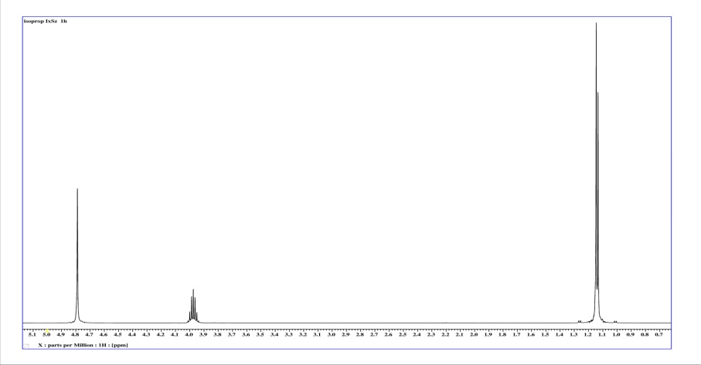
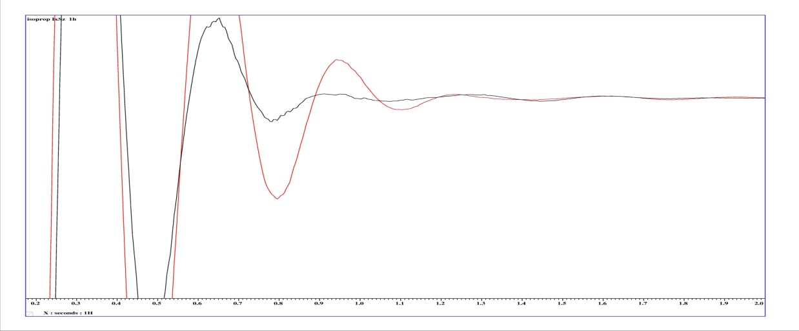
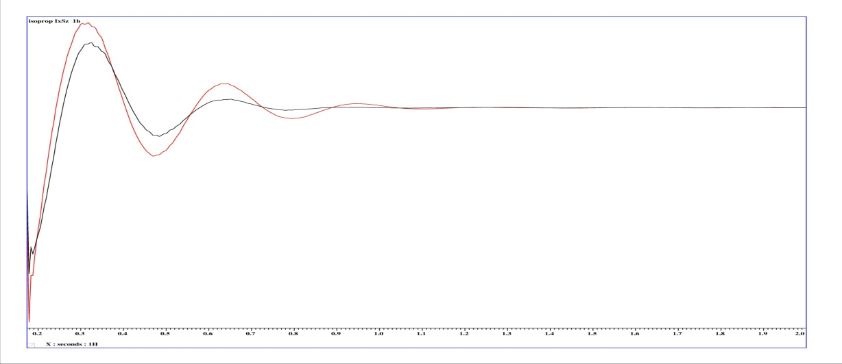
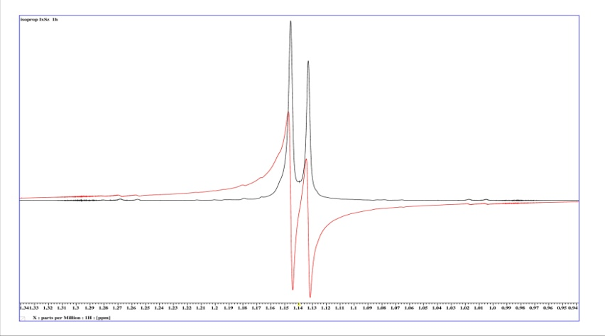
Kopplungsentwicklung 2 Spins ½
J Evolution 2 Spins ½
I_{x} I_{y}
I_{x} I_{y}
I_{x} I_{y}
I_{x} I_{y}
expectation values of I_{y} and I_{x}S_{z}
< I_{y} >_{Ens} ~ − cos ( ω_{I} t ) cos ( J/2 t )
< I_{x} S_{z} >_{Ens} ~ sin ( ω_{I} t ) sin ( J/2 t )
Rotating frame of reference assumed for Spin I ω_{I} = 0
< I_{y} >_{Ens} ~ cos ( J/2 t ) , < I_{x} S_{z} >_{Ens} ~ − sin ( J/2 t )

Slide 20
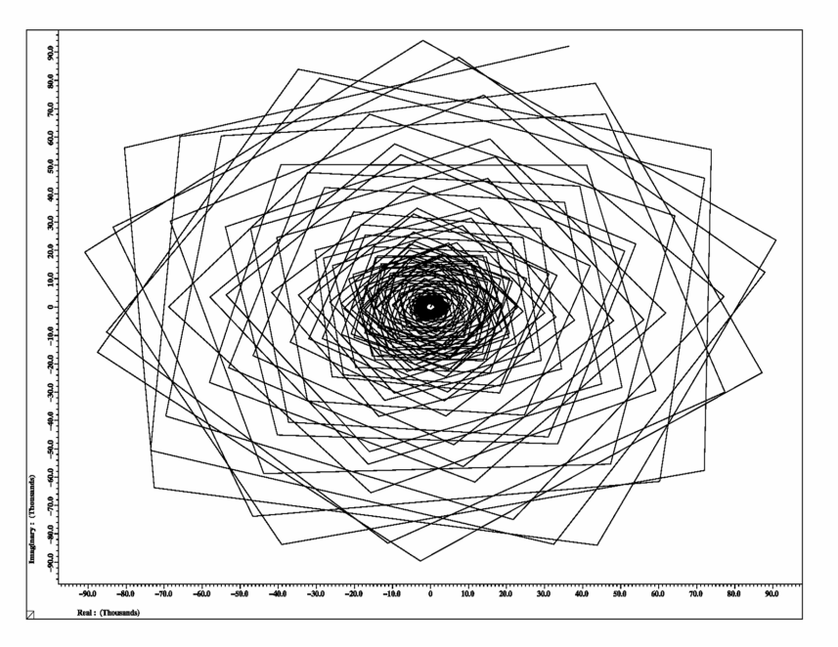
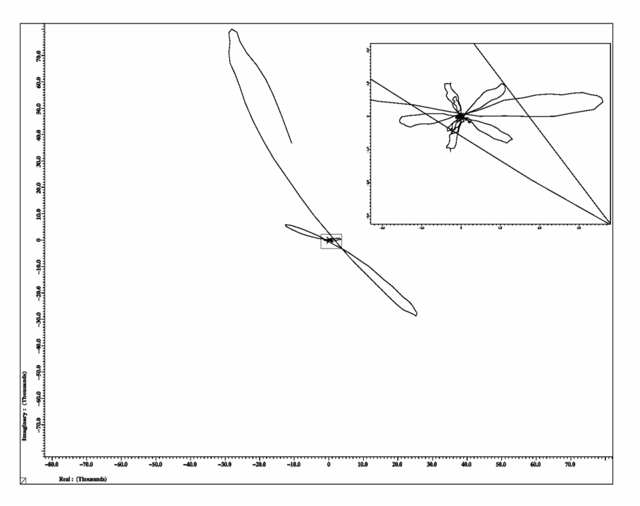
Kopplungsentwicklung
J Evolution
B₀ (shift) evolution
I_{y}
cos( ω_{I} t ) I_{y} + sin( ω_{I} t ) I_{x}
I_{y}
I_{x}
I_{x}
J evolution
cos( J/2 t ) I_{y} + sin( J/2 t ) I_{x} S_{z}
I_{y}
I_{y}
I_{x}S_{z}
I_{x}
I_{x}

Slide 21
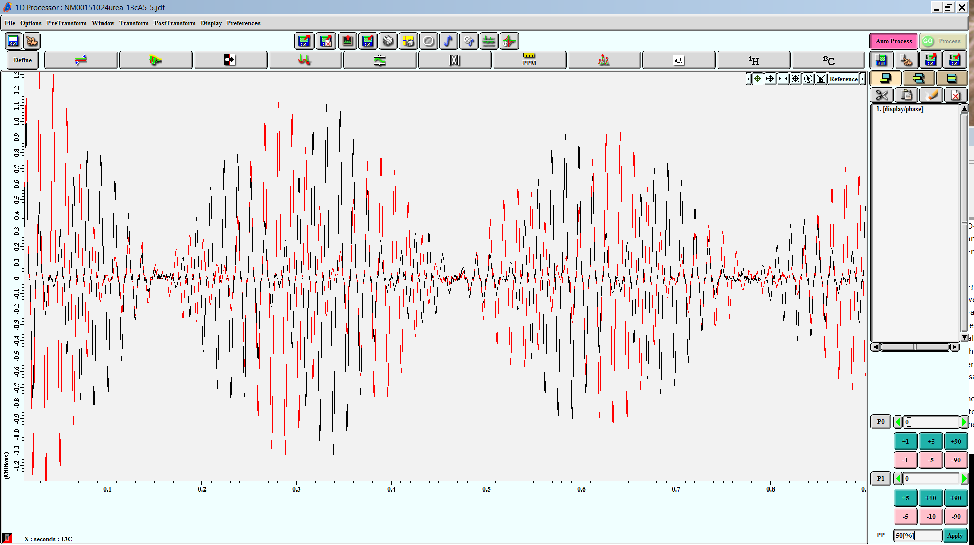
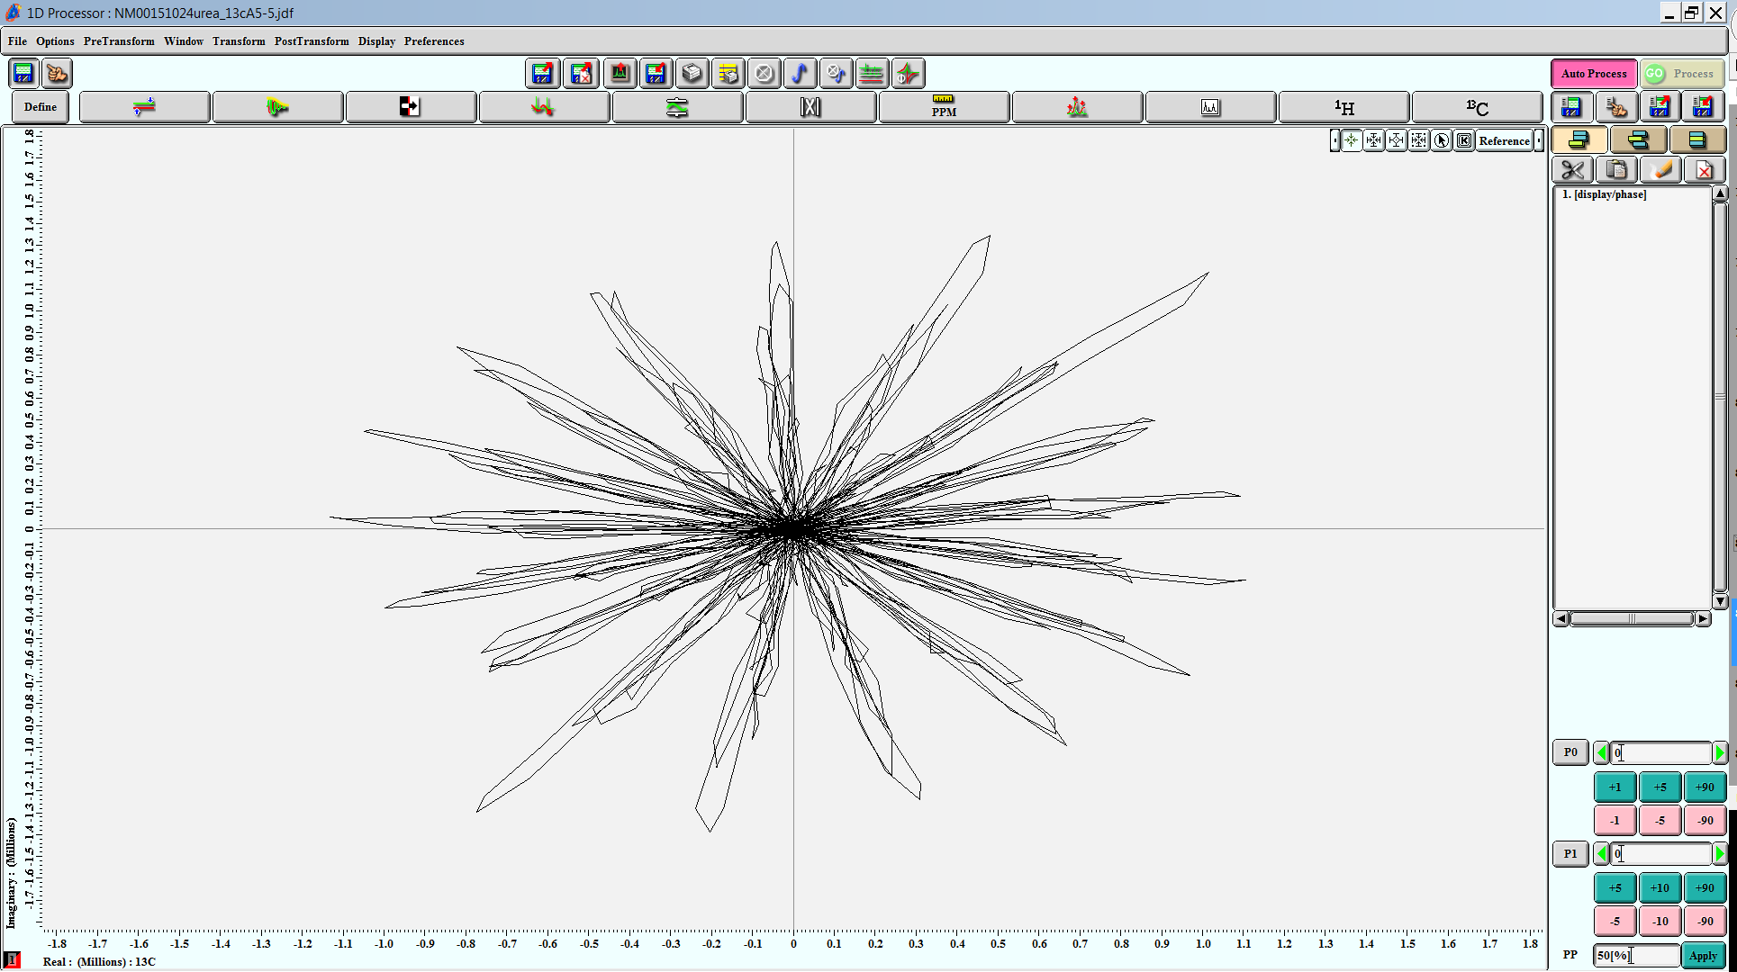
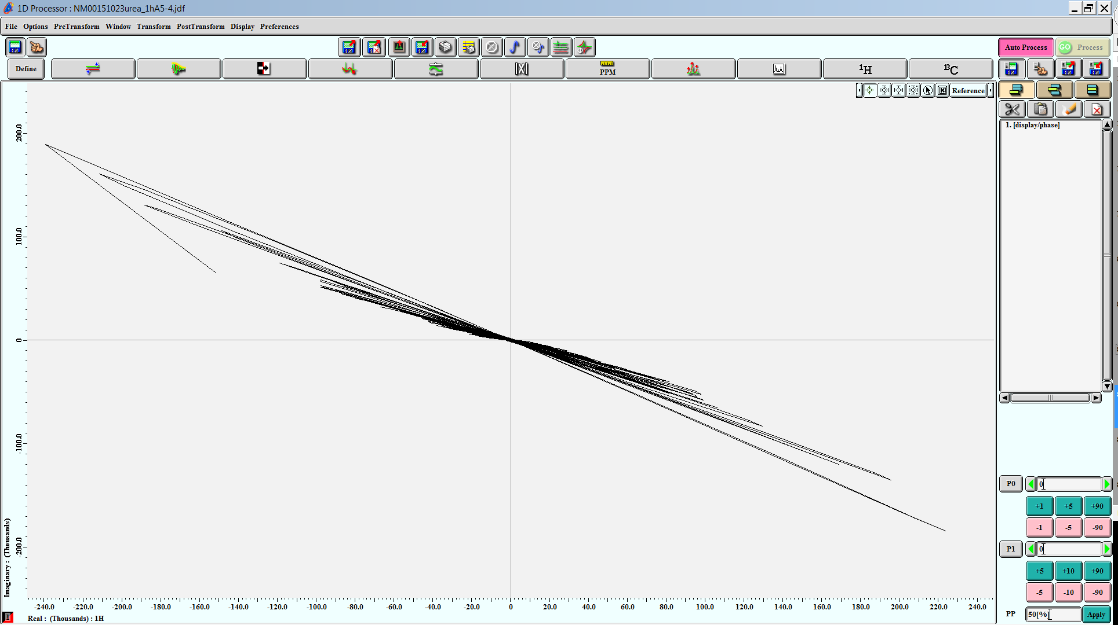
J Evolution
√(I_{x}² + I_{y}²)

Slide 22
Kopplungsentwicklung
J Evolution
B₀
B₀
z
z
r
r
x
x
y
y
After application of a 90° y pulse only the x components of angular momentum are known. Z and y components are uncertain.
QM state
(no proper picture just a visualization)

Slide 23
Kopplungsentwicklung
J Evolution
J evolution (AX- approximation): Spins undergo a precession about the z component of their coupling „ partners“ .
QM state
(no proper picture just a visualization)
At some time no macroscopic magnetization can be observed.
J evolution carries on in the same direction
QM state
(no proper picture just a visualization)
At some time macroscopic magnetization is restored.

Slide 24
J Evolution
I-spin
S-spin
QM state
(no proper picture just a visualization)
z
y
I_{x}- magnetization
x
+
S_{x}- magnetization
QM state
(no proper picture just a visualization)
neither I_{x}- nor I_{y}- magnetization
+z
z
z
z
neither S_{x}- nor S_{y}- magnetization
-y
-y
-y
-y
I_{z}S_{y}- coherence
-x
z
+x
z
x
z
x
z
x
I_{y}S_{z}- coherence
+y
y
y
y
y
x
x
−I_{x}- magnetization
x
x
+
−S_{x}- magnetization
-z
no I_{z}S_{y} , I_{y}S_{z} - coherence

Slide 25
Kopplungsentwicklung
J Evolution / COSY
I_{x}- magnetization
S_{x}- magnetization
I_{x}- magnetization
z
z
Ein Zustand.
z
z
y
y
y
y
(S_{x}- magnetization )
t₁
z
x
z
x
z
x
z
x
y
y
y
y
I_{y}S_{z}- coherence
(I_{y}- magnetization
I_{y}S_{z}- coherence
I_{y}- magnetization )
x
x
x
x
90 °
I_{z}S_{y}- coherence
I_{z}S_{y}- coherence
t₂₋ acquisition
S_{x}- magnetization
I_{y}S_{z}- coherence
I_{y}S_{z}- coherence

Slide 26
COSY , Two RF- pulses
90°
90°
t₁ δt increments
acquisition
δt dwell time
S_{x}- magnetization
S_{y}- magnetization
I_{z}S_{y}- coherence
90°
90°
t₁ –evolution,
t₁ incremented
cos ω t₁
sin ω t₁
I_{y}S_{z}- coherence
t₂ – evolution, acquisition M₊ = M_{x}+ i M_{y}
I_{x}- magnetization
sin ω t₁
sin ω t₁ (exp (i ω t₂ ))

Slide 27
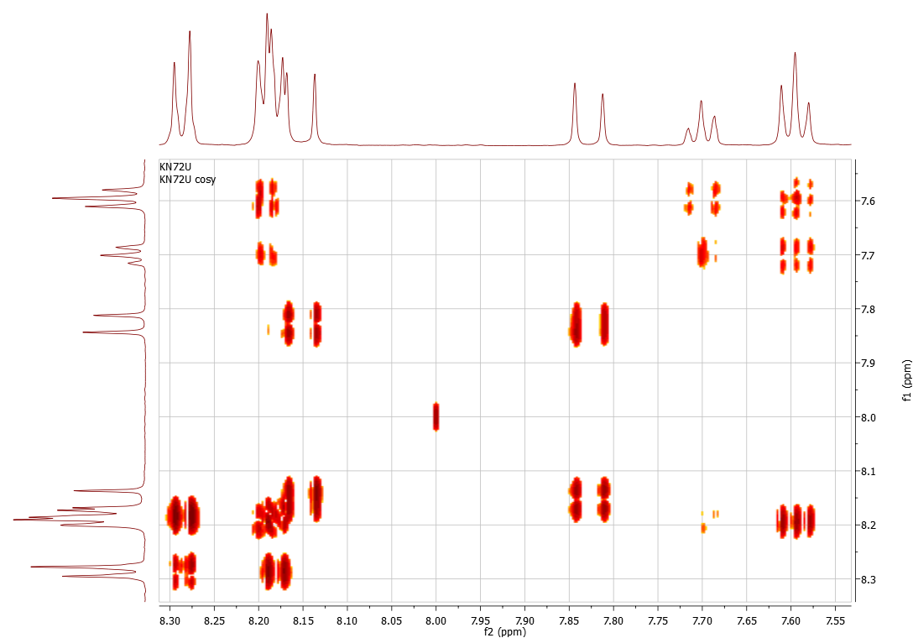
COSY Experiment

Slide 28
J Evolution (Ensemble Average)
ensemble
thermal equilibrium
B₀
c_{Iz} = 0
c_{Sz} = 0
after 90° - pulse
c_{Ix} = 0
c_{Sx} = 0
after sel. −90° - pulse I nucleus
c_{Iz} = 0
c_{Sx} = 0
c_{IzSx} = 0
after J coupling evolution
c_{Iz} = 0
c_{Sx} = 0
c_{IzSx} = 0
y
c_{IzSy} = 0
x

Slide 29
Axioms of Quantum Theory*
* Frederic Schuller FAB Erlangen Nuremberg
Axiom 1 : with every quantum system, there is associated a complex Hilbertspace (H, +, ., < , >) The states of the system are all positive trace-class linear maps ρ H -> H for which Tr ρ = 1
Almost everywhere it is stated: the (normalized) elements ψ ε H are the states of the quantum system.
False !!

Slide 30
Axioms of Quantum Theory*
* Frederic Schuller FAB Erlangen Nuremberg
Axiom 4 : Unitary dynamics: during time intervals (t1,t2)
during which no measurement occur
state ρ(t2) @ time t2
ρ(t1) @ time t1
are related through:
r(t2)=U(t2-t1) r(t1) U⁻¹(t2-t1)
where U(t) := exp (-i / h H t ) H energy observable

Slide 31
Appendix 1

Slide 32
COSY Experiment
IzSz
Iz
IzSz
Iz
Iz
t₁
acquisition t₂
Iz
− 2 IxSz
− Ix
-Iy
-Iy
-IySz
-Iy
thermal equilibrium
− Iy
−2 IySz
2 IySz
-Ix
Iy
-Ix
-Ix
Ix
-Ix
I_{z} + S_{z}
Ix
Ix
π J t
Ix
90° y-pulse
IySz
π J t
Iy
Iy
I_{x} + S_{x}
-Iz
Iy
2 IxSz
Ix
-Iz
-Iz
-Iz
shift ω_{I} ω_{s}
I_{x} cos ω_{I} t₁ + I_{y} sin ω_{I} t₁
+ S_{x} cos ω_{S} t₁ + S_{y} sin ω_{s} t₁
coupling
( I_{x} cos π J t₁ + 2 I_{y} S_{z} sin π J t₁ ) cos ω_{I} t₁
+ ( I_{y} cos π J t₁ − 2 I_{x} S_{z} sin π J t₁ ) sin ω_{I} t₁
90° y-pulse
( − I_{z} cos π J t₁ + 2 I_{y} S_{x} sin π J t₁ ) cos ω_{I} t₁
+ ( I_{y} cos π J t₁ + 2 I_{z} S_{x} sin π J t₁ ) sin ω_{I} t₁
only I_{x} + i I_{y} and S_{x} + i S_{y} can be recorded (observables) :
I_{z} does not change and can‘t be recorded.
how does 2 I_{y} S_{x} evolve ?
( I_{y} cos ω_{I} t₂ − I_{x} sin ω_{I} t₂ ) ( S_{x} cos ω_{S} t₂ + S_{y} sin ω_{S} t₂ )
shift ω_{I} ω_{s}
I_{y} S_{x} cos ω_{I} t₂ cos ω_{S} t₂ − I_{x} S_{y} sin ω_{I} t₂ sin ω_{S} t₂
− I_{x} S_{x} sin ω_{I} t₂ cos ω_{S} t₂ + I_{y} S_{y} cos ω_{I} t₂ sin ω_{S} t₂ )

Slide 33
Two Frequency Axes
preparation λ = t₁ = n Δt
acquisition
t₁ has to be incremented
t₁
t₂
rf
rf
ω
ω
FT along t₂
FT along t₁
ω
t₁
t₁
(Sin ( ω t₁ ) Sin (J t₁ ) )
f₁
ω
t₂
f₂
f₂
sin ( ω t₁ ) sin (J t₁ ) exp ( i ω t₂ )

Slide 34
COSY- Experiment (¹H, ¹H)
COSY – Experiment (¹H, ¹H)
90°
90°
t₁ incremented
t₂ acquisition
propionic acid

Slide 35

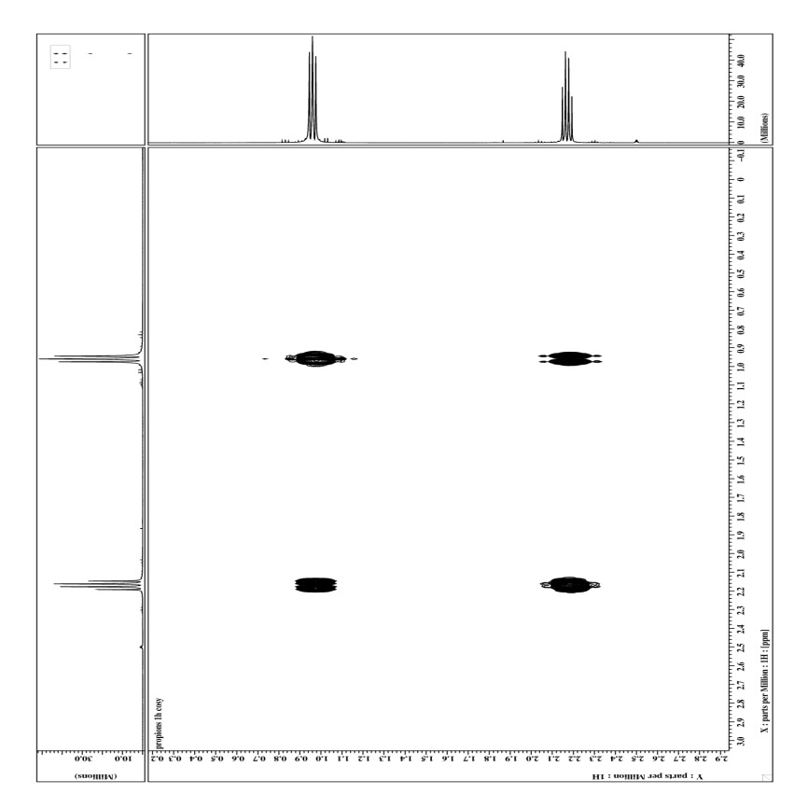
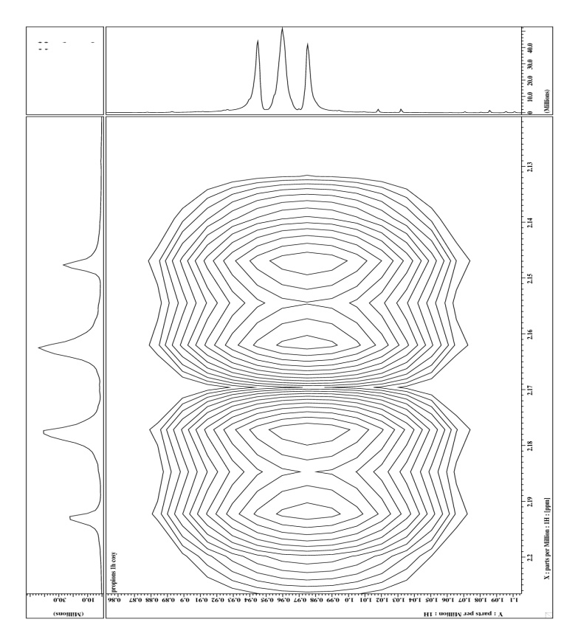
COSY- Experiment
COSY Experiment Phase Cycles

Slide 36
COSY Experiment
t₁
acquisition t₂
only ( I_{y} cos π J t₁ sin ω_{I} t₁ + 2 I_{z} S_{x} sin π J t₁ sin ω_{I} t₁ ) yields an observable signal.
I_{y} cos π J t₁ sin ω_{I} t₁ delivers after FT in t₁ ( δ(ν₂ − ν_{I} − J/2) + δ(ν₂ − ν_{I} + J/2) ) cos π J t₁ sin ω_{I} t₁
along t₁ modulated by J and shift evolution according to cos π J t₁ sin ω_{I} t₁ : delivers pure real function
I_{y} cos π J t₁ sin ω_{I} t₁ cos FT with respect to t₁ yields:
(δ(ν₂ − ν_{I} − J/2) + δ(ν₂ − ν_{I} + J/2) )( δ(ν₁ − ν_{I} − J/2) + δ(ν₁ − ν_{I} + J/2) )
= δ(ν₂ − ν_{I} − J/2) δ(ν₁ − ν_{I} − J/2) + δ(ν₂ − ν_{I} + J/2) δ(ν₁ − ν_{I} + J/2)
+ δ(ν₂ − ν_{I} − J/2) δ(ν₁ − ν_{I} + J/2) ) + δ(ν₂ − ν_{I} + J/2) ( δ(ν₁ − ν_{I} − J/2)
diagonal and off- diagonal peaks
No plain phase a calculate absolute value (magnitude spectrum )
|| spc(ν₂ , ν₁ ) || = spc(ν₂ , ν₁ ) spc(ν₂ , ν₁ ) *
√ ( )
ν₁
t₁
t₁
J
J
J
J
ν_{S}
ν_{I}
ν_{S}
ν_{I}
t₂
ν₂
ν₂

Slide 37
COSY- Experiment
COSY Experiment
t₁
acquisition t₂
only ( I_{y} cos π J t₁ sin ω_{I} t₁ + 2 I_{z} S_{x} sin π J t₁ sin ω_{I} t₁ ) ) yields an observable signal.
2 I_{z} S_{x} sin π J t₁ sin ω_{I} t₁ a yielding after successive J- evolution S_{y} – magnetization.
a FT with respect to t₂ delivers ( δ(ν₂ − ν_{S} − J/2) + δ(ν₂ − ν_{S}+ J/2) ) sin π J t₁ sin ω_{I} t₁
real function of t₁ sin π J t₁ sin ω_{I} t₁
S_{y} sin π J t₂ sin π J t₁ sin ω_{I} t₁ a with cos FT in t₁
( δ(ν₂ − ν_{S} − J/2) + δ(ν₂ − ν_{S} + J/2) ) ( δ(ν₁ − ν_{I} − J/2) + δ(ν₁ − ν_{I} + J/2) )
= δ(ν₂ − ν_{S} − J/2) δ(ν₁ − ν_{I} − J/2) + δ(ν₂ − ν_{S} + J/2) δ(ν₁ − ν_{I} + J/2)
+ δ(ν₂ − ν_{S} − J/2) δ(ν₁ − ν_{I} + J/2) ) + δ(ν₂ − ν_{S} + J/2) ( δ(ν₁ − ν_{I} − J/2)
cross - peaks
No simple phase relation therefore a absolute value spectrum || spc(ν₂ , ν₁ ) || = √ ( spc(ν₂ , ν₁ ) spc(ν₂ , ν₁ ) ) *
ν₁
t₁
t₁
J
J
J
J
ν_{S}
ν_{I}
ν_{S}
ν_{I}
t₂
ν₂
ν₂

Slide 38
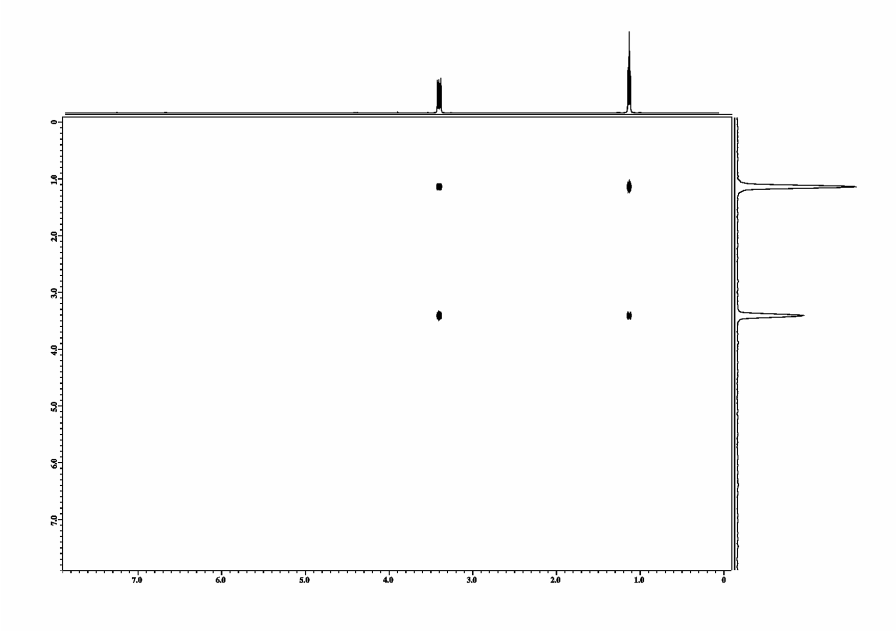
2D- Spektrum
2D Spectrum
FID ( t₁ , t₂ ) =
sin ω _{A}t₁ (exp (i ω_{A} t₂ ))
+
sin ω_{B} t₁ (exp (i ω_{B} t₂ ))
* cos J_{AB}/2t₁
* cos J_{AB}/2t₂
* cos J_{AB}/2t₁
* cos J_{AB}/2t₂
+
sin ω _{A}t₁ (exp (i ω_{B} t₂ ))
+
sin ω_{B} t₁ (exp (i ω_{A} t₂ ))
* sin J_{AB}/2t₂
* sin J_{AB}/2t₁
* sin J_{AB}/2t₁
* sin J_{AB}/2t₂
FT :
SPC ( t₁ , ω₂ ) =
δ (ω_{A} − ω₁ ) δ (ω_{A} −ω₂ )
δ (ω_{B} -ω ₁ ) δ (ω_{B} -ω ₂ )
+
∗ (δ ( -J_{AB} /2 ) + δ ( J_{AB} /2 ))
∗ (δ ( - J_{AB} /2 ) + δ ( J_{AB} /2 ))
∗ (δ ( -J_{AB} /2 ) + δ ( J_{AB} /2 ))
∗ (δ ( - J_{AB} /2 ) + δ ( J_{AB} /2 ))
δ (ω_{A} −ω₁ ) δ (ω_{A} −ω₂ )
ω_{Α}
∗ (δ ( -J_{AB} /2 ) + δ ( J_{AB} /2 ))
∗ (δ ( -J_{AB} /2 ) + δ ( J_{AB} /2 ))
ω_{Α}

Slide 39
COSY- Experiment
COSY Experiment
t₁
acquisition t₂
How does 2 I_{y} S_{x} ?evolve ?
shift ω_{I} ω_{s}
I_{y} S_{x} cos ω_{I} t₂ cos ω_{S} t₂ − I_{x} S_{y} sin ω_{I} t₂ sin ω_{S} t₂
− I_{x} S_{x} sin ω_{I} t₂ cos ω_{S} t₂ + I_{y} S_{y} cos ω_{I} t₂ sin ω_{S} t₂ )
I_{x} S_{y} cos ω_{S} t₂ cos ω_{I} t₂ − I_{y} S_{x} sin ω_{S} t₂ sin ω_{I} t₂
− I_{x} S_{x} sin ω_{S} t₂ cos ω_{I} t₂ + I_{y} S_{y} cos ω_{S} t₂ sin ω_{I} t₂ )
I_{y} S_{x} ( cos ω_{I} t₂ cos ω_{S} t₂ − sin ω_{S} t₂ sin ω_{I} t₂ )
+ I_{x} S_{y} ( cos ω_{I} t₂ cos ω_{S} t₂ − sin ω_{S} t₂ sin ω_{I} t₂ )
− I_{x} S_{x} ( sin ω_{I} t₂ cos ω_{S} t₂ + sin ω_{S} t₂ cos ω_{I} t₂ )
− I_{y} S_{y} (cos ω_{I} t₂ sin ω_{S} t₂ + cos ω_{S} t₂ sin ω_{I} t₂ )
cos α cos β − sin α sin β = cos ( α + β )
cos α sin β − sin α cos β = sin ( α + β )
cos α sin -β − sin α cos -β = sin ( α − β )
− cos α sin β − sin α cos β = sin ( α − β )
I_{y} S_{x} ( cos ( (ω_{I} + ω_{S} ) t₂ ) + I_{x} S_{y} ( cos ( (ω_{I} + ω_{S} ) t₂ )
double quantum coherences
I_{x} S_{x} ( sin( ( ω_{S} − ω_{I} ) t₂ ) + I_{y} S_{y} ( sin( ( ω_{S} − ω_{I} ) t₂ )
zero quantum coherences
J coupling evolution :
I_{y} S_{x} a I_{y} ( S_{x} + S_{y} I_{z} ) a ( I_{y} − I_{y} S_{z} ) ( S_{x} + S_{y} I_{z} ) = … I_{y} S_{z} S_{x} … I_{y} S_{z} S_{y} I_{z}
= … I_{y} S_{y} … I_{x}S_{x}

