Slide 1

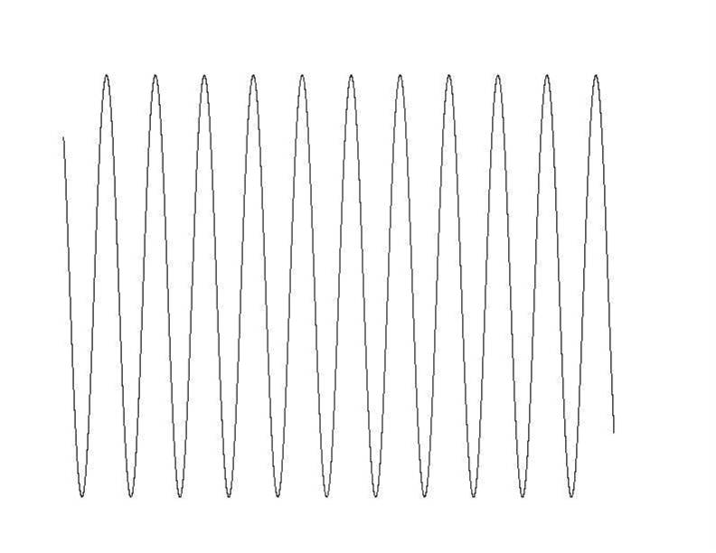
COSY
preparation
acquisition
dw
rf
rf
Number of data points , acquisition time -> spectral resolution
distance between points (dwell time) -> spectral range
2 * dw
rf
rf
3 * dw
rf
rf
number of increments , acquisition time -> spectral resolution
distance of increments (dwell time) -> spectral range

Slide 2
J Evolution
B₀
B₀
z
z
r
r
x
x
y
y
After application of a 90° y pulse only the x components of angular momnetum are known. Z and y components are uncertain.
QM state
(no proper picture just a visualization)

Slide 3
J Evolution / COSY
I_{x}- magnetization
S_{x}- magnetization
QM state
(no proper picture just a visualization)
I_{x}- magnetization
z
z
z
z
y
y
y
y
I_{y}S_{z}- coherence
z
x
z
x
z
x
z
x
y
y
y
y
S_{x}- magnetization
x
x
x
x
t₁
I_{z}S_{y}- coherence
I_{z}S_{y}- coherence
90 °
I_{y}S_{z}- coherence
t₂ acquisition
I_{y}S_{z}- coherence
I_{y}S_{z}- coherence
I_{x}- magnetization

Slide 4
COSY , Two RF- pulses
90°
90°
t₁ δt increments
acquisition
δt dwell time
S_{x}- magnetization
S_{y}- magnetization
I_{z}S_{y}- coherence
90°
90°
t₁ –evolution,
t₁ incremented
cos ω t₁
sin ω t₁
I_{y}S_{z}- coherence
t₂ – evolution, acquisition M₊ = M_{x}+ i M_{y}
I_{x}- magnetization
sin ω t₁
sin ω t₁ (exp (i ω t₂ ))

Slide 5
B₀- and B₁- Evolution
Iz
Iz
Iz
-Iy
-Iy
-Iy
-Ix
Ix
-Ix
-Ix
Ix
Ix
Iy
φ
Iy
φ
Iy
ω t
-Iz
-Iz
-Iz
J Coupling Evolution
IzSz
IzSz
AX- Approximation
− 2 IxSz
− Ix
−2 IySz
2 IySz
− Iy
Iy
π J t
π J t
Ix
2 IxSz
B₀- and B₁ -Evolution
IzSz
Iz
-IySz
-IySz
-Ix
-IxSz
Ix
IxSz
IySz
φ
I_{z}
IySz
ω t
I_{y}S_{z} ( I_{y} cos ω_{I} t₁ − I_{x} sin ω_{I} t₁ ) S_{z}
-IzSz
-Iz
I_{x}
+ S_{x}
( S_{z} cos φ − S_{y} sin φ )
I_{y}S_{z} ( I_{y} cos φ + I_{z} sin φ) S_{z}

Slide 6
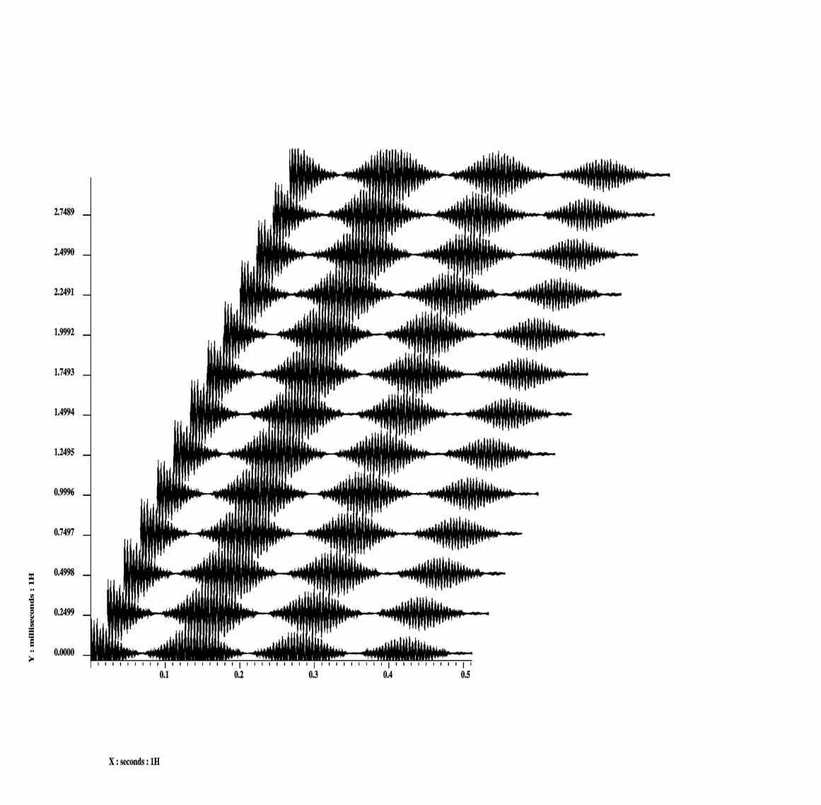
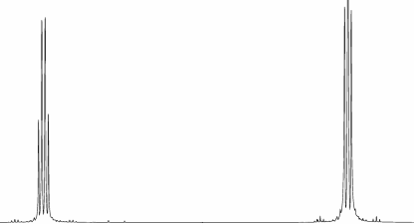
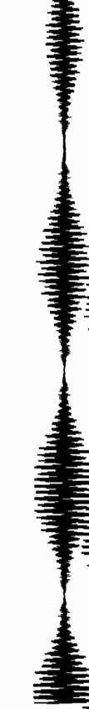
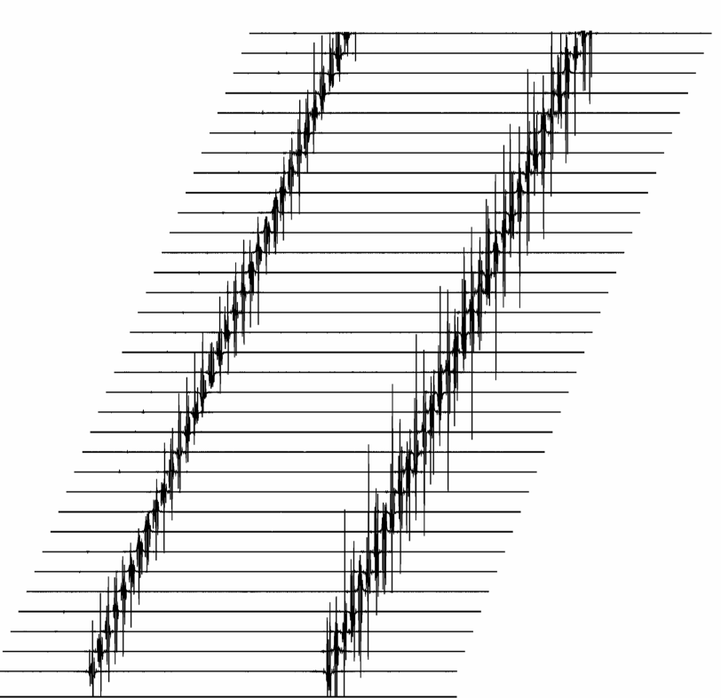
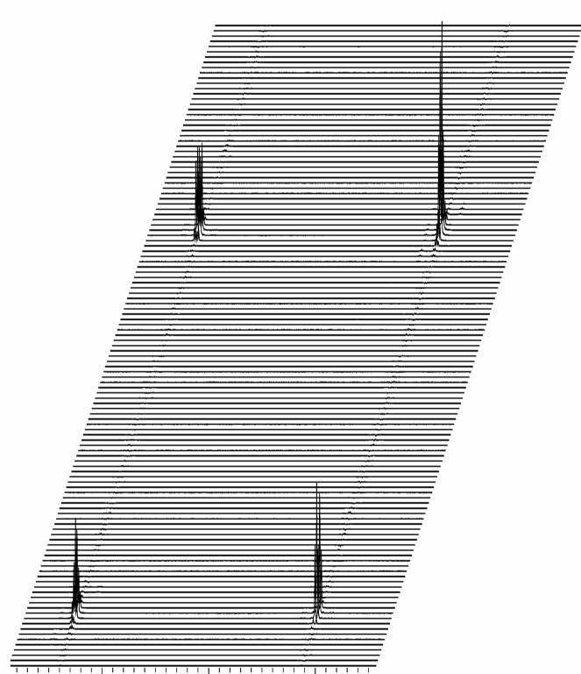
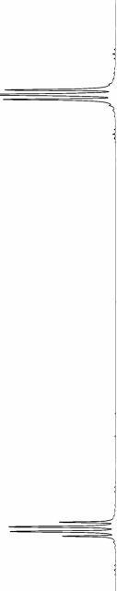
COSY experiment
t₁
t₂
Two dimensional experiment
rf
rf
FT in t₂
FT in t₁
t₁
t₁
f₁
t₂
f₂
f₂

Slide 7
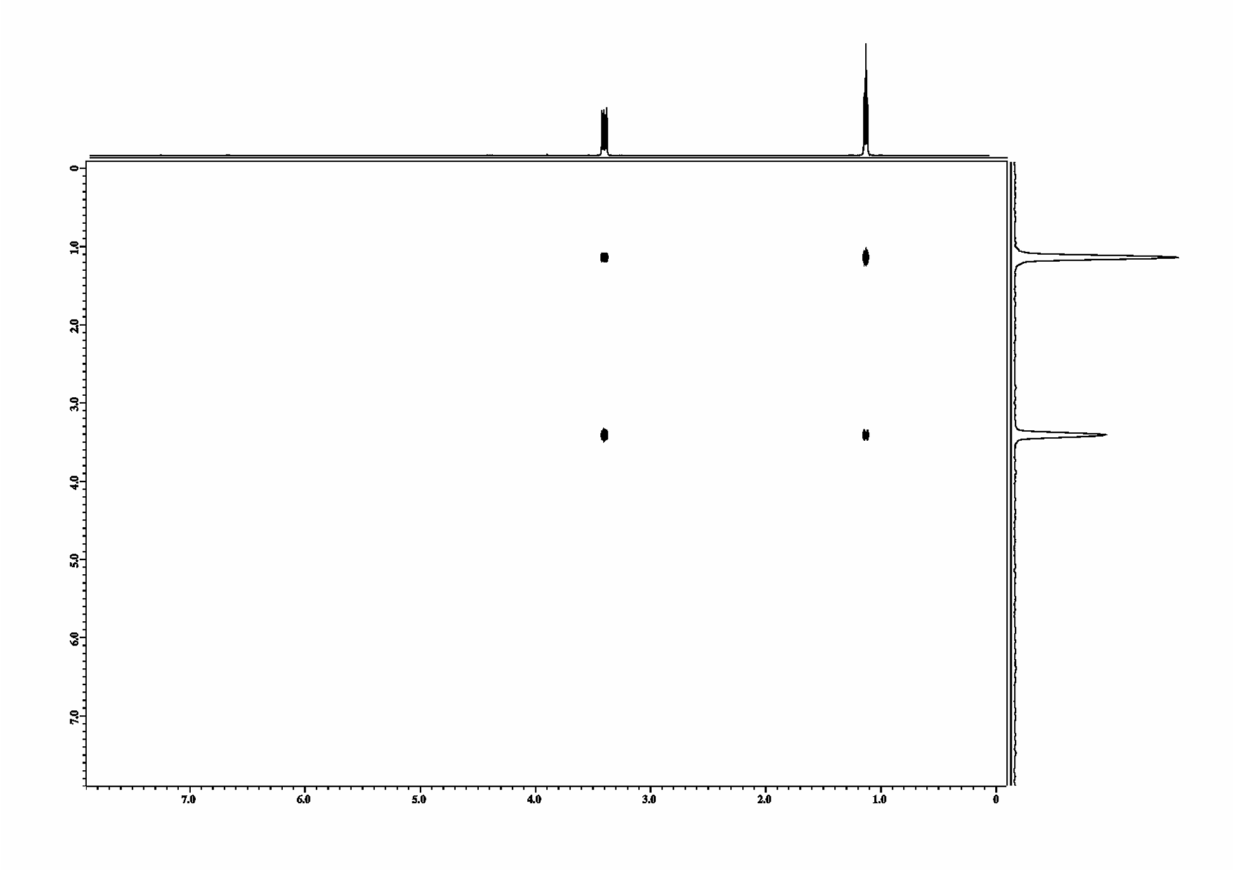
2D Spectrum
FID ( t₁ , t₂ ) =
sin ω _{A}t₁ (exp (i ω_{A} t₂ ))
+
sin ω_{B} t₁ (exp (i ω_{B} t₂ ))
* cos J_{AB}/2t₁
* cos J_{AB}/2t₂
* cos J_{AB}/2t₁
* cos J_{AB}/2t₂
+
sin ω _{A}t₁ (exp (i ω_{B} t₂ ))
+
sin ω_{B} t₁ (exp (i ω_{A} t₂ ))
* sin J_{AB}/2t₂
* sin J_{AB}/2t₁
* sin J_{AB}/2t₁
* sin J_{AB}/2t₂
FT :
SPC ( t₁ , ω₂ ) =
δ (ω_{A} − ω₁ ) δ (ω_{A} −ω₂ )
δ (ω_{B} -ω ₁ ) δ (ω_{B} -ω ₂ )
+
∗ (δ ( -J_{AB} /2 ) + δ ( J_{AB} /2 ))
∗ (δ ( - J_{AB} /2 ) + δ ( J_{AB} /2 ))
∗ (δ ( -J_{AB} /2 ) + δ ( J_{AB} /2 ))
∗ (δ ( - J_{AB} /2 ) + δ ( J_{AB} /2 ))
ω_{Α}
δ (ω_{A} −ω₁ ) δ (ω_{A} −ω₂ )
ω_{Α}
∗ (δ ( -J_{AB} /2 ) + δ ( J_{AB} /2 ))
∗ (δ ( -J_{AB} /2 ) + δ ( J_{AB} /2 ))
Opposite sign within a cross peak,
convolution with sine function

Slide 8
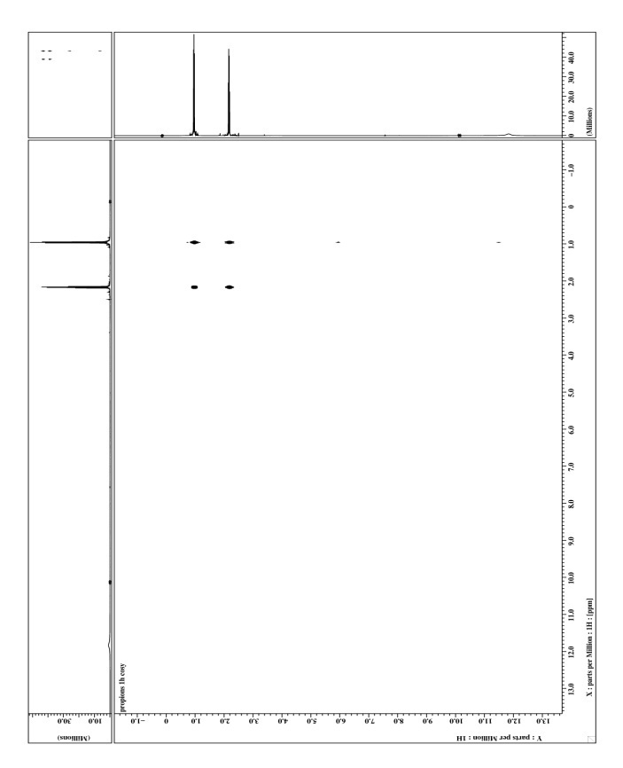
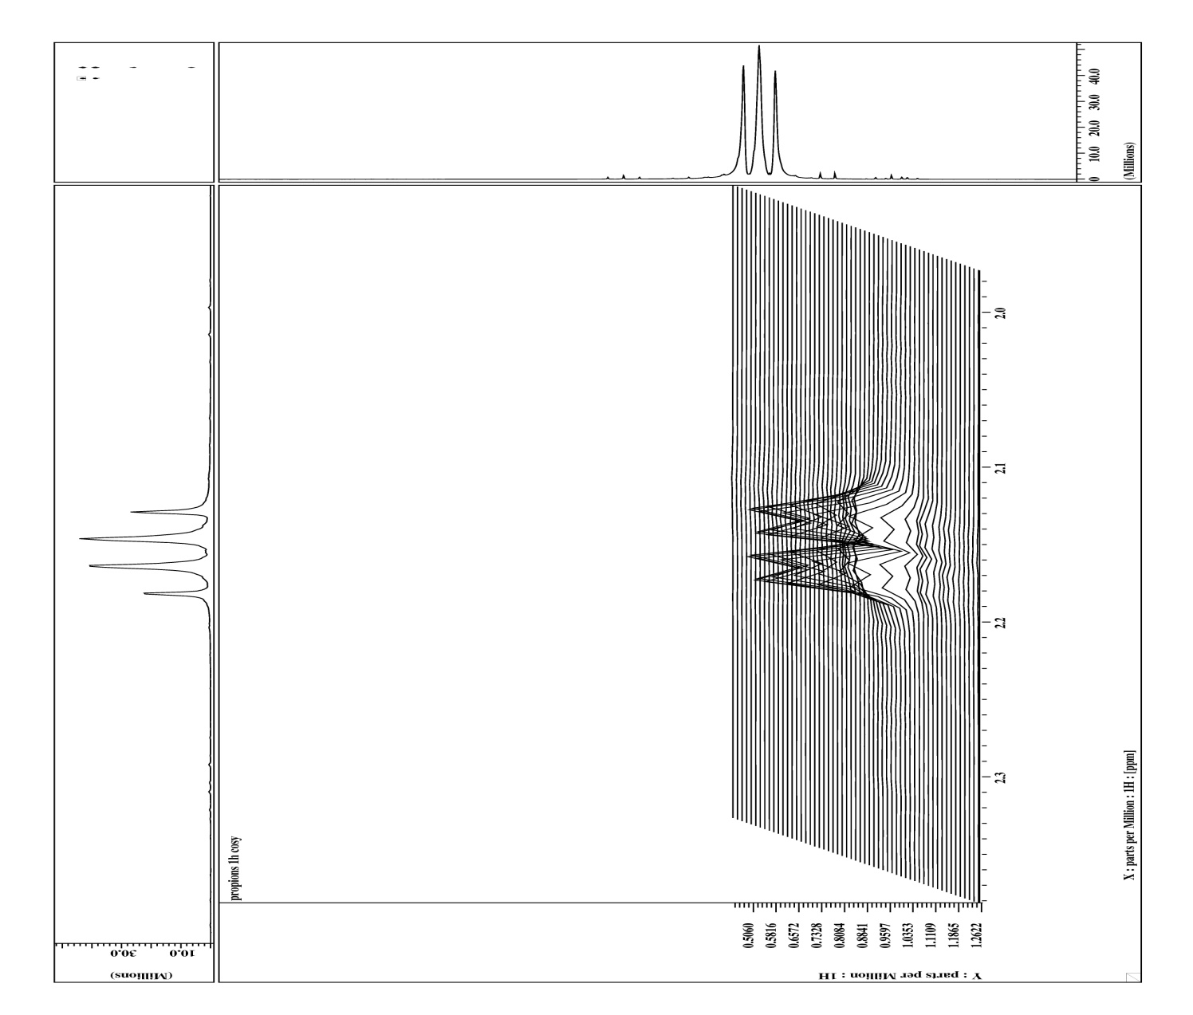
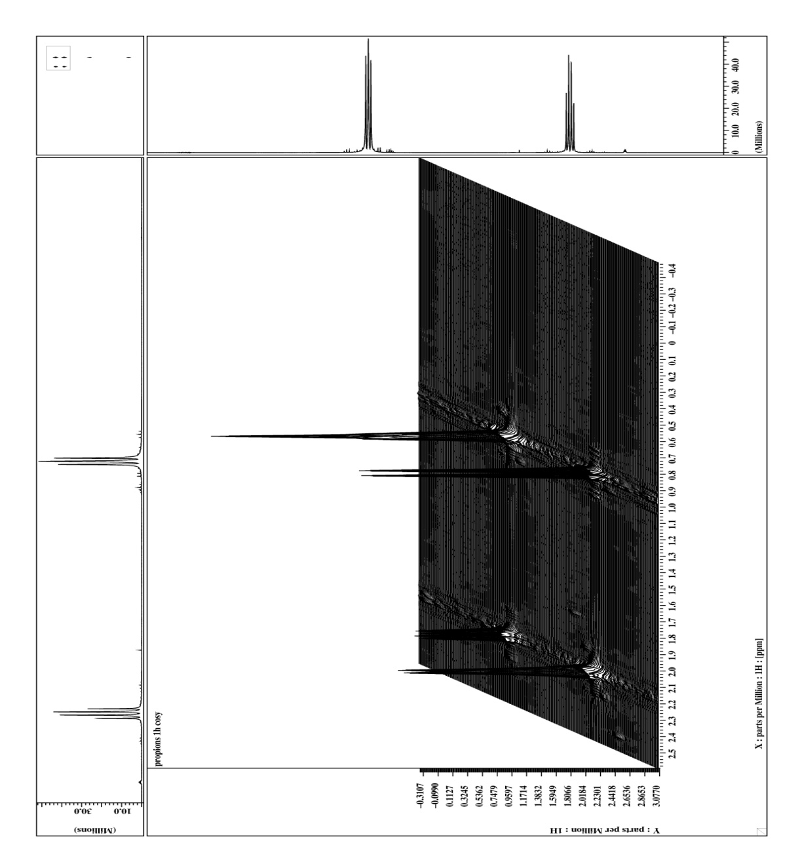
COSY- Experiment (¹H, ¹H)
COSY – Experiment (¹H, ¹H)
90°
90°
t₁ incremented
t₂ acquisition
propanoic acid

Slide 9

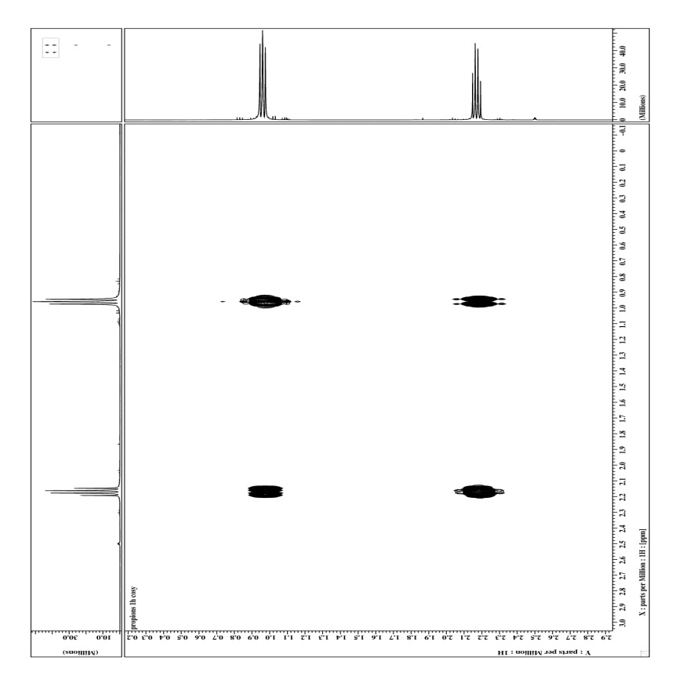
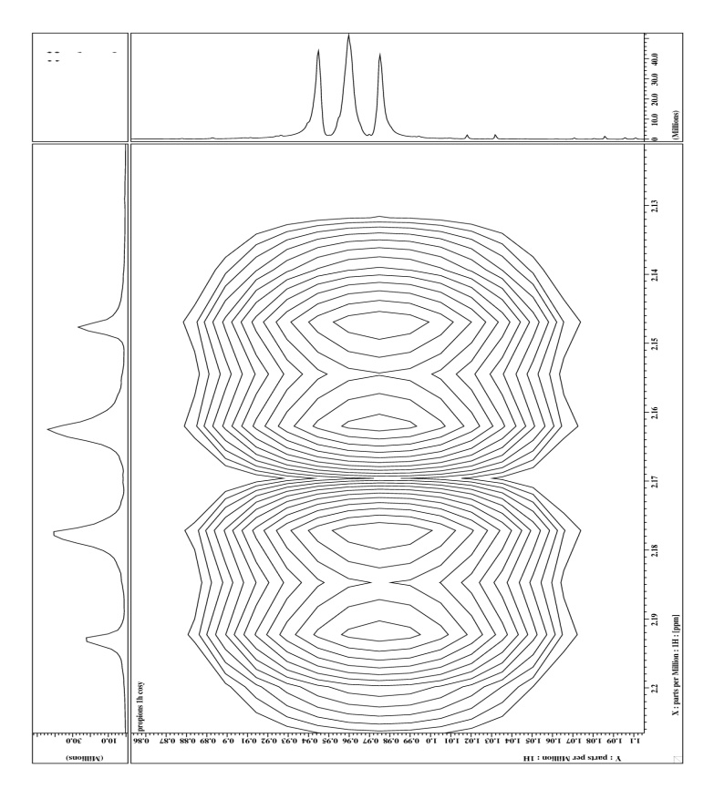
COSY Experiment Phase Cycles

Slide 10
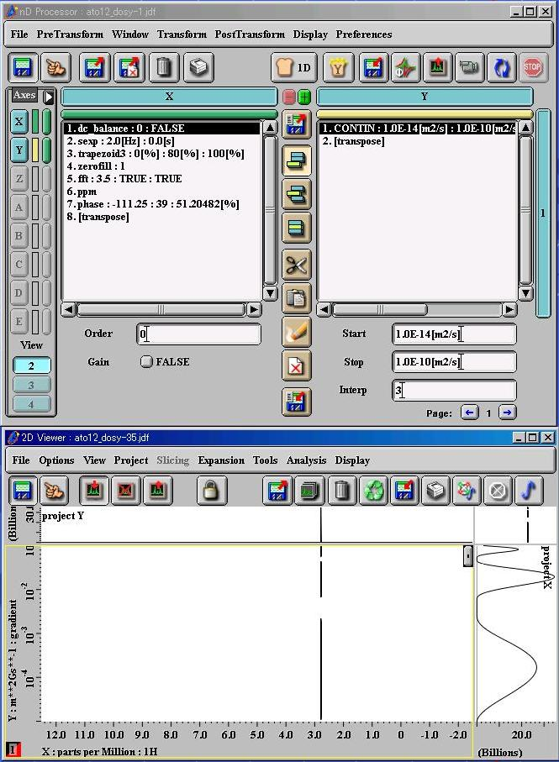
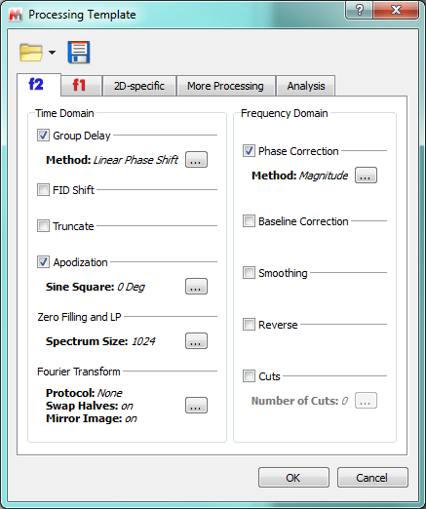
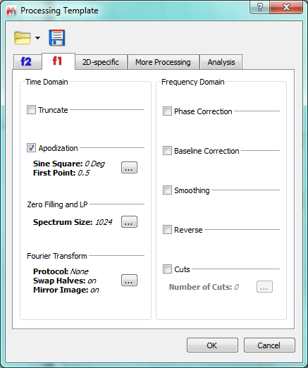
Processing
1. sinbell_auto
2. fft : 1 : TRUE : TRUE
3. ppm
4. [transpose]
1. zerofill : 2
2. sinbell_auto
3. fft : 1 : TRUE : TRUE
3. ppm
5. abs
6. thresh : 1 : 1
4. [transpose]

Slide 11
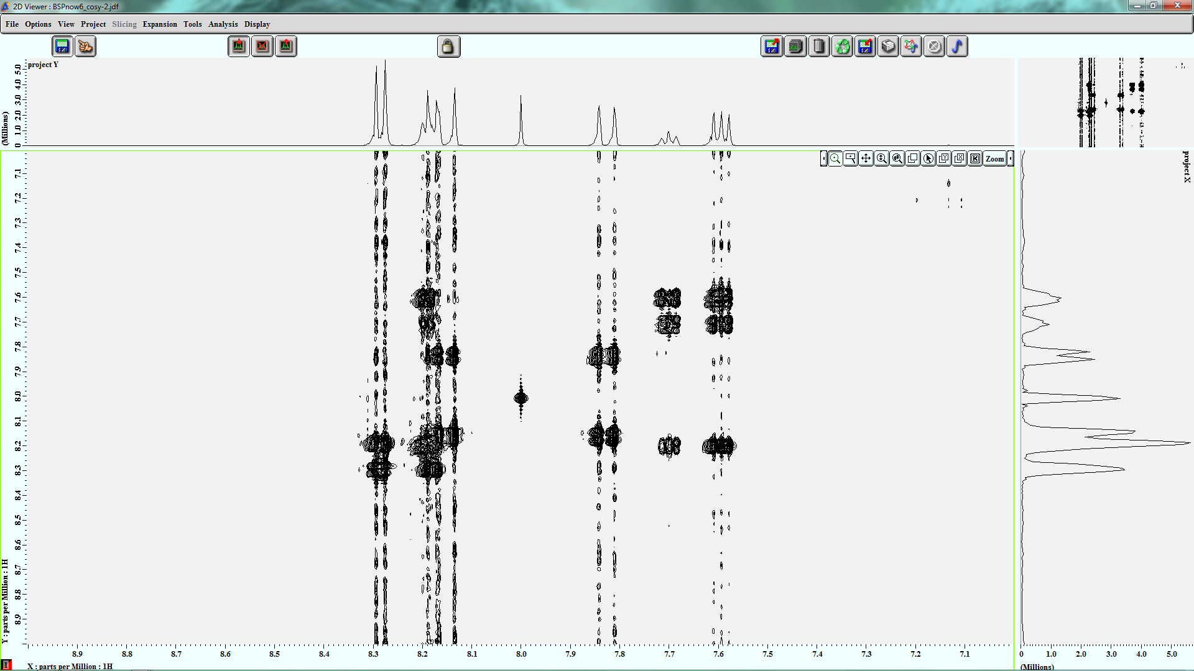
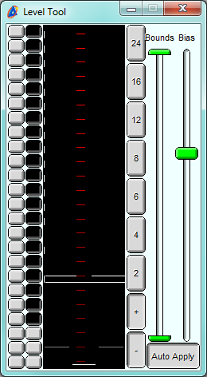
Processing
contour plot levels can be adjusted
t1 noise

Slide 12
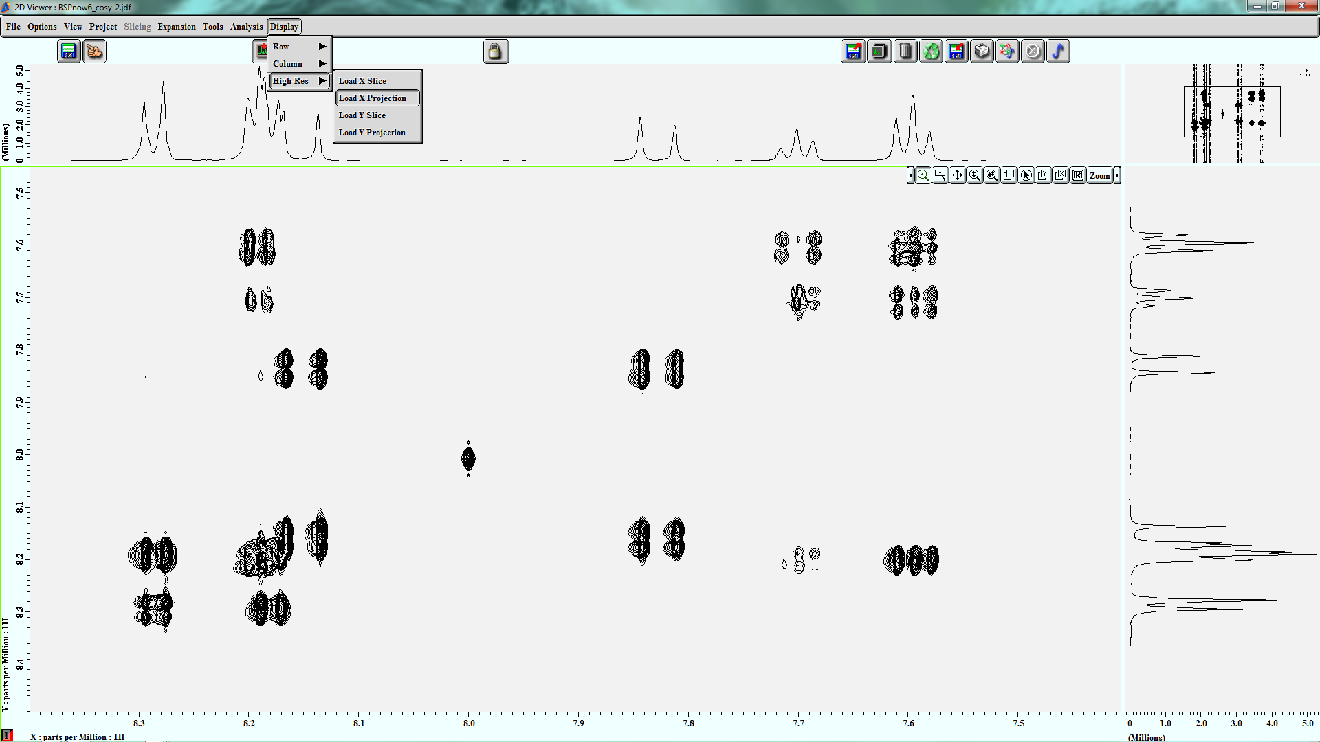
Processing
External projection can be loaded

Slide 13
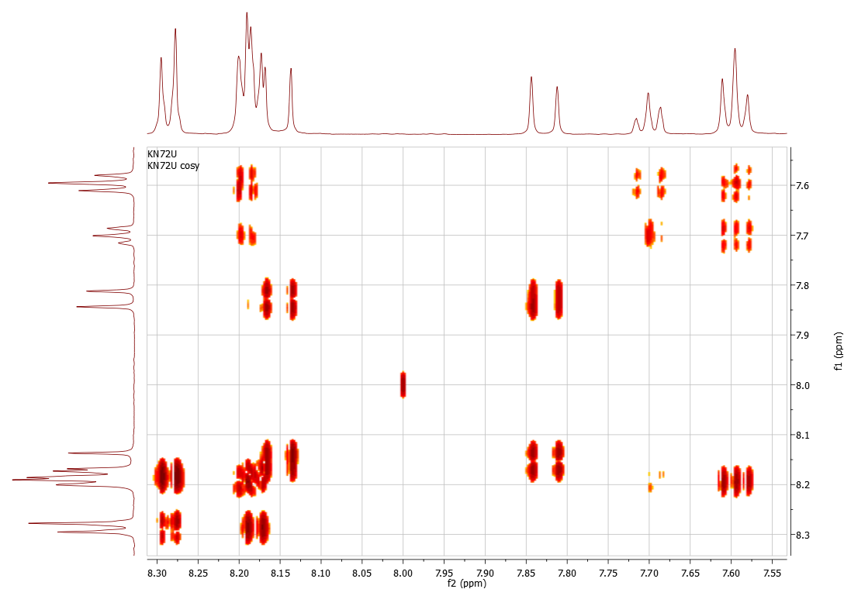
COSY Experiment

Slide 14
Processing
Resolution differ in both dimensions
Resolution better
Resolution worse
Resolution better

Slide 15
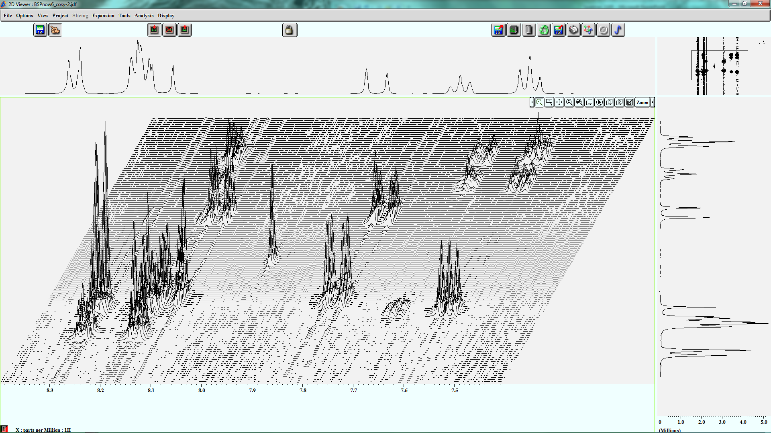
Processing
stack plot

Slide 16
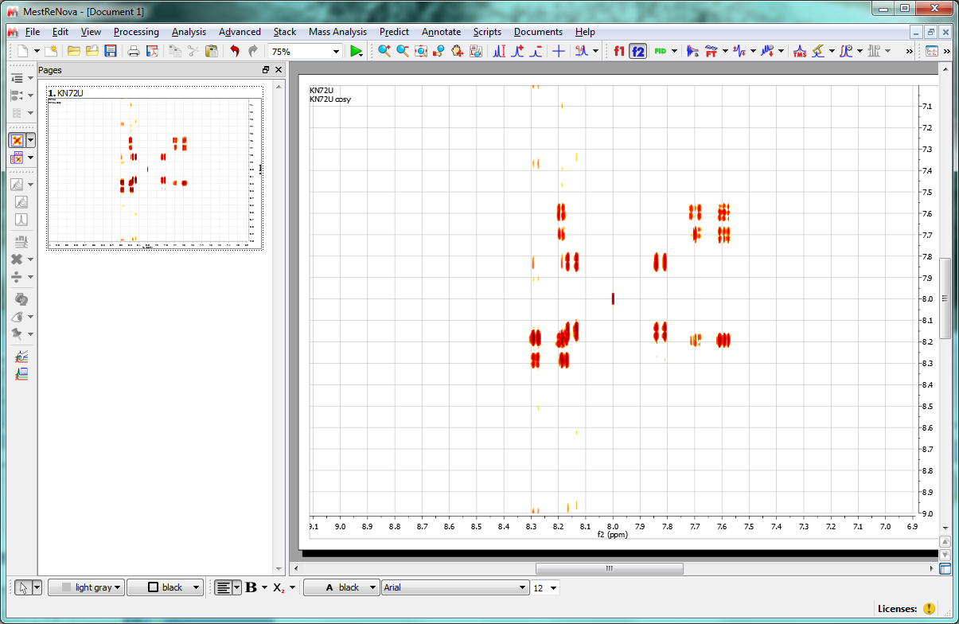
Processing
Templates can be created and stored.
different processing in both dimensions

Slide 17
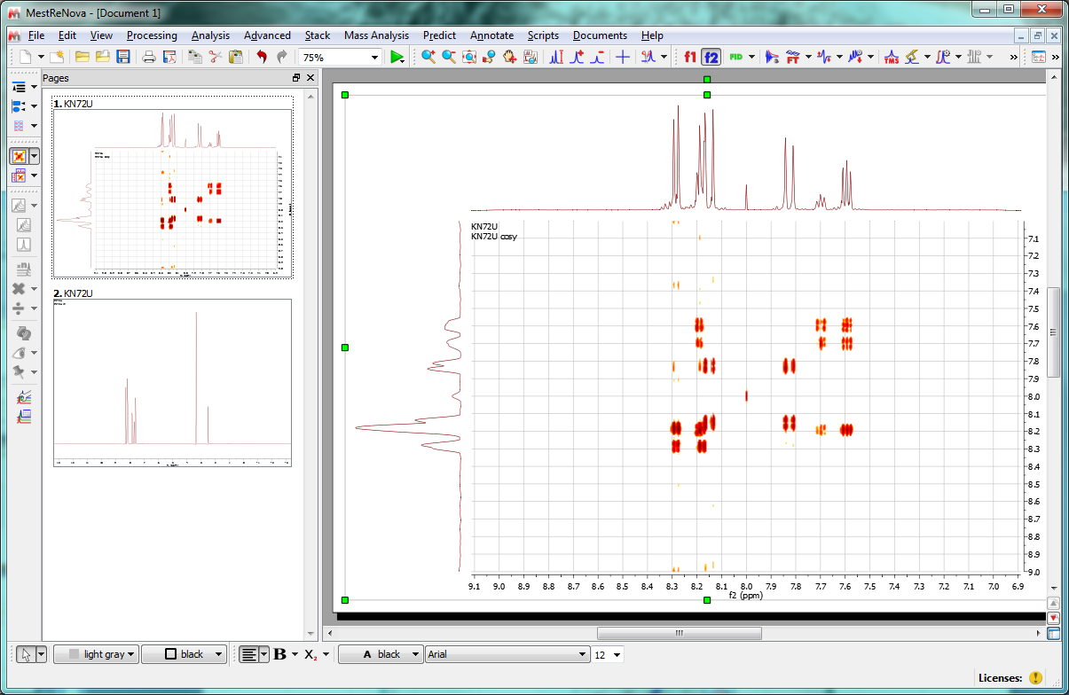
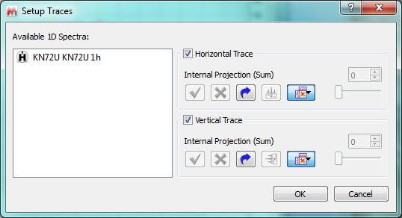
Processing
Load external projections; choose from list

Slide 18
COSY Cross Peaks
chemical shift COrrelation SpectroscopY COSY
H
H
Reveals scalar coupling network
H
90°
90°
t₁ incremented
acquistion
H
Cross peaks connect coupling protons

Slide 19
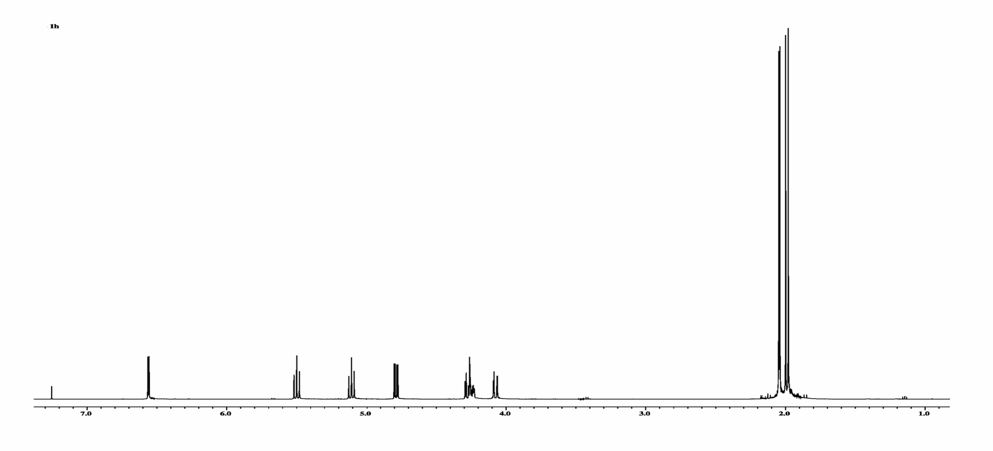
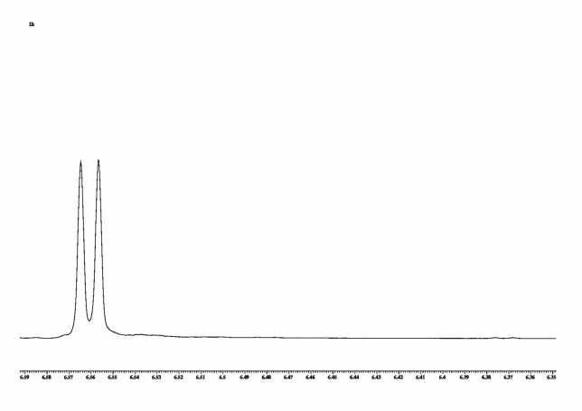
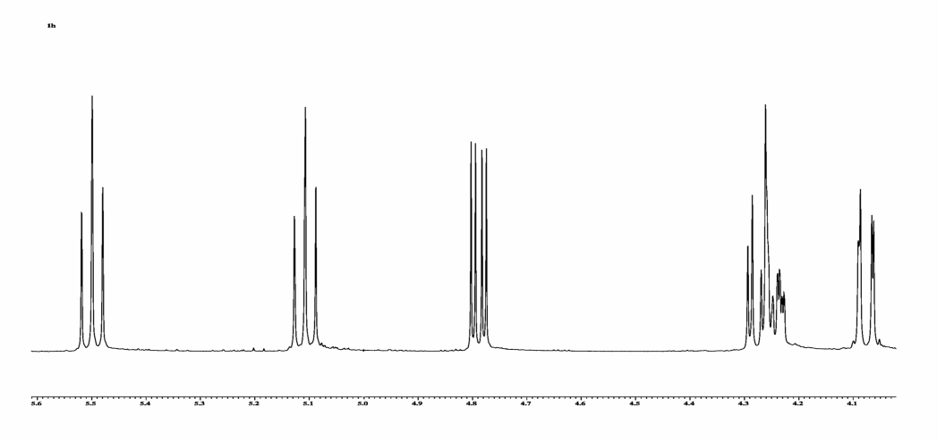
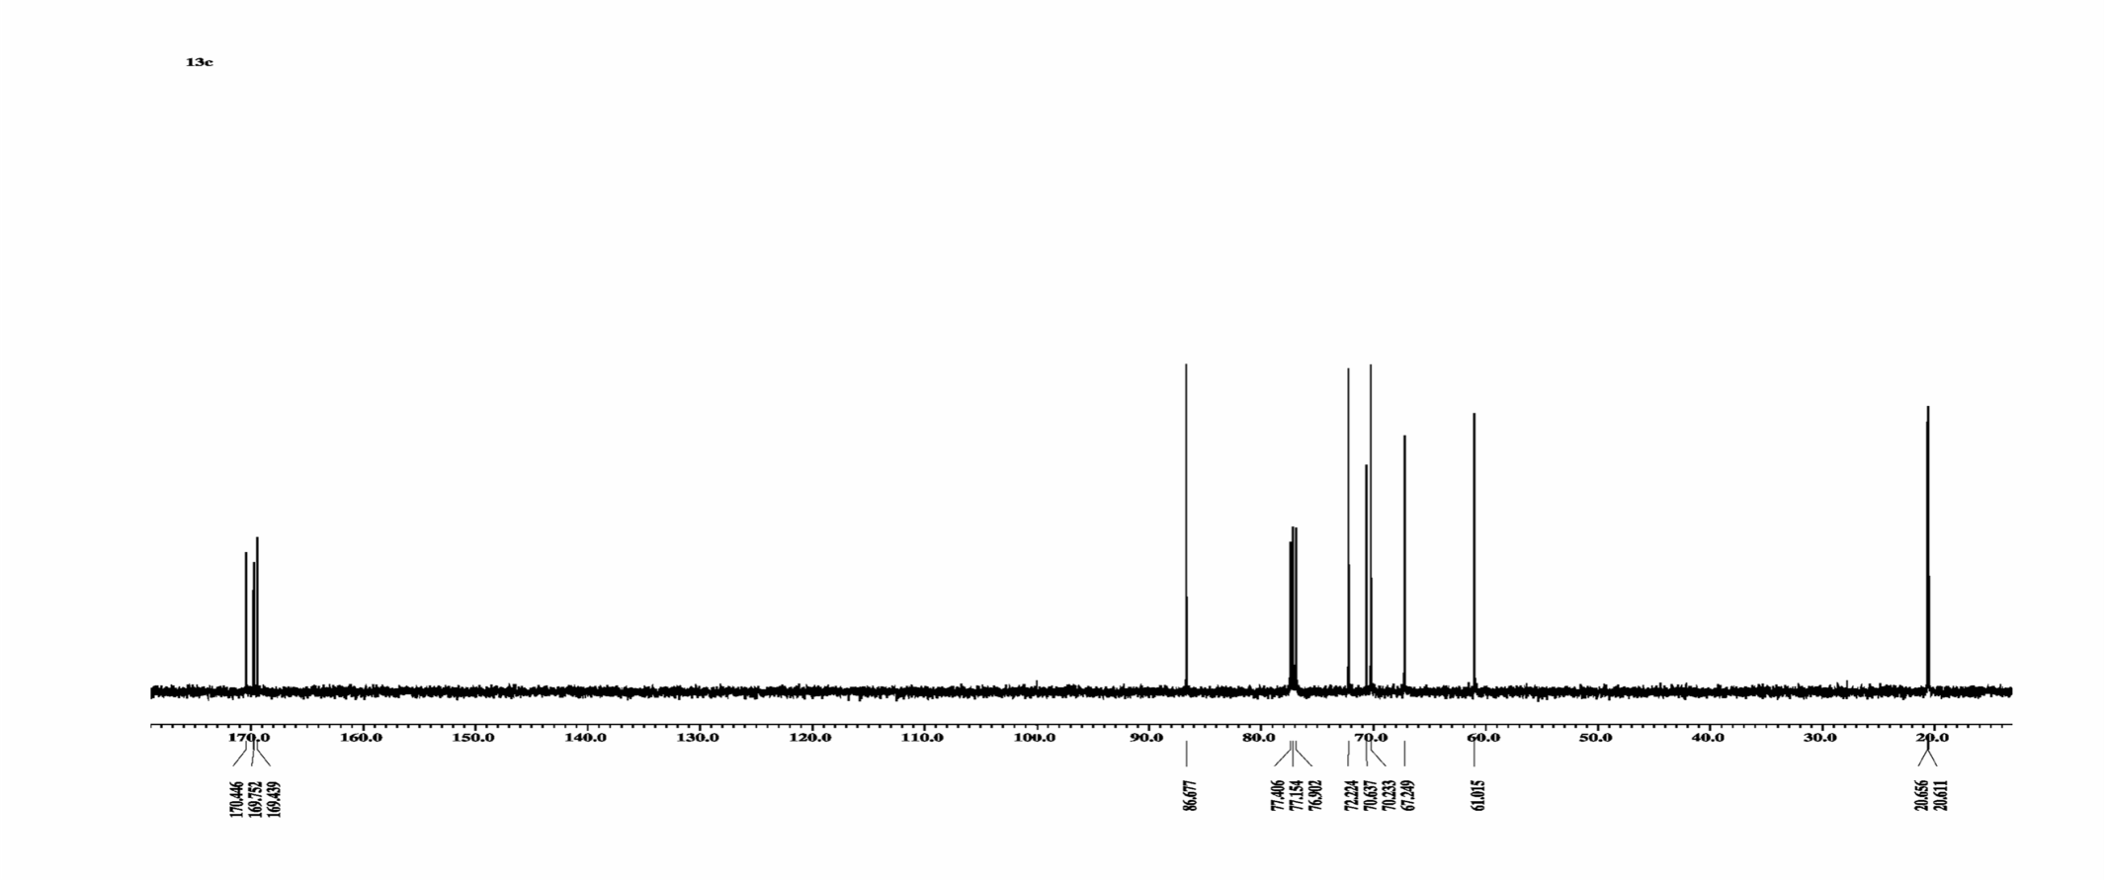
Beispiel Zuckerderivat ¹H-Spektrum
Glucose Derivative ¹H ,¹³C
4 ∗ 3
application
1
1
1
1
2
1
13C-Spectrum
4 CH
CH2
4 CH3
4 q C
CH

Slide 20
Beispiel Zuckerderivat ¹H-Spektrum
Dept Spectra
4 ∗ 3
Distortionless Enhancement by Polarisation Transfer DEPT
13C-Spectrum
4 CH
CH2
4 CH3
4 q C
CH
DEPT 135
DEPT 45
DEPT 90

Slide 21
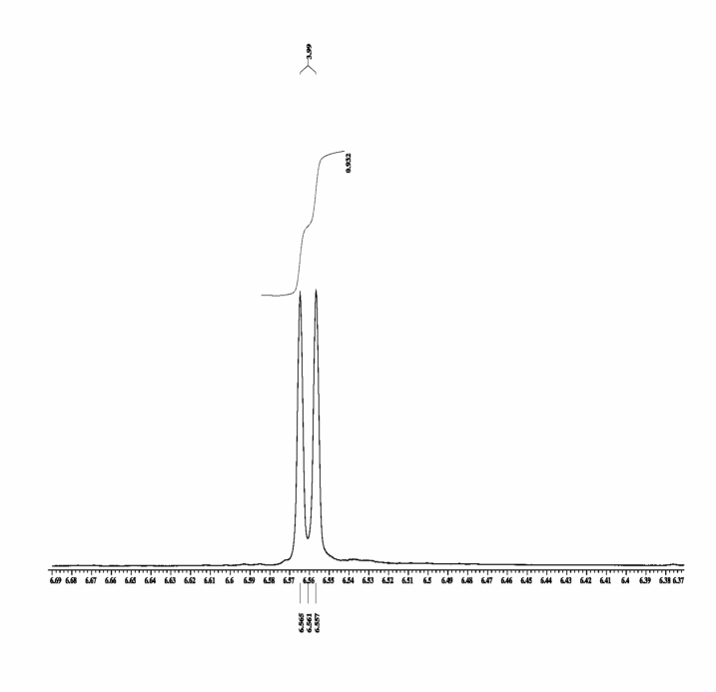
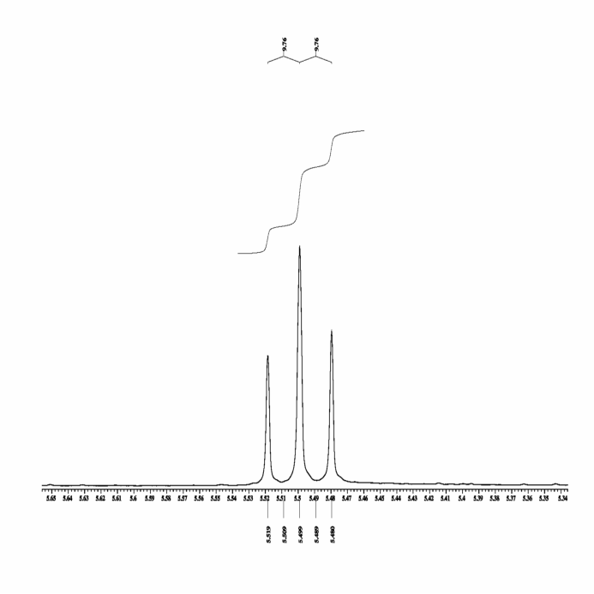
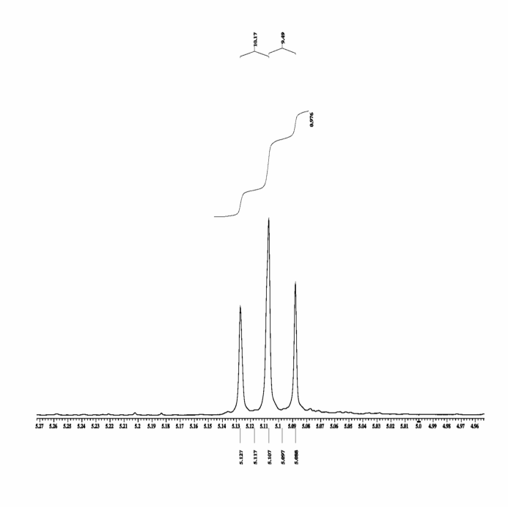
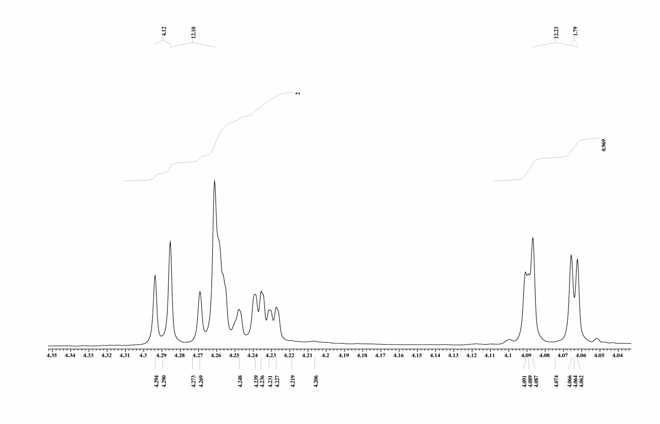
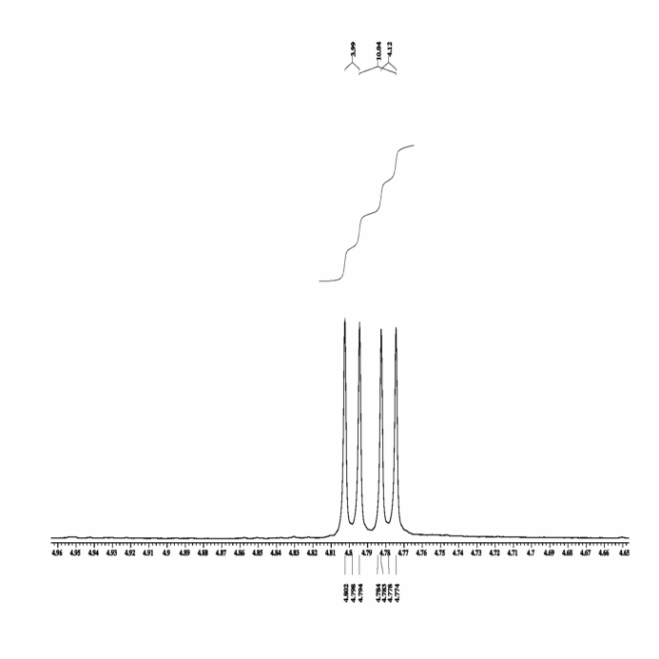
H –H Coupling Constants
Coupling partners cannot be assigned unambiguously
4.0
9.8
9.8
10.2
9.8
0.99
0.98
0.98
4.1
12.1
12.2
1.8
4.0
10.0
4.1
2.00
0.97
0.97

Slide 22
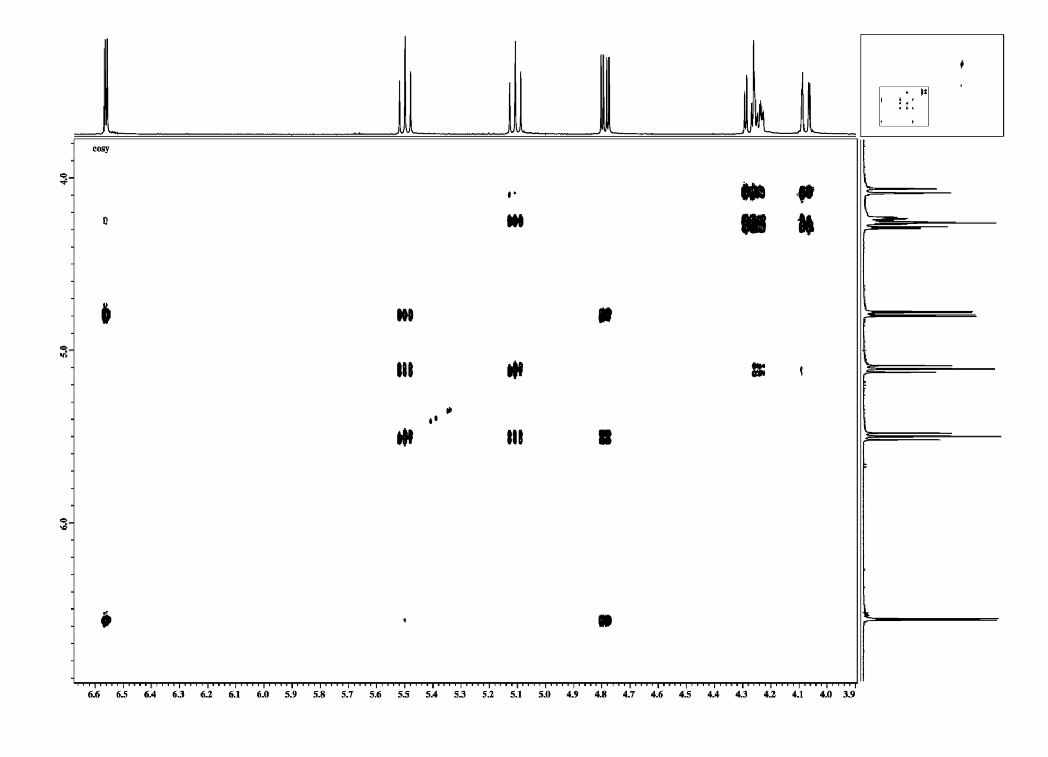
Glucose Derivative COSY
6´
O
C
H
O
C
H
O
C
H
O
C
H
O
C
H
H
C
H
O
Cross peaks indicate coupling protons.
1
2
3
4
5
6
1
3
4
2
6´
5
6
6
5
6´
2
4
3
1

Slide 23
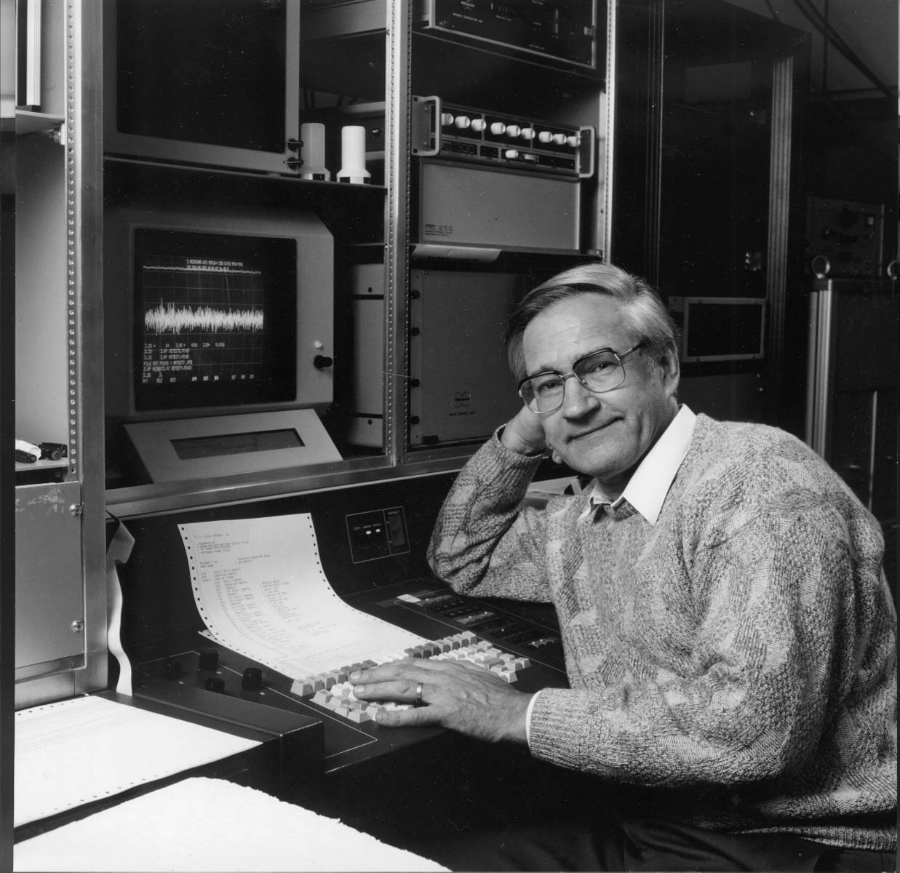
Nobel Laureate 1991
Richard Ernst Nobel laureate 1991

Slide 24
COSY
acquisition
n * dw
rf
rf
J large
J small
J too small
IzSz
− Ix
−2 IySz
2 IySz
S_{z}
I_{z}
π J t
I_{x} ( I_{x} cos π J t − I_{y} S_{z} sin π J t )
Ix

Slide 25
TOCSY
correlation spectroscopy COSY
Total correlated spectrum TOCSY
H
H
H
Echo refocuses shifts , scalar couplings remain
90°
180°
90°
180°
180°
180°
H
t₁ incremented
acquisition
H
O
H
H

Slide 26
TOCSY
correlation spectroscopy COSY
H
time dependent Schrödinger equation d/dt σ = i h [ H , σ ]
H
H
AX –approximation H _{coupl.} = J_{IS} I_{z} S_{z} + J_{SM} S_{z} M_{z}
H
I_{x} a I_{y}S_{z} , S_{y}M_{z}
O
H
90°
90°
t₁ incremented
acquisition
H
Total correlated spectrum TOCSY
90°
180°
180°
180°
180°
t₁ incremented
acquisition
Echo refocuses shifts , scalar couplings remain
AB- coupling H _{coupl.} = J_{IS} I_{z} S_{z} + J_{IS} I_{x} S_{x} + J_{IS} I_{y} S_{y} + J_{SM} S_{z} M_{z.} + J_{SM} S_{x} M_{x .}+ J_{SM} S_{y}M_{y}
I_{x} a I_{y}S_{z} a I_{y}S_{x}M_{y} a S_{z}M_{y} a M_{x}

Slide 27
Decapeptide (AG Koksch)
tyrosine
Y2
I1
N4
isoleucine
S3
asparagine
serine
P5
proline
D6
aspartate
G7
glycine
threonine
T10
T8
threonine
W9
tryptophan

Slide 28
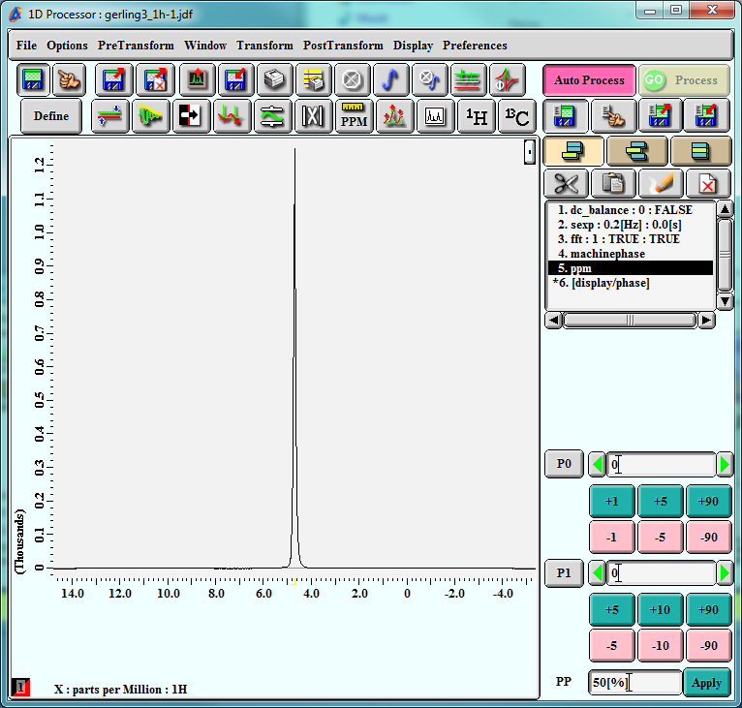
Decapeptide in 20% D2O
Native environment
NH – protons
indicate secondary structure

Slide 29
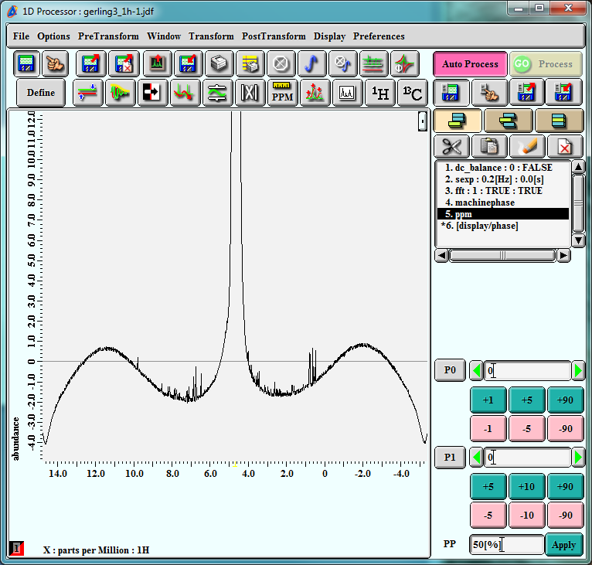
Decapeptide in 20% D2O

Slide 30
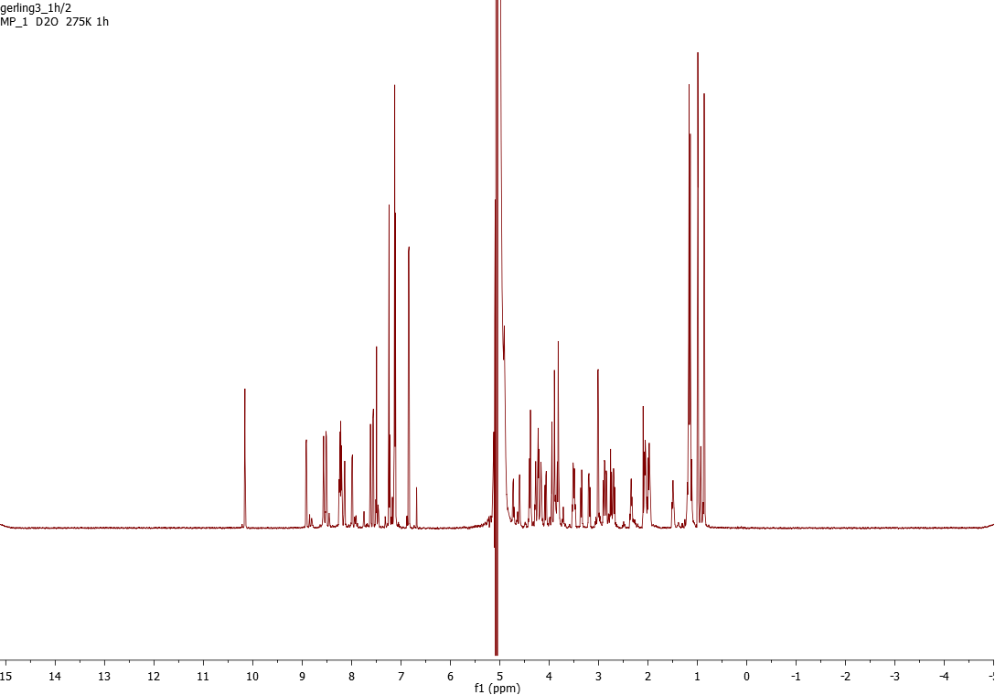
Presaturation Decapeptide in 20% D2O

Slide 31
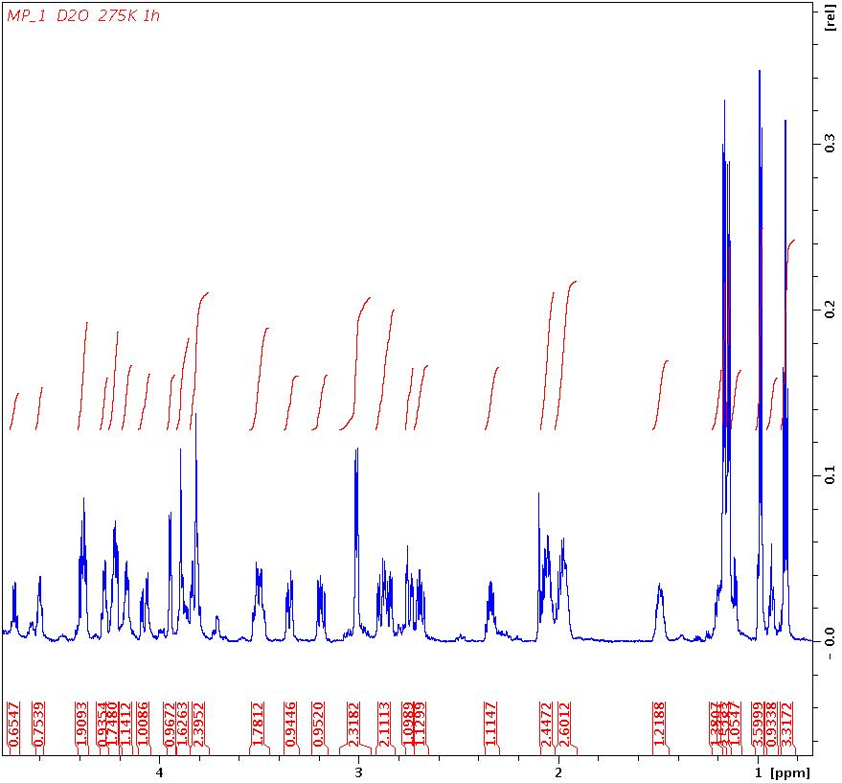
Aliphatic Region Decapeptide
P5
P5
Y2
P5
P5
P5
I1
I1
P5
G7
D6
D6
I1
I1
S3
W9
W9
N4
N4
I1
I1

Slide 32
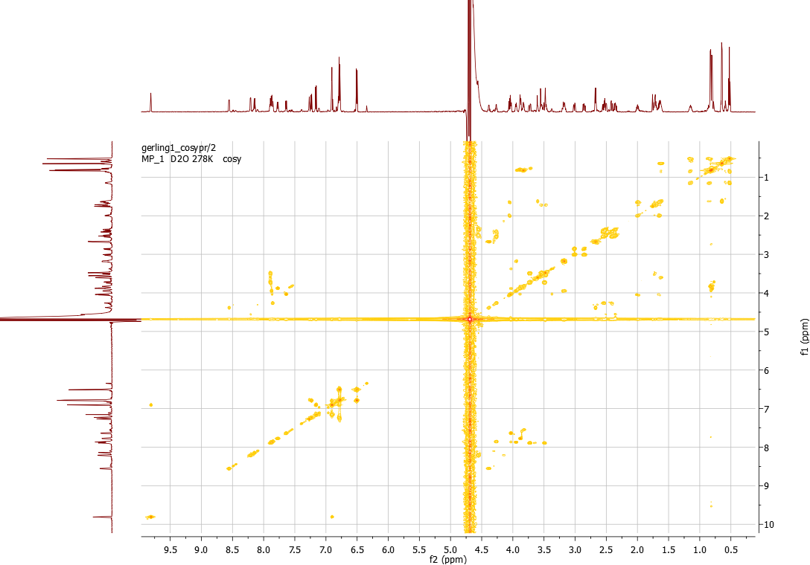
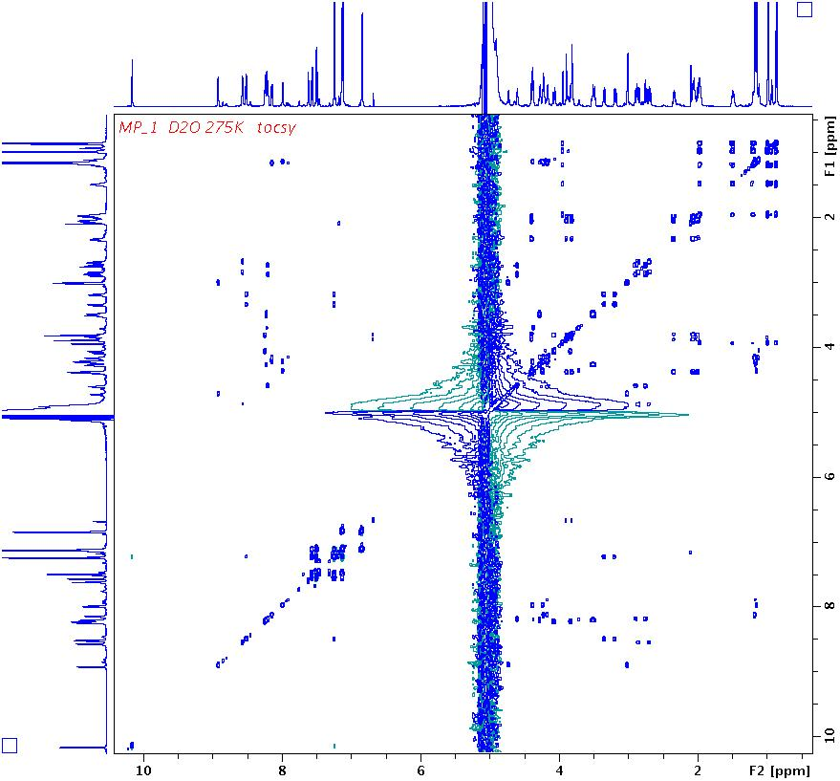
TOCSY / COSY
TOCSY
COSY
NH, CαH

Slide 33

  TOCSY 2° Amid – αHs - βHs

Slide 34
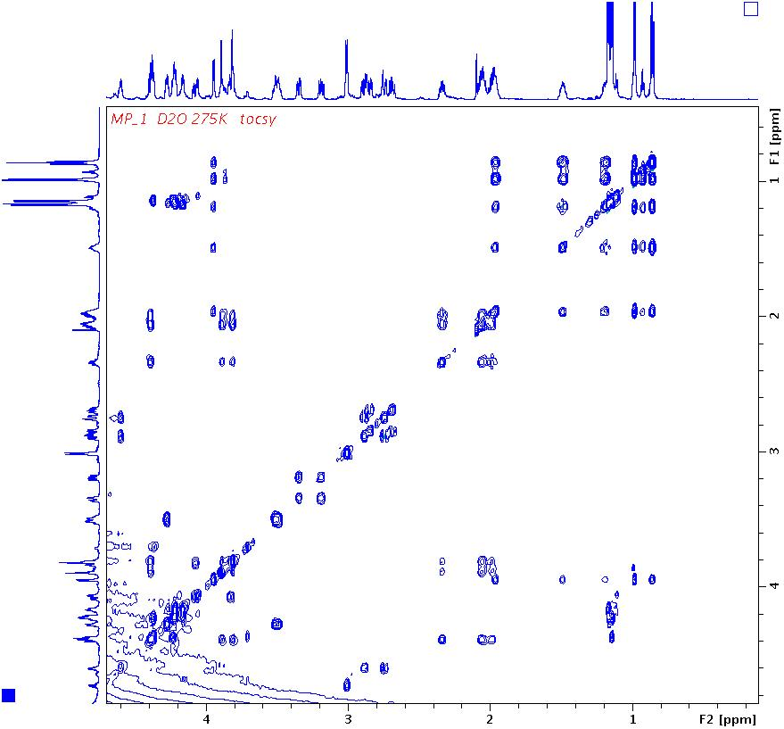

  TOCSY 2°
P5
P5
Y2
P5
P5
P5
T8,T10
I1
I1
P5
G7
D6
D6
I1
I1
S3
W9
W9
N4
N4
I1
I1
I1
I1
T8,T10
isoleucine
I1
I1
P5
D6
N4
D6
N4
threonine
Y2
G7
W9
proline
W9
S3
G7
P5
P5
P5
T8,T10

Slide 35
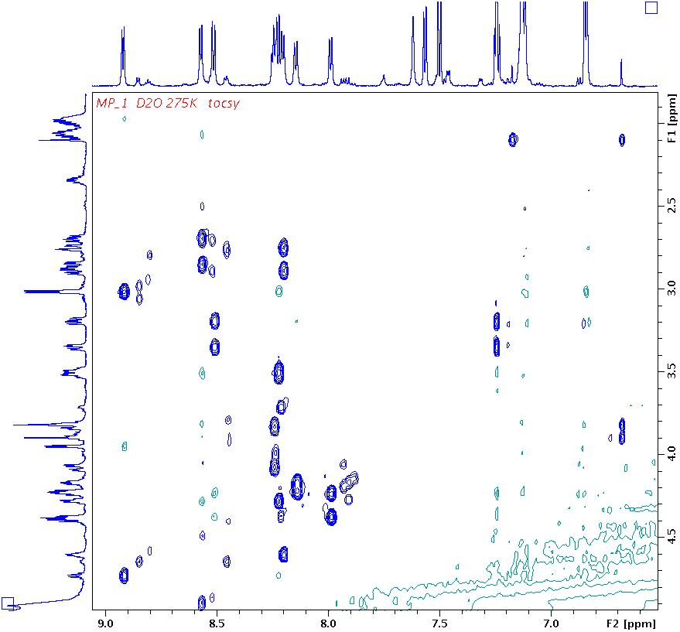
  TOCSY 2°
S3
W9
Y2
N4
W9
G7
D6
T10
T8
I1
N4
N4
D6
D6
D6
N4
N4
D6
Y2
Y2
W9
W9
W9
W9
W9
W9
S3
S3
G7
G7
G7
G7
T10
T8
T10
T10
S3
S3
T10
T8
T8
T8
D6
D6
Y2
Y2
N4
W9
N4

Slide 36
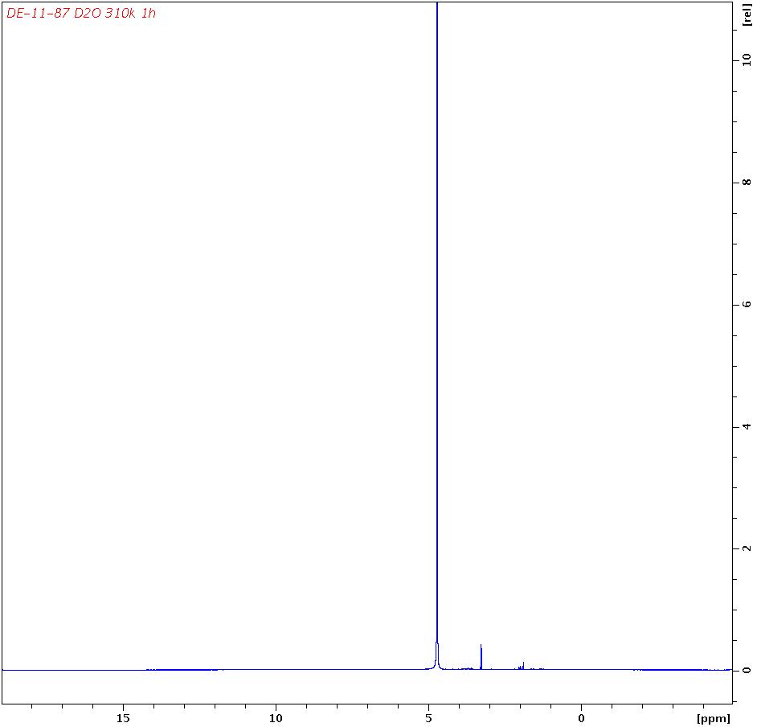
Pentasaccharide in D2O
  TOCSY 2° Amid – αHs - βHs

Slide 37
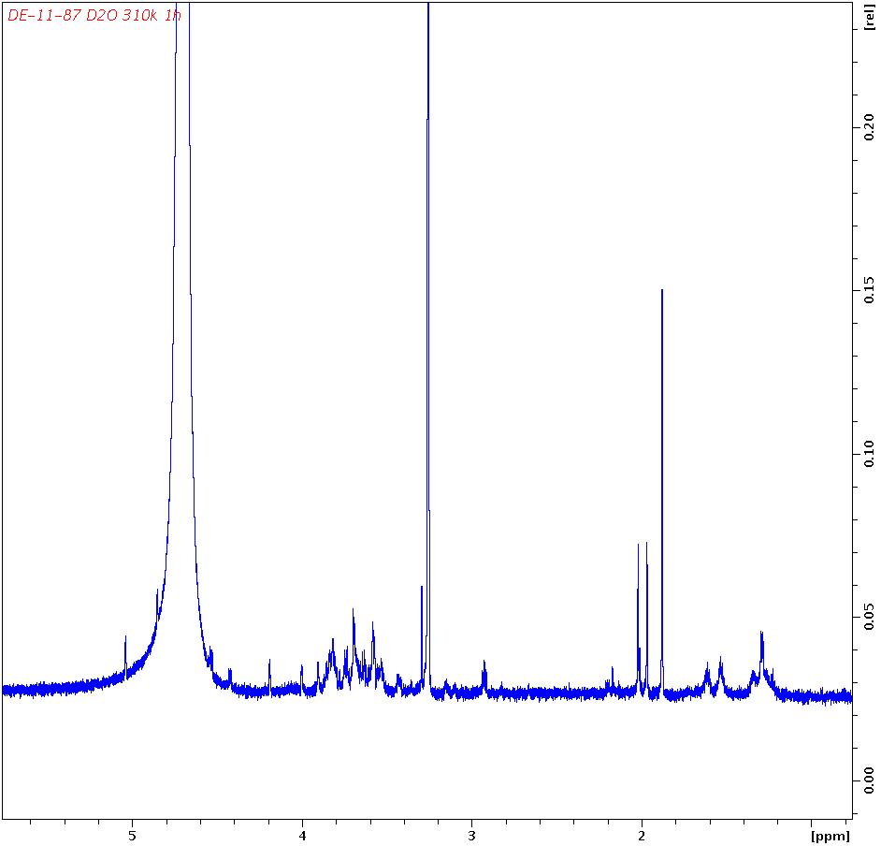
Pentasaccharide in D2O (AG Seeberger)
  TOCSY 2° Amid – αHs - βHs

Slide 38
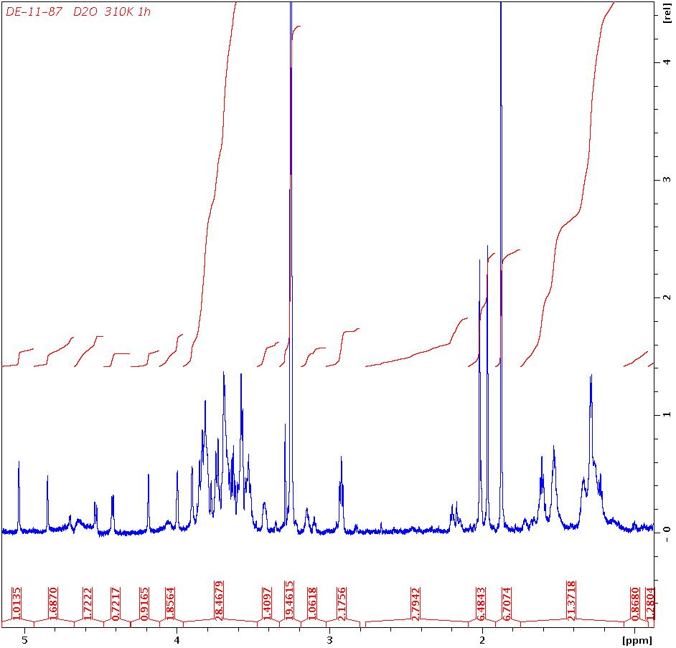
Pentasaccharide in D2O Presaturation
  TOCSY 2° Amid – αHs - βHs

Slide 39
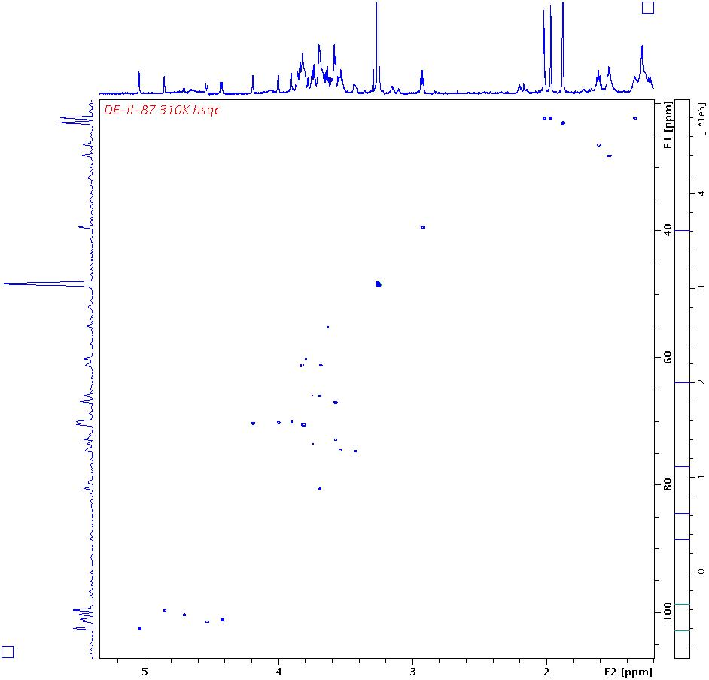
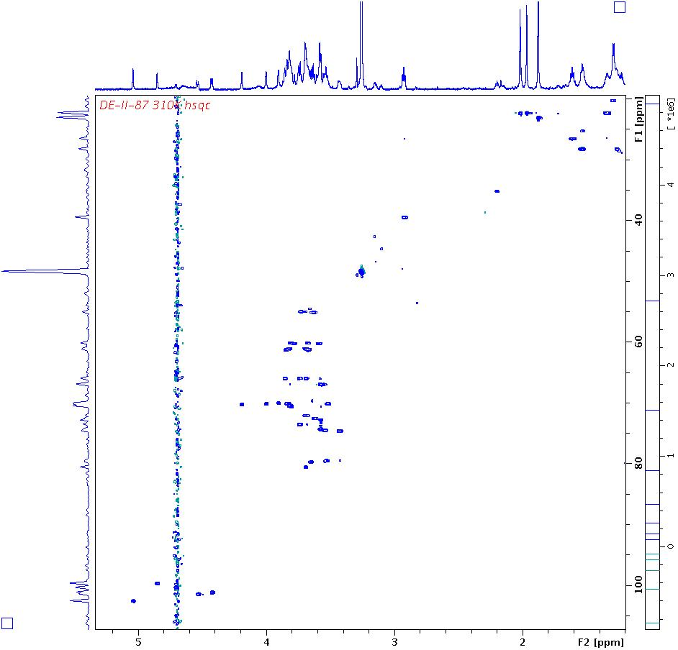
  HSQC Pentasaccharide
anomeric signals

Slide 40
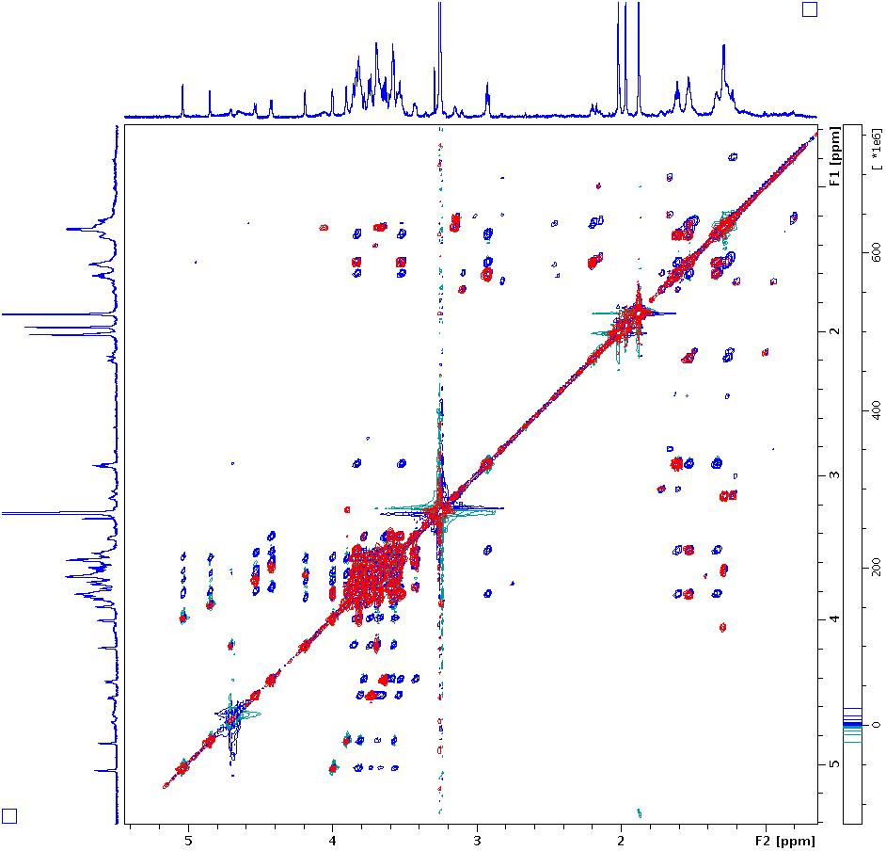
Pentasaccharide TOCSY / COSY
  TOCSY COSY
anomeric protons
carbohydrate signals

Slide 41
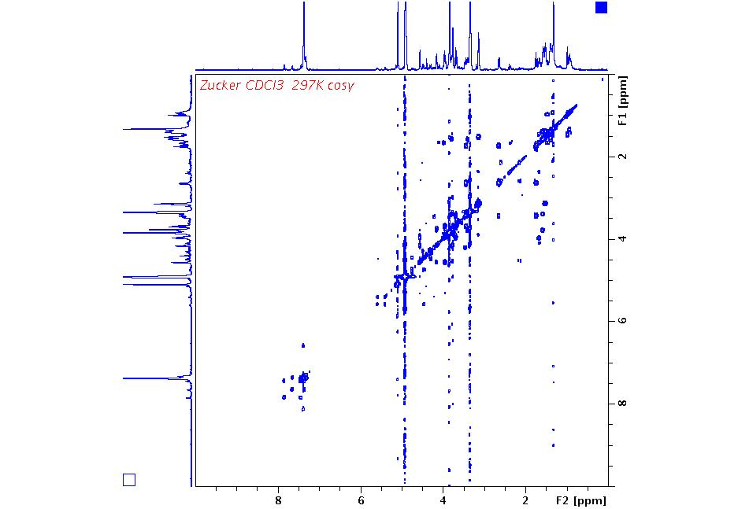

ECSY Exchange Experiment
90° y
90° y
- 90° y
t₁
t_{Mix}
t₂
DQT Experiment
90°
90°
90°
t₂
t_{Mix}
t₁
I_{x} a I_{y}S_{z} a I_{y}S_{x} a I_{y}S_{z} a I_{x}
Double quantum transitions in F1
Doppelter Spektralbereich benötigt

Slide 42




3D Experiments
Pulse sequence1
Pulse sequence2
Pulse sequence3
t₁
t₂
t₃
FT in t₂
FT in t₃

Slide 43



3D Experiments
t₁
t₂
t₃
Pulse sequence1
Pulse sequence2
Pulse sequence3

Slide 44



Unknown Sample ¹H in D₂O
in DMSO
HDO
2
¹H
1
DMSO

Slide 45





Unknown Sample ¹³C ( ¹³C -¹H Couplings)
J ca. 2 Hz
J ca. 2 Hz
J ca. 2 Hz
δ ca. 63 ppm
BB decoupled
¹³C
H
H
H
O
C
C
O
H
H
H
J ca. 140 Hz
Non decoupled

Slide 46


Glycol ¹³C ( ¹³C -¹H Couplings)
J ca. 140 Hz
J ca. 2 Hz
¹H
J ??
ca. 10 Hz
J ??
AA´BB´- System
H
H
H
O
¹³C
C
O
H
H
H

Slide 47
Sucrose ¹H (¹H-¹³C Couplings)
J ca. 167 Hz
H
CH2OH
H
HO
O
H
HO
H
OH
CH2OH
H
H
O
O
H
HO
CH2OH
OH
H

Slide 48
Sucrose ¹H (¹H-¹³C Couplings)
J ca. 167Hz
J ca. 70*2Hz
J ca. 72*2Hz

Slide 49
Sucrose ¹H (¹H-¹³C Couplings)
H
CH2OH
H
HO
O
H
HO
H
OH
CH2OH
H
H
O
O
α- anomeric C pyranoses smaller shifts larger 1J
H
HO
α- D- glucose
93.6 ppm
170 Hz
CH2OH
OH
H

Slide 50
HMQC, HMBC
Depending on the choice of J evolution delay 1/2J different correlations can be obtained.
90°
180°
1H (S)
1/2J
t₁/2
t₁/2
1/2J
acquisition
S_{z}
(population)
180 degree pulse destroys coupling in f1
90°
90°
13C (I)
I_{z}
(population)
decoupling destroys couplings in f2
ω_{13C} + ω_{1H}
ω_{13C} + - ω_{1H}
ω_{1H}
S_{x}
ω_{13C}
I_{z}S_{y} I_{z}S_{x}
coherence
S₋ coherence
exp( i ( ω_{1H} ) t₂)
exp( i ( ω_{13C} ) t₁)
I_{y}S_{y} I_{y}S_{x}
coherence
S₋I_{z} coherence
I₊S₊ I₊S₋
coherence
I₊S₋
coherence
exp( i ( ω_{13C} + ω_{1H} ) t₁/2)
*
exp( i ( ω_{13C} - ω_{1H} ) t₁/2)
= exp( i ( ω_{13C} ) t₁)
I _{x} S _{x} ( cos(ω_{13C} t₁/2) I_{x} + sin(ω_{13C} t₁/2) I _{y} ) ( cos(ω_{1H} t₁/2) S_{x} + sin(ω_{1H} t₁/2) S _{y} )
trigonometric formulas :
cos ( α +/− β ) = cos ( α ) cos( β ) −/+ sin ( α ) sin( β )
sin ( α +/− β ) = sin ( α ) cos( β ) +/− cos ( α ) sin( β )
Z-gradient
5
3
4

Slide 51
Phase Cycling (e.g.)
90°- y
180°- y
B1_{X}
B0
B1_{X}
90°- y
180°- x
B1_{Y}
B1_{Y}

Slide 52
Application Sugar Derivative COSY
6´
O
C
H
O
C
H
O
C
H
O
C
H
O
C
H
H
C
H
O
1
2
3
4
5
6
1
3
4
2
6´
5
6
6
5
6´
2
4
3
1

Slide 53


13C Spektrum
Application Sugar Derivative ¹³C Spectrum

Slide 54

HMQC- Spektrum
Application Sugar Derivative HMQC
1
3
4
2
6´
5
6
6
4
3
2
5
6´
O
C
H
O
C
H
O
C
H
O
C
H
O
C
H
H
C
H
O
1
2
3
4
5
6
1
3
86 ppm
1

Slide 55
HMQC, HMBC (HSQC)
Heteronuclear Multiple Quantum Correlation HMQC
Heteronuclear Multiple Bond Correlation HMBC
( Heteronuclear Single Quantum Correlation HSQC )
Correlation of heteronuclear shifts
90°
180°
1H
1/2J
t₁/2
t₁/2
1/2J
acquisition
t₁ incremented
90°
90°
13C
decoupling
HMQC,HSQC
J = 120 – 160 (250) Hz ¹J Couplings
H
H
H
H
O
HMBC
J = 2 - 8 (20) Hz ²⁻⁵ J Couplings

Slide 56

HMBC- Spektrum
Application Sugar Derivative HMBC
1
3
4
2
6´
5
6
3J (4,6)
1J (6‘,6)
1J (6,6)
6
4J (1,4)
2J (3,4)
3J (6´,4)
3J (6,4)
4
3J (1,3)
1J (3,3)
2J (4,3)
2J (2,3)
3
2J (1,2)
2J (3,2)
2
1J (2,2)
5
2J (4,5)
1J (5,5)
2J (6,5)
3J (3,1)
2J (2,1)
1
1J (1,1)
6
5
1
4
2
3

Slide 57



HMBC
Me6
Me2
Me4
Me3
3
4
2
6´
5
6
6
COO4
4
COO2
3
COO3
2
COO6
Me2
Me6
Me4
Me3
Me6
COO6
6
Me4
COO4
COO2
COO4
4
3
2
COO3
COO2
COO6
Me3
COO3
Me2

Slide 58
Application Sugar Derivative HMQC
Data base prediction yields an suggestion for the remaining residue.
20.7 20.6
170 169
61.0
72.2
86.8
67.2
70.2
70.6
4.28 4.08
6.96
4.23
5.11
5.50
4.79

Slide 59
HMQC, HMBC
Depending on the choice of J evolution delay 1/2J different correlations can be obtained.
90°
180°
1H
1/2J
t₁/2
t₁/2
1/2J
J = 120 – 160 (250) Hz
¹J couplings
acquisition
180 degree pulse destroys coupling in f1
H
H
90°
90°
H
13C
H
O
decoupling off
decoupling
ω_{13C} + ω_{1H}
ω_{13C} + - ω_{1H}
ω_{1h}
J = 2 - 8 (20) Hz
²⁻⁵ J couplings
ω_{13C}
Couplings in f2 can be made visible by leaving the 13C decoupler off all the time
¹³C decoupling
¹³C decoupling switched off

Slide 60

Glycol HMBC non decoupled D2O
¹H
¹³C
J ca. 140 Hz
J ??
ca. 10 Hz
J ??
J ca. 2 Hz
H
H
H
O
¹³C
C
O
H
H
H

Slide 61



¹³C – 1H Kopplungen
anomeric C pyranoses 150 - 180 Hz axial OH -> larger 1J
a- D-glucose
b- D-glucose
170 Hz
161 Hz
146 Hz
145 Hz
178Hz 97 ppm
155 Hz 100 ppm

Slide 62
HSQC (2D Hetero Nuclear Correlation)
Heteronuclear Single Quantum Correlation HSQC
90°
180°
90°
180°
90°
180°
1H (I)
1/2J
1/2J
t₁/2
t₁/2
1/2J
1/2J
acquisition
180°
90°
t₁ incremented
90°
180°
13C (S)
decoupling
I_{z} , S_{z}
I_{x} ,S_{z}
I_{x} , I_{y}, I_{y}S_{z},S_{z}
I_{x} , I_{y}S_{z}, S_{z}
I_{x} , I_{z}S_{y}, S_{y}
I_{x} , I_{z}S_{x}, S_{y}, S_{x}
I_{x} , I_{z}S_{x}, S_{x}
I_{x} , I_{z}S_{y}, S_{y}
I_{z} , I_{x}S_{z}, S_{z}
I_{z} , I_{y}, S_{z}
B₀ evolution t₁
Δω_{carbon} t
B₀ evolution t₂
Δω_{proton} t
Z-gradient
4
1
J = 120 – 160 (250) Hz ¹J Couplings, 2-8 Hz ^{2,3}J Couplings

Slide 63





Glucosamine Derivative CDCl3
¹⁸
¹
⁶
²
³
⁴
⁷

Slide 64





HSQC without Decoupling
acq
acq
acq
dec
dec

Slide 65
HMQC Cross peaks in case of an AB System
Inner lines belong to both nuclei
H
H
H
H
C
C
C
C

Slide 66


NM00160206B in DMSO
D₂O
CDCl₃

Slide 67



NM00160206B in DMSO
D₂O
CDCl₃

Slide 68
Elucidating the Carbon Scaffold
H H H H H H H H H
C-C Corrrelation
| | | | | | | | |
C ----------C----------C----------C----------C----------C----------C----------C----------O---------C----------C
| | | | | |
H H C C----H
Correlation of heteronuclear shifts
H H H H H H H H H
H-H Corrrelation
| | | | | | | | |
C ----------C----------C----------C----------C----------C----------C----------C----------O---------C----------C
| | | | | |
H H C C----H
H H H H H H H H H
HMQC/HSQC
| | | | | | | | |
C ----------C----------C----------C----------C----------C----------C----------C----------O---------C----------C
| | | | | |
H H C C----H
H H H H H H H H
HMBC
| | | | | | | | |
C ----------C----------C----------C----------C----------C----------C----------C----------O---------C----------C
| | | | | |
H H C C----H H
Hetero nuclear skeleton

Slide 69



Glucosamine Derivative CDCl3
⁴
⁷
¹⁷
^{17 Me}
J NH ca. 100 Hz
J ca. 8 Hz
^{7 NH}
^{4 H „anomeric“}

Slide 70



Glucosamine Derivative CDCl3
¹⁸
¹
⁶
²
³
⁴
⁷
-O-CH2-Ph 3x

Slide 71


Glucosamine Derivative CDCl3
¹⁸
¹
⁶
²
³
⁴
⁷
¹⁷

Slide 72

HMBC Glucosamine Derivative
¹⁸
¹
¹⁶
²
³
⁴
⁷
¹⁴

Slide 73


HMBC Glucosamine Derivative
¹
¹⁸
⁶
¹²
²
³
⁴
¹¹
¹³
⁷
¹⁴
¹⁶
¹⁵
¹⁷
12
13
3J 12-11
3J 17-13
3J 17-14
3J 12-14
3J 17-14

Slide 74

HMBC Glucosamine Derivative
12
13
3J 12-11
¹
¹⁸
⁶
¹²
3J 17-13
²
³
⁴
¹¹
¹³
⁷
¹⁴
¹⁶
¹⁵
¹⁷
3J 17-14
3J 12-14
3J 17-14

Slide 75


HSQC

Slide 76



HSQC

Slide 77

Edited HSQC.
¹³C
J ca. 140 Hz
CH3
CH3
CH3
CH3
J ca. 2 Hz
Cross peaks originating from CH and CH3 groups have opposite sign than those arising from CH2 carbons.
CH2
CH

Slide 78

Edited HSQC
-OH
CH3-CN
MeOD D2
CH3
CH3
CH3
CH3
CH2
CH3
CH3
CH2
CH
CH2
CH2
CH

Slide 79

Polysaccharide AV500
ΝHAc
CH2-chain
CH2-chain
H2NCH2-chain
H2NCH2-chain
CHNHAc
CH2OH
CH2OH
ΟCH2-CH
OCH2R
OCH
OCH
αCH
αCH
βCH
βCH

Slide 80

Polysaccharide AV500
ΝHAc
CH2-chain
CH2-chain
H2NCH2-chain
H2NCH2-chain
CHNHAc
CH2OH
CH2OH
13C exp. time 3h
ΟCH2-CH
OCH2R
OCH
OCH
αCH
αCH
βCH
βCH

Slide 81

Edited HSQC Polysaccharide AV500
exp. time 1h
ΝHAc

Slide 82

Edited HSQC Polysaccharide AV500
CH2OH
CH2OH
ΟCH2-CH
OCH2R
OCH
OCH2R
OCH

Slide 83

Edited HSQC Polysaccharide AV500
αCH
αCH
βCH
βCH

Slide 84



HMQC / HETCORR
There exists a method for direct observation of C-H correlations as well.
HMQC
90°
180°
Advantage:
S/n 8times better
1H
1/2J
t₁/2
t₁/2
1/2J
acquisition
90°
90°
13C
Draw back:
Central lines (99%) have to be suppressed
HETCORR
decoupling
180°
90°
t₁/2
t₁/2
1/2J
1/3J
acquisition
13C
90°
90°
1H
decoupling

Slide 85

HMQC / HETCORR
Cyclosporine (ciclosporin)

Slide 86
Cyclosporine HMQC and HETCORR
180°
90°
t₁/2
t₁/2
1/2J
1/3J
acquisition
13C
90°
90°
1H
decoupling
13C in f2
1H in f2
13C in f1
1H in f1
HETCORR
HMQC

Slide 87
HMQC-HMBC vs. HETCORR
1/3J
Intensity of 2 1H signals
Intensity of 1 13C signal
Intensity of 1 13C signal
Intensity of 1 13C signal
Intensity of 2 1H signals
Intensity of 2 1H signals
7.5
7.0
190
60
40
190
60
40
7.0
7.5
HMBC
HETCORR

Slide 88

Sucrose HETCORR J=140Hz
1
5
3
4
3
5
2
4
6
1
6
H
CH2OH
4
6
H
HO
5
3
2
1
H
HO
H
OH
CH2OH
H
1
O
O
H
2
H
5
HO
3
4
6
CH2OH
1
OH
H

Slide 89

Sucrose HETCORR J=4Hz
2
1
5
3
5
3
4
2
4
6
1
6
2
4
1
2,1
3,1,1´
1,1,1´
3
6
6
5
5,6
5
3,4
4
5,4
4,4
6,4
3
4,3
1,3
H
CH2OH
3,3
4
6
H
HO
5
3
2
1
H
HO
6OH
H
OH
CH2OH
6OH
H
1
3OH
O
O
H
2,3OH
2
H
5
3OH
HO
4OH
2,1OH
3
4
1,1OH
1OH
6
CH2OH
2OH
1,2OH
OH
H
2,2OH
1
2,1
3,1
4OH
5,4OH

Slide 90
HMQC / HETCORR
H
CH2OH
4
6
H
HO
5
3
2
1
H
HO
H
OH
CH2OH
H
1
O
O
H
2
H
5
HO
3
4
6
CH2OH
OH
H

Slide 91
HMBC / HETCORR
H
CH2OH
O
4
6
H
HO
5
3
2
1
H
HO
H
OH
CH2OH
H
1
O
O
H
2
H
5
HO
3
4
6
CH2OH
OH
H

Slide 92
1⁵N- ¹H- Korrelation
Η−Ν
Η−Ν
Η−Ν
Η−Ν
Η−Ν
Η−Ν
Η−Ν
Η−Ν
Η−Ν
Η−Ν
Η−Ν
Η
Η
Ν
Η
Η

Slide 93




¹⁵N- ¹H- Korrelation
¹⁵N- ¹H- Correlation
1H in f2
15N in f1

Slide 94

Peptide ¹⁵N- ¹H- Correlation HSQC
amide region
1H in f2
15N in f1
back folded signals

Slide 95

¹⁵N- ¹H- Korrelation
Peptide ¹³C- ¹H- Correlation
aliphatic residue region
1H in f2
13C in f1

Slide 96


Noble Laureate 2002
Kurt Wüthrich

Slide 97


¹H- ¹⁹F- HMBC / ¹⁹F- ¹H- HMBC
CF3
CH3
CH2
¹H
¹⁹F
CF2
CH3
¹⁹F
only 1H-1Hcouplings
¹H
CH2
CF3
only 19F-19F couplings
19F -1H Cosy would not work comparably. Due to the vast spectral range of 19F only a short dwell time can be used. Therefore the evolution period (t1) will be too short (compared to 1/J(1H19F) to generate cross peaks.

Slide 98
³¹P- ¹³C- Couplings
8 Hz
³¹P
6.3 Hz
7.7 Hz
¹³C
Notes:
p31tst /z/data/schaefer/nmr

Slide 99
³¹P- ¹³C- HMQC
³¹P -¹³C HMQC

Slide 100
¹³C- ¹³C- Couplings
1J CC sp-sp 150-180 Hz sp2-sp 80 – 130 Hz sp3-sp, sp2-sp2 50 -80
sp3–sp3 35-50 Hz
13C satellites
13C satellites
50-60 Hz
34Hz
¹³C
I

Slide 101
1D Inadequate ¹³C- ¹³C Couplings
Incredible Natural Abundance Double Quantum Transition Experiment
equimolar mixture of ethanol and isopropanol
¹H
¹³C

Slide 102
1D- Inadequate ¹³C-¹³C Couplings
J=37.5 Hz
13C
J=38.3 Hz
13C
13C
13C
13C
38.46
37.52
38.15
37.52
8058.90
8020.44
7229.67
7192.15
3091.35
3053.20
2211.78
2174.26

Slide 103


Example 1H
Si Me₂ Cl

Slide 104








Example 1D Inadequate
1D-Inadequate
33.7
33.7
37.7
33.1
28.0
29.9
29.4
8.7
26.5
26.7
8.7
6.3 , 4.0
31 ppm
49 ppm
40 ppm
39 ppm
28.1
5.6
32.7
37.2
33.2
33.7
2.5
27.5
28.3
23 ppm
3.9
5.4
37.9
3.6
27.3 ppm
27.0 ppm
25.0 ppm
24.7 ppm
20 ppm

Slide 105
Example 1D Inadequate
27.3
Si Me₂ Cl
33.7
37.7
33.7
29.9
29.4
28.0
26.5
26.7
8.7
31
8.7
6.3 , 4.0
25
49
20
39
27
40 ppm
39 ppm
49 ppm
23
24
40
33.1
31
27
23
20
25
40
31 ppm
27.3
24
49
39

Slide 106




2D Inadequate Double and Zero Quantum
90°
180°
90°
135°
relaxation
1/ 4J
1/ 4J
t₁
t₁ acquisition
2192
2192
4375
9399 = 7212+2192
3070
3070
6137
9902 = 2*( 8040 – 3070)
3070
11098 = 8040+3070
7212
7212
9399 = 7212+2192
14424
8040
9902 = 2*( 8040 – 3070)
8040
16080
8040
11098 = 8040+3070

Slide 107

Example 2D- Inadequate
49
40
39
31
27.3
27
25
24
23
20
27.3
Si Me₂ Cl
31
25
49
20
39
27
24
23
40
common double quantum transitions (cross peaks) indicate a 1J coupling which is a prerequisite for their generation.

Slide 108


Example 2D- Inadequate
33.7
28.0
37.7
33.7
29.4
8.7
28.1
29.9
28.2
28.1
26.7
28.2
26.5
6.3 , 4.0
8.7
49 ppm
39 ppm
40 ppm
27
23
39 ppm + 27ppm =66 ppm
24
27.3
Si Me₂ Cl
31
25
20
39
49
27
23
24
40
40
39
49

Slide 109
2D- Inadequate Long Range Couplings
49
40
39
31
27.3
27
25
24
23
20
27.3
Si Me₂ Cl
31
25
49
20
39
27
24
23
40
Long range couplings may give rise to double quantum transitions as well. Zero or negative transitions might also be found. Back folding has to be taken into account.

Slide 110

Example HMQC
25
20
27
Si Me₂ Cl
24
23
27.3
49
27.3
31
23
40
25
27.3
Si Me₂ Cl
identify CH2
31
25
49
20
39
27
24
23
40

Slide 111

Example COSY
25
20
27
Si Me₂ Cl
24
23
27.3
49
27.3
Si Me₂ Cl
31
23
40
25
27.3
31
25
49
20
39
27
24
23
40

Slide 112

Example HMBC
25
20
27
Si Me₂ Cl
24
23
27.3
49
27.3
Si Me₂ Cl
31
23
40
25
27.3
Si Me₂ Cl
31
25
49
20
39
27
24
23
20
40
23
25
24
27.3
27
31
39
40
49

Slide 113

Example HMBC
27.3
Si Me₂ Cl
31
25
49
20
39
27
24
23
40

Slide 114

Example 1H
27.3
Si Me₂ Cl
31
25
49
20
39
27
24
23
27
20
Si Me₂ Cl
40
40
49
24
25
31
24
27.3
25
23
23
27.3
20
27
25
Si Me₂ Cl
24
31
23
40
49
25
27.3
23
27.3

Slide 115

Example 13C
27.3
Si Me₂ Cl
31
25
49
20
39
20
27
Si Me₂ Cl
27
24
23
40
23
24
25
27.3
49
40
31
39
40
27
25
23
20
31
Si Me₂ Cl
49
24
27.3
39

Slide 116

Example 1H
27.3
Si Me₂ Cl
OH
31
25
49
20
39
27
27
20
Si Me₂ Cl
24
23
40
24
40
49
31
24
25
23
27.3
27.3
23
25
20
27
25
Si Me₂ Cl
24
31
23
40
49
25
27.3
23
27.3

Slide 117

Example 13C
27.3
Si Me₂ Cl
OH
31
25
49
20
39
27
24
23
40
20
27
Si Me₂ Cl
23
24
25
27.3
49
40
31
39
40
27
25
23
20
31
Si Me₂ Cl
49
24
27.3
39

Slide 118

GRAZED Experiment
H₂O
DMSO
Acetone
´¹H
t₁
t₂
90
90
Z-gradient
2
1
4.0= 2.0+2.0
A different choice of gradient amplitude from that used in a COSY experiment ( one to one) yields double quantum coherences, which appear as artefacts in an ordinary COSY (only phase cycling).
5.0= 2.5+2.5
6.3= 4.3+2.0
6.8= 4.3+2.5
One 90° pulse suffices when starting from an higher order equilibrium magnetization M₀ = exp(-H/kT) =
1 - H/kT + H²/(kT)² + ...
H² = (I_{Z}+S_{Z})² = ... + I_{Z}S_{Z}
90° pulse converts I_{Z}S_{Z} into DQT I_{X}S_{X}
8.6= 4.3+4.3

Slide 119
1D NOESY Experiment
t₁
t_{mix}
acquisition t₂
n₁
2D
n_{S}
n_{I}
n₂
Any two dimensional experiment can be transformed into a set of one dimensional ones by means of selective pulses.
_{P90sel.}
n_{S}
t_{const}
t_{mix}
acquisition t₂
Z-Gradient
n_{I}
1D
n_{S}
n₂

Slide 120

GOESY (e.g.)
Gradient aided NOSY (one dimensional )

Slide 121


Beispiele für chemischen Austausch
GOESY
7
7´
1
5
4
3
Ph-CH2
6
1
2
2
3
4
5,5´
7
6´
6

Slide 122
1D HMQC/HMBC Experiment
1H
1/2J
t₁/2
t₁/2
1/2J
acquisition
t₁ incremented
90°
90°
13C
decoupling
Any two dimensional experiment can be transformed into a set of one dimensional ones by means of selective pulses.
1H
1/2J
Fixed t₁
1/2J
acquisition
t₁ fixed
Fixed t₁
90°
13C
_{P90sel.}
decoupling
Z-Gradient
5
3
4

Slide 123

1D HMQC (e.g.)
DEPT test sample

Slide 124

1D HMQC (e.g.)
DEPT test sample
1J 129.59 Hz
2J 4.68 Hz
1J 124.90 Hz
2J 2.21 Hz

Slide 125

1D HMQC (e.g.)
139.6 Hz

Slide 126


1D HMQC (e.g.)

Slide 127

1D HMQC (e.g.)

Slide 128

1D HMQC Pulse Sequence Modified
180 ° pulse 1H-
13C couplings remain active
180 ° pulse refocusses 1H-1H couplings

Slide 129

Fast 2D NMR
r.f.
gradients

Slide 130

Pure Shift NMR

