Slide 1

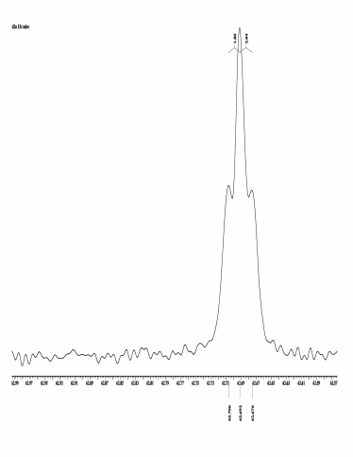
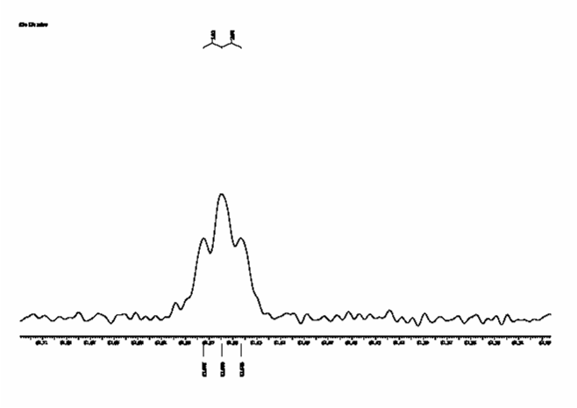
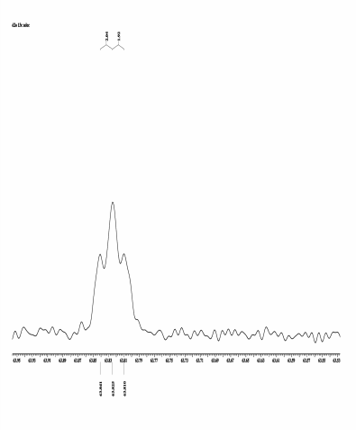
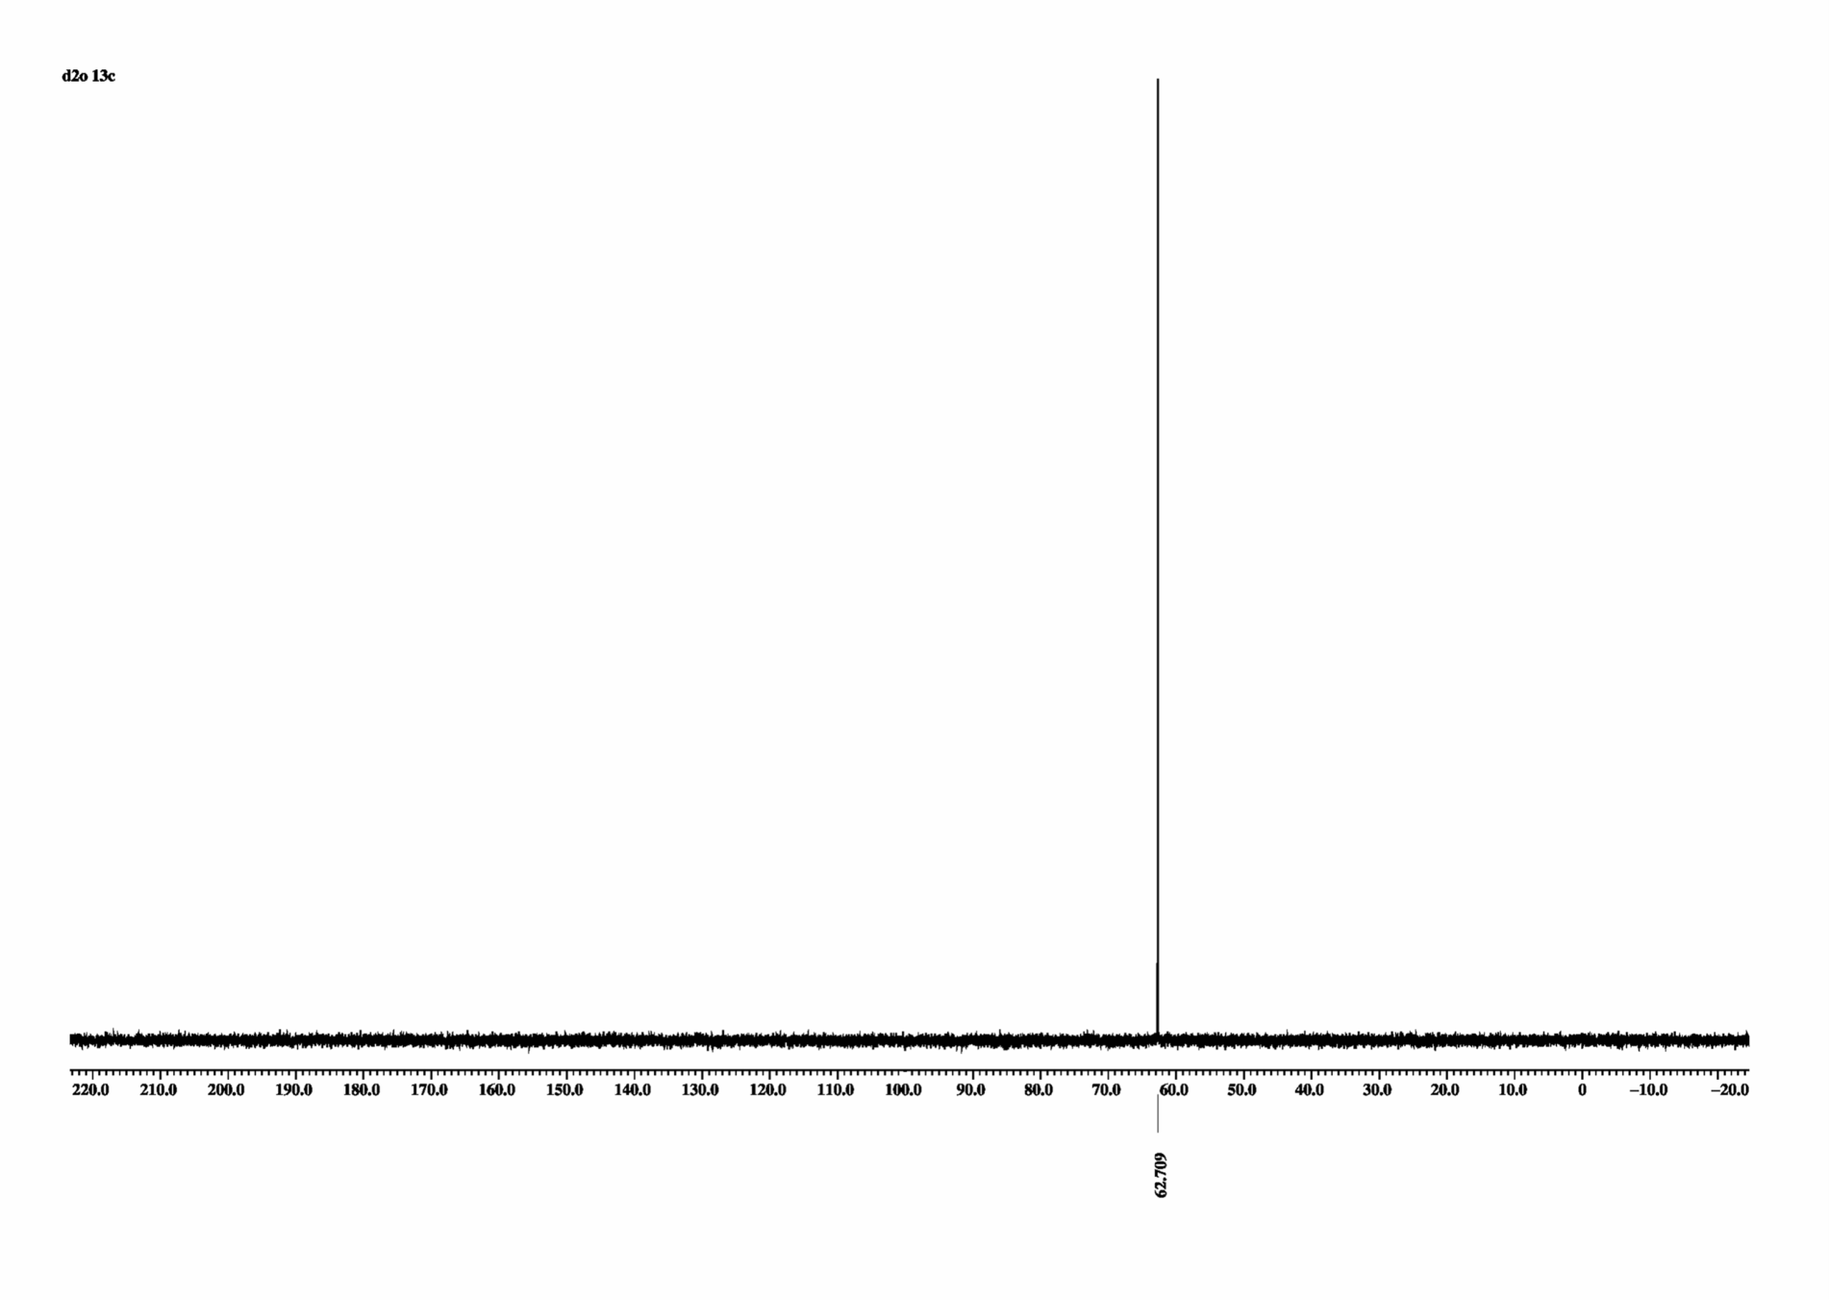
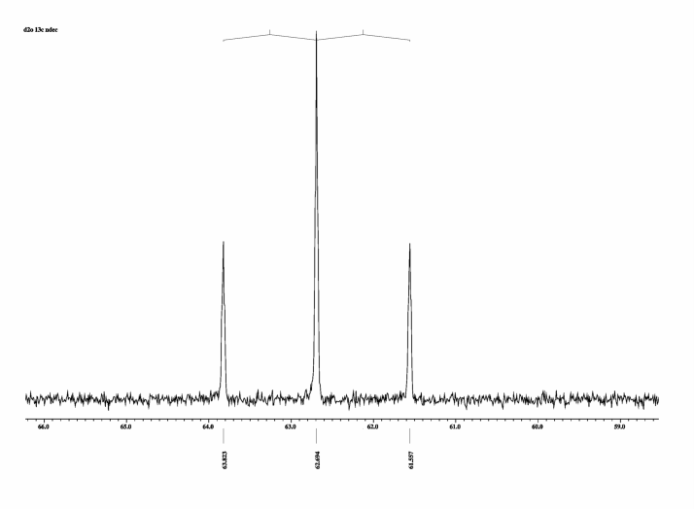
Unknown Sample ¹³C ( ¹³C -¹H Couplings)
J ca. 2 Hz
J ca. 2 Hz
J ca. 2 Hz
δ ca. 63 ppm
BB decoupled
¹³C
H
H
H
O
C
C
O
H
H
H
J ca. 140 Hz
Non decoupled

Slide 2
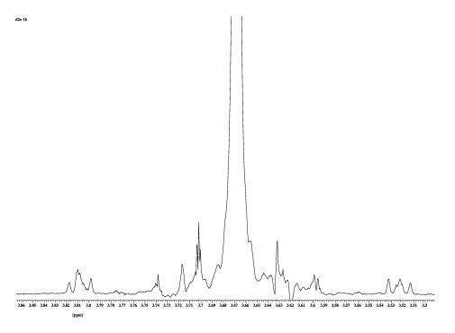
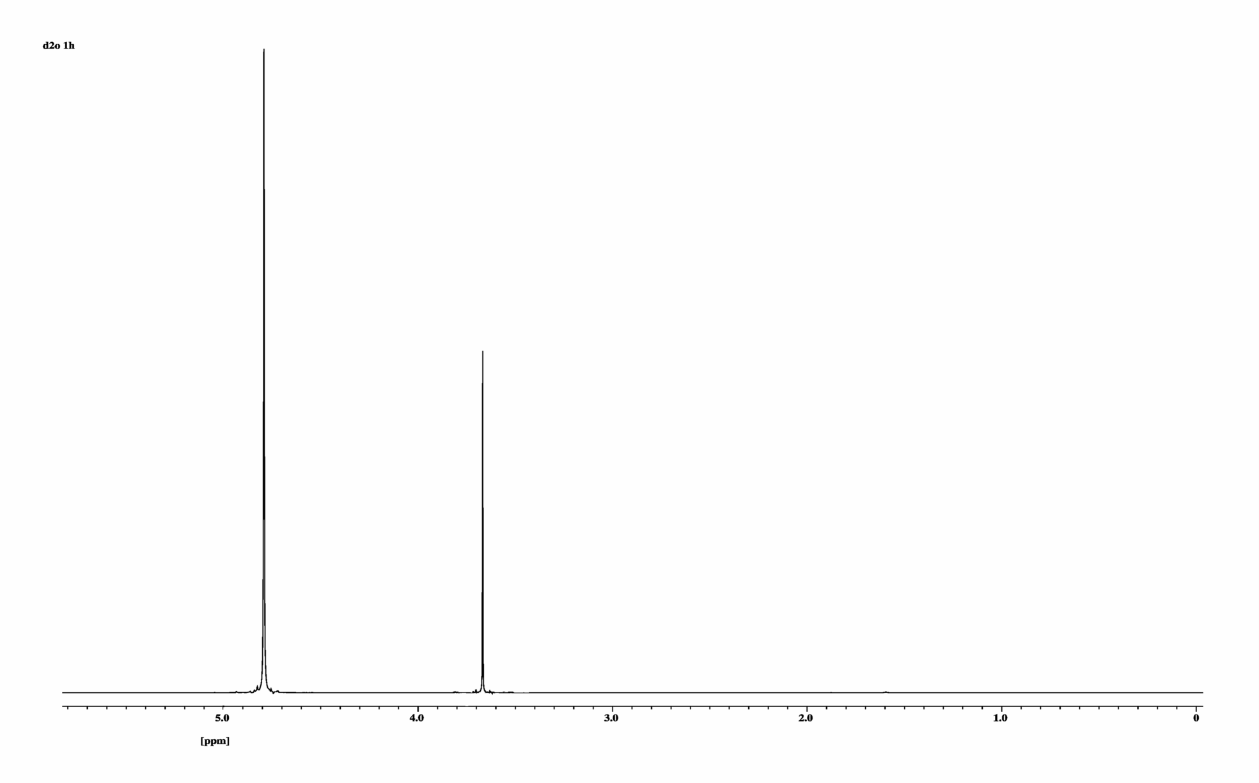
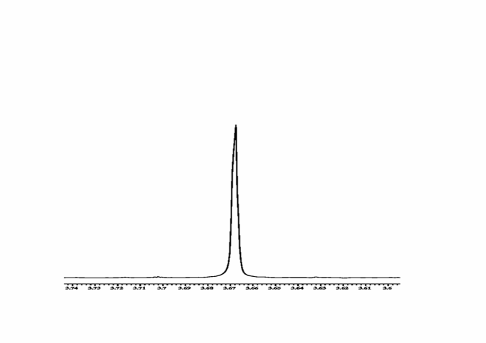
Glycol ¹³C ( ¹³C -¹H Couplings)
J ca. 140 Hz
J ca. 2 Hz
¹H
J ??
ca. 10 Hz
J ??
AA´BB´- System
H
H
H
O
¹³C
C
O
H
H
H

Slide 3
Sucrose ¹H (¹H-¹³C Couplings)
J ca. 167 Hz
H
CH2OH
H
HO
O
H
HO
H
OH
CH2OH
H
H
O
O
H
HO
CH2OH
OH
H

Slide 4
Sucrose ¹H (¹H-¹³C Couplings)
J ca. 167Hz
J ca. 70*2Hz
J ca. 72*2Hz

Slide 5
Sucrose ¹H (¹H-¹³C Couplings)
H
CH2OH
H
HO
O
H
HO
H
OH
CH2OH
H
H
O
O
α- anomeric C pyranoses smaller shifts larger 1J
H
HO
α- D- glucose
93.6 ppm
170 Hz
CH2OH
OH
H

Slide 6
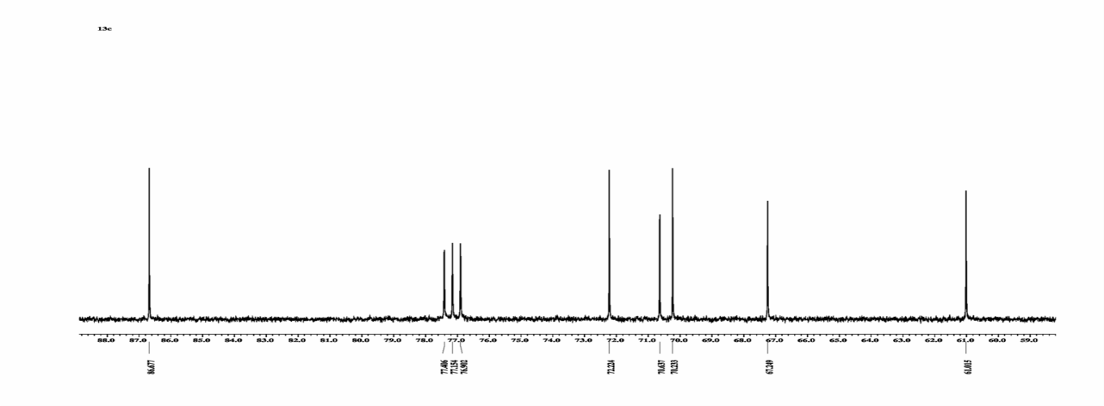
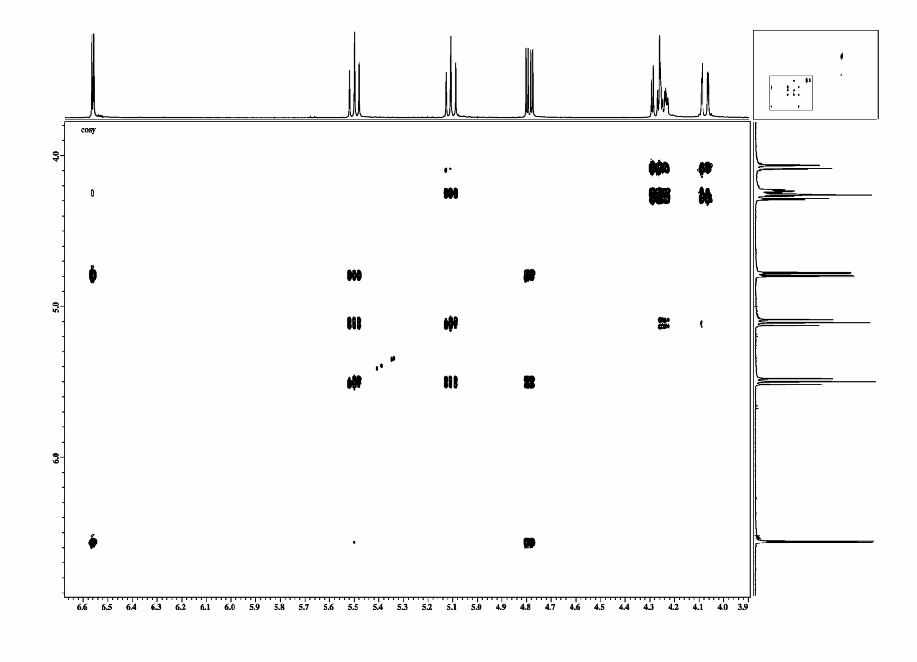
Application Sugar Derivative COSY
1
3
4
2
6´
5
6
6
5
6´
2
4
6´
3
O
C
H
O
C
H
O
C
H
O
C
H
O
C
H
H
C
H
O
1
2
3
4
5
6
1
3
1

Slide 7
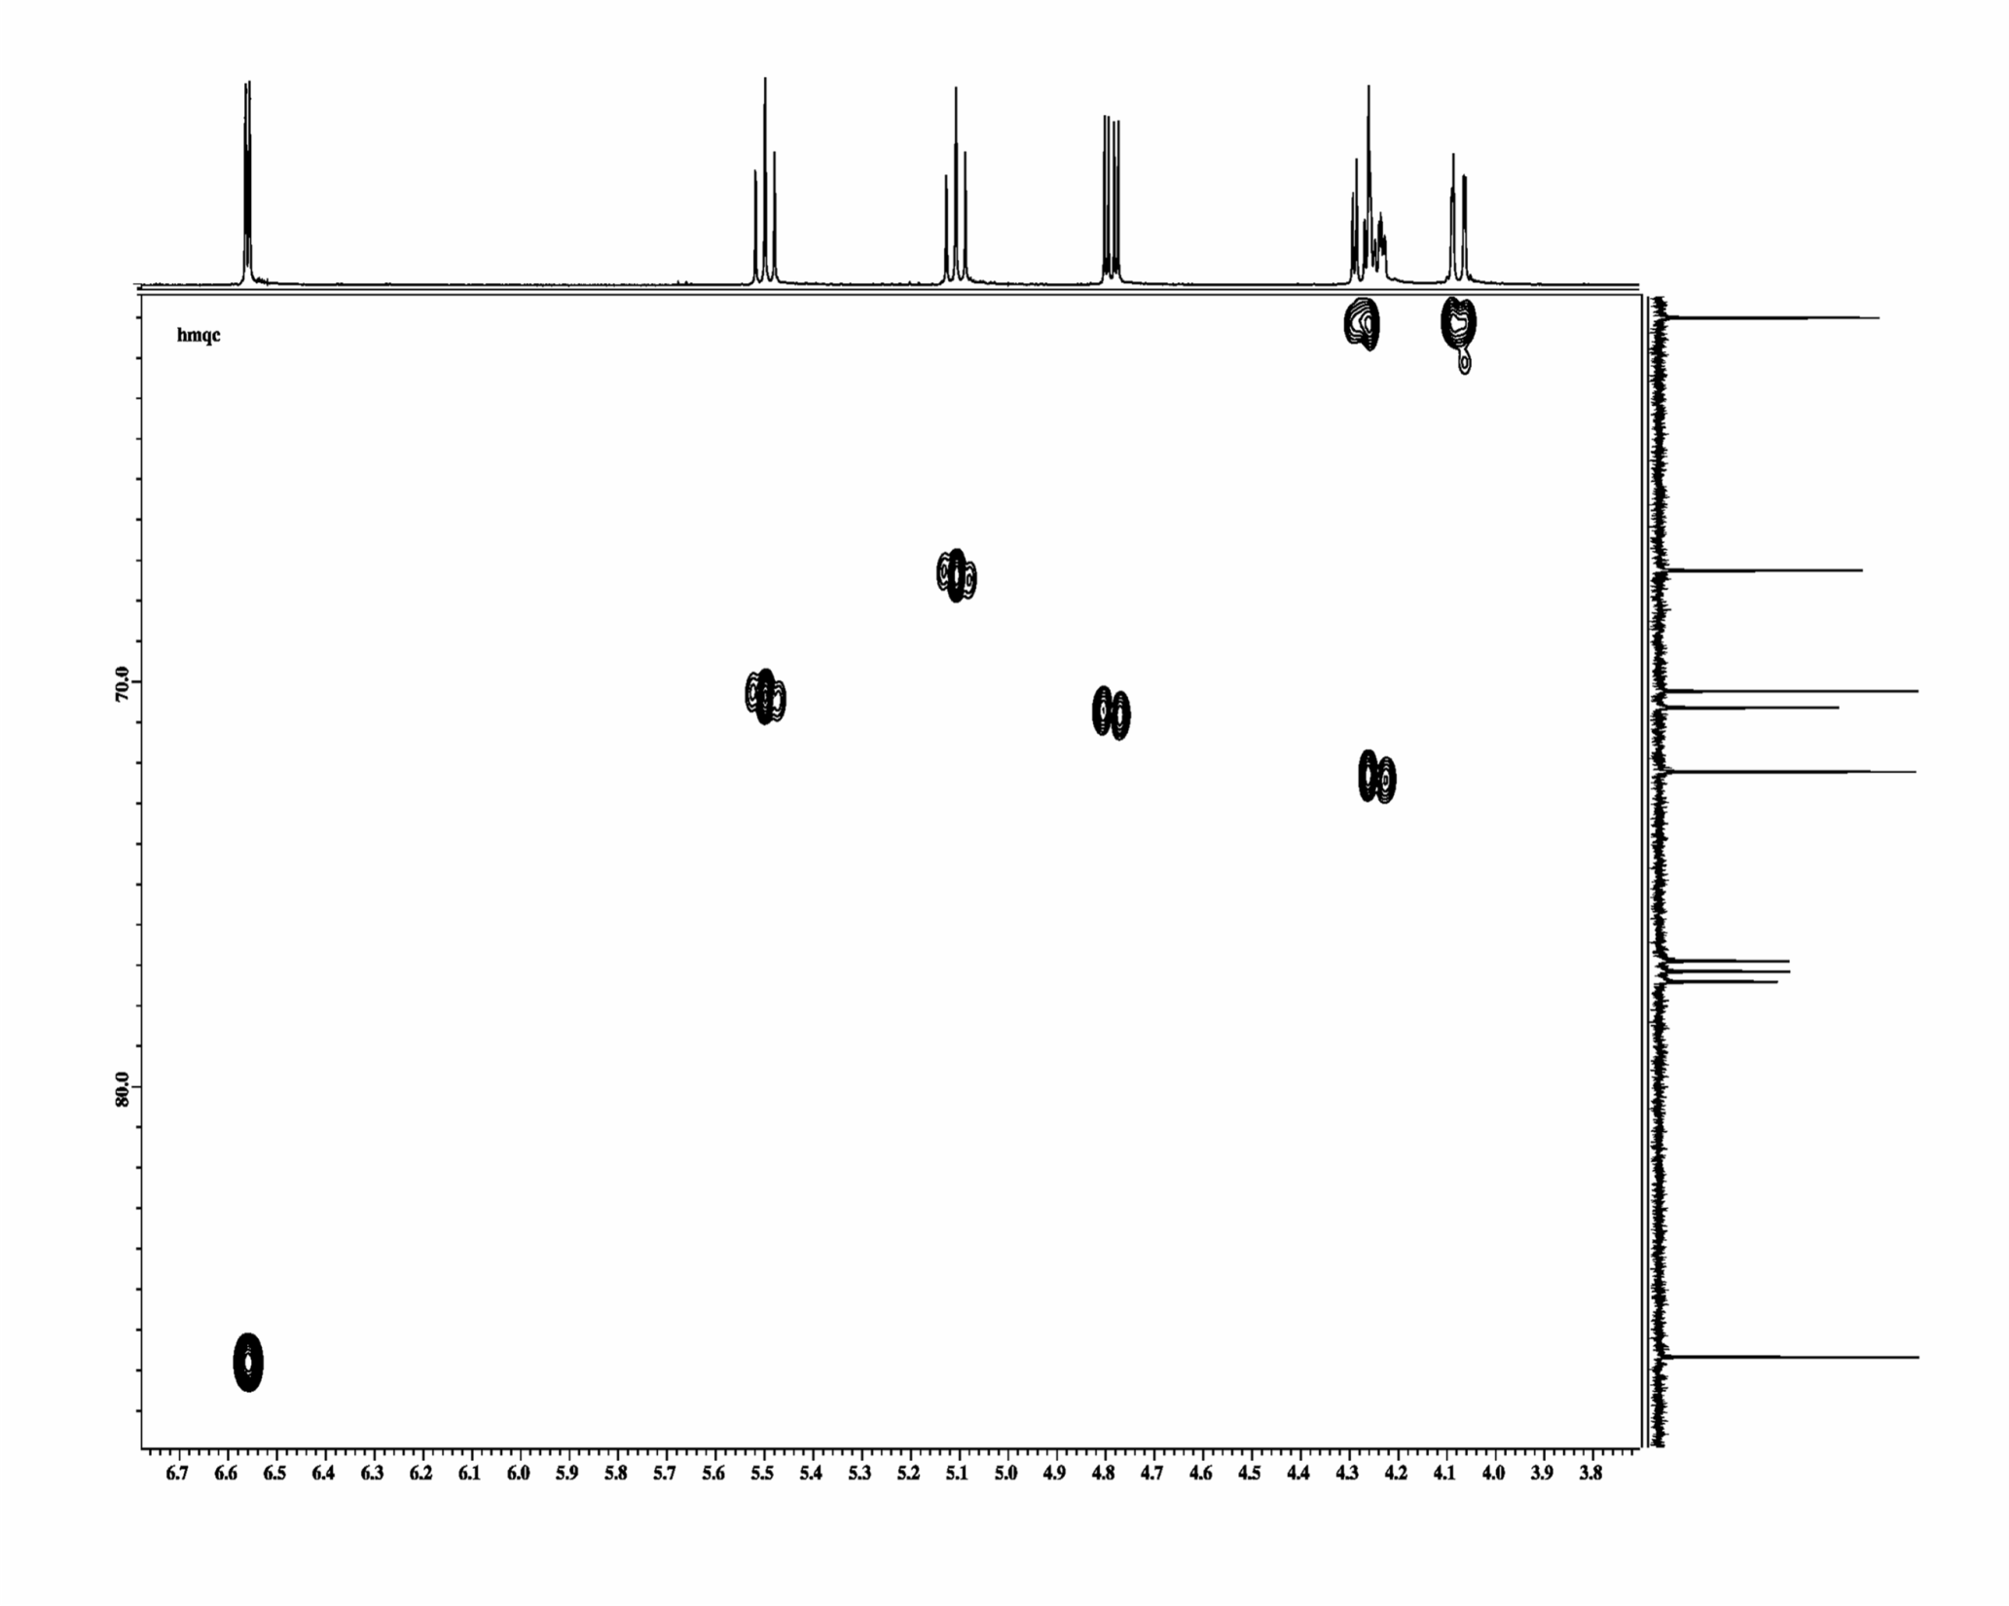
HMQC- Spektrum
Application Sugar Derivative HMQC
1
3
4
2
6´
5
6
6
4
3
2
5
6´
O
C
H
O
C
H
O
C
H
O
C
H
O
C
H
H
C
H
O
1
2
3
4
5
6
86 ppm
1

Slide 8
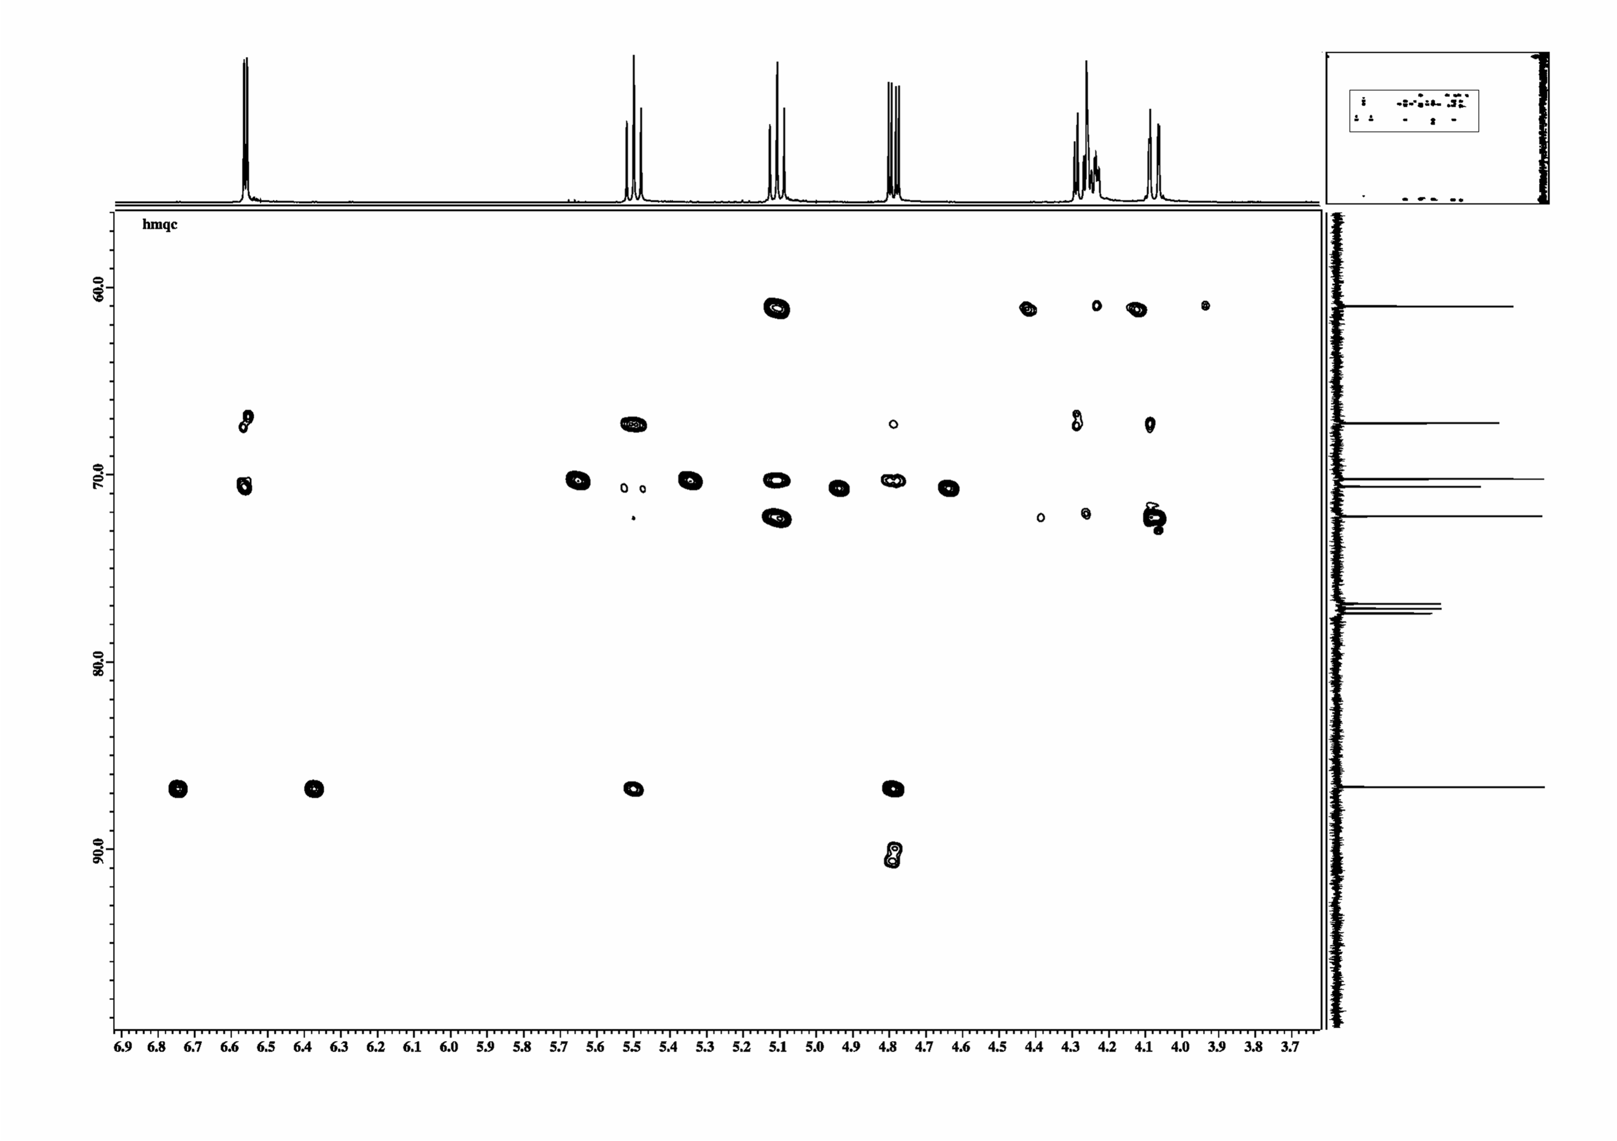
HMBC- Spektrum
Application Sugar Derivative HMBC
1
3
4
2
6´
5
6
3J (4,6)
1J (6‘,6)
1J (6,6)
6
4J (1,4)
2J (3,4)
3J (6´,4)
3J (6,4)
4
3J (1,3)
1J (3,3)
2J (4,3)
2J (2,3)
3
2J (1,2)
2J (3,2)
2
1J (2,2)
5
2J (4,5)
1J (5,5)
2J (6,5)
3J (3,1)
2J (2,1)
1
1J (1,1)
6
5
1
4
2
3

Slide 9
Application Sugar Derivative HMQC
Data base prediction yields an suggestion for the remaining residue.
20.7 20.6
170 169
61.0
72.2
86.8
67.2
70.2
70.6
4.28 4.08
6.96
4.23
5.11
5.50
4.79

Slide 10
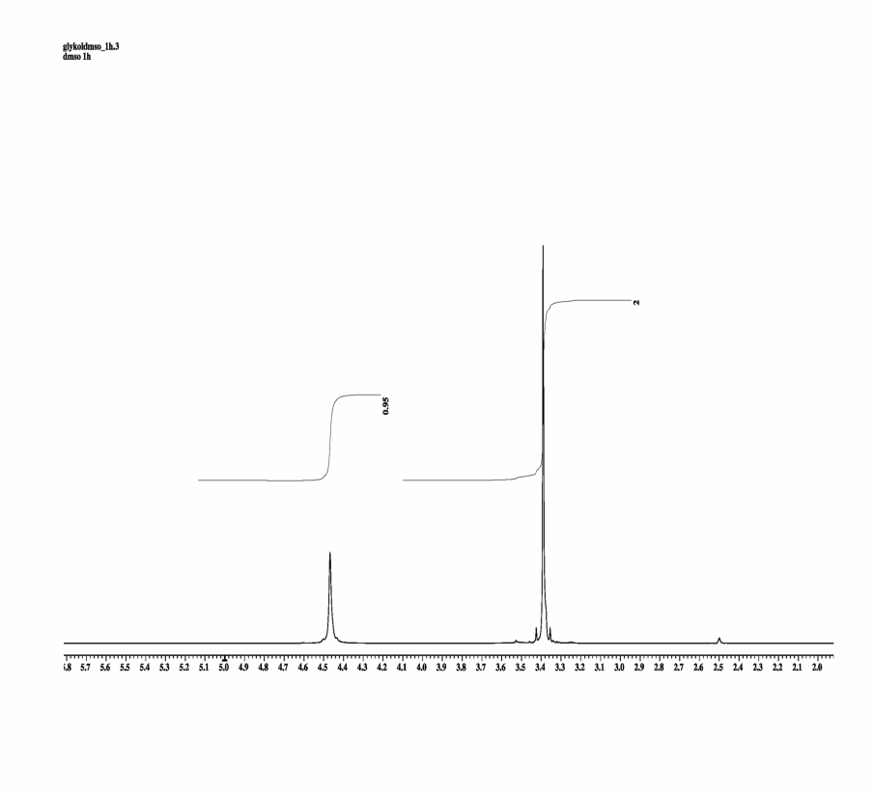
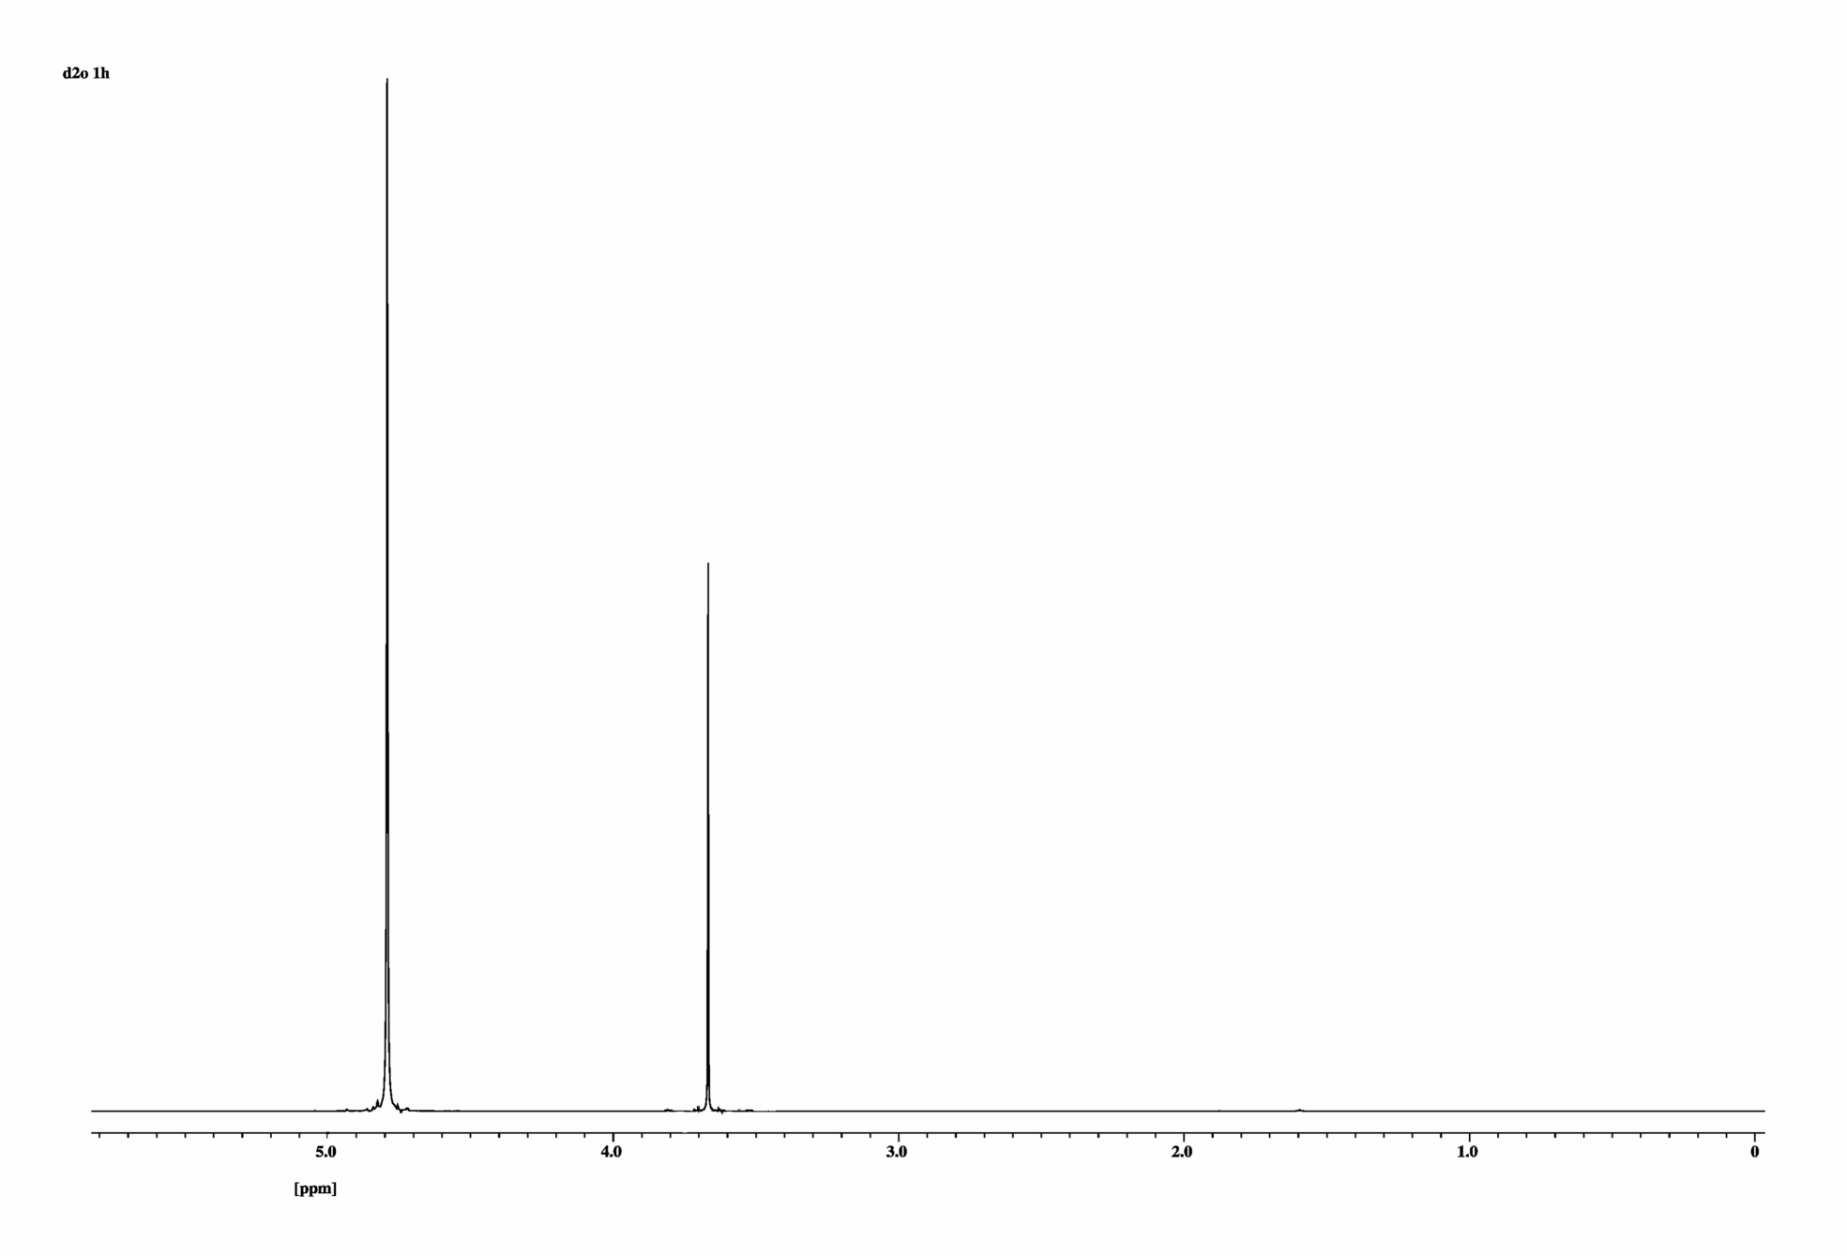
Hetero Nuclear Correlation
in DMSO
HDO
2
¹H
1
DMSO

Slide 11
Hetero Nuclear Correlation
J ca. 140 Hz
J ca. 2 Hz
¹H
J ??
ca. 10 Hz
J ??
AA´BB´- System
H
H
H
O
¹³C
C
O
H
H
H

Slide 12
Structure Elucidation
H
H
H
COSY 2J ,3J (4J…)
H
O
H
H
H
H
H
HMQC 1J
H
O
H
H
H
H
H
HMBC (1J) 2J ,3J (4J…)
H
O
H
H

Slide 13
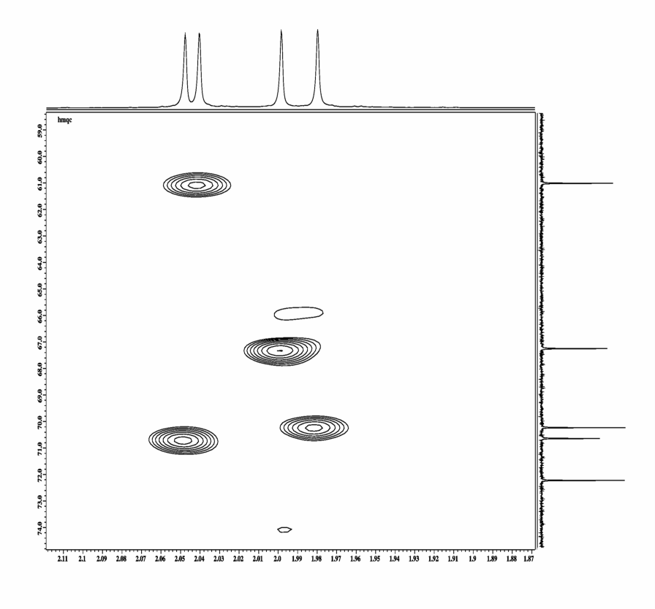
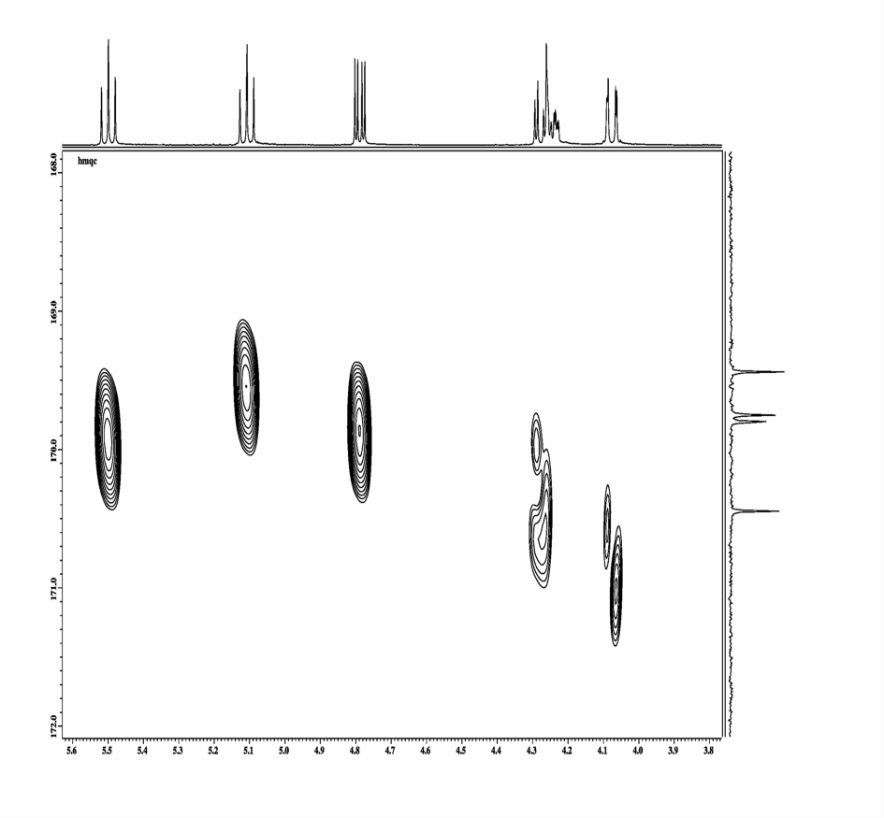
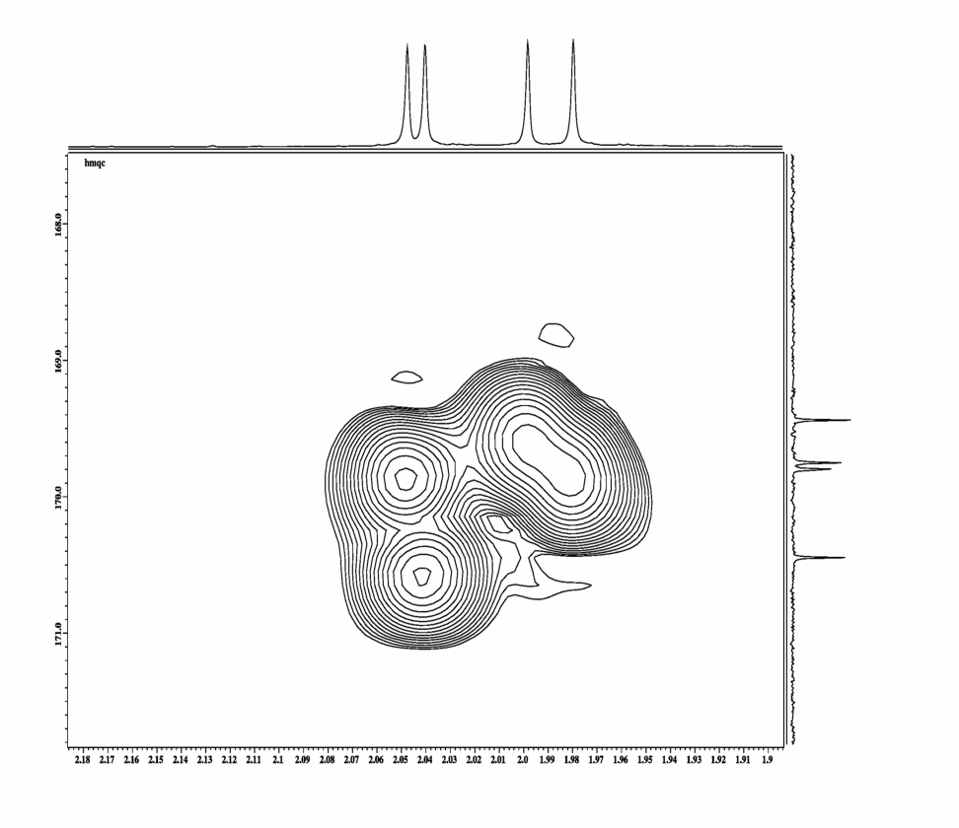
HMBC
Me6
Me2
Me4
Me3
3
4
2
6´
5
6
6
COO4
4
COO2
3
COO3
2
COO6
Me2
Me6
Me4
Me3
Me6
COO6
6
Me4
COO4
COO2
COO4
4
3
2
COO3
COO2
COO6
Me3
COO3
Me2

Slide 14
Cartesian Product Operators
I_{z}S_{z} I_{x}S_{x} I_{y}S_{y}
I_{x}S_{z} I_{y}S_{z}
I_{x} I_{y} I_{z}
S_{x} S_{y} S_{z}
S_{x}I_{z} S_{y}I_{z}
I_{y}S_{x} I_{x}S_{y} 1
only I_{x} , S_{x} ,I_{y}, S_{y}, I_{z}, S_{z}can be observed
M_{x}I_{x} M_{x}I_{y} M_{x} I_{z}
M_{x}I_{x}S_{z} M_{x}I_{y}S_{z}
M_{x}I_{z}S_{z} M_{x}I_{x}S_{x} M _{x}I_{y}S_{y}
M_{x}S_{x} M_{x}S_{y} M_{x}S_{z}
M _{x}I_{y}S_{x} M _{x}I_{x}S_{y} M _{x}1
M_{x} S_{x}I_{z} M_{x} S_{y}I_{z}
d/dt O = ih [ H, O ] = c1 O1 + c2 O2 + c3 O3 ……..
Time evolution according to B₀ for spins I and S and I_{z}S_{z} can be calculated one by one.
[ A, B ] = 0 a exp( i (A + B) t) = exp( i At) exp( i B t) = exp( i B t) exp( i At)
[ I_{z} , I_{z}S_{z}] = 0 a exp( i H t) = exp( i ω_{Ι}Ι_{z} t) exp( i ω_{S}S_{z} t) exp( i J Ι_{z}S_{z} t)
[ H, A ] = 0, [ H, C ] = 0 aexp( i Ht) AC exp( − i Ht) = exp( i Ht) A exp( − i Ht) C
H = ω_{I} I_{z} a
S_{z}I_{x} a S_{z}I_{x} cos (ω_{I}t) + S_{z}I_{y} sin ( ω_{I}t)
H = ω₁I_{y} a
S_{z}I_{x} a S_{z}I_{x} cos (φ ) − S_{z}I_{y} sin ( φ_{I})
H = ω₁S_{y} a
S_{z}I_{x} a S_{z}I_{x} cos (φ ) + S_{x}I_{x} sin ( φ_{I})

Slide 15
HMQC, HMBC
Depending on the choice of J evolution delay 1/2J different correlations can be obtained.
90°
180°
1H (S)
1/2J
t₁/2
t₁/2
1/2J
acquisition
S_{z}
(population)
90°
90°
13C (I)
I_{z}
(population)
decoupling destroys couplings in f2
ω_{1H}
S_{x}

Slide 16
B₀- and B₁- Evolution
Iz
Iz
Iz
-Iy
-Iy
-Iy
-Ix
Ix
-Ix
-Ix
Ix
Ix
Iy
φ
Iy
φ
Iy
ω t
-Iz
-Iz
-Iz
J Coupling Evolution
IzSz
IzSz
AX- Approximation
− 2 IxSz
− Ix
−2 IySz
2 IySz
− Iy
Iy
sin ( π J t )
π J t
π J t
Ix
cos ( π J t )
2 IxSz
B₀- and B₁ -Evolution
IzSz
Iz
-IySz
-IySz
-Ix
-IxSz
Ix
IxSz
IySz
φ
I_{z}
IySz
ω t
I_{y}S_{z} ( I_{y} cos ω_{I} t₁ − I_{x} sin ω_{I} t₁ ) S_{z}
-IzSz
-Iz
I_{x}
+ S_{x}
( S_{z} cos φ − S_{y} sin φ )
I_{y}S_{z} ( I_{y} cos φ + I_{z} sin φ) S_{z}

Slide 17
HMQC, HMBC
Depending on the choice of J evolution delay 1/2J different correlations can be obtained.
90°
180°
1H (S)
1/2J
t₁/2
t₁/2
1/2J
acquisition
S_{z}
(population)
180 degree pulse destroys coupling in f1
90°
90°
13C (I)
I_{z}
(population)
decoupling destroys couplings in f2
ω_{13C} + ω_{1H}
ω_{13C} + - ω_{1H}
ω_{1H}
S_{x}
ω_{13C}
I_{z}S_{y} I_{z}S_{x}
coherence
S₋ coherence
exp( i ( ω_{1H} ) t₂)
exp( i ( ω_{13C} ) t₁)
I_{y}S_{y} I_{y}S_{x}
coherence
S₋I_{z} coherence
I₊S₊ I₊S₋
coherence
I₊S₋
coherence
exp( i ( ω_{13C} + ω_{1H} ) t₁/2)
*
exp( i ( ω_{13C} - ω_{1H} ) t₁/2)
= exp( i ( ω_{13C} ) t₁)
I _{x} S _{x} ( cos(ω_{13C} t₁/2) I_{x} + sin(ω_{13C} t₁/2) I _{y} ) ( cos(ω_{1H} t₁/2) S_{x} + sin(ω_{1H} t₁/2) S _{y} )
trigonometric formulas :
cos ( α +/− β ) = cos ( α ) cos( β ) −/+ sin ( α ) sin( β )
sin ( α +/− β ) = sin ( α ) cos( β ) +/− cos ( α ) sin( β )
Z-gradient
5
3
4

Slide 18
Phase Cycling (e.g.)
90°- y
180°- y
B1_{X}
B0
B1_{X}
90°- y
180°- x
B1_{Y}
B1_{Y}

Slide 19
HMQC, HMBC
Depending on the choice of J evolution delay 1/2J different correlations can be obtained.
90°
180°
1H
1/2J
t₁/2
t₁/2
1/2J
J = 120 – 160 (250) Hz
¹J couplings
acquisition
180 degree pulse destroys coupling in f1
H
H
90°
90°
H
13C
H
O
decoupling off
decoupling
ω_{13C} + ω_{1H}
ω_{13C} + - ω_{1H}
ω_{1h}
J = 2 - 8 (20) Hz
²⁻⁵ J couplings
ω_{13C}
Couplings in f2 can be made visible by leaving the 13C decoupler off all the time
¹³C decoupling
¹³C decoupling switched off

Slide 20
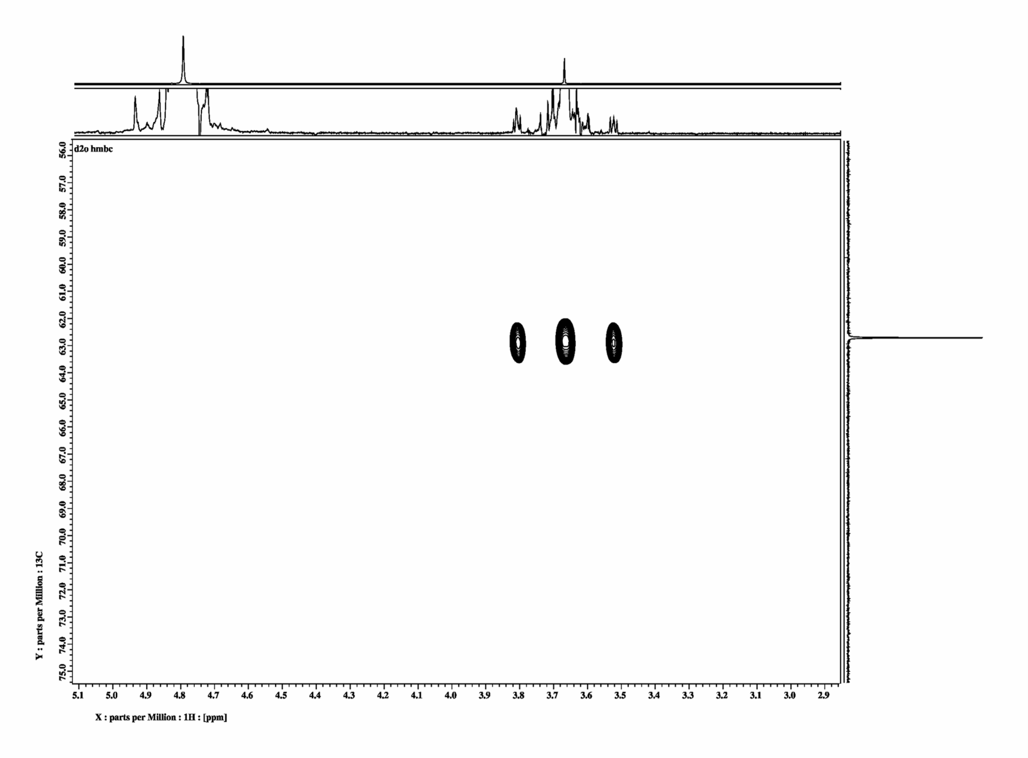
Glycol HMBC non decoupled D2O
¹H
¹³C
J ca. 140 Hz
J ??
ca. 10 Hz
J ??
J ca. 2 Hz
H
H
H
O
¹³C
C
O
H
H
H

Slide 21
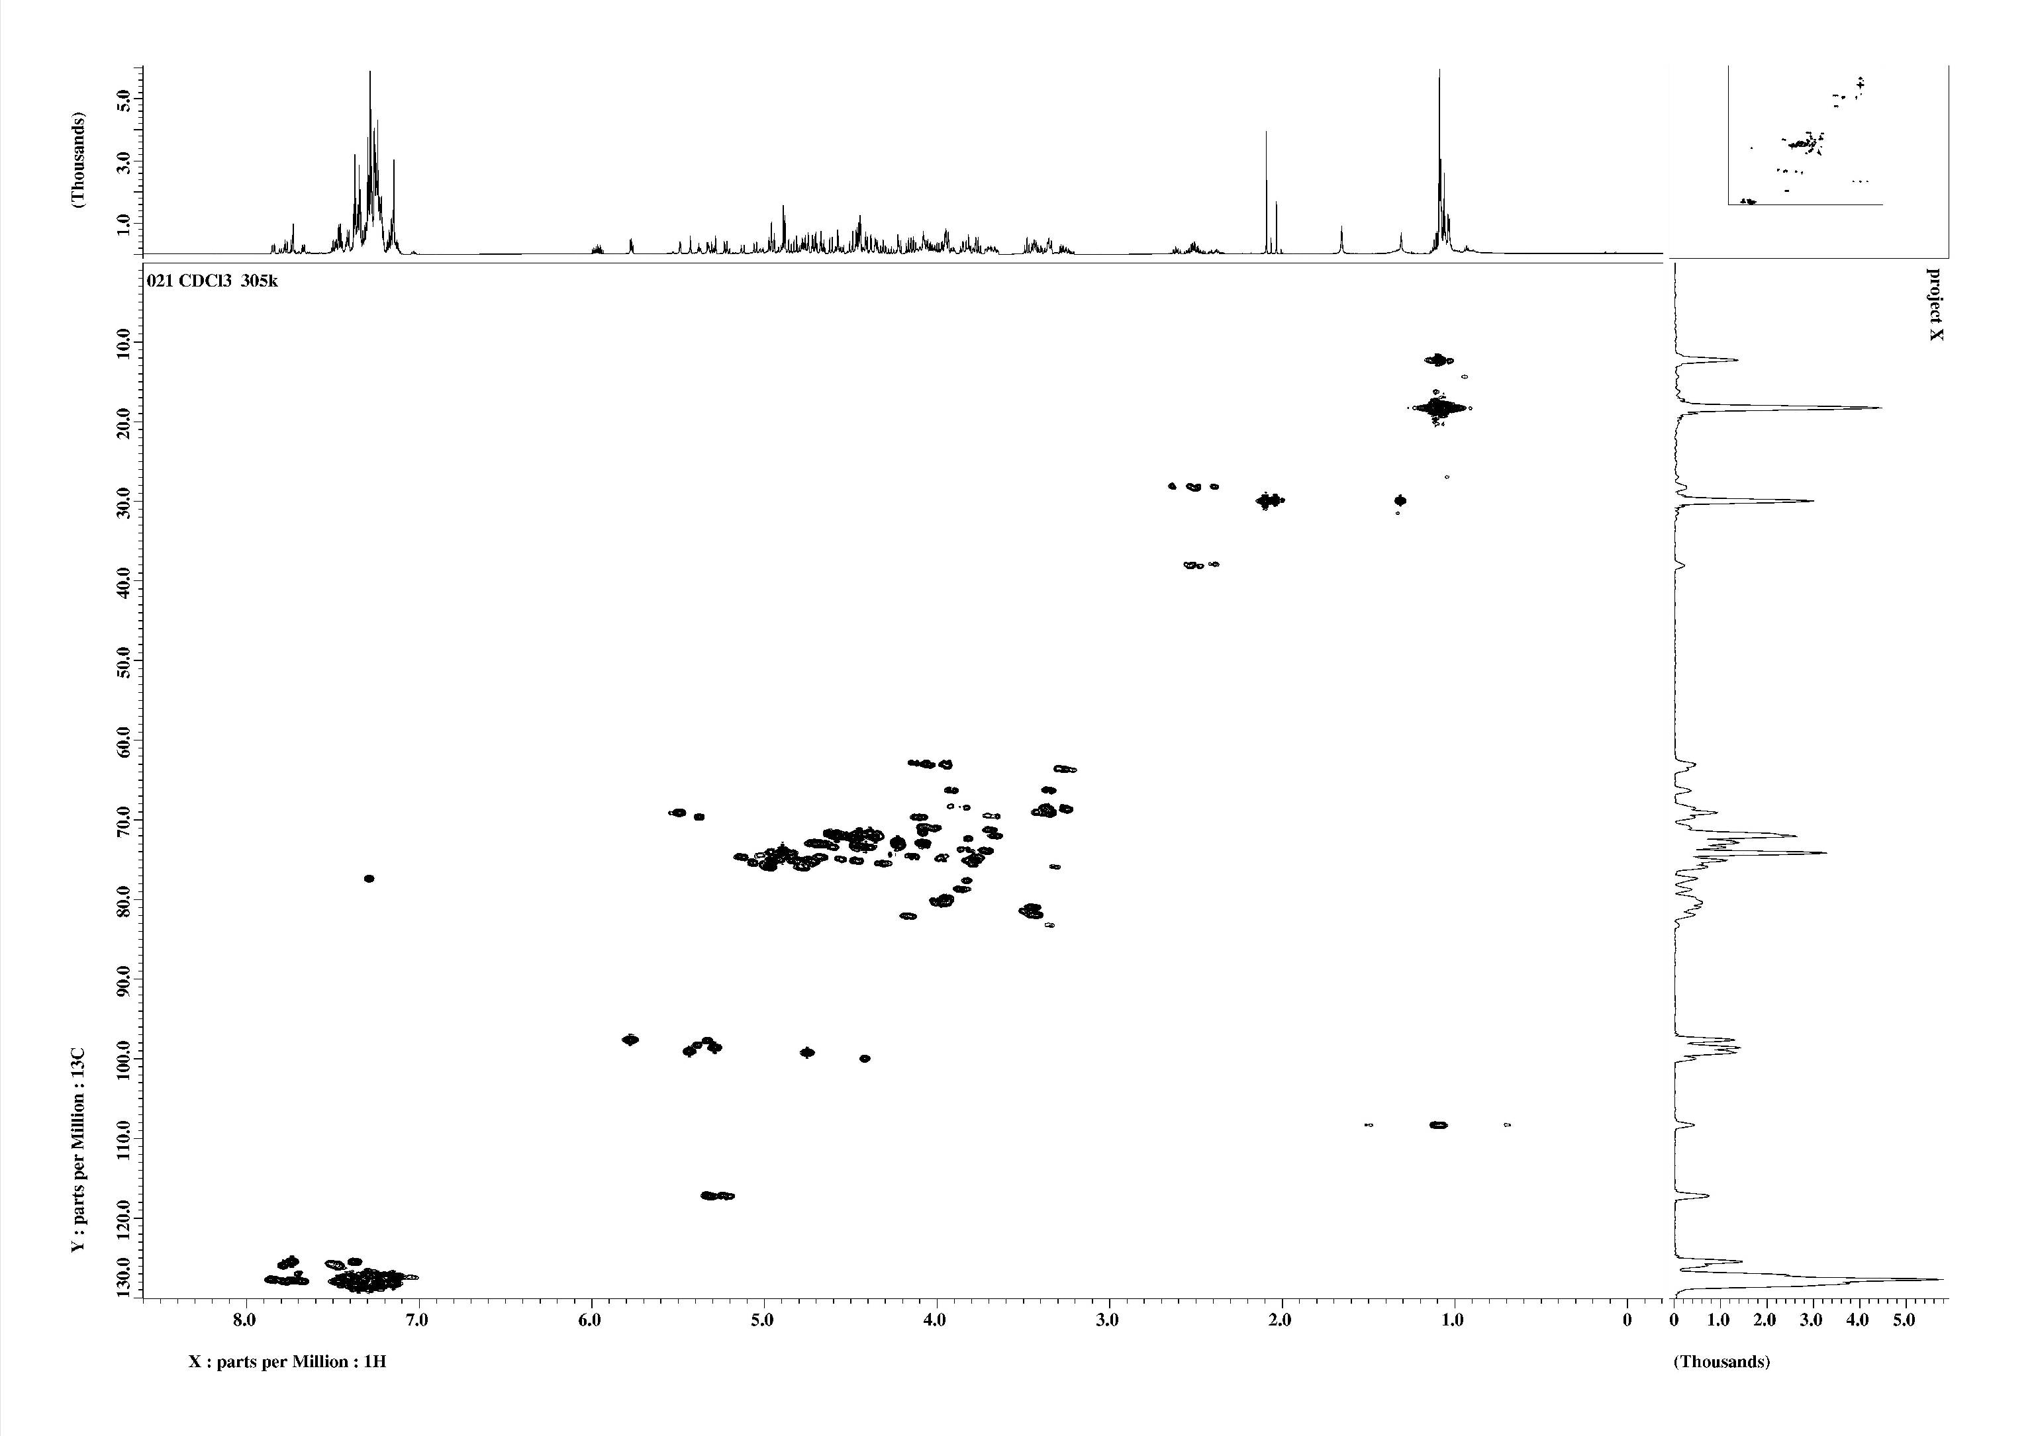
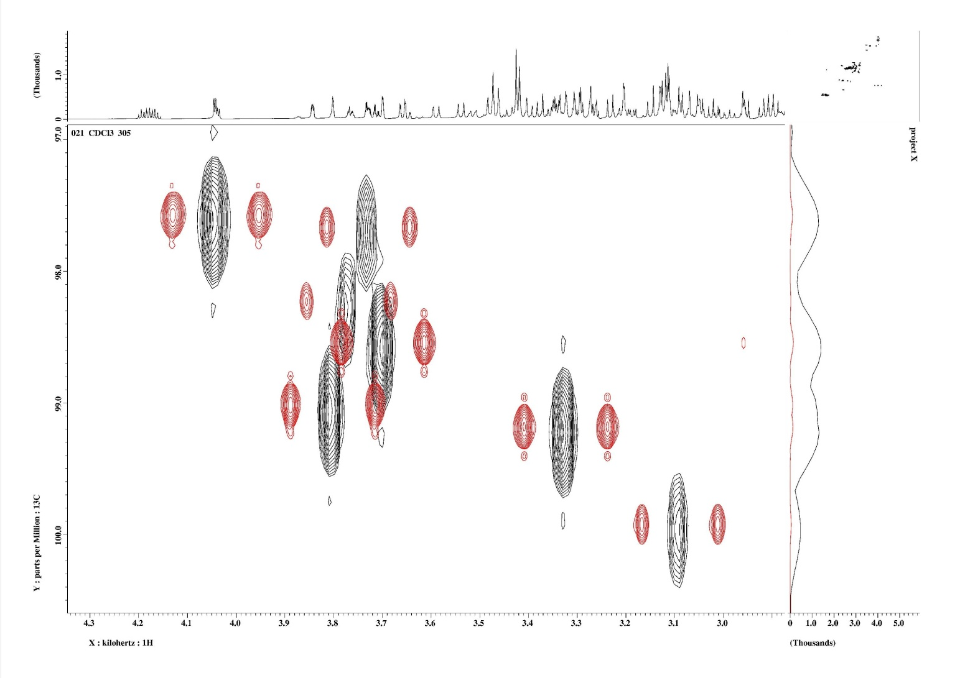
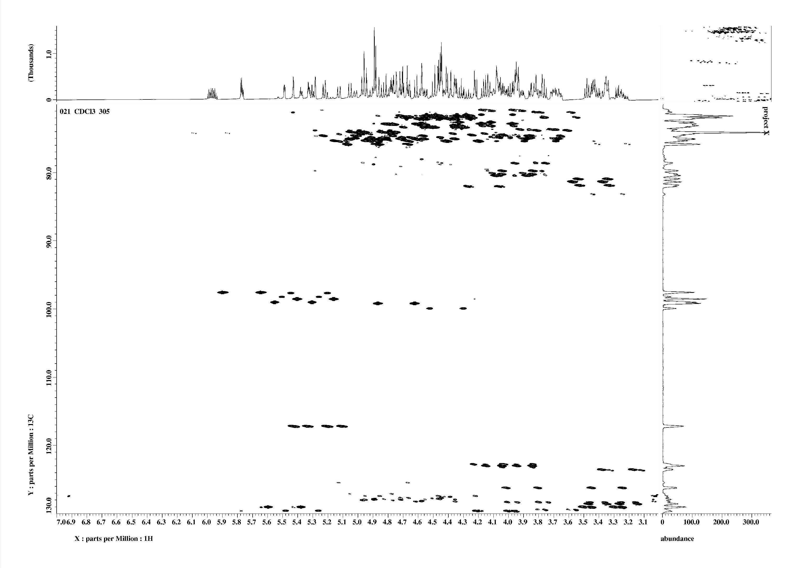
¹³C – 1H Couplings
anomeric C pyranoses 150 - 180 Hz axial OH -> larger 1J
a- D-glucose
b- D-glucose
170 Hz
161 Hz
146 Hz
145 Hz
178Hz 97 ppm
155 Hz 100 ppm

Slide 22
Elucidating the Carbon Scaffold
H H H H H H H H H
C-C Correlation
| | | | | | | | |
C ----------C----------C----------C----------C----------C----------C----------C----------O---------C----------C
| | | | | |
H H C C----H
Correlation of heteronuclear shifts
H H H H H H H H H
H-H Correlation
| | | | | | | | |
C ----------C----------C----------C----------C----------C----------C----------C----------O---------C----------C
| | | | | |
H H C C----H
H H H H H H H H H
HMQC/HSQC
| | | | | | | | |
C ----------C----------C----------C----------C----------C----------C----------C----------O---------C----------C
| | | | | |
H H C C----H
H H H H H H H H
HMBC
| | | | | | | | |
C ----------C----------C----------C----------C----------C----------C----------C----------O---------C----------C
| | | | | |
H H C C----H H
Hetero nuclear skeleton

Slide 23
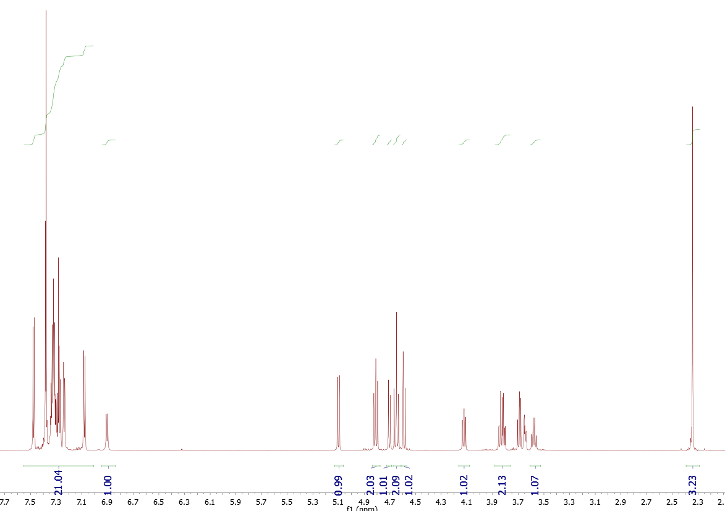
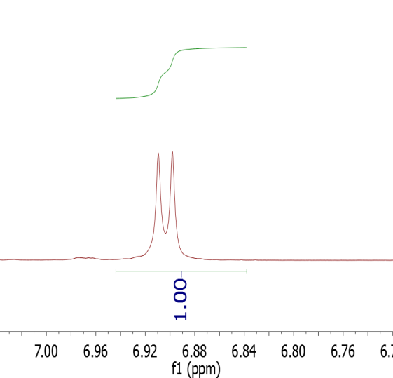
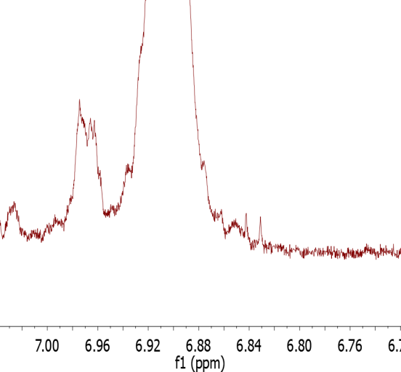
Glucosamine Derivative CDCl3
⁴
⁷
¹⁷
^{17 Me}
J NH ca. 100 Hz
J ca. 8 Hz
^{7 NH}
^{4 H „anomeric“}

Slide 24
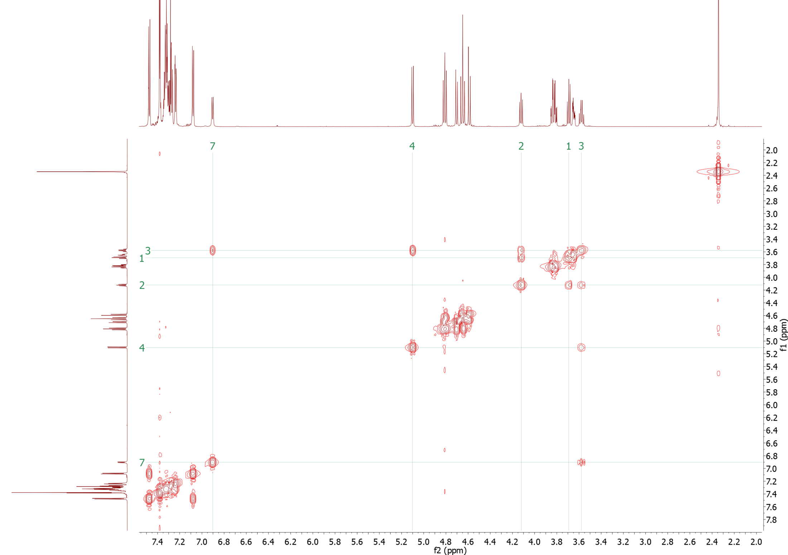

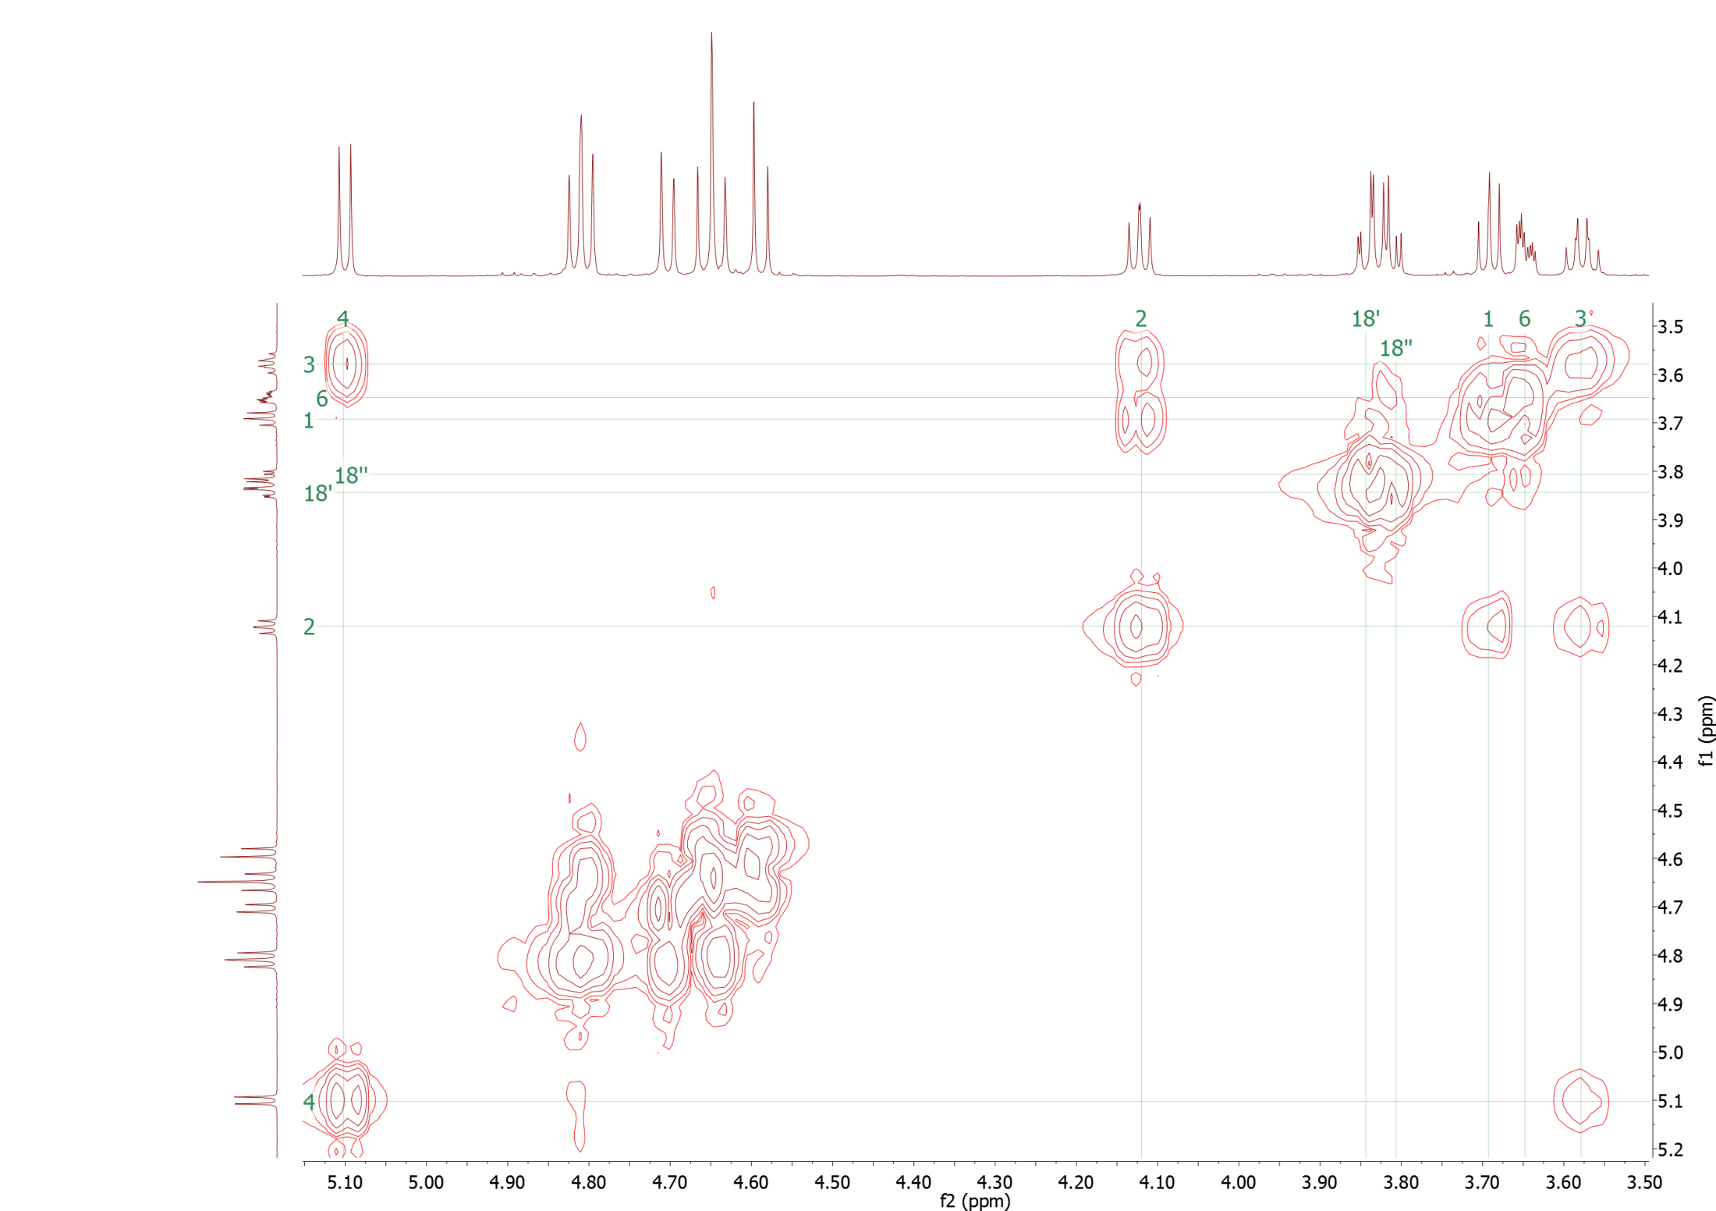
Glucosamine Derivative CDCl3
¹⁸
¹
⁶
²
³
⁴
⁷
-O-CH2-Ph 3x

Slide 25
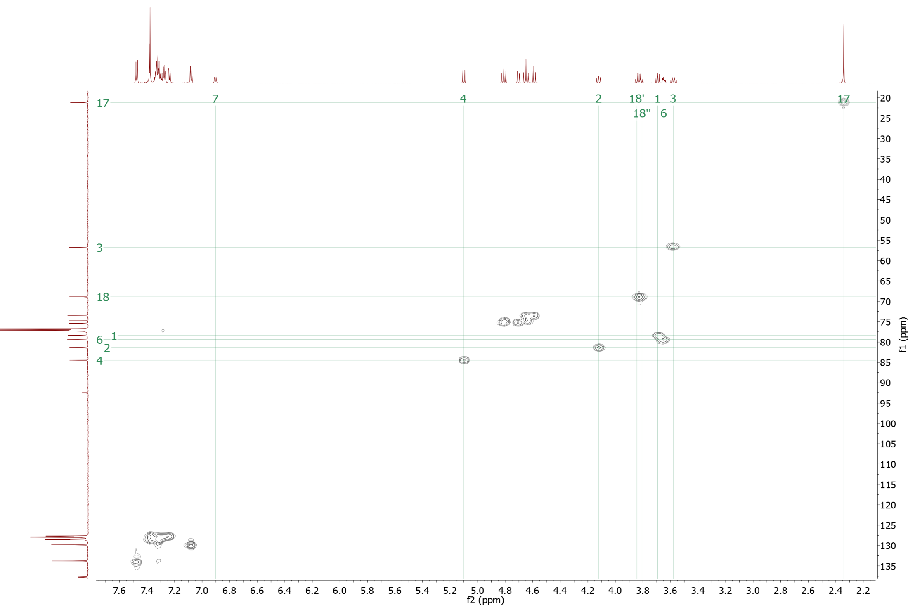
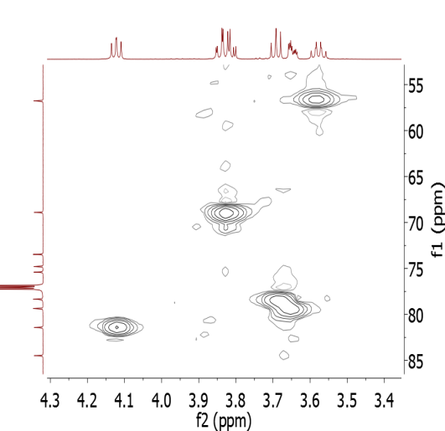
Glucosamine Derivative CDCl3
¹⁸
¹
⁶
²
³
⁴
⁷
¹⁷

Slide 26
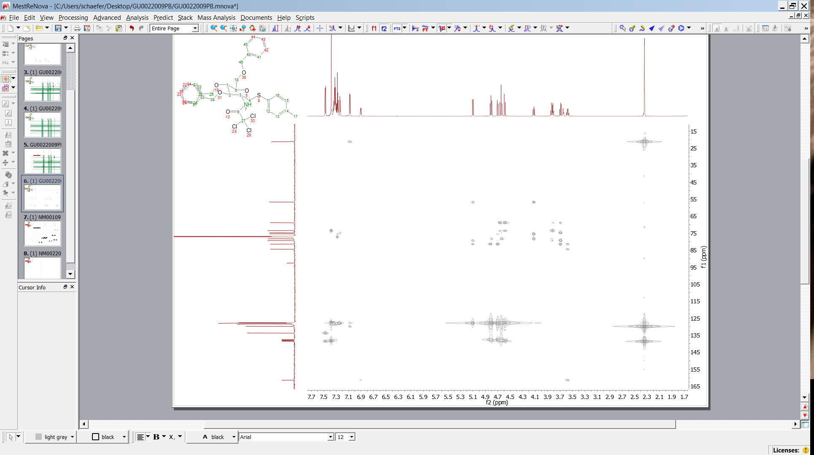
HMBC Glucosamine Derivative
¹⁸
¹
¹⁶
²
³
⁴
⁷
¹⁴

Slide 27
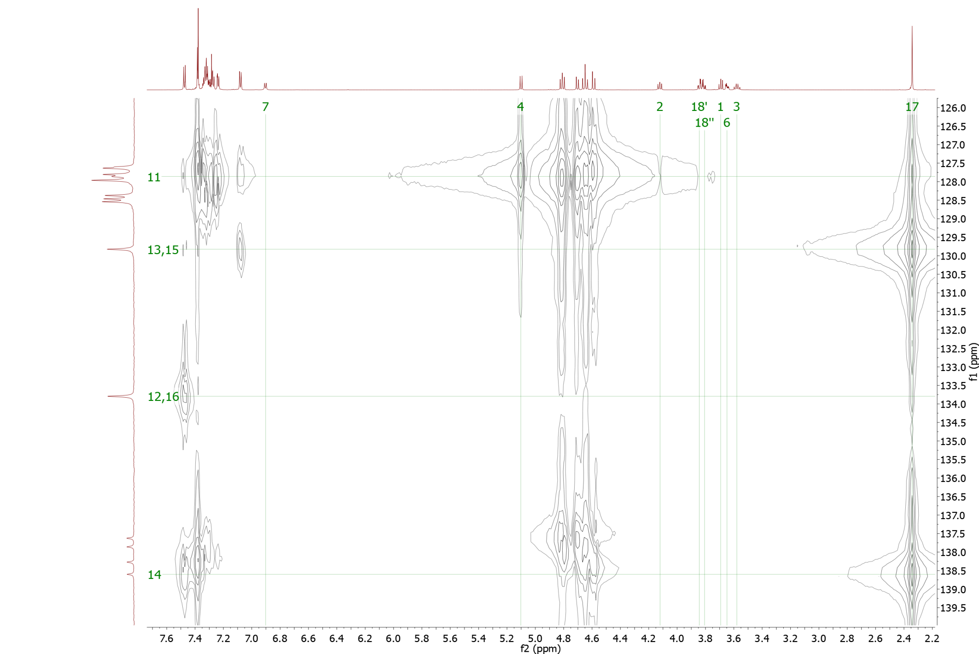
HMBC Glucosamine Derivative
¹
¹⁸
⁶
¹²
²
³
⁴
¹¹
¹³
⁷
¹⁴
¹⁶
¹⁵
¹⁷
12
13
3J 13-11
3J 4-11
3J 13-15
3J 17-13,15
3J 12-16
2J 17-14
3J 12-14

Slide 28
Glucosamine Derivative CDCl3
¹⁸
¹
⁶
²
³
⁴
⁷
12
16
13
15
-O-CH2-Ph 3x

Slide 29
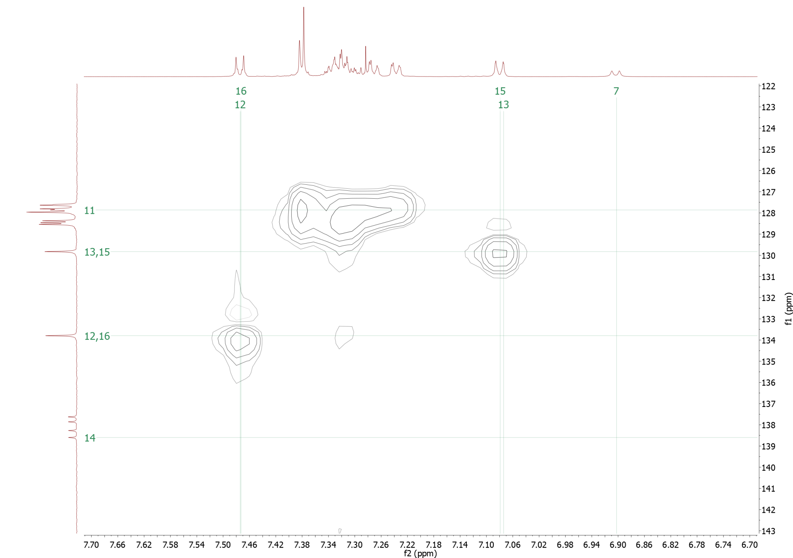
HMQC Glucosamine Derivative
¹
¹⁸
⁶
¹²
²
³
⁴
¹¹
¹³
⁷
¹⁴
¹⁶
¹⁵
¹⁷
3J 17-14

Slide 30
HMBC Glucosamine Derivative
¹
¹⁸
⁶
¹²
²
³
⁴
¹¹
¹³
⁷
¹⁴
¹⁶
¹⁵
¹⁷
12
13
3J 13-11
3J 4-11
3J 13-15
3J 17-13,15
3J 12-16
3J 12-14
2J 17-14

Slide 31
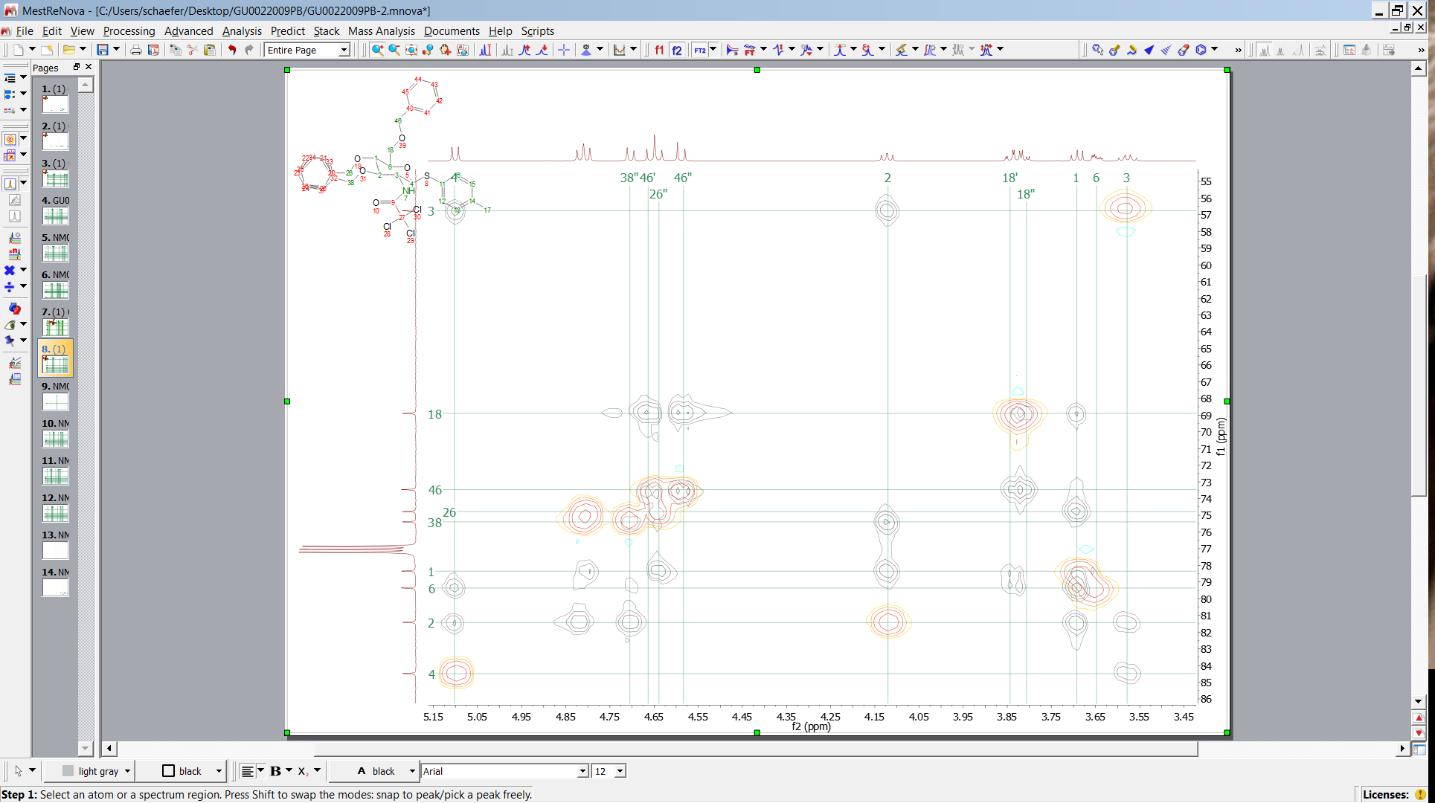
HMBC Glucosamine Derivative
38´
26´
¹
¹⁸
⁶
¹²
3J 17-13
²
³
⁴
¹¹
¹³
⁷
¹⁴
¹⁶
¹⁵
¹⁷
3J 17-14
3J 12-14
3J 17-14

Slide 32
HMBC Glucosamine Derivative
¹
¹⁸
⁶
¹²
²
³
⁴
¹¹
¹³
⁷
¹⁴
¹⁶
¹⁵
¹⁷
38´
46´
12
13
3J 12-11
3J 17-13
3J 17-14
38
46
3J 17-14
3J 12-14

Slide 33
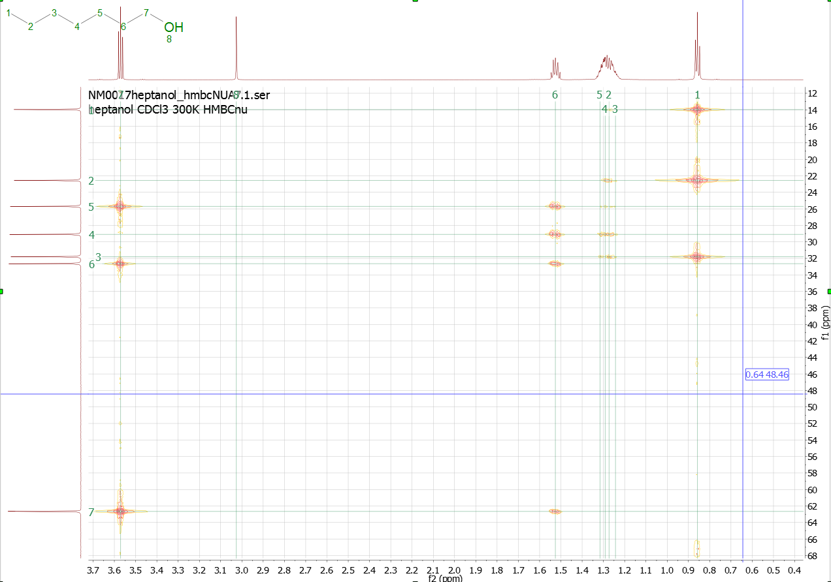
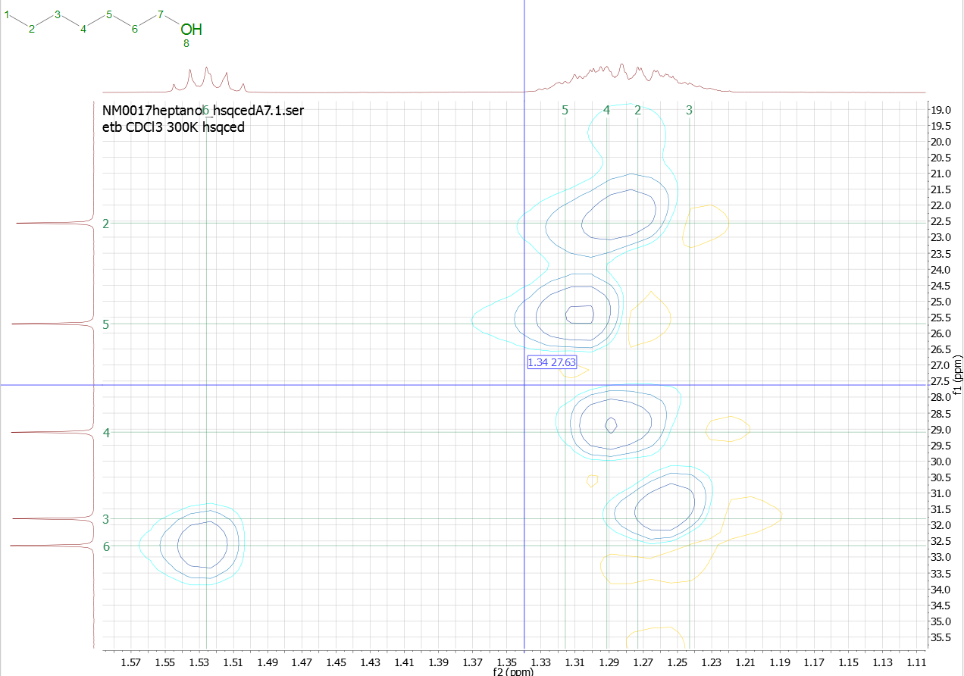
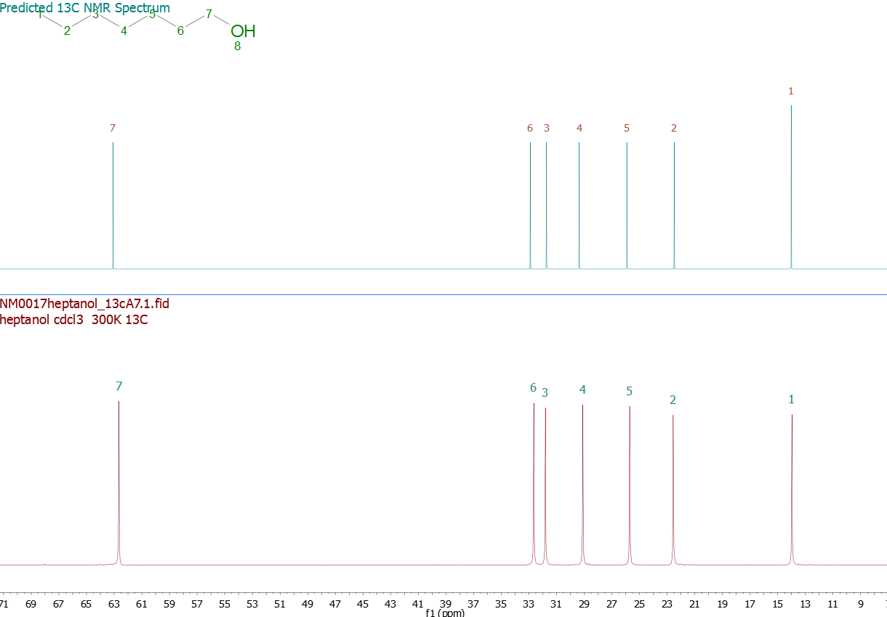
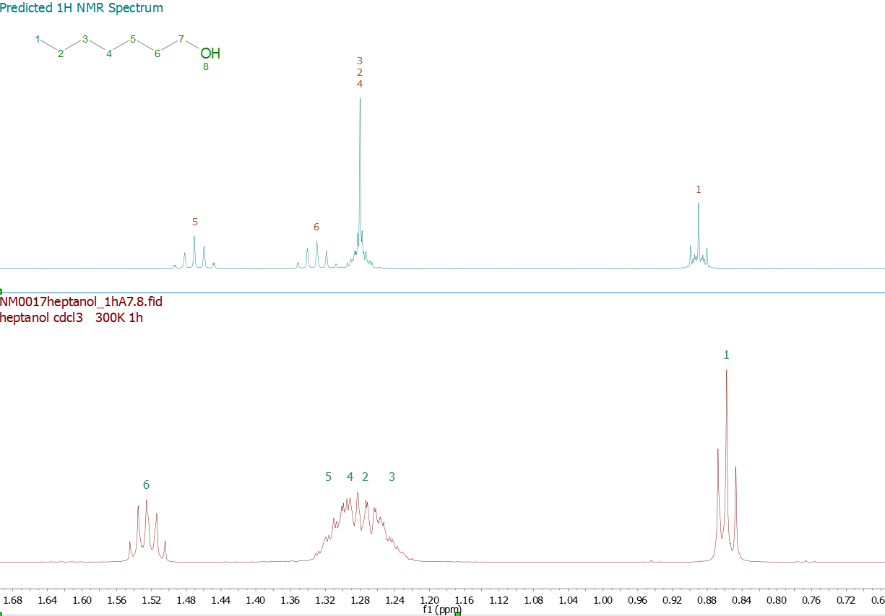
H
Alkyl Chain (e.g.)

Slide 34
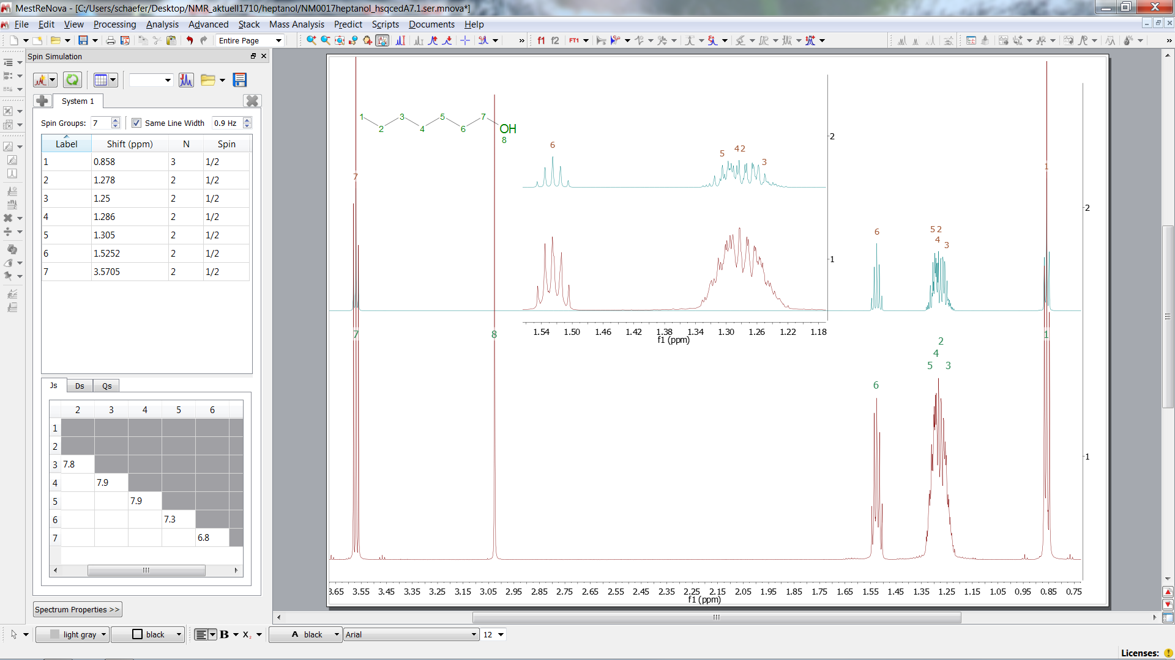
H
Alkyl Chain (e.g.)

Slide 35
HMQC Cross peaks in case of an AB System
Inner lines belong to both nuclei
H
H
H
H
C
C
C
C

Slide 36
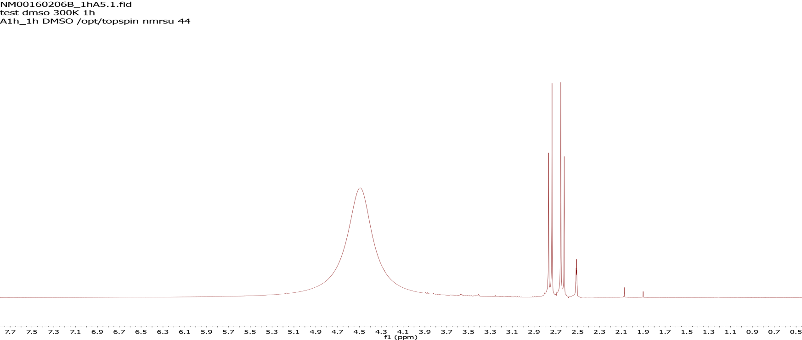
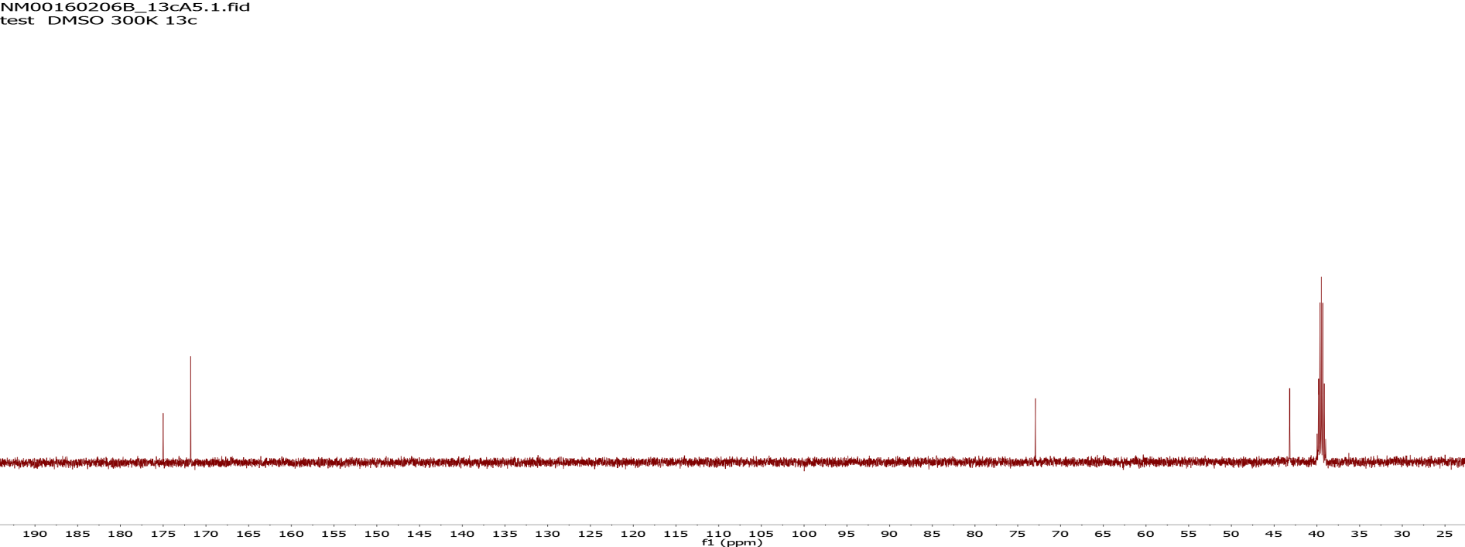
NM00160206B in DMSO
D₂O
CDCl₃

Slide 37
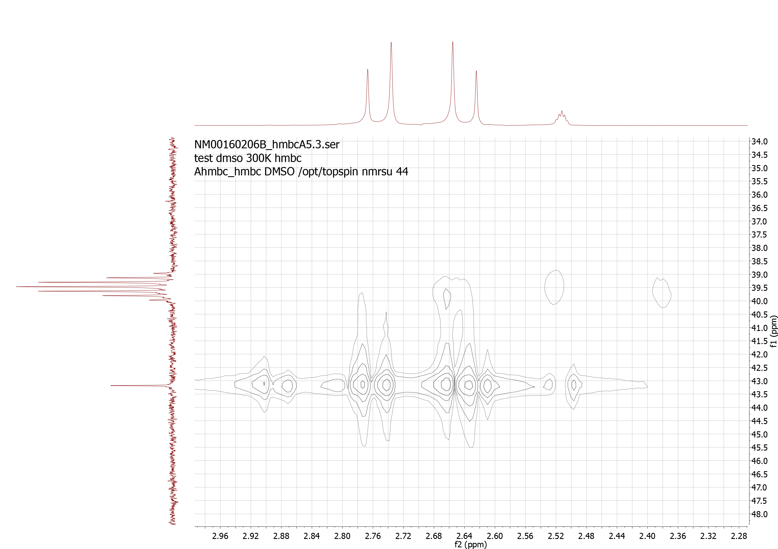
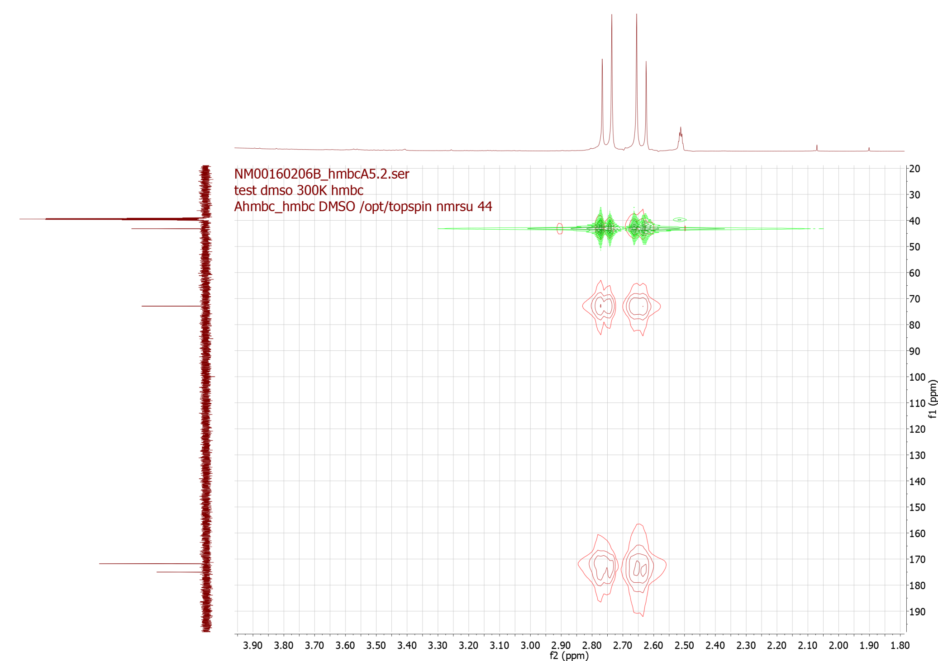
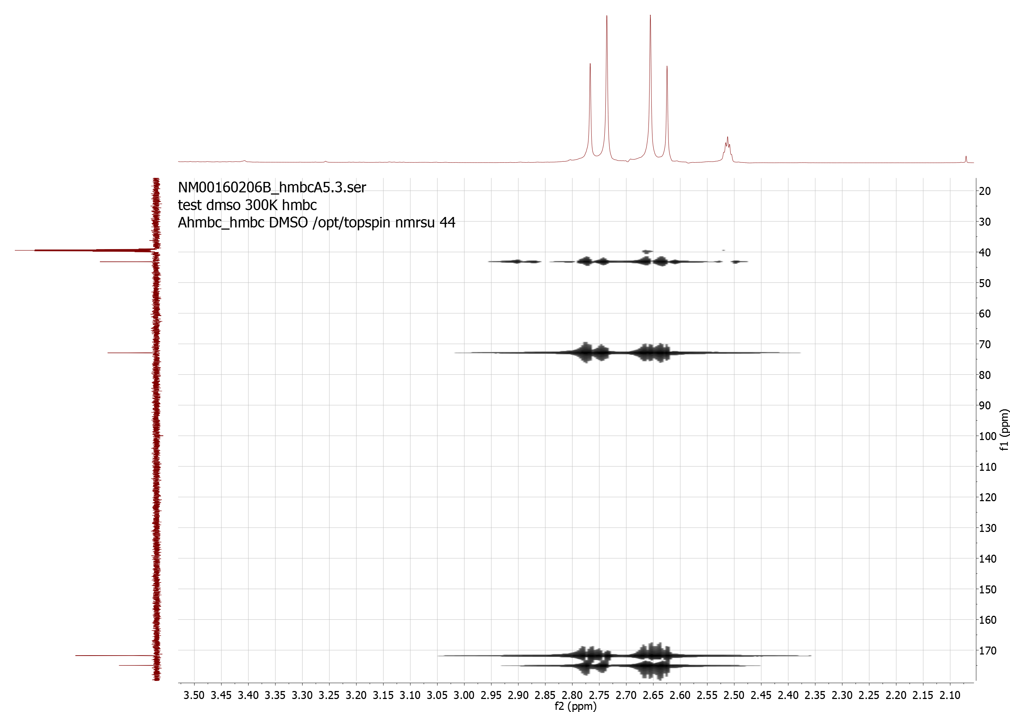
NM00160206B in DMSO
D₂O
CDCl₃

Slide 38
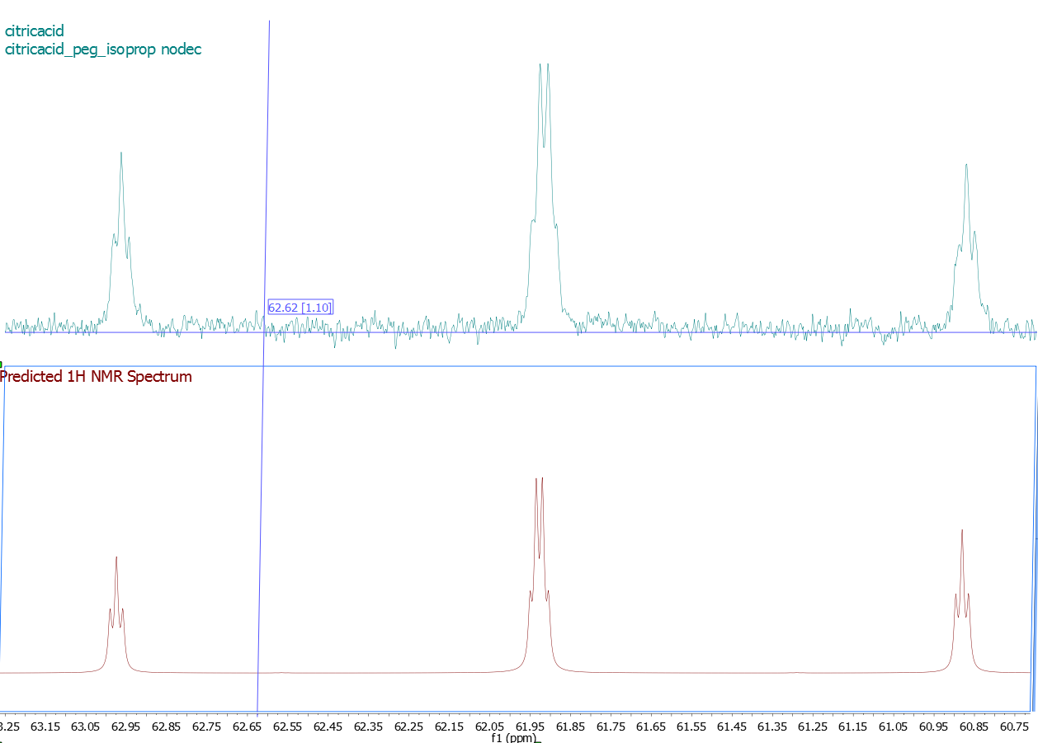
Spinsimulation

Slide 39
HSQC (2D Hetero Nuclear Correlation)
Heteronuclear Single Quantum Correlation HSQC
90°
180°
90°
180°
90°
180°
1H (I)
1/2J
1/2J
t₁/2
t₁/2
1/2J
1/2J
acquisition
180°
90°
t₁ incremented
90°
180°
13C (S)
decoupling
I_{z} , S_{z}
I_{x} ,S_{z}
I_{x} , I_{y}, I_{y}S_{z},S_{z}
I_{x} , I_{y}S_{z}, S_{z}
I_{x} , I_{z}S_{y}, S_{y}
I_{x} , I_{z}S_{x}, S_{y}, S_{x}
I_{x} , I_{z}S_{x}, S_{x}
I_{x} , I_{z}S_{y}, S_{y}
I_{z} , I_{x}S_{z}, S_{z}
I_{z} , I_{y}, S_{z}
B₀ evolution t₁
Δω_{carbon} t
B₀ evolution t₂
Δω_{proton} t
Z-gradient
4
1
J = 120 – 160 (250) Hz ¹J Couplings, 2-8 Hz ^{2,3}J Couplings

Slide 40
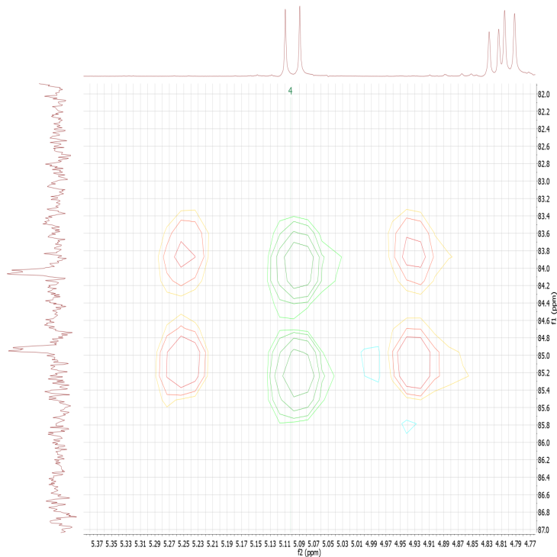
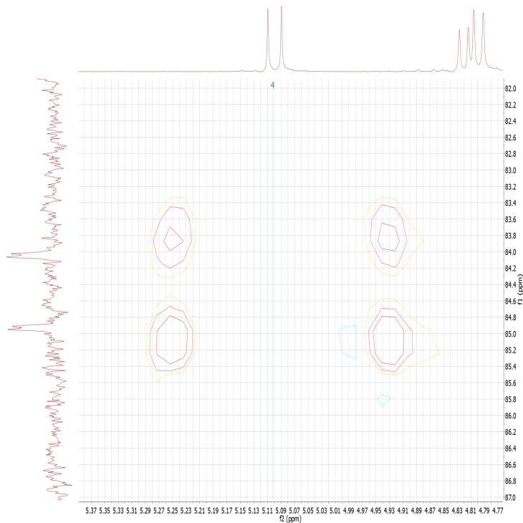
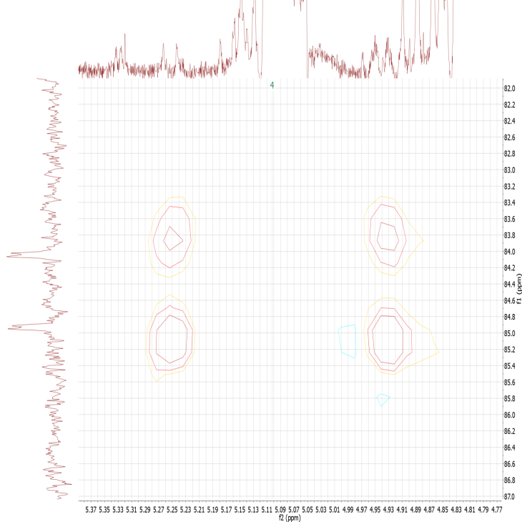
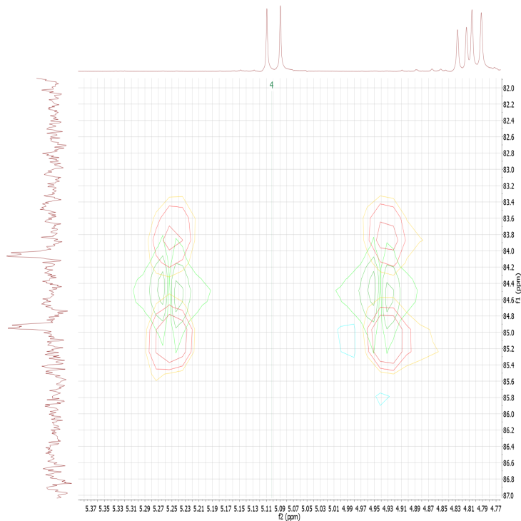
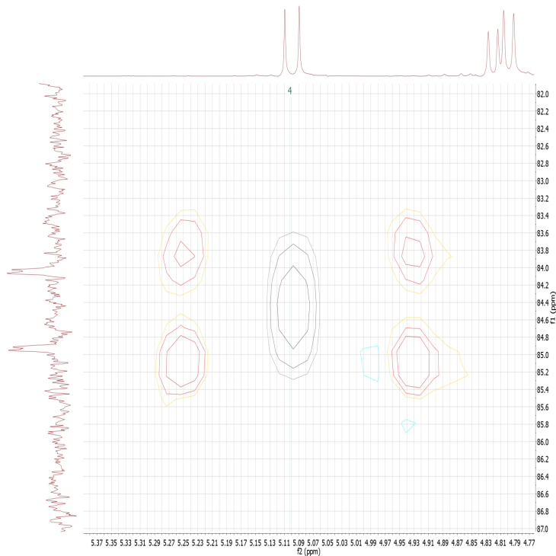
HSQC without Decoupling
⁴
acq
acq
acq
acq
dec
dec

Slide 41
HSQC
Heteronuclear Single Quantum Correlation HSQC
90°
180°
90°
180°
90°
180°
1H
1/2J
1/2J
t₁/2
t₁/2
1/2J
1/2J
acquisition
180°
90°
t₁ incremented
90°
180°
13C
decoupling
Z-gradient
4
1
J = 120 – 160 (250) Hz ¹J Couplings, 2-8 Hz ^{2,3}J Couplings

Slide 42
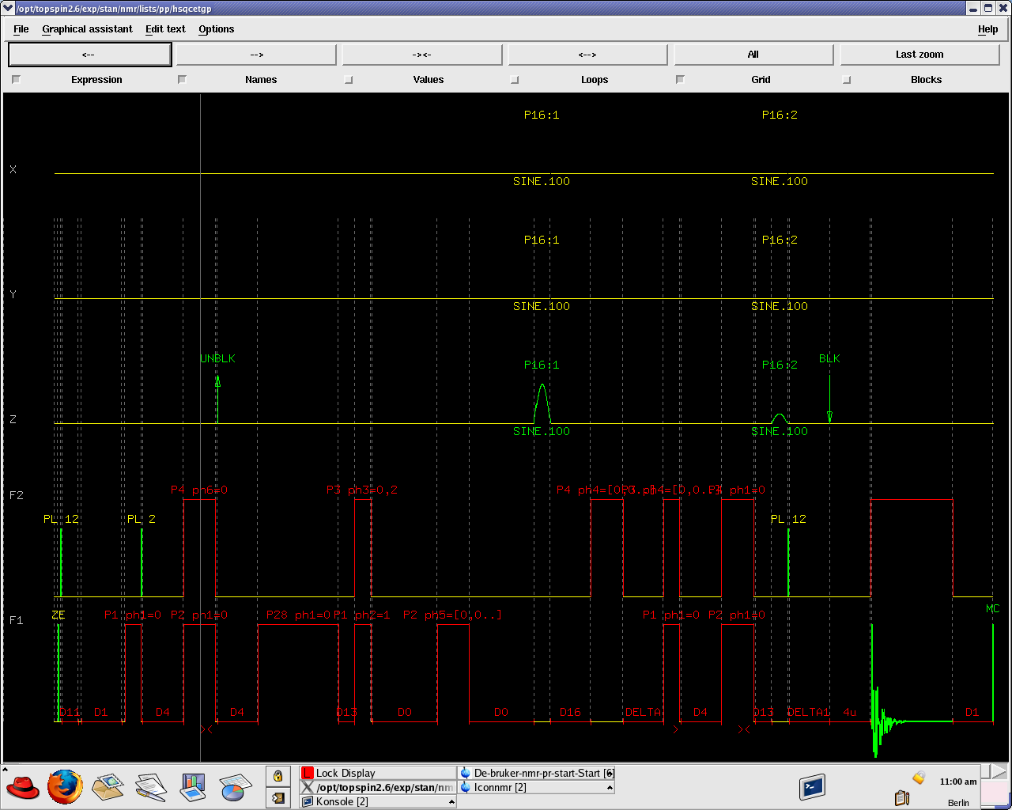
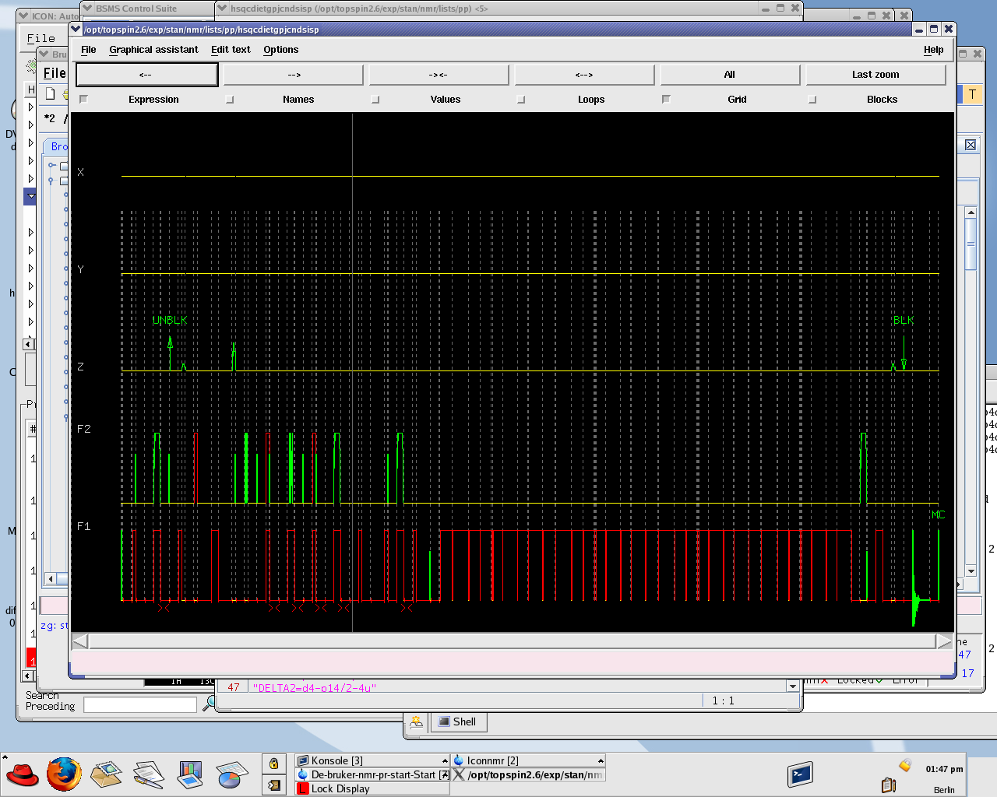
HSQC

Slide 43



HSQC

Slide 44

Edited HSQC.
¹³C
J ca. 140 Hz
CH3
CH3
CH3
CH3
J ca. 2 Hz
Cross peaks originating from CH and CH3 groups have opposite sign than those arising from CH2 carbons.
CH2
CH

Slide 45

Edited HSQC
-OH
CH3-CN
MeOD D2
CH3
CH3
CH3
CH3
CH2
CH3
CH3
CH2
CH
CH2
CH2
CH

Slide 46

Oligosaccharide AV500
ΝHAc
CH2-chain
CH2-chain
H2NCH2-chain
H2NCH2-chain
CHNHAc
CH2OH
CH2OH
ΟCH2-CH
OCH2R
OCH
OCH
αCH
αCH
βCH
βCH

Slide 47

Polysaccharide AV500
ΝHAc
CH2-chain
CH2-chain
H2NCH2-chain
H2NCH2-chain
CHNHAc
CH2OH
CH2OH
13C exp. time 3h
ΟCH2-CH
OCH2R
OCH
OCH
αCH
αCH
βCH
βCH

Slide 48

Edited HSQC Polysaccharide AV500
exp. time 1h
ΝHAc

Slide 49

Edited HSQC Polysaccharide AV500
CH2OH
CH2OH
ΟCH2-CH
OCH2R
OCH
OCH2R
OCH

Slide 50

Edited HSQC Polysaccharide AV500
αCH
αCH
βCH
βCH

Slide 51



HMQC / HETCOR
There exists a method for direct observation of C-H correlations as well.
HMQC
90°
180°
1H
1/2J
t₁/2
t₁/2
1/2J
Advantage:
S/n 8 times better
acquisition
90°
90°
Draw back:
Central lines (99%) have to be suppressed
13C
decoupling
HETCORR
180°
90°
acquisition
13C
I_{z}
t₁/2
t₁/2
1/2J
I_{y}S_{z}
1/2J
I_{x}
90°
90°
1H
S_{z}
S_{x}
S_{x}
I_{z}S_{y}
decoupling

Slide 52

HMQC / HETCOR
Cyclosporine (ciclosporin)

Slide 53
Cyclosporine HMQC and HETCOR
180°
90°
13C
t₁/2
t₁/2
1/2J
1/2J
acquisition
90°
90°
1H
decoupling
13C in f2
1H in f2
13C in f1
1H in f1
HETCORR
HMQC

Slide 54
HMQC-HMBC vs. HETCOR
1/3J
Intensity of 2 1H signals
Intensity of 1 13C signal
Intensity of 1 13C signal
Intensity of 1 13C signal
Intensity of 2 1H signals
Intensity of 2 1H signals
7.5
7.0
190
60
40
190
60
40
7.0
7.5
HMBC
HETCORR

Slide 55

Sucrose HETCOR J=140Hz
1
5
3
4
3
5
2
4
6
1
6
H
CH2OH
4
6
H
HO
5
3
2
1
H
HO
H
OH
CH2OH
H
1
O
O
H
2
H
5
HO
3
4
6
CH2OH
1
OH
H

Slide 56
HMQC / HETCOR
H
CH2OH
4
6
H
HO
5
3
2
1
H
HO
H
OH
CH2OH
H
1
O
O
H
2
H
5
HO
3
4
6
CH2OH
OH
H

Slide 57

Sucrose HETCOR J=4Hz
2
1
5
3
5
3
4
2
4
6
1
6
2
4
1
2,1
3,1,1´
1,1,1´
3
6
6
5
5,6
5
3,4
4
5,4
4,4
6,4
3
4,3
1,3
H
CH2OH
3,3
4
6
H
HO
5
3
2
1
H
HO
6OH
H
OH
CH2OH
6OH
H
1
3OH
O
O
H
2,3OH
2
H
5
3OH
HO
4OH
2,1OH
3
4
1,1OH
1OH
6
CH2OH
2OH
1,2OH
OH
H
2,2OH
1
2,1
3,1
4OH
5,4OH

Slide 58
HMBC / HETCOR
H
CH2OH
O
4
6
H
HO
5
3
2
1
H
HO
H
OH
CH2OH
H
1
O
O
H
2
H
5
HO
3
4
6
CH2OH
OH
H

Slide 59
1⁵N- ¹H- Korrelation
Η−Ν
Η−Ν
Η−Ν
Η−Ν
Η−Ν
Η−Ν
Η−Ν
Η−Ν
Η−Ν
Η−Ν
Η−Ν
Η
Η
Ν
Η
Η

Slide 60




¹⁵N- ¹H- Korrelation
¹⁵N- ¹H- Correlation
1H in f2
15N in f1

Slide 61

Peptide ¹⁵N- ¹H- Correlation HSQC
amide region
1H in f2
15N in f1
back folded signals

Slide 62

¹⁵N- ¹H- Korrelation
Peptide ¹³C- ¹H- Correlation
aliphatic residue region
1H in f2
13C in f1

Slide 63


Noble Laureate 2002
Kurt Wüthrich

Slide 64


¹H- ¹⁹F- HMBC / ¹⁹F- ¹H- HMBC
CF3
CH3
CH2
¹H
¹⁹F
CF2
CH3
¹⁹F
only 1H-1Hcouplings
¹H
CH2
CF3
only 19F-19F couplings
19F -1H Cosy would not work comparably. Due to the vast spectral range of 19F only a short dwell time can be used. Therefore the evolution period (t1) will be too short (compared to 1/J(1H19F) to generate cross peaks.

Slide 65
³¹P- ¹³C- Couplings
8 Hz
³¹P
6.3 Hz
7.7 Hz
¹³C
Notes:
p31tst /z/data/schaefer/nmr

Slide 66
³¹P- ¹³C- HMQC
³¹P -¹³C HMQC

Slide 67
¹³C- ¹³C- Couplings
1J CC sp-sp 150-180 Hz sp2-sp 80 – 130 Hz sp3-sp, sp2-sp2 50 -80
sp3–sp3 35-50 Hz
13C satellites
13C satellites
50-60 Hz
34Hz
¹³C
I

Slide 68
1D Inadequate ¹³C- ¹³C Couplings
Incredible Natural Abundance Double Quantum Transition Experiment
equimolar mixture of ethanol and isopropanol
¹H
¹³C

Slide 69
1D- Inadequate ¹³C-¹³C Couplings
J=37.5 Hz
13C
J=38.3 Hz
13C
13C
13C
13C
38.46
37.52
38.15
37.52
8058.90
8020.44
7229.67
7192.15
3091.35
3053.20
2211.78
2174.26

Slide 70


Example 1H
Si Me₂ Cl

Slide 71








Example 1D Inadequate
1D-Inadequate
33.7
33.7
37.7
33.1
28.0
29.9
29.4
8.7
26.5
26.7
8.7
6.3 , 4.0
31 ppm
49 ppm
40 ppm
39 ppm
28.1
5.6
32.7
37.2
33.2
33.7
2.5
27.5
28.3
23 ppm
3.9
5.4
37.9
3.6
27.3 ppm
27.0 ppm
25.0 ppm
24.7 ppm
20 ppm

Slide 72
Example 1D Inadequate
27.3
Si Me₂ Cl
33.7
37.7
33.7
29.9
29.4
28.0
26.5
26.7
8.7
31
8.7
6.3 , 4.0
25
49
20
39
27
40 ppm
39 ppm
49 ppm
23
24
40
33.1
31
27
23
20
25
40
31 ppm
27.3
24
49
39

Slide 73




2D Inadequate Double and Zero Quantum
90°
180°
90°
135°
relaxation
1/ 4J
1/ 4J
t₁
t₁ acquisition
2192
2192
4375
9399 = 7212+2192
3070
3070
6137
9902 = 2*( 8040 – 3070)
3070
11098 = 8040+3070
7212
7212
9399 = 7212+2192
14424
8040
9902 = 2*( 8040 – 3070)
8040
16080
8040
11098 = 8040+3070

Slide 74

Example 2D- Inadequate
49
40
39
31
27.3
27
25
24
23
20
27.3
Si Me₂ Cl
31
25
49
20
39
27
24
23
40
common double quantum transitions (cross peaks) indicate a 1J coupling which is a prerequisite for their generation.

Slide 75


Example 2D- Inadequate
33.7
28.0
37.7
33.7
29.4
8.7
28.1
29.9
28.2
28.1
26.7
28.2
26.5
6.3 , 4.0
8.7
49 ppm
39 ppm
40 ppm
27
23
39 ppm + 27ppm =66 ppm
24
27.3
Si Me₂ Cl
31
25
20
39
49
27
23
24
40
40
39
49

Slide 76
2D- Inadequate Long Range Couplings
49
40
39
31
27.3
27
25
24
23
20
27.3
Si Me₂ Cl
31
25
49
20
39
27
24
23
40
Long range couplings may give rise to double quantum transitions as well. Zero or negative transitions might also be found. Back folding has to be taken into account.

Slide 77

Example HMQC
25
20
27
Si Me₂ Cl
24
23
27.3
49
27.3
31
23
40
25
27.3
Si Me₂ Cl
identify CH2
31
25
49
20
39
27
24
23
40

Slide 78
Example HMQC
25
20
27
Si Me₂ Cl
24
23
27.3
49
27.3
31
23
40
25
27.3
Si Me₂ Cl
identify CH2
31
25
49
20
39
27
24
23
40

Slide 79

Example COSY
25
20
27
Si Me₂ Cl
24
23
27.3
49
27.3
Si Me₂ Cl
31
23
40
25
27.3
31
25
49
20
39
27
24
23
40

Slide 80

Example HMBC
25
20
27
Si Me₂ Cl
24
23
27.3
49
27.3
Si Me₂ Cl
31
23
40
25
27.3
Si Me₂ Cl
31
25
49
20
39
27
24
23
20
40
23
25
24
27.3
27
31
39
40
49

Slide 81

Example HMBC
27.3
Si Me₂ Cl
31
25
49
20
39
27
24
23
40

Slide 82

Example 1H
27.3
Si Me₂ Cl
31
25
49
20
39
27
24
23
27
20
Si Me₂ Cl
40
40
49
24
25
31
24
27.3
25
23
23
27.3
20
27
25
Si Me₂ Cl
24
31
23
40
49
25
27.3
23
27.3

Slide 83

Example 13C
27.3
Si Me₂ Cl
31
25
49
20
39
20
27
Si Me₂ Cl
27
24
23
40
23
24
25
27.3
49
40
31
39
40
27
25
23
20
31
Si Me₂ Cl
49
24
27.3
39

Slide 84

Example 1H
27.3
Si Me₂ Cl
OH
31
25
49
20
39
27
27
20
Si Me₂ Cl
24
23
40
24
40
49
31
24
25
23
27.3
27.3
23
25
20
27
25
Si Me₂ Cl
24
31
23
40
49
25
27.3
23
27.3

Slide 85

Example 13C
27.3
Si Me₂ Cl
OH
31
25
49
20
39
27
24
23
40
20
27
Si Me₂ Cl
23
24
25
27.3
49
40
31
39
40
27
25
23
20
31
Si Me₂ Cl
49
24
27.3
39

Slide 86

GRAZED Experiment
H₂O
DMSO
Acetone
´¹H
t₁
t₂
90
90
Z-gradient
2
1
4.0= 2.0+2.0
A different choice of gradient amplitude from that used in a COSY experiment ( one to one) yields double quantum coherences, which appear as artefacts in an ordinary COSY (only phase cycling).
5.0= 2.5+2.5
6.3= 4.3+2.0
6.8= 4.3+2.5
One 90° pulse suffices when starting from an higher order equilibrium magnetization M₀ = exp(-H/kT) =
1 - H/kT + H²/(kT)² + ...
H² = (I_{Z}+S_{Z})² = ... + I_{Z}S_{Z}
90° pulse converts I_{Z}S_{Z} into DQT I_{X}S_{X}
8.6= 4.3+4.3

Slide 87
1D NOESY Experiment
t₁
t_{mix}
acquisition t₂
n₁
2D
n_{S}
n_{I}
n₂
Any two dimensional experiment can be transformed into a set of one dimensional ones by means of selective pulses.
_{P90sel.}
n_{S}
t_{const}
t_{mix}
acquisition t₂
Z-Gradient
n_{I}
1D
n_{S}
n₂

Slide 88

GOESY (e.g.)
Gradient aided NOSY (one dimensional )

Slide 89


Beispiele für chemischen Austausch
GOESY
7
7´
1
5
4
3
Ph-CH2
6
1
2
2
3
4
5,5´
7
6´
6

Slide 90
1D HMQC/HMBC Experiment
1H
1/2J
t₁/2
t₁/2
1/2J
acquisition
t₁ incremented
90°
90°
13C
decoupling
Any two dimensional experiment can be transformed into a set of one dimensional ones by means of selective pulses.
1H
1/2J
Fixed t₁
1/2J
acquisition
t₁ fixed
Fixed t₁
90°
13C
_{P90sel.}
decoupling
Z-Gradient
5
3
4

Slide 91

1D HMQC (e.g.)
DEPT test sample

Slide 92

1D HMQC (e.g.)
DEPT test sample
1J 129.59 Hz
2J 4.68 Hz
1J 124.90 Hz
2J 2.21 Hz

Slide 93

1D HMQC (e.g.)
139.6 Hz

Slide 94


1D HMQC (e.g.)

Slide 95

1D HMQC (e.g.)

