Slide 1
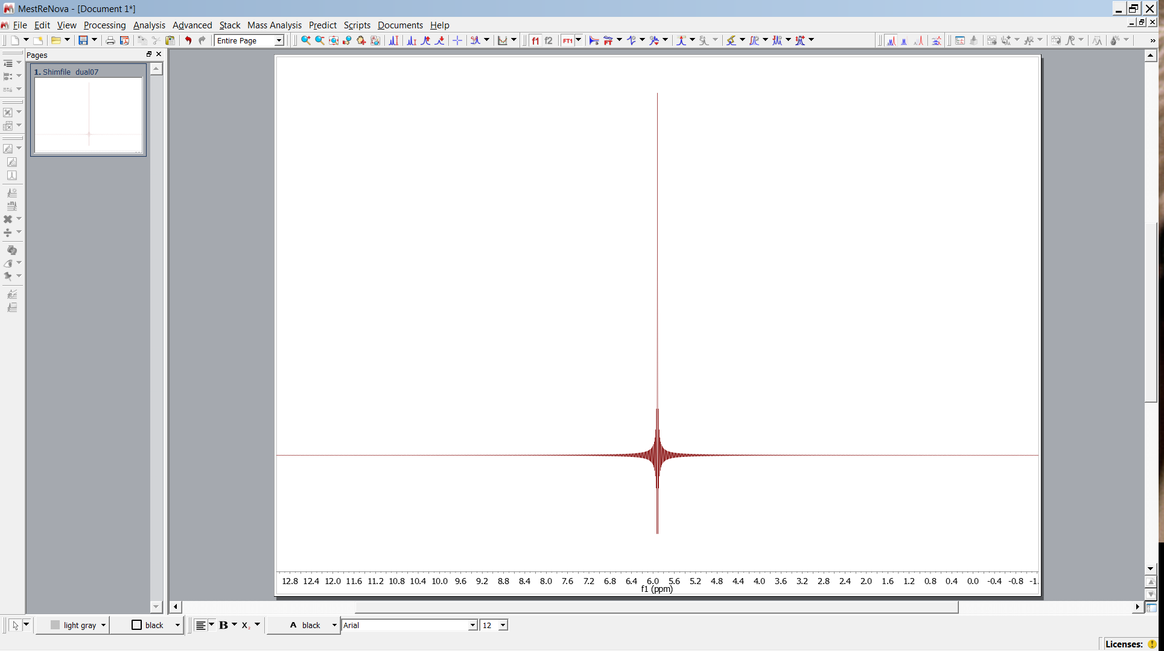
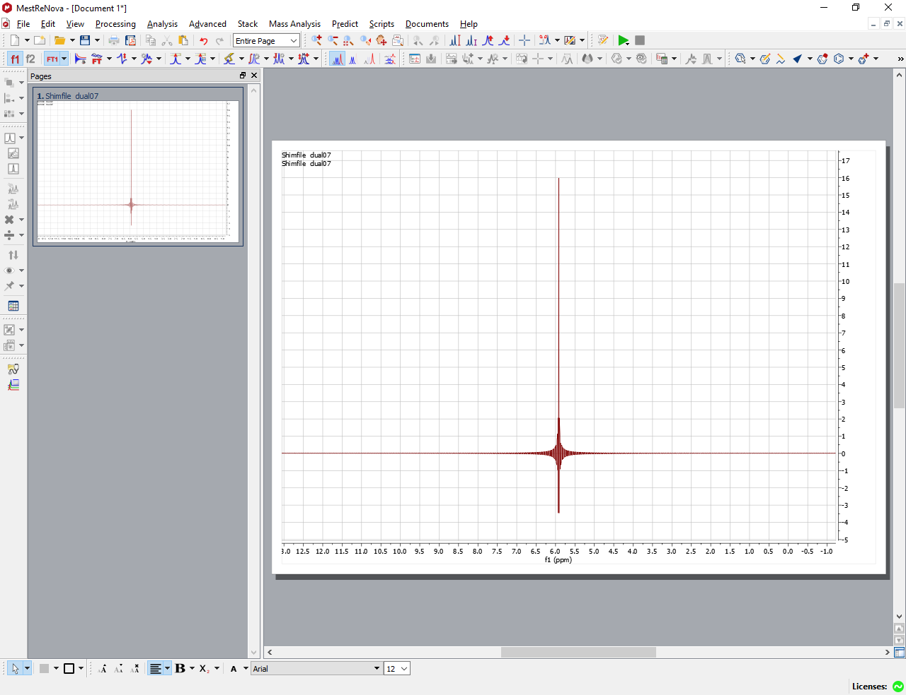
MNOVA
old design version 10
new design version 12 classic

Slide 2
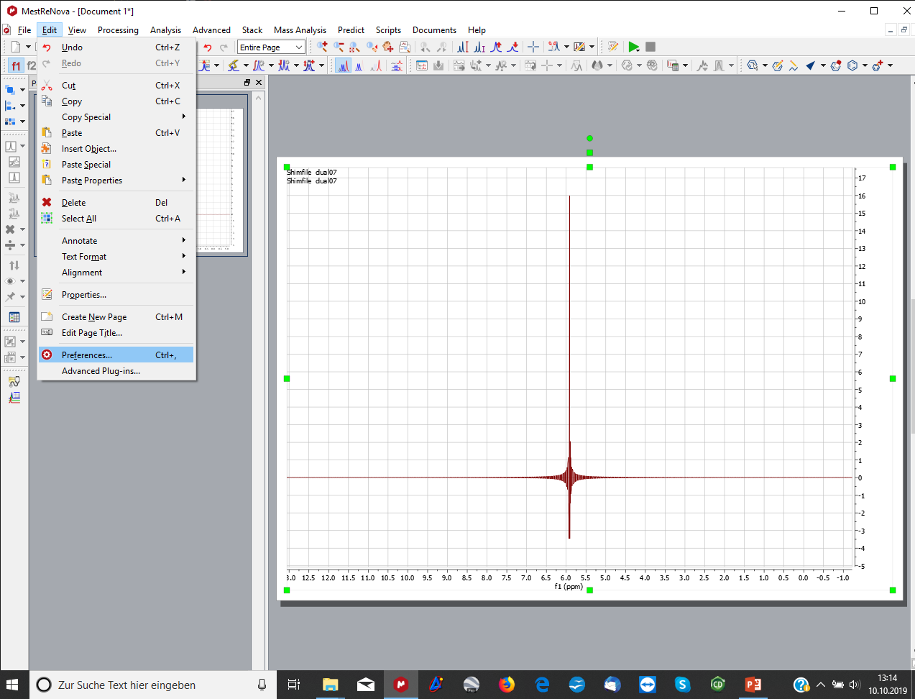
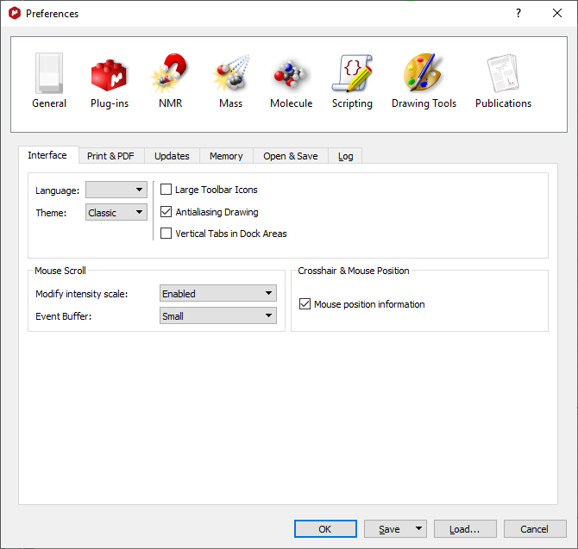
Change Design

Slide 3
Rectangle
open rechteck-1.jdf

Slide 4
Rectangle
open rechteck-1.jdf

Slide 5
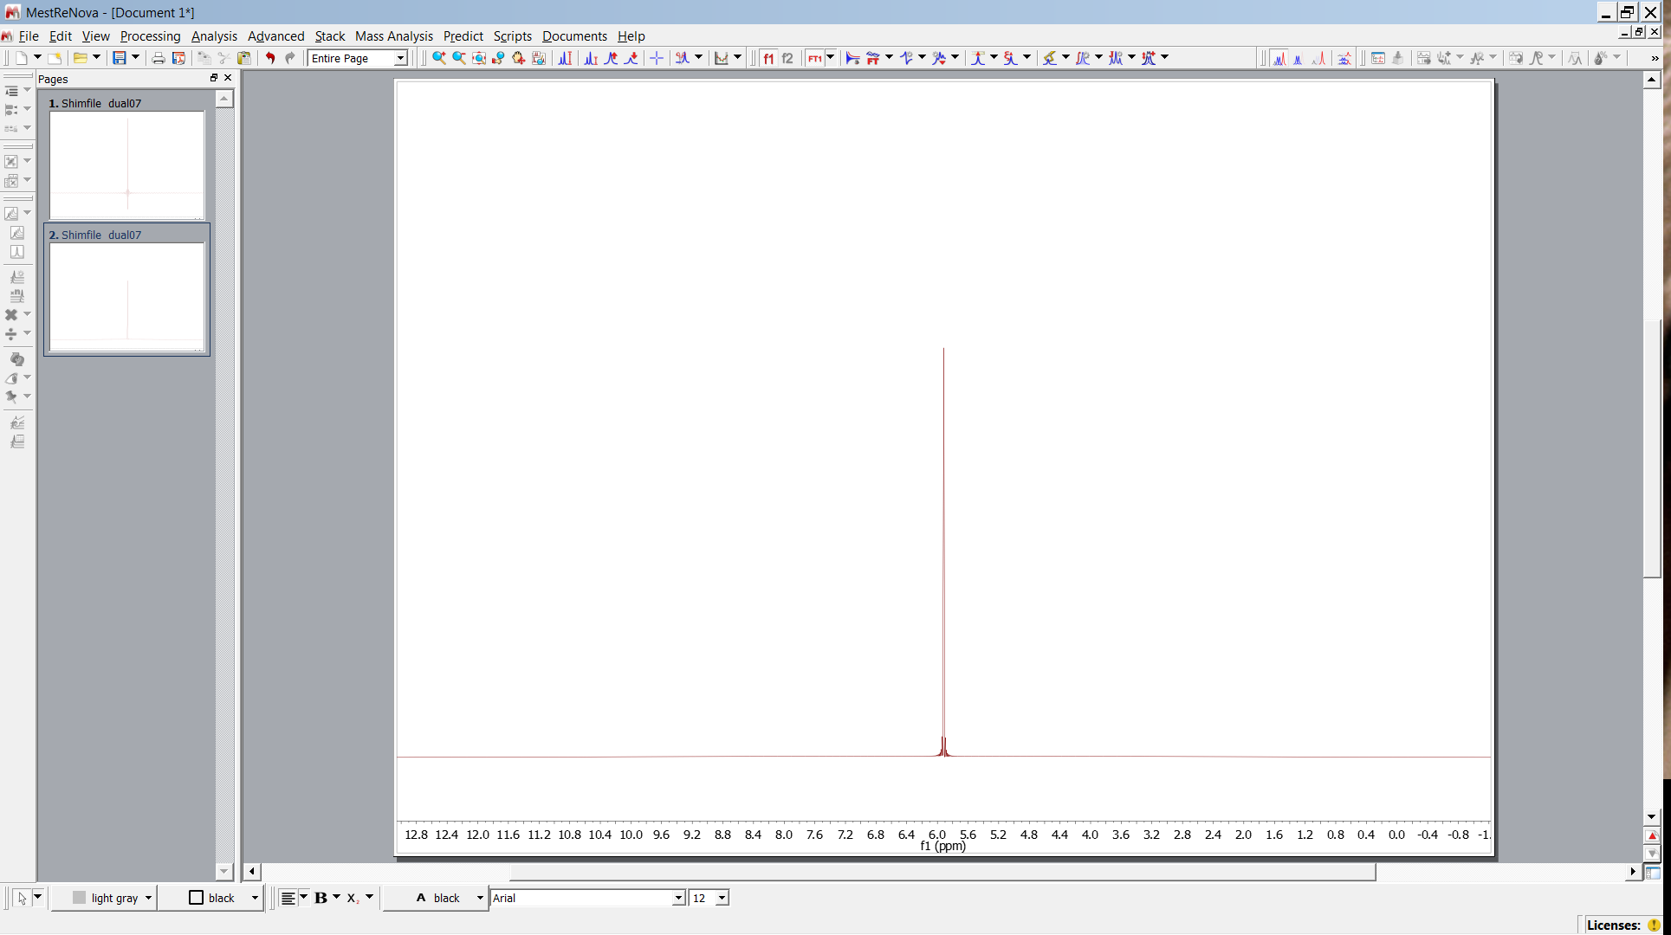
Triangle
open dreieck-1.jdf
change size of pages

Slide 6
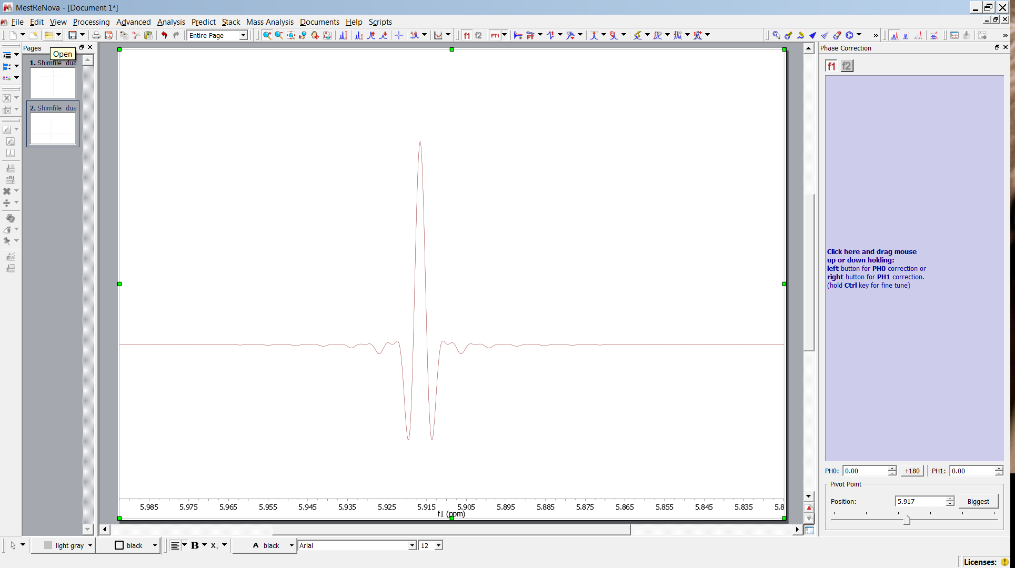
Rectangle
open rechteck-1.jdf
open dreieck-1.jdf
activate

Slide 7
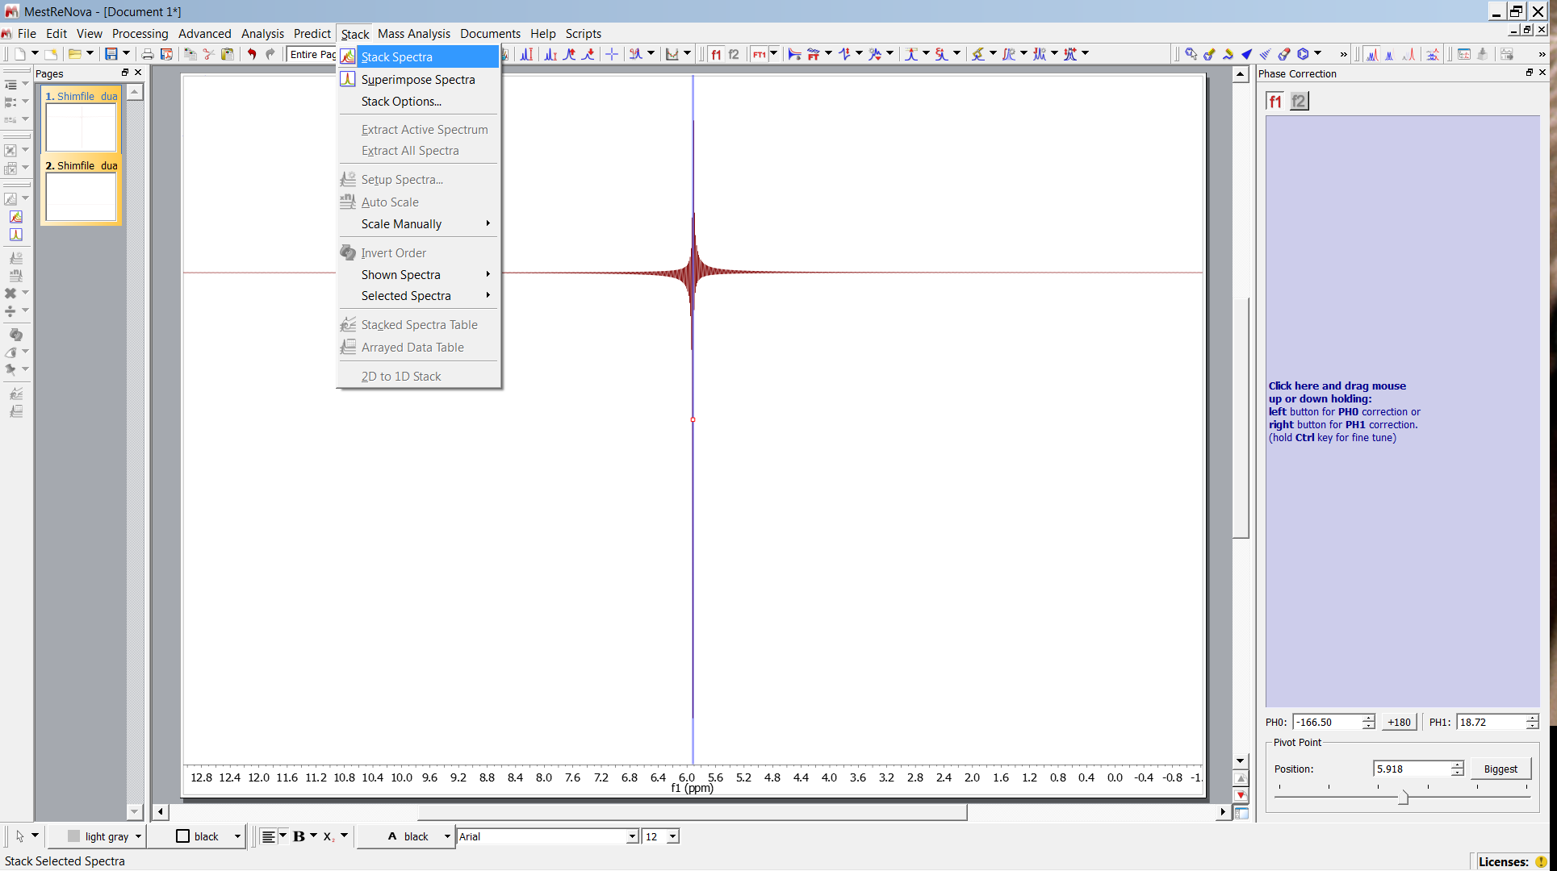
Rectangle

Slide 8
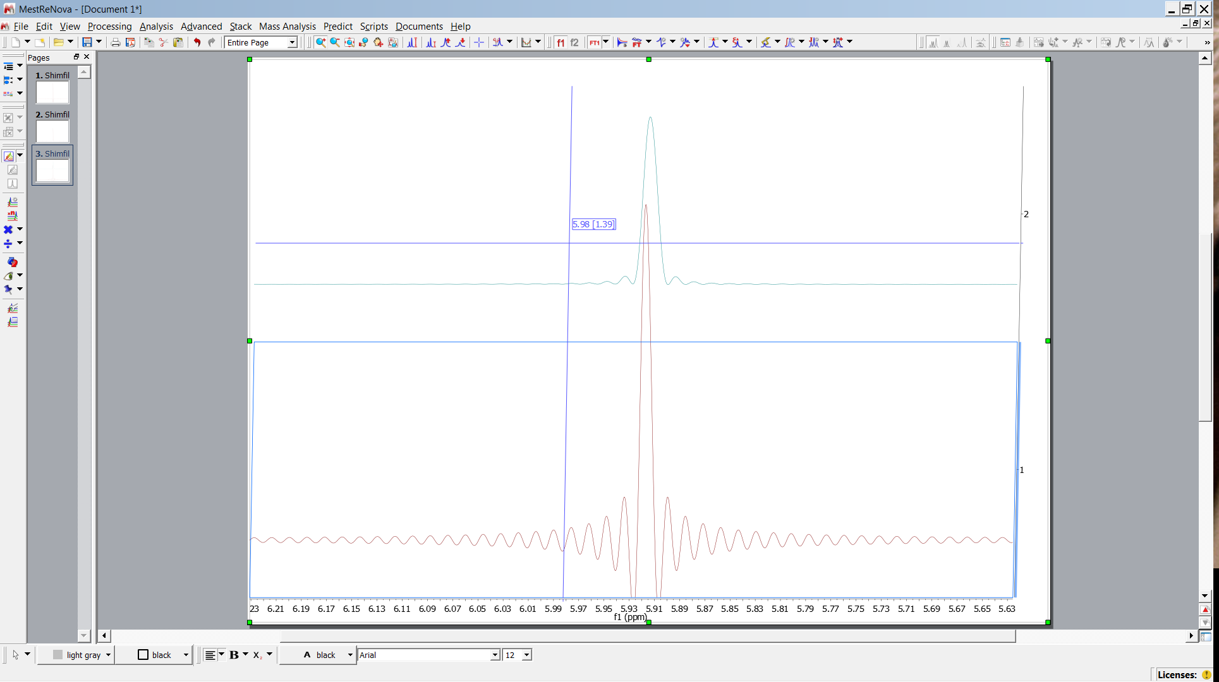
Rectangle
Use mouse to expand
Use mouse wheel to scale

Slide 9
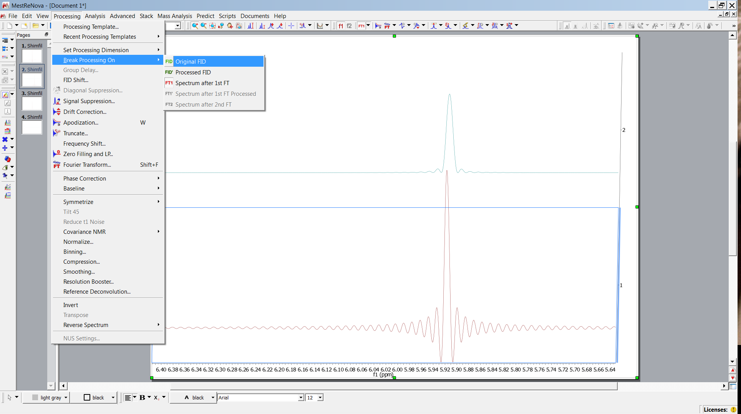
Rectangle

Slide 10
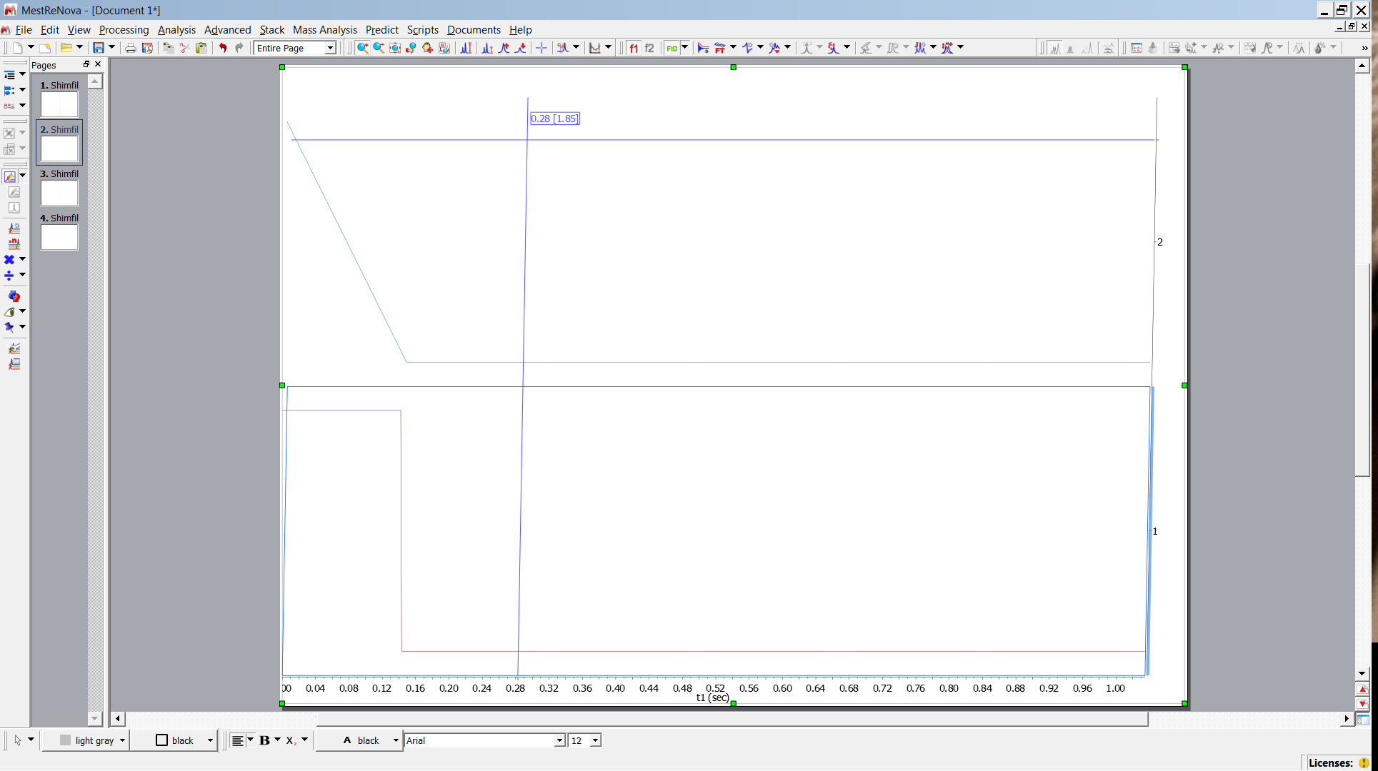
Compare “FIDs”

Slide 11
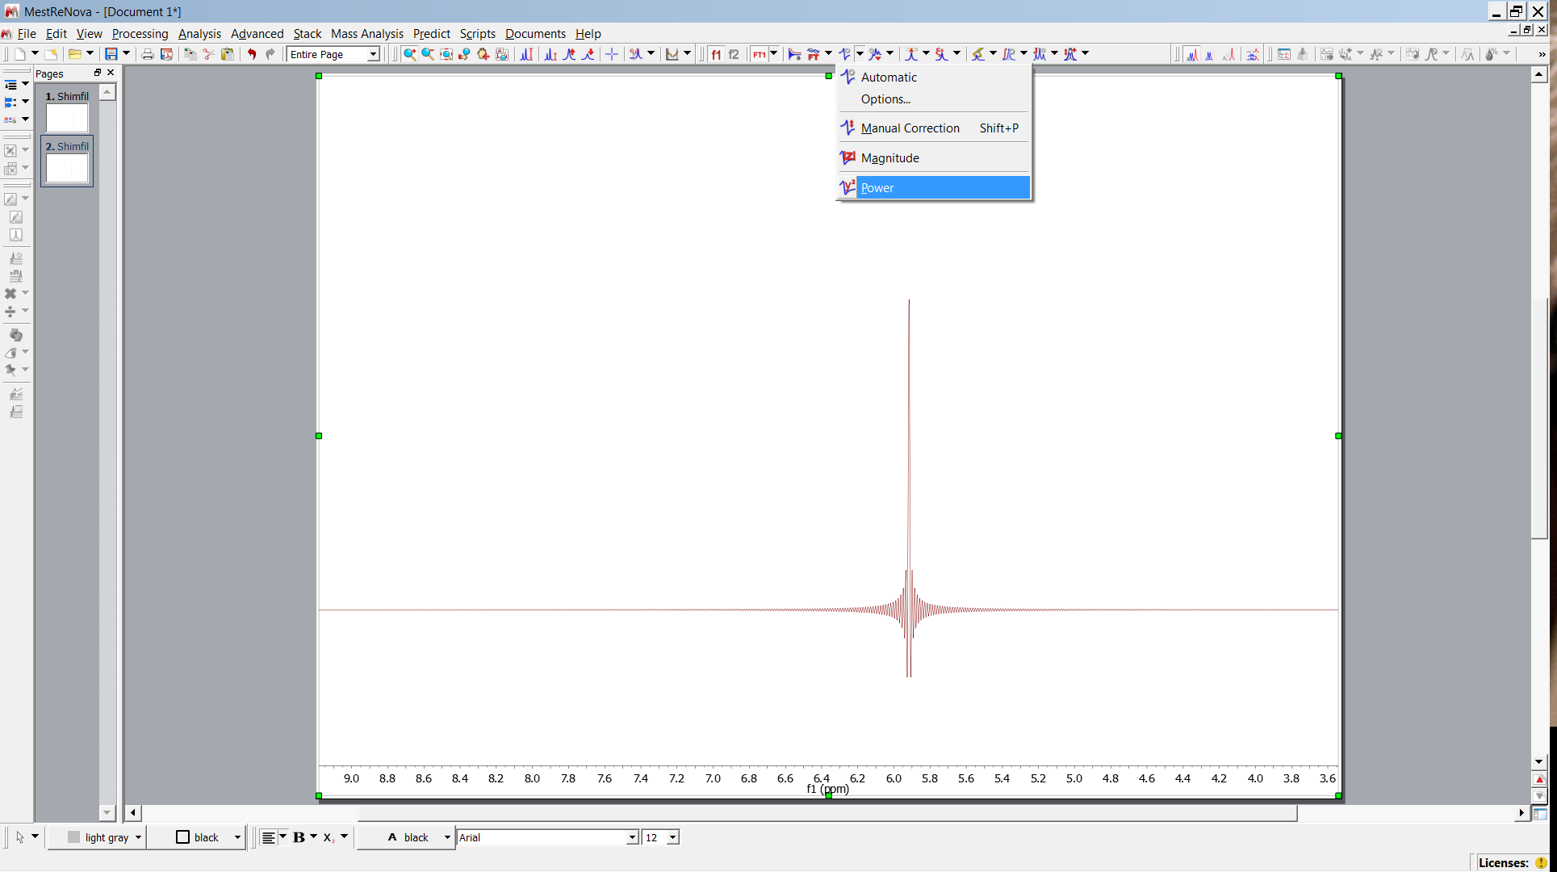
Convolution
rectangle # rectangle = triangular function
# Π = Δ
FT( Π ) = sinc
FT( Π # Π ) = sinc² = FT ( Δ )

Slide 12
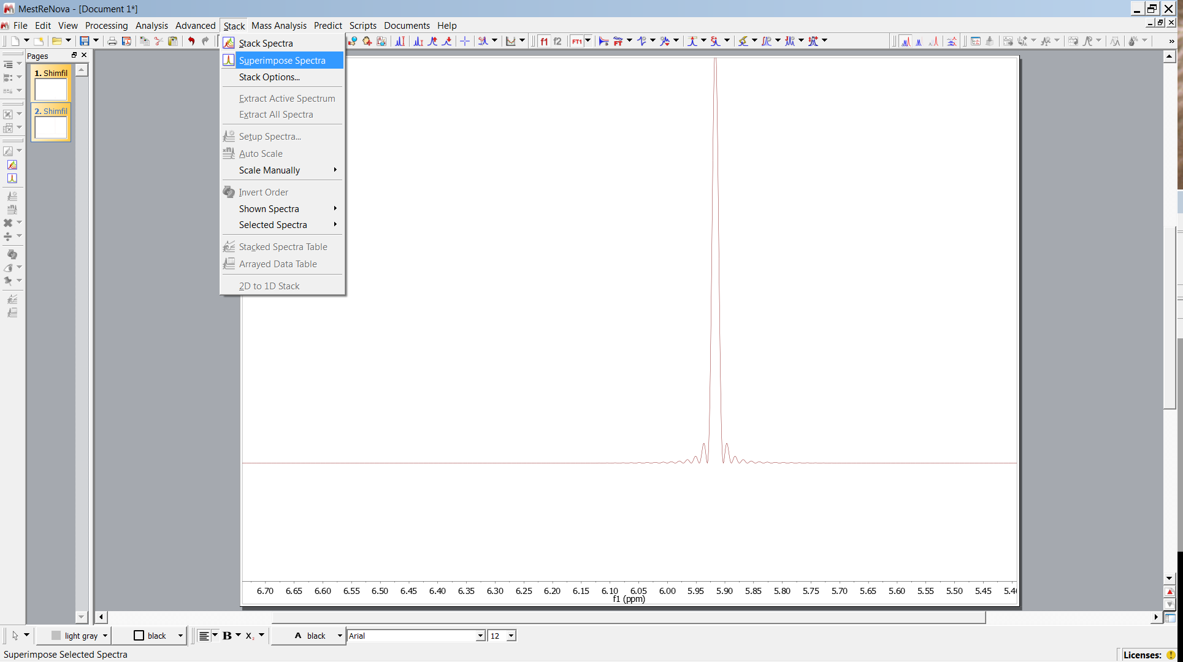
Convolution

Slide 13
Convolution

Slide 14
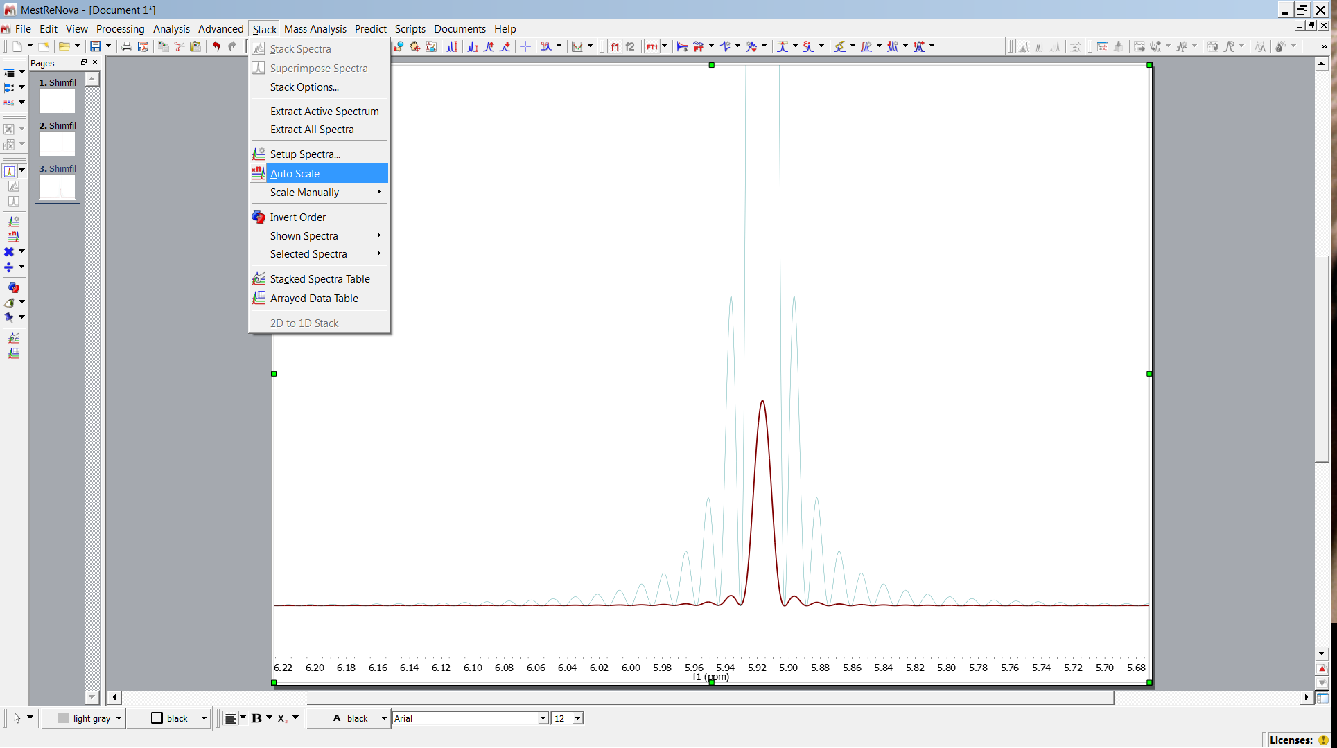
Convolution

Slide 15
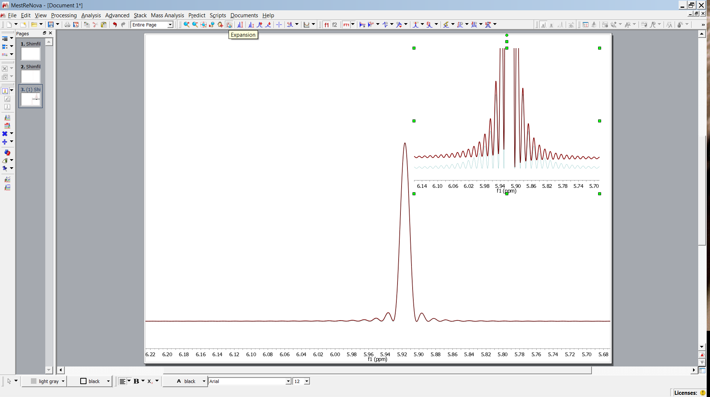
Convolution

Slide 16
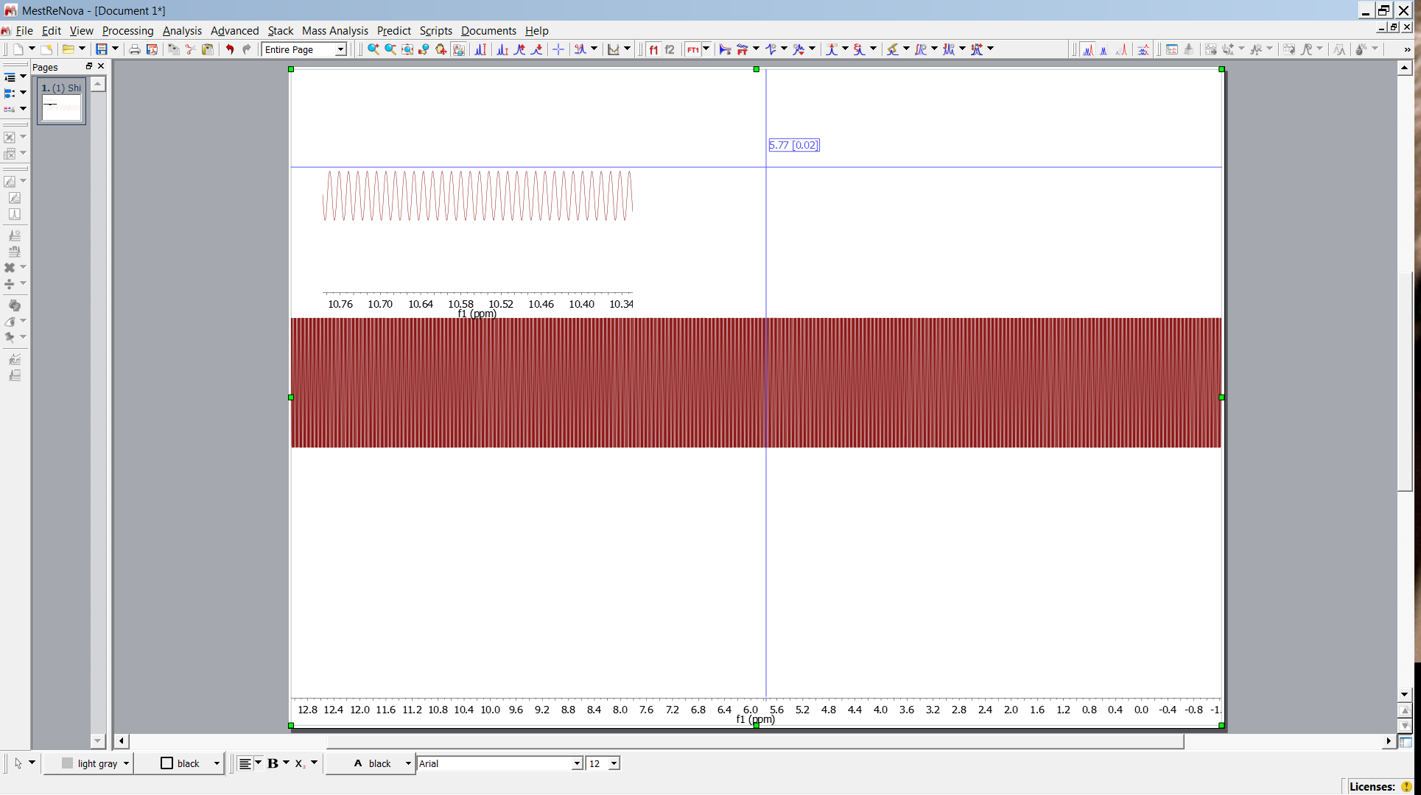
Delta Function
open delta-1.jdf

Slide 17
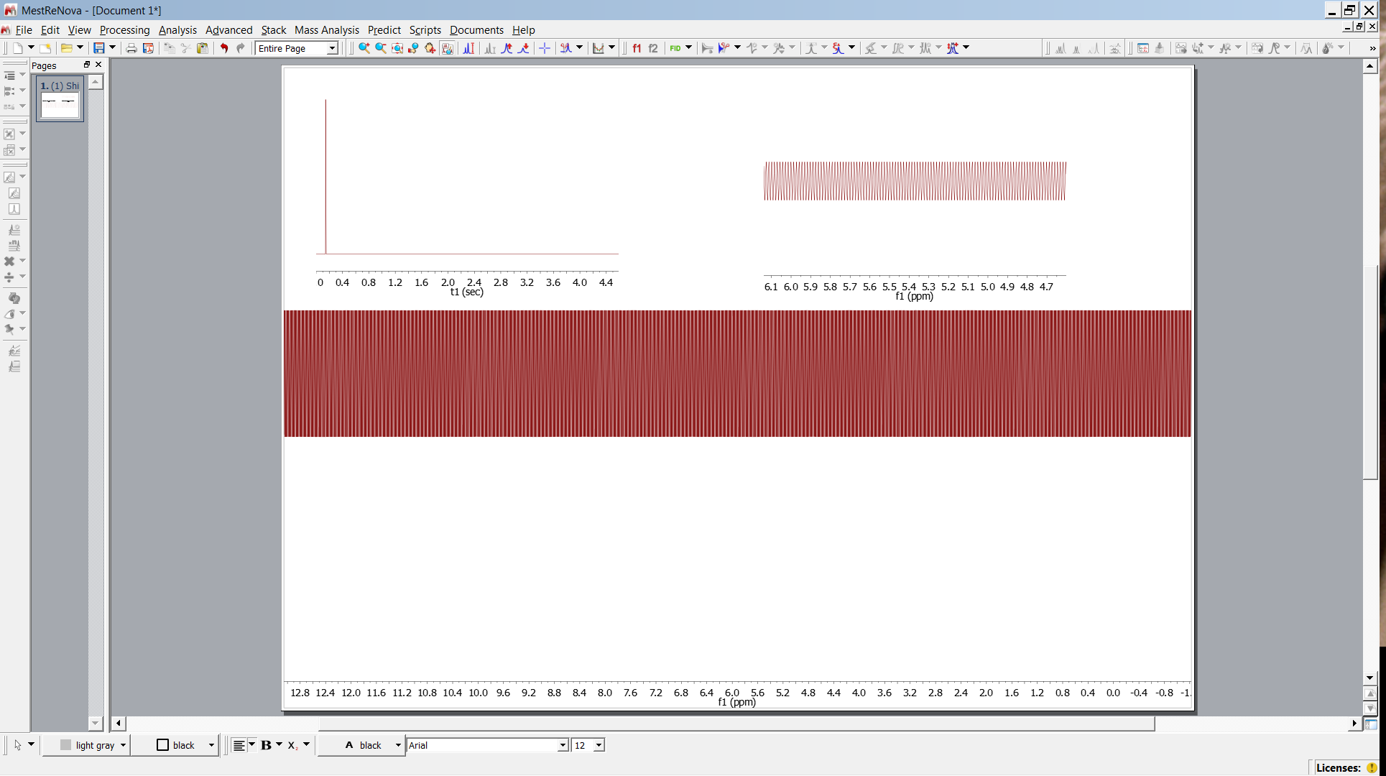
Delta Function
original FID
expansion

Slide 18
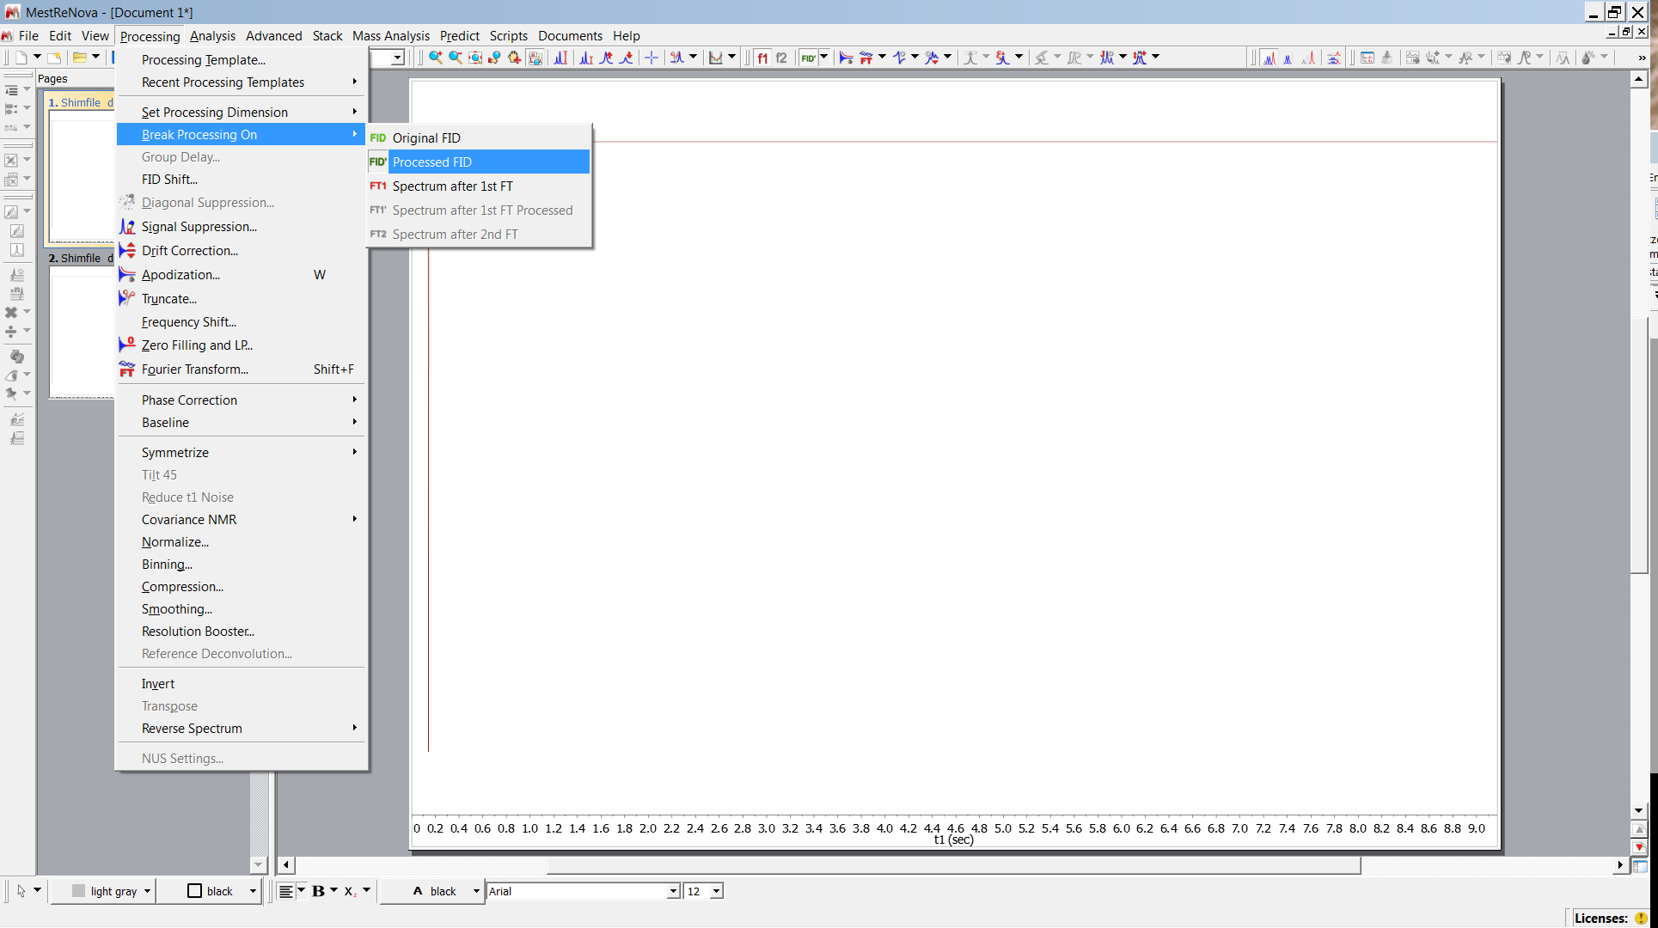
Delta Function

Slide 19
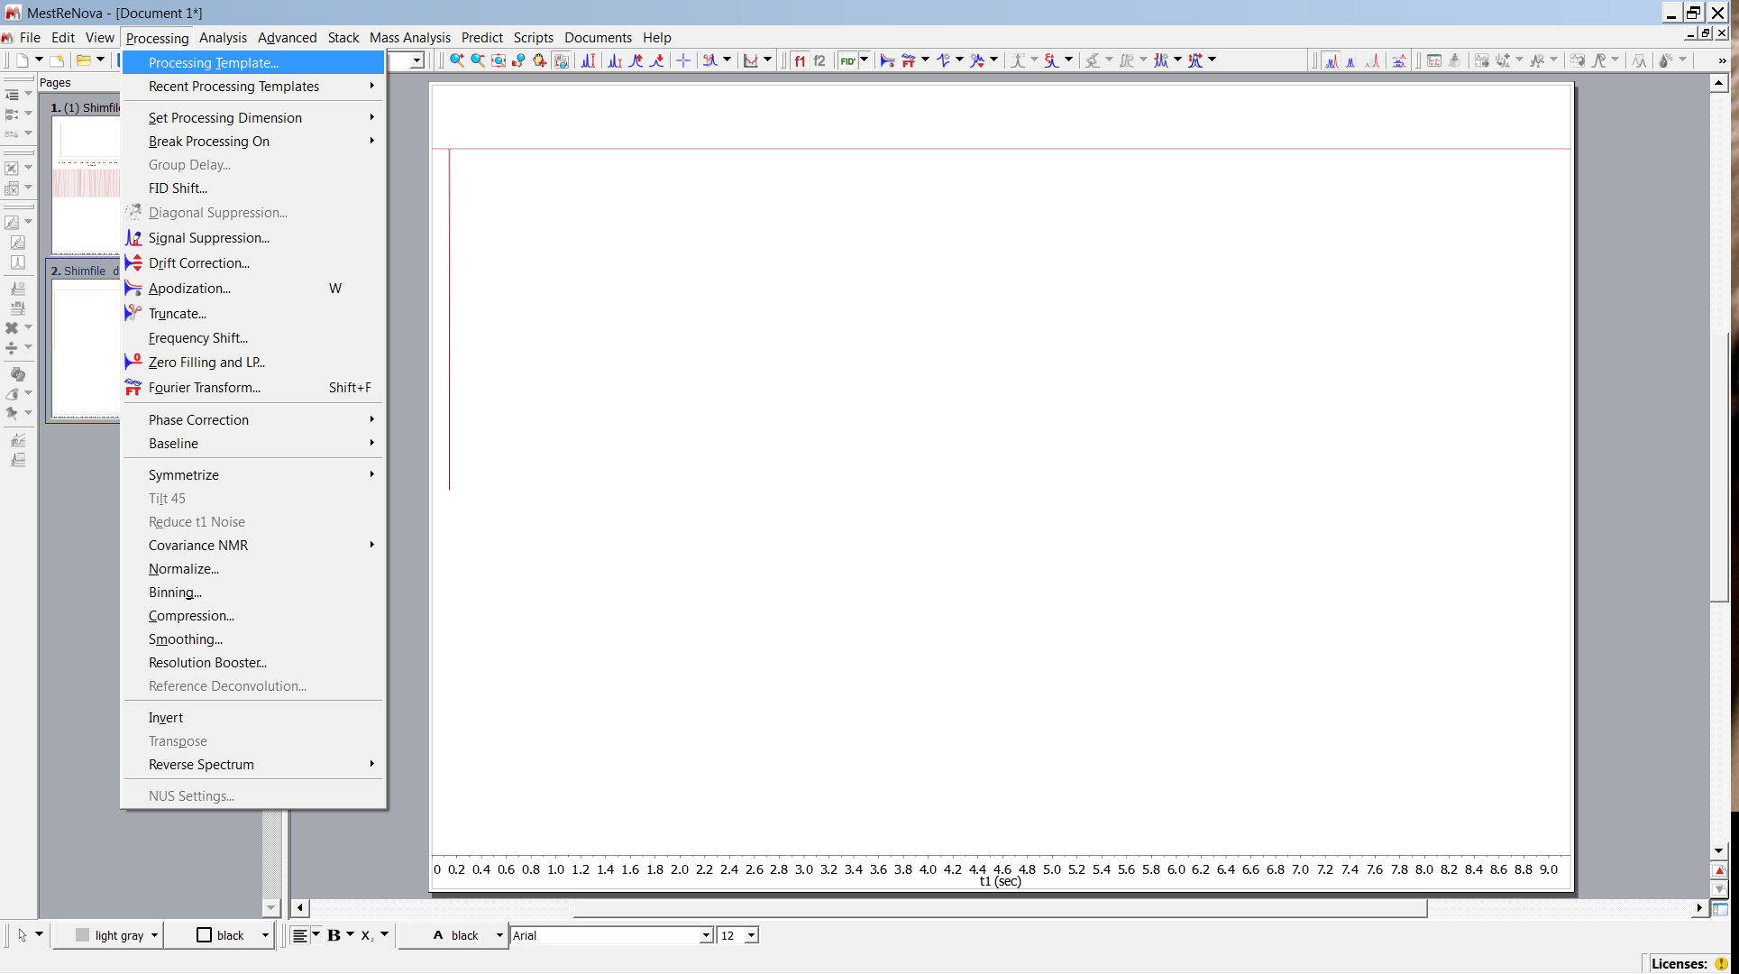
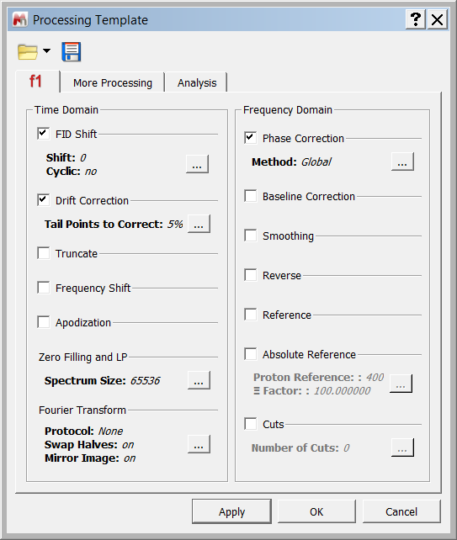
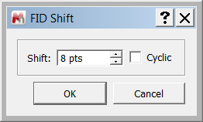
Delta Function

Slide 20
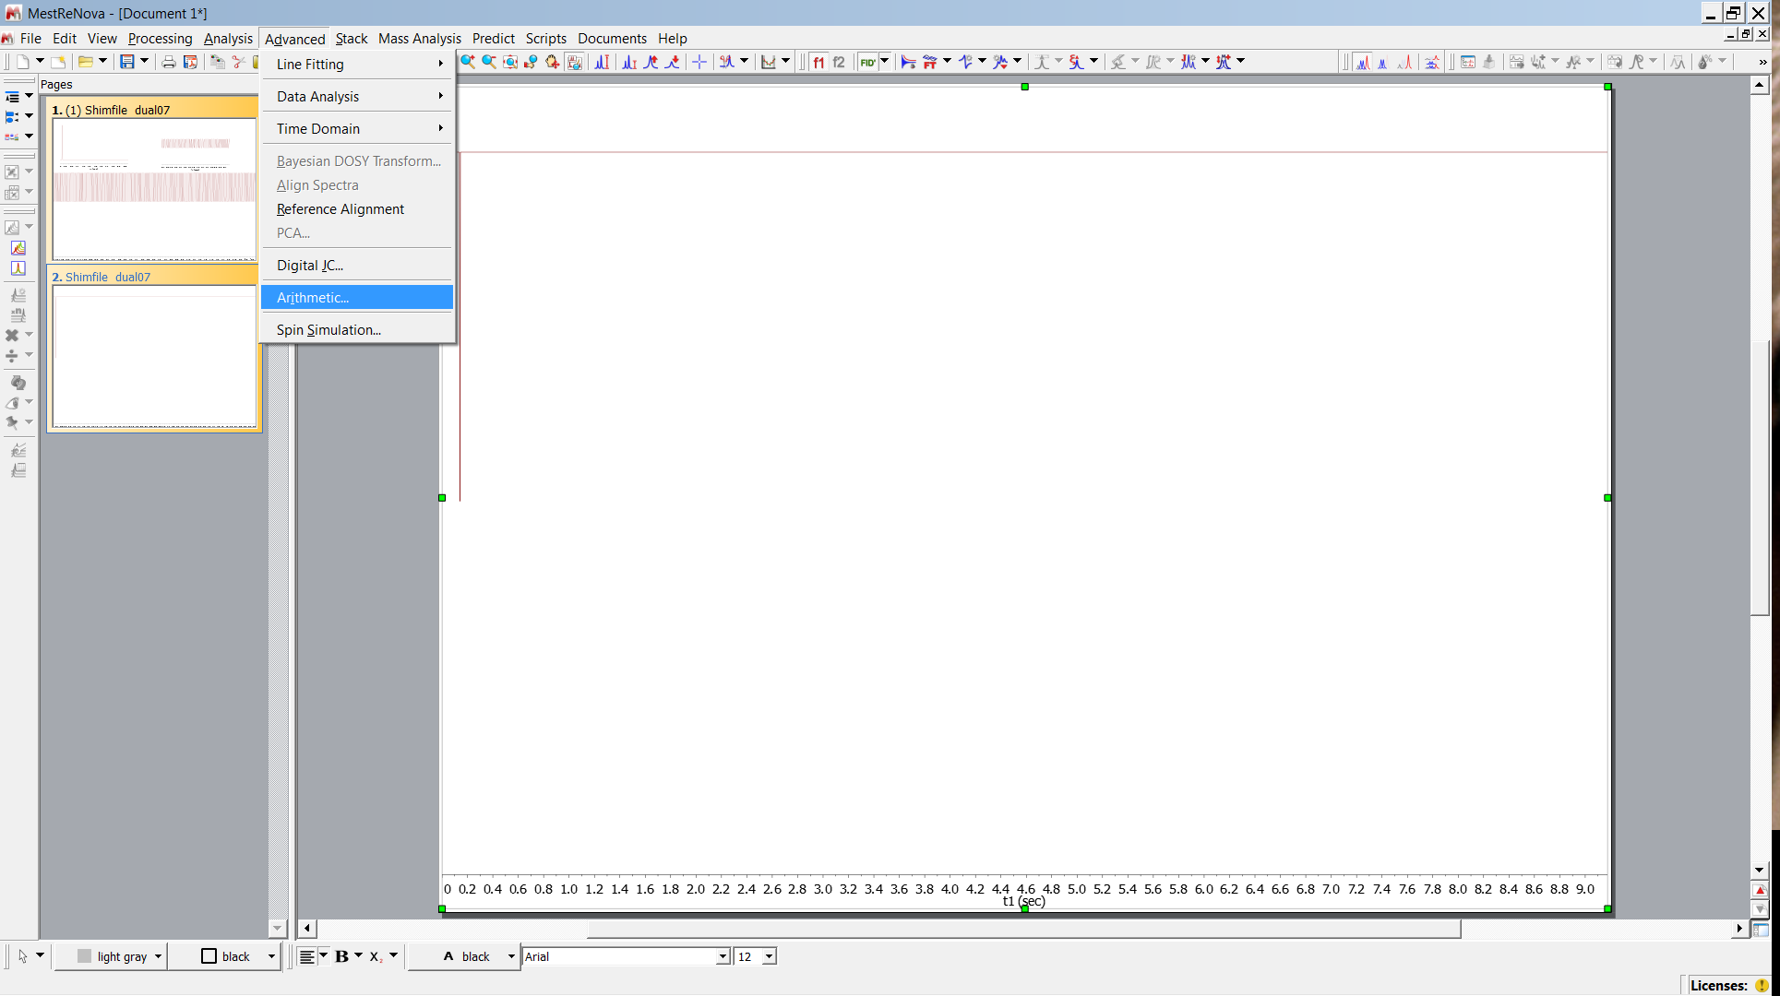
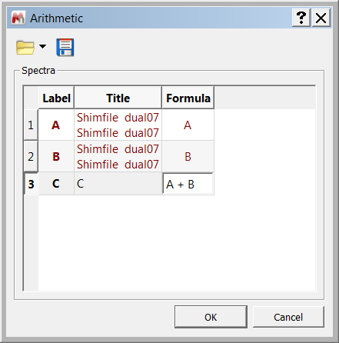
Delta Function
select both

Slide 21
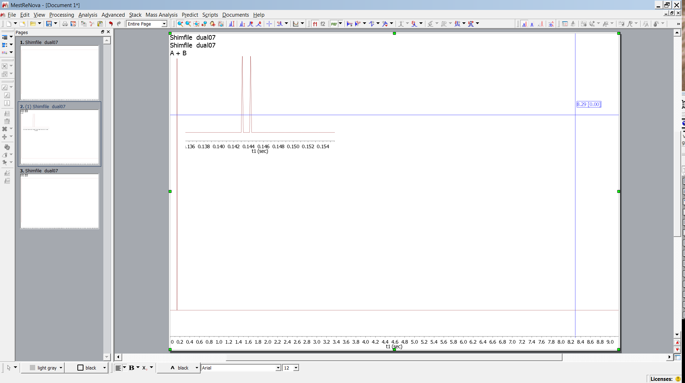
Delta Function
sum of two delta functions

Slide 22
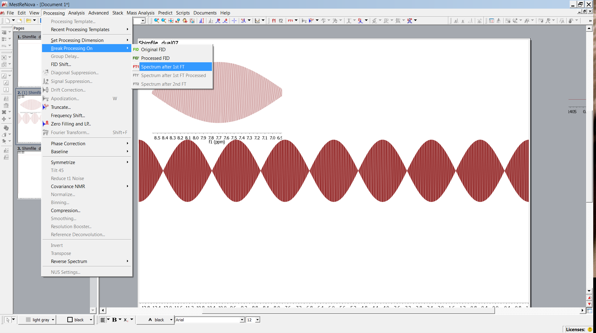
Delta Function
undulations

Slide 23
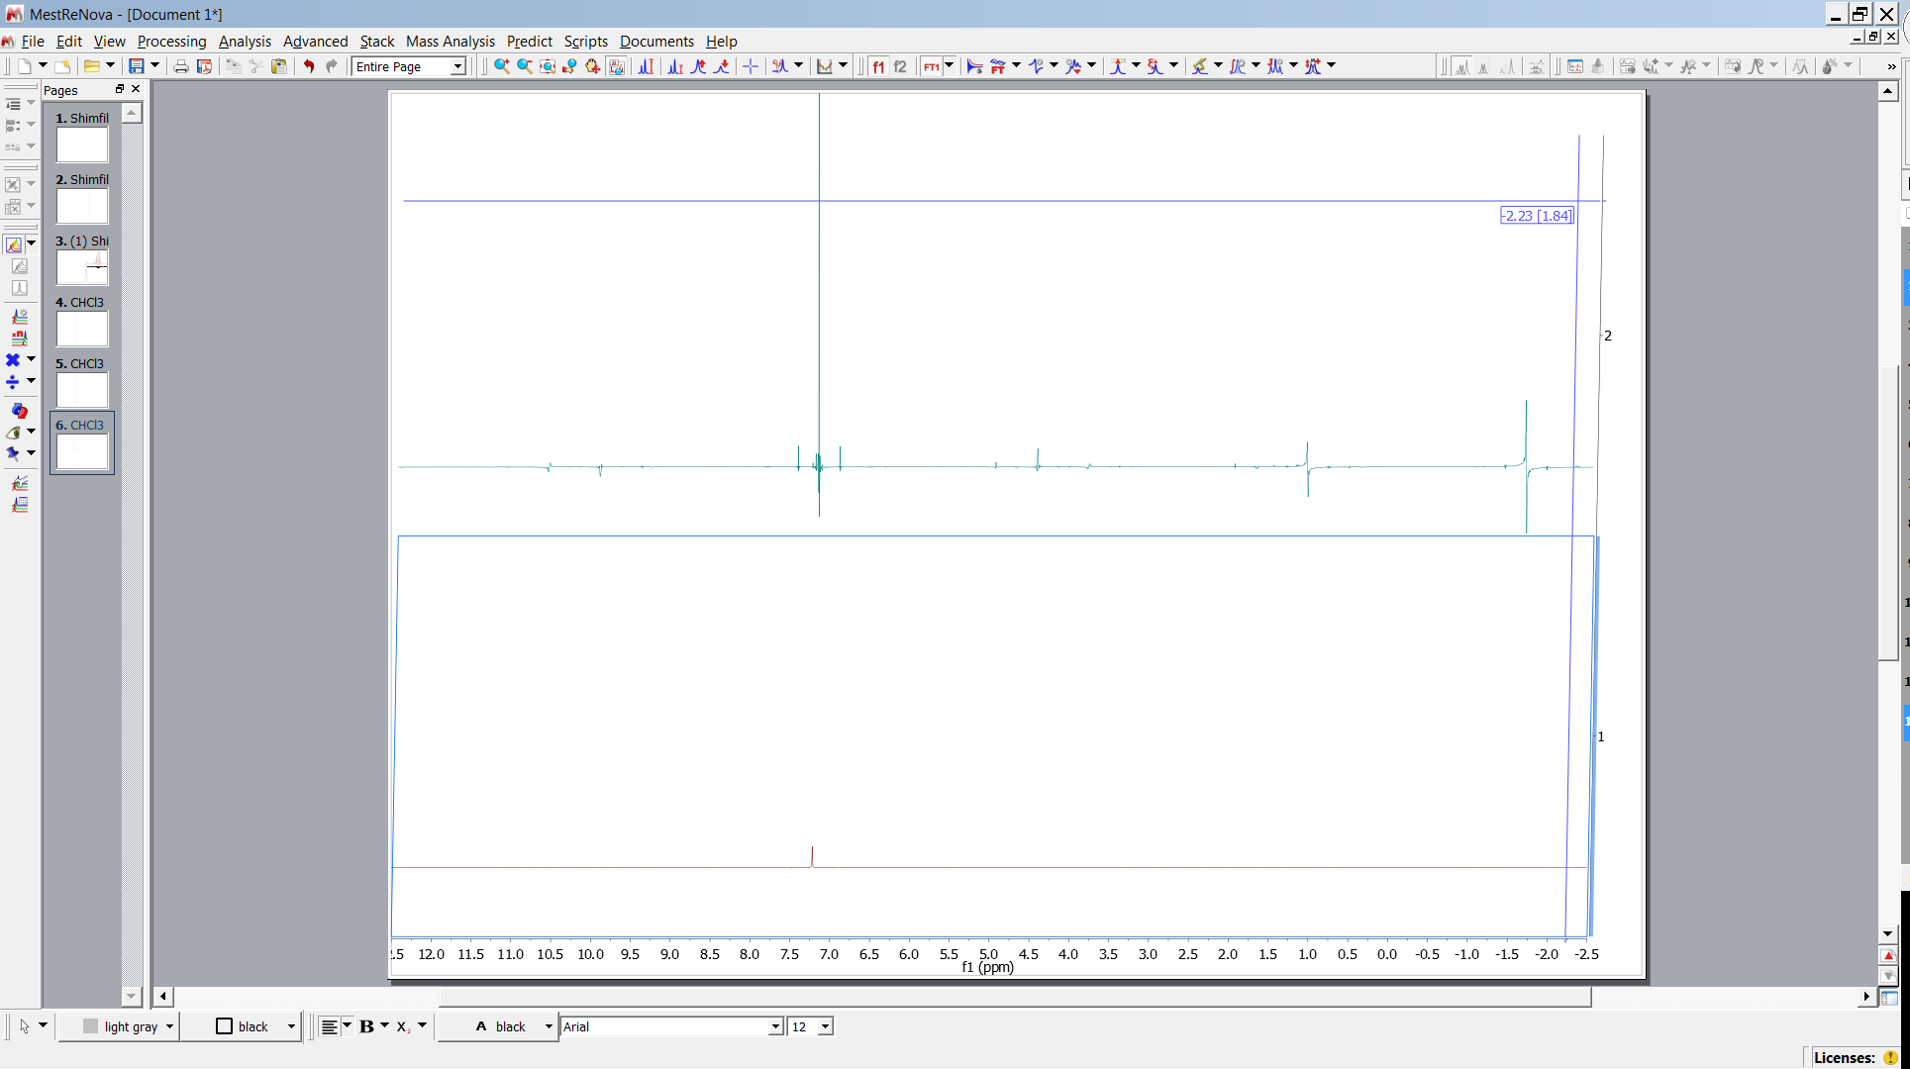
Arte Facts Cut off
Compare cutoff-1.jdf cutoff-2.jdf

Slide 24
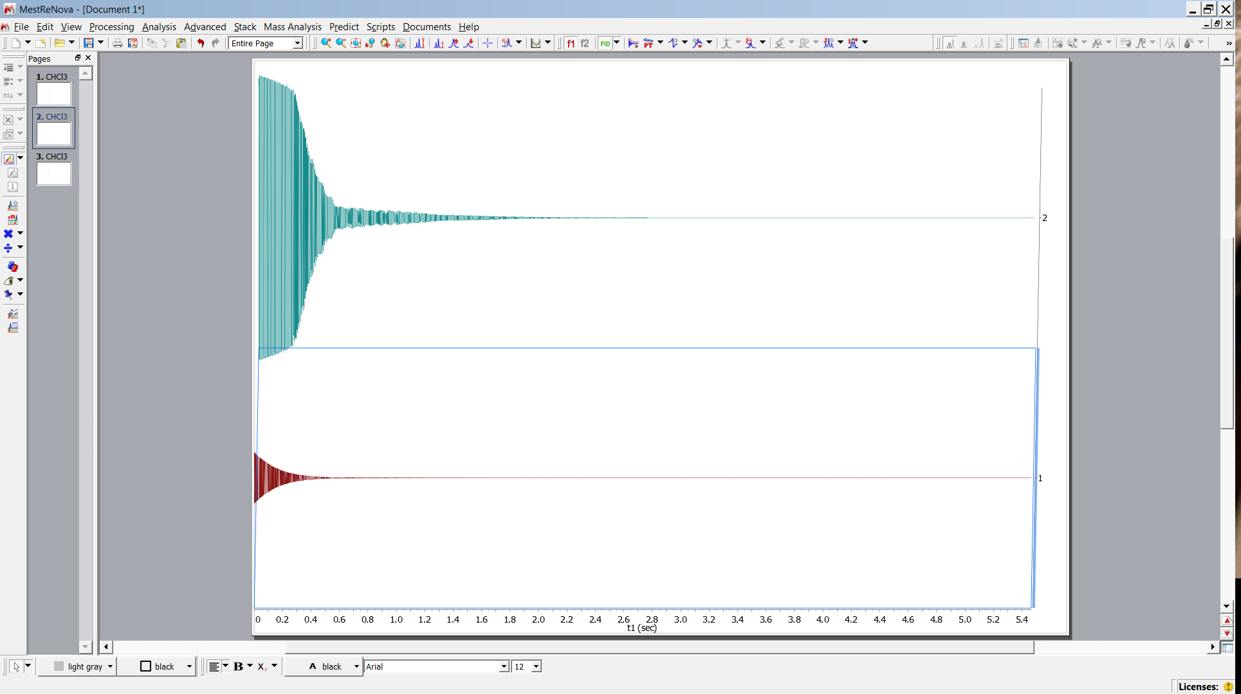
Arte Facts Cut off
Compare FIDs

Slide 25
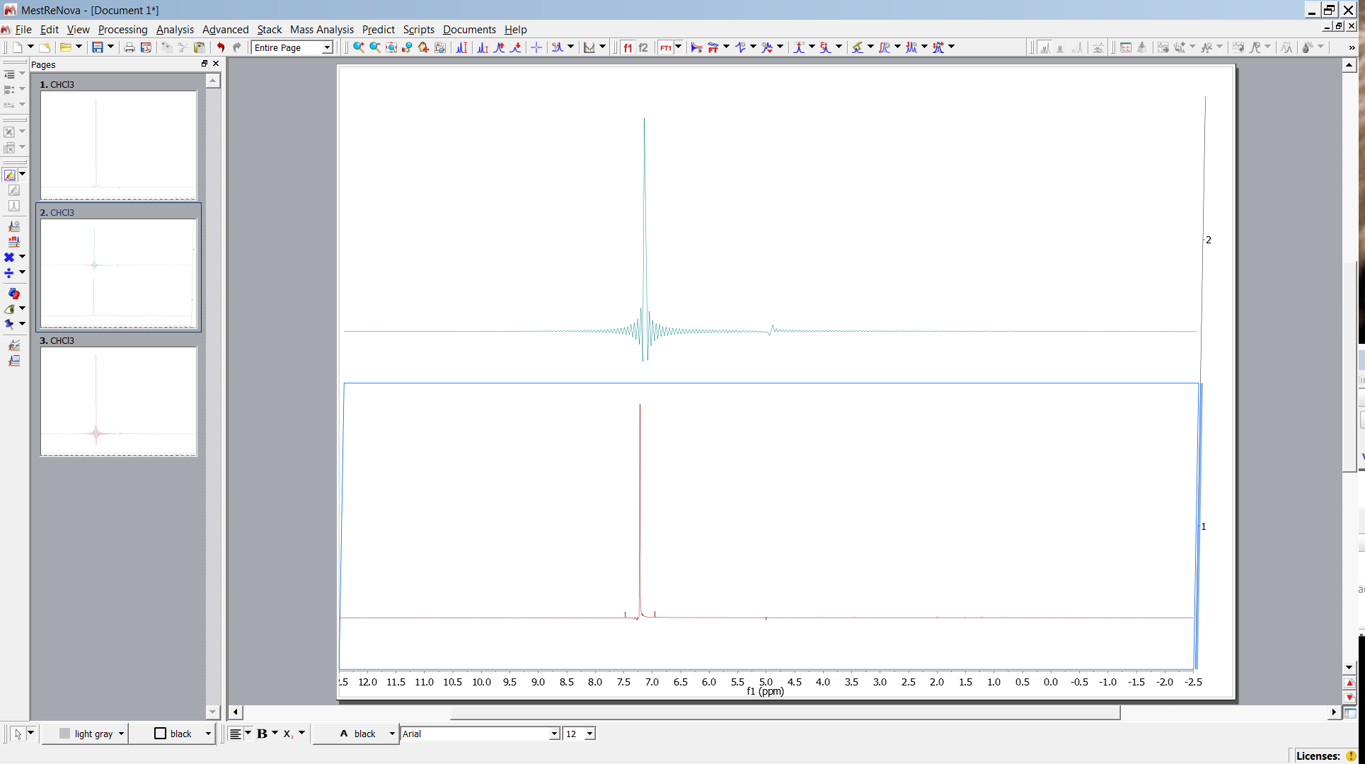
Arte Facts Digital Resolution
Compare sinc-1.jdf sinc-2.jdf

Slide 26
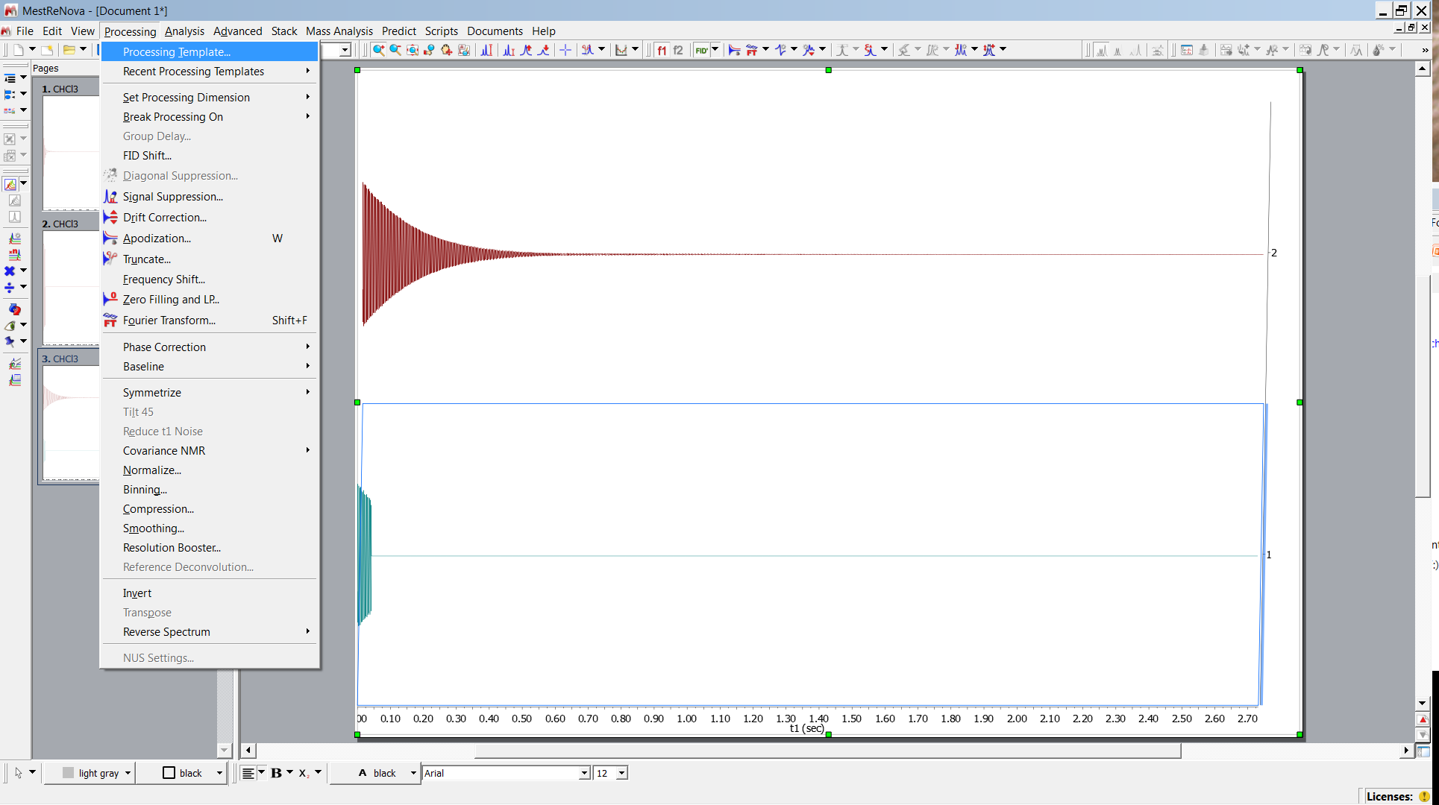
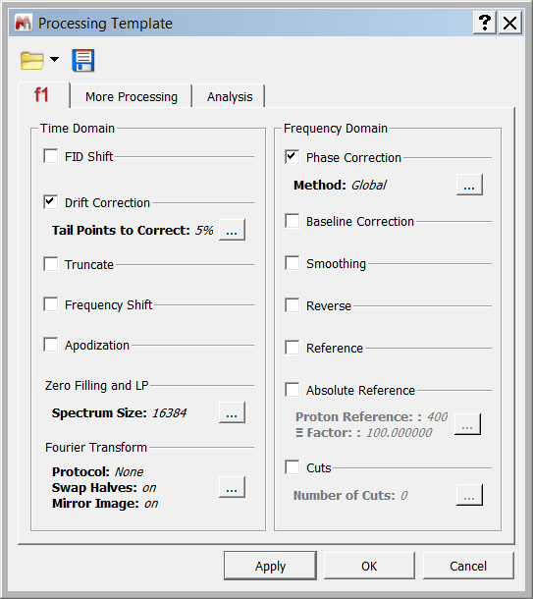
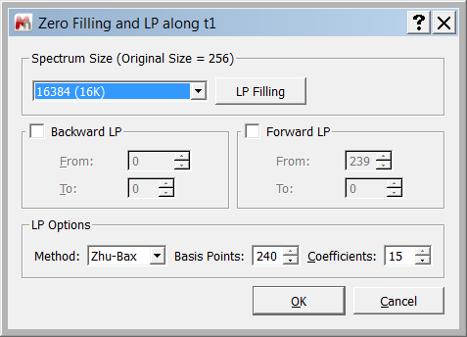
Arte Facts Digital Resolution
Compare processed FIDs (break processing on ..)

Slide 27
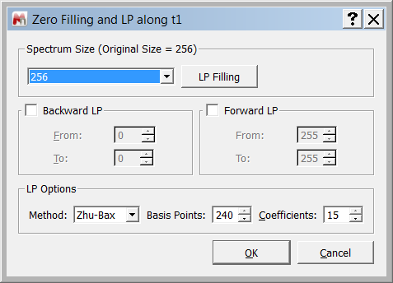
Arte Facts Digital Resolution
Compare processed FIDs (break processing on ..)

Slide 28
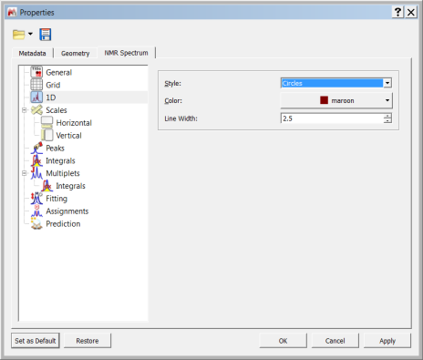
Arte Facts Digital Resolution
Too few data points

Slide 29
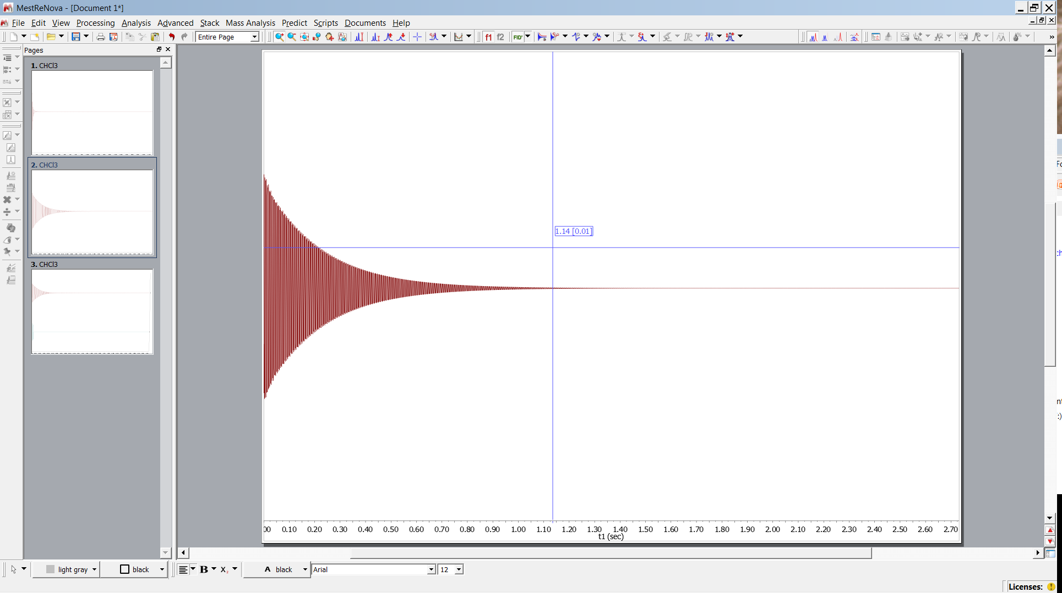
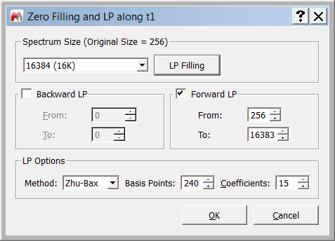
Arte Facts Digital Resolution
Linear Prediction (kind of convolution)

Slide 30
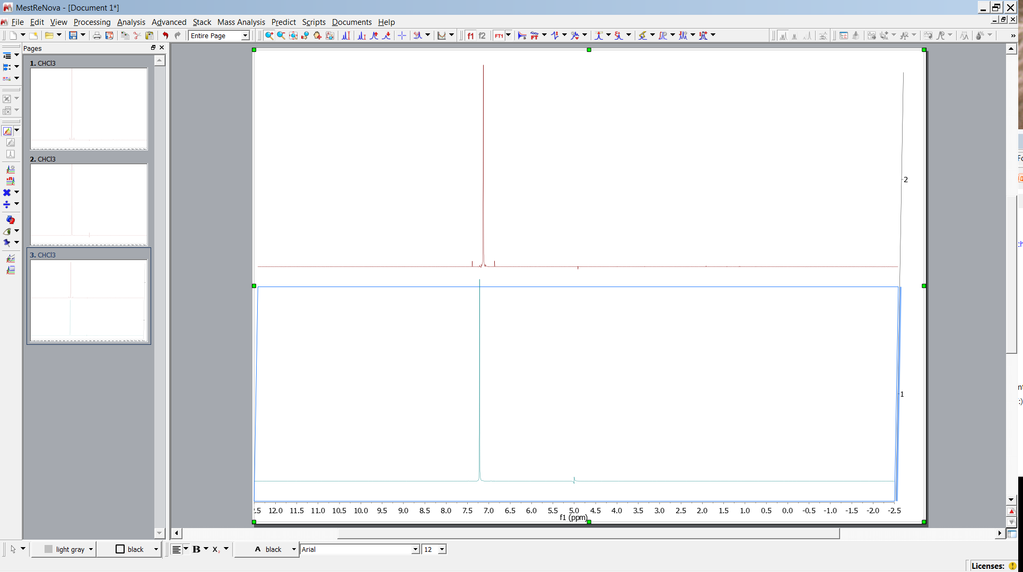
Arte Facts Digital Resolution
Compare spectra

Slide 31
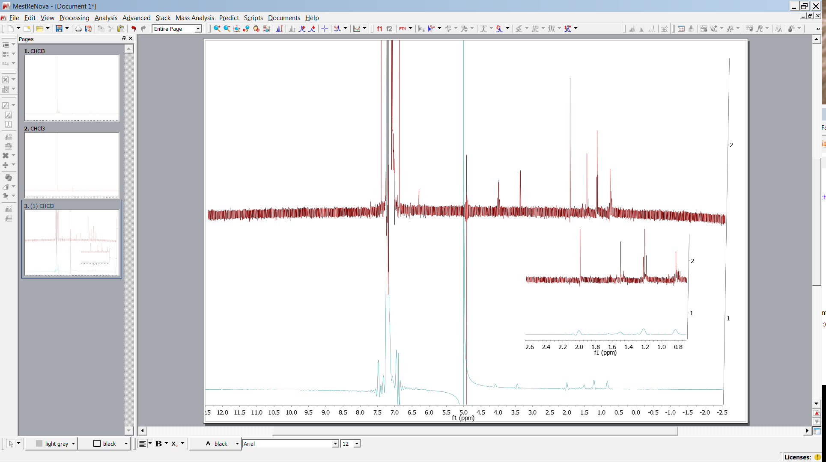
Arte Facts Digital Resolution
Compare spectra

Slide 32
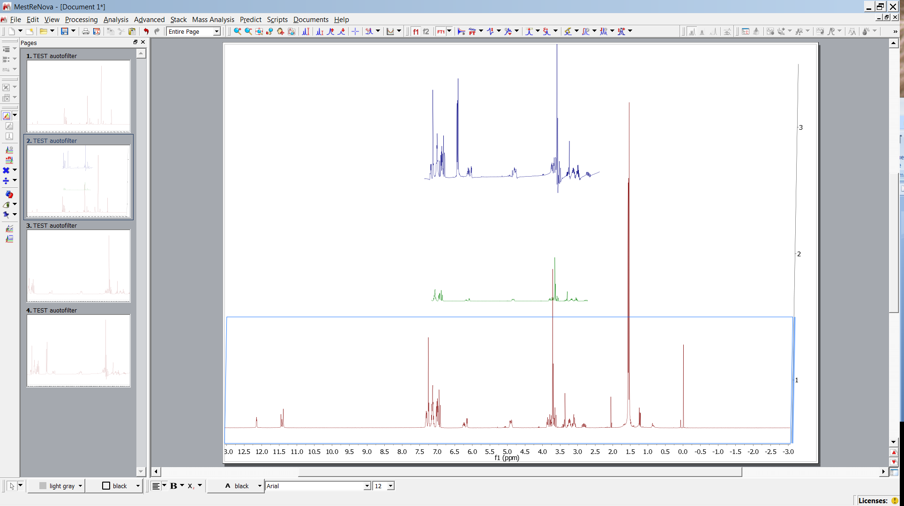
Digital Filtering
Open and stack Filter_1hj -1,2,3.jdf
Backfolding
Small spectral range
Digital filter applied
Full spectral range

Slide 33
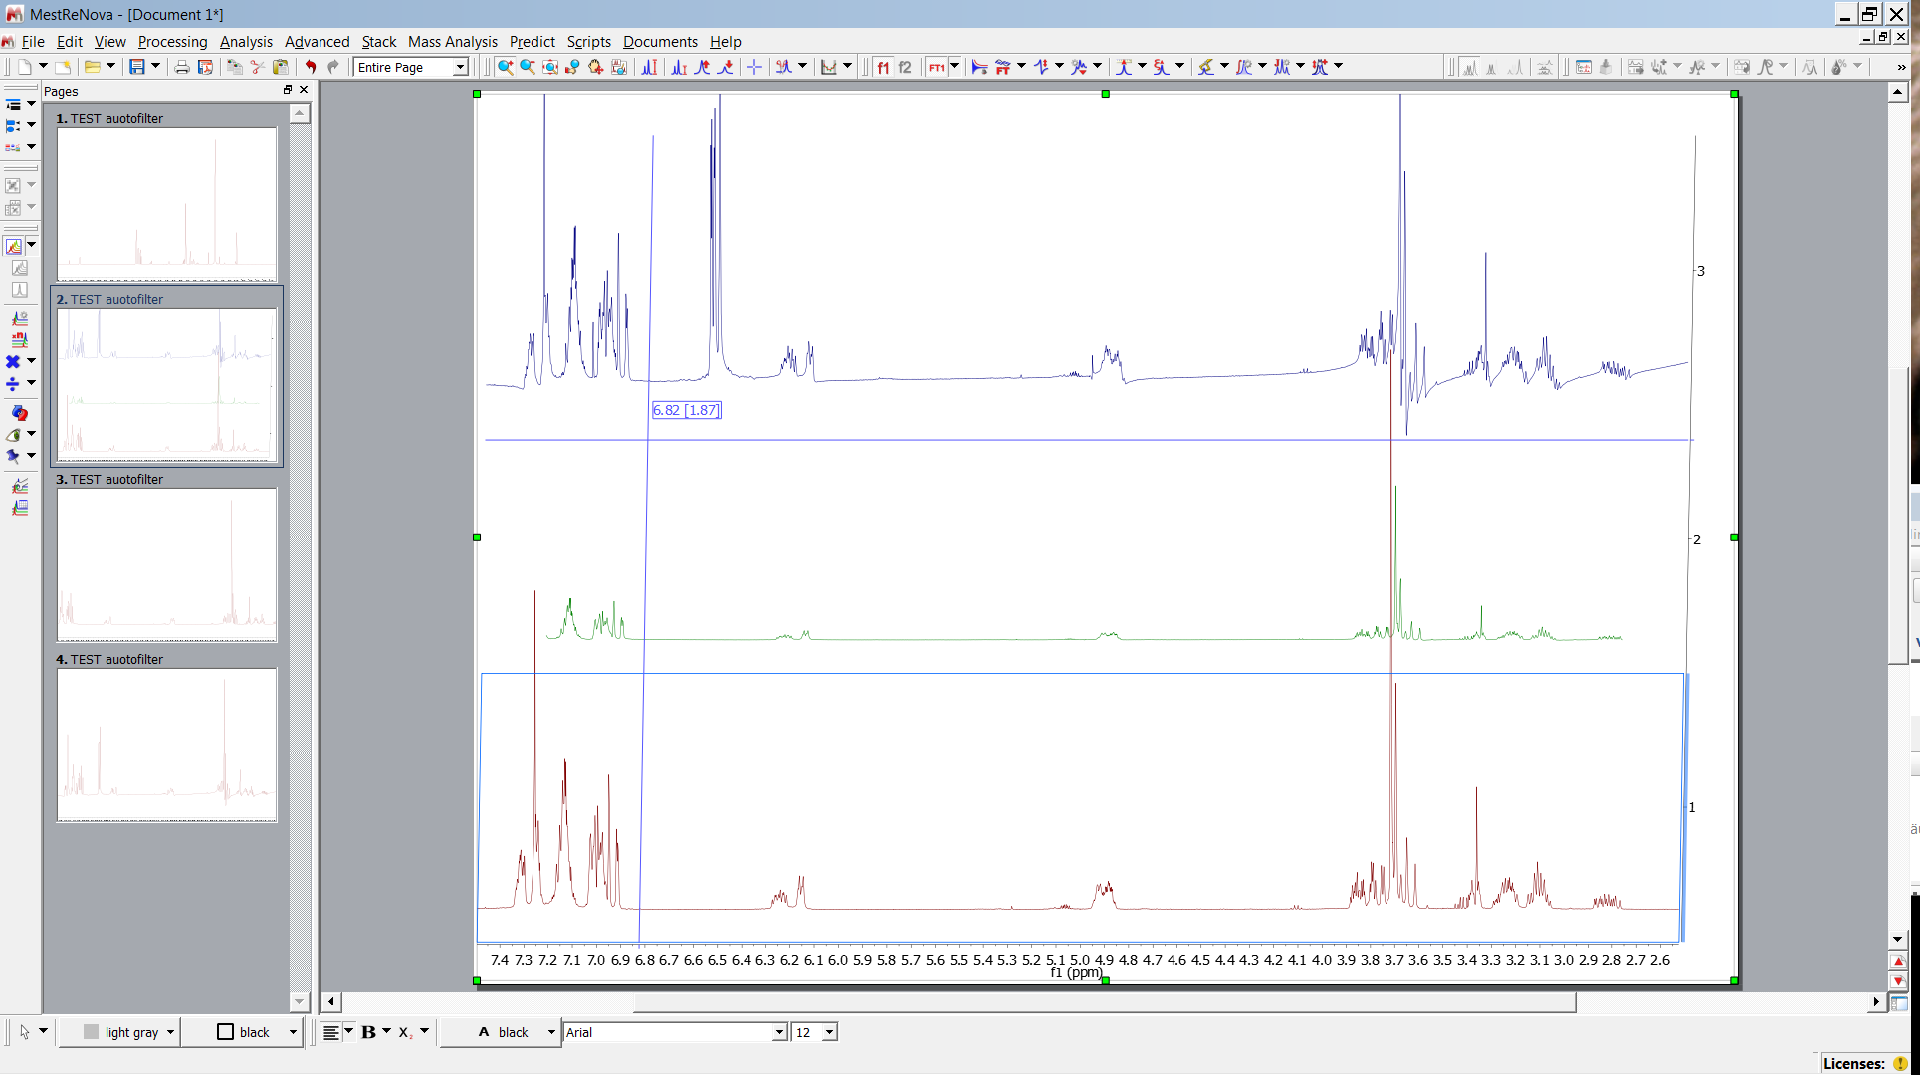
Digital Filtering
Open and stack Filter_1hj -1,2,3.jdf
Backfolding
Small spectral range
Digital filter applied
Full spectral range

Slide 34
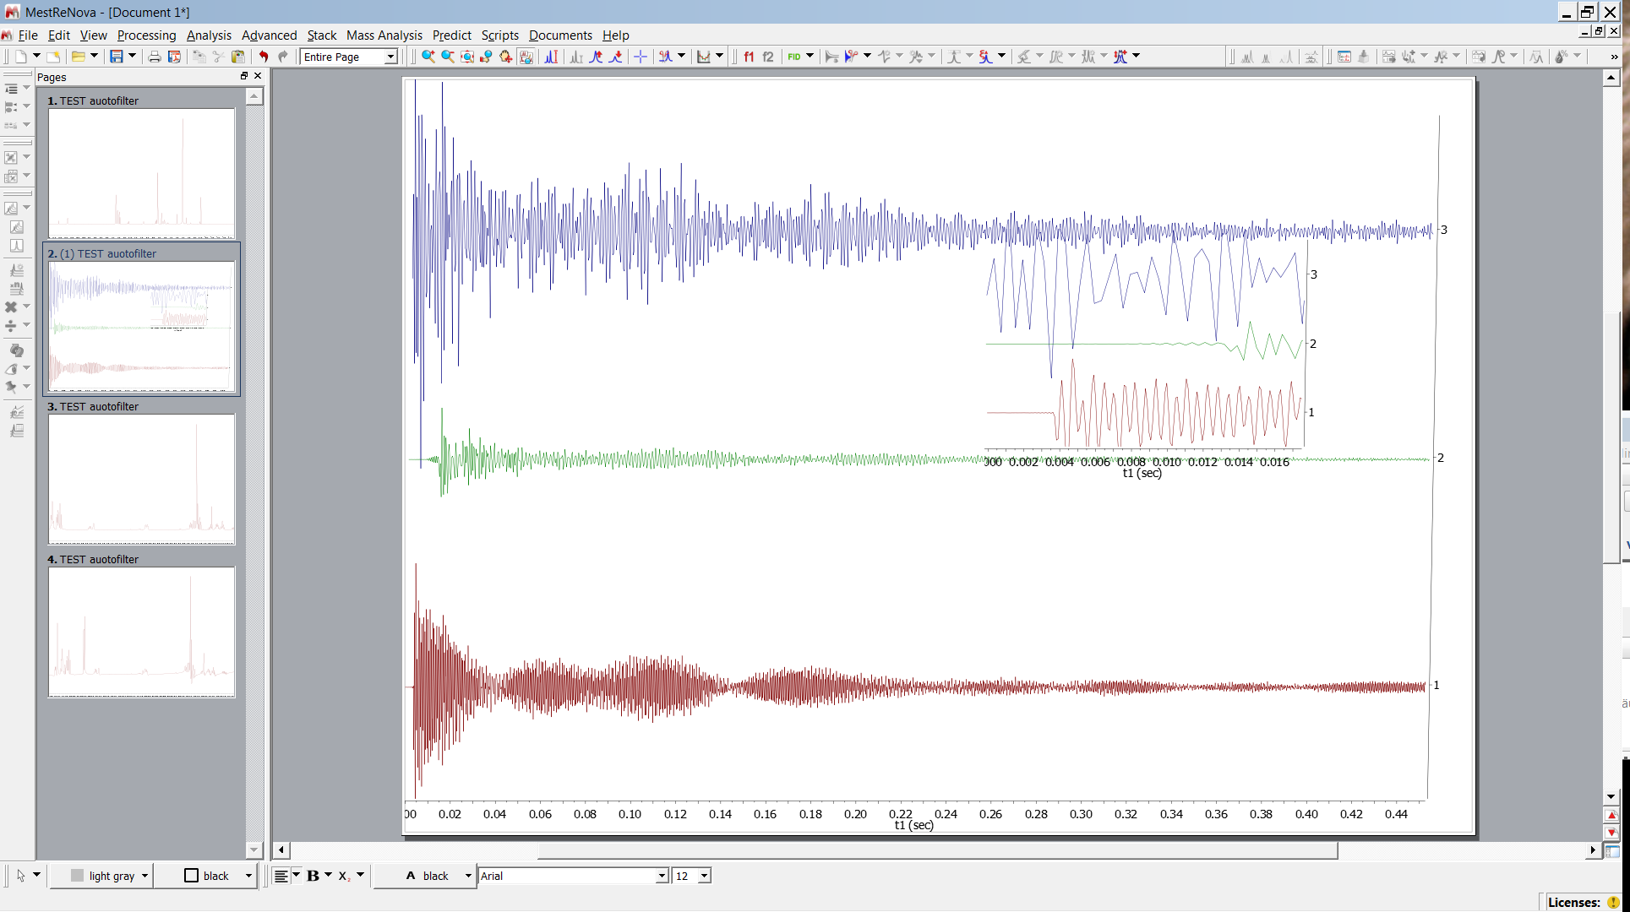
Digital Filtering
Compare FIDs
Small spectral range
sinc
Digital filter applied
sinc
Full spectral range

