Slide 1
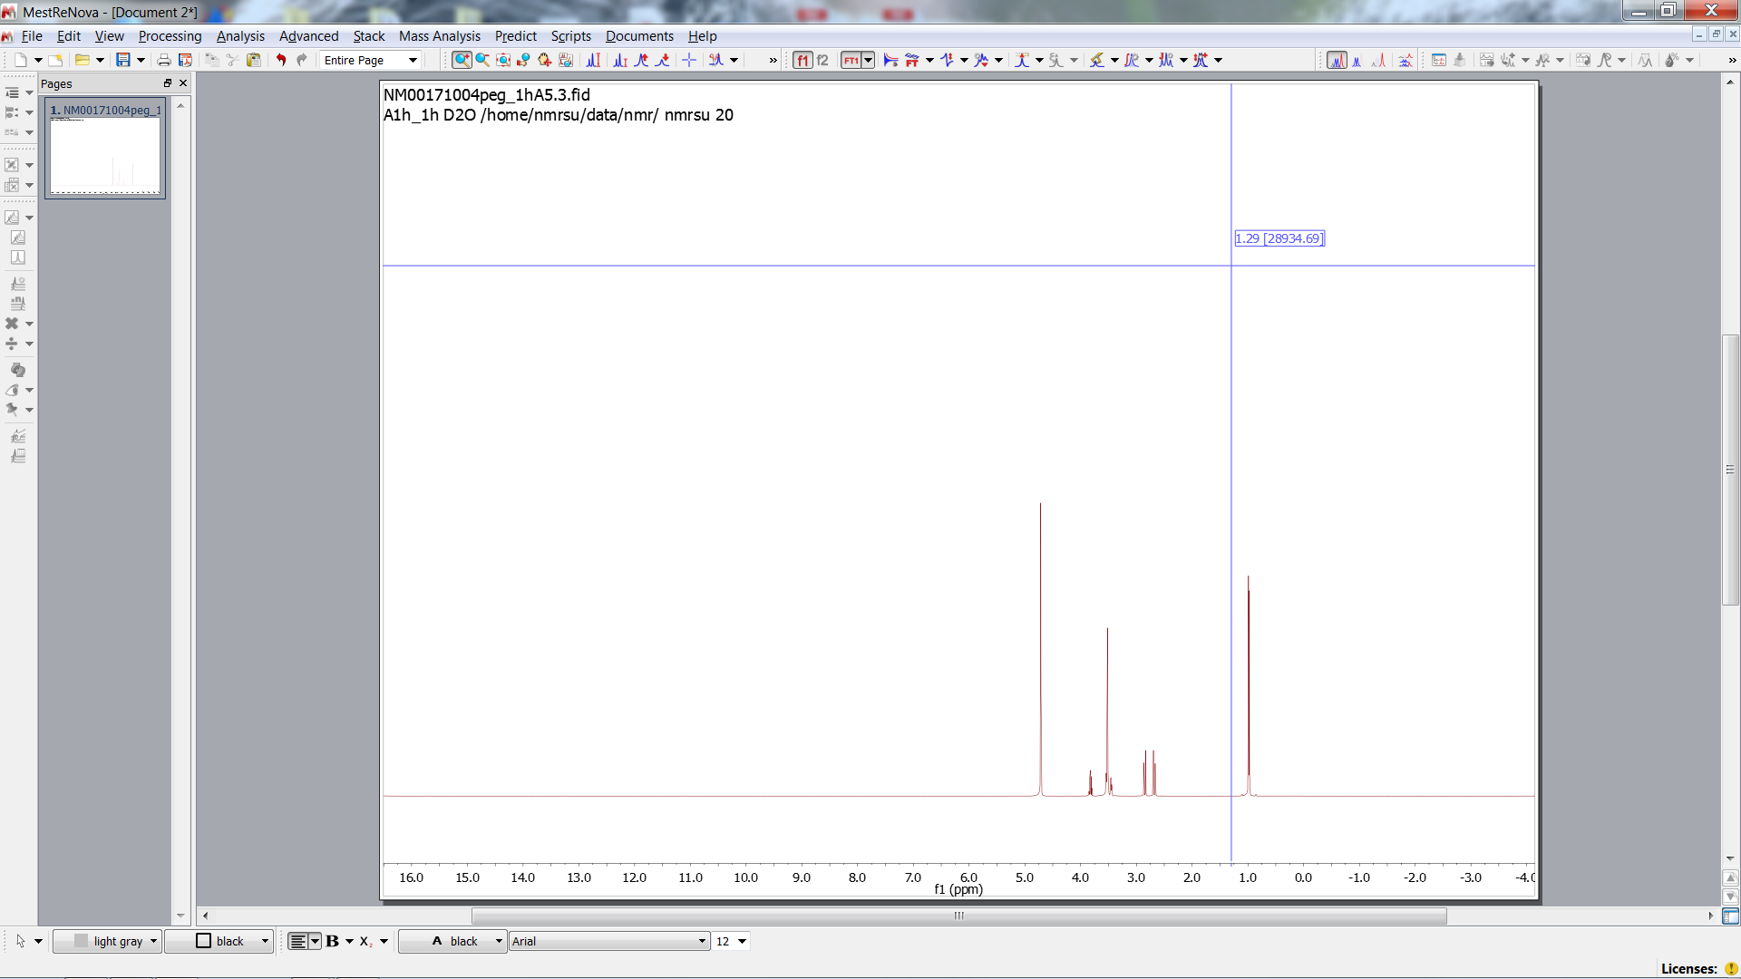
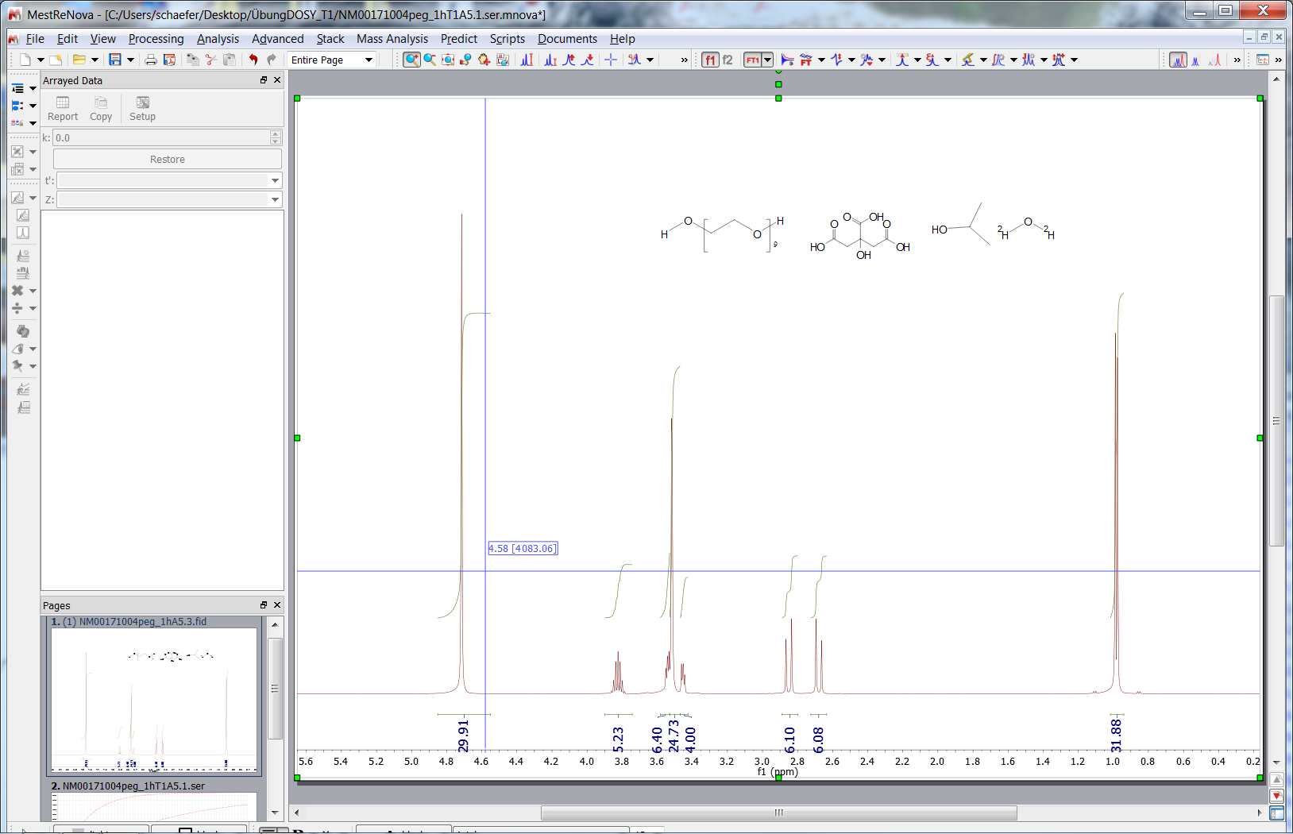
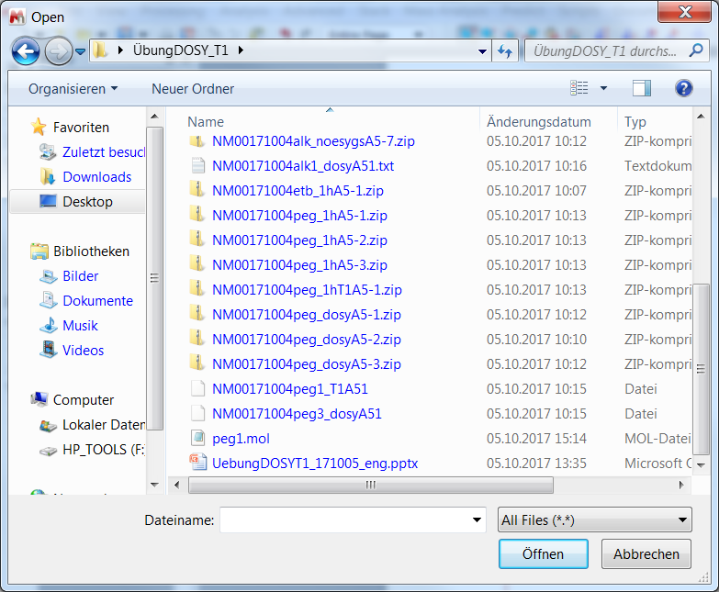
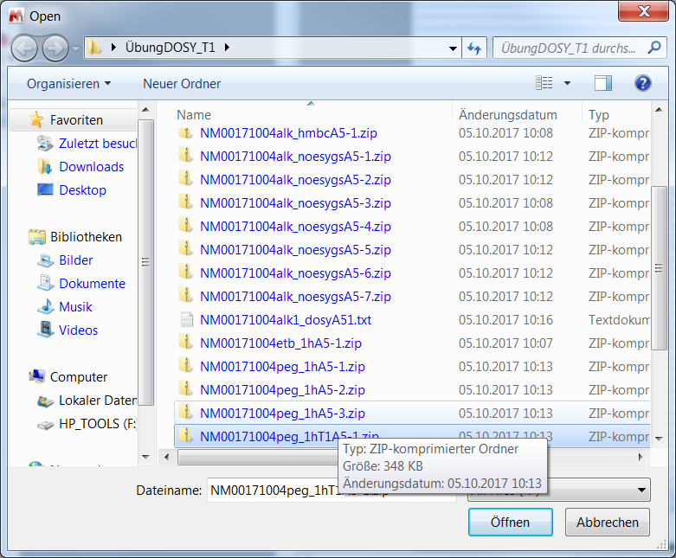
1H
OH
CH3
OH
OH
CH
PEG
CH2
OH
CH3
PEG
CH2
OH
CH

Slide 2
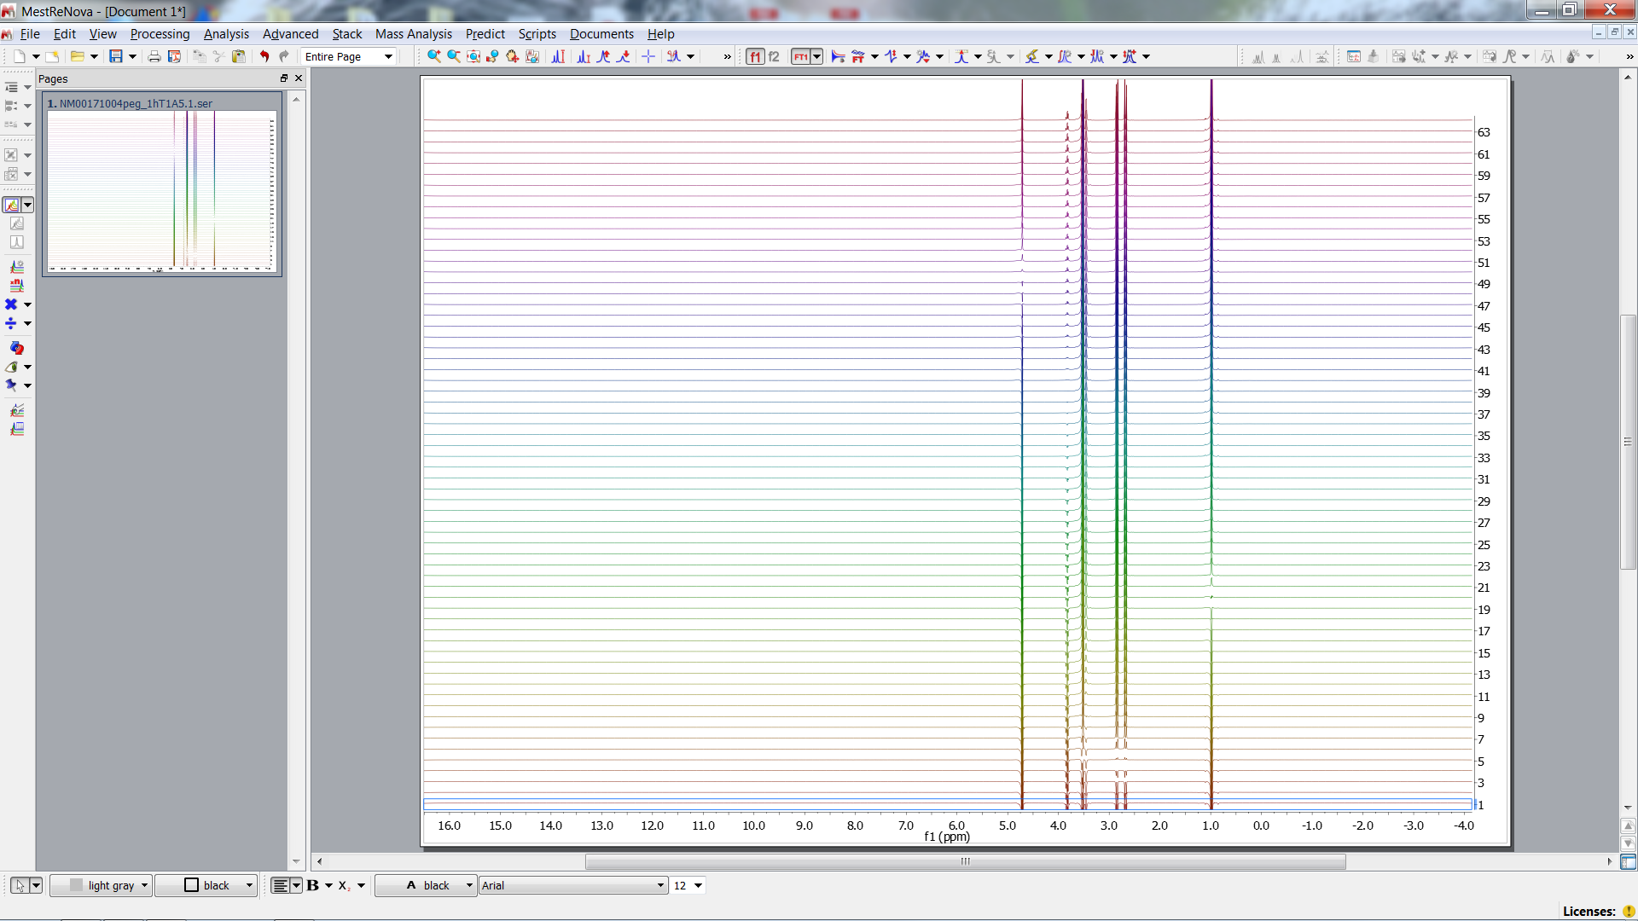
T1 Experiment

Slide 3
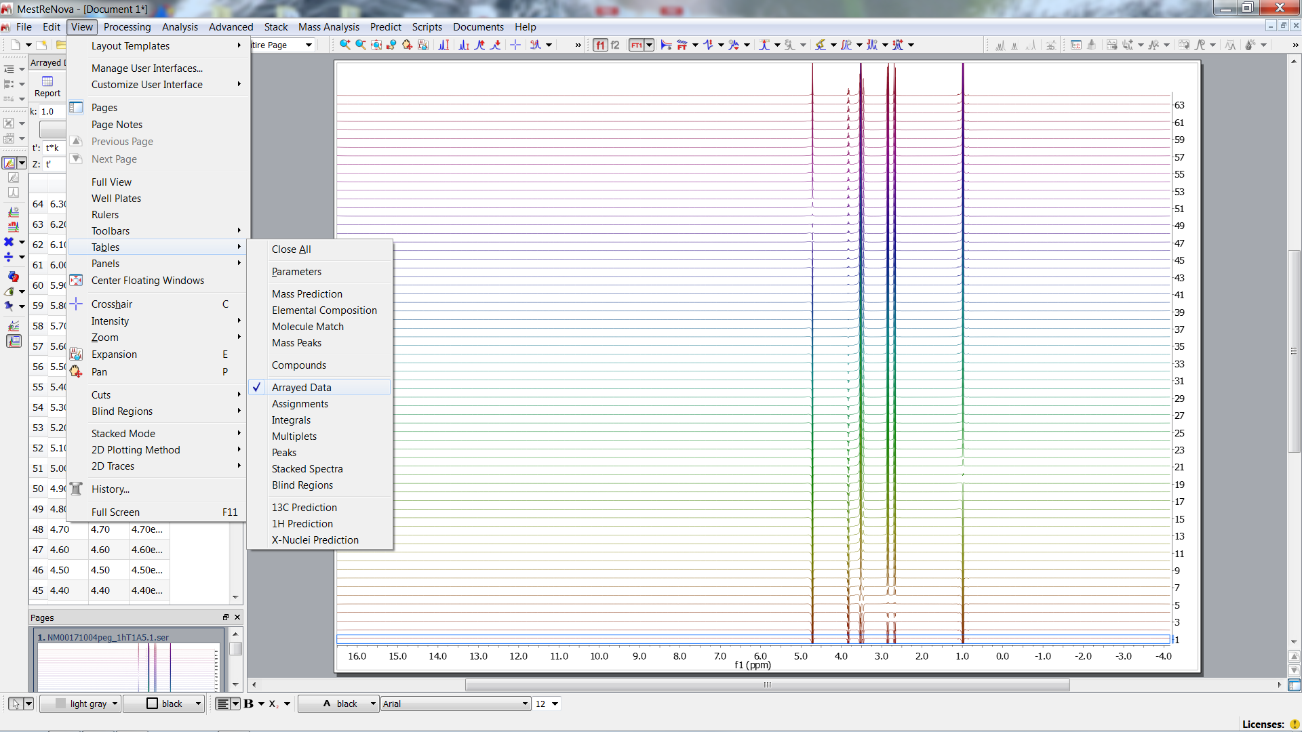
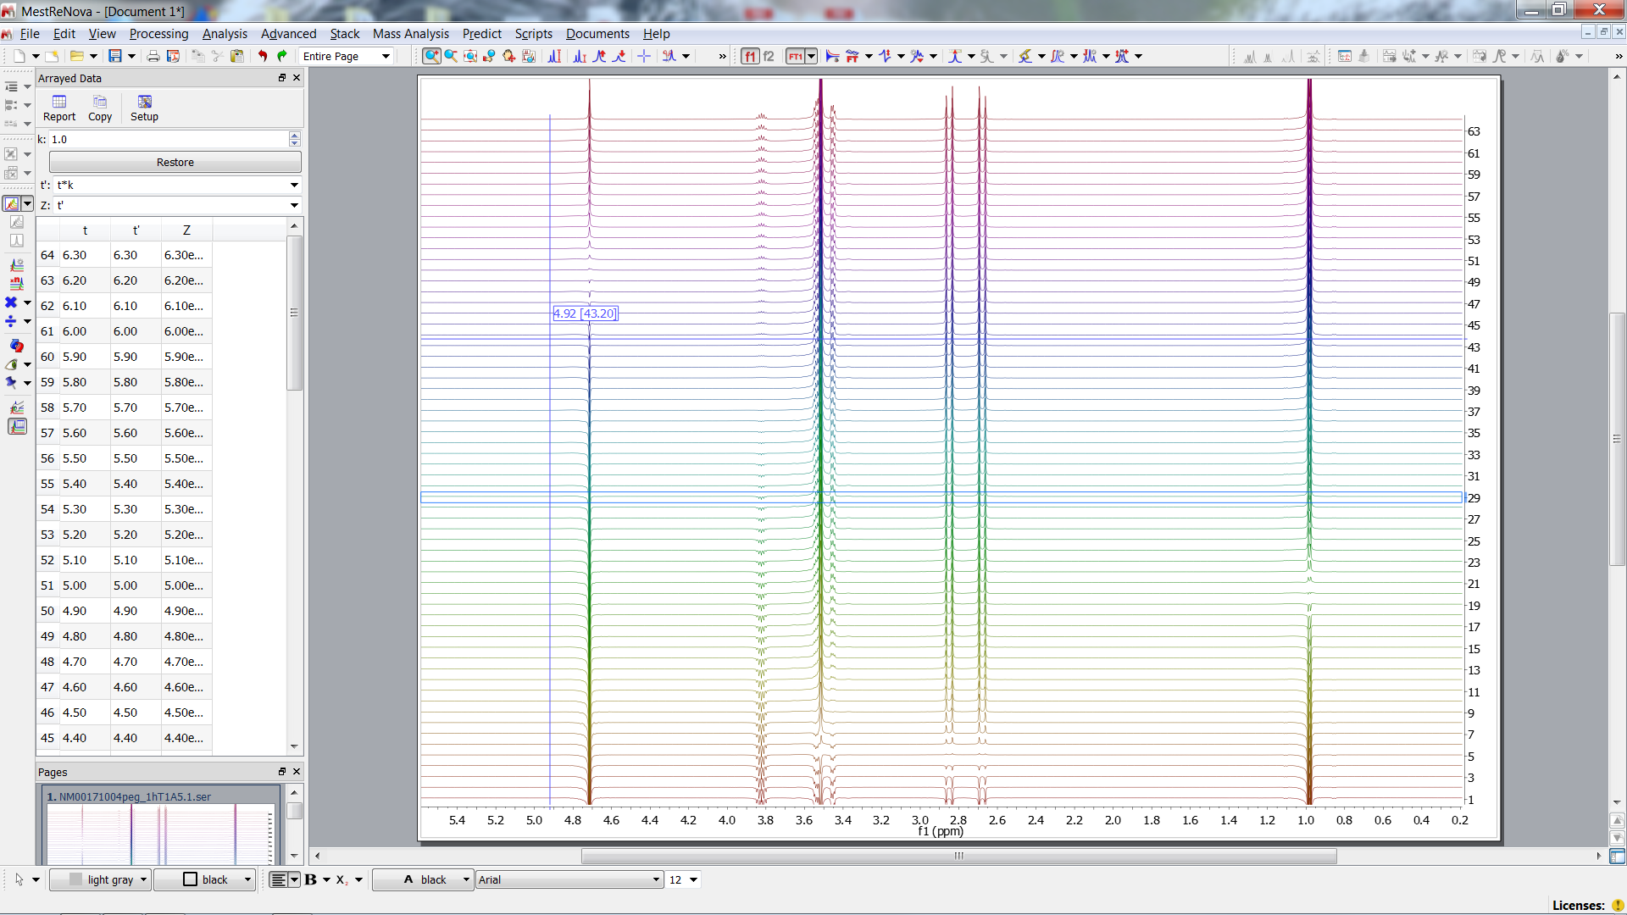
Arrayed Data
t= 6.3 s
180°
90°
k possible scaling factor
t
var.
t= 0.05 s

Slide 4
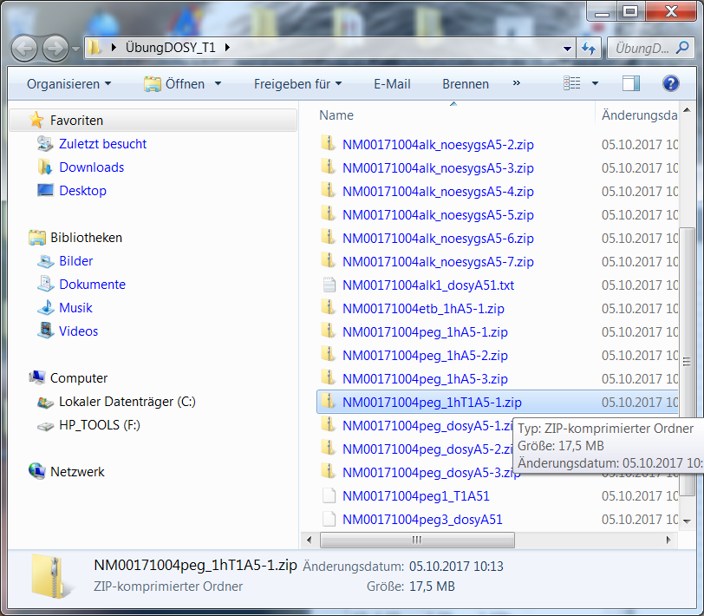
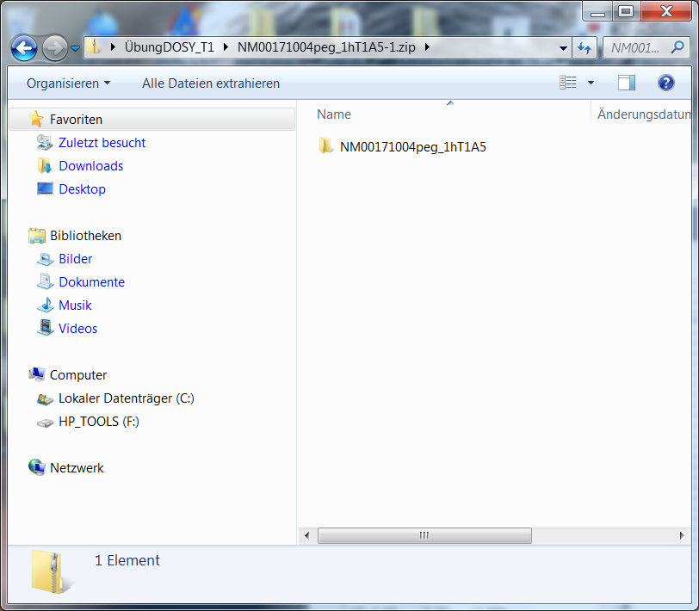
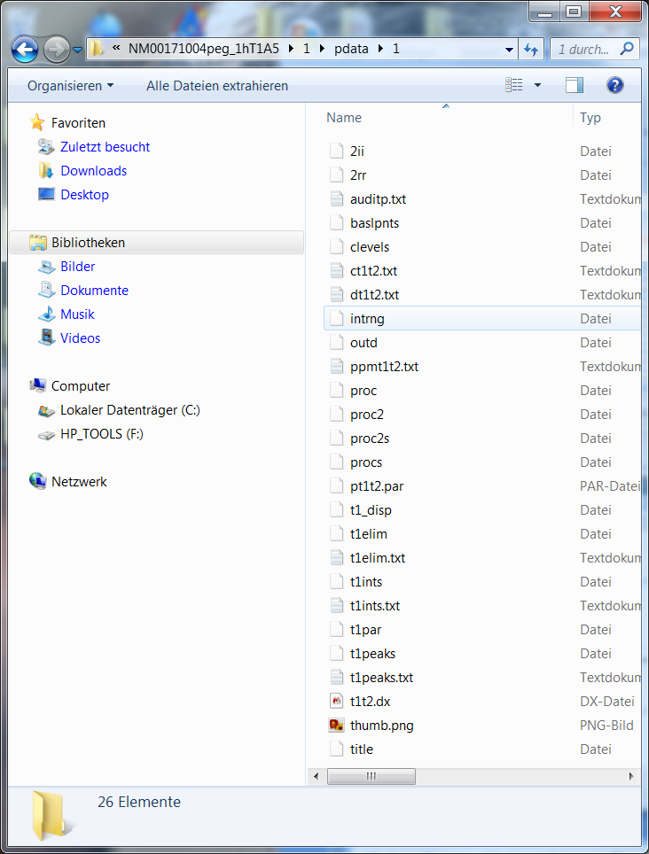
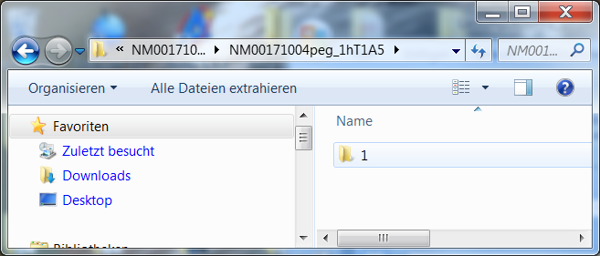
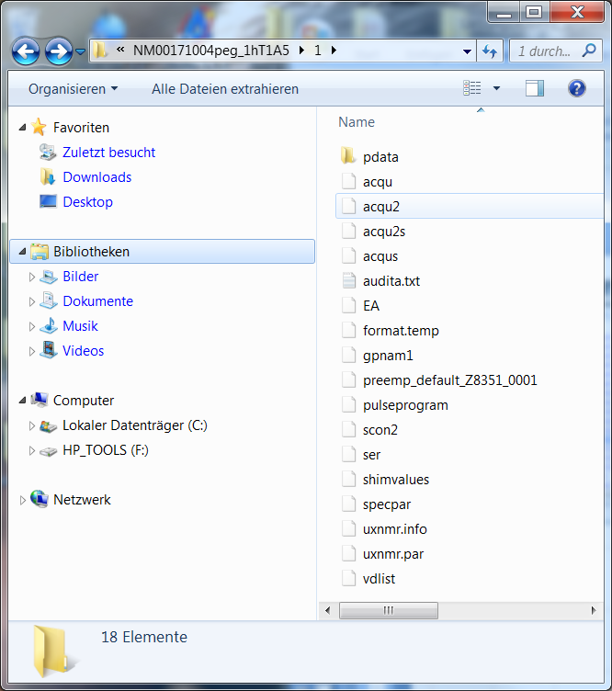
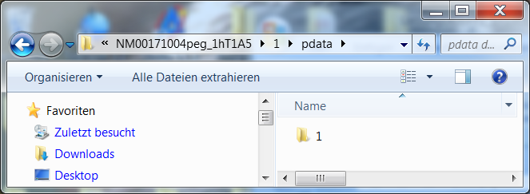
BRUKER File Format
Zipped Folder
Folder containing n exp. data
proc. data
Fit function
Fit result
1st exp. data
Folder of proc.. data
1st processed data
data
Delay list

Slide 5
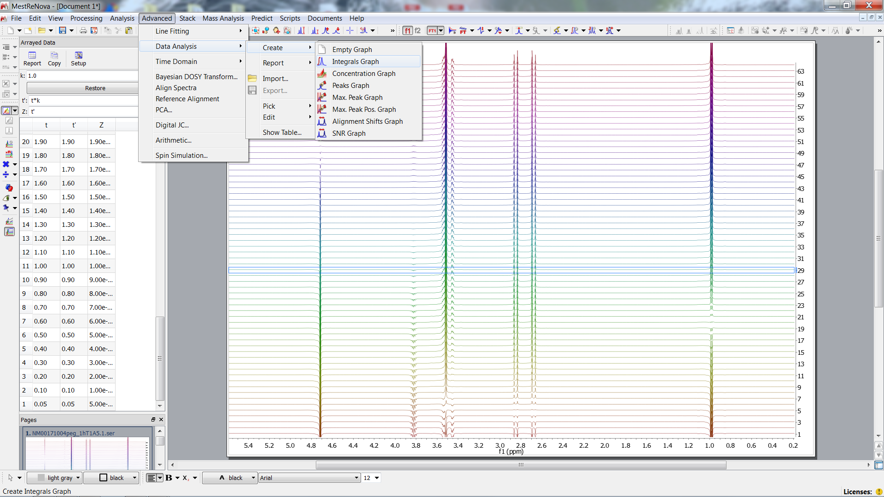
Choose Regions of Interest
Integrals recommended

Slide 6
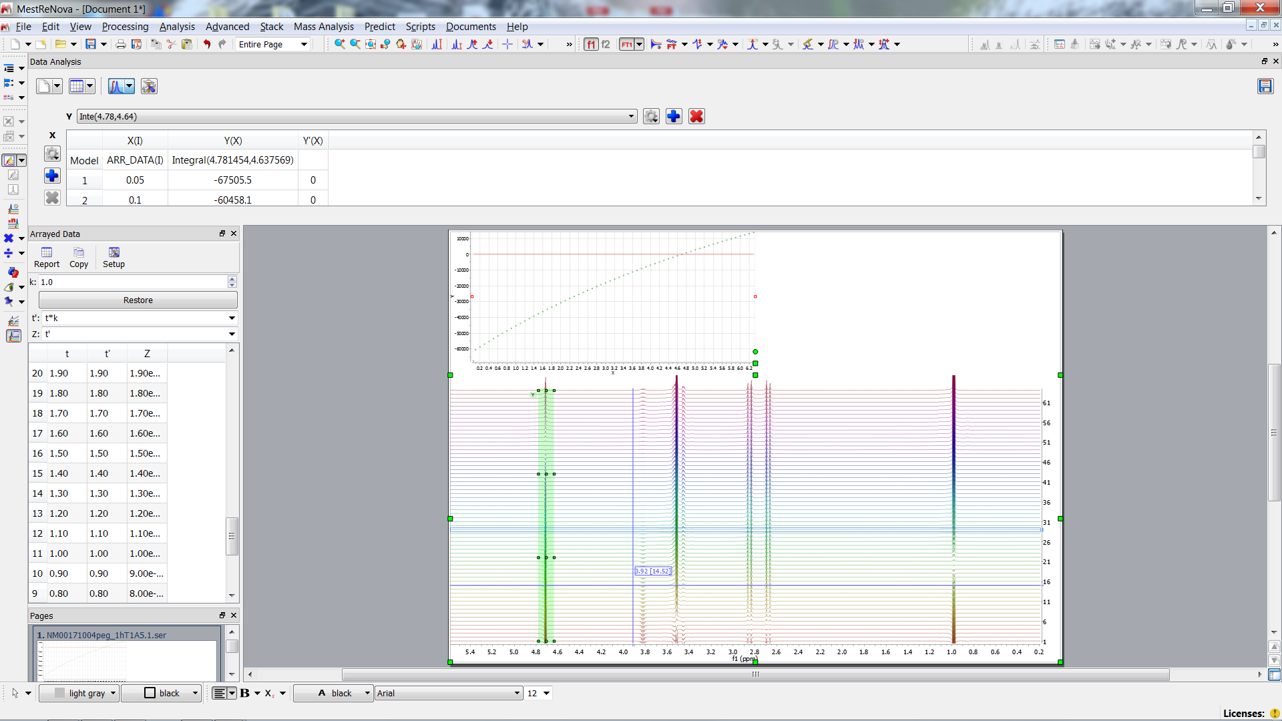
Recovery of Magnetization
X vs. Y for each peak (multiplett)
M_{z}(t) for OH

Slide 7
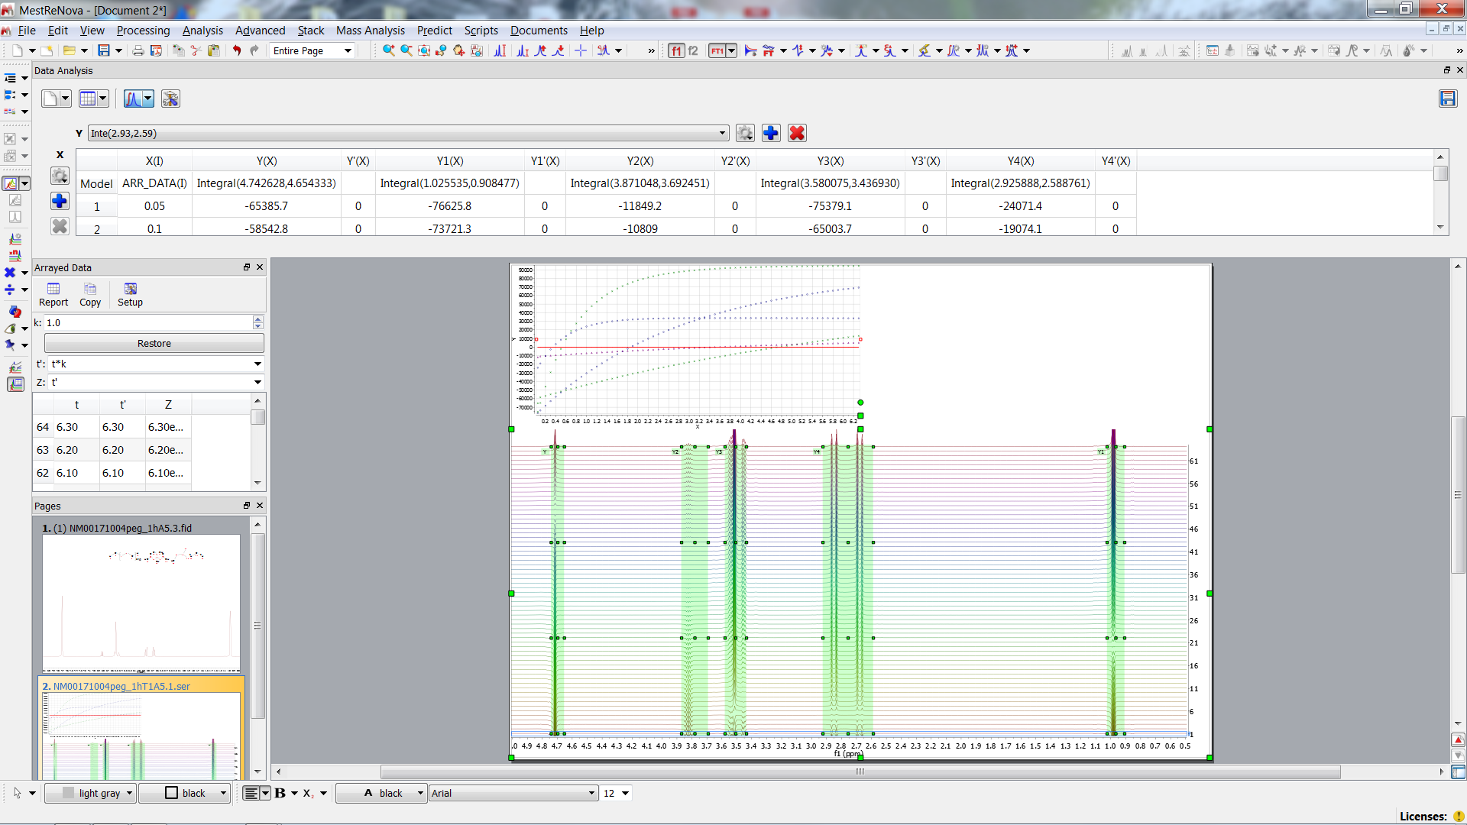
Recovery of Magnetization
PEG
CH3
CH2
OH
CH
CH3
OH
CH
PEG
CH2

Slide 8
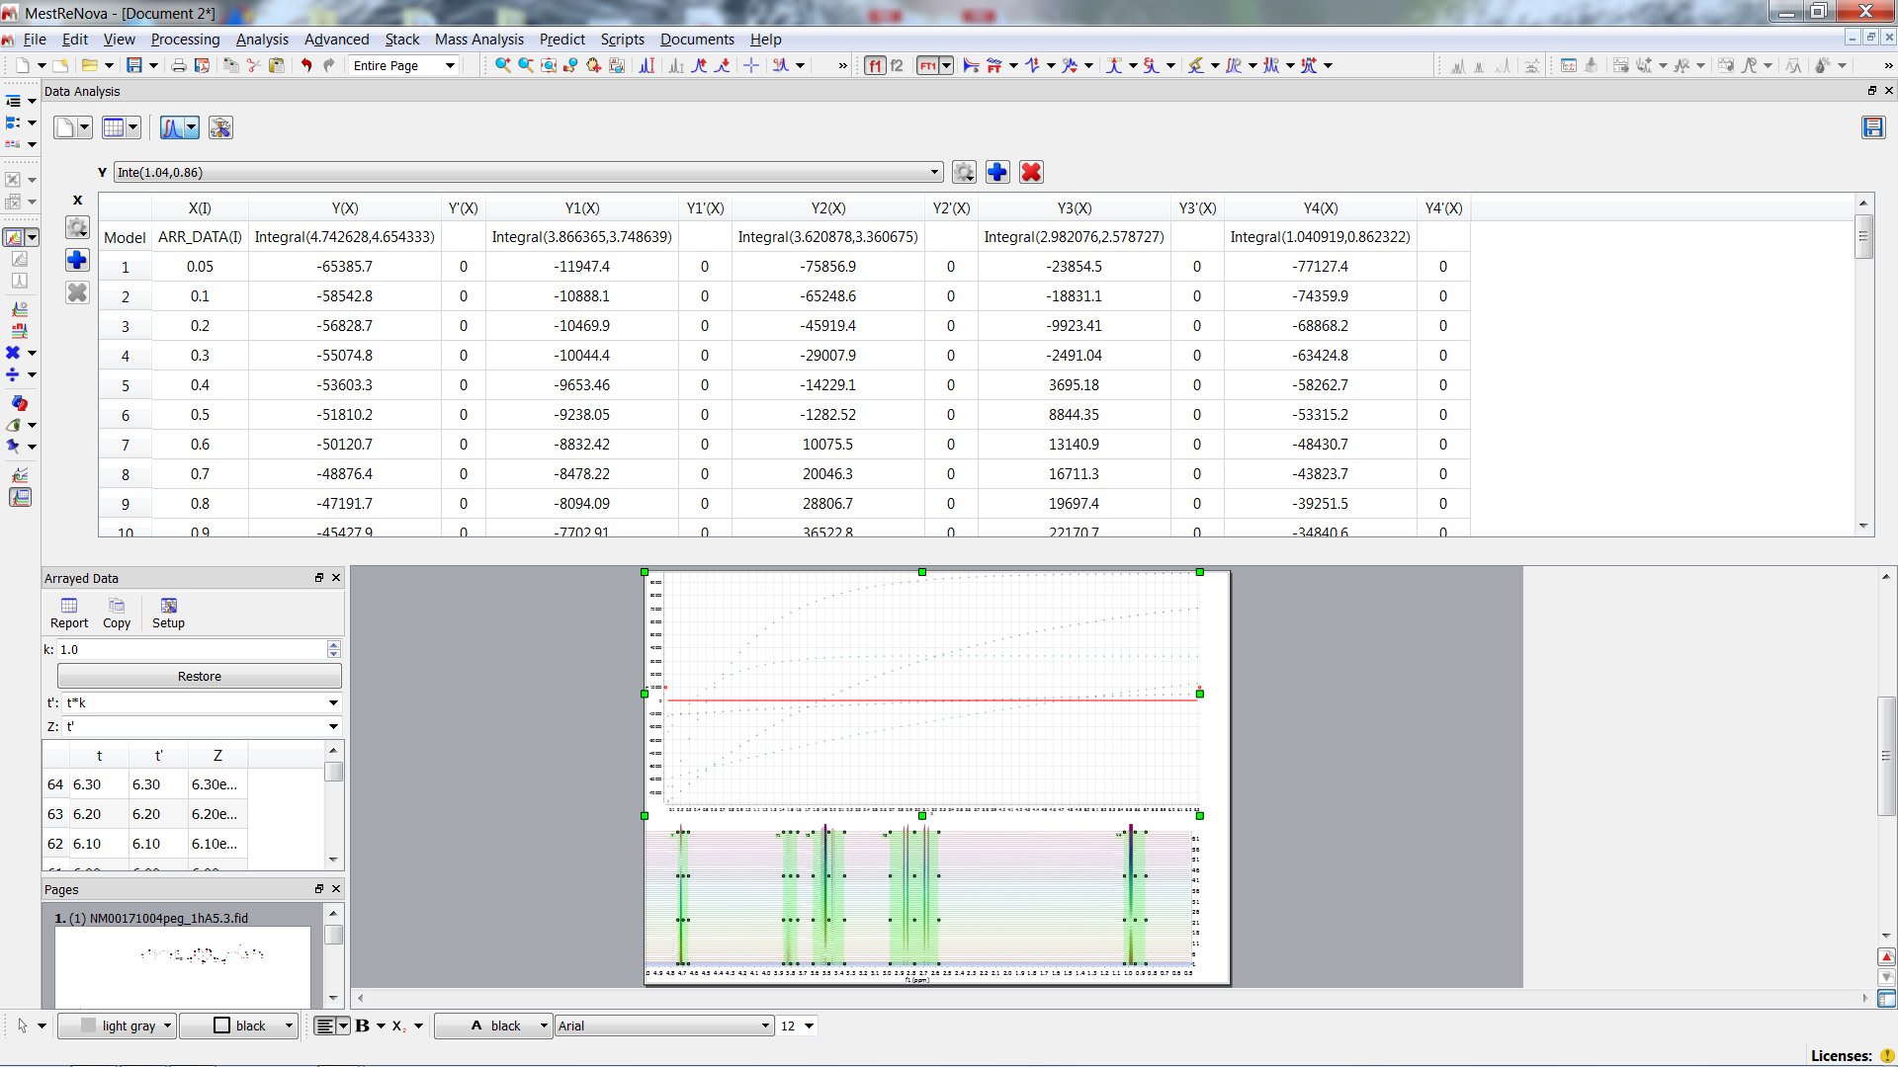
Recovery of Magnetization
OH
CH
PEG
CH2
CH3

Slide 9
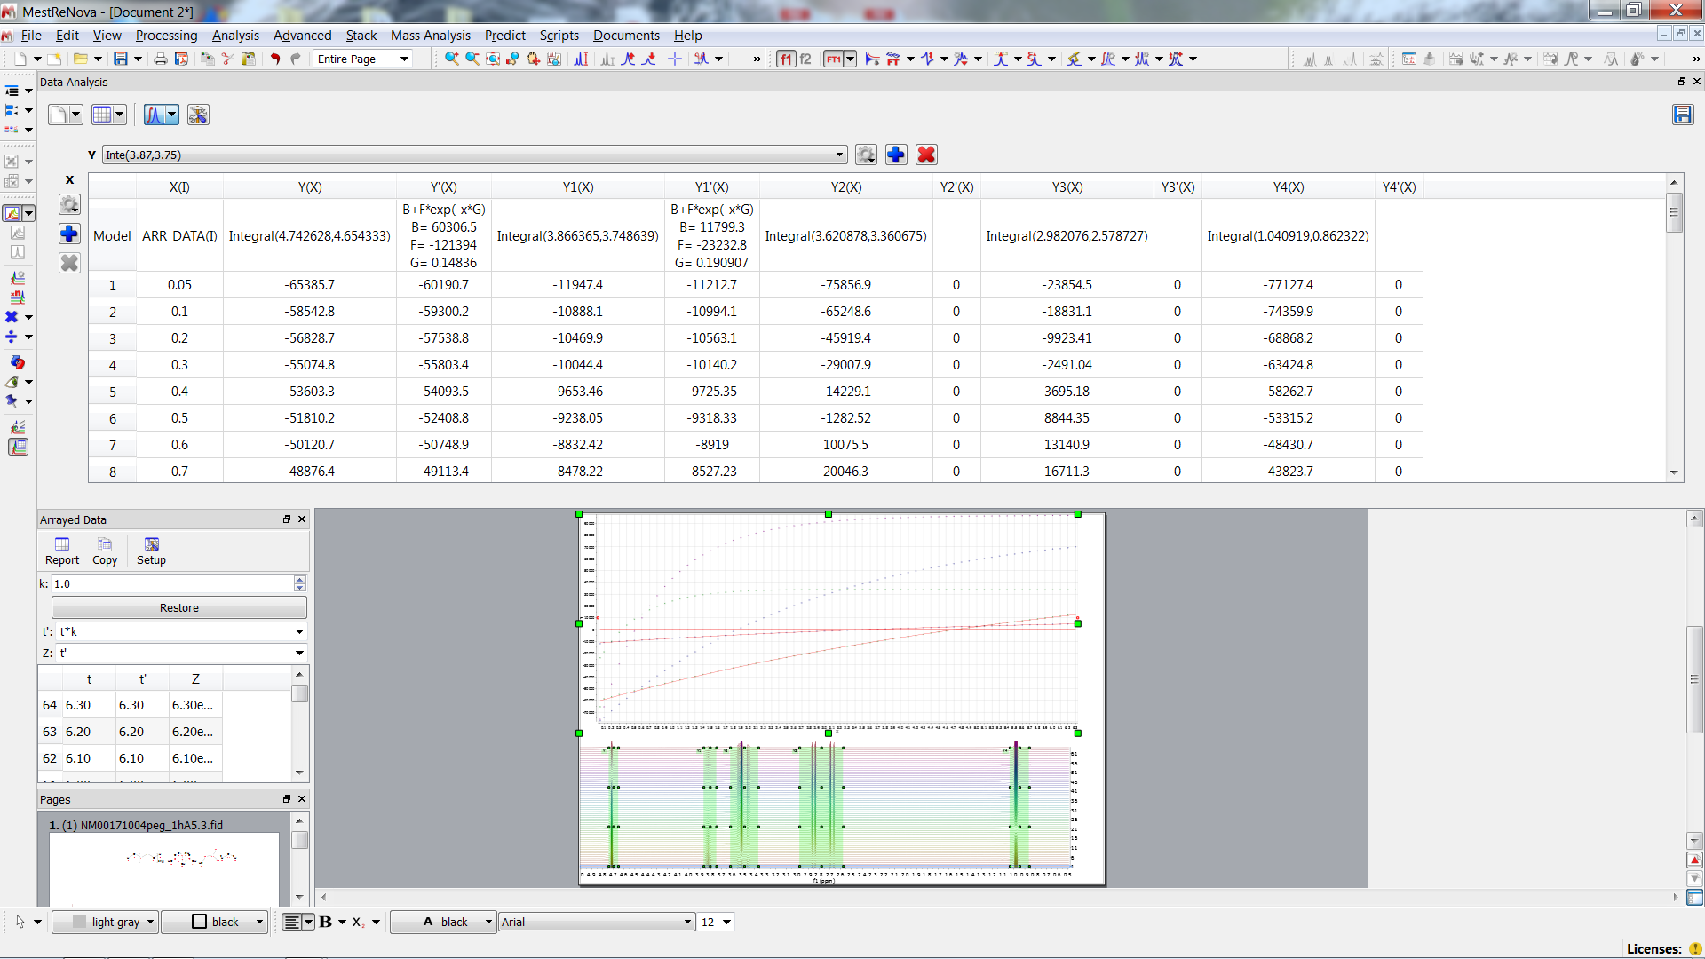
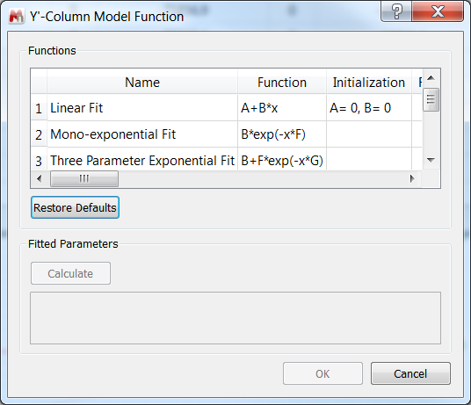
Choose Fit Function
OH
CH
PEG
CH2
CH3

Slide 10
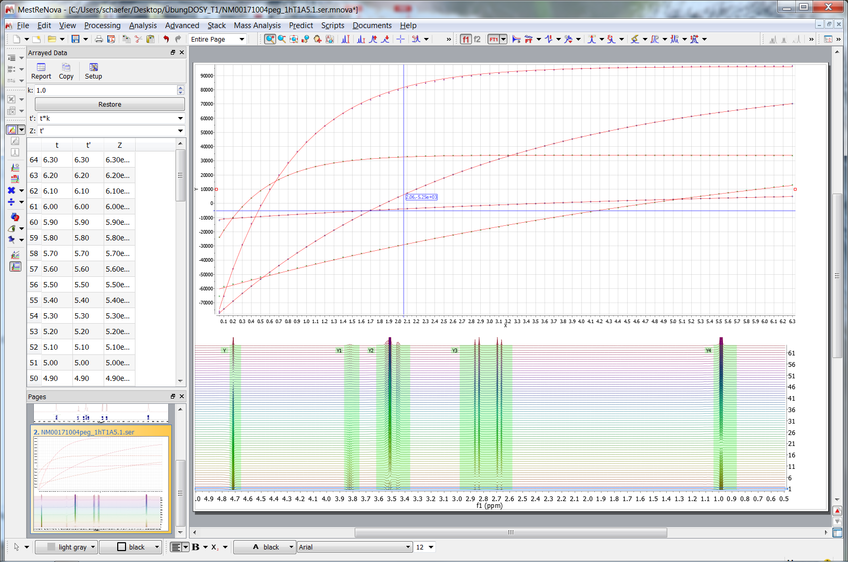
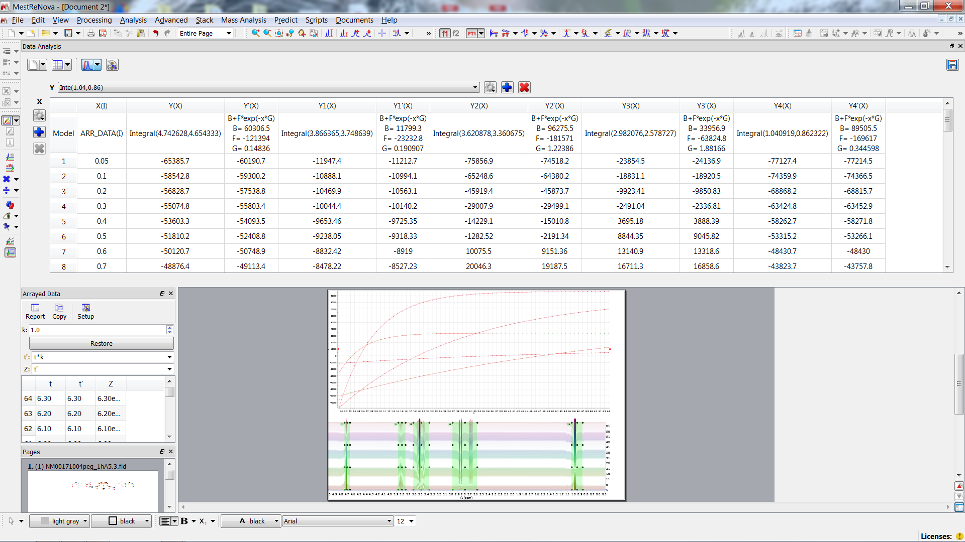
Calculate Fit
PEG
CH
PEG
CH2
CH3
CH3
CH2
OH
CH

Slide 11
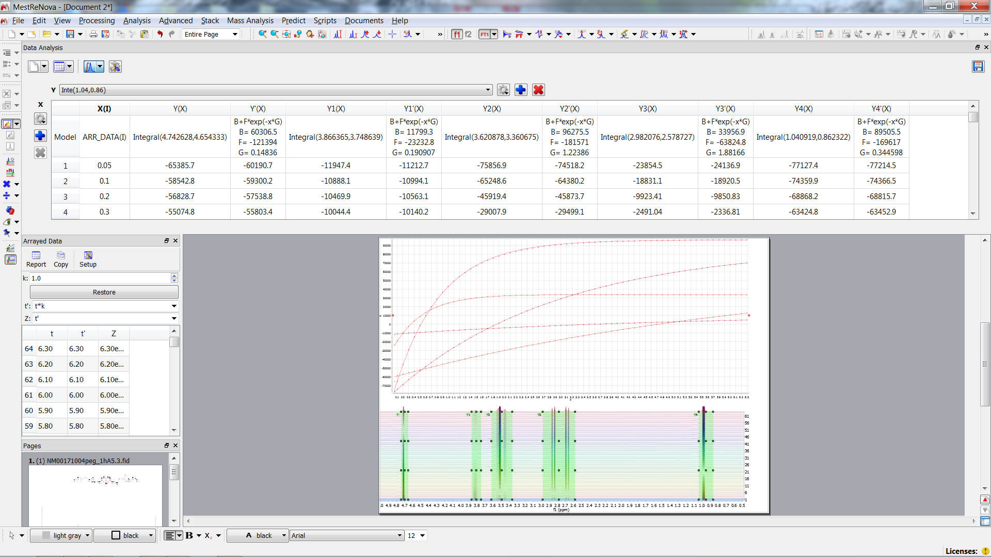
Comparisson with BRUKER FiT
OH
CH
PEG
CH2
CH3
1/G 6.756 5.238 0.817 0.531 2.901
BRUKER 6.614 s 4.567 s 0.716 s 0.535 s 2.865 s

Slide 12
1H

Slide 13
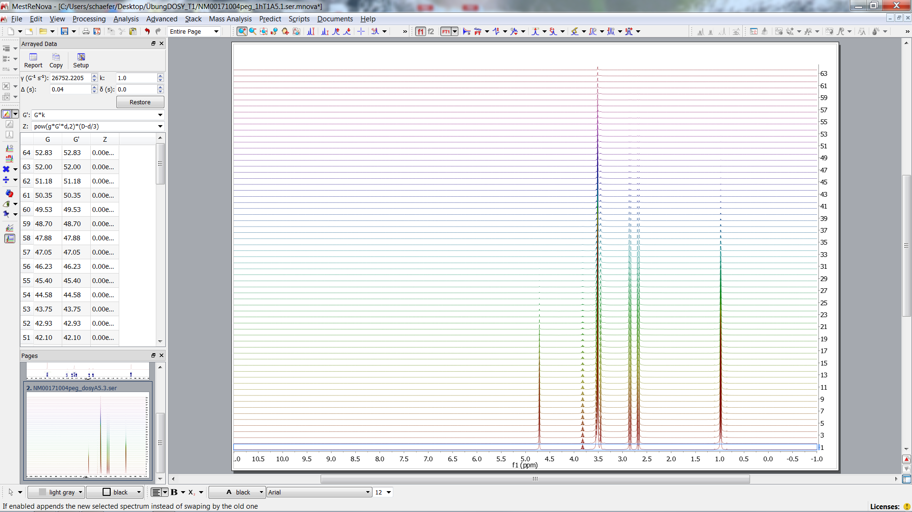
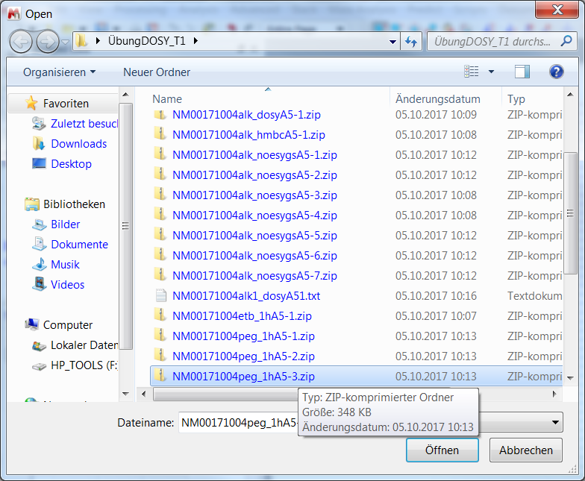
DOSY Experiment(Diffusion Coefficient)

Slide 14
DOSY Experiment(Diffusion Coefficient)
Gradient strength has to be incremented
δ
Δ

Slide 15
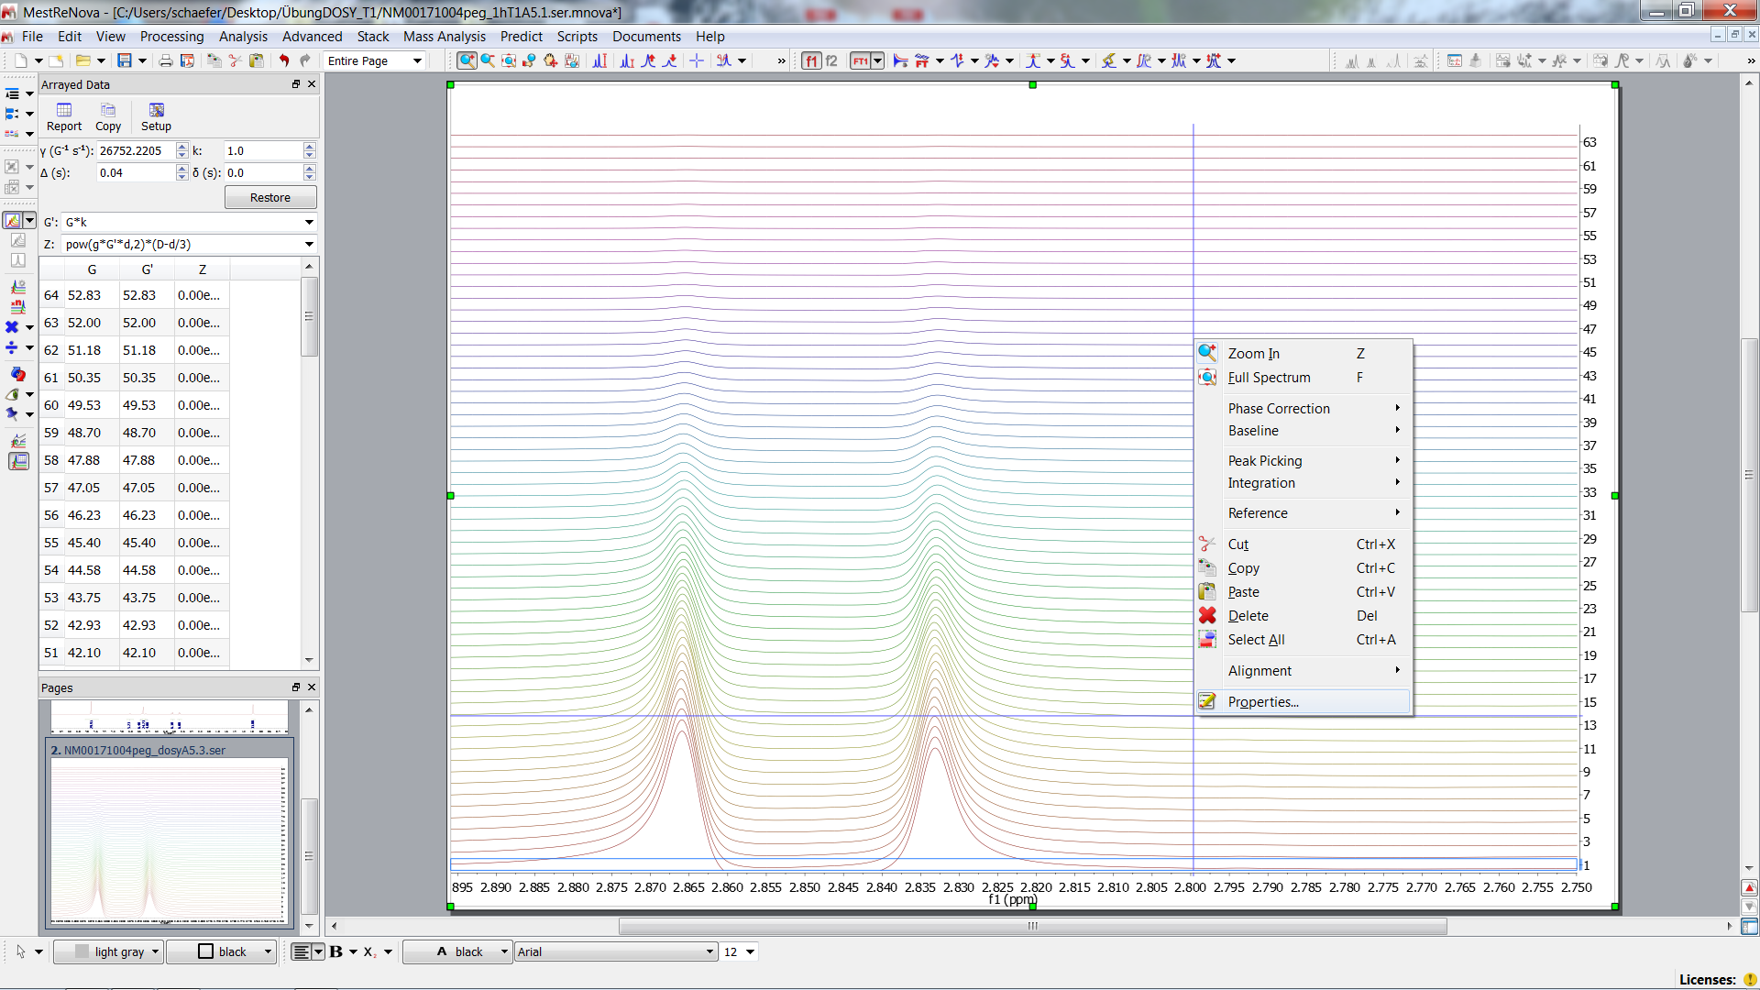
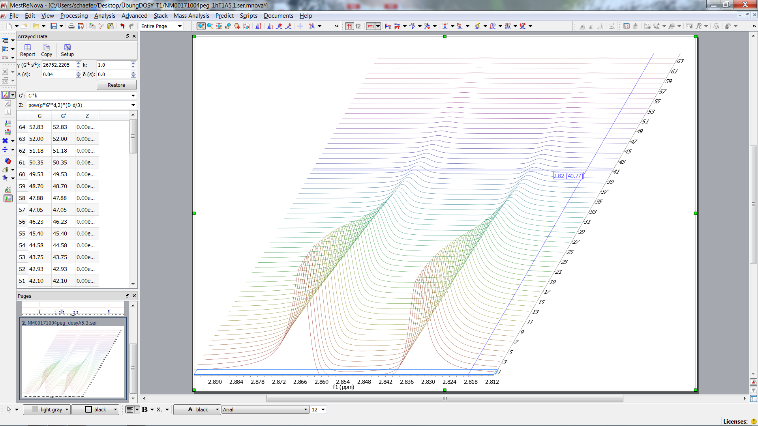
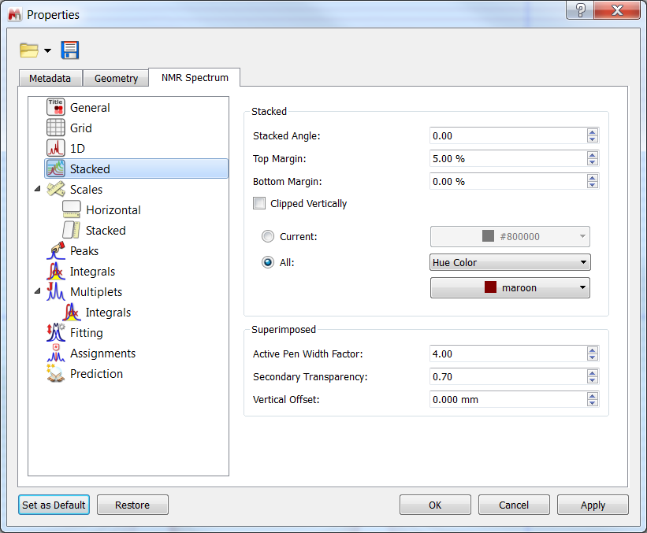
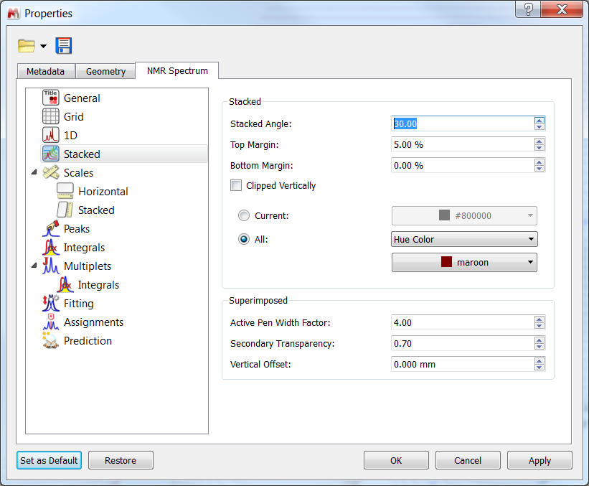
Stacked Plot
δ (little delta) has to be taken from BRUKER DOSY data
Observe Gaussian decay (diffusion)

Slide 16
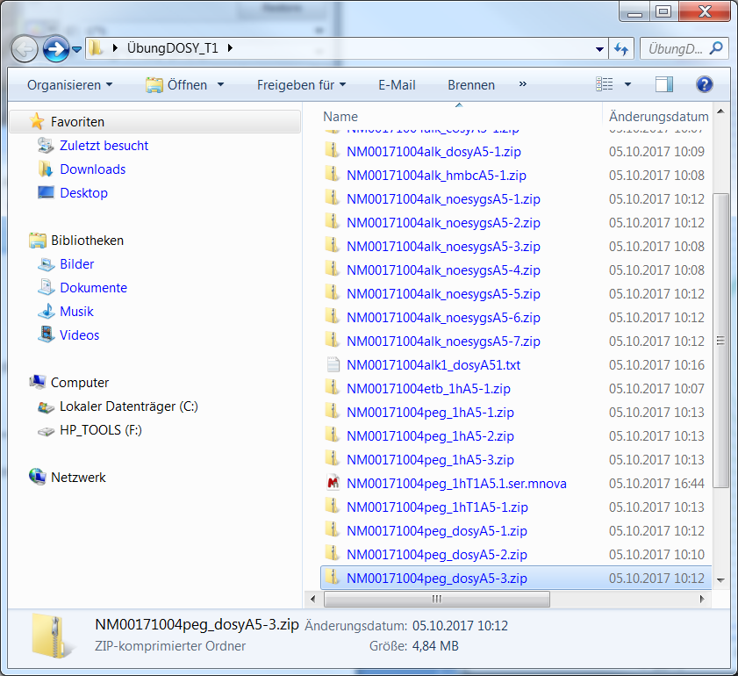
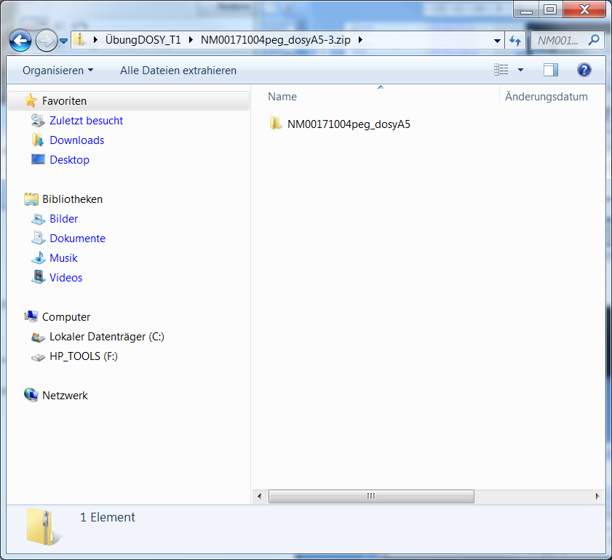
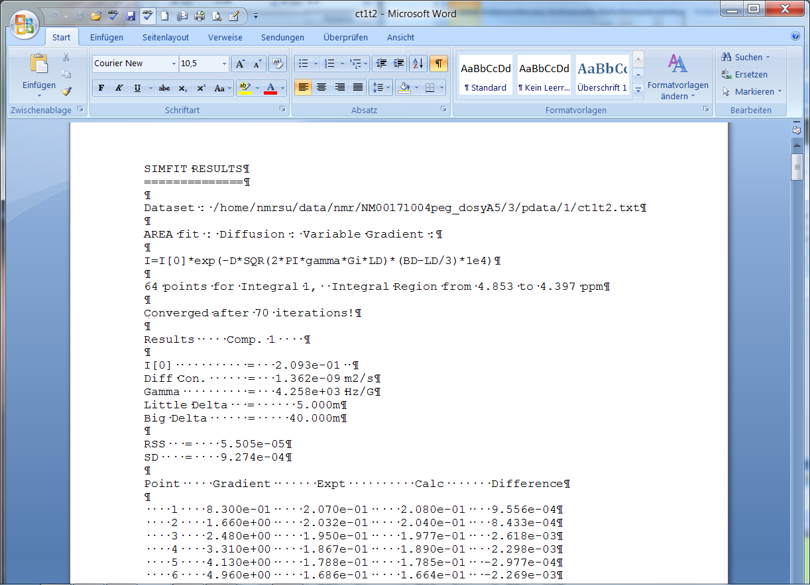
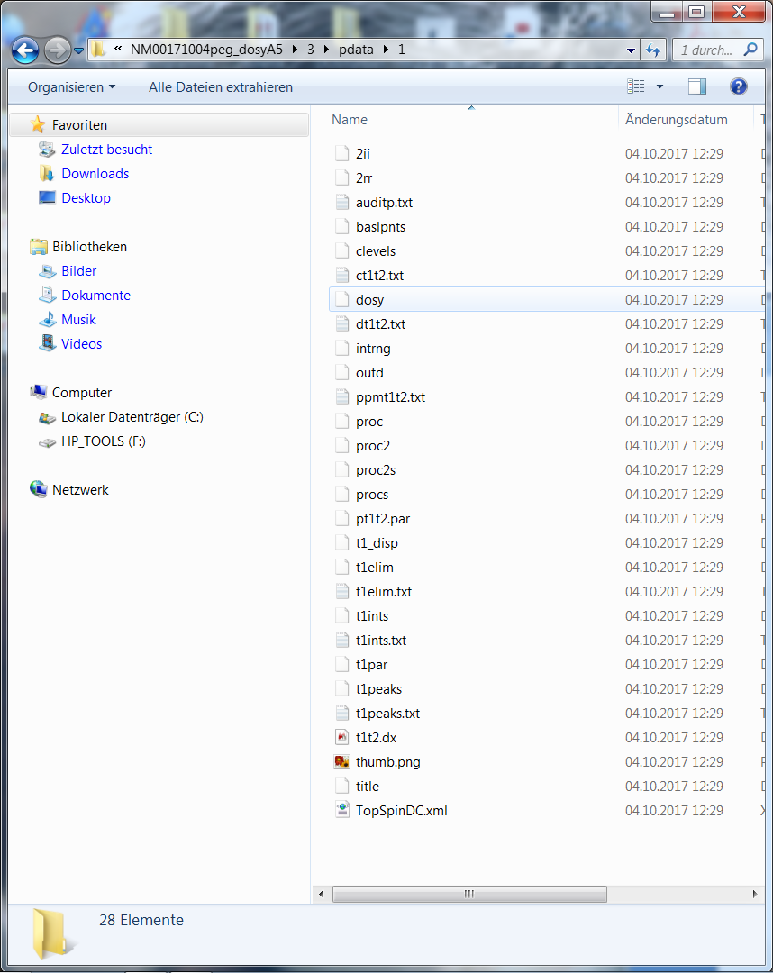
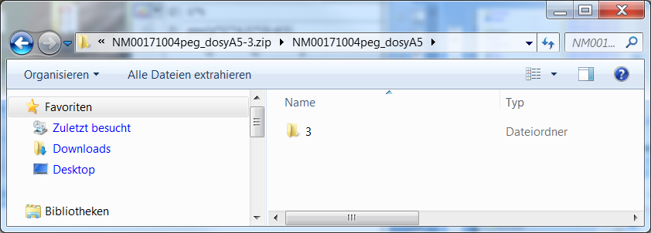
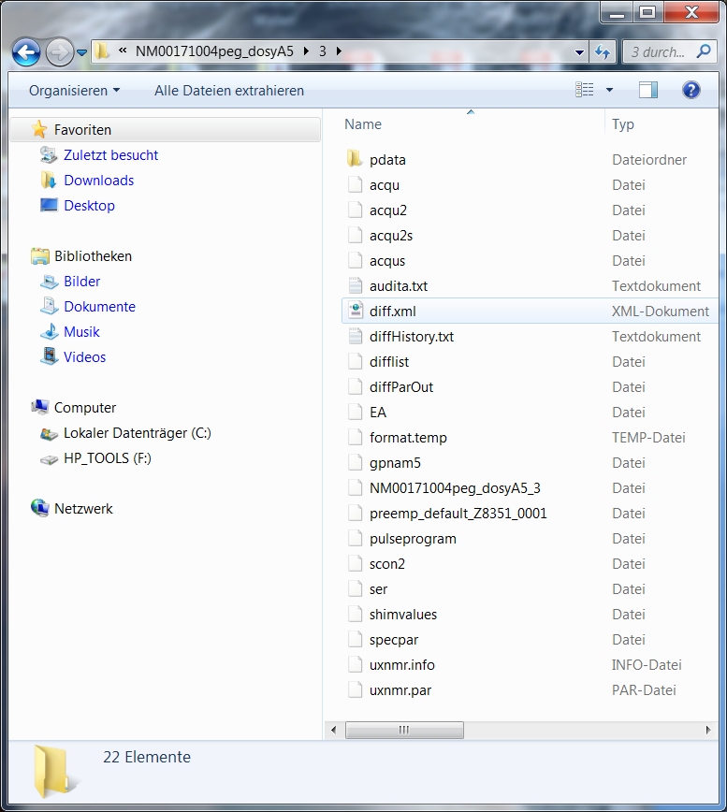
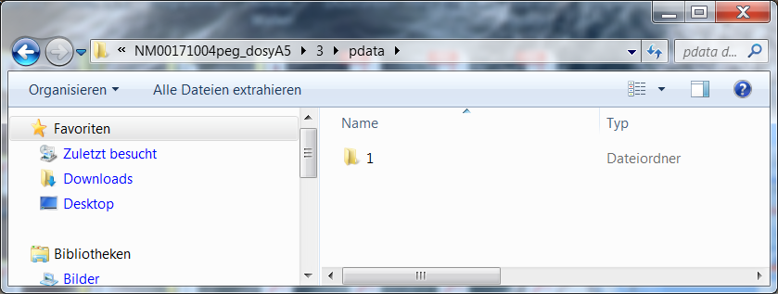
Zipped Folder
BRUKER File Format
Folder containing n exp. data
proc. data
3rd exp. data set
DOSY Fit result
Folder of proc.. data
(little delta) has to be taken from BRUKER DOSY data
5 ms = 0,.005
1st processed data
proc. data set

Slide 17
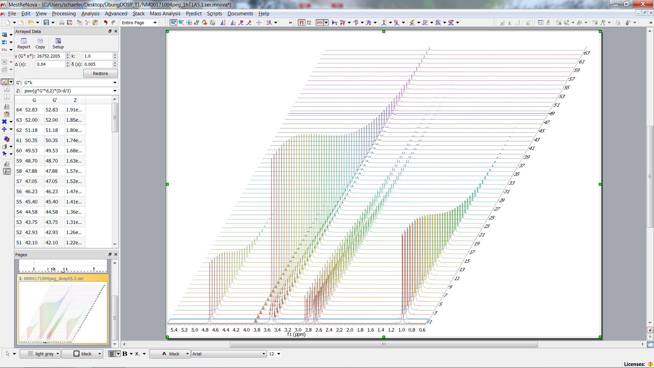
DOSY
δ (little delta) has to be taken 0.005
z axis (gradient) can be calculated by Mnova

Slide 18
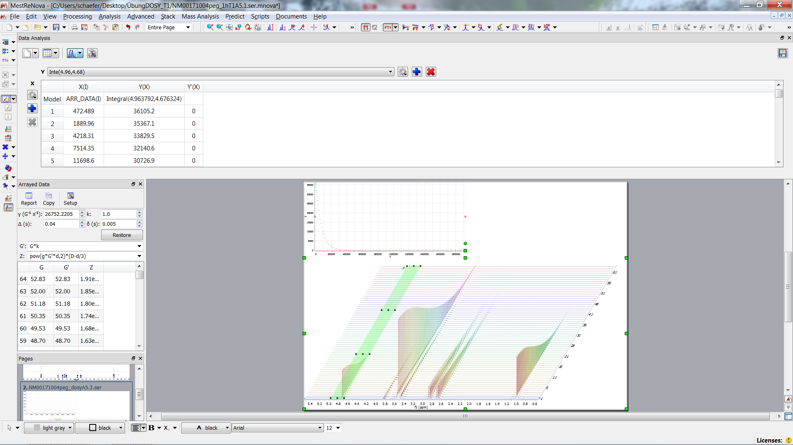
Choose Regions of Interest
(c.f. T1)
Exponential decay (see fit func)
Observe Gaussian decay (diffusion)

Slide 19
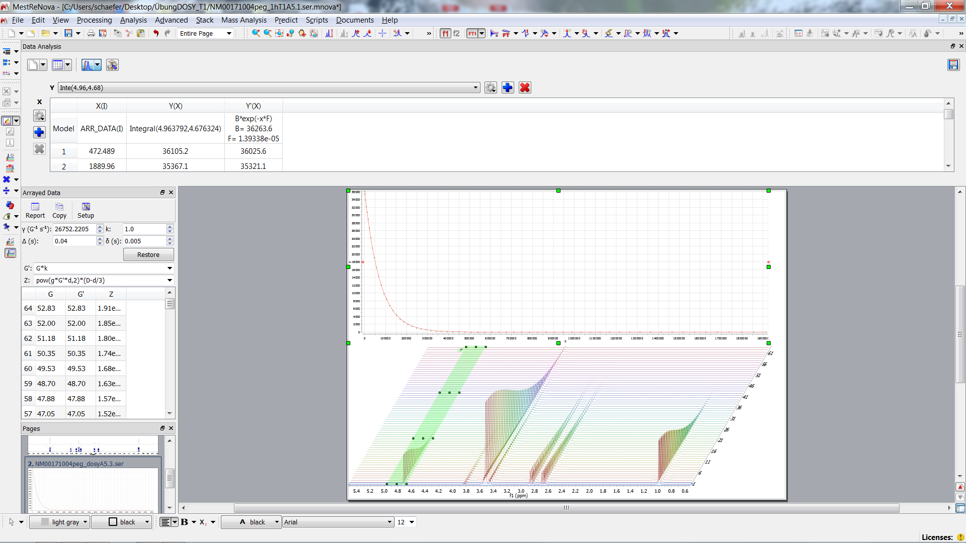
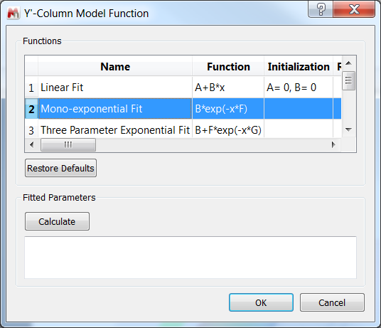
Choose Mono-exponential Fit
(c.f. T1)
Result
Observe Gaussian decay (diffusion)

Slide 20
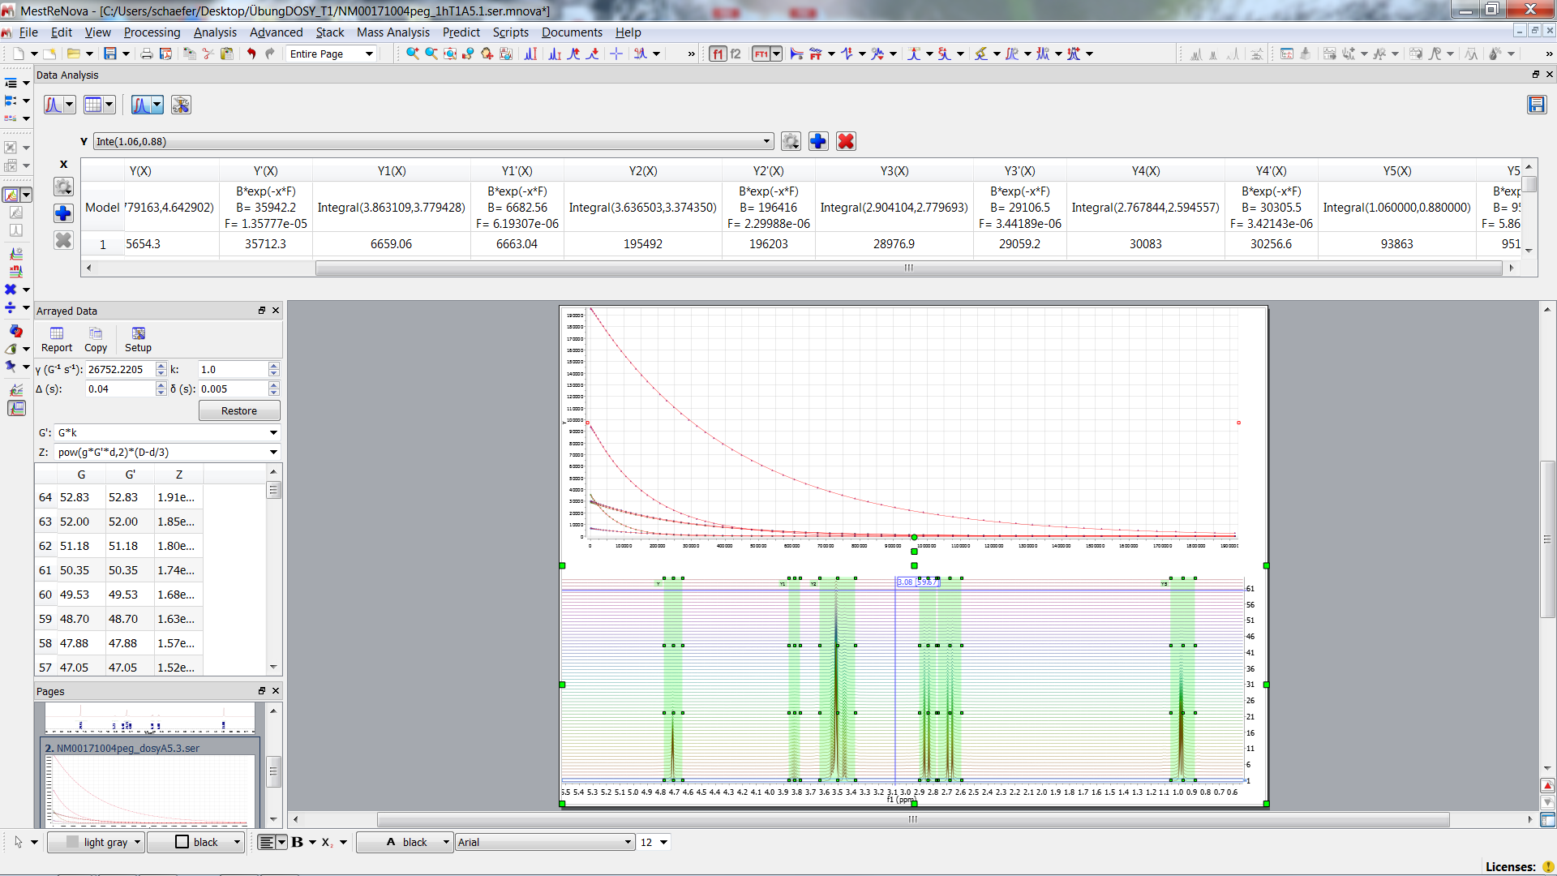
Mono-exponential Fit for All Regions
(c.f. T1)

Slide 21
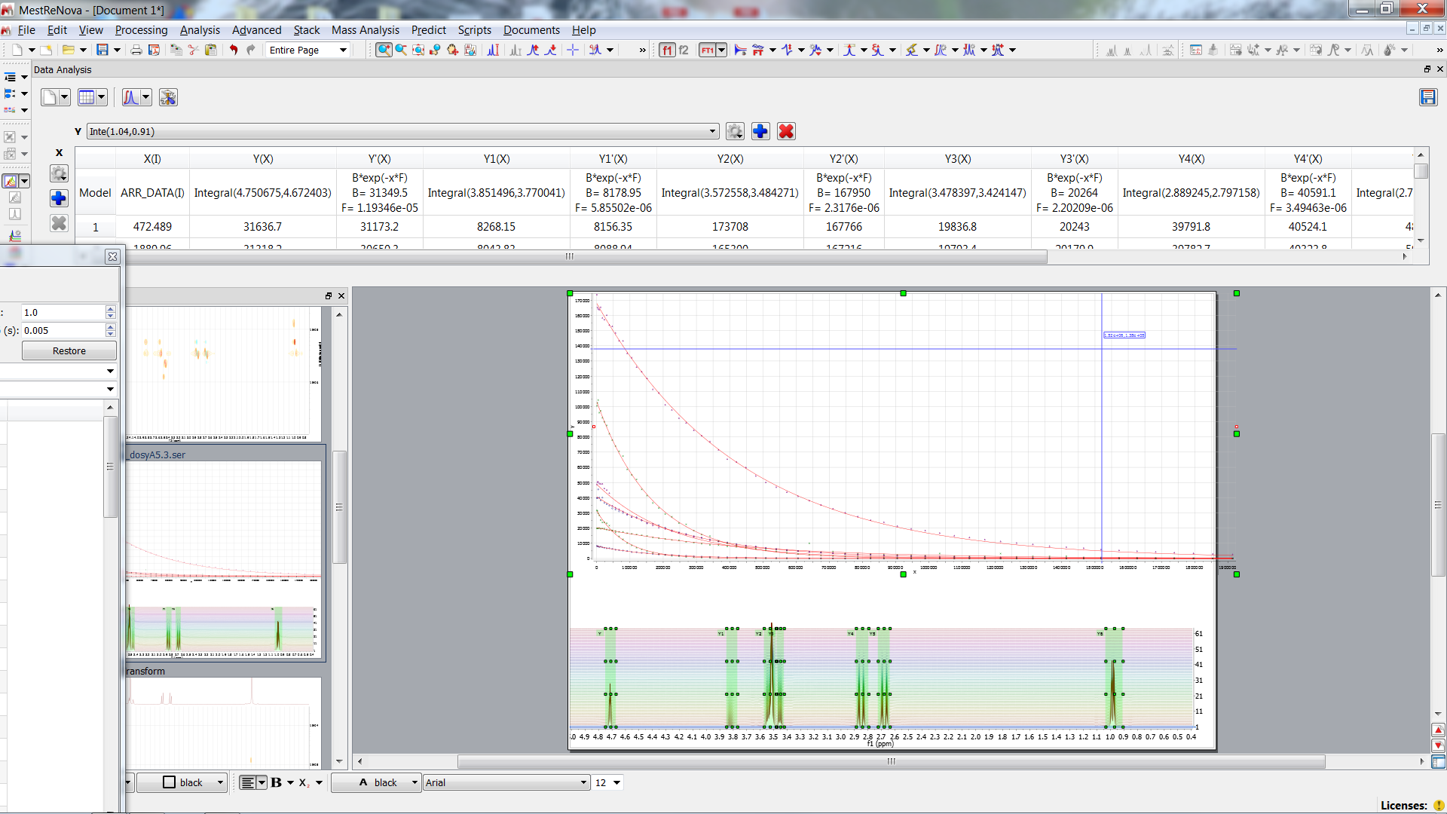
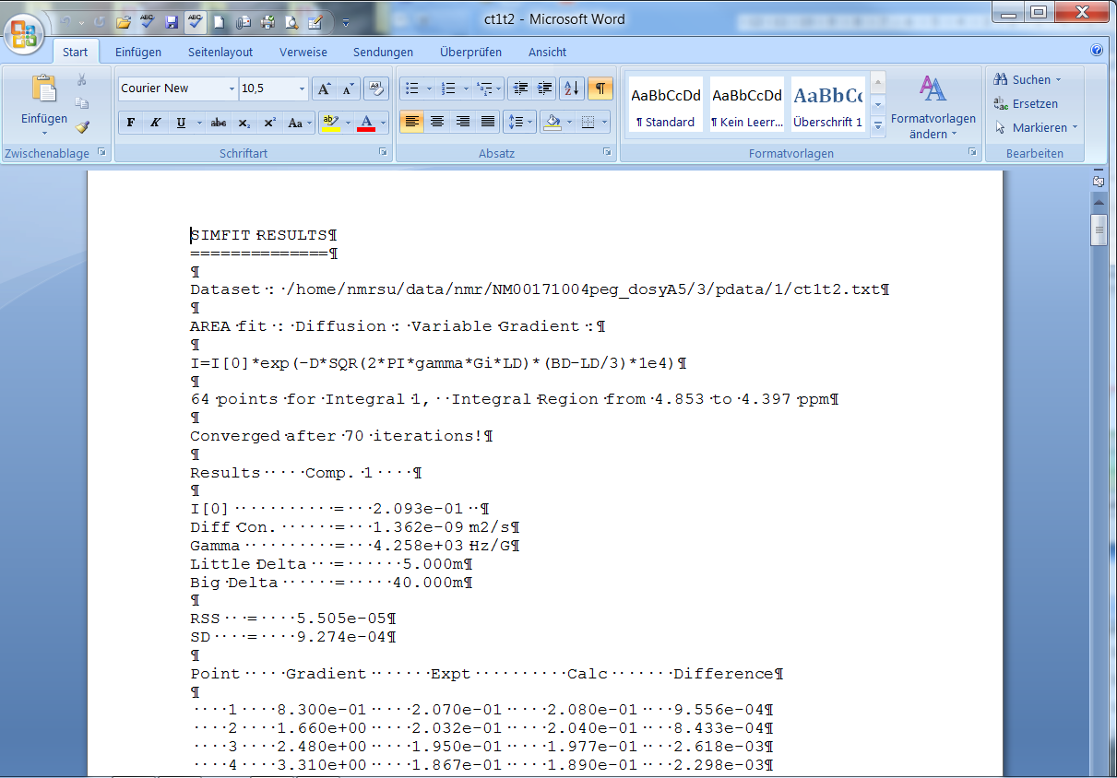
Compare with BRUKER Results
MNOVA calculates Diffusion coefficients in cm2/s while BRUKER uses units m2/s => D_{MNOVA}/D_{BRUKER} 1e+4 !!!
OH
CH
PEG
PEG
CH2
BRUKER 1.36e-9 6.49 e-10 2.37 e-10 1.87 e-10 3.49 e-10
PEG
PEG
CH2
CH2
CH3
BRUKER 2.37 e-10 1.87 e-10 3.49 e-10 3.39 e-10 5.88 e-10
Diff Con. _{BRUKER} in m2/s
Diff Con._{Mnova} in cm2/s
Diff _{BRUER}/Diff _{Mnova} => Factor 10⁻⁴

Slide 22
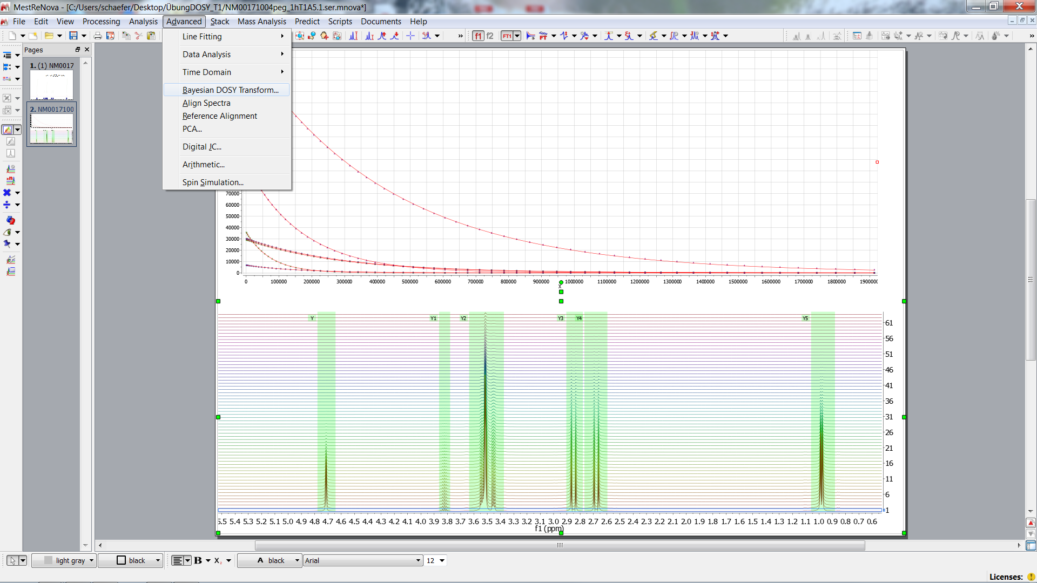
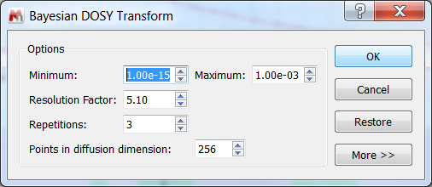
2D- DOSY Spectrum

Slide 23
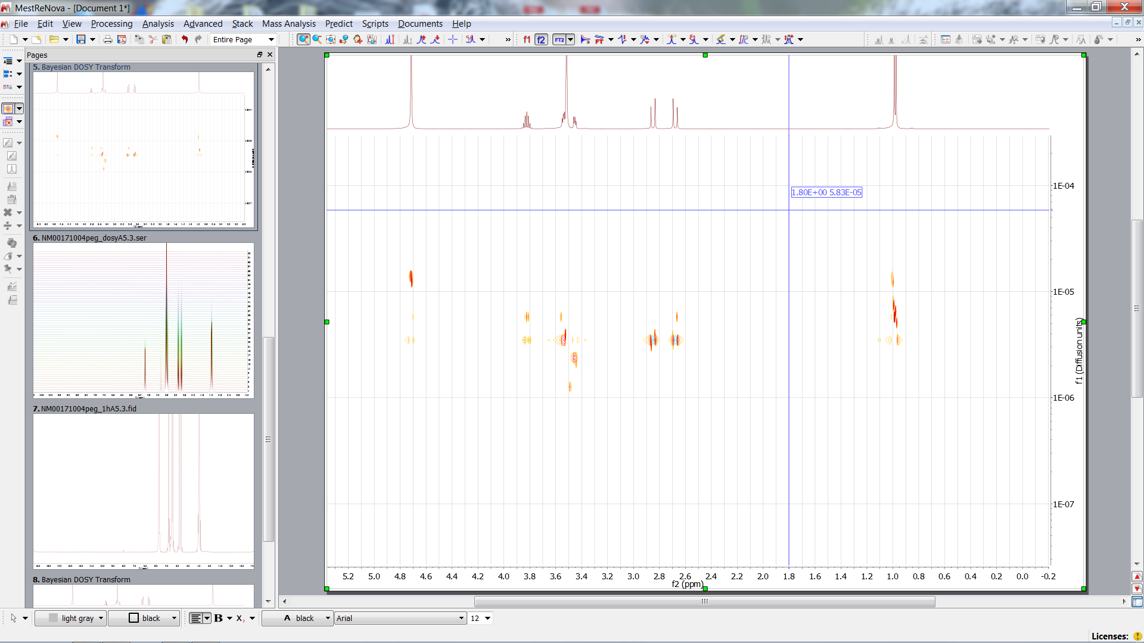
2D- DOSY Spectrum

Slide 24
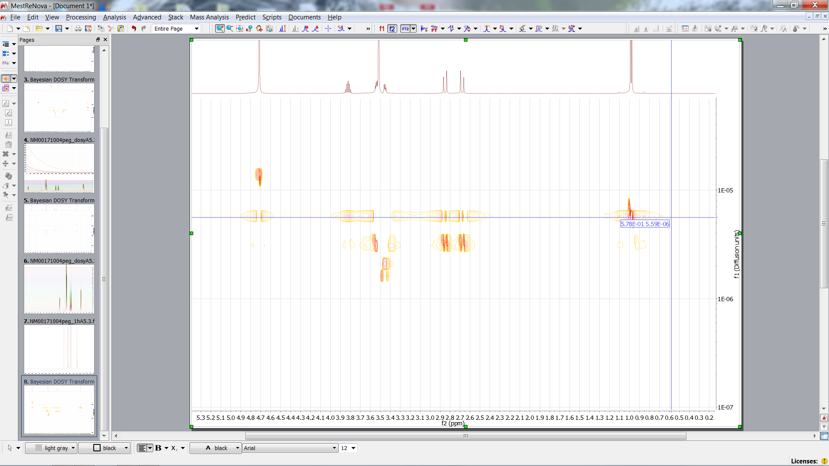
2D- DOSY Spectrum
OH
CH3
CH
CH2
PEG

Slide 25
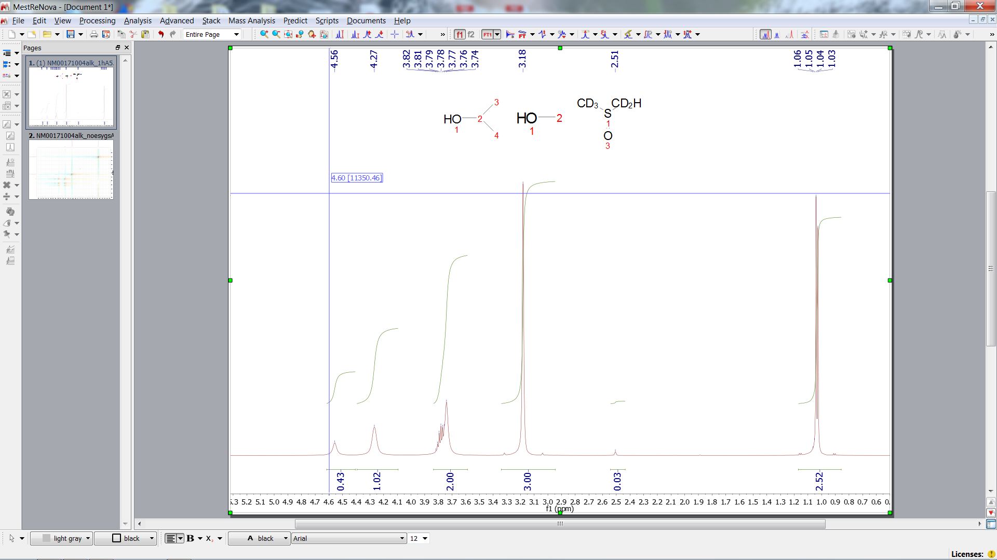
1H Exchange
CH3(MeOH)
CH3(isopr.)
CH(isopr.)
HDO
OH(MeOH)
OH(isopr.)
DMSO

Slide 26
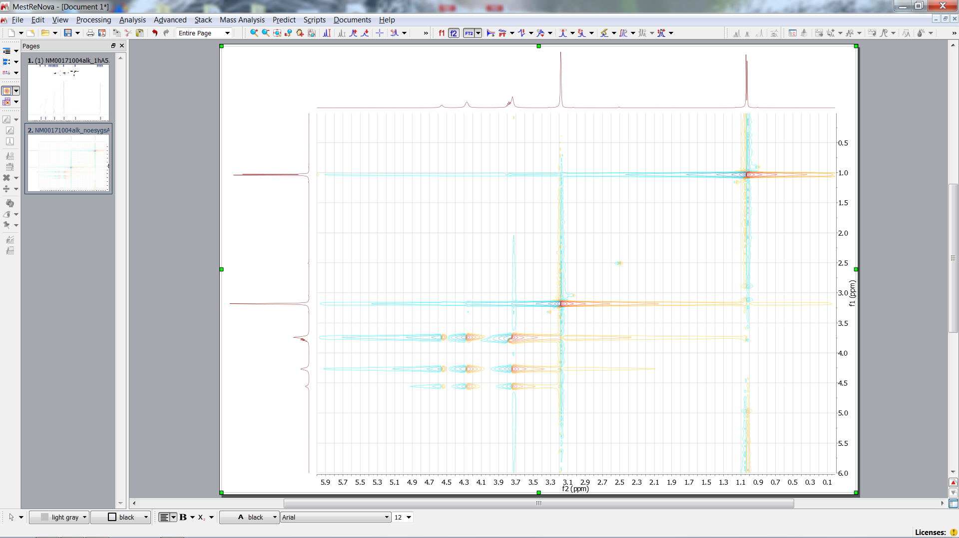
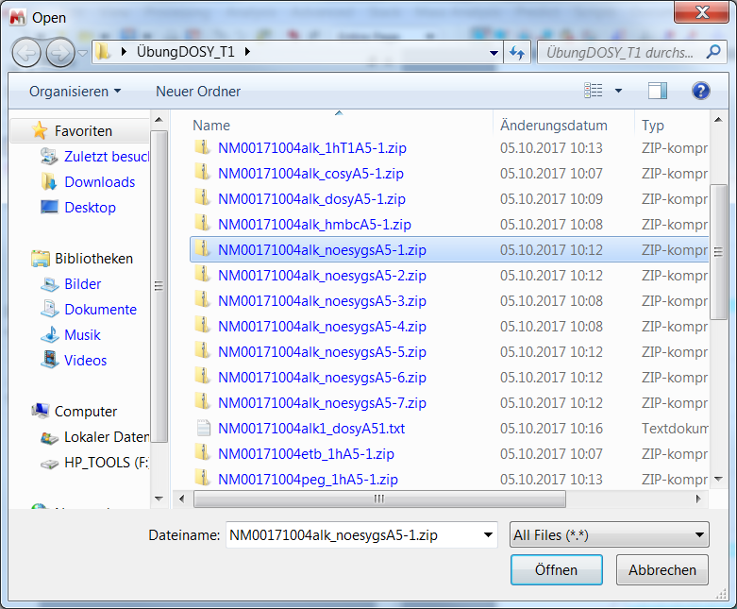
2D-ECSY Spectrum
OH
90° y
90° y
- 90° y
t₁
t_{mix}
B₀ - evolution
t₂

Slide 27
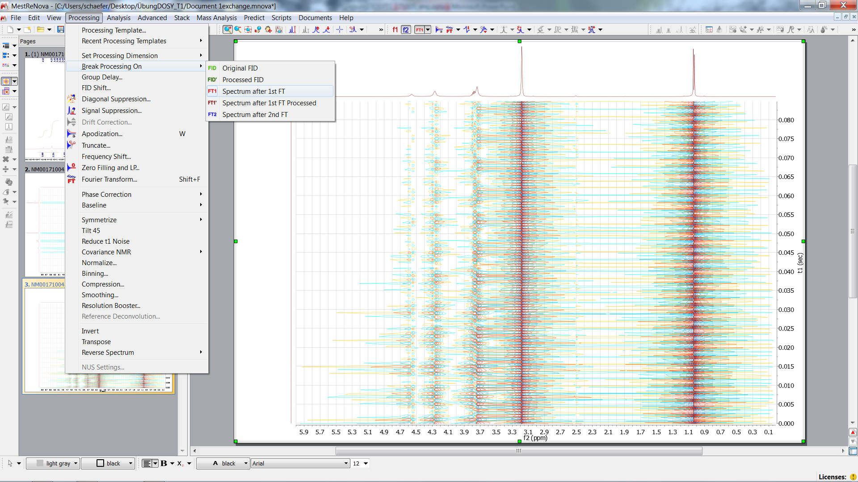
FT along t₂ -> Series of FIDs along t₁
90° y
90° y
- 90° y
t₁
t_{mix}
B₀ - evolution
t₂

Slide 28
FT along t₁ (2D) and Phase Correction

Slide 29
Manual Phase Correction

Slide 30
F1 needs Phase Correction

Slide 31
Load 1D Spectra as Projections (if needed)

Slide 32
Apply Baseline Correction (if needed)

Slide 33
Assignment
CH3(MeOH)
CH3(isopr.)
CH(isopr.)
OH(isopr.)
OH(MeOH)
HDO
DMSO
90° y
90° y
- 90° y
CH3(isopr.)
CH3(isopr.)
t₁
t_{mix} = 0.2 s
t₂
DMSO
DMSO
CH3(MeOH)
OH exchange !!!
HDO /OH(MeOH)
HDO/ OH(isopr.)
OH(MeOH)/OH(isopr.)

Slide 34
Exchange Cross Peaks Depend on Mixing Time
CH3(MeOH)
CH3(isopr.)
CH(isopr.)
OH(isopr.)
OH(MeOH)
HDO
DMSO
90° y
90° y
- 90° y
CH3(isopr.)
t₁
t_{mix} = 0.2 s
CH3(isopr.)
t₂
DMSO
DMSO
CH3(MeOH)
OH exchange !!!
HDO /OH(MeOH)
HDO/ OH(isopr.)
OH(MeOH)/OH(isopr.)

Slide 35
Exchange Cross Peaks Depend on Mixing Time
CH3(MeOH)
CH3(isopr.)
CH(isopr.)
OH(isopr.)
OH(MeOH)
HDO
DMSO
CH3(isopr.)
CH3(isopr.)
Different mixing times
t_{mix} = 0.003s
DMSO
DMSO
CH3(MeOH)
OH exchange !!!
HDO /OH(MeOH)
HDO/ OH(isopr.)
OH(MeOH)/OH(isopr.)

