Slide 1
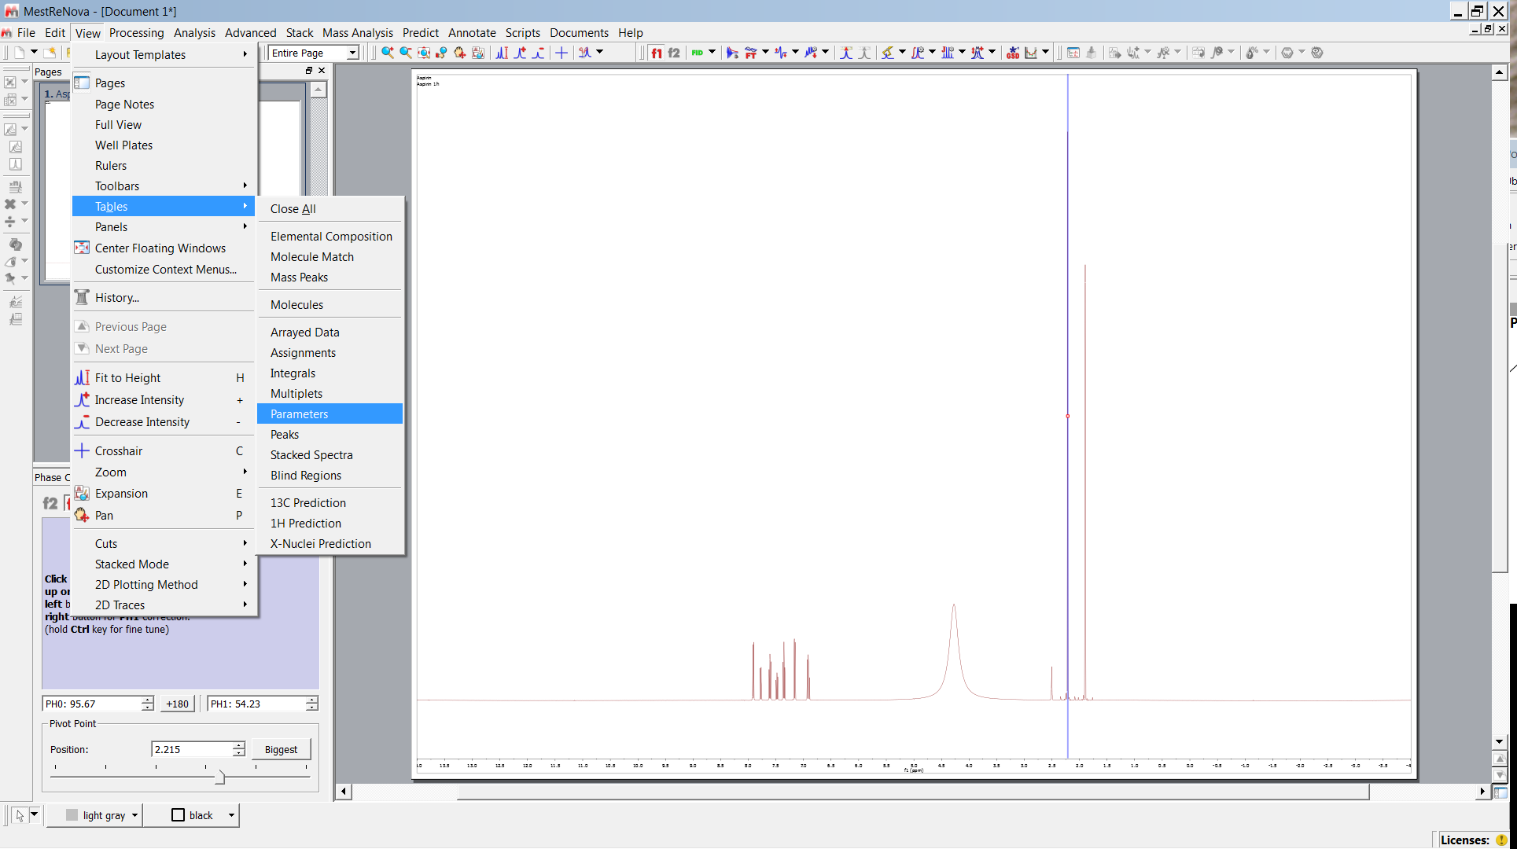
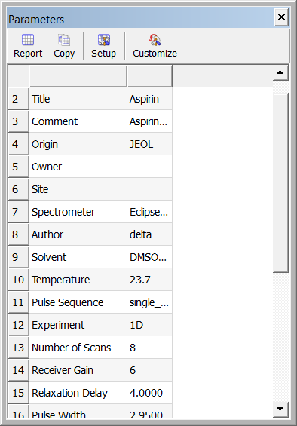
View Parameters

Slide 2
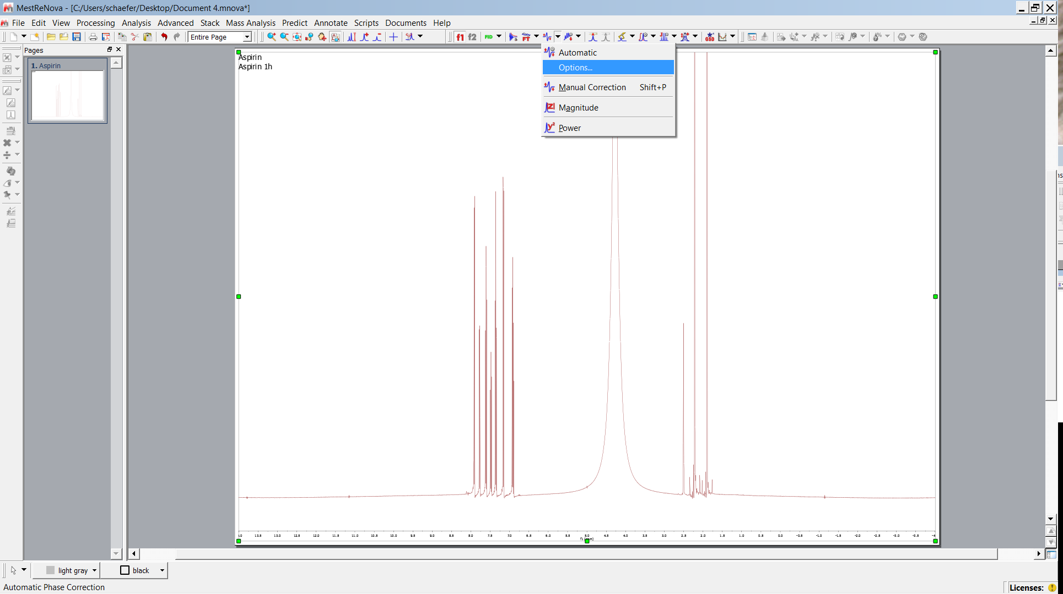
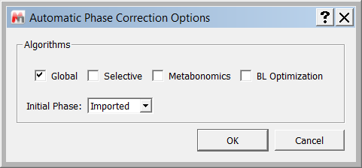
Phase Correction
Standard Params

Slide 3
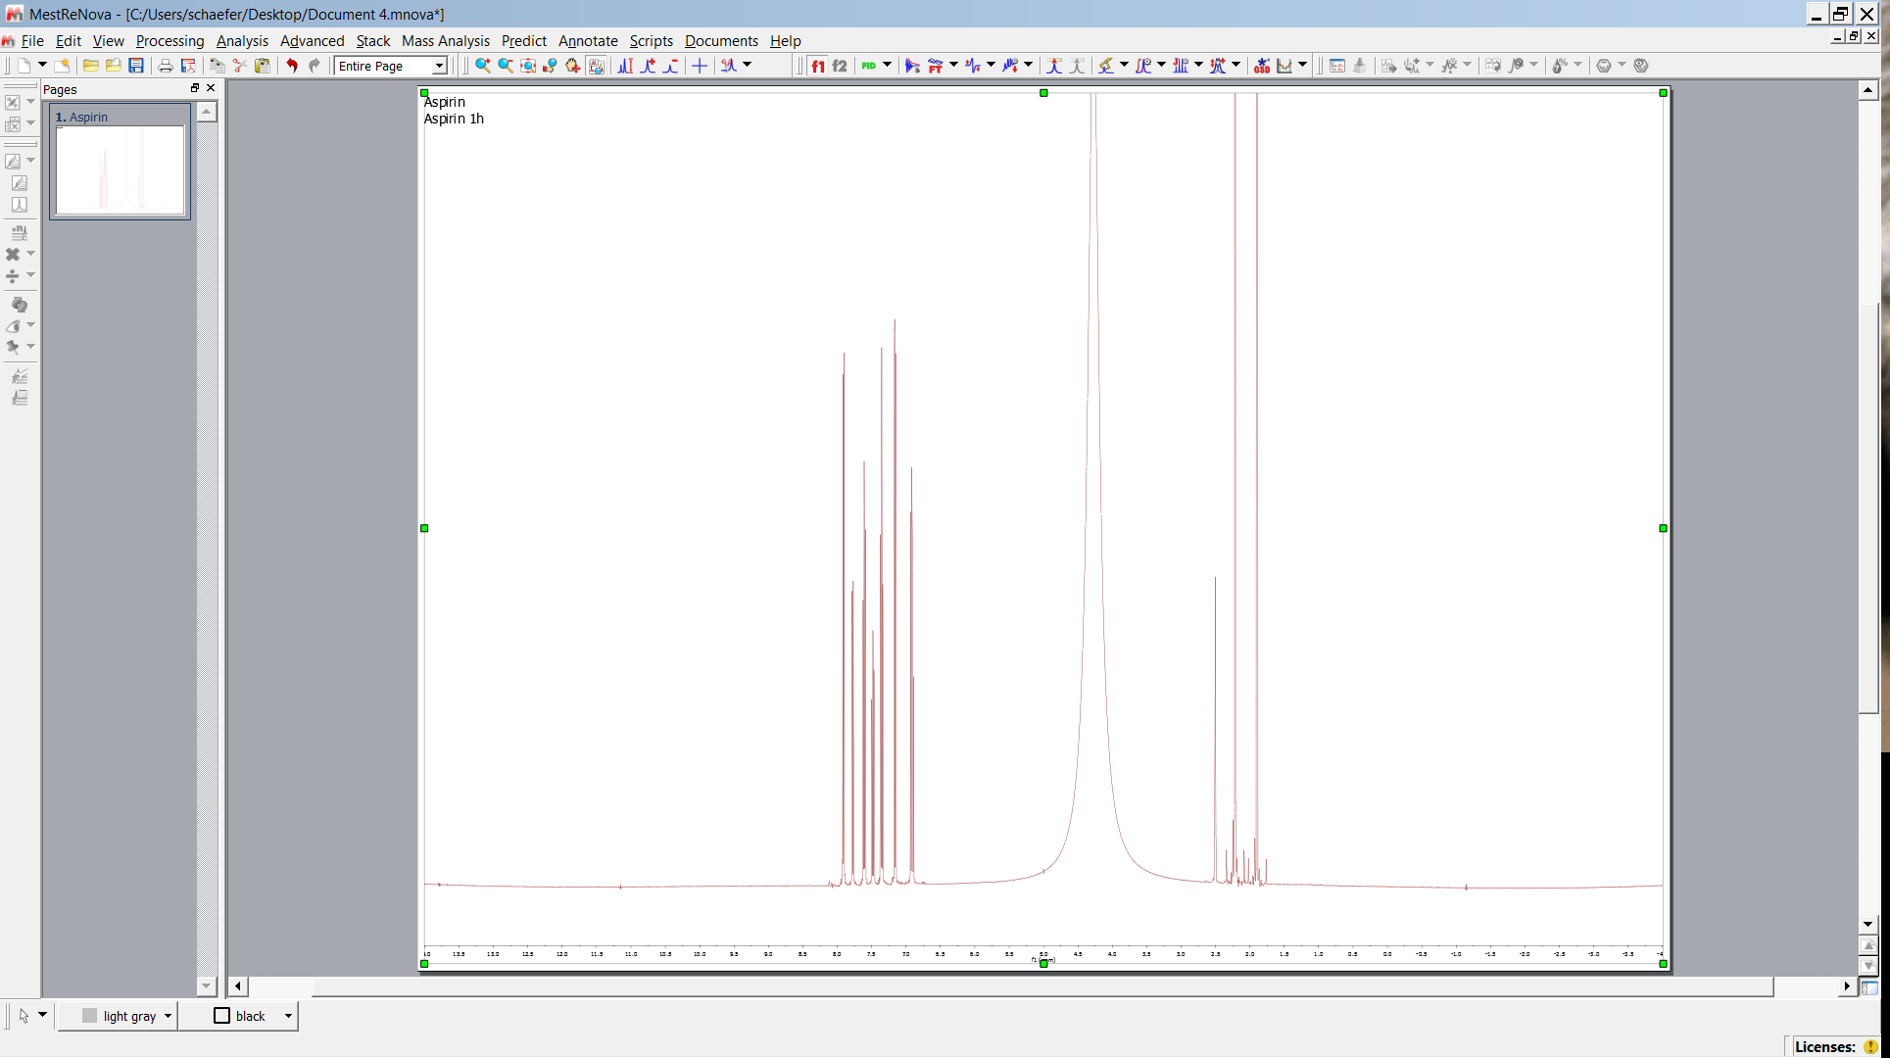
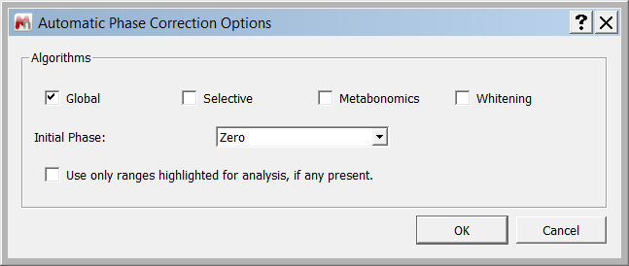
Phase Correction
Choose selective
instead of global for dept

Slide 4
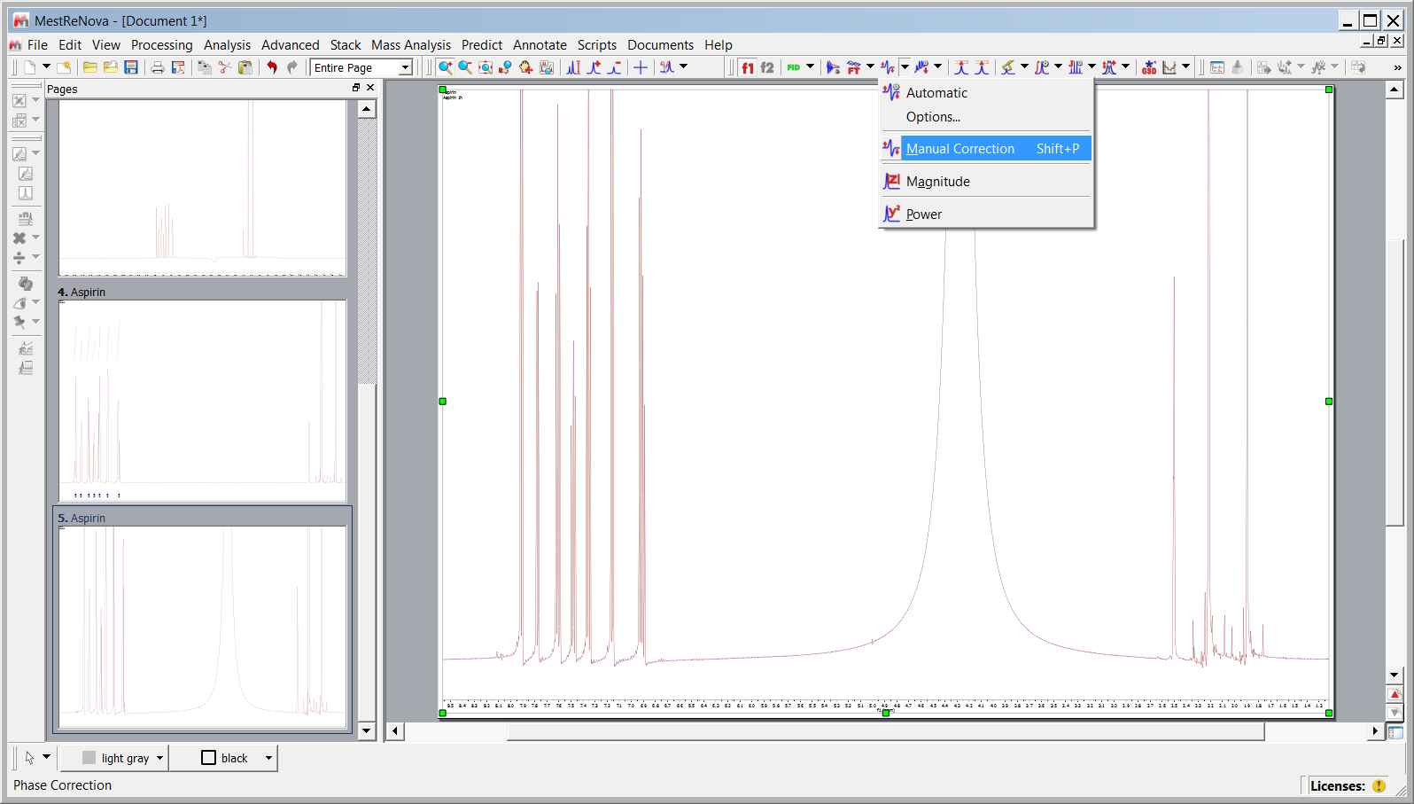
Phase Correction
recommended

Slide 5
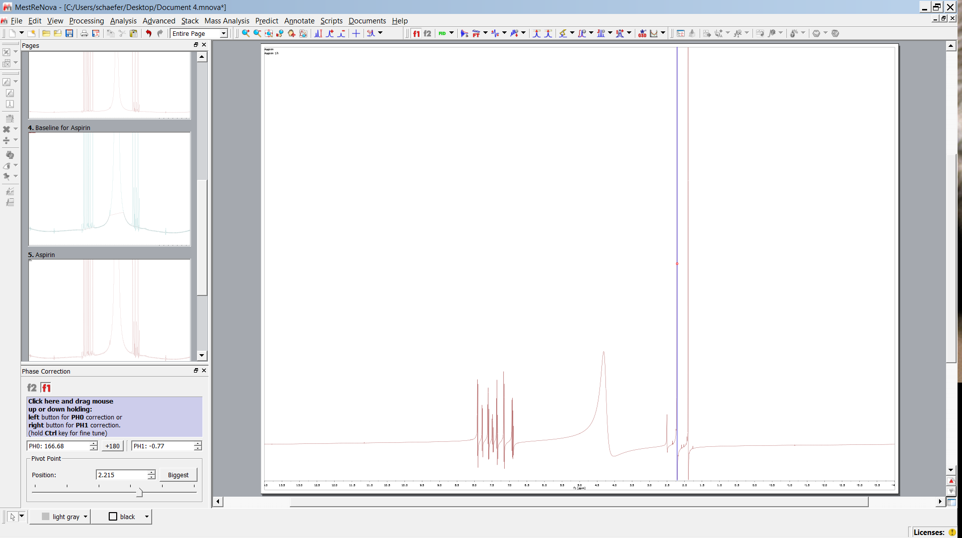
Phase Correction
pivot
Zeroth order

Slide 6
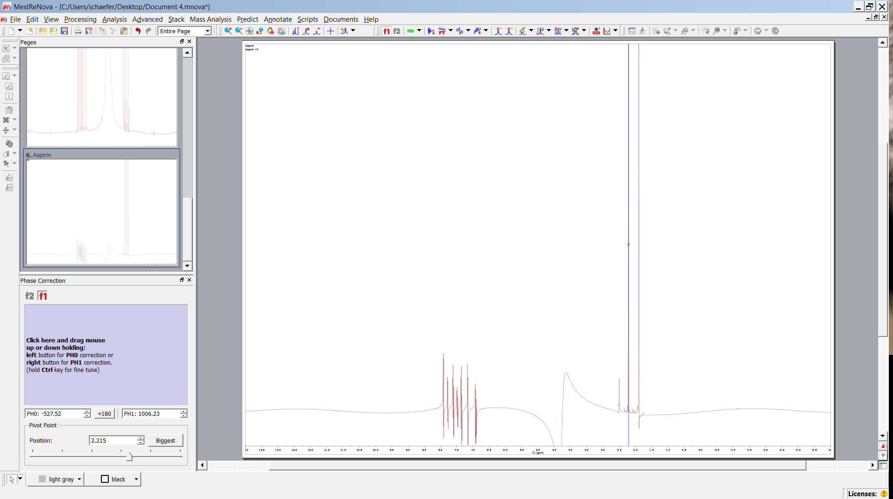
Phase Correction
recommended
first order

Slide 7
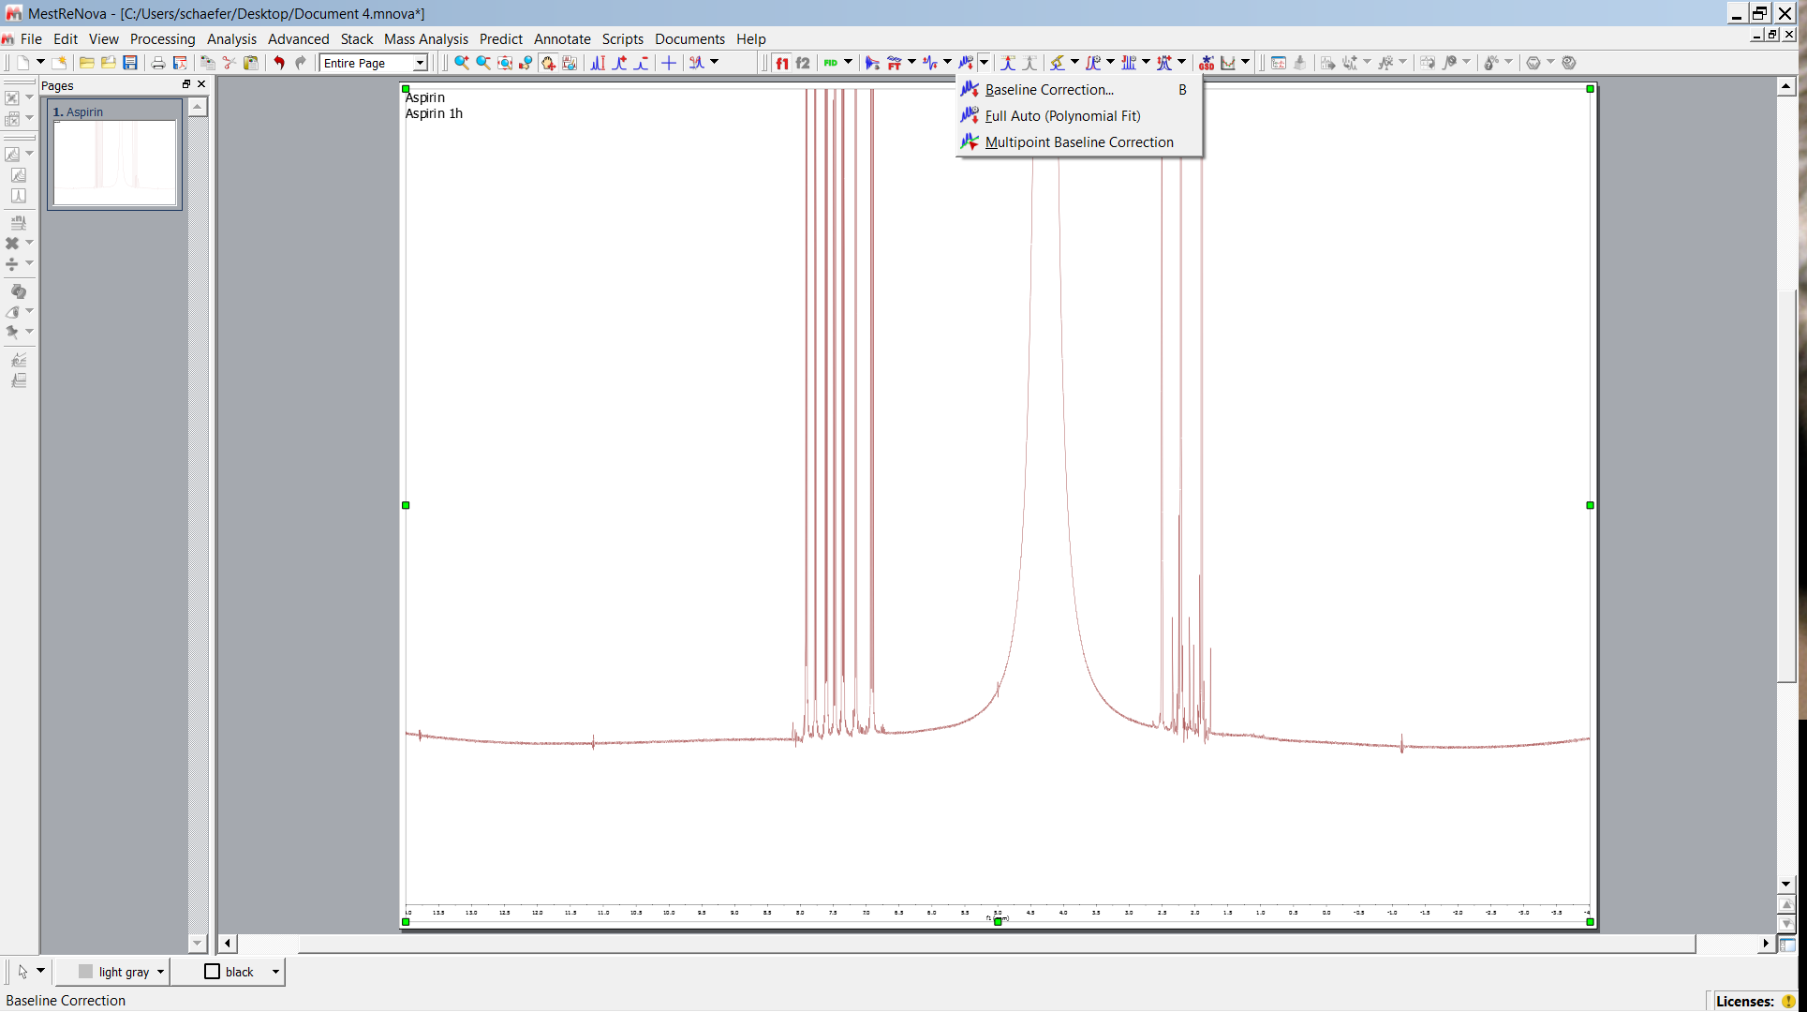
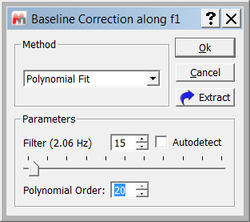
Baseline Correction

Slide 8
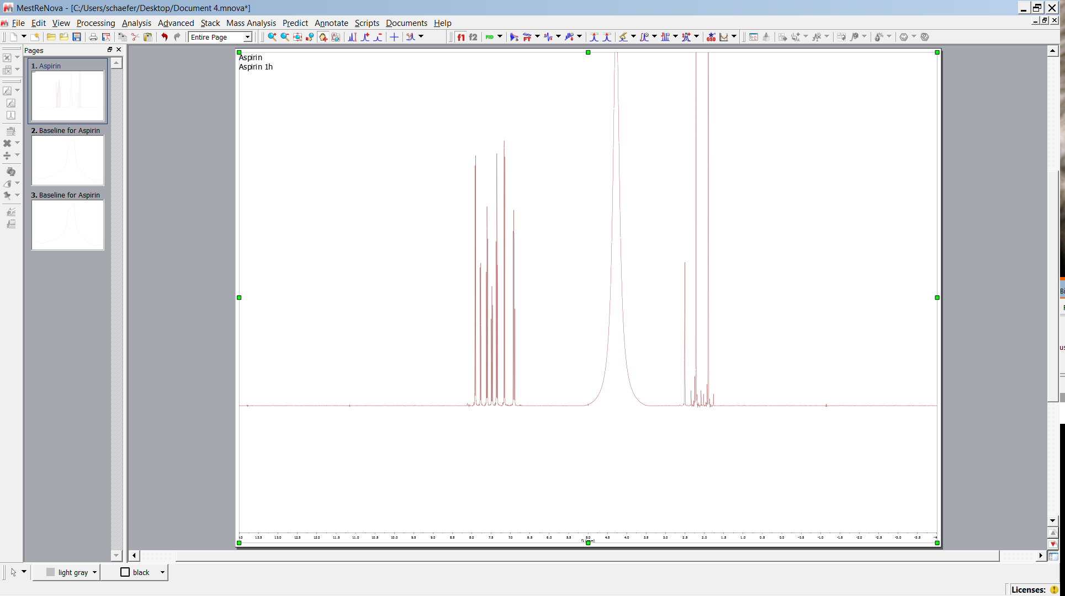
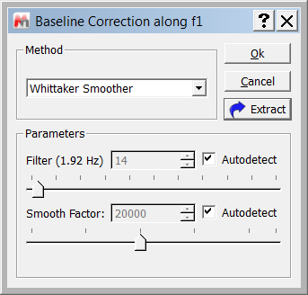
Baseline Correction
or choose Bernstein pol., Polynomial
Polynomial order etc.

Slide 9
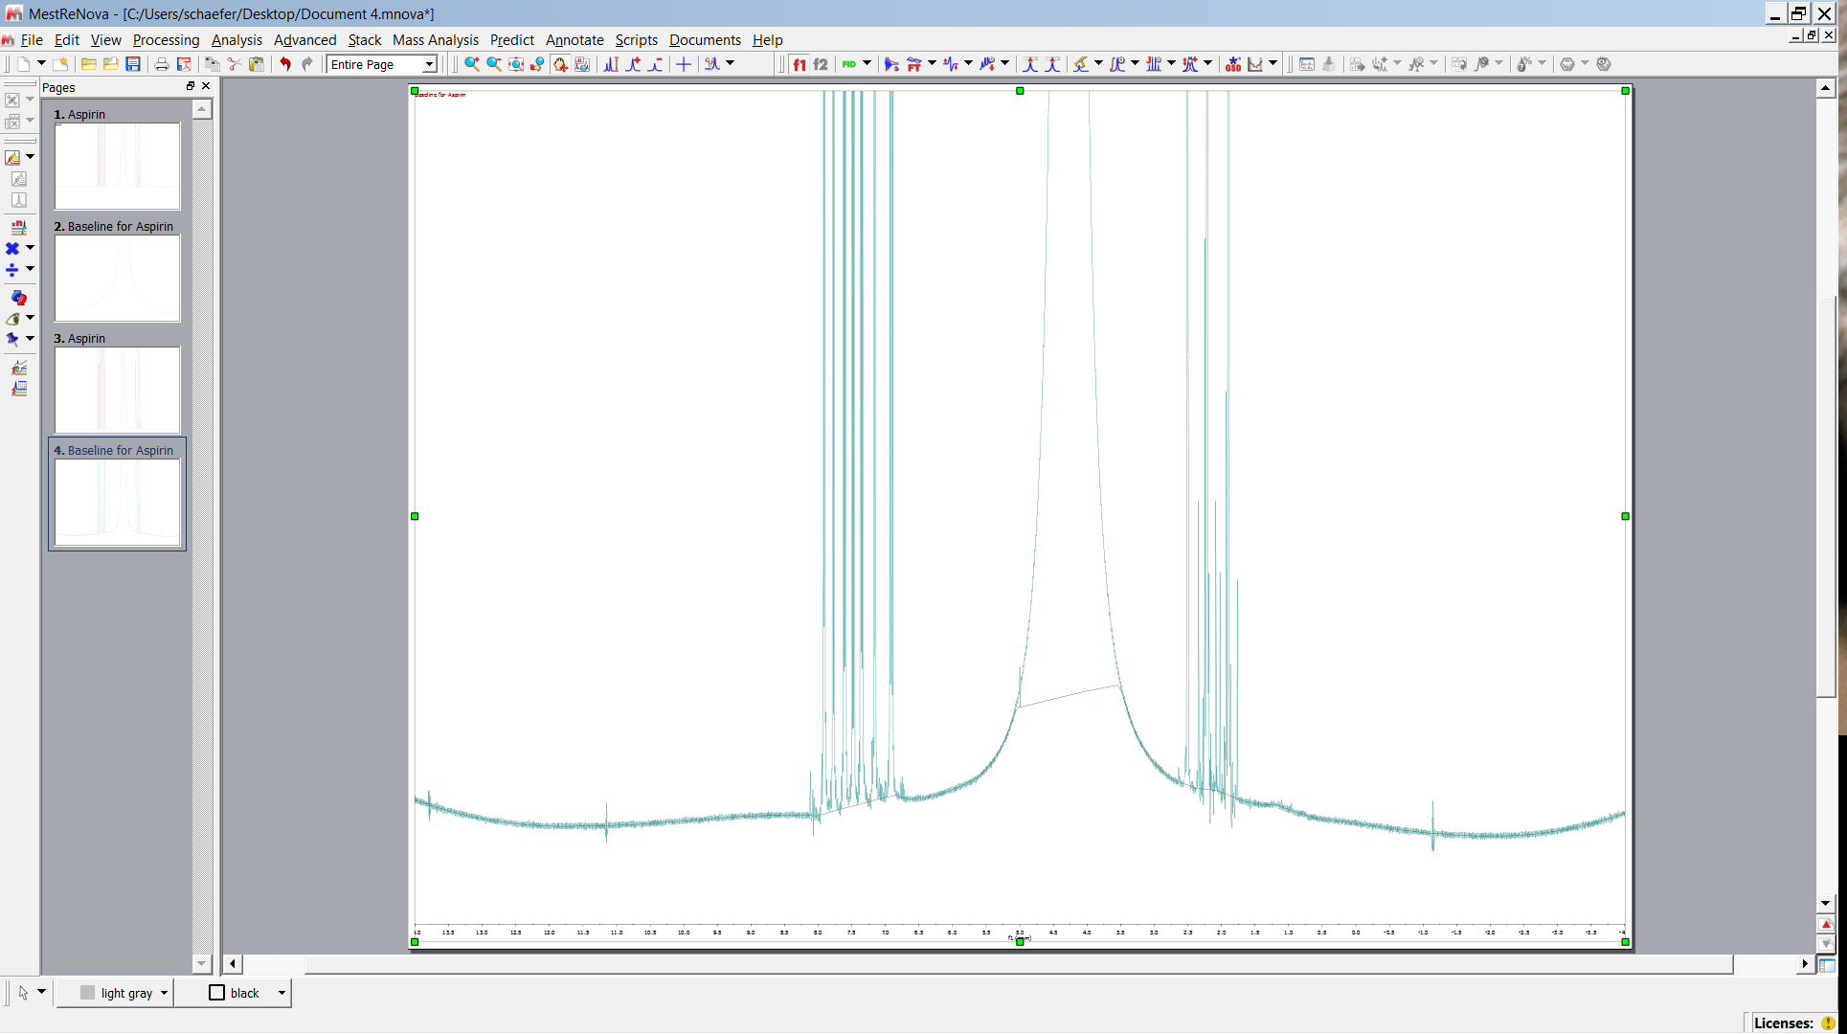
Baseline Correction
Whittacker baseline e.g.

Slide 10
Baseline Correction
recommended

Slide 11
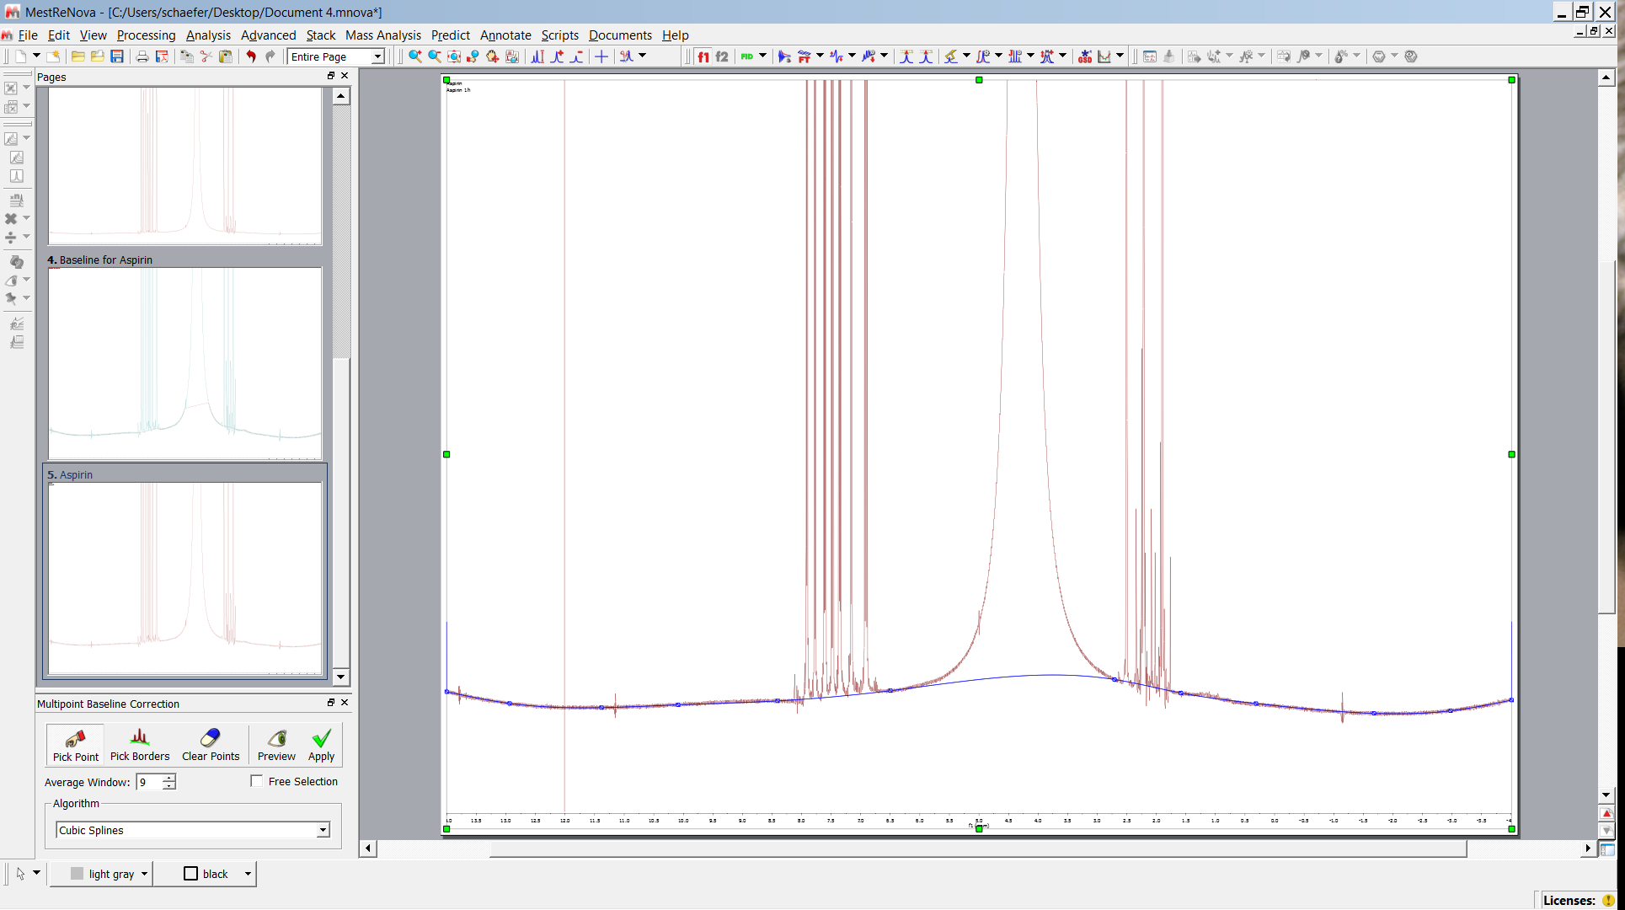
Multipoint spline
3
3
3
3
2
1
3

Slide 12
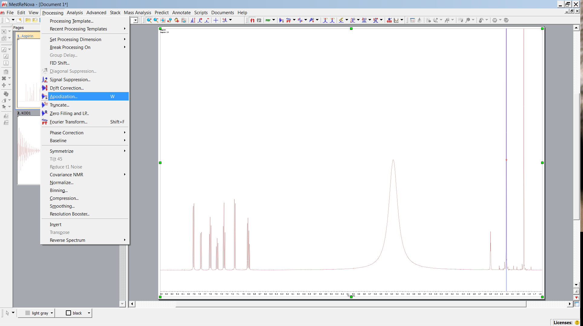
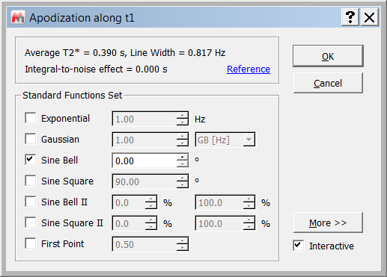
Solvent Signal Removal 1

Slide 13
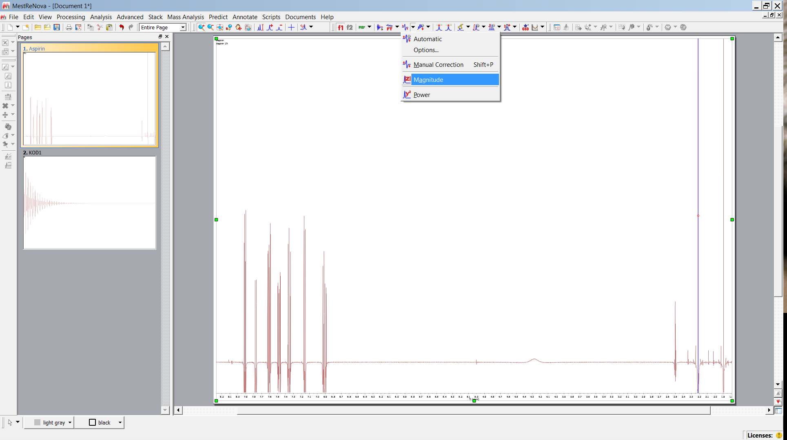
Solvent Signal Removal 1
Calculate absolute value spectrum

Slide 14
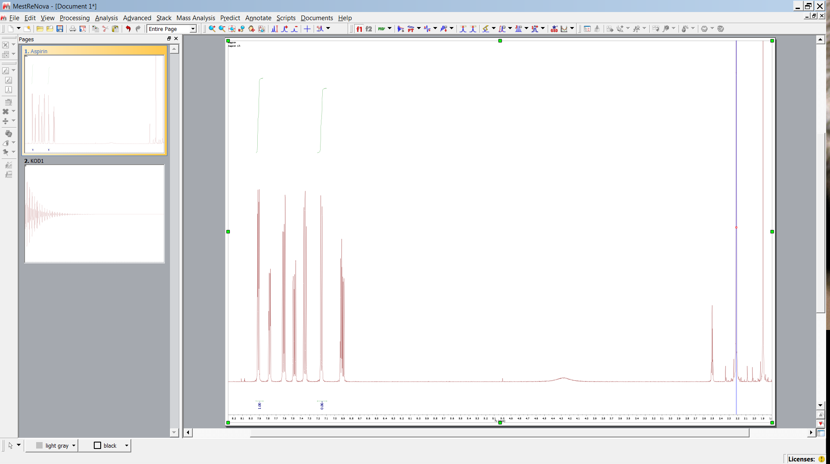
Solvent Signal Removal 1
Observe influence on integration

Slide 15
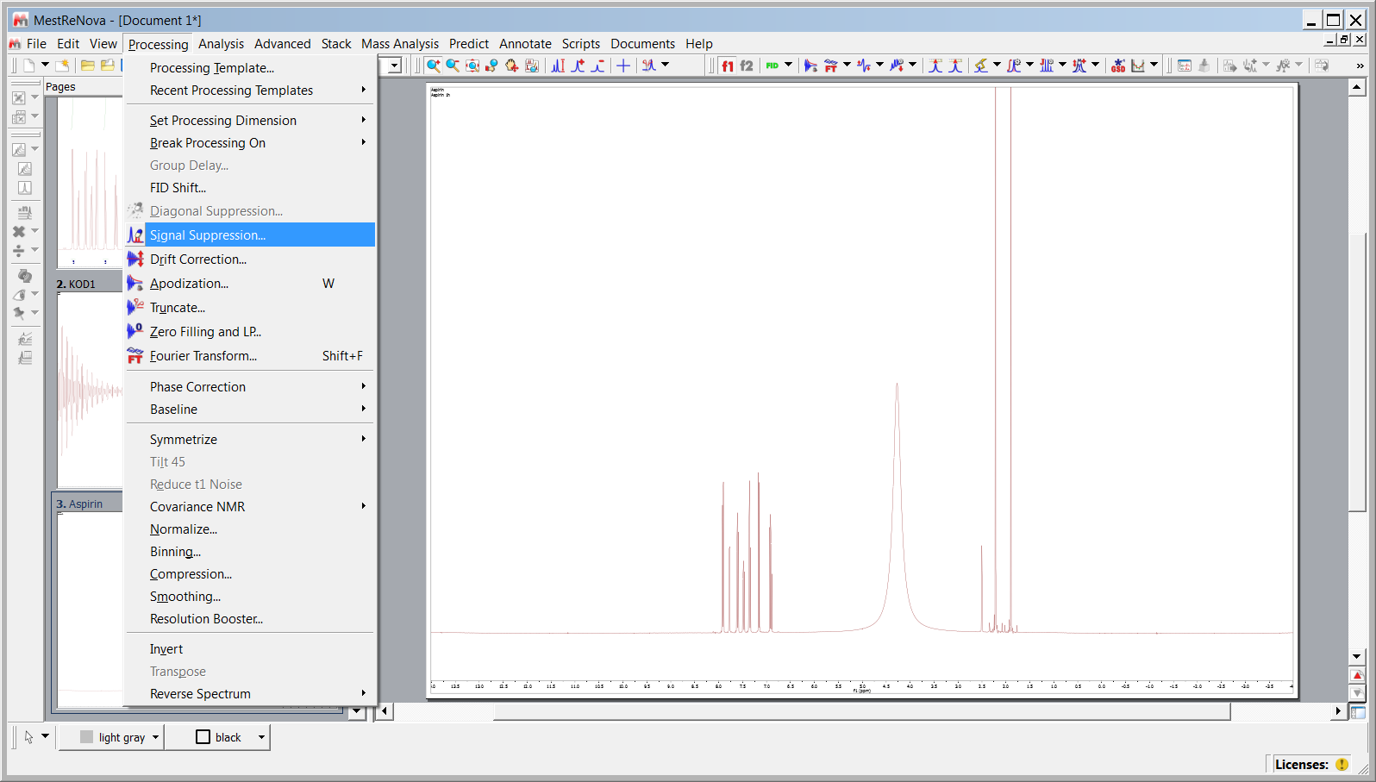
Solvent Signal Removal 2
4.3 ppm

Slide 16
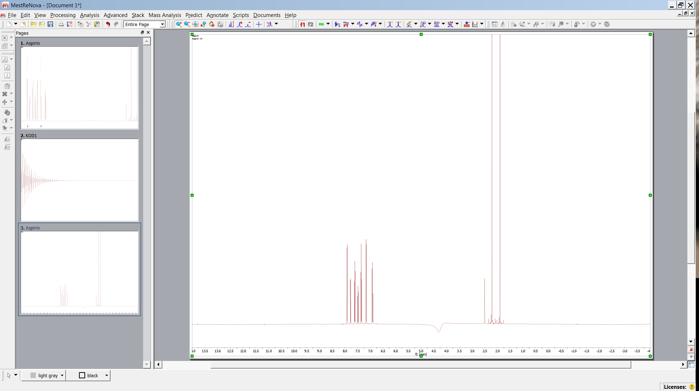
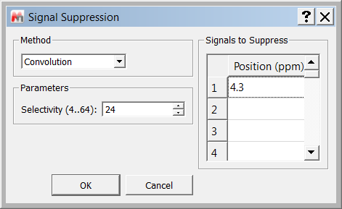
Solvent Signal Removal 2

Slide 17
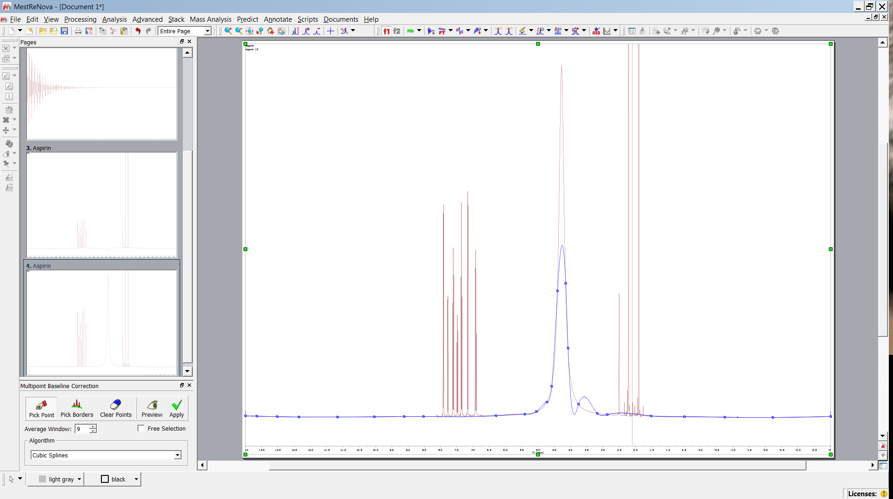
Solvent Signal Removal 3
Multipoint baseline spline correction can be used

Slide 18
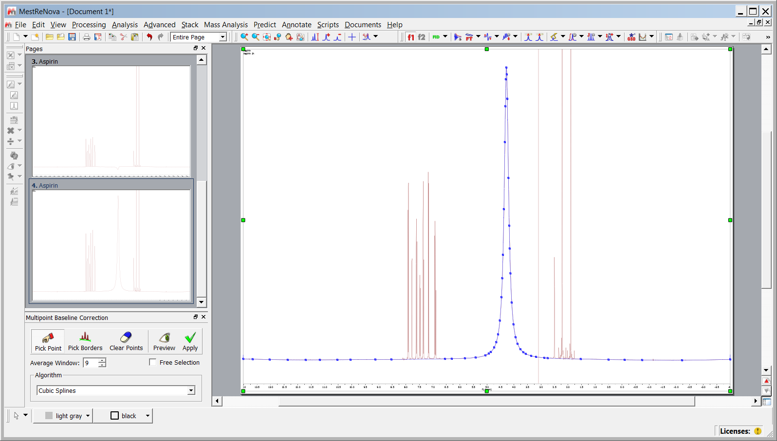
Solvent Signal Removal 3

Slide 19
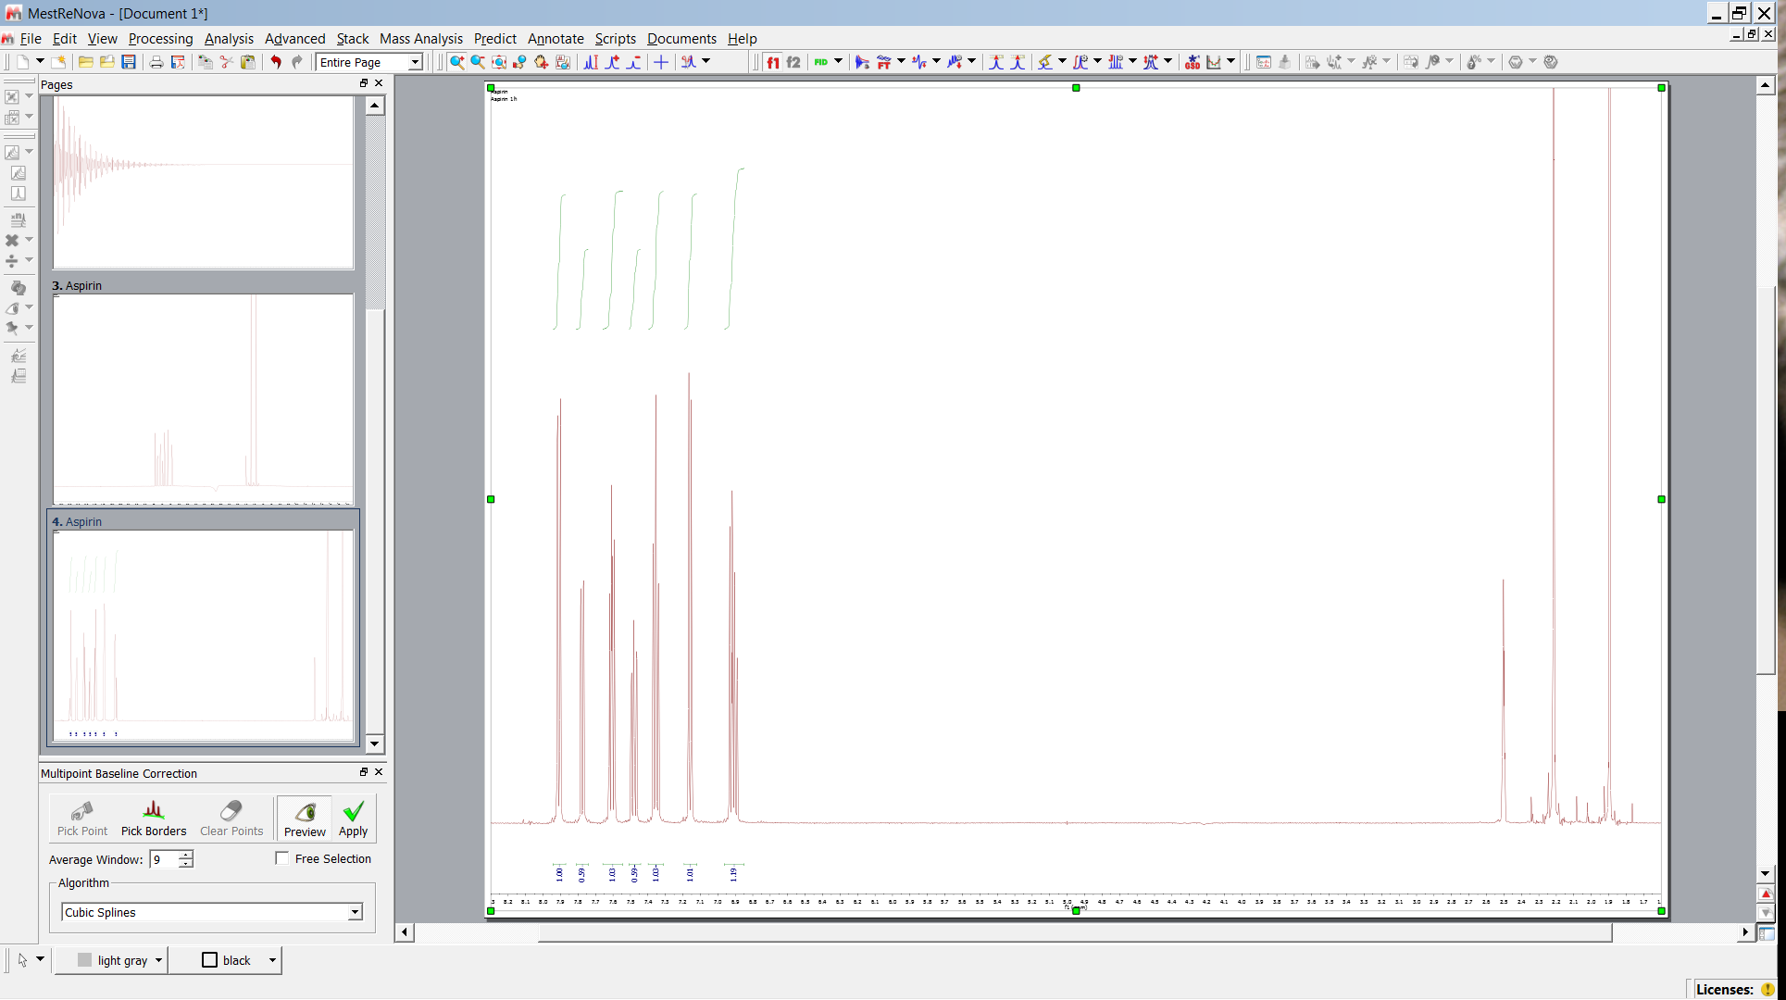
Solvent Signal Removal 3

Slide 20
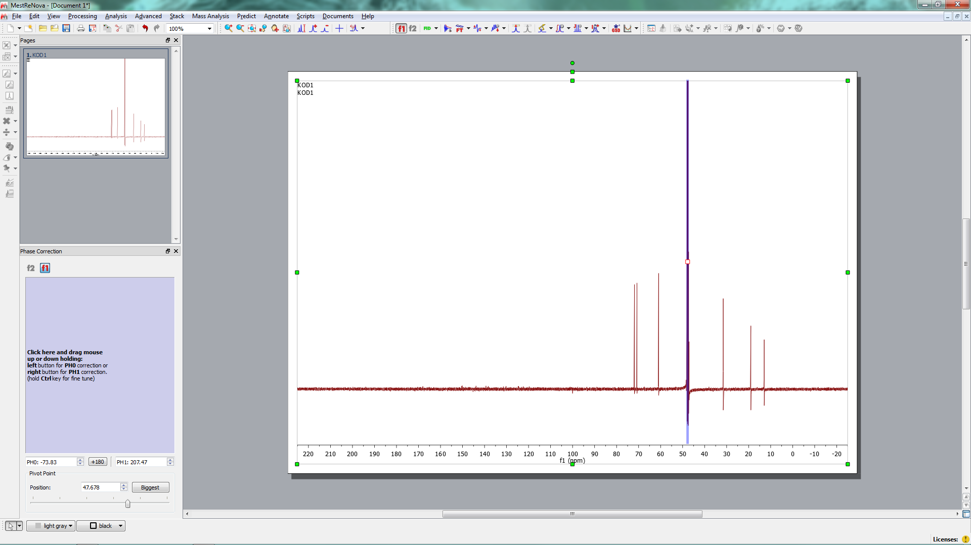
Processing 13C

Slide 21
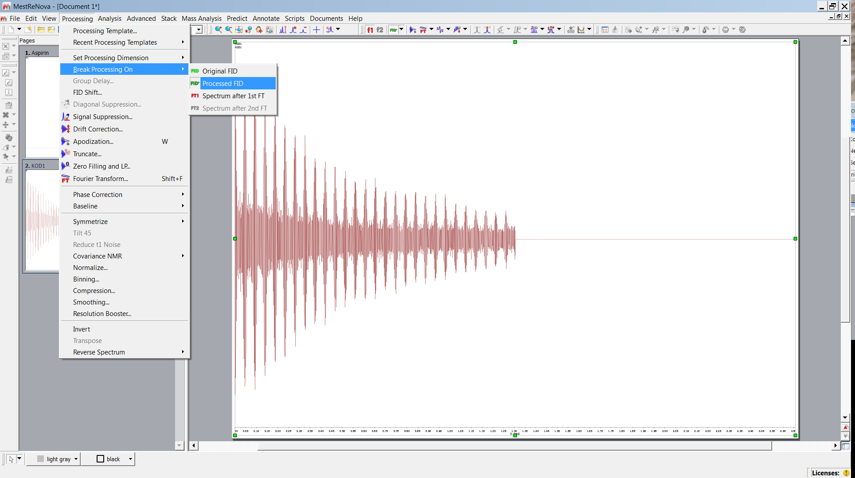
Filter Function

Slide 22
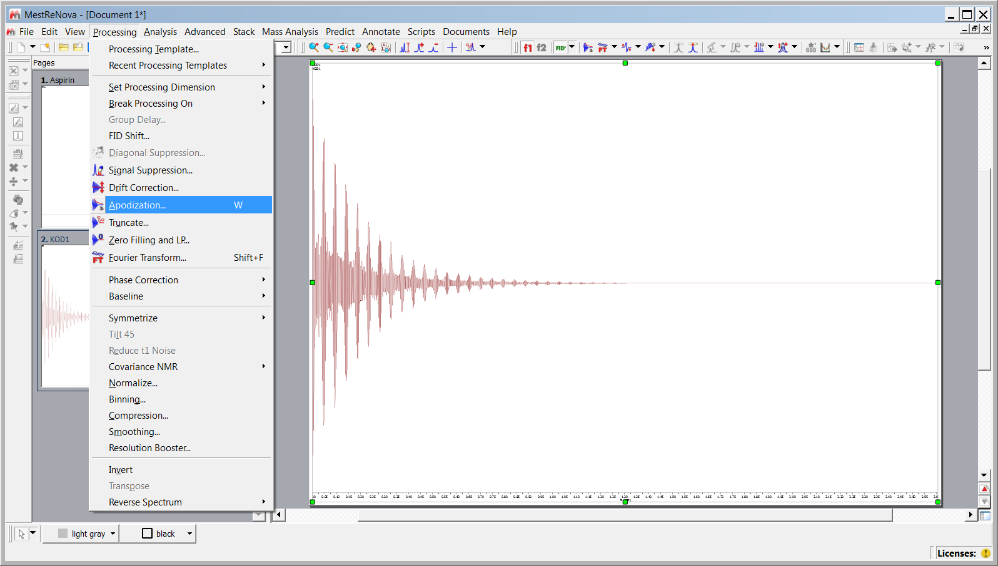
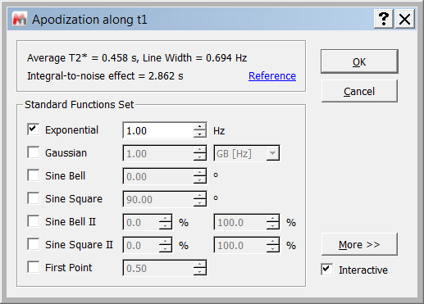
Filter Function

Slide 23
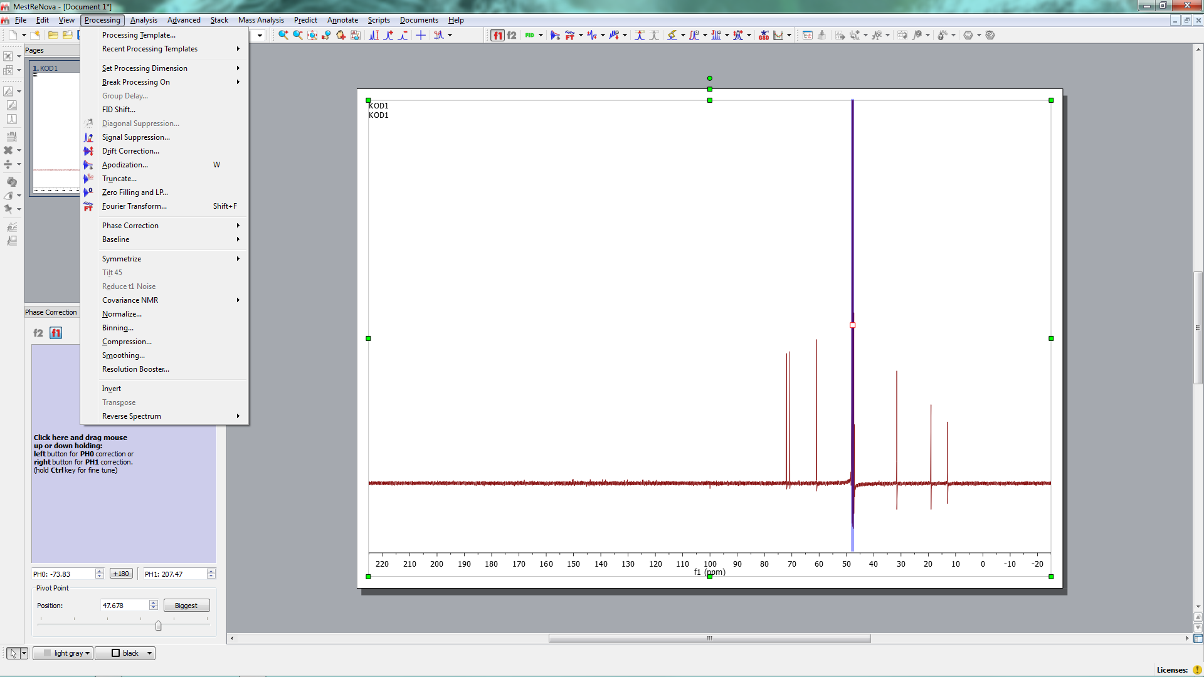
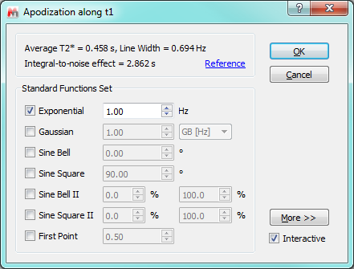
Filter Function
apodization, Line broadening impoves S/N ratio, yields better phase correction
and integrals
1.= 13C
2…10 for polymer 13c
0.2 dilute 1H

Slide 24
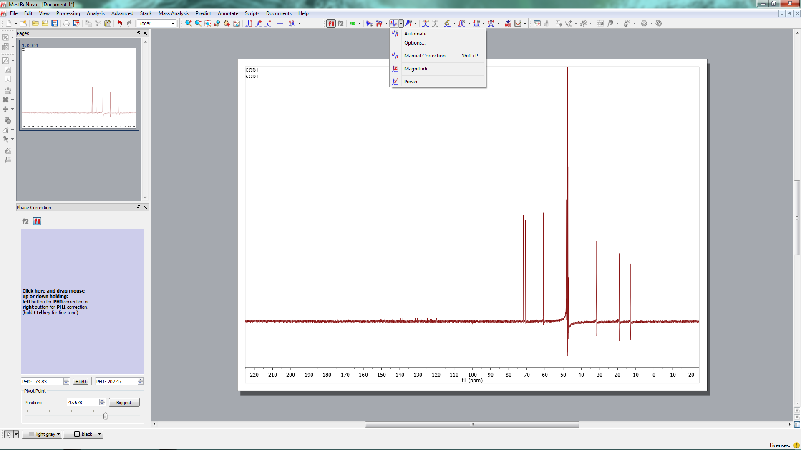
Phase Correction
Manual
Manual

Slide 25
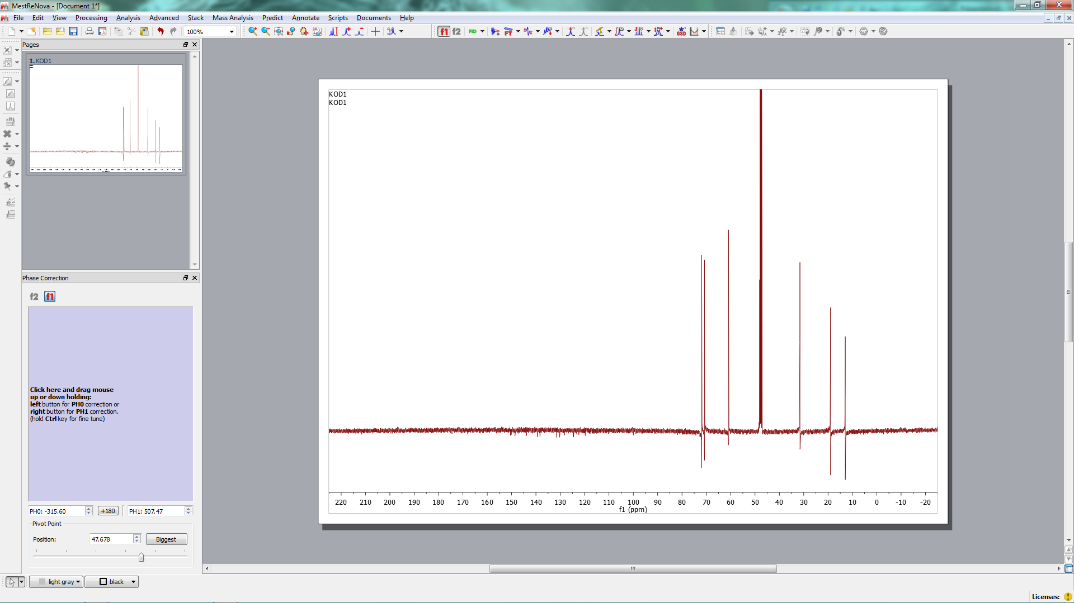
Phase Correction 13C
Prozessierung 13C
Pivot
0. Ordnung
Pivot

Slide 26
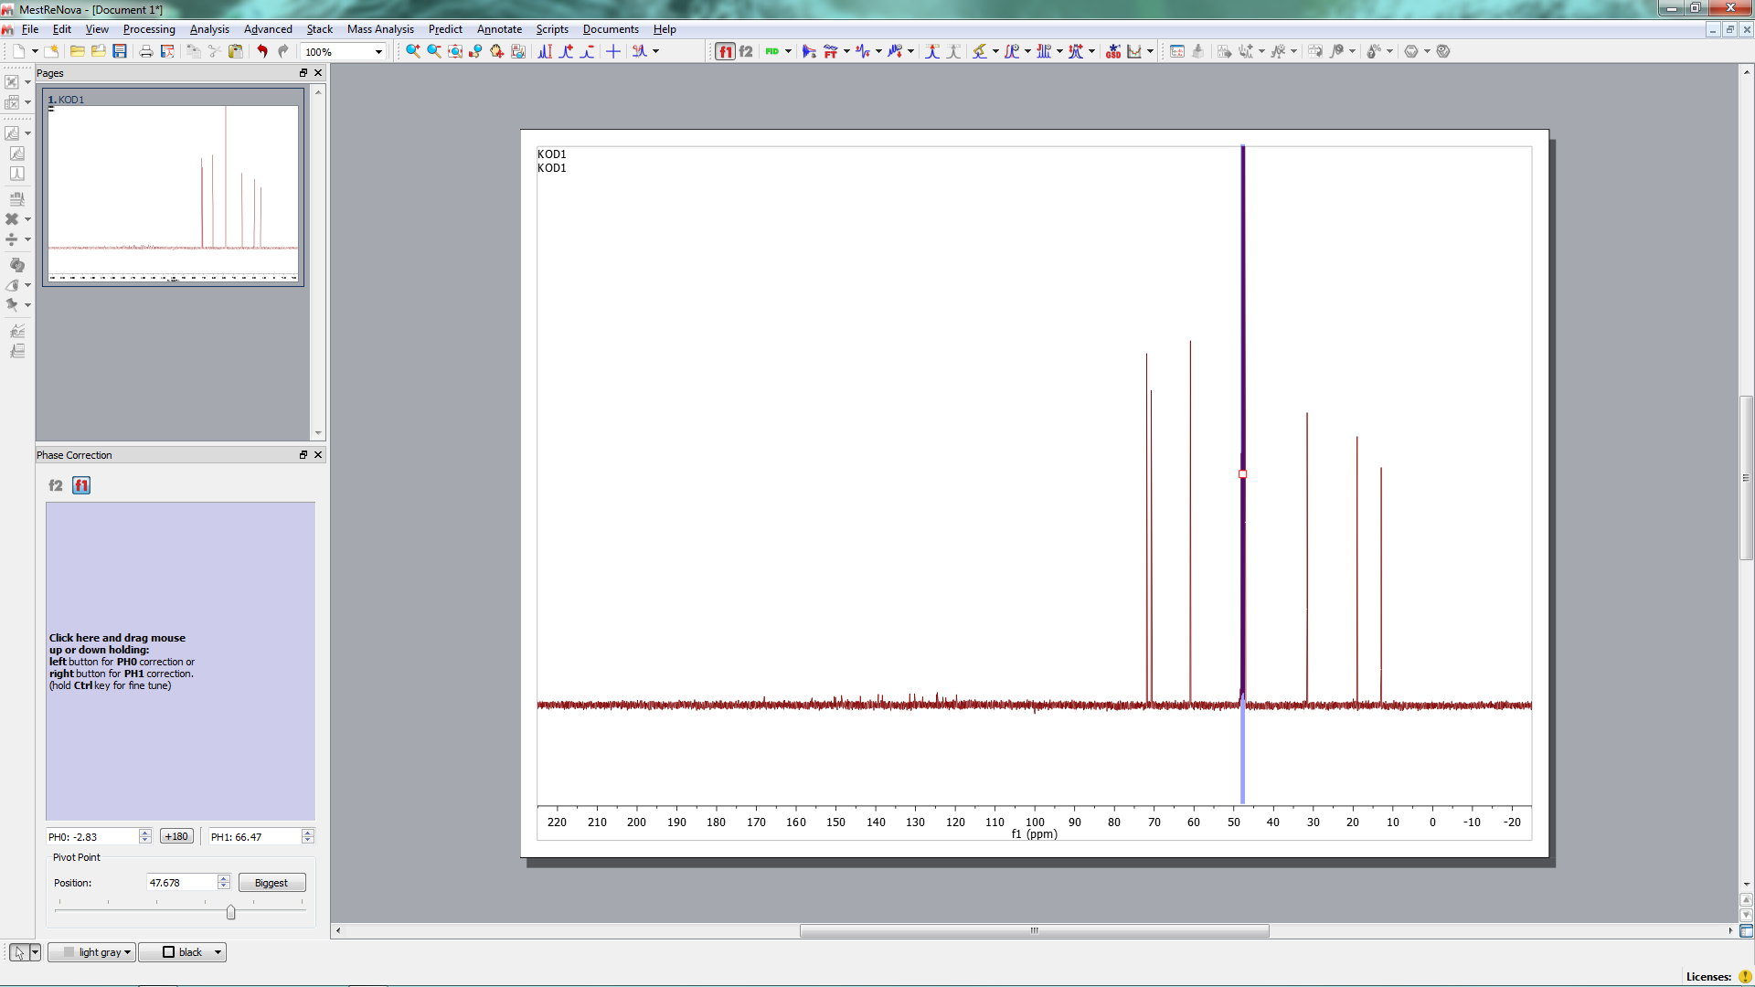
Phase Correction 13C
Prozessierung 13C
Ordnung

Slide 27
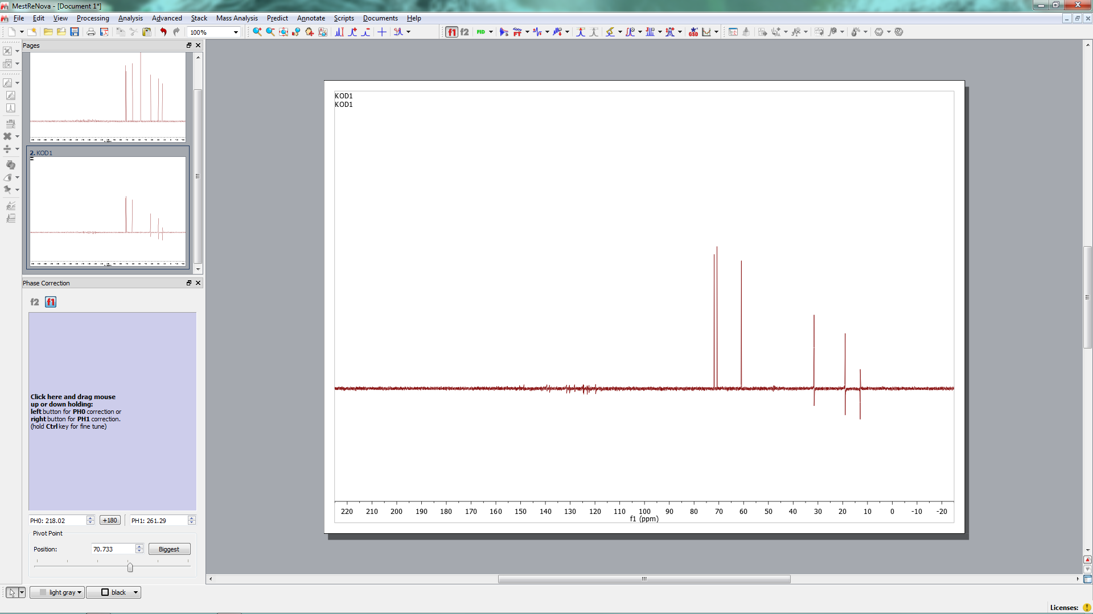
Dept Processing
Prozessierung 13C
Phasenkorrektur
dept (135) apply line broadening ans phase correction
Ordnung

Slide 28
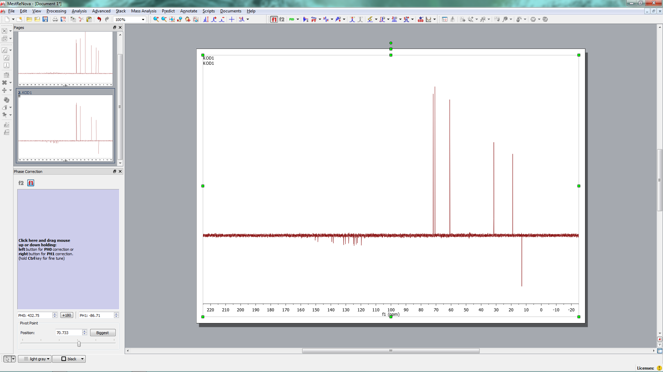
Prozessierung 13C
Phasenkorrektur
1st try wrong
Ordnung
Versuch falsch

Slide 29
Phasenkorrektur
2nd try wrong
2. Versuch falsch

Slide 30
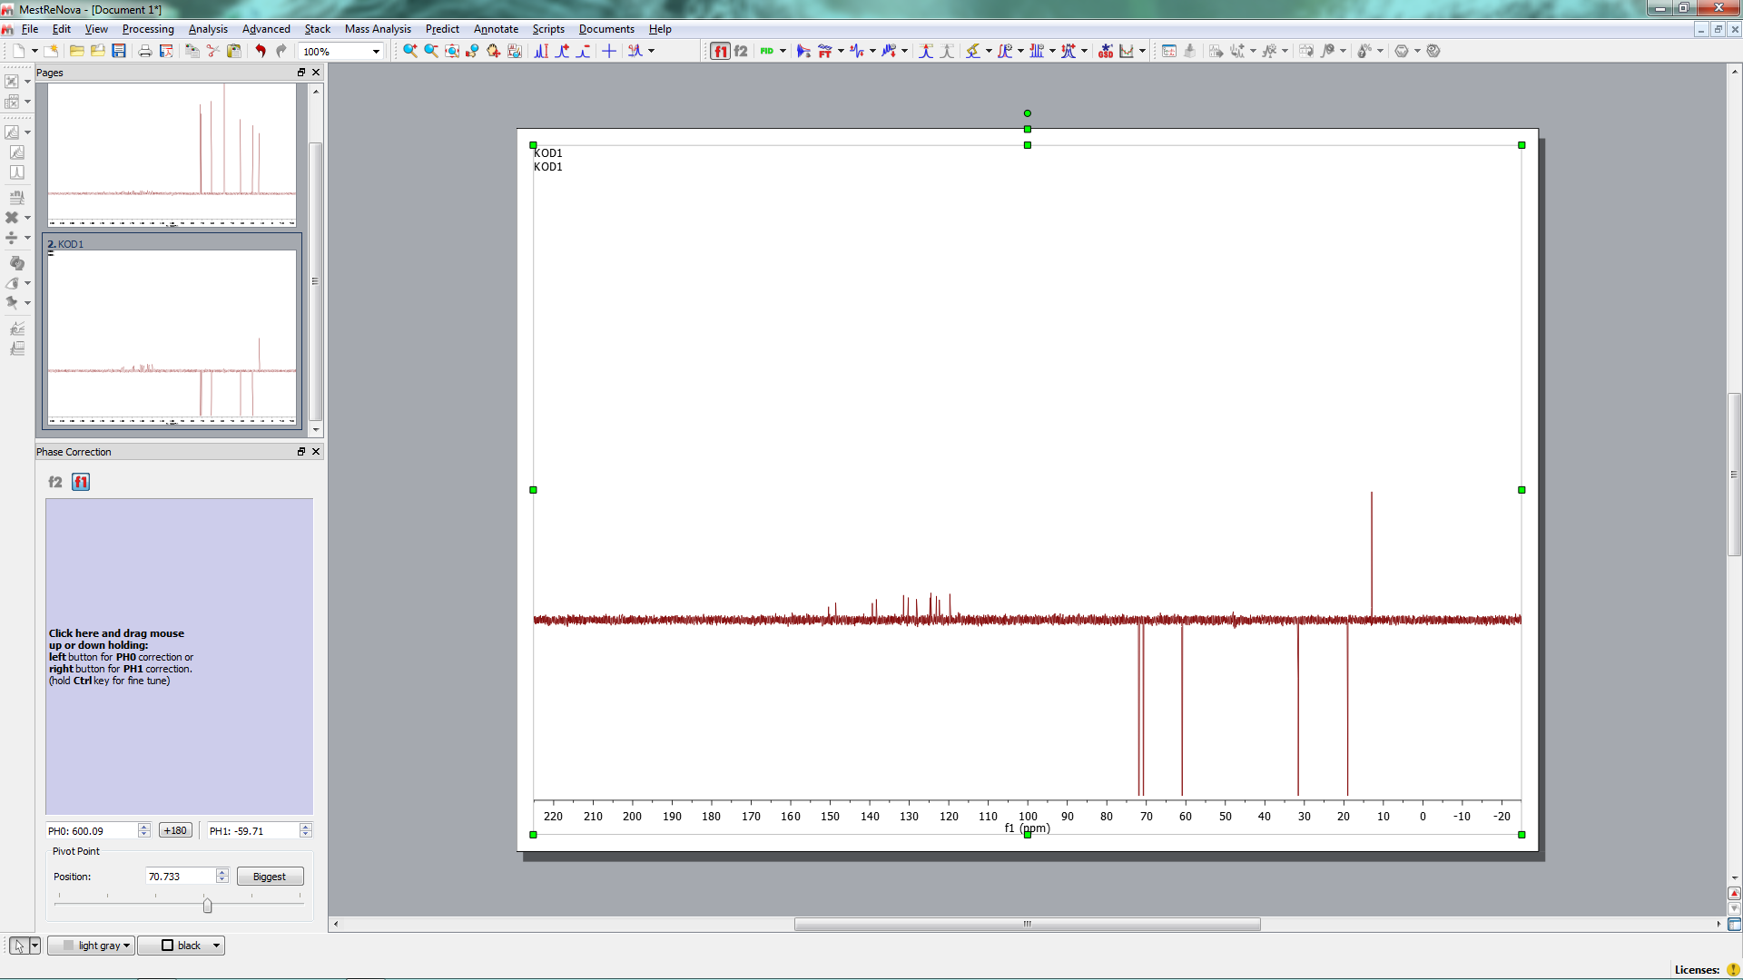
Prozessierung 13C
Phasenkorrektur
3rd try
CH3
CH
CH2
Ordnung
3. Versuch richtig

Slide 31
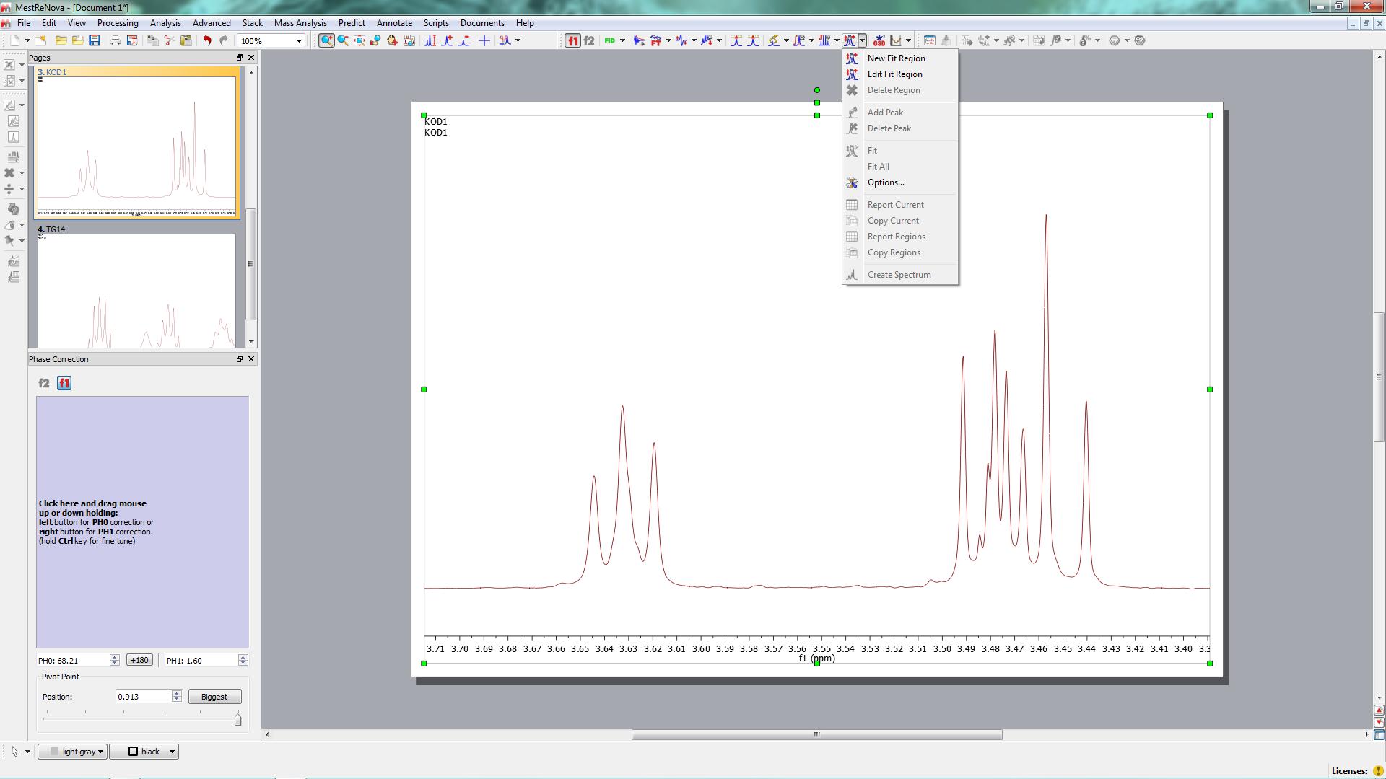
Lorentzian Deconvolution
Line Fitting , Lorentzian deconvolution
New fit region

Slide 32
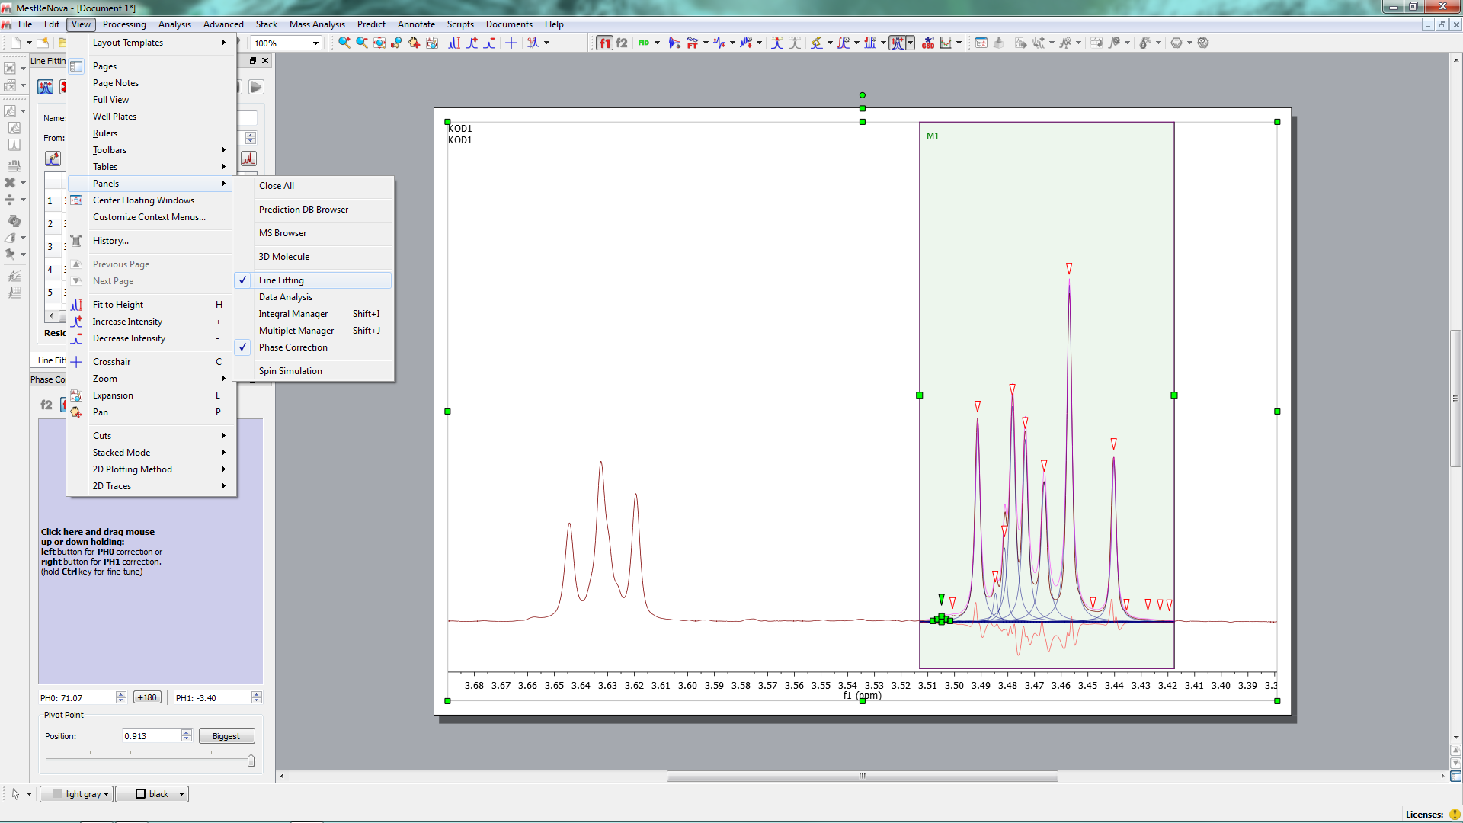
Lorentzian Deconvolution

Slide 33
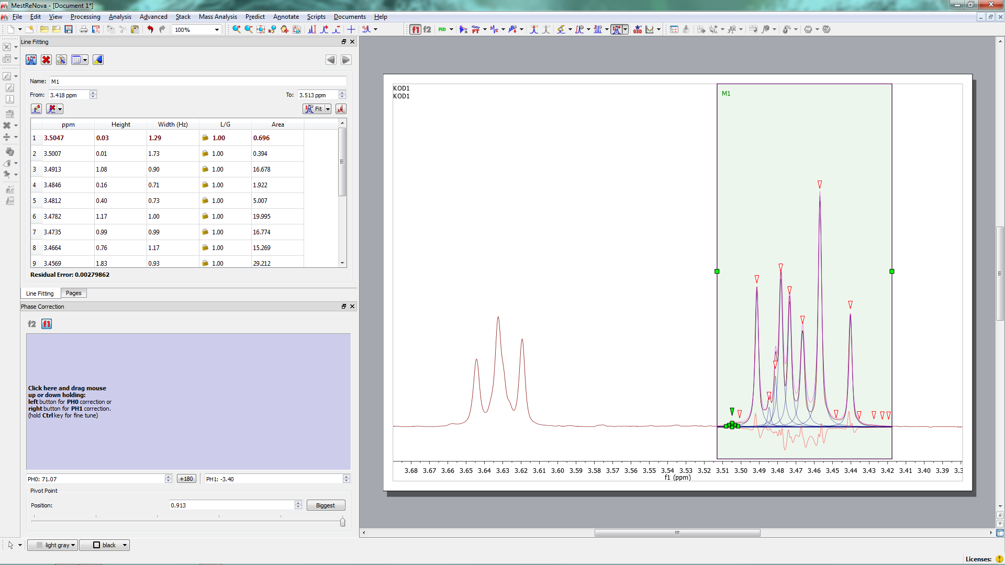
Lorentzian Deconvolution
change fit region
move down

Slide 34
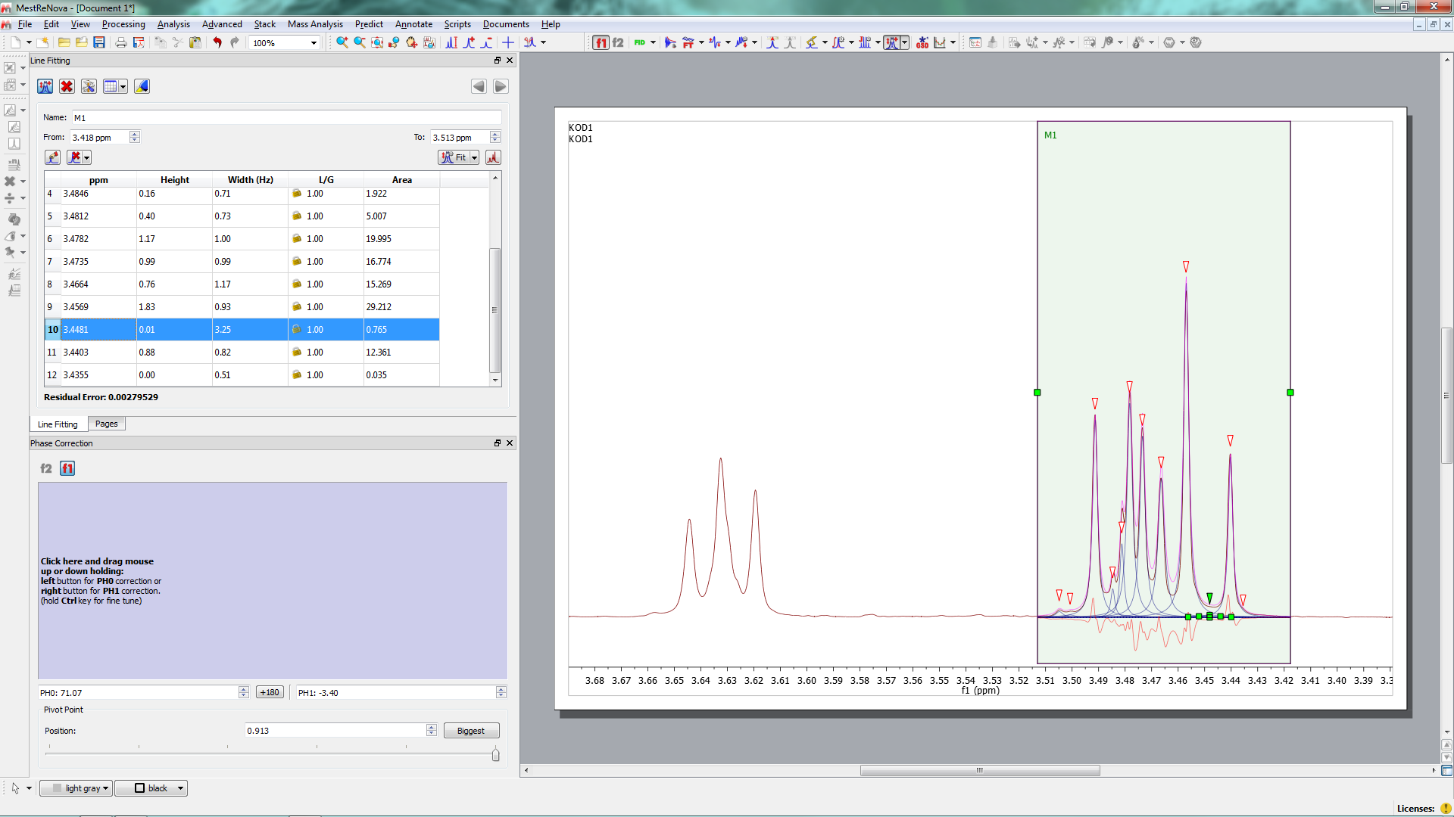
Lorentzian Deconvolution
2 delete peak
3 Create spectrum
1 mark peak unwanted (impurity peak e.g.)

Slide 35
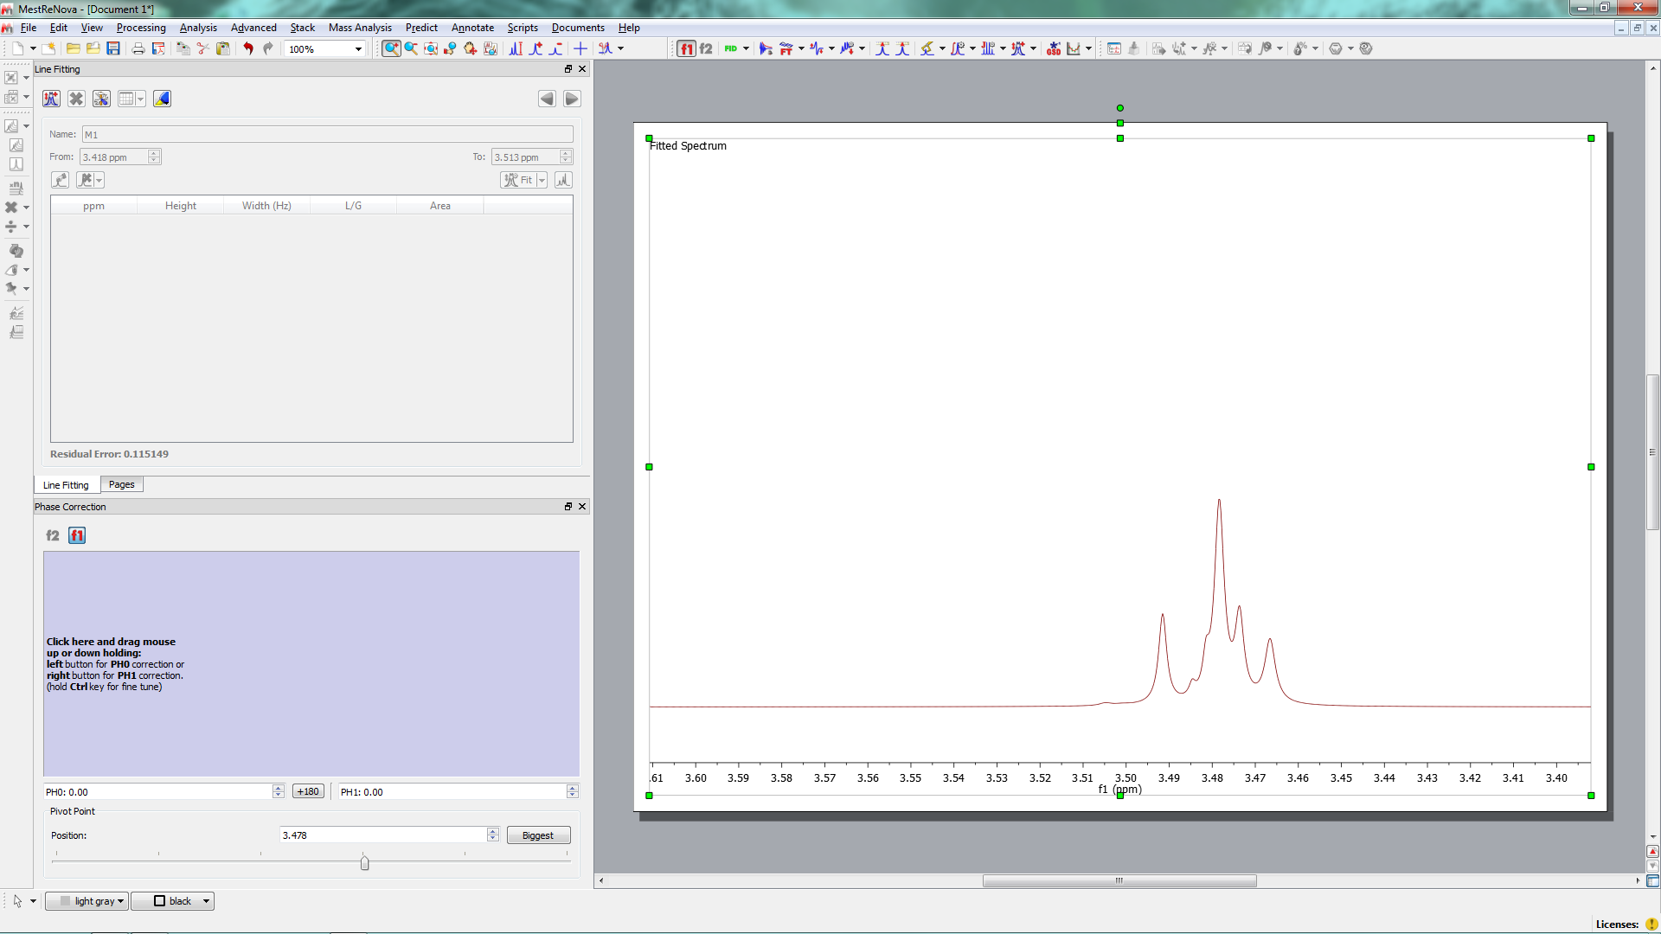
Lorentzian Deconvolution
Line Fitting , Lorentz deconvolution
New fit region

Slide 36
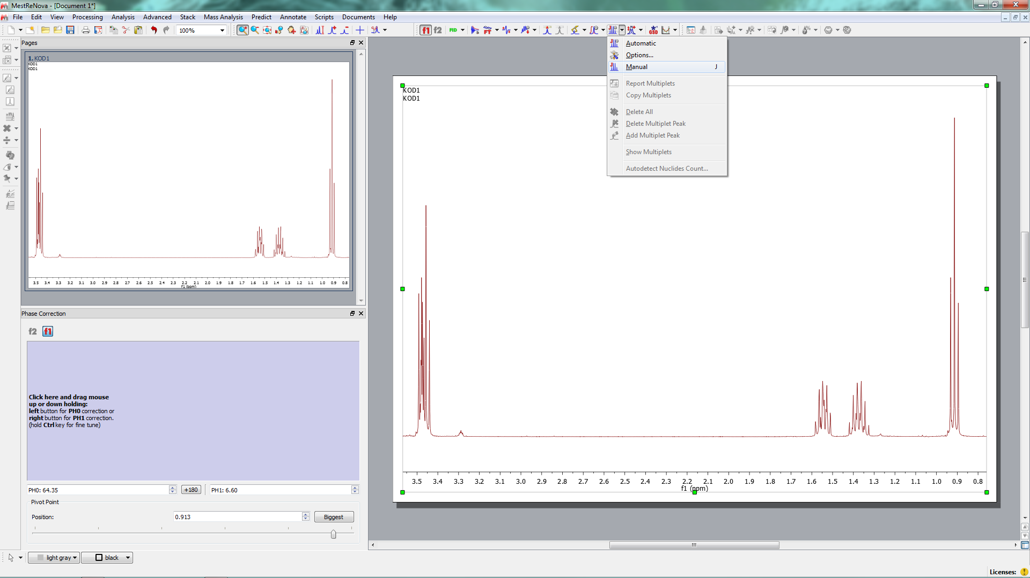
Multiplet Analysis
Simualtion
New fit region
Multiplet Analysis

Slide 37
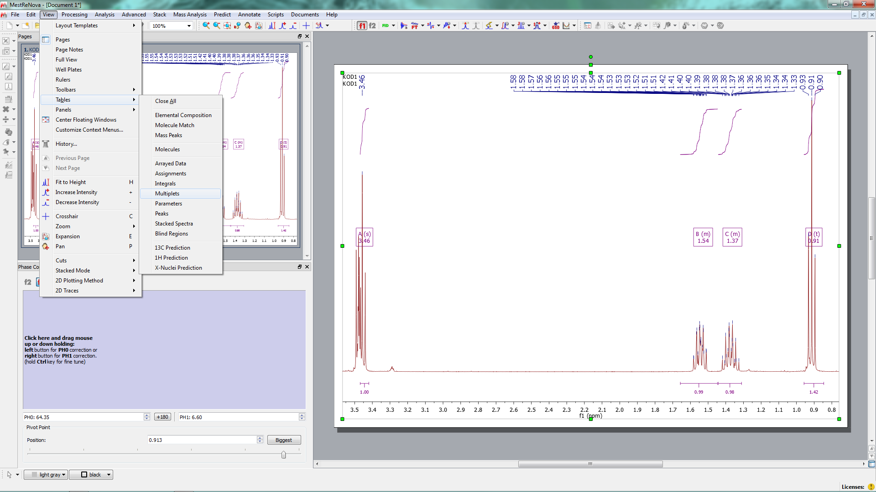
Multiplett Analysis
Simualtion
New fit region
Display

Slide 38
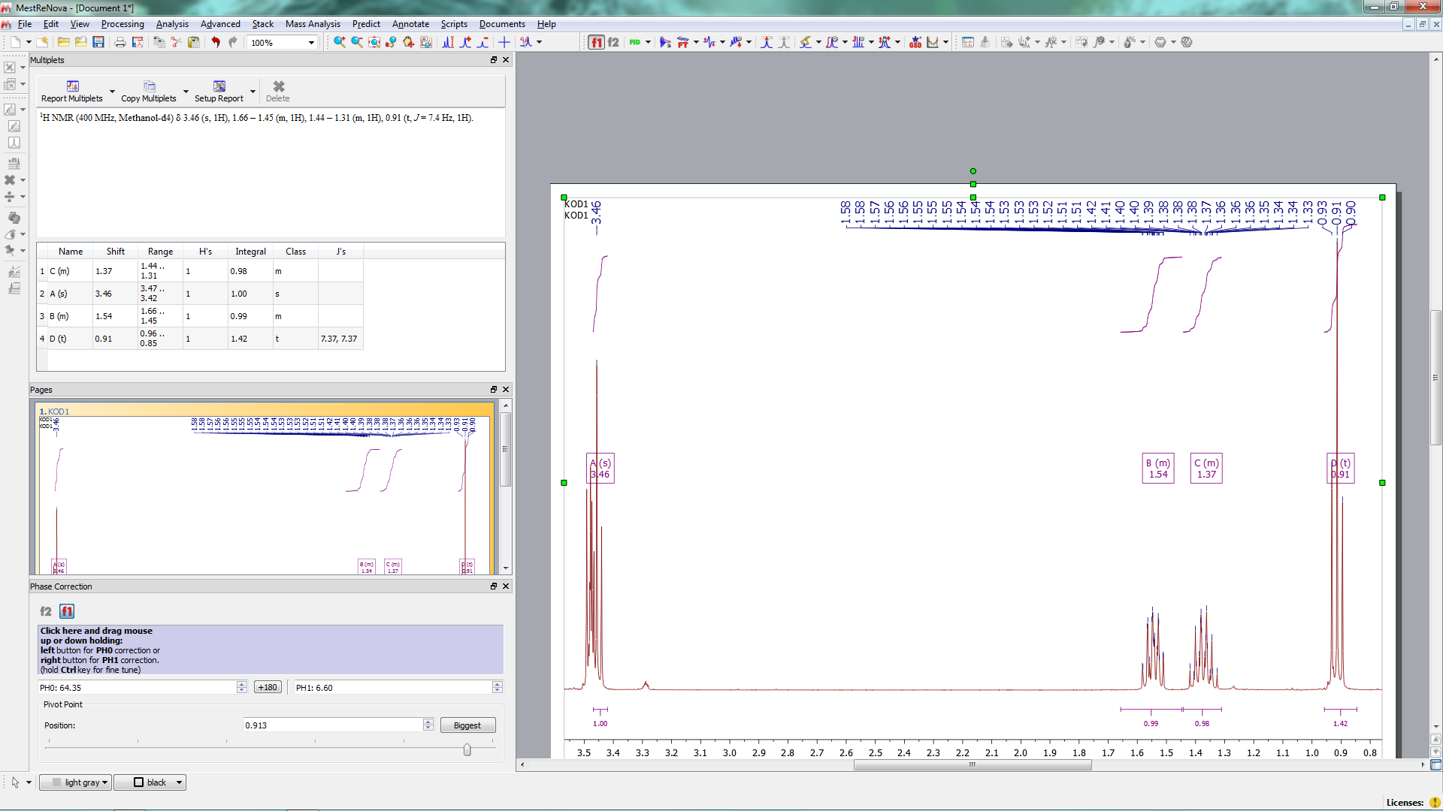
Multiplet Analysis
Simualtion
New fit region

Slide 39
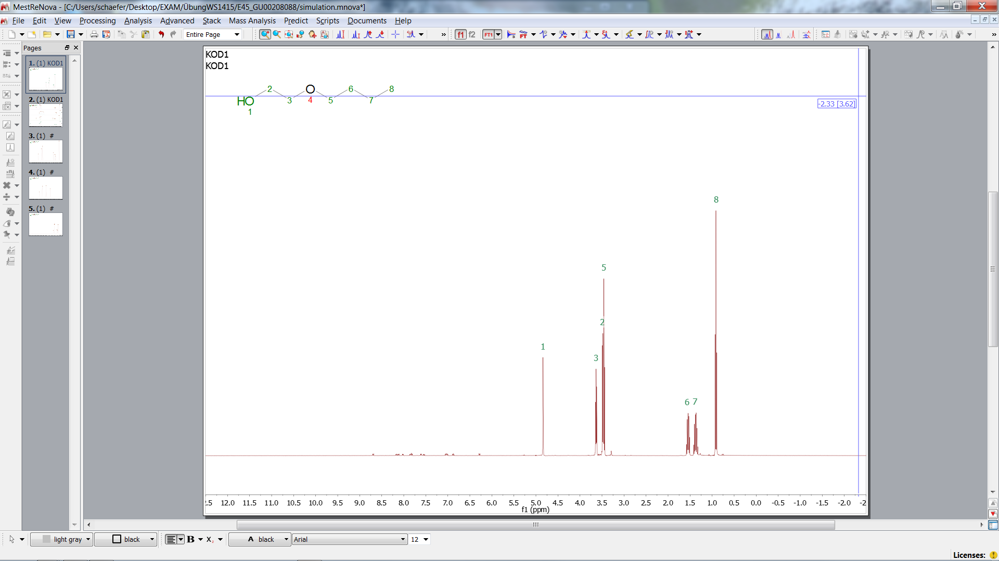
Prediction
New fit region
Load structure

Slide 40
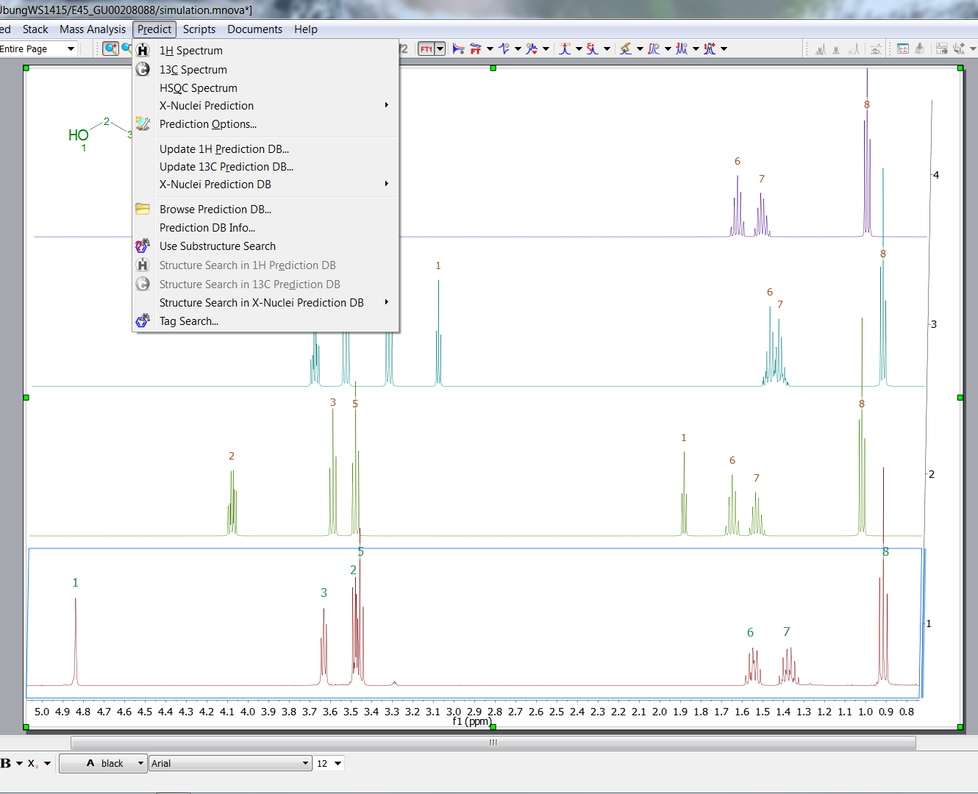
Prediction
New fit region

Slide 41
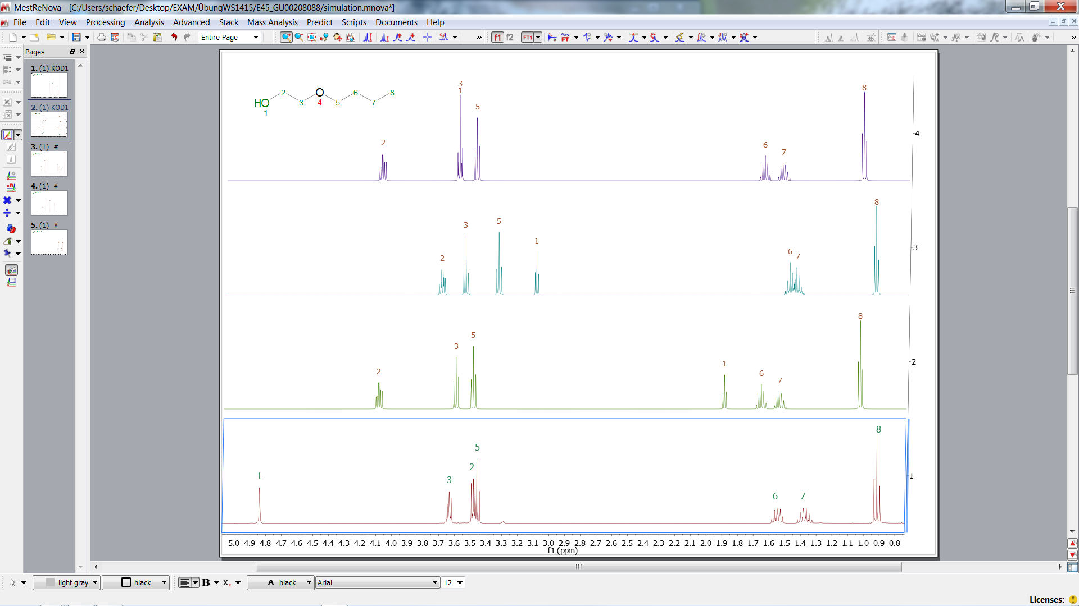
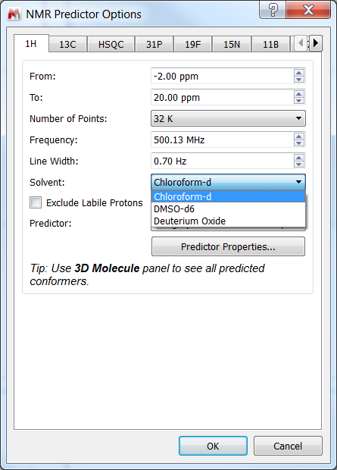
Prediction
New fit region
Predicted in D2O
Predicted in DMSO
Predicted in CDCl3
Exp. in MeOD

Slide 42
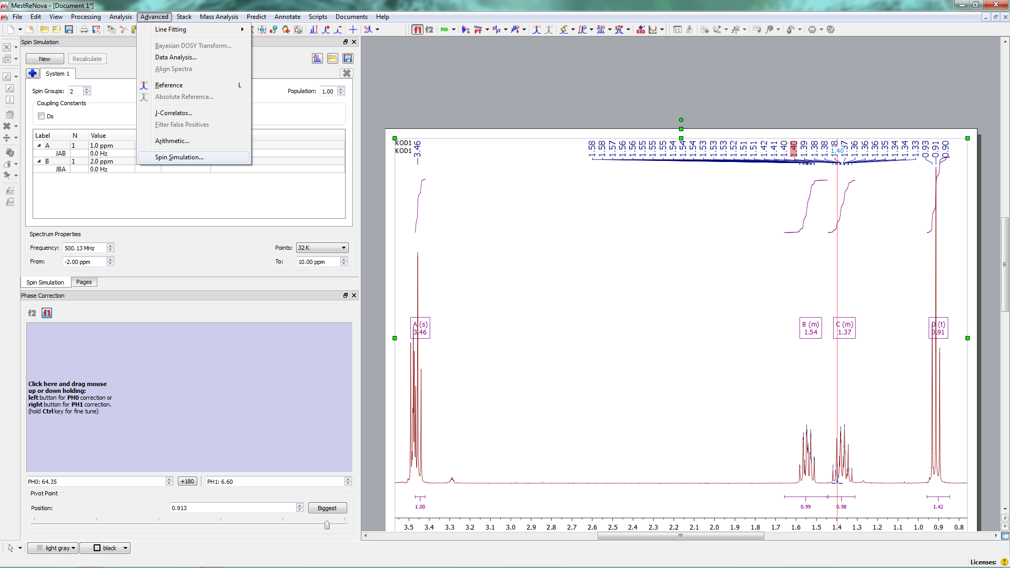
Spin Simulation
Simualtion
New fit region
Spin simulation

Slide 43
Spin Simulation
Simualtion
Results from multiplet analysis can be loaded
New fit region
number of groups of non equivalent nuclei

Slide 44
Spin Simulation
Simualtion
New fit region
Coupling constants and shifts
Number of equivalent (magnetically) nuclei

Slide 45
Spin Simulation
ggf speichern
Simualtion
New fit region
Add more spins systems in case of conformeres ansd mixtures
half line width
number of points in simulation

Slide 46
Spin Simulation
Simualtion
New fit region
New or recalculate

Slide 47
Spin Simulation
Activate (choose) cntrl. click

Slide 48
Spin Simulation
Simualtion
Superimpose spectra
New fit region

Slide 49
Superimpose Stack Spectra
Auto Scale

Slide 50
Superimpose Stack Spectra

