Slide 1
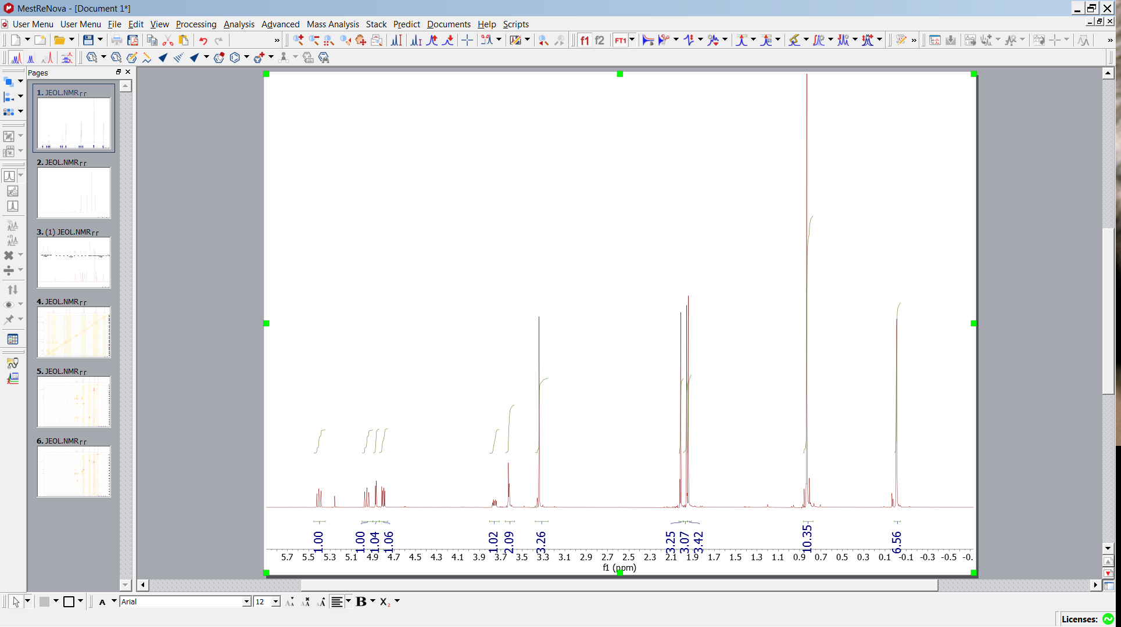
BSPrh9 1H
- Open BSPrh9 1H
- 1H baseline correction integration
-13C Apodization

Slide 2
BSPrh9 1H
- Open BSPrh9 1H
- 1H baseline correction integration
-13C Apodization
Singlets
1 OMe
3
2 Si-Me
1 t-Bu

Slide 3
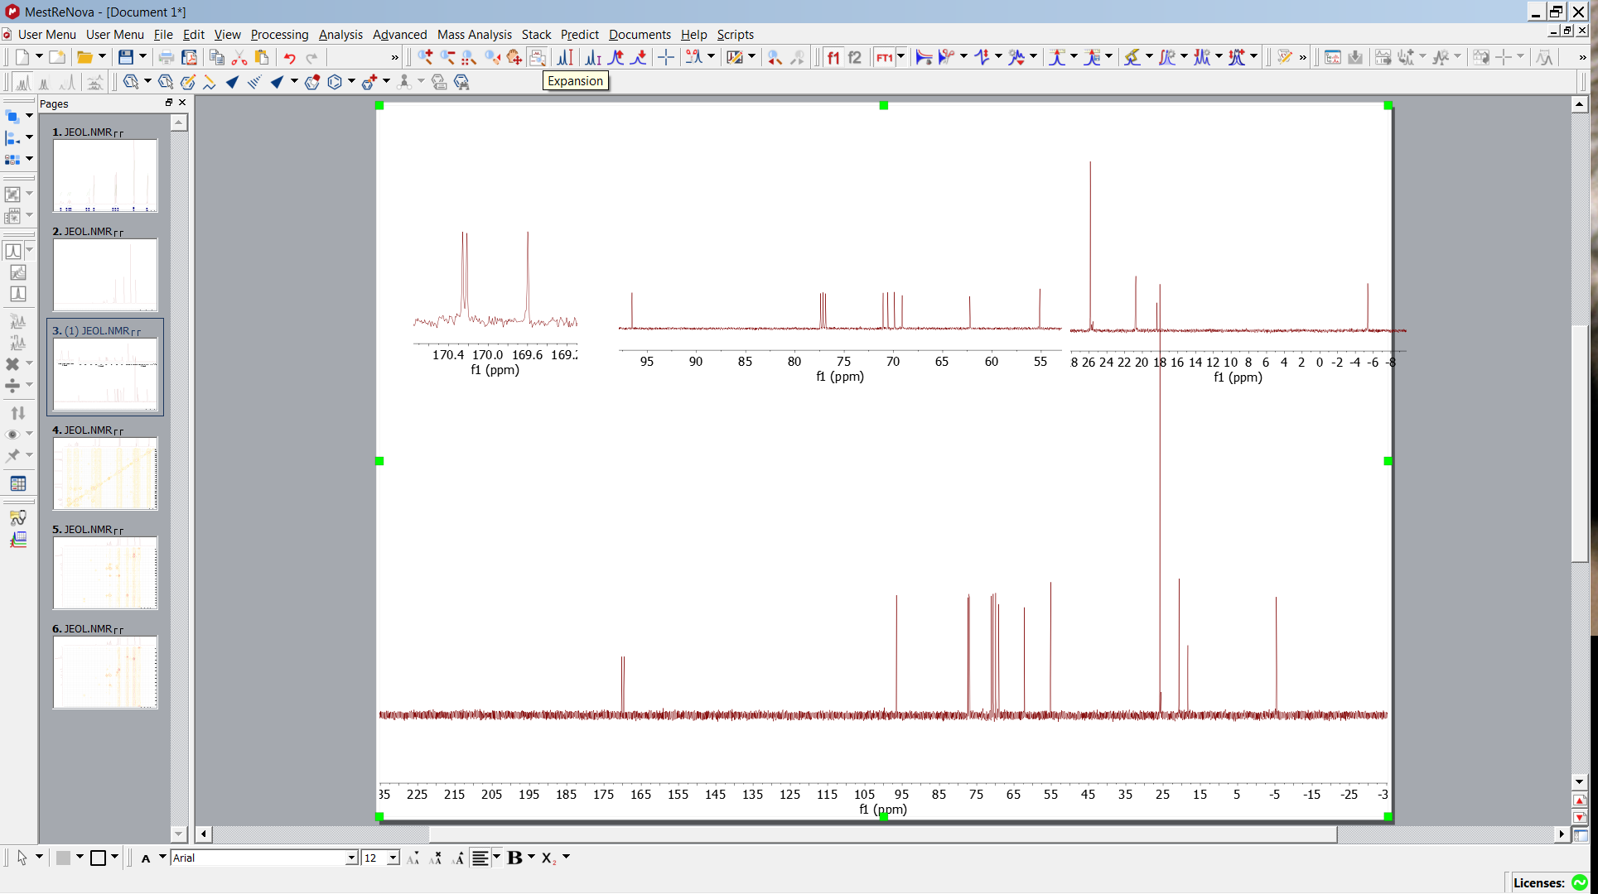
13C
Expansion opens and displays subspectra

Slide 4
13C
3 COO
5 O-CH
O-Me
2 Si-C
anomeric C
3 Me-COO
CDCl3

Slide 5
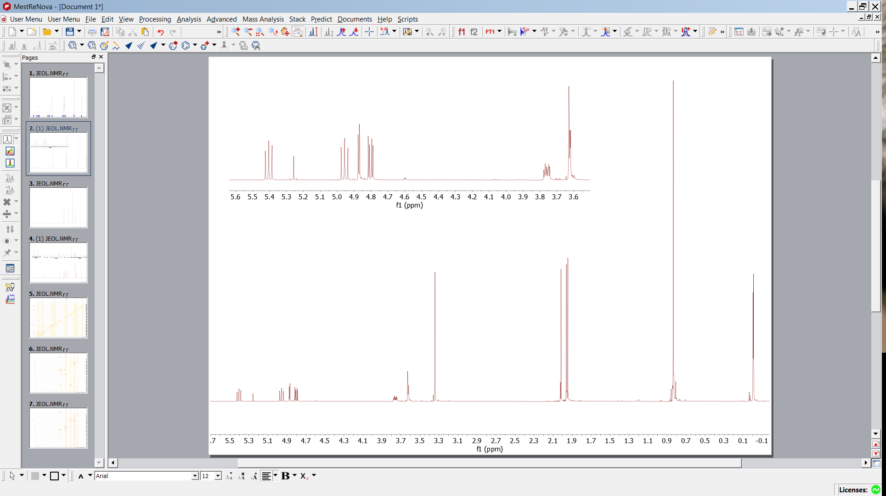
Groups
Structure elements :
C-O + 1 anomeric C 7 H (1 duplet ) could be Sugar !!!
could be t-Bu
Protection groups
could be O-Me
could be COOMe
could be Si-(Me)2

Slide 6
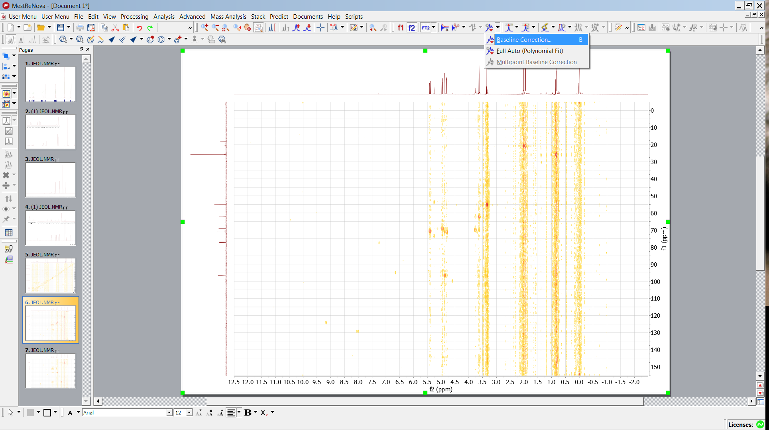
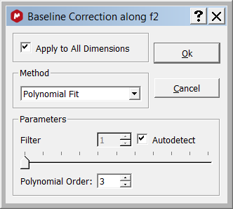
HMQC

Slide 7
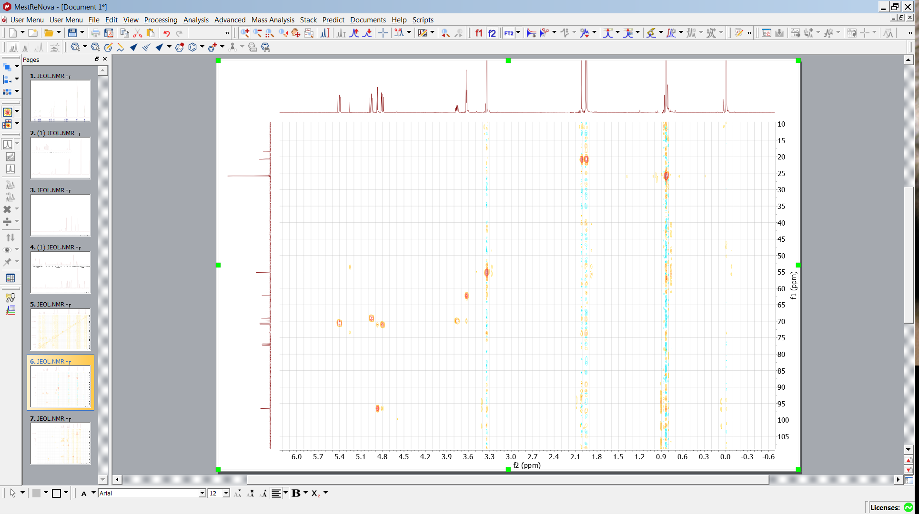
HMQC
Use HMQC to confirm first guess and identify CH2 , Cq
identify corresponding carbons
Cq t-Bu
CH3 14
CH3
t-Bu
OCH3
OCH2-
OCH-
anomeric CH
anomeric CH

Slide 8
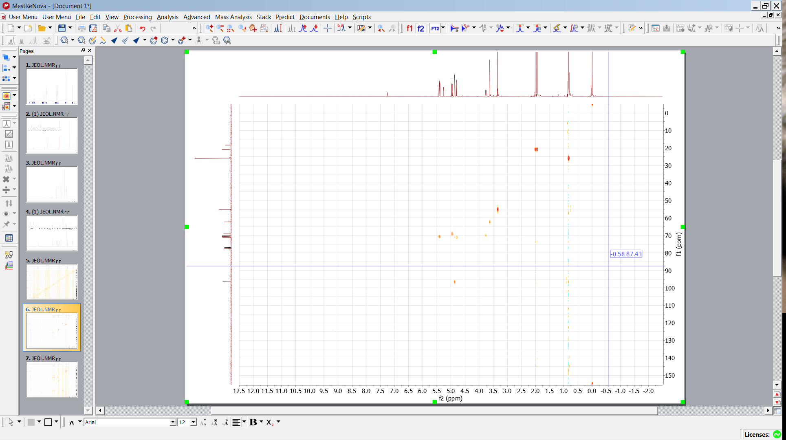
HMQC
Some signal might be back folded
OCH2-
OCH3
OCH-
anomeric CH
Si-CH3

Slide 9
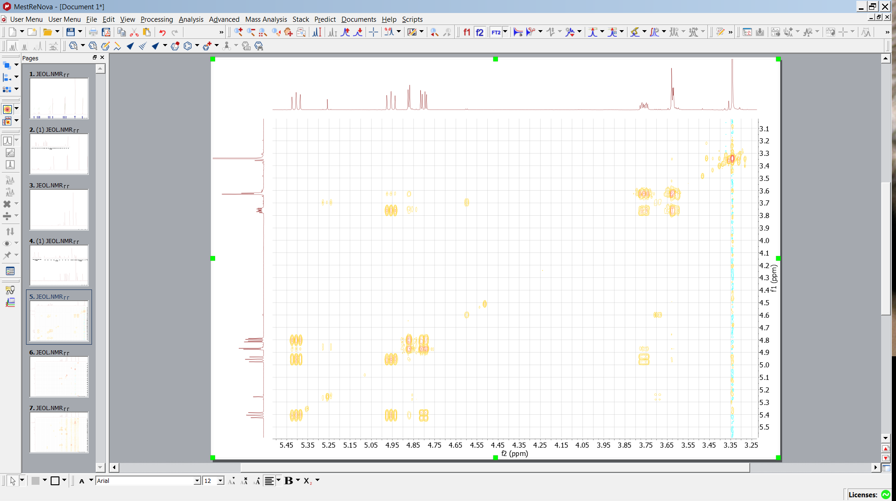
6´
COSY
O
C
H
O
C
H
O
C
H
O
C
H
O
C
H
H
C
H
O
Assuming hexose derivative assign sugar scaffold (pyranose)
assign signals starting at 1
1
2
3
4
5
6
3
4
1
2
5
6
6´
???

Slide 10
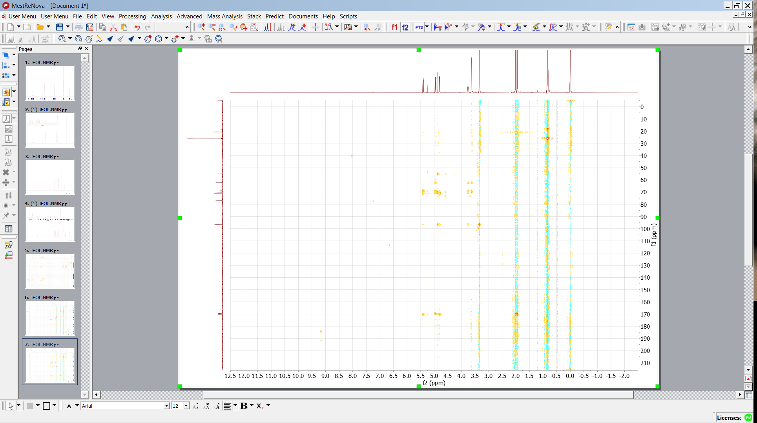
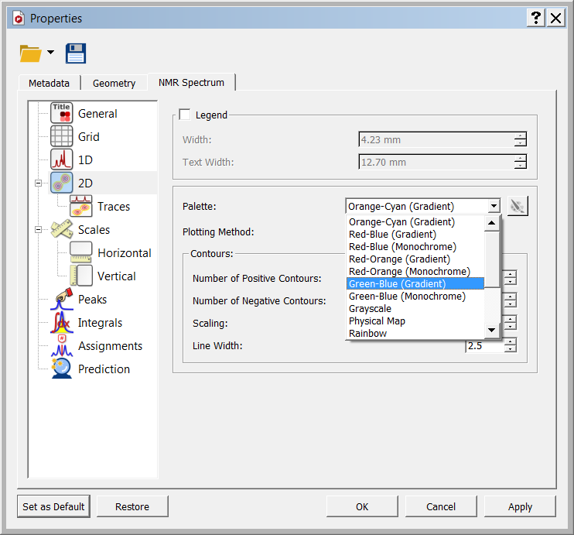
HMBC
Use HMBC to determine position of protection groups
- Baseline correction
- prepare for overlay (perhaps more convient
Right mouse3 click, properties

Slide 11
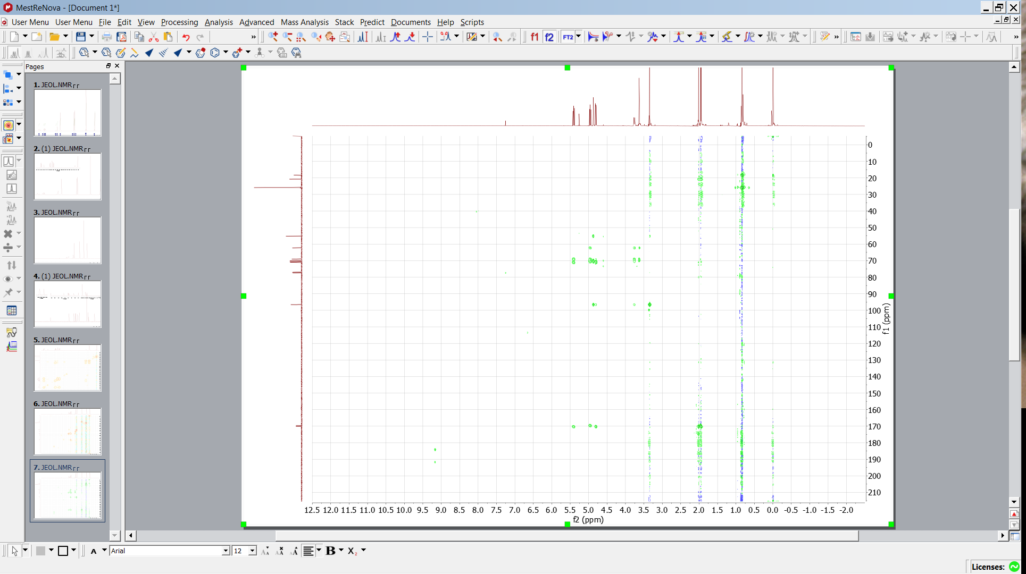
HMBC
Stack superimpose
activate

Slide 12
HMBC
Stack superimpose
activate

Slide 13
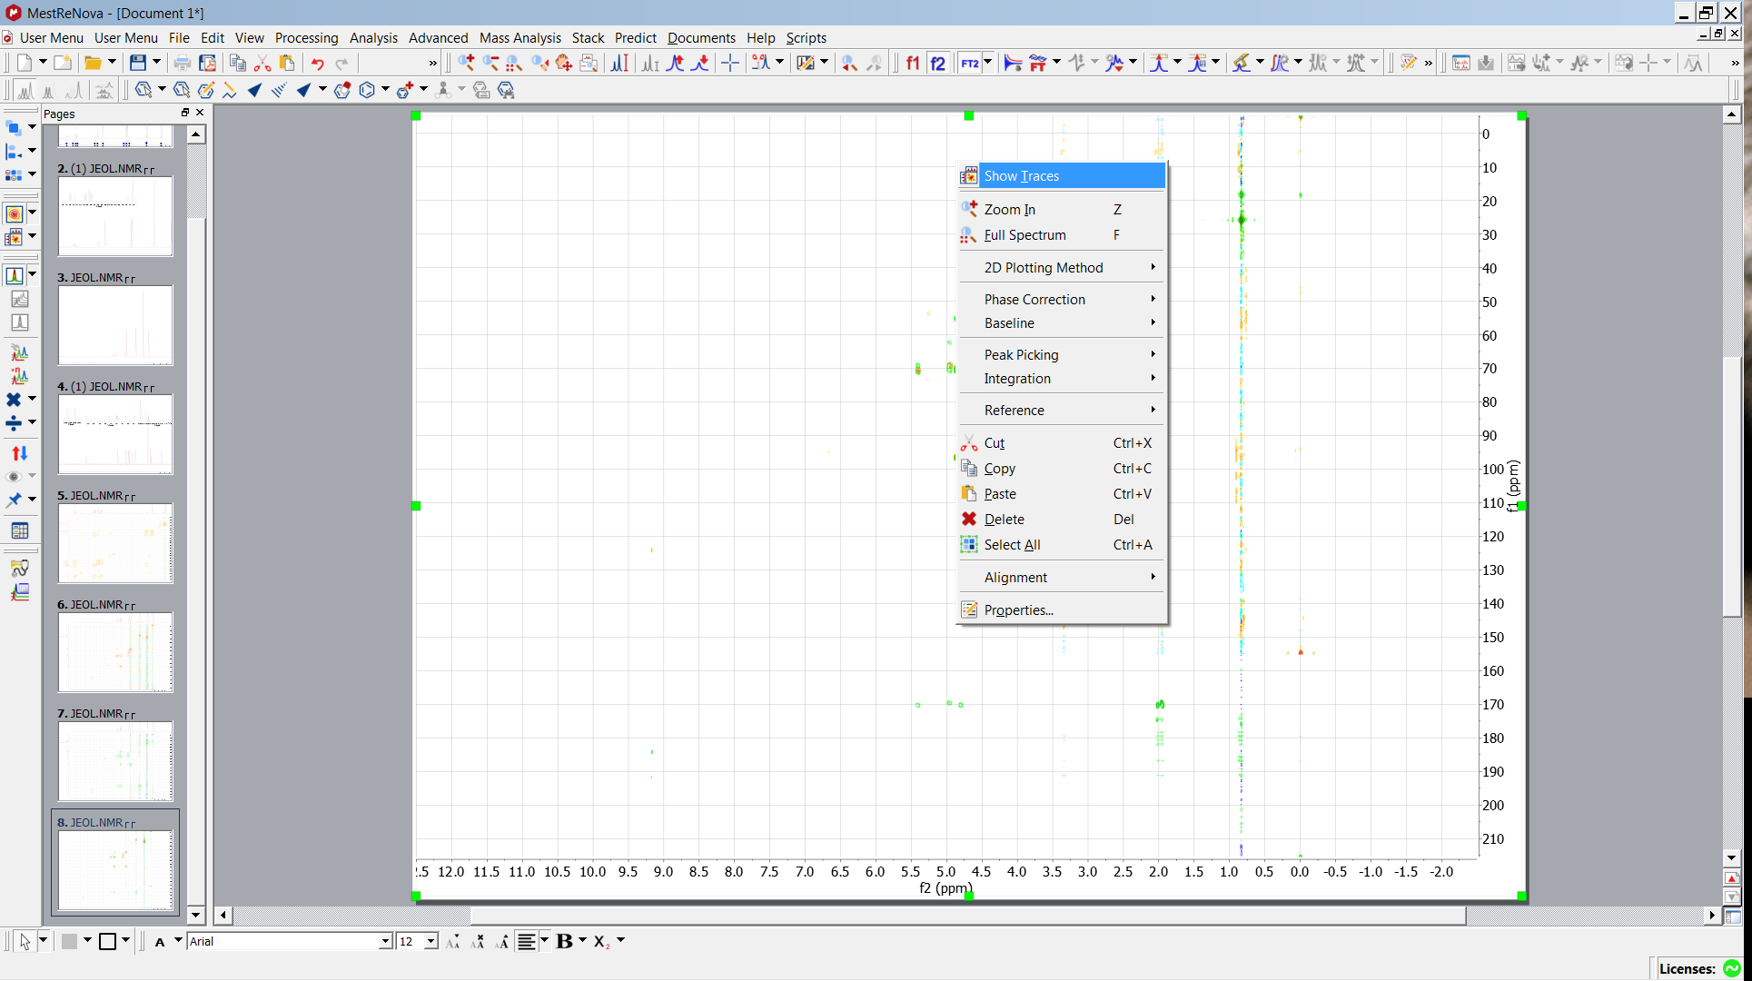
HMBC+HMQC
Right mouse click
Chose traces

Slide 14
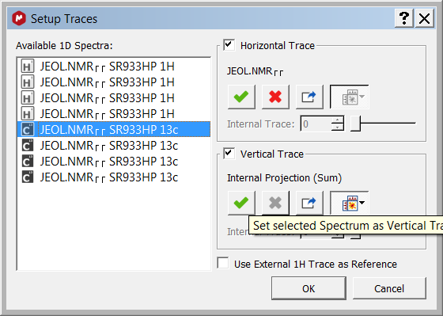
HMBC+HMQC

Slide 15
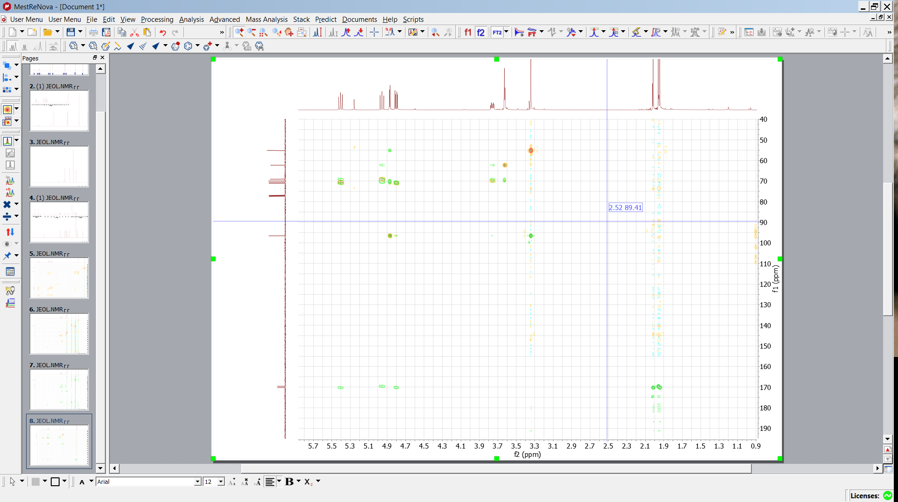
HMBC+HMQC
Position of acetyl protecting groups
zoom

Slide 16
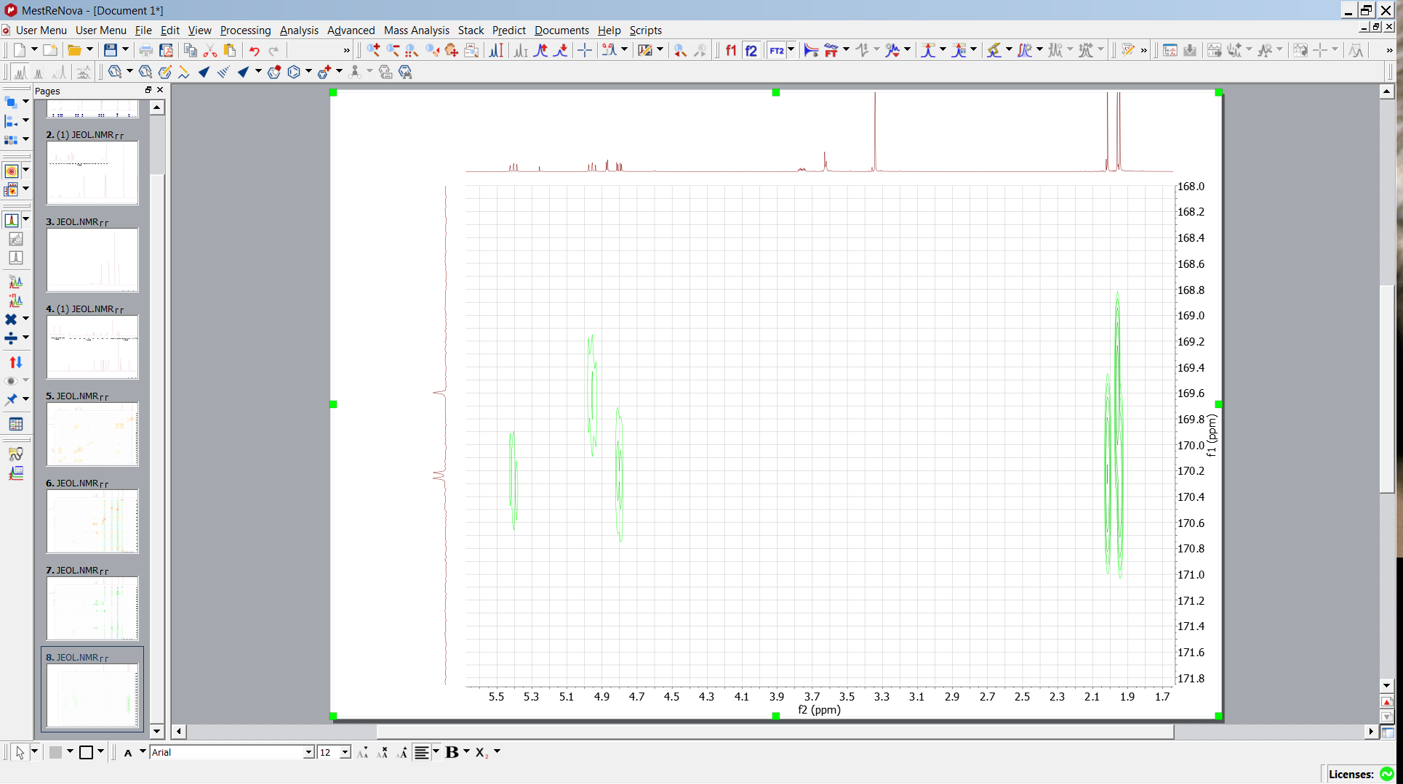
HMBC+HMQC
3
1
4
2
Position of acetyl protecting group
using COSY assignment via 3J CH
3
OAc in pos 3 ,4, 2
3J C_{O}H_{sugar}
Assign corresponding
Me groups in pos 3 ,4, 2
Via 3J C_{OO}H_{Me}

Slide 17
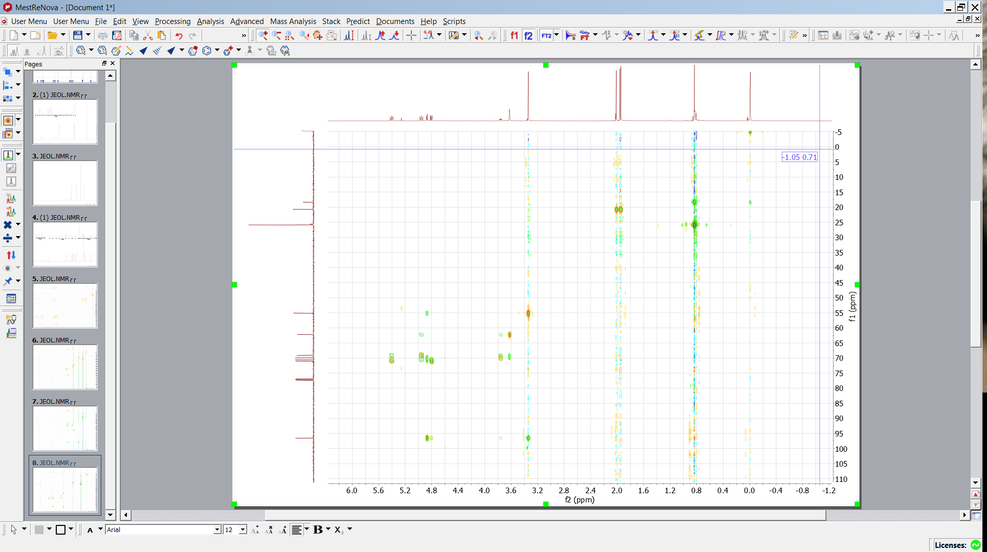
Further Clues
3
1
4
2
Cq of t-Bu
2J C_{q}H_{t-Bu}
O-Me in pos 1
3J C_{OMe}H_{anomeric}
Si t-Bu Me2
4J C_{q}H_{Si-Me}
3
O-Me in pos 1
3J C_{anomeric}H_{OMe}

Slide 18
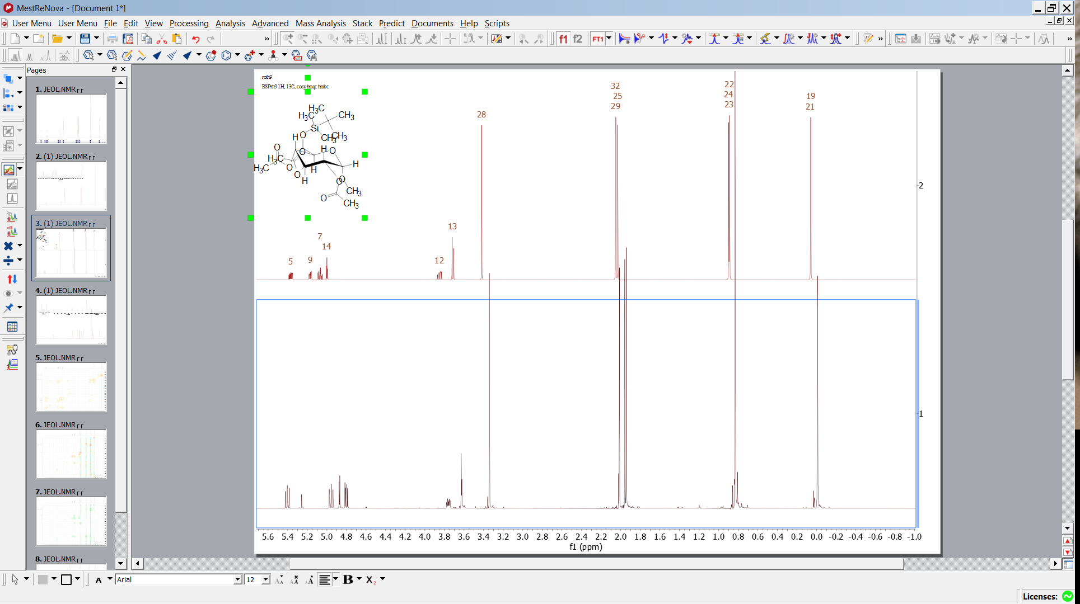
Final Test Predict and Compare
Look for 4J couplings Me Ac -> ring carbons

Slide 19
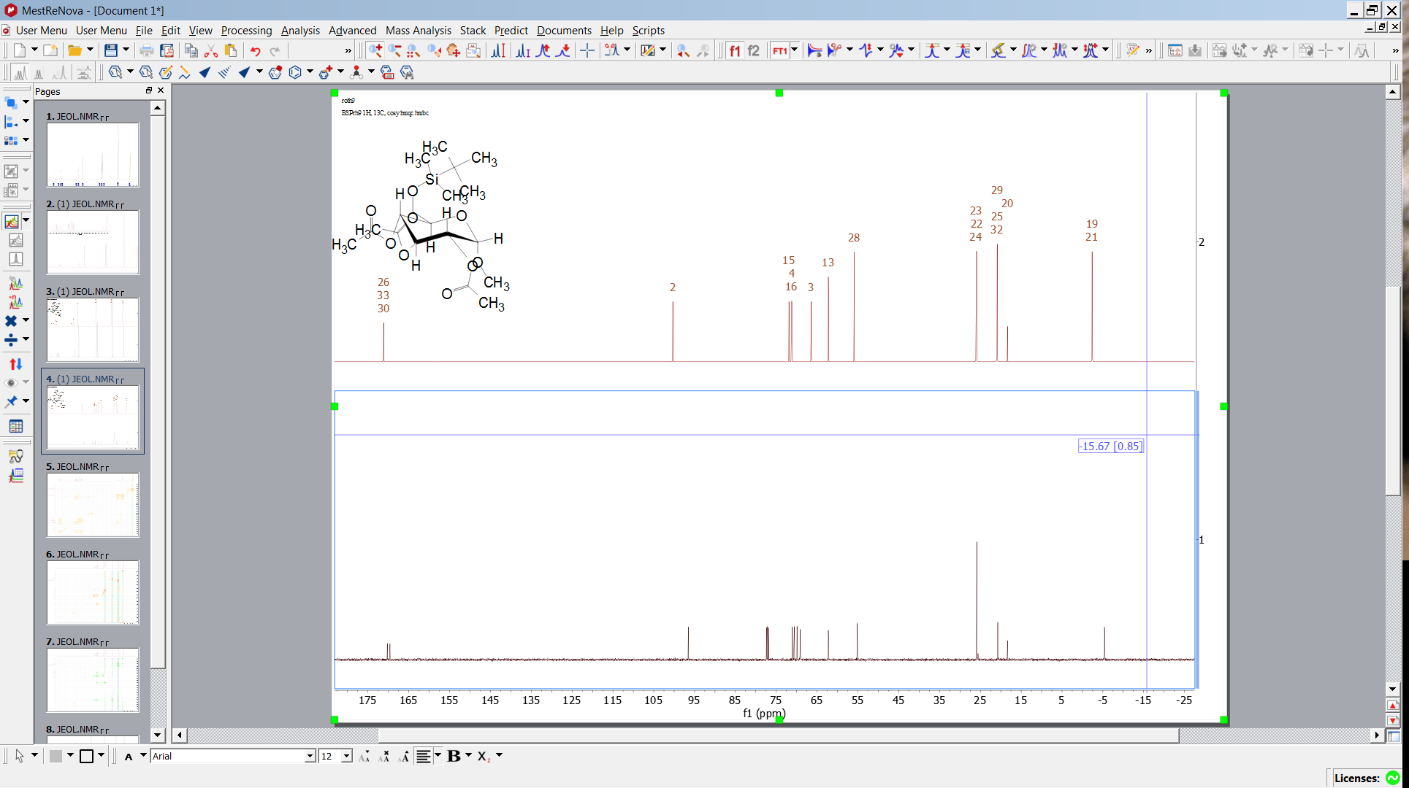
Final Test Predict and Compare

Slide 20
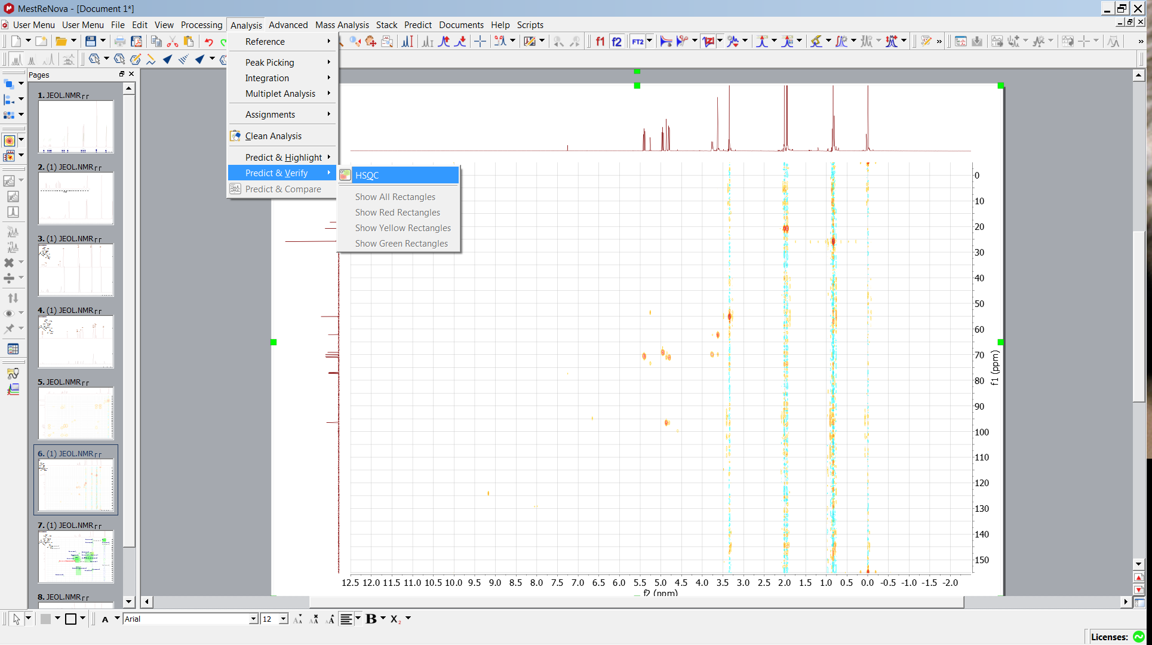
Final Test Predict and Verify

Slide 21
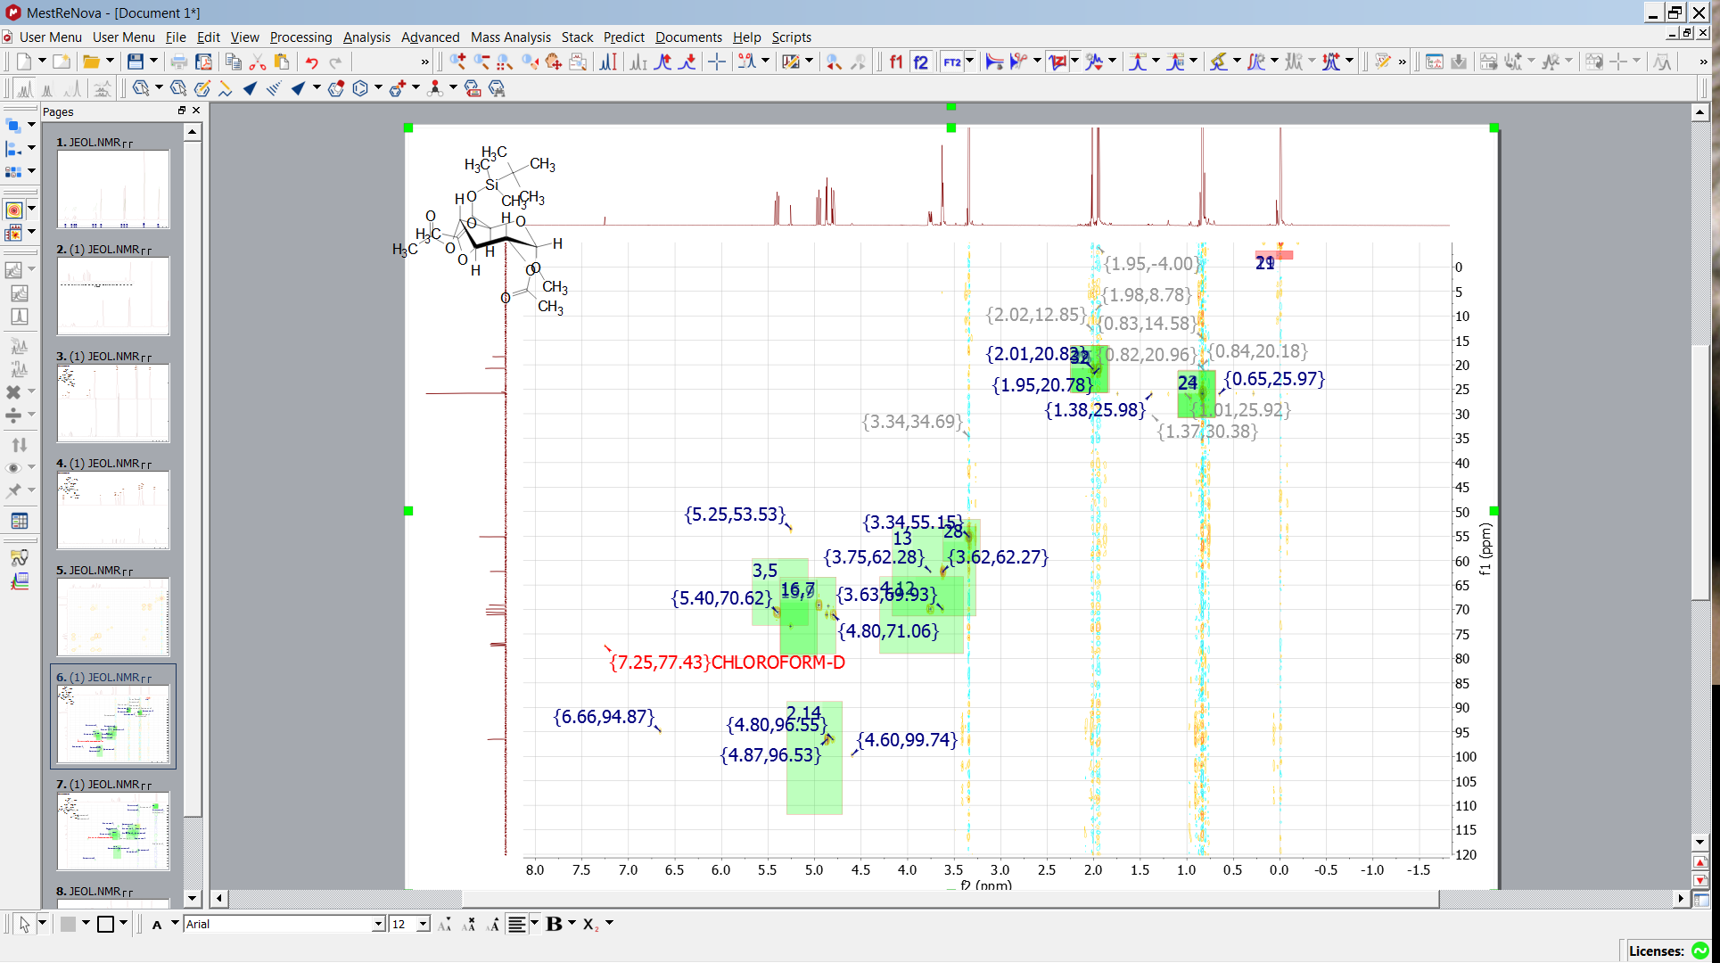
Final Test Predict and Verify

